Slide 1
Investigating Uneven Surface Heating in the Carolina Sandhills Region
Cameron Gilbert

Slide 2
Background

Slide 3
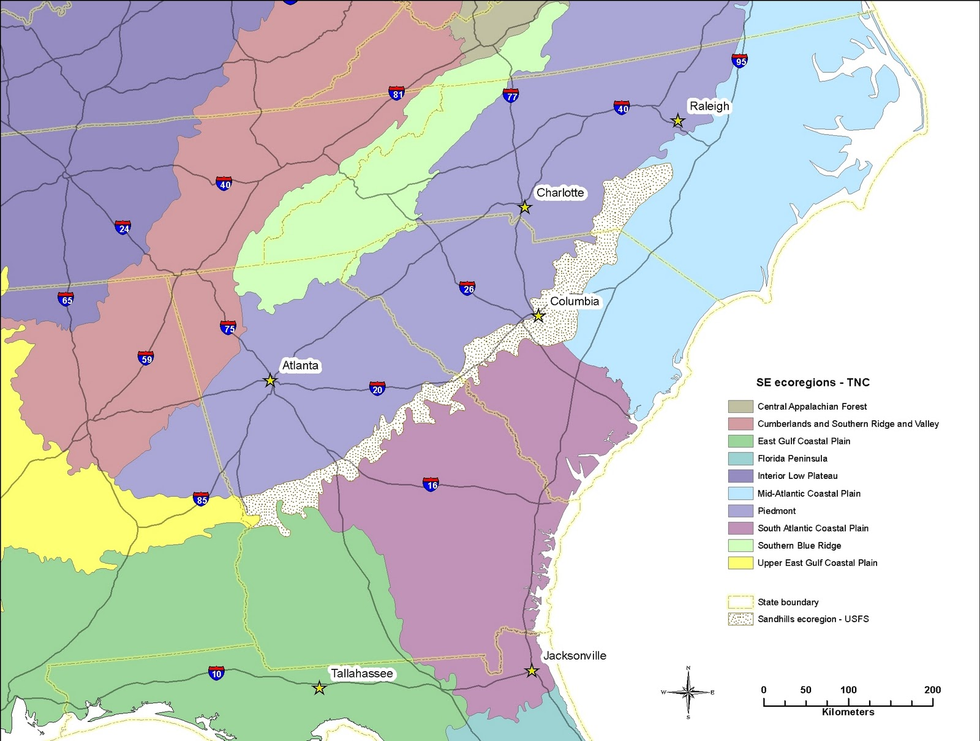
Background
The Carolina Sandhills is a thin region in between the southeastern coastal plain and piedmont regions
It is characterized by sandy soils, longleaf pine trees, and low brush/wiregrass (Wildlife, 2024)
Wildlife, C. (2024, October 28). The North Carolina Sandhills and Their Wildlife - North Carolina Wildlife Federation. North Carolina Wildlife Federation. https://ncwf.org/blog/sandhills/

Slide 4
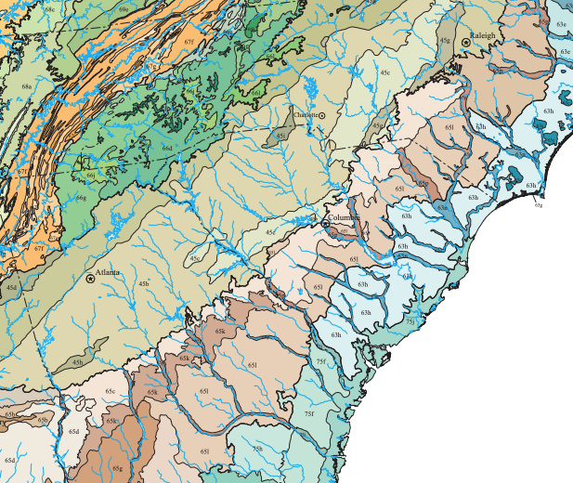
Background
The sandy soils drain extremely well and do not hold many nutrients, leading to a dry environment (Wildlife, 2024)
This dryness, along with sands low heat capacity, leads the region to warm faster than the surroundings.
U.S. Environmental Protection Agency. (2013). Level III and IV ecoregions of the continental United States [Map]. National Health and Environmental Effects Research Laboratory, Corvallis, OR. https://www.epa.gov/eco-research/level-iii-and-iv-ecoregions-continental-united-states

Slide 5
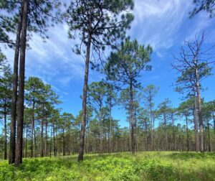
Background
The sandy, dry, and low-nutrient environment create a restrictive ecosystem for most plants.
It is also subject to many natural brushfires and unnatural controlled burns to sustain ecological balance.
Wildlife, C. (2024, October 28). The North Carolina Sandhills and Their Wildlife - North Carolina Wildlife Federation. North Carolina Wildlife Federation. https://ncwf.org/blog/sandhills/

Slide 6
Science Question

Slide 7
Can we detect a signature of enhanced surface heating in the sandhills region using satellite data?

Slide 8
Data & Methods

Slide 9
Dataset
I will be using MODIS daily LST data from both Terra and Aqua Satellites (11A1) for land surface data and MODIS 16-Day Vegetation Index (13A1) from both Terra and Aqua for NDVI
Both datasets are collected from NASA’s Earth Datastore

Slide 10
Dataset
Data is downloaded from 2020-2025 in June, July, August
  Selected the summer months to target the summer temperatures for our LST data and to get healthy, mature vegetation. There is also less cloud cover on average during this period.
Data is filtered by NASA’s Earth Datastore on the first pass, any files with greater than 30% cloud cover are not downloaded

Slide 11
Land Surface Temperature Data Pipeline
Read data files and extract data from bands of interest
LST Day & Night
Quality Control Day & Night
Build and apply quality control mask to data
Any pixels flagged as poor quality & pixels with an average error >= 3K are masked out
Reproject
Reproject from MODIS native sinusoidal projection to EPSG:32617. Using bilinear interpolation to fill in gaps when pixels do not fall exactly on grid
Trim
Trim excess data from well outside of our study region to save memory
Save
The data is grouped by month and averaged, then saved as a geoTIFF for analysis. Save a day, night, and diurnal range file for each month
Notes:
Land Surface Temperature data is further post processed after download. The quality control data that accompanies each image is used to filter out any pixels that have been flagged as poor quality or did not have LST produced.
The same quality control data is also used to filter out any pixels that have an average error above 3 Kelvin.
The daytime passes of both satellites are grouped together to create a common ‘day’ dataset, and the nighttime passes are handled the same way.

Slide 12
Land Surface Temperature Pipeline
After processing, we are left with a sample size of 269 observations, which are then grouped by month and averaged.
Then a final average is completed for the day, night, and diurnal range files. Producing a dataset that represents the average LST from all 269 observations.

Slide 13
Vegetation Index Data Pipeline
Read data files and extract data from bands of interest
16 Day NDVI
16 Day EVI
16 Day Pixel Reliability
Build and apply quality control mask to data
Any pixels flagged as worse than moderate quality are masked out
Reproject
Reproject from MODIS native sinusoidal projection to EPSG:32617. Using bilinear interpolation to fill in gaps when pixels do not fall exactly on grid
Trim
Trim excess data from well outside of our study region to save memory
Save
The data is grouped by month and averaged, then saved as a geoTIFF for analysis. Save a NDVI & EVI file for each month
Notes:
Land Surface Temperature data is further post processed after download. The quality control data that accompanies each image is used to filter out any pixels that have been flagged as poor quality or did not have LST produced.
The same quality control data is also used to filter out any pixels that have an average error above 3 Kelvin.
The daytime passes of both satellites are grouped together to create a common ‘day’ dataset, and the nighttime passes are handled the same way.

Slide 14
Vegetation Index Data Pipeline
After processing, we are left with a sample size of 48 16-day observations, which are then grouped by month and averaged.
Then a final average is completed for the NDVI and EVI files. Producing a dataset that represents the average vegetation index from all 48 observations.

Slide 15
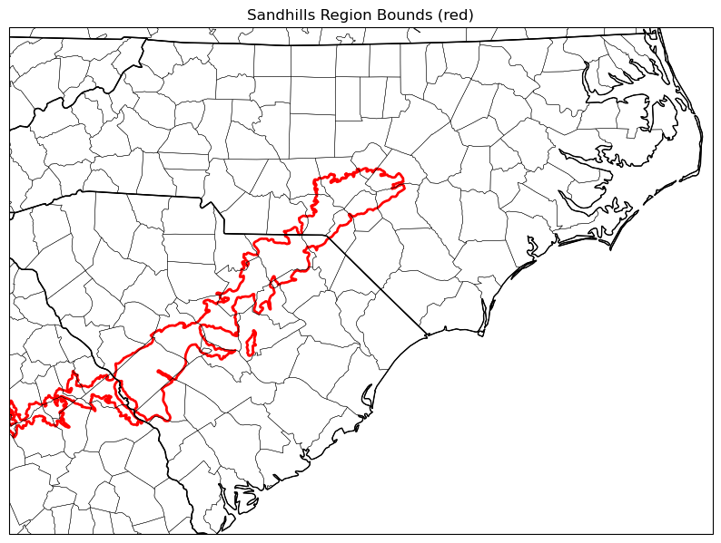
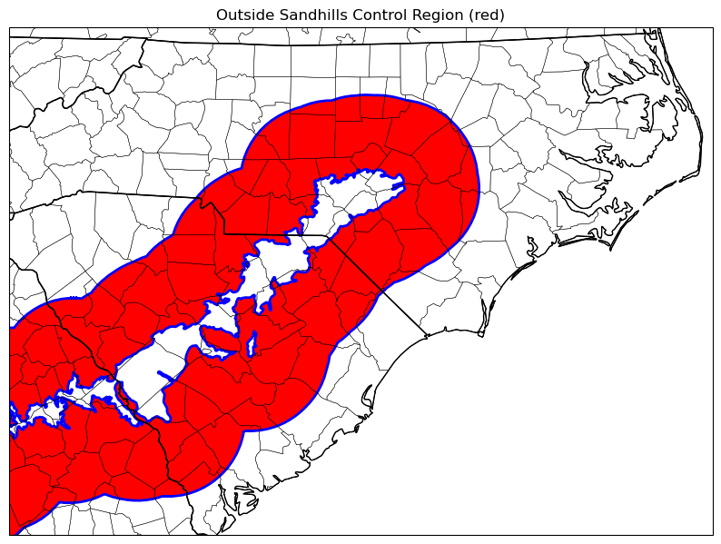
Methods
The sandhills region is defined by using the level IV ecoregion shapefile provided by the EPA
An area is defined 75 km around the region to serve as a control group
  75 km is chosen to avoid comparing temperatures affected by the higher elevations to the west and the ocean to the east

Slide 16
Results

Slide 17
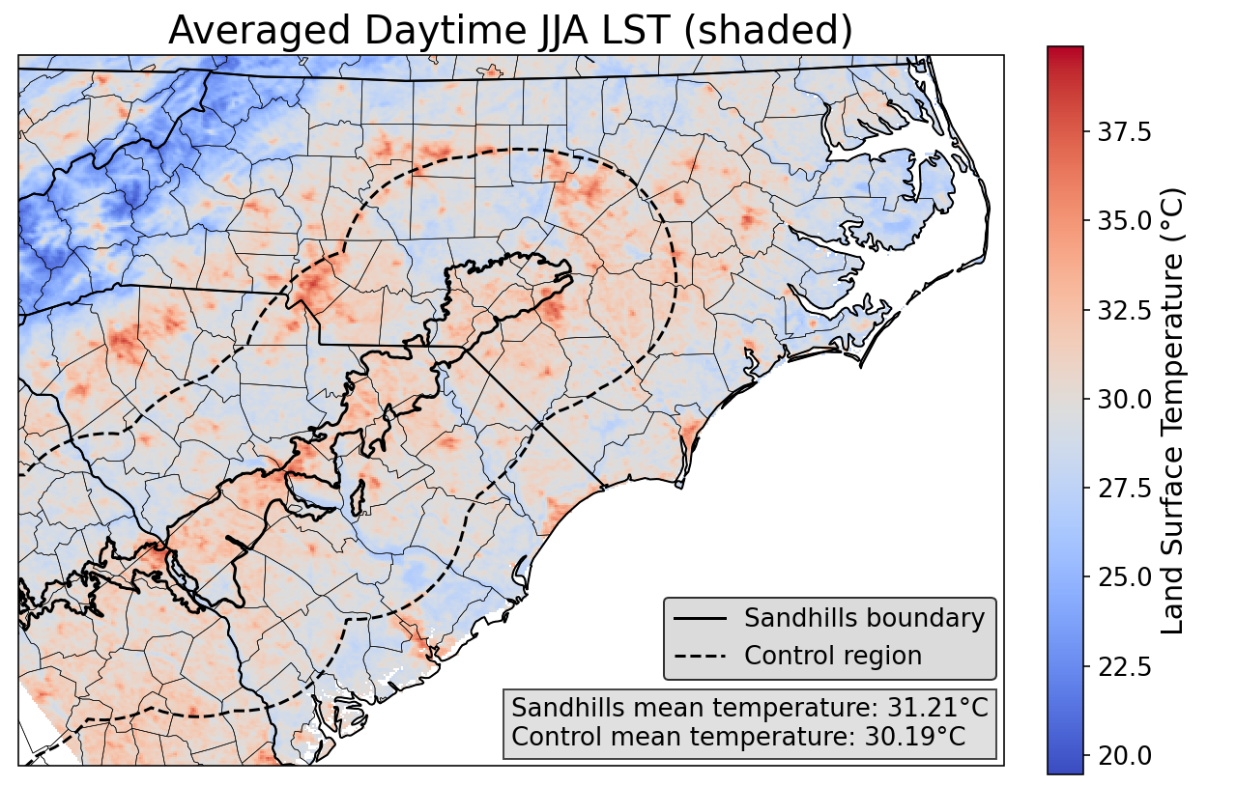
Daytime Land Surface Temperature
Sandhills region has an average daytime summer temperature 1.02°C higher than the control region

Slide 18
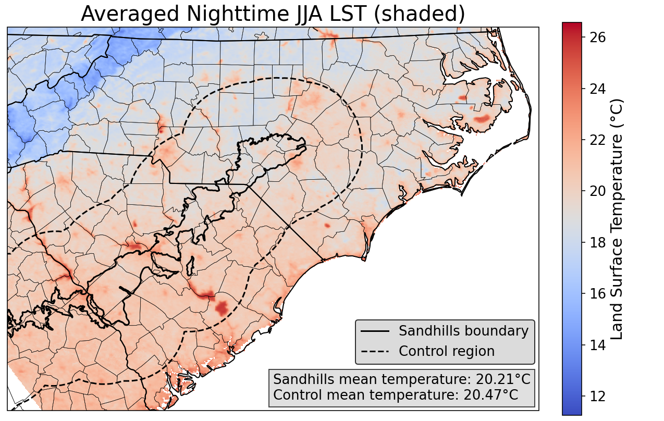
Nighttime Land Surface Temperature
Sandhills region has an average nighttime summer temperature 0.26°C lower than the control region

Slide 19
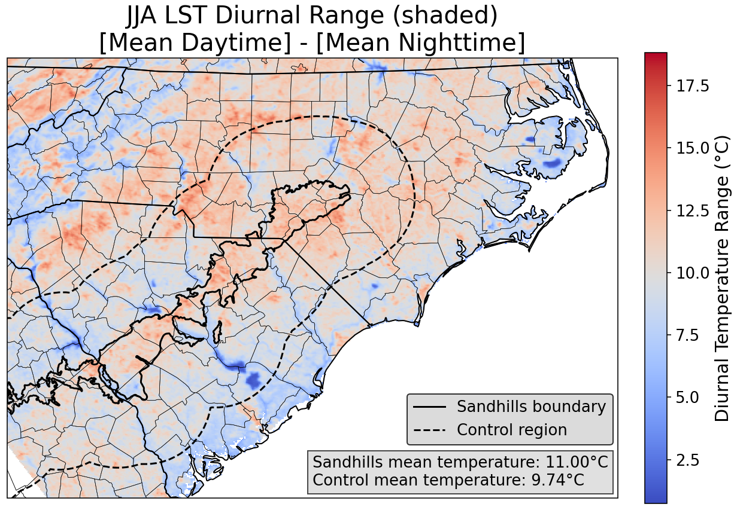
Diurnal Land Surface Temperature Range
As expected, the sandhills region has a larger diurnal range than the control region.

Slide 20
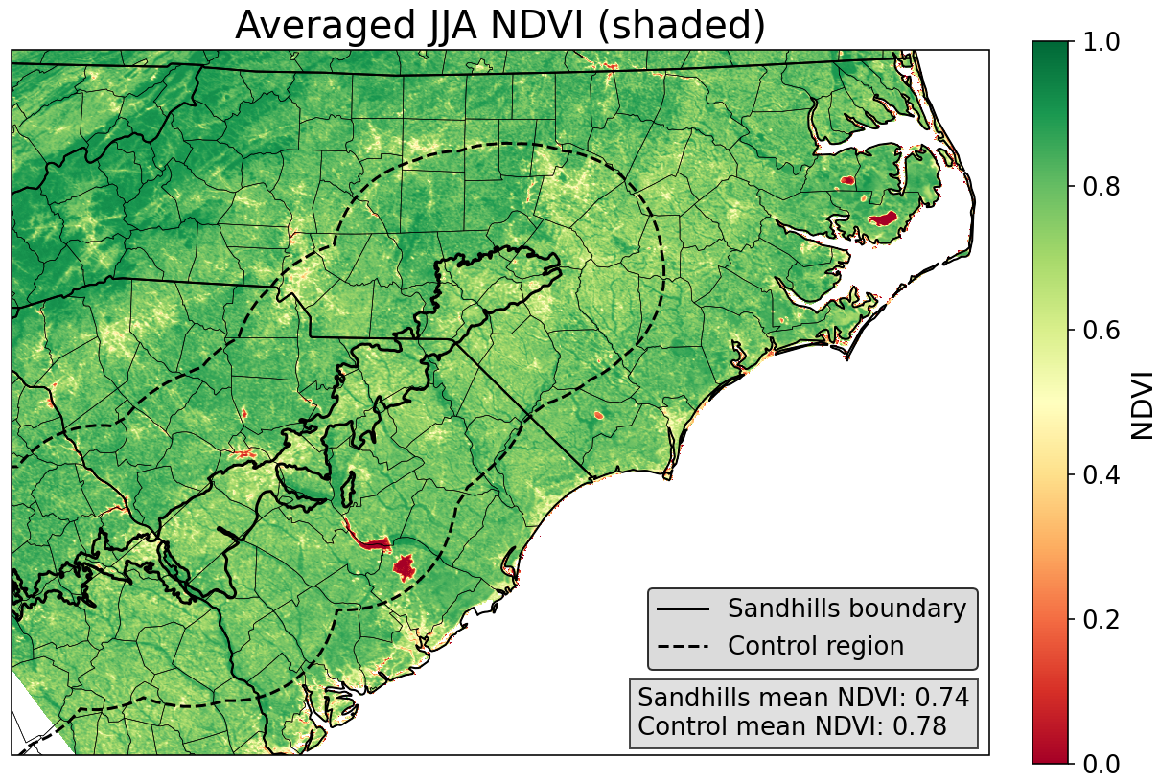
NDVI
Sandhills region has a slightly lower average summertime NDVI than the control, 0.04 NDVI units lower.
The small difference does not surprise me, as the longleaf pine forests and savannas that dominated this region are shrinking (Oswalt et al., 2022) and being replaced by more traditional vegetation

Slide 21
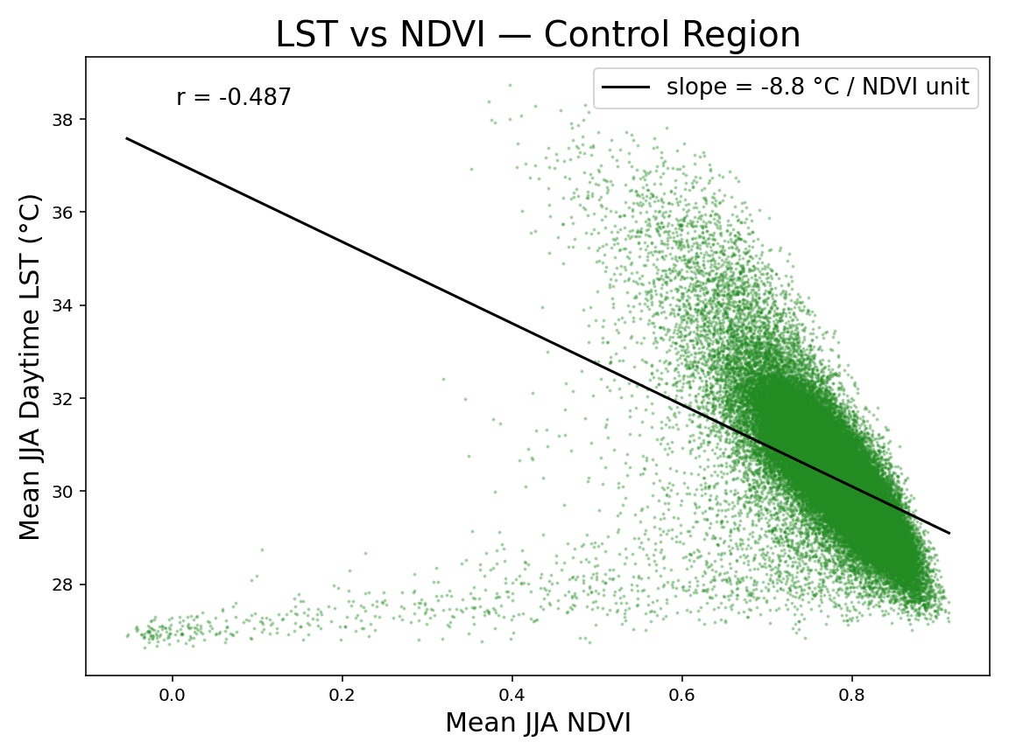
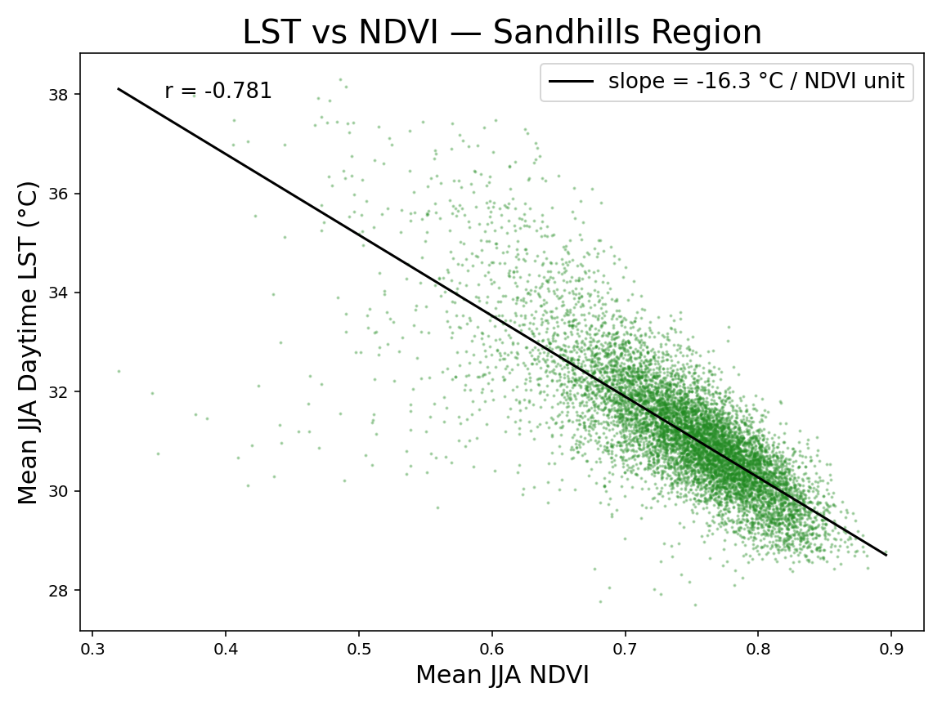
NDVI vs LST
Water Signature
Notes:
An increase in the NDVI in the sandhills gives you less cooling than an increase in the NDVI in the control region. This makes sense because the dry sandy soil in the sandhills causes vegetation to grow that is adapted to dry conditions, leading to less transpiration. This does not happen in the clay soils of the piedmont to the west or the sandy loam soils to the east where more efficient transpiration can occur.

Slide 22
Conclusion

Slide 23
Conclusions - LST
The sandhills region does see warmer temperatures during the day when compared to the surrounding areas
The region has slightly lower but similar nighttime temperatures to the surroundings, and thus has a larger diurnal temperature range as well

Slide 24
Conclusions - NDVI
The sandhills region has slightly lower NDVI than the surrounding regions. This is expected as the region is dryer than the surroundings and supports browner plant life adapted for dry conditions.
The small difference is not surprising, as the longleaf pine forests and savannas that dominated this region are shrinking (Oswalt et al., 2022)

Slide 25
Conclusions – NDVI vs LST
An increase in the NDVI in the sandhills causes less cooling than an increase in the NDVI in the control region.
This makes sense because the dry sandy soil in the sandhills causes vegetation to grow that is adapted to dry conditions, leading to less transpiration. This does not happen in the clay soils of the piedmont to the west or the sandy loam soils to the east where more efficient transpiration can occur.

Slide 26
Conclusion – Science Question
Can we detect a signature of enhanced surface heating in the sandhills region using satellite data?
Yes, there is a clear summer daytime heating difference between the sandhills region and its surroundings that can be detected via land surface temperature data.

Slide 27
Sources

Slide 28
Sources
NASA. (2017a). LP DAAC - MOD11A1. Doi.org. https://doi.org/10.5067/MODIS/MOD11A1.061
LST Data
NASA. (2017b). LP DAAC - MOD13A1. Doi.org. https://doi.org/10.5067/MODIS/MOD13A1.061
Vegetation Index Data
Oswalt, C. M., Woodall, C. W. W., & Brooks, H. (2022). Is the footprint of longleaf pine in the Southeastern United States still shrinking? In Proceedings of the 17th Biennial Southern Silvicultural Research Conference. E–Gen. Tech. Rep. SRS–203. Asheville, NC: U.S. Department of Agriculture, Forest Service, Southern Research Station. 2 P., 2015. https://research.fs.usda.gov/treesearch/47668
Restoration. (2026). Native Seed Collection - Regions Map. Blogspot.com. https://srs4158clemson.blogspot.com/2011/11/native-seed-collection-regions-map.html
US EPA. (2015, November 25). Level III and IV Ecoregions of the Continental United States. US EPA. https://www.epa.gov/eco-research/level-iii-and-iv-ecoregions-continental-united-states
Wildlife, C. (2024, October 28). The North Carolina Sandhills and Their Wildlife - North Carolina Wildlife Federation. North Carolina Wildlife Federation. https://ncwf.org/blog/sandhills/

