Slide 1
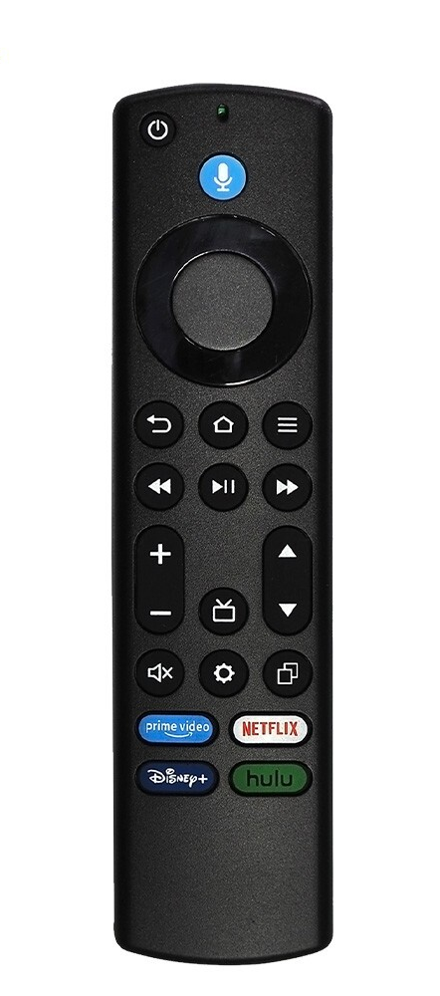
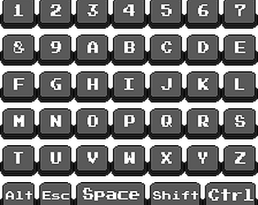
action[K_SPACE] = 'key_media_play_pause'
action[K_BACKSPACE] = 'key_back'
action[K_r] = 'key_volume_up'
action[K_f] = 'key_volume_down'
action[K_h] = 'key_home'
action[K_e] = 'key_dpad_center'
action[K_2] = 'key_tv_input_hdmi_2'
action[K_k] = 'key_sleep'
action[K_j] = 'key_wakeup'
action[K_m] = 'key_volume_mute'
action[K_d] = 'key_media_next'
action[K_a] = 'key_media_previous'
action[K_c] = 'key_captions'

