Slide 1
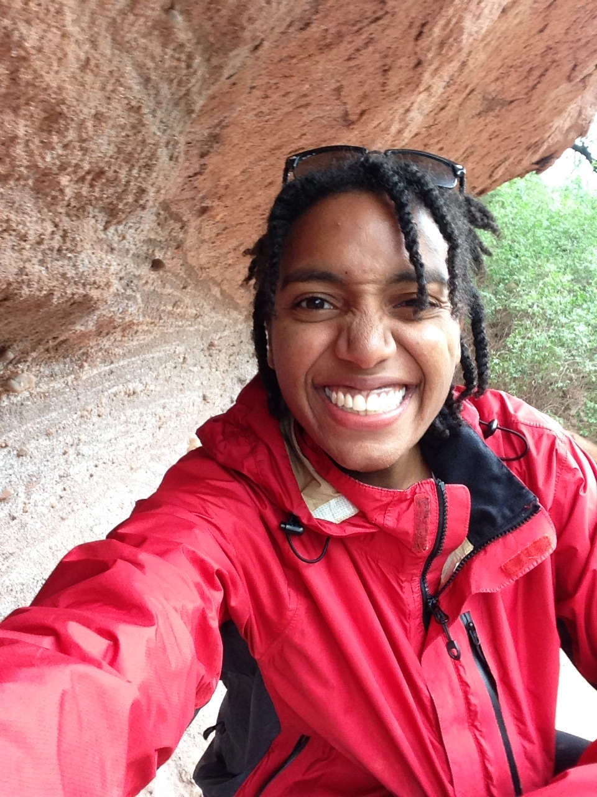
Camera Ford
Camera Ford is a recent graduate of Brown University with a Bachelor's degree in Geology. Growing up in Harlem made her aware of economic and educational disparities from an early age. She wants to use her education to benefit communities who do not have adequate access to scientific information. She has worked on research projects that apply Earth Science and social justice issues that include natural hazard prevention and indigenous land rights.
Presenting her research and facilitating campus workshops about social injustices led her to a love of communication and public speaking. She also has experience writing for, editing, and managing the College Hill Independent, a student newspaper with a weekly circulation of 2,000.
Camera is devoted to bringing science out of the lab and into the real world through science communication, public policy, and improvements in public access to Earth Science education. She is fluent in Dutch and Italian, which comes in handy when trotting the globe.
Notes:
Name, pic, bio

Slide 2

Notes:
Personal Intro and transition to the project name
Time: 40-60 seconds

Slide 3
Market Opportunity
$250 Billion millennial travel spending per year
73 million US residents traveled overseas
956 million international tourists (Jan 2016 – Sept 2016)
Notes:
Discuss how big the market is and how your taking a little piece of it can still be impactful and generate revenue
Time: 40 secs
Mention that growth is worldwide
Get worldwide travel industry #s
3 big #s
Use competitors #s if similar size

Slide 4
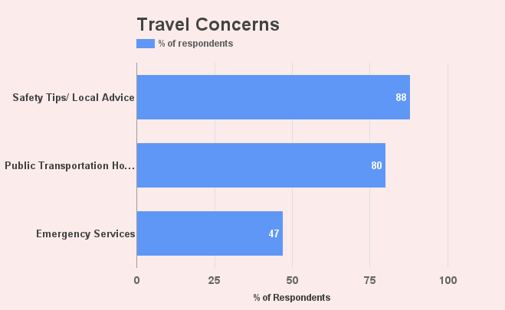
Customer Insights
Notes:
Talk about who your target customers, and the 2-3 high level points you learned about the problems they face related to your project; It would be great to mention how many folks you surveyed and interviewed; Use google forms to get exact percentages
Time: 40 sec
Survey/Interviews: ~200 respondents, 90% women, 85% millennials
88 %: worry about safety, including racism and sexism, while traveling solo or in an unfamiliar place
80%: want to know how to use public transportation
88%: want safety tips + local advice
Focus on 2 customer segments: but, diff needs for international vs. domestic
71% travel within US
43% international
54% city/town, 13% rural

Slide 5
Value Proposition
Travel Safer
Travel Cheaper
Travel Smarter
Notes:
Discuss the main benefit(s) of your product/service for each customer segment; Mention your advantages to competitors here
Time: 40-60 sec

Slide 6
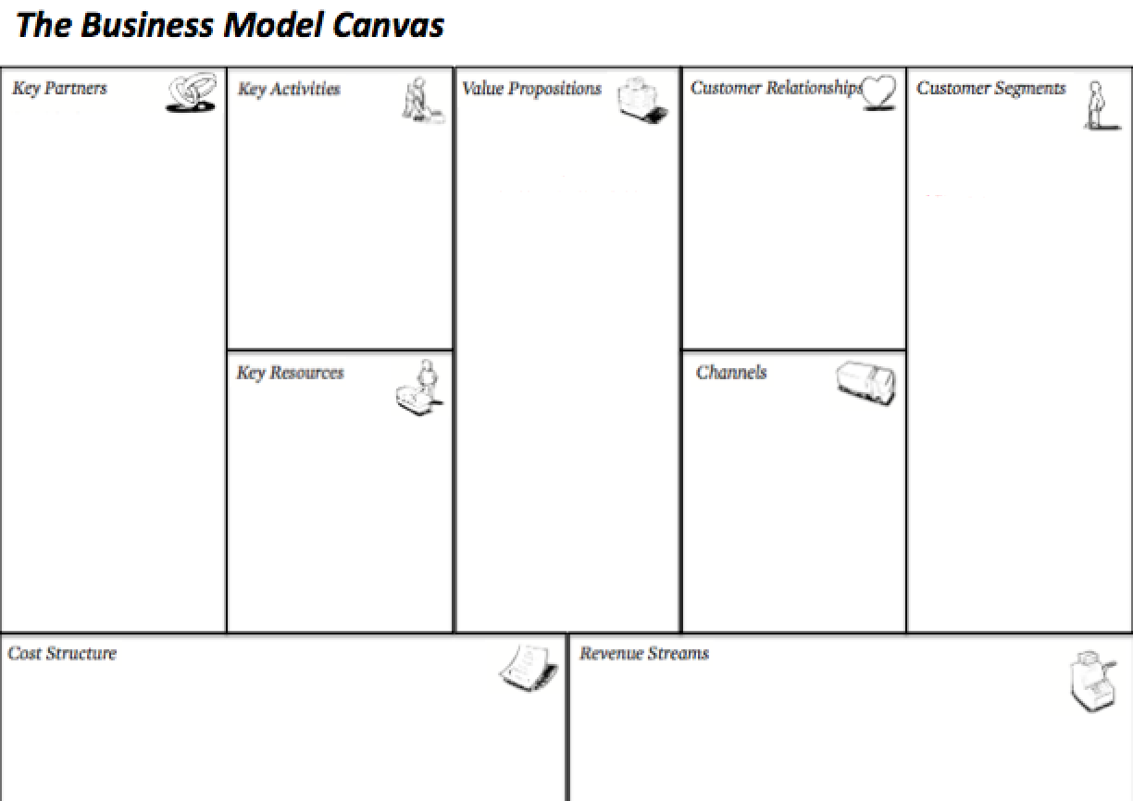
Compiling information/app building
+Community building/grow user base
+Develop revenue model and relationships
Social media campaign
+blog/web community
+Improve & expand features & locations
+Forum for user interaction/feedback
Large travel companies
+Colorway, Travel Noire, Parlour mag, other black travel blogs/sites
+Tourism bureaus
Use public transportation more easily
Travel companion app
Travel Safer
Travel Cheaper
Travel Smarter
Millennial Travelers
Middle-aged travelers
Tourism Bureaus
Travel-based companies
HBA
+Personal connections to potential users
Standalone phone app
+ web-based community
Single-time app cost
Ads
Annual subscription fee for premium access
Sponsored content
Contracts with tourism bureaus
Customer acquisition cost: ~$3,000 for first 1,000 users
Web/app development: ~75% of investment costs
Domain name & hosting
Copyright/trademark rights
Notes:
Present what your initial thoughts were on your business model canvas; Contrast with what you learned from class, interviews and surveys and the changes you made to the canvas
Time: ~20 seconds
Over the course of the program, Globetrot evolved from a basic transportation app to a travel ecosystem and community focused on a fuller travel experience. The customer segments went from all travelers to focusing on millennials, women, and people of color and includes tourism bureaus and advertisers. Globetrot also went from a single-time app cost to developing a subscription model with premium services for customers.
Use bmc, or come up with a different visualization to show pre- and post-learning
Customer relationships = get keep & grow
Key resource = stuff you already have
Key activity = what you’re gonna focus on to grow the business

Slide 7
Revenue Model
Annual Subscription for Premium Features
Sponsored Content & Ads
Aggregate Data Partnerships
Contracts with Tourism Bureaus
Notes:
Be prepared to defend your model during Q/A
Time: 60 sec
Price based on a similar tool to yours
Partnering w/other companies
Freemium model. Free for safety + transportation,
Free app services, partnerships to grow user base

Slide 8
Strategy & Milestones
Deadline | Milestone | Strategy
Feb 2017 | Launch Blog/Website | Build website, gain followers via social media campaign
May 2017 | Launch Free App Version | Continue building community via blogging and social media campaign
Spring 2018 | Launch Subscription App Version | Beta testing of free version; Marketing; Partnerships with tourism bureaus; Targeted advertising
Notes:
Describe how you will get your product out to the customer segments
Time: 40-60 sec
transition to a demo of the app/website you created so that they can ask questions for Q/A later; Close with an ask (for mentorship, money, site visit, etc.)- then drive home the mission statement or slogan. Thank everyone, and “But I need help to get to these milestones.
I’m asking for mentorship and connections to develop a marketing strategy and continue developing the revenue model. For anyone interested in offering a financial investment, know that I would use about 75% of the funds on website/mobile app development and 25% to administrative costs like trademarks and domain hosting.

