Slide 1
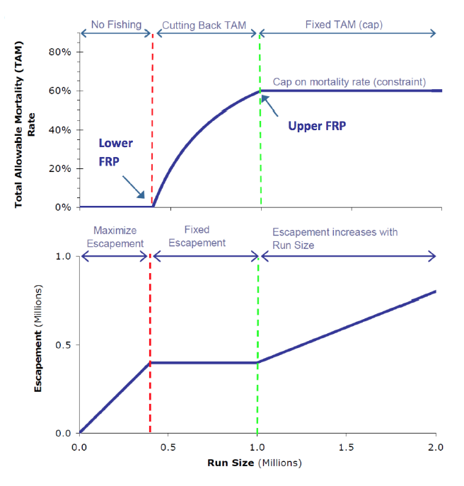

Slide 2
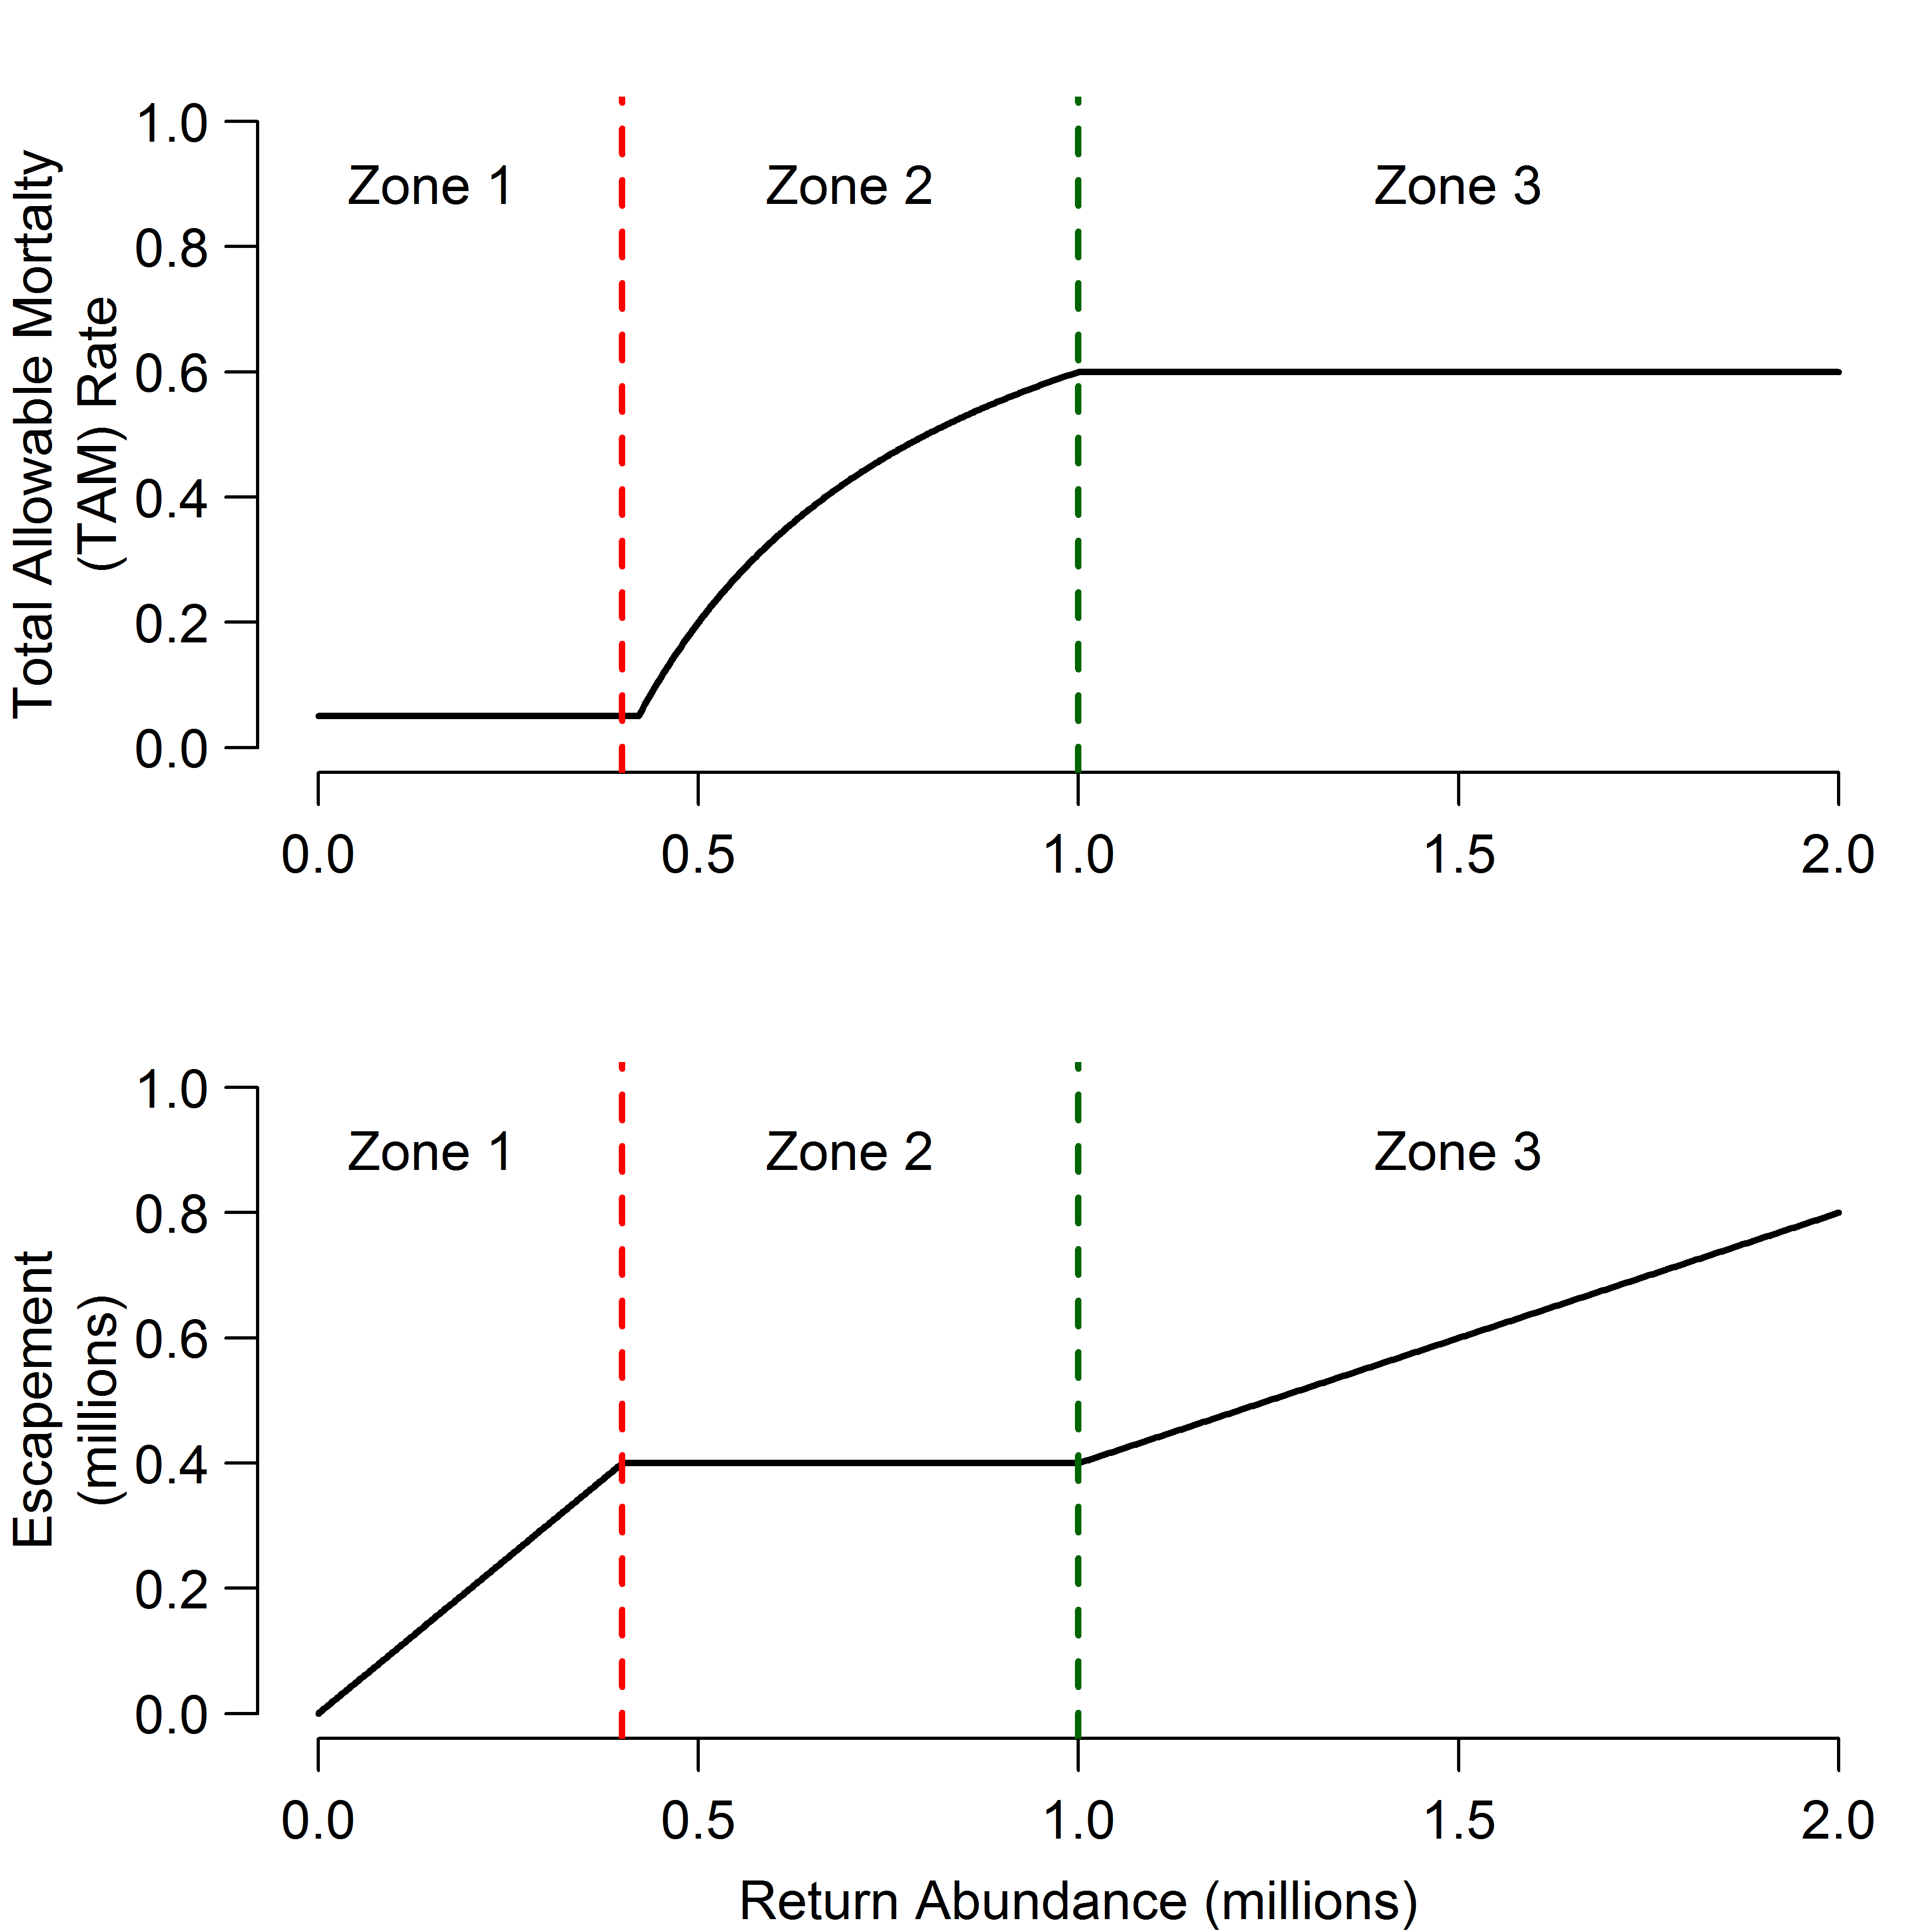
Min. Fishing
TAM Increases
TAM Stable
Maximize Escapement
Fixed Escapement
Escapement Increases With Run Size

