Slide 1

ECOLOGICAL RISK ASSESSMENT
Western Cape Bioregion Fire Assessment
Which Bioregions Are Burning Worst, and Is That Changing?
Prepared for: Western Cape Conservation Planning Unit
Prepared by: Cameron Green, Spatial Data Infrastructure Engineer — Riskscape Analytics
July 2026
Notes:
Good morning, thanks for making time. Your question was really two questions in one: which of our bioregions are taking the worst fires, and is that getting more frequent or less over time. What follows is a bioregion-by-bioregion assessment built from fourteen years of real fire records and our production severity model, ending in a concrete recommendation on where monitoring effort should go first this season.

Slide 2

SCOPE & DATA
What This Assessment Covers
• Question: which Western Cape bioregions are burning most severely, and is fire frequency rising or falling over time?
• Fire record: 4,644 mapped ignition points across the Western Cape, spanning 2012 to 2026 (4,631 matched to a bioregion by location)
• Severity: Riskscape's production severity model (summer season)
• Trend: fires split into two full-year periods — 2012–2019 and 2020–2025 — and compared as an annualised rate (2026 excluded; it only has data through March)
• Bioregions: the national vegetation map, clipped to the Western Cape and dissolved to seven biomes — Fynbos, Nama-Karoo, Succulent Karoo, Albany Thicket, Azonal Vegetation, Forests, and Grassland
Three views, one dataset
1. Ignition frequency — how often fires start, by bioregion
2. Mean severity — how intense fires get, by bioregion
3. Decade trend — whether that picture is improving or worsening over time
RISKSCAPE | Spatial Actuarial Technologies
Confidential — Western Cape Bioregion Fire Assessment
Notes:
Quick grounding before the maps. This draws on 4,644 mapped ignitions across the Western Cape since 2012, joined directly to bioregion polygons from the national vegetation map — the same ecological zones you'd recognise as Fynbos, Karoo, and so on. We're layering on our production severity model, and to answer the 'is this changing' half of your question, we split the record into two full-year periods, 2012 to 2019 and 2020 to 2025, and compare annualised rates. Three views of that data: how often, how bad, and which direction things are trending.

Slide 3
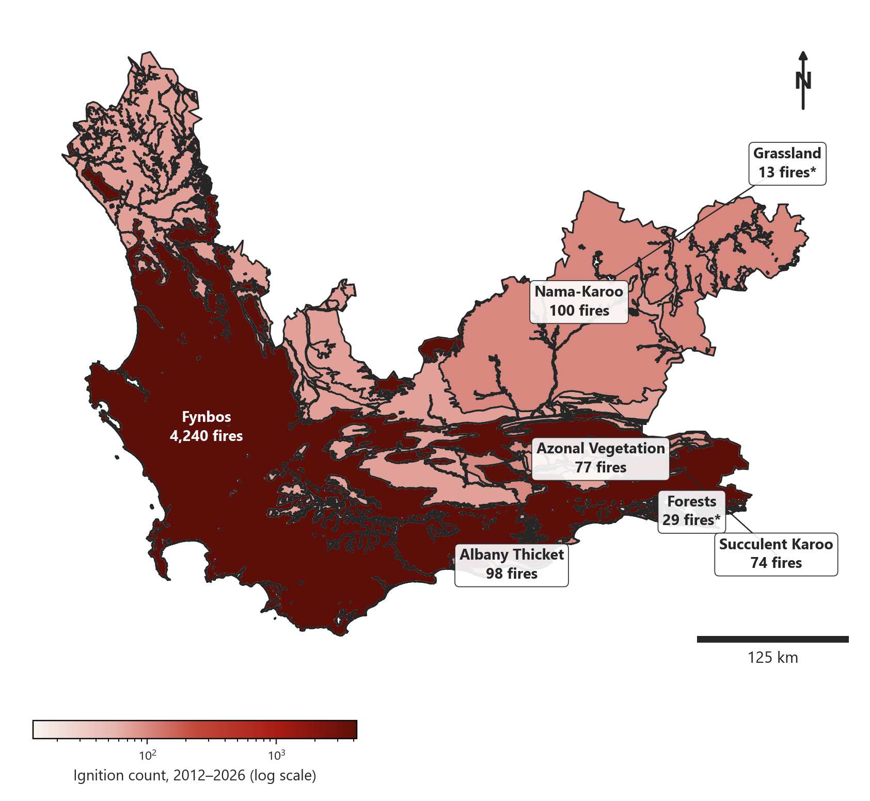
FINDING 1 OF 3
Ignition Frequency by Bioregion
• Fynbos absorbs 4,240 of the record's 4,631 matched ignitions — 92% of every fire in this assessment, on the province's largest bioregion by area
• Nama-Karoo (100), Albany Thicket (98), and Azonal Vegetation (77) follow, all far smaller in scale
• Grassland (13) and Forests (29) are marked with an asterisk — small enough that a single unusual year can swing the numbers a long way
• Frequency alone says almost nothing about the smaller bioregions — that's what the next two maps are for
Ignition count per bioregion, 2012–2026, log scale (n = 4,631 matched ignitions)
RISKSCAPE | Spatial Actuarial Technologies
Confidential — Western Cape Bioregion Fire Assessment
Notes:
This first map is a straight count, shown on a log scale because Fynbos otherwise swamps everything else — it accounts for 92% of every matched ignition in this dataset, which shouldn't be surprising since it's also the largest bioregion in the province by a wide margin. The smaller bioregions — Grassland at just 13 fires, Forests at 29 — get an asterisk on their labels for exactly that reason: with so few events, a single unusual year can swing the percentage a long way, and I don't want you reading more into those numbers than the sample supports.

Slide 4
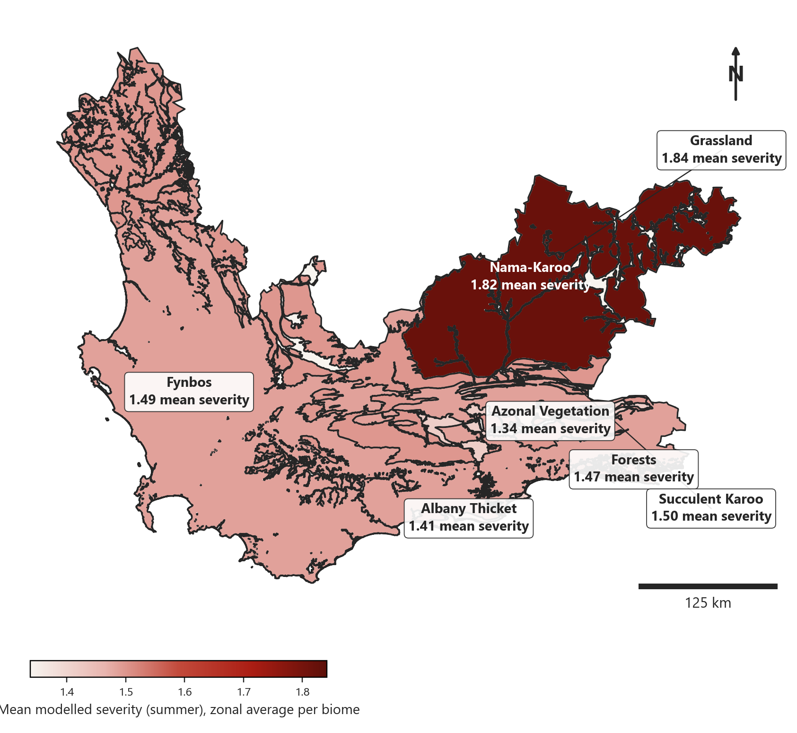
FINDING 2 OF 3
Mean Severity by Bioregion
• Grassland returns the single highest mean severity of any bioregion (1.84) — but on a base of only 13 recorded fires
• Nama-Karoo is a close second (1.82) on a much larger base of 100 fires — the more statistically credible 'high severity' case
• Fynbos sits in the middle of the range (1.49) despite dominating every frequency count
• Azonal Vegetation is the least severe on average of the seven (1.34)
Zonal mean severity (summer), per bioregion
RISKSCAPE | Spatial Actuarial Technologies
Confidential — Western Cape Bioregion Fire Assessment
Notes:
Frequency told us where fires happen most often; this map tells us how intense they get once they do — the zonal average of our severity model inside each bioregion. Grassland technically tops the list at 1.84, but I'd lean on Nama-Karoo as the more trustworthy 'high severity' finding here, since its 1.82 average sits on a base of 100 fires rather than 13. Fynbos, despite dominating every count we've looked at, actually sits in the middle of the severity range — scale and intensity are two different things.

Slide 5
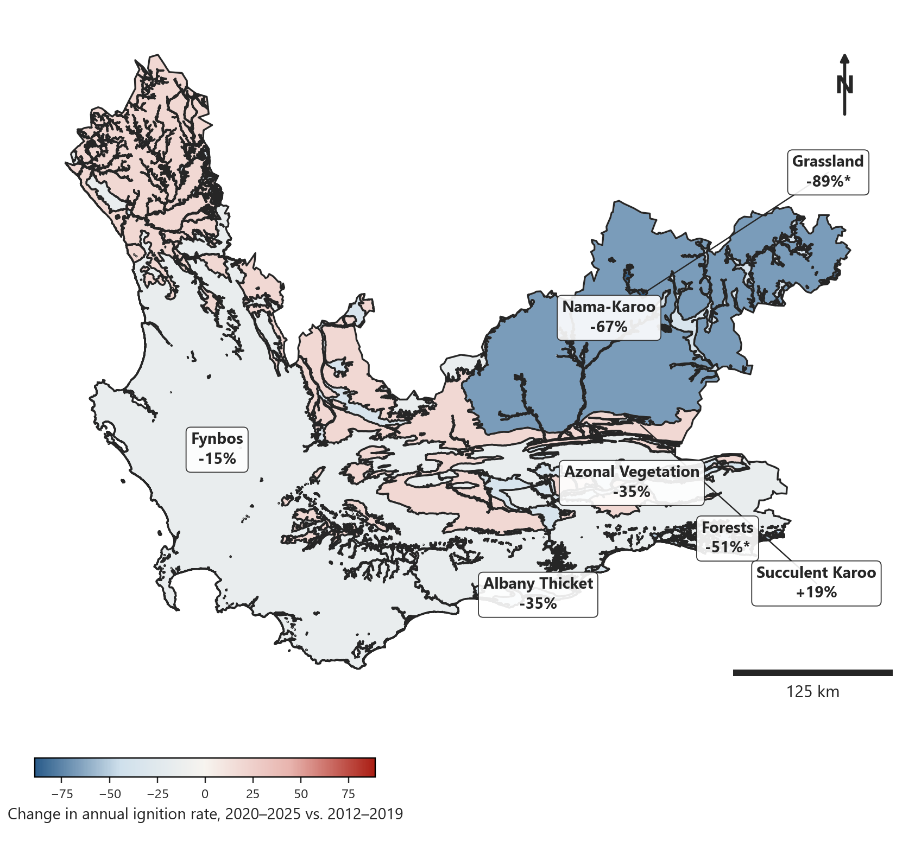
FINDING 3 OF 3
Is Fire Frequency Changing Over Time?
• Succulent Karoo is the only bioregion trending upward — annualised ignitions rose an estimated 19% from the 2010s to the 2020s
• Every other bioregion declined, led by Grassland (-89%, small sample) and Nama-Karoo (-67%)
• Fynbos, the dominant bioregion by scale, declined a more modest 15%
• A decline elsewhere doesn't offset a rise — Succulent Karoo is the one bioregion whose trajectory is moving the wrong way
Change in annualised ignition rate, 2020–2025 vs. 2012–2019
RISKSCAPE | Spatial Actuarial Technologies
Confidential — Western Cape Bioregion Fire Assessment
Notes:
This map turns a snapshot into a trend by comparing two full-year periods, 2012 to 2019 against 2020 to 2025. The headline: six of seven bioregions are trending down, some sharply — but Succulent Karoo is the exception, up an estimated 19%. That's a real, if modest, signal on a reasonable base of 70-plus fires each period, and it's the one line in this whole assessment moving in the wrong direction. Everything else declining doesn't cancel that out — if anything it makes Succulent Karoo stand out more.

Slide 6
RECOMMENDATION
Where Monitoring Effort Should Go First
Bioregion | Ignitions | Mean Severity | 2020s Trend | Priority
Nama-Karoo | 100 | 1.82 | -67% | High severity — monitor
Succulent Karoo | 74 | 1.50 | +19% | Only rising trend — watch
Grassland | 13 | 1.84 | -89%* | Highest severity, small sample
Fynbos | 4,240 | 1.49 | -15% | Dominant by scale, moderate
Albany Thicket | 98 | 1.41 | -35% | Lower priority
Forests | 29 | 1.47 | -51%* | Small sample
Azonal Vegetation | 77 | 1.34 | -35% | Lowest severity
• Ranking combines severity with trend direction, not severity alone
• Asterisked rows (Grassland, Forests) carry small samples — read their swings as suggestive, not conclusive
• Nama-Karoo and Succulent Karoo are the two cases most worth a closer look this season
RISKSCAPE | Spatial Actuarial Technologies
Confidential — Western Cape Bioregion Fire Assessment
Notes:
Direct answer: Nama-Karoo and Succulent Karoo are where I'd send monitoring attention first, for two different reasons. Nama-Karoo combines the second-highest severity in the province with a credible, large-sample result — worth understanding whether that historical decline holds. Succulent Karoo is the one bioregion getting worse, not better, and if that trend continues it deserves attention now, before it becomes a bigger problem. Grassland's severity number is technically the highest of all seven, but with only 13 fires on record over fourteen years, I wouldn't act on that number alone yet — flag it, don't prioritise on it.

Slide 7
METHODOLOGY & LIMITATIONS
How This Was Built, and Where to Be Careful
• Bioregion assignment is a direct spatial join against the national vegetation map, clipped to the Western Cape and dissolved to seven broad biomes — not the province's finer-grained bioregion subtypes
• The decade comparison uses annualised rates over complete calendar years only (2012–2019 vs. 2020–2025); 2026 is excluded because it only has data through March
• Grassland and Forests have small underlying samples (13 and 29 ignitions across 14 years) — their large percentage swings should be read as suggestive, not statistically robust
• Severity is drawn from the summer production model only; a fuller assessment would also compare autumn, winter, and spring, since fire timing can differ meaningfully by vegetation type
• This is a screening-level view to guide where monitoring effort goes, not a substitute for on-the-ground ecological survey
RISKSCAPE | Spatial Actuarial Technologies
Confidential — Western Cape Bioregion Fire Assessment
Notes:
A few honest caveats before you act on this. We assigned every fire to a bioregion using the province's seven broad biomes, not the finer bioregion subtypes underneath them — that's the right level of detail for a monitoring-priority conversation, but it does mean we're not distinguishing, say, one type of Fynbos from another. The decade comparison deliberately uses complete calendar years and drops the partial 2026 data, so the trend numbers are on a fair footing. And I want to repeat the small-sample flag on Grassland and Forests one more time here, because an -89% swing on 13 fires is a very different kind of finding than a -67% swing on 100. Treat this as a strong screening tool for where to look closer, not a final verdict.

Slide 8
Next Steps
• Prioritise field monitoring visits toward Nama-Karoo and Succulent Karoo this season
• Extend the trend analysis to year-by-year, not just decade halves, once monitoring budget allows
• Revisit this assessment as each new fire season's data comes in
Cameron Green — Spatial Data Infrastructure Engineer
cameron.green@riskscape.pro | +27 83 301 3201
Riskscape — Spatial Actuarial Technologies
Notes:
That's the assessment: three views of the same fourteen years of data, converging on one recommendation — Nama-Karoo and Succulent Karoo are your two priority cases, for different reasons, and the smaller bioregions deserve a caveat rather than a confident number. Happy to take questions, and happy to rerun the trend piece year-by-year rather than by decade half if that would be more useful for how your team actually plans field visits.

