Slide 1

EMERGENCY RESPONSE ASSESSMENT
Western Cape Largest Fire Events Assessment
Where Are the Largest Fires, and What Are They Associated With?
Prepared for: Western Cape Emergency Management Office
Prepared by: Cameron Green, Spatial Data Infrastructure Engineer — Riskscape Analytics
July 2026
Notes:
Good morning. Your question is about the extremes: not every fire, but the biggest ones — where they happen and what's common about the ground they happen on, so you know where to focus response planning. What follows isolates the 50 largest fire events on our full fourteen-year record, checks what vegetation they share, and — importantly — tests them against our own composite risk model, including an honest look at where that model falls short.

Slide 2

SCOPE & DATA
What This Assessment Covers
• Question: where are the largest fire events on record, and what landscape features do they share?
• Fire record: the full 4,669-event Western Cape record, 2012–2026 — this assessment isolates the 50 largest by area
• Vegetation: summer NDVI and the same bioregion classification used across this analysis
• Risk cross-check: the composite risk index built for the insurer brief (severity + vegetation dryness), reused here to test whether it actually flags where the biggest fires happen
• Smallest fire in this top-50 shortlist: 80 km². Largest: 537 km²
Three views, one dataset
1. Scale — which 50 fires are the largest on record
2. Association — what vegetation and bioregion they share
3. Model check — do they fall where our composite risk index says they should
RISKSCAPE | Spatial Actuarial Technologies
Confidential — Western Cape Largest Fire Events Assessment
Notes:
Quick grounding before the maps. We start from the full 4,669-event fire record for the Western Cape and deliberately narrow to the 50 largest by area — from 537 square kilometres down to 80 — because for response planning, the extremes are what matter, not the average case. We check what vegetation those 50 have in common, and then we do something worth flagging up front: we test them against the same composite risk index we built for the insurer brief, to see whether that model actually flags where the biggest fires happen. Spoiler — it's a mixed result, and I'll walk you through exactly how mixed.

Slide 3
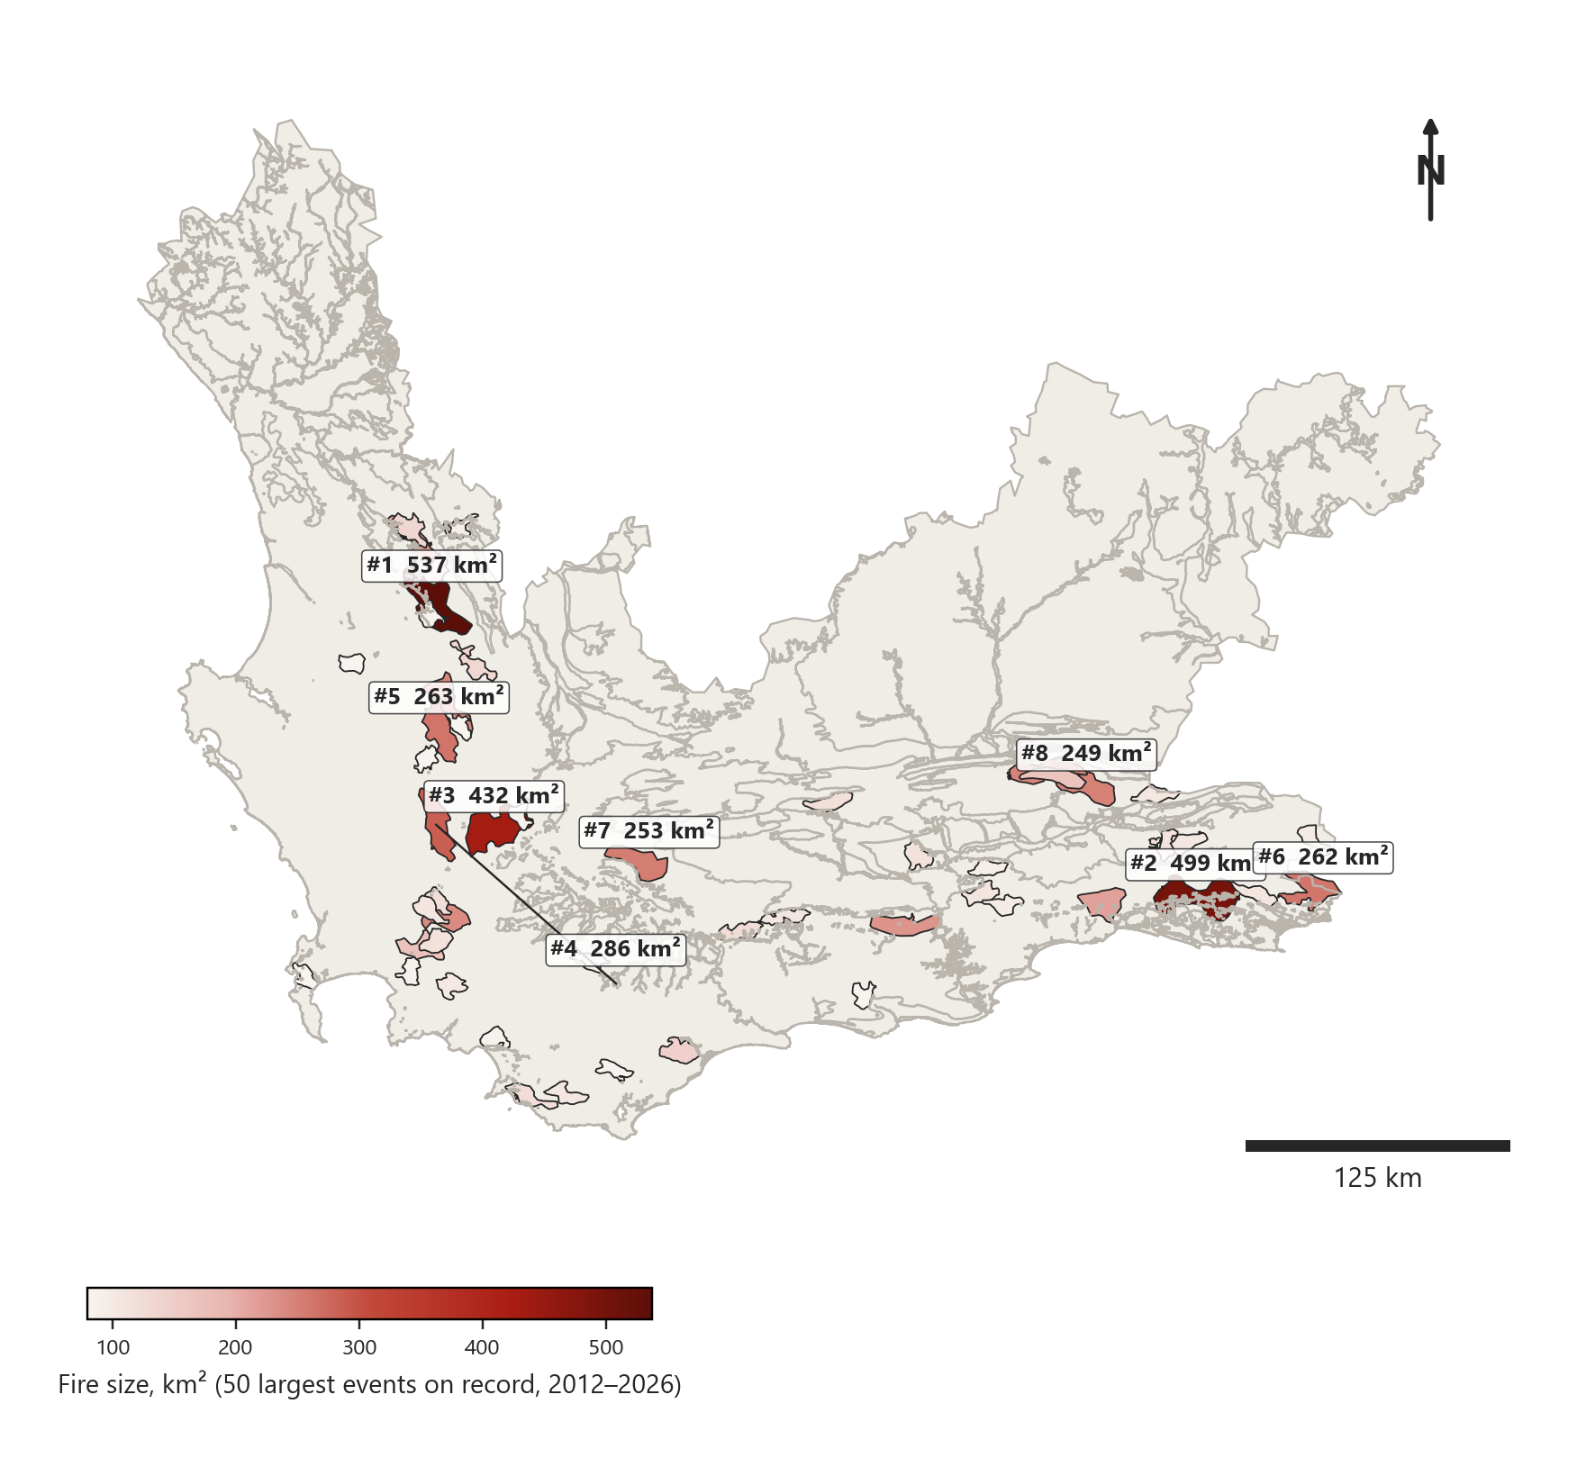
FINDING 1 OF 3
The 50 Largest Fire Events on Record
• The largest fire on record burned 537 km² in December 2025; the 50th-largest still covers 80 km²
• These 50 are a deliberate shortlist out of 4,669 total records — the extremes, not the average case
• Several of the largest events cluster along the same mountain corridors, visible as repeated large shapes close together
• The eight largest are labelled directly on the map with their real size in km²
The 50 largest fire events by area, 2012–2026 (537 km² down to 80 km²)
RISKSCAPE | Spatial Actuarial Technologies
Confidential — Western Cape Largest Fire Events Assessment
Notes:
This map is exactly what it says: the 50 largest fires this province has on record, by area, shaded from light to dark red by size. It's a deliberate shortlist — burying these 50 among 4,600-plus smaller events would make this map useless for response planning, where the extremes are what actually matter. Worth noticing: several of the biggest fires aren't scattered randomly, they cluster along the same mountain corridors, which is exactly the kind of pattern that matters for pre-positioning resources.

Slide 4
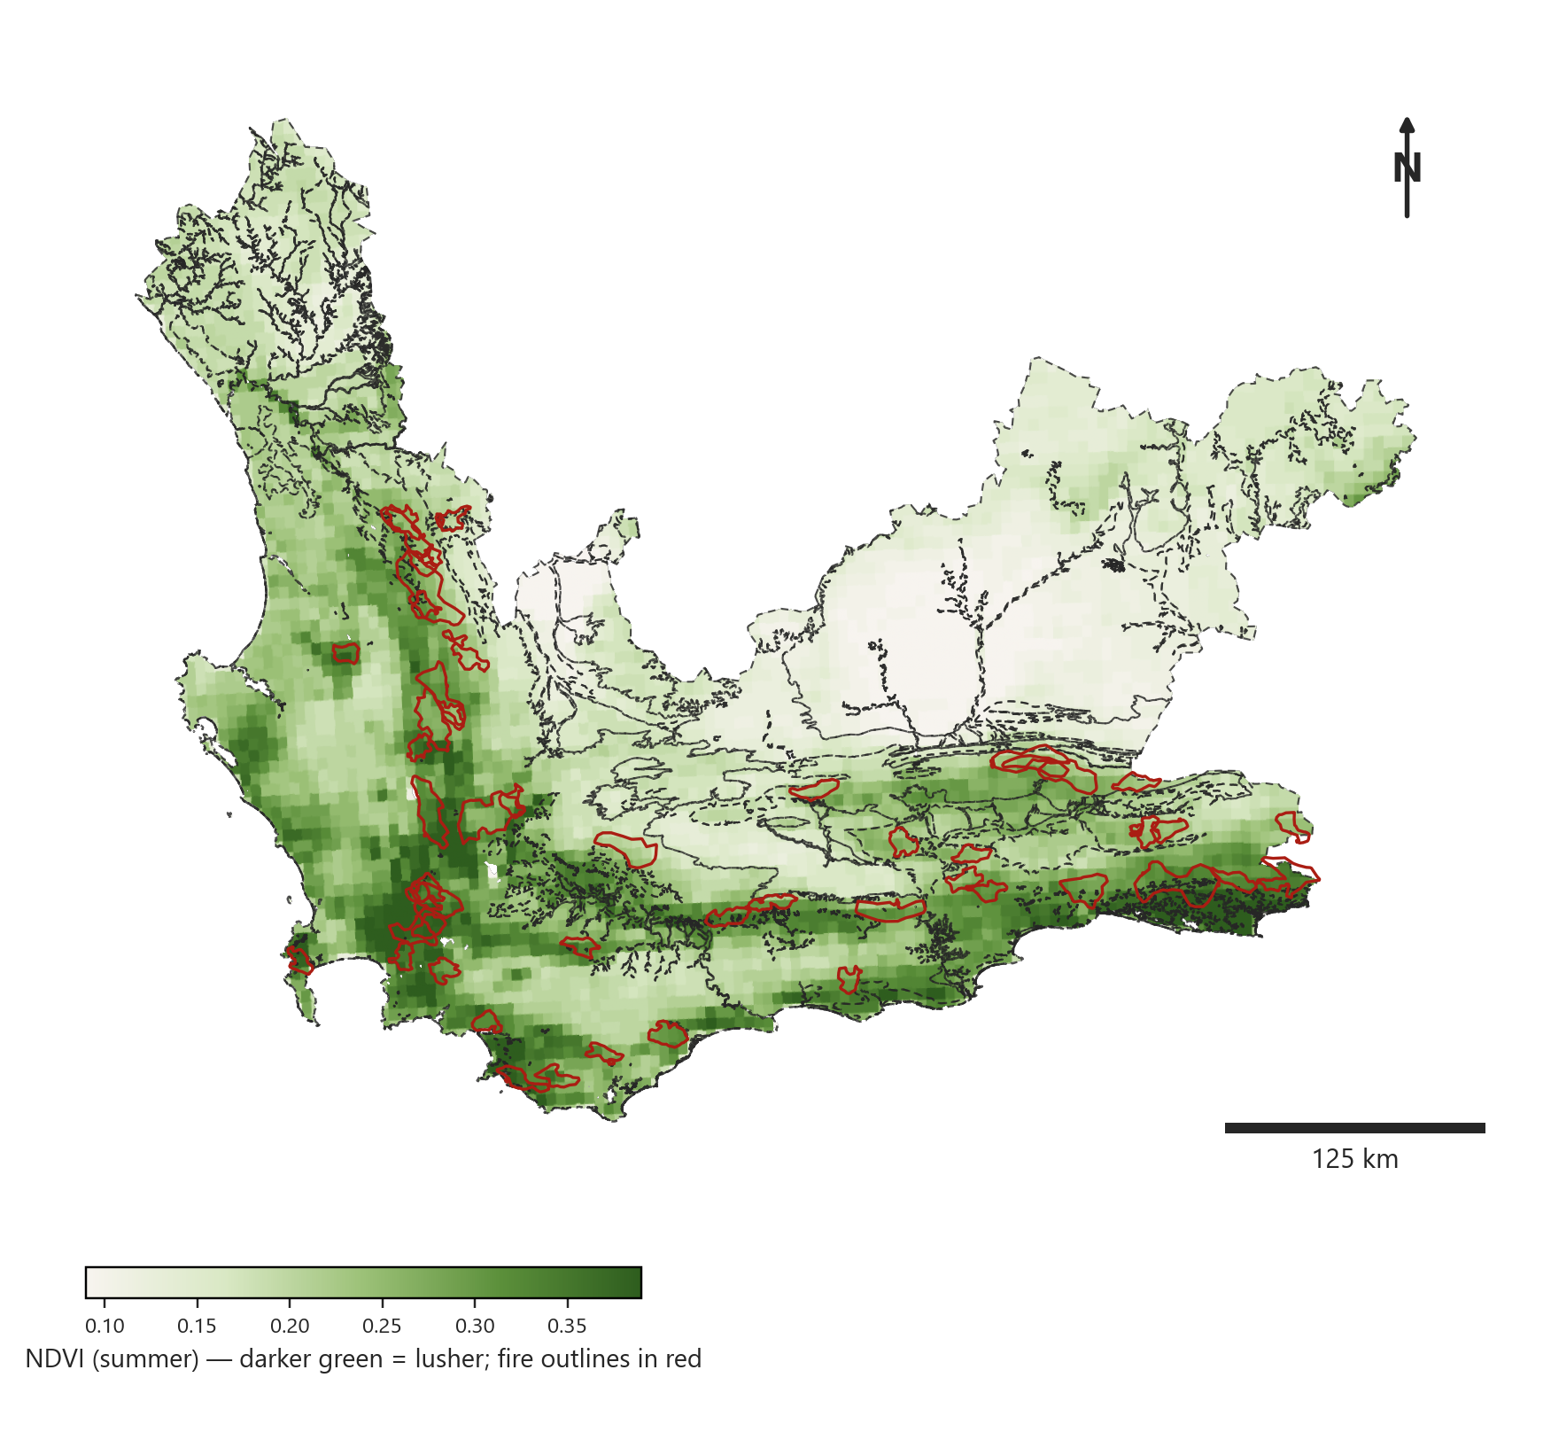
FINDING 2 OF 3
Largest Fires Over Vegetation and Bioregions
• Every one of the 50 largest fires on record falls inside the Fynbos bioregion — 50 of 50, no exceptions
• Fynbos is also the largest bioregion in the province by area, so this is partly a base-rate effect, not proof that Fynbos alone is uniquely dangerous per square kilometre
• Several of the largest fires sit in visibly darker-green, lusher pockets — fuel load, not just dryness, appears to matter for reaching this scale
• This is a verified pattern in the real record, not an assumption going in
The same 50 fires over summer NDVI and bioregion boundaries
RISKSCAPE | Spatial Actuarial Technologies
Confidential — Western Cape Largest Fire Events Assessment
Notes:
Same 50 fires, now laid over summer vegetation greenness and bioregion boundaries. The clean finding is that all 50 — every single one — sit inside Fynbos. I want to be careful with that: Fynbos is also by far the largest bioregion in this province, so part of this is simply a base-rate effect, not proof that Fynbos is uniquely hazardous per square kilometre compared to, say, Nama-Karoo. What is worth noting is that several of the very largest fires sit in the darker, lusher green patches rather than the driest ones — suggesting fuel load matters here as much as dryness for a fire actually reaching this scale.

Slide 5
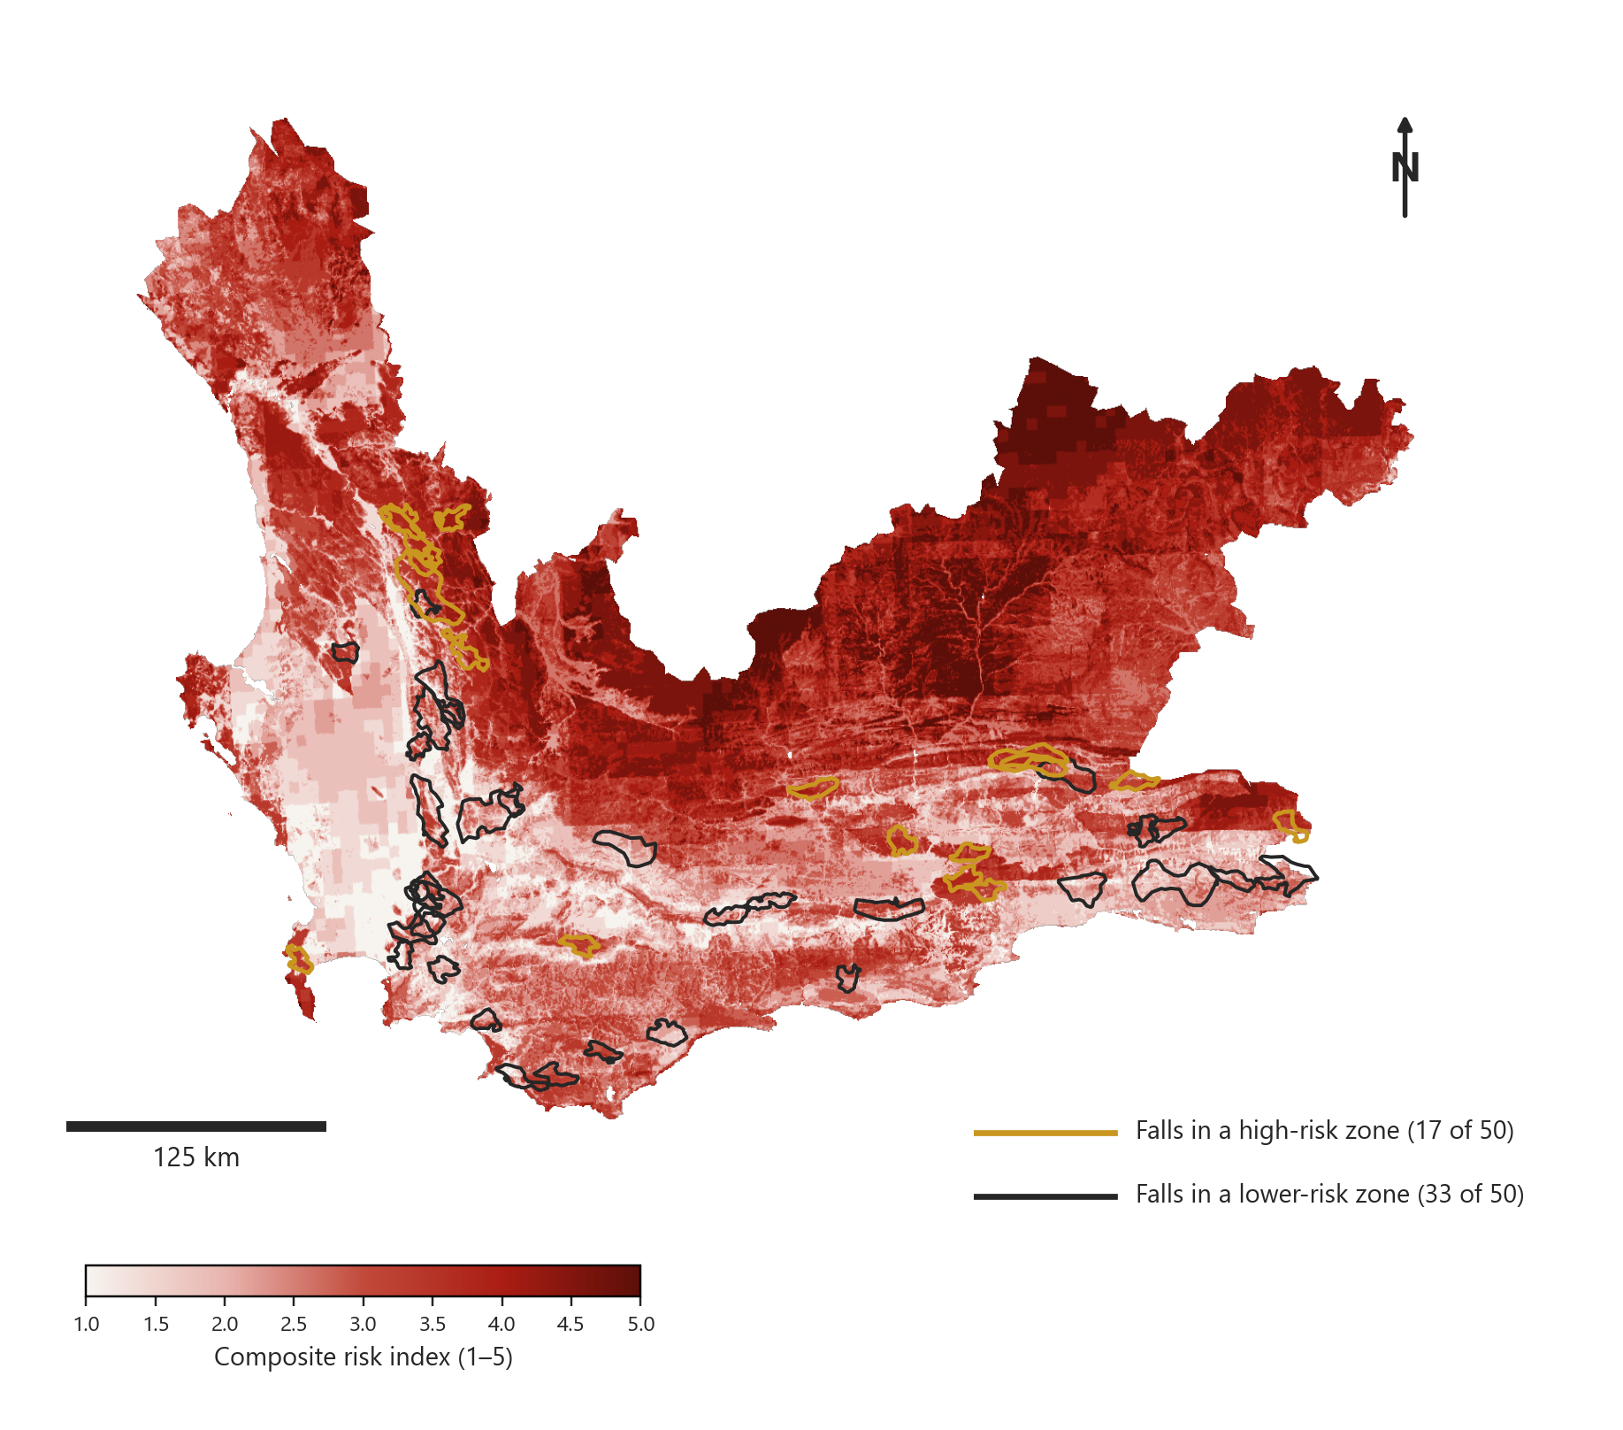
FINDING 3 OF 3
Checking the Composite Risk Model Against Reality
• Only 17 of the 50 largest fires on record (34%) fall inside a zone this index rates as high risk (3 or higher out of 5)
• The other 33 (66%) occurred somewhere the model currently rates as lower risk
• This is the same composite index built for the insurer brief, reused here as a genuine cross-check — and it does not reliably predict where the biggest fires actually happen
• That gap is the central finding of this assessment: severity plus vegetation dryness alone doesn't fully explain fire size
Composite risk index, with the 50 largest fires outlined by model agreement
RISKSCAPE | Spatial Actuarial Technologies
Confidential — Western Cape Largest Fire Events Assessment
Notes:
This is the slide I most want you to sit with. We took the same composite risk index built for the insurer brief and checked it against these 50 real, largest fires. Only 17 of them — a third — fall inside a zone the index calls high risk. The other two-thirds happened somewhere the model currently rates as lower risk. I'd rather tell you that plainly than bury it: a model built from severity and vegetation dryness is useful for some questions, but it has a real blind spot for predicting the biggest fires specifically, and that's exactly the kind of thing you need to know before you rely on it for emergency response planning.

Slide 6
THE RECORD
The 10 Largest Fires on Record
Start Date | Area (km²) | Days Burned | Risk Score | Model Agreement
2025-12-22 | 537.4 | 14 | 3.22 | Agrees
2018-10-25 | 498.7 | 22 | 1.99 | Disagrees
2016-01-30 | 431.8 | 20 | 2.05 | Disagrees
2024-01-22 | 285.7 | 12 | 2.15 | Disagrees
2017-01-16 | 262.7 | 8 | 2.26 | Disagrees
2025-12-22 | 261.7 | 25 | 2.48 | Disagrees
2017-02-23 | 253.3 | 11 | 2.08 | Disagrees
2016-12-14 | 248.8 | 12 | 2.95 | Disagrees
2016-02-25 | 246.4 | 10 | 3.48 | Agrees
2016-01-08 | 242.9 | 12 | 2.33 | Disagrees
• All ten of these fires — and all 50 in the shortlist — occurred in Fynbos vegetation
• Only 2 of the top 10 fell in a zone the model rated high-risk, in line with the 34% agreement rate across all 50
• Don't rely on the composite index alone for pre-positioning — pair it with the historical size pattern directly
RISKSCAPE | Spatial Actuarial Technologies
Confidential — Western Cape Largest Fire Events Assessment
Notes:
Here's the real top 10, largest to smallest, with each one's actual risk score from the composite index and whether it agreed. Only two of the ten biggest fires we have on record sat in a zone the model called high-risk — consistent with the one-in-three rate across the full top 50. My direct recommendation: use this historical size-and-location pattern directly for pre-season planning, alongside the composite index rather than instead of it. The index still has value, it just isn't sufficient on its own for this particular question.

Slide 7
METHODOLOGY & LIMITATIONS
How This Was Built, and Where to Be Careful
• "Top 50 by area" is a deliberate simplification — it surfaces the extremes and excludes mid-sized events that could still matter operationally
• The composite risk index was built for a different question (insurer premium tiering) and reused here as a genuine cross-check, not a purpose-built emergency response model
• All 50 largest fires being in Fynbos partly reflects that Fynbos is the largest bioregion in the province by a wide margin — a base-rate effect worth remembering before treating vegetation type alone as the explanation
• Days burned varies substantially even among similarly-sized fires (8 to 25 days in the top 10 alone) — a separate signal from area that a full response-planning model would also want to incorporate
• This is a historical pattern-recognition exercise, not a substitute for real-time fire behaviour prediction during an active event
RISKSCAPE | Spatial Actuarial Technologies
Confidential — Western Cape Largest Fire Events Assessment
Notes:
A few caveats before you plan around this. Restricting to the top 50 is a deliberate choice to keep this focused on the extremes, but it does mean some mid-sized fires that could still matter operationally aren't shown here. The composite risk index was genuinely built for a different client and a different question — reusing it here as a cross-check is legitimate, but it was never tuned for this specific question, and the disagreement rate we found reflects that. All 50 fires being in Fynbos is partly just base rate, since Fynbos dominates the province by area — I wouldn't over-read that as proof of anything causal about the vegetation itself. And notice how much days-burned varies even among similarly-sized fires — that's a separate operational signal worth tracking alongside area.

Slide 8
Next Steps
• Use the historical top-50 pattern directly for pre-season resource pre-positioning, alongside the composite index rather than instead of it
• Investigate why two-thirds of the largest fires fall outside the model's high-risk zones — fuel continuity, wind exposure, and suppression access are candidates not yet in the index
• Revisit this list every season as new large fires occur
Cameron Green — Spatial Data Infrastructure Engineer
cameron.green@riskscape.pro | +27 83 301 3201
Riskscape — Spatial Actuarial Technologies
Notes:
That's the assessment: fifty real fires, one clean vegetation finding, and one honest model limitation. Use the historical pattern directly for pre-positioning, keep pushing on why the composite index misses two-thirds of the biggest events, and let's revisit this every season as the record grows. Happy to take questions, and very happy to dig into candidate features — wind, fuel continuity, access — that might close that gap in a future version of the model.

