Slide 1

WILDFIRE RISK ASSESSMENT
Western Cape Wildfire Risk Assessment
Premium Tier Recommendations by District Municipality
Prepared for: Western Cape Regional Underwriting Team
Prepared by: Cameron Green, Spatial Data Infrastructure Engineer — Riskscape Analytics
July 2026
Notes:
Good morning, thank you for the time. You asked us a direct question: where in the Western Cape should wildfire premiums be highest, and why. What I'm going to walk through is a district-by-district risk assessment built from fourteen years of real fire records and our production severity model, ending in a concrete tiering recommendation you can hand to pricing today.

Slide 2

SCOPE & DATA
What This Assessment Covers
• Question: which of the six Western Cape district municipalities carry enough wildfire risk to justify a higher premium tier?
• Fire record: 4,644 mapped ignition points and 4,669 fire events across the Western Cape, drawn from satellite detections spanning 2012 to 2026
• Severity: Riskscape's production severity model (summer season — the peak fire period for this region's fynbos and renosterveld vegetation)
• Vegetation dryness: NDVI (Normalised Difference Vegetation Index), used as a proxy for fuel dryness
• Boundaries: the six official district municipalities — City of Cape Town, Cape Winelands, Overberg, Eden, Central Karoo, and West Coast
Three views, one dataset
1. Fire frequency — how often ignitions occur, by district
2. Fire severity — how intense fires get once started
3. Composite risk — severity and vegetation dryness combined into a single ranked index, which is what should actually drive premium tiers
RISKSCAPE | Spatial Actuarial Technologies
Confidential — Western Cape Wildfire Risk Assessment
Notes:
Before the maps, a quick word on what's under the hood. This draws on 4,644 individually mapped ignition points and 4,669 full fire event polygons going back to 2012 — so this isn't a thin sample, it's a fourteen-year record. On top of that we layer our own production severity model for the summer fire season, and a vegetation dryness signal from satellite NDVI. Three views of that data answer three different pieces of your question: how often, how bad, and — combining the two — how risky. That third one is what should actually set your tiers, and I'll show you why frequency alone would mislead you.

Slide 3
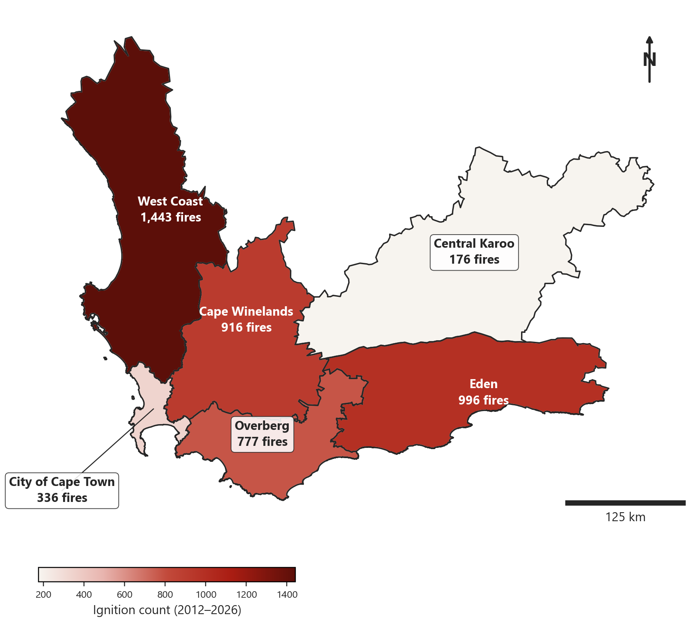
FINDING 1 OF 3
Fire Frequency by District Municipality
• West Coast has the most recorded ignitions of any district: 1,443 since 2012
• Eden (996) and Cape Winelands (916) follow, both well above the six-district average
• Central Karoo has by far the fewest — just 176 — despite covering the largest area
• Frequency alone would rank West Coast as the clear priority — but frequency is only half the picture, as the next two maps show
Ignition count per district, 2012–2026 (n = 4,644 mapped ignitions)
RISKSCAPE | Spatial Actuarial Technologies
Confidential — Western Cape Wildfire Risk Assessment
Notes:
This first map is the simplest cut: how many fires have actually started in each district since 2012. West Coast leads by a wide margin at 1,443 ignitions, with Eden and Cape Winelands both close behind in the high 900s. Central Karoo sits at the opposite end with only 176 — remarkable given it's the largest district by area. If you priced purely on how often fires start, West Coast would be your top tier and Central Karoo your lowest. Hold that thought, because the next two maps are going to complicate that story.

Slide 4
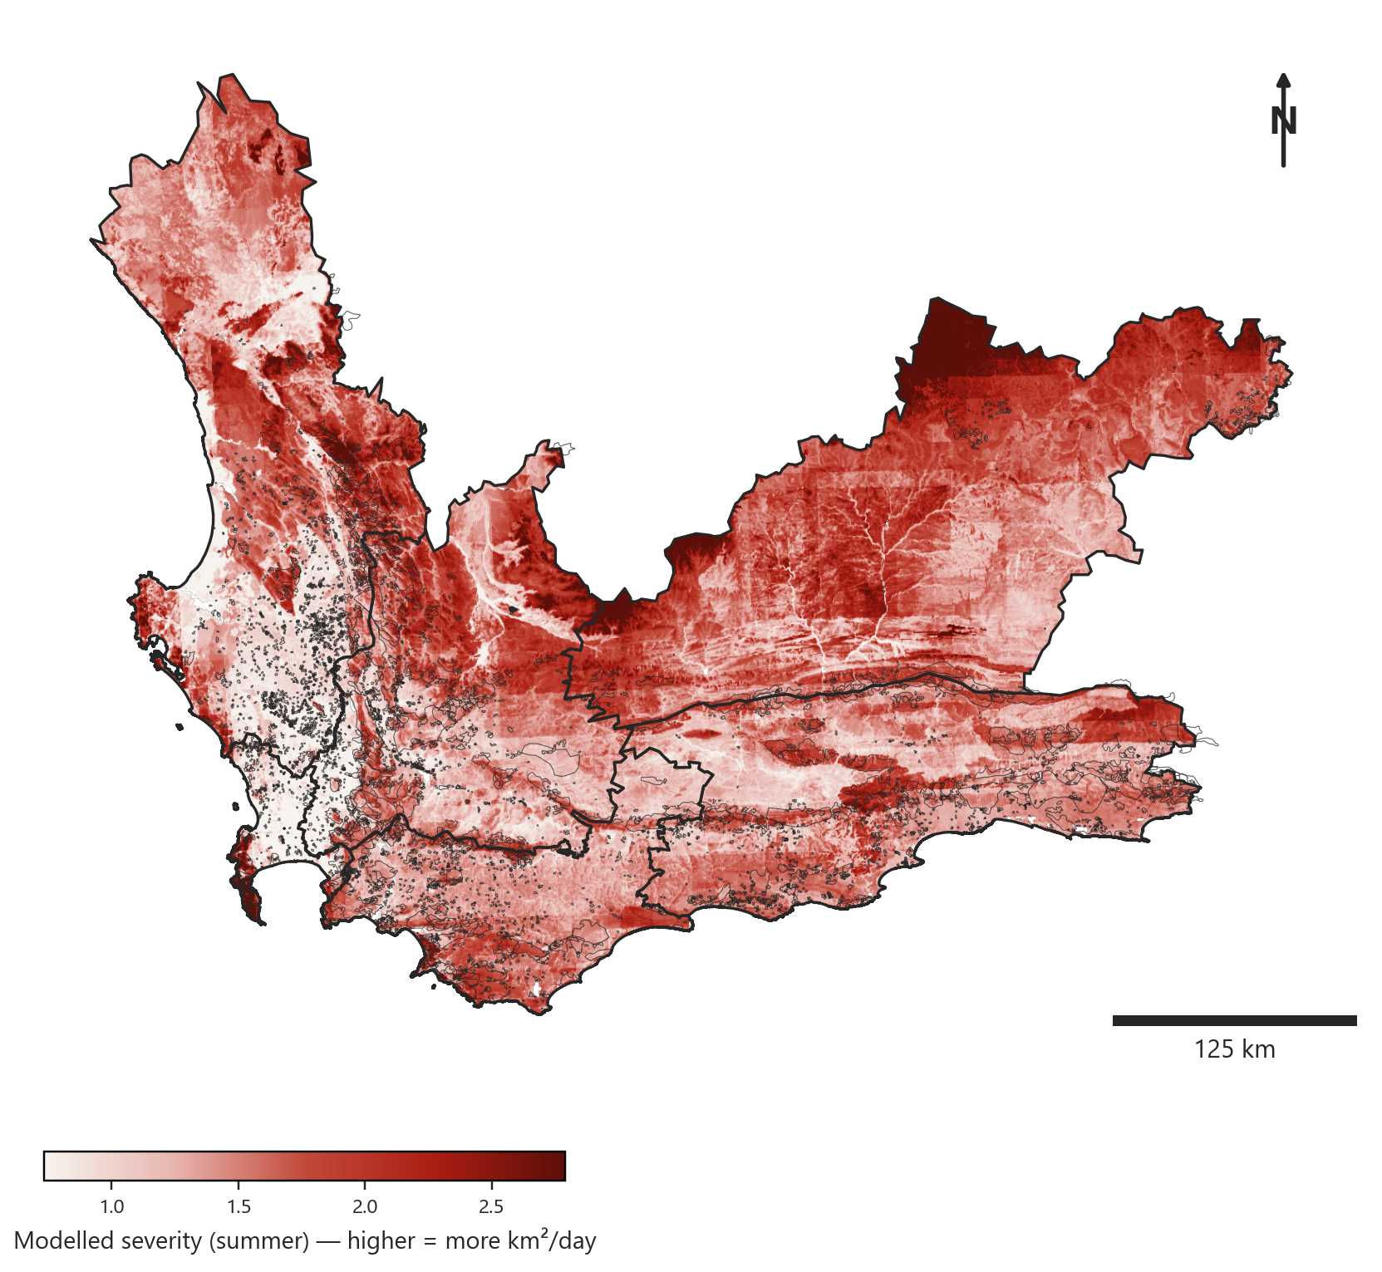
FINDING 2 OF 3
Seasonal Severity with Fire Events Overlaid
• Background shading is Riskscape's production severity model for the summer season
• Thin outlines are every real fire event in the fourteen-year record, shown against the model
• Central Karoo's eastern reaches and the West Coast interior both show sustained high-severity shading
• Severity and frequency diverge here: the areas with the most fires are not always the areas where fires burn most intensely
Modelled summer severity (km²/day) with the full fire event record overlaid
RISKSCAPE | Spatial Actuarial Technologies
Confidential — Western Cape Wildfire Risk Assessment
Notes:
Frequency told us where fires start most often; this map tells us how intense they get once they do. The shading is our production severity model, and every real fire event in the record is drawn on top so you can see the model checked against what actually happened. Notice the eastern part of Central Karoo runs consistently dark here — high modelled severity — even though we just saw it has the fewest ignitions of any district. That combination, low frequency but high severity, is exactly the kind of risk that a frequency-only pricing model would miss entirely.

Slide 5
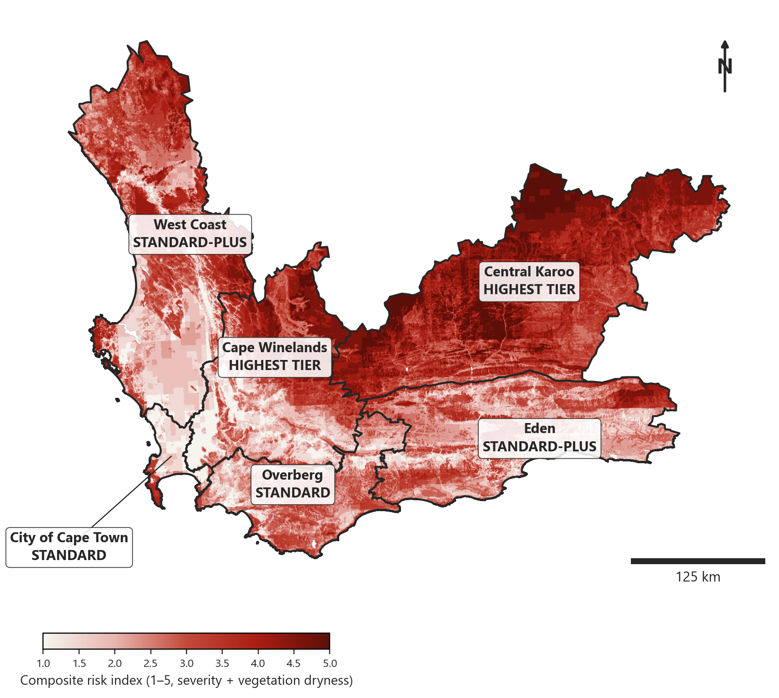
FINDING 3 OF 3
Composite Wildfire Risk Index
• Severity and NDVI vegetation dryness are each reclassified onto a common 1–5 scale, then blended 60/40 in favour of severity
• Central Karoo returns the highest composite score of any district — 4.02 out of 5 — despite ranking last on raw fire count
• Cape Winelands ranks second (2.80), followed closely by West Coast (2.76) and Eden (2.52)
• This is the layer we recommend anchoring premium tiers to, not the raw ignition count
Composite risk index (1–5): 60% severity, 40% vegetation dryness, blended per pixel
RISKSCAPE | Spatial Actuarial Technologies
Confidential — Western Cape Wildfire Risk Assessment
Notes:
This is the map that should actually drive your pricing. We took the severity model and the vegetation dryness index, put both on the same 1-to-5 scale, and blended them 60/40 in favour of severity, since severity already reflects fuel, weather, and terrain through the production model. The headline result: Central Karoo comes out on top with a composite score of 4.02, the highest of any district in this assessment — driven by a combination of high severity and very dry vegetation — even though it had the fewest fires on record. That's the central finding of this assessment, and it's the reason we don't recommend pricing off frequency alone.

Slide 6
RECOMMENDATION
Recommended Premium Tiers by District
District Municipality | Ignitions | Mean Severity | Composite Risk | Recommended Tier
Central Karoo | 176 | 1.80 | 4.02 | Highest
Cape Winelands | 916 | 1.49 | 2.80 | Highest
West Coast | 1,443 | 1.43 | 2.76 | Standard-plus
Eden | 996 | 1.47 | 2.52 | Standard-plus
Overberg | 777 | 1.43 | 2.44 | Standard
City of Cape Town | 336 | 1.10 | 1.71 | Standard
• Ranking is set by composite risk (severity + dryness), not ignition count
• Central Karoo and Cape Winelands justify the highest tier despite very different fire frequencies
• West Coast — the highest-frequency district — lands in the middle tier once severity and dryness are accounted for
RISKSCAPE | Spatial Actuarial Technologies
Confidential — Western Cape Wildfire Risk Assessment
Notes:
So here's the direct recommendation: set premium tiers from the composite risk column, not the ignition count column. On that basis, Central Karoo and Cape Winelands justify your highest tier. West Coast, despite having the most fires of any district by a wide margin, settles into the middle tier once we account for how intense those fires actually get and how dry the vegetation is. City of Cape Town is the clearest standard-tier case on every measure we looked at. I'd treat this table as the starting point for a pricing conversation, not the final word — happy to walk through where exactly you'd want to draw the tier boundaries.

Slide 7
METHODOLOGY & LIMITATIONS
How This Was Built, and Where to Be Careful
• Composite weighting (60% severity / 40% vegetation dryness) reflects expert judgement, not a calibration against your claims history — we'd recommend re-weighting once real loss data is available
• The severity model is trained on historical fire, climate, and terrain patterns; it describes what has happened, not a guaranteed forecast of next season
• Risk classes were computed using Western Cape data only, so scores are relative within this province — they should not be compared directly to districts modelled elsewhere
• District boundaries are administrative, not ecological — risk does not stop at a municipal line, so properties near a boundary deserve individual underwriting attention regardless of district tier
• This assessment is a portfolio-level screening tool for setting tiers, not a substitute for site-level survey on individual high-value policies
RISKSCAPE | Spatial Actuarial Technologies
Confidential — Western Cape Wildfire Risk Assessment
Notes:
A few things worth being upfront about before this goes into a pricing decision. The 60/40 weighting between severity and vegetation dryness is a reasonable expert-assigned starting point, not something we've calibrated against your actual claims — once you can share loss history, we'd want to refit those weights properly. The severity model itself is trained on historical patterns, so treat it as a description of the past rather than a guaranteed forecast. We deliberately computed the risk classes using only Western Cape data, so these scores are relative within the province and shouldn't be compared to any other region's numbers directly. And administrative boundaries are convenient for pricing tiers, but risk doesn't respect a district line — a property right on a boundary still needs individual attention. Bottom line: this is a strong portfolio-level starting point, not a replacement for underwriting judgement on individual risks.

Slide 8
Next Steps
• Agree tier cut-offs with your pricing team, anchored on the composite risk index
• Share historical claims data so the severity/dryness weighting can be recalibrated against real losses
• Revisit this assessment each season as new fire and severity data comes in
Cameron Green — Spatial Data Infrastructure Engineer
cameron.green@riskscape.pro | +27 83 301 3201
Riskscape — Spatial Actuarial Technologies
Notes:
That's the assessment: three views of the same fourteen years of data, converging on one recommendation — price from the composite risk index, not raw fire counts, and Central Karoo and Cape Winelands are your highest-priority districts even though one of them barely shows up on a simple fire count. Happy to take questions now, and as soon as you're able to share claims history we'd like to come back and recalibrate the severity-versus-dryness weighting against your real losses rather than our expert estimate.

