Slide 1
:) Workshop – 1 – SE

Slide 2

Poor choice of technologies
- leads to issues such as wasted time with having to find verbose ways to solve a problem
- other tools may solve it more elegantly and with more ease
- it hinders the quality of the product
- as well as hindering business operation as the more time spent extending a project unnecessarily, is wasted for the business

Slide 3
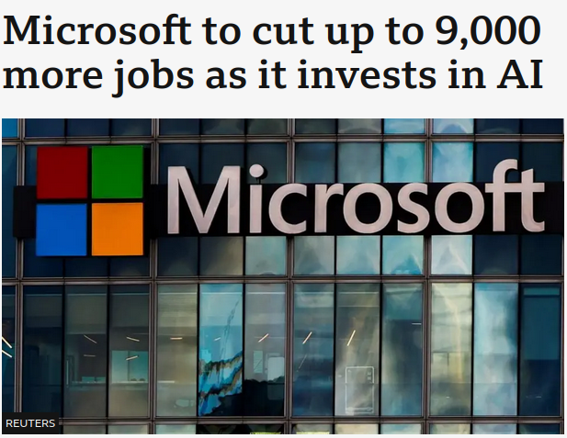
Losing critical staff at crucial point of the project
Means people with knowledge of the codebase no longer exist
Leads to a codebase which no one is knowledgeable making it so no meaningful changes can be implemented

Slide 4




Top manager make decisions without consulting the others
- making decisions on a product without consulting the people building it is an uninformed one leading to potentially serious ramifications such as a worsened user experience and therefore a hindered business as stakeholders and users may be less willing to invest into such a service , app, etc.

