Slide 1
Ticketing Attendance Data Modeling
Cami Hauver – U of U Data Analytics Course 2024

Slide 2



Introduction
Data background:
Anonymized historical data from a non-profit organization
Mission: natural science public education and conservation awareness
Data origin:
Pulled from business database, csv
Historical admissions ticketing data
Data scope:
Over 1,000,000 rows
16 columns:
Number of admits
Date/Time
Transaction ID
Sale type code
Ticketing type code
Sale type code
Zipcode
Location (city, county, state)

Slide 3

Objectives
Create a model from guest attendance and ticketing data that:
Utilizes data between the years 2021 and 2023
Predicts guest membership
Provide insight into what data is most important for accurate predictions
Provide insight into this question:
Are there certain guest demographics or locations that are more likely to be members?

Slide 4
Methods
Clean data and load into SQL
NULL, empty values, special characters, datatypes
Refine and filter data from SQL for modeling
Date filtering (2021-2023)
Exclude irrelevant ticketing (general admission or membership)
Exclude out-of-state attendees
Categorize demographic and location features
Normalize and standardize data
Skew to non-members
SMOTE (synthetic minority oversampling technique)
Standard Scaler

Slide 5



Methods
Implement model:
Python script, Jupyter Notebooks
Random Forest Classifier
Sklearn
Feature Importances
Optimize model:
Parameter tuning
Multiple iterations
Document changes in performance

Slide 6
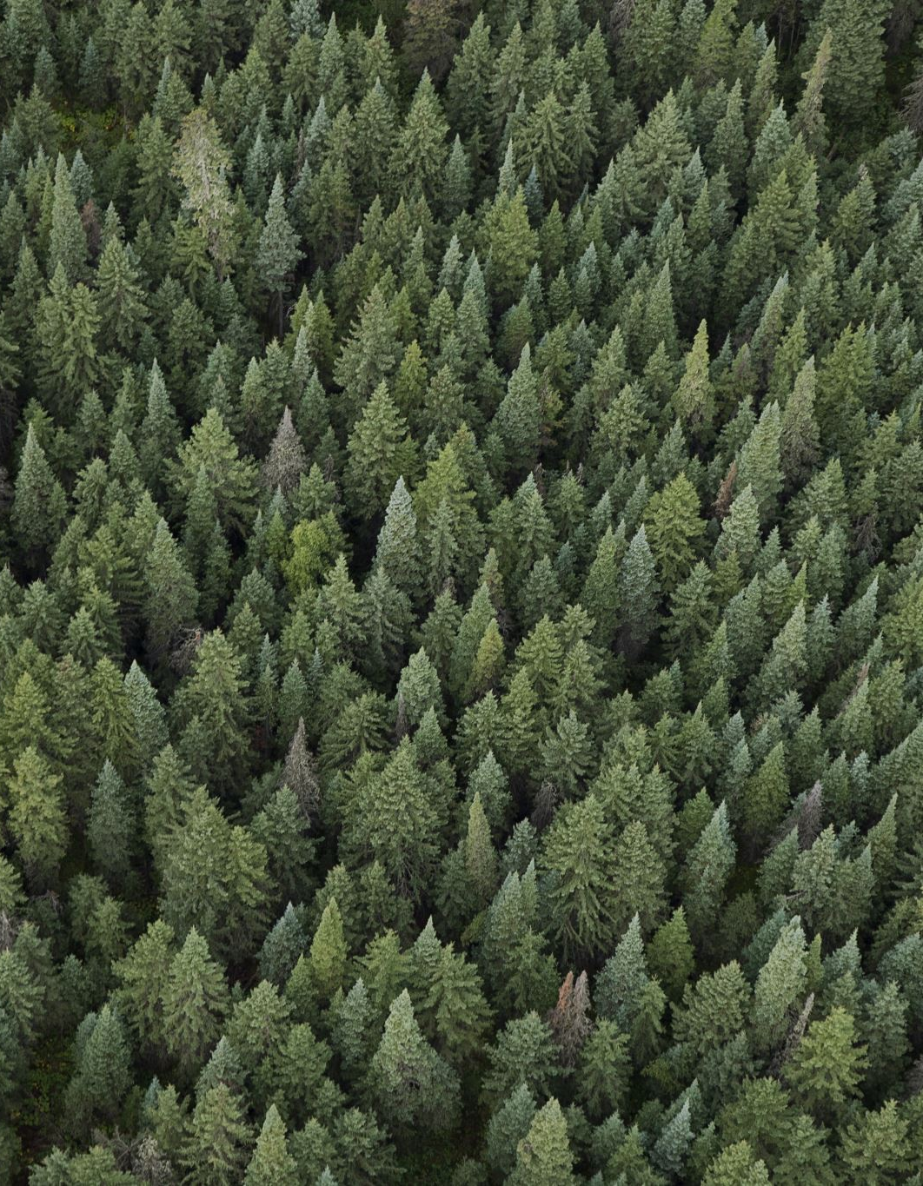
Methods
Random Forest Classifier Model
Target:
Member (1)
Non-member (0)
Features:
Year, Month, Location categories, Demographic categories

Slide 7
Methods
Random Forest Models:
Iterate with different feature sets
Version 1:
52 columns
Year
Month
Zipcode
Member
Small, medium, and large family/group
Adult, student, military, teen, child, two & under, senior
Salt Lake, Utah, or Davis County
Cities within Salt Lake, Utah, or Davis County
Version 2 (condensed):
13 columns
Year
Month
Zipcode
Member
Small, medium, and large family/group
Adult, teen, child
Salt Lake, Utah, or Davis County

Slide 8
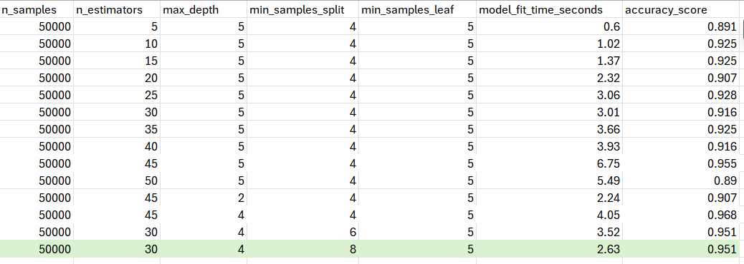
Methods
Version 1 Random Forest Model
Parameter tuning

Slide 9
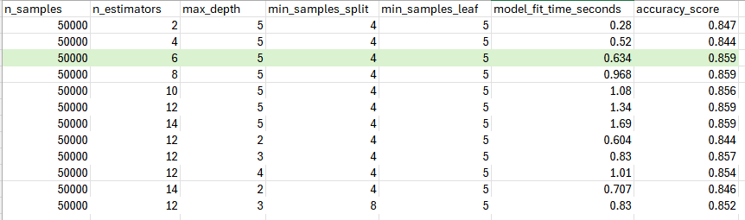
Methods
Version 2 Random Forest Model
Parameter tuning

Slide 10
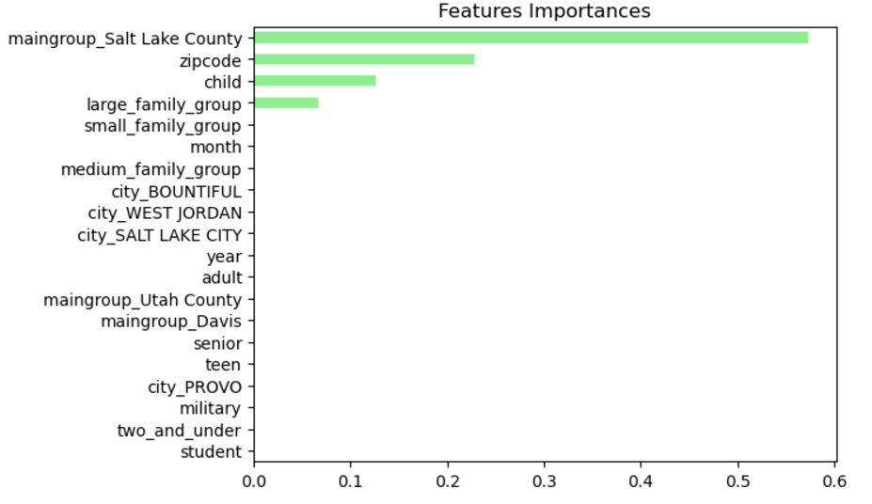
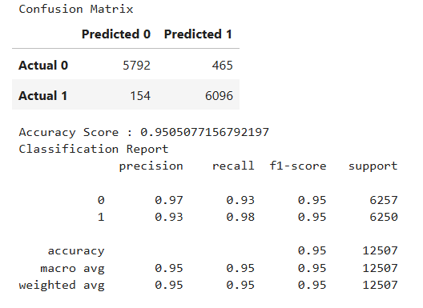
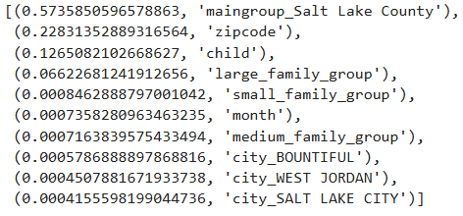
Results
Random Forest Model
Version 1

Slide 11
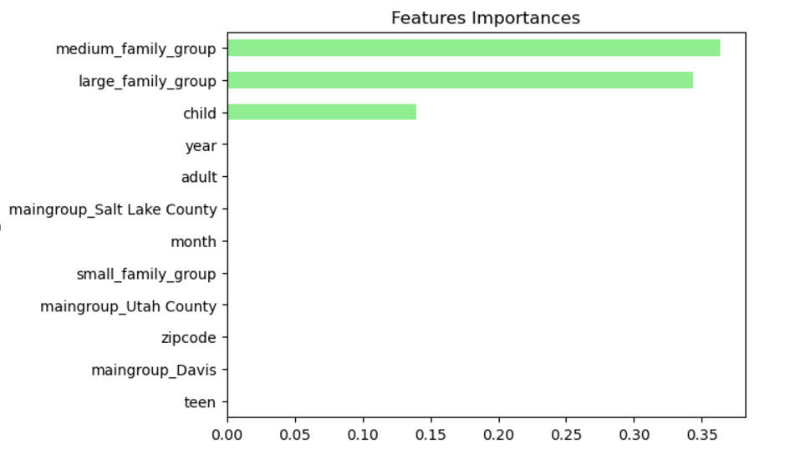
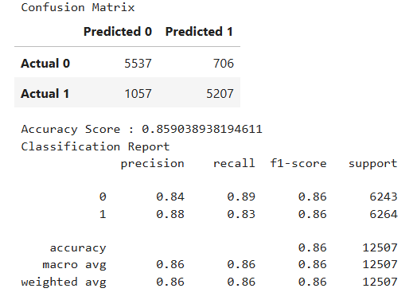
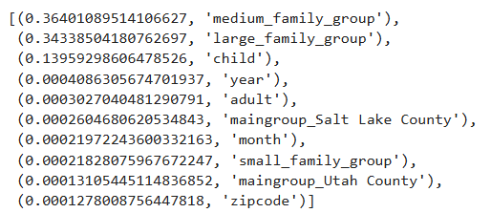
Results
Random Forest Model
Version 2 (condensed)

Slide 12
Analysis
Random Forest Models:
Performance Comparison
Version 1:
Higher Accuracy (95%)
Requires more data
More computing power/time
Top important features:
Main Group: Salt Lake County
Zipcode
Child
Version 2 (condensed):
Lower accuracy (86%)
Requires less data
Less computing power/time
Top important features:
Medium Family Group
Large Family Group
Child

Slide 13
Conclusion
Two optimized Random Forest Classification Model options:
Built with data only from years 2021 – 2023
Predicts guest membership 86-95%
Based on existing historical ticketing data (guest location and demographics)
Two options depending on data available and computing power/time
Provide insight into what data is most important for accurate predictions
Each model has differing important features results:
Version 1:
Salt Lake County
Zipcode
Child
Both models list ‘Child’ as an important demographic feature
Version 2:
Medium Family or Group
Large Family or Group
Child

Slide 14
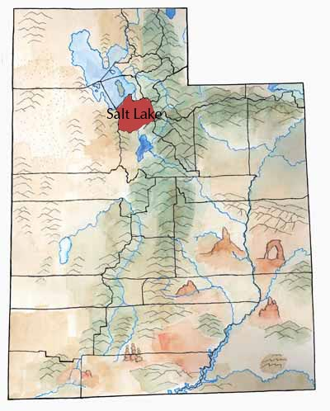
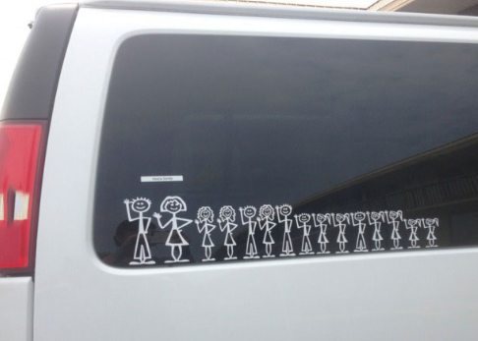
Conclusion
Are there certain guest demographics or locations that are more to be members?
Salt Lake County residency and zipcode may be reliable predictors of guest membership
Guests that are children and/or that belong to medium (5-6 members) and large families (>7 members) may also be more likely to be members

Slide 15

Suggestions for Next Steps
Resolve overfitting
Further model hyperparameter tuning:
Sklearn GridSearchCV
Model cross-validation
Refine feature selection
Explore modeling options that can predict guest non-membership
Are there locations/demographics that marketing should focus efforts to increase membership?

Slide 16
Questions?
Acknowledgements:
Thank you, Drew Hoang, for your instruction throughout this course; for your skills, wisdom, and patience!
Thank you, Henry Deane and Natural Chan, for being fantastic TAs and always being extremely helpful!

Slide 17
Resources
Code source:
Data Analytics Course Module 20 Supervised Learning files

