Slide 1
Bayesian Stats and Monte Carlo Simulation
Cam Kirk

Slide 2
Lies, Damn Lies, and Statistics
- Mark Twain

Slide 3
Bayes’ Theorem

Slide 4
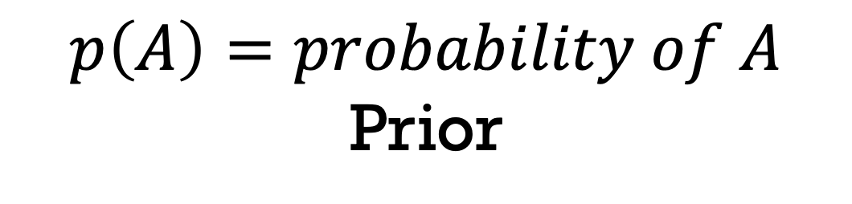
Bayes’ Theorem
$$p\left(A\right)=probability of A$$
Prior

Slide 5
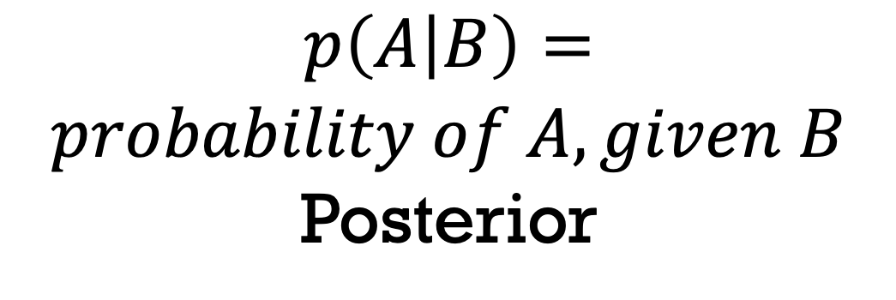
Bayes’ Theorem
$$p\left(A | B\right)=$$
$$probability of A, given B$$
Posterior

Slide 6
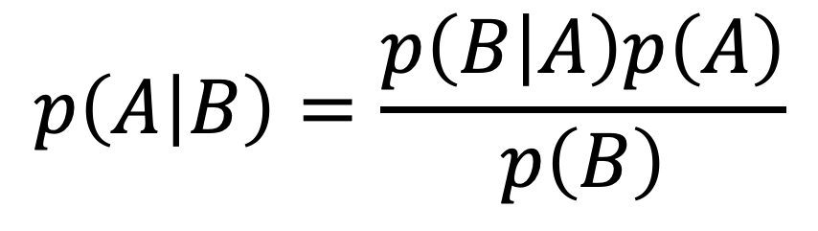
Bayes’ Theorem
$$p\left(A | B\right)=\frac{p\left(B | A\right)p\left(A\right)}{p\left(B\right)}$$

Slide 7
Bayes’ Theorem
What?

Slide 8
Monty Hall Problem

Slide 9
Monty Hall Problem
A
B
C

Slide 10
Monty Hall Problem
A
B
C

Slide 11
Monty Hall Problem
A
B
C

Slide 12
Monty Hall Problem
A
B
C

Slide 13
Monty Hall Problem
Do you switch?
A
B
C

Slide 14
Monty Hall Problem
Tabular Method

Slide 15
Monty Hall Problem
A
B
C
1/3
1/3
1/3

Slide 16
 | Prior | Likelihood |  | Posterior
 | p(A) | p(B|A) |  | p(A|B)
A | 1/3
B | 1/3
C | 1/3

Slide 17
Monty Hall Problem
A
B
C
1/2
1

Slide 18
 | Prior | Likelihood |  | Posterior
 | p(A) | p(B|A) |  | p(A|B)
A | 1/3 | 1/2
B | 1/3 | 0
C | 1/3 | 1

Slide 19
 | Prior | Likelihood |  | Posterior
 | p(A) | p(B|A) |  | p(A|B)
A | 1/3 | 1/2 | 1/6
B | 1/3 | 0
C | 1/3 | 1 | 1/3
Multiply columns 1 and 2

Slide 20
 | Prior | Likelihood |  | Posterior
 | p(A) | p(B|A) |  | p(A|B)
A | 1/3 | 1/2 | 1/6 | 1/3
B | 1/3 | 0
C | 1/3 | 1 | 1/3 | 2/3
Sum of column 3 is ½. Divide by ½ for p(A|B)

Slide 21
I don’t believe your math lies.
Okay, I’ll prove it with an experiment!

Slide 22
Monty Hall Problem
Experimental Method

Slide 23
Monte Carlo Simulation

Slide 24
Monte Carlo Simulation
Short version:
Throw random $#!% numbers at a system until it gives us some useful information

Slide 25
Let’s talk code!

