Slide 1
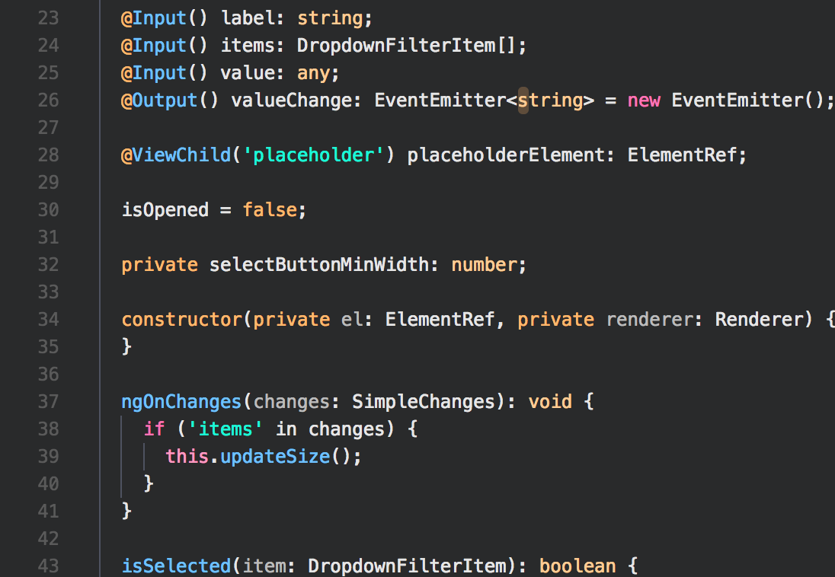

Web-API Developer Challenge
Zürich, 15.11.2017
CONFIDENTIAL AND PROPRIETARY Any use of this material without specific permission of
Open Web Technology is strictly prohibited

Slide 2

Web-ApI DevelopeR
Challenge
Create the „Contacts API“. It’s a simple API, where a user can get a quick overview over all contacts resources like person, skills...
The following use cases should be implemented:
UC1
Create an CRUD endpoint for managing contacts. A contact should have at least the following attributes and appropriate validation:
Firstname
Lastname
Fullname
Address
Email
Mobile phone number
UC2
Create a CRUD endpoint for skills. A contact can have multiple skills and a skill can belong to multiple contacts. A skill should have the following attributes and appropriate validation:
Name
Level (expertise)

Slide 3
Web-ApI DevelopeR
Challenge
UC3
Document your API with Swagger.
UC4 (optional)
Implement the following security aspects. All bullet points are optional and can be implemented partially.
Authentication
Authorization
Users can only change their contact
Have checks for skills changes (e.g. the current user can’t change skills for other users)

Slide 4
Web-ApI Developer
Challenge
Notes
Use Git and make your code available via GitHub or Bitbucket.
Use appropriate tools, libraries and frameworks to make your life easy.
Use as much Spring (Spring Boot) as possible

