Slide 1



Starting soon!

Slide 2

Mondays at 9 AM US/Pacific (16:00 UTC)
https://dotnetdocs.dev

Slide 3
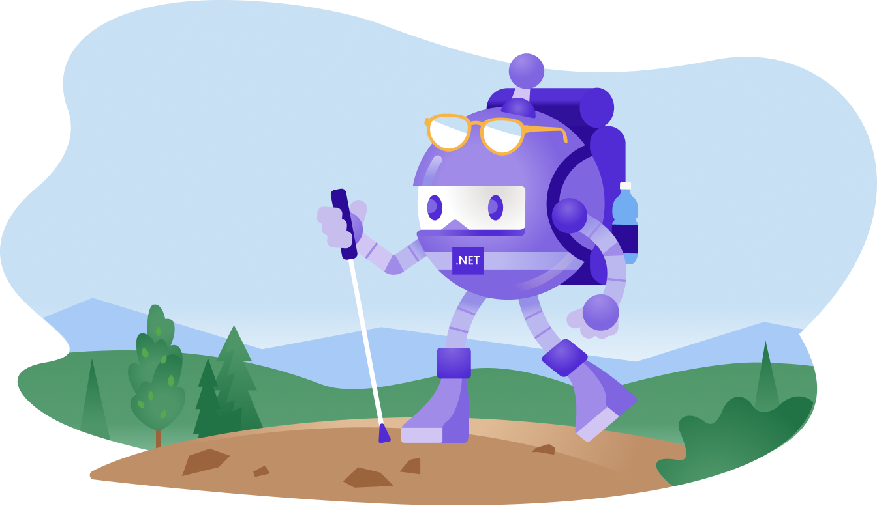
will be right back!

Slide 4


Slide 5


Slide 6

The Docs
Show

Slide 7
Mondays | 9 AM US/Pacific

Slide 9
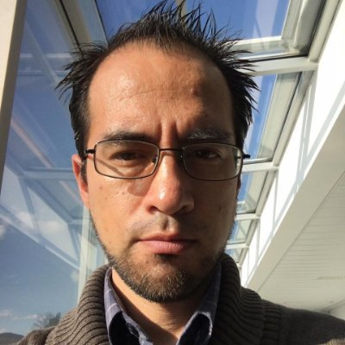
This week: Serverless Machine Learning
with Luis Beltran
Monday | 9 AM US/Pacific (16:00 UTC)

Slide 10
✨ Special Episode! ✨ .NET IoT Ask Me Anything
with Laurent Ellerbach, Krzysztof Wicher, and Jose Perez Rodriguez
Monday | 9 AM US/Pacific (16:00 UTC)

Slide 11
Mondays | 9 AM US/Pacific

