Slide 1



Starting at 11:00 AM US/Central (16:00 UTC)!

Slide 2

Mondays at 11:00 AM US/Central (16:00 UTC)
https://dotnetdocs.dev

Slide 3

will be right back!

Slide 4


Slide 5


Slide 6

The Docs
Show

Slide 9
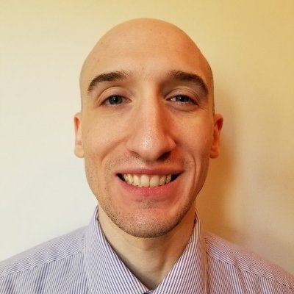
This week: .NET open-source projects
with Isaac Levin
Monday | 11 AM US/Central (16:00 UTC)

Slide 10

This week: Exploring ASP.NET Core + Vue.js with Matt Millican
Monday | 11 AM US/Central (16:00 UTC)

