Slide 1



Starting soon!

Slide 2

Mondays at 9 AM US/Pacific (16:00 UTC)
https://dotnetdocs.dev

Slide 3
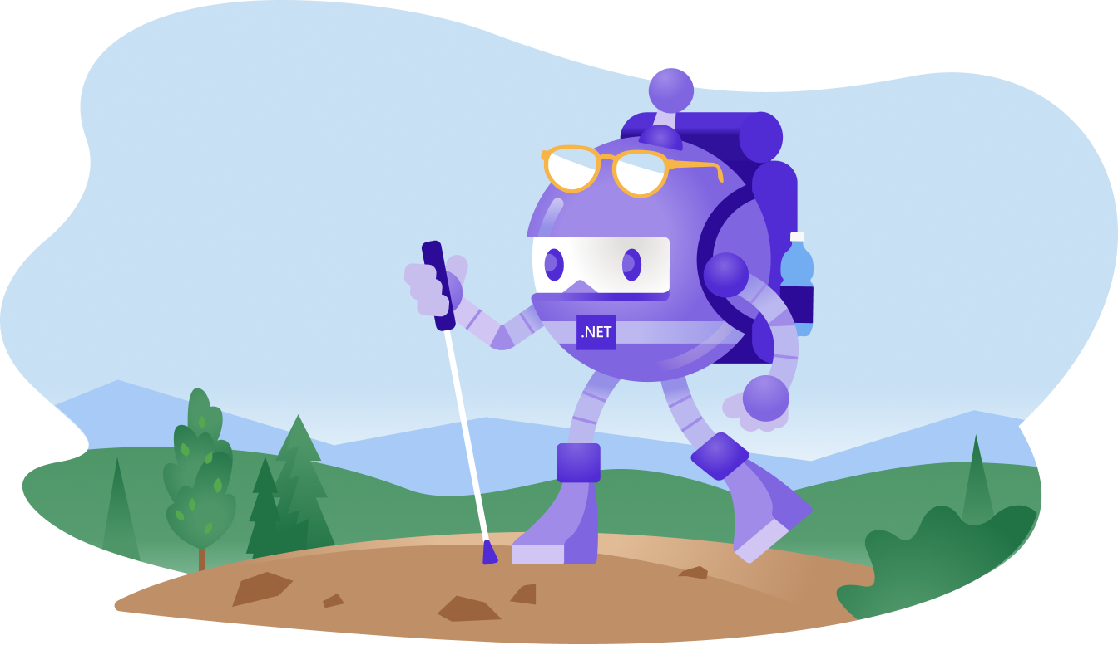
will be right back!

Slide 4


Slide 5


Slide 6

The Docs
Show

Slide 9
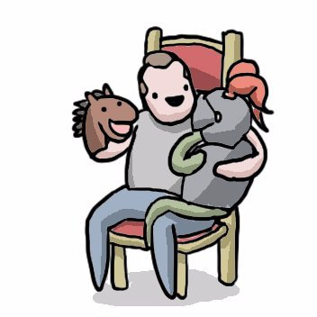
This week: Hacking DateTime bugs in PROD with Jon Skeet
Monday | 9 AM US/Pacific (16:00 UTC)

