Slide 1

Decision-Grade Multi-Objective Benchmarking of AI and Heuristic Controller Placement in Multi-Site Software Defined Networks
BSc Honours in Computer Science Mini-Dissertation Defense | University of Zululand (2026) | Aligned with UNIZULU 2026 Scoring Rubric (100 Marks) •
Thabang Nhlokoma Buthelezi (230011908) | Supervisors: Prof. P. Mudali & Mr. S. Zwane | Dissemination: SATNAC 2026 Paper & Poster
Notes:
Good morning Prof. Mudali, Mr. Zwane, and esteemed members of the examination panel. [2-second pause; scan the room]​
​My name is Thabang Buthelezi, and today I am proud to present and defend my BSc Honours mini-dissertation in Computer Science:​
'Decision-Grade Multi-Objective Benchmarking of AI and Heuristic Controller Placement in Multi-Site Software Defined Networks.' [Pause]​
​Over the past five years, a wave of Software-Defined Networking literature has proposed Deep Reinforcement Learning for controller placement. Yet a critical engineering question remains unanswered: [Slight pause for emphasis]​
​When we account for multi-second offline training overhead, single-link failure survivability, and kernel-level OpenFlow switching delays... does Deep Reinforcement Learning actually outperform classical heuristics on small-to-medium Wide Area Networks? [Pause]​
​Today, I will walk you through our 300-run factorial benchmark, our 10,000-episode stability audit, and our 1,000-state dynamic churn investigation that answer this question definitively.​
​

Slide 2

Slide 2: The Controller Placement Problem & Literature Gap (2021–2026)
Multi-Site WAN Challenge: Decoupling the control plane from OpenFlow switches introduces propagation delay L(P) and single-link (N−1) cut vulnerability (Mohanty et al., 2021; Wang & Chen, 2021; Boudi, 2026).
Three Blind Spots (2021–2026): (1) Single-Metric Myopia strands switches behind bridges (Yusuf et al., 2023); (2) Conflating Training (ω_train) & Inference (τ_inf) in DRL (Benoudifa et al., 2023; Kurra et al., 2025; Farahi et al., 2026); (3) Unvalidated Graph Models omit OVS queuing (Priya et al., 2025).
Study (2021–2026) | Primary Method | Latency L(P) | N−1 Link Reliability | ω_train vs. τ_inf | Mininet RTT | 3D Pareto
Mohanty et al. (2021) | k-Center Heuristic | Yes | No | Omitted | No | No
Wang & Chen (2021) | Link-Failure Foresight | Yes | Yes | Omitted | No | No
Radam et al. (2022) | Hybrid HSA-PSO | Yes | Partial | Omitted | No | Partial
Benoudifa et al. (2023) | MuZero DRL | Yes | No | Omitted | No | No
Yusuf et al. (2023) | CPCSA Critical Switch | Yes | Yes | Omitted | Yes | No
Kurra et al. (2025) | CAPFUL Dynamic DRL | Yes | Partial | Omitted | Partial | No
Farahi et al. (2026) | AP-DQN (PyTorch DRL) | Yes | Partial | Omitted | No | No
This Study (2026) | 5-Way Benchmark | Yes | Yes (Reach_avg) | Yes (Separated) | Yes (5-Way) | Yes (2D/3D)
Notes:
On Slide 2, we establish the core operational challenge and the literature gaps motivating our work.​
​​In a multi-site Software Defined Network, decoupling the control plane from forwarding hardware means every Packet-In and Flow-Mod exchange must traverse wide-area fiber links. Choosing where to deploy k distributed controllers directly dictates both end-to-end control latency and fault survivability.​
​[Gesture toward Table 2.1]​
When we audited recent studies from 2021 through 2026, we uncovered three critical blind spots in the literature:​​
First, Optimizing only for a single : when algorithms focus exclusively on average delay, they tend to pull controllers into the center of the network. As a result, outer switches are left completely stranded if a single critical link fails.​
​Second, and equally important, is the omission of the training tax: recent reinforcement learning models—such as AP-DQN and MuZero—frequently report sub-millisecond forward-pass speeds, but they completely omit the multi-second offline training overhead required to learn that policy in the first place.​
​And third, unvalidated graph assumptions: most published studies simply calculate shortest paths on paper. They never test whether those theoretical rankings still hold true once real switch software, Open vSwitch packet processing, and operating system queuing jitter are introduced.​
​Together, these three gaps lead directly to our research questions ​
on Slide 3.​
​
​

Slide 3

Slide 3: Research Questions, 7 Objectives & Formal Hypotheses
RQ1 (→ Obj. 1, 2, 3, 4, 5): How do the 5 paradigms trade off L(P), N−1 reachability, and ω_train vs. τ_inf?
RQ2 (→ Obj. 1, 4, 5, 7): How does graph topology (scale-free BA, planar Waxman, WANs) govern dominance?
RQ3 (→ Obj. 3, 6, 7): Do graph rankings hold in Mininet/OVS RTT, and at what T_break does DQN amortize ω_train?
Hypotheses (α = 0.05, N ≤ 50): H_01 (Null): No DRL latency gain; H_11 (Alt.): Static ω_train leaves DRL dominated.
Obj. | Specific Research Objective (Dissertation Sec. 1.4.2) | RQs | Primary Deliverable & Empirical Verification | Slide / Ch.
Obj. 1 | Build Python benchmark pipeline (Internet2, ATT-MPLS, BA, Waxman) | RQ1, RQ2 | Modular graph & SHA-256 cached N−1 engine (10⁻⁹ parity, 46.4% faster) | Slide 4 (Ch. 3)
Obj. 2 | Implement 5 paradigms: Random, K-Center, K-Means, GA & PyTorch DQN | RQ1 | Unified API across all 5 placement algorithms (22/22 unit tests pass) | Slide 5 (Ch. 3)
Obj. 3 | Run 1,000-ep DQN pilot (Internet2) & 10-run stability audit (10k ep) | RQ1, RQ3 | Converges in ~20 ep (13.199 mean); divergence_flag = False (10/10) | Slides 6–7 (Ch. 4)
Obj. 4 | Execute 5 × 2 × 2 × 3 synthetic factorial matrix (N_obs = 300) & ANOVA | RQ1, RQ2 | GA wins 12/12 cells; ANOVA F=118.90 (p<0.0001); DQN vs KM p=0.68 | Slides 8–9 (Ch. 4)
Obj. 5 | Synthesize 2D & 3D Pareto frontiers across L(P), Reach_avg, and ω_train | RQ1, RQ2 | Greedy K-Center (BA) & K-Means (Waxman) dominate static frontier | Slides 8–9 (Ch. 4)
Obj. 6 | Validate 5 strategies in Mininet/OVS (TCLink) & 3-trial 2s Gate Test | RQ3 | Exact rank parity (ρ=+1.00; GA 2.718 ms, KM 2.852 ms); Gate 2,876 ms | Slides 11–12 (Ch. 4)
Obj. 7 | Formulate bounded deployment guide (N ≤ 50) & 1k-state churn T_break | RQ2, RQ3 | Decision flowchart (N ≤ 50); DQN breaks even at T_break = 59–65 ep | Slides 10, 13 (Ch. 4–5)
Notes:
On Slide 3, we map our three core research questions directly to our seven specific objectives and formal hypotheses. First, Research Question 1 asks how our five paradigms trade off propagation latency, link survivability, and offline training versus online inference runtime. We answer this across Objectives 1 through 5—building our unified benchmarking engine, running our 10,000-episode stability audit, and executing our 300-run synthetic factorial experiment to generate 2D and 3D Pareto frontiers. Second, Research Question 2 investigates how graph structure—specifically scale-free hubs versus planar spatial meshes—governs algorithmic dominance. This is operationalized across Objectives 1, 4, and 5, isolating the structural drivers of placement efficiency. And third, Research Question 3 takes these algorithms into physical deployment: Do our graph-level rankings survive OpenFlow kernel emulation? And under dynamic link churn, when does a pre-trained DRL policy break even against re-running heuristics? This is fulfilled by Objective 6—our five-way Mininet RTT validation and 2-Second Gate Test—and Objective 7, our bounded decision framework. [Direct eye contact with the panel; slight pause]Together, these objectives formally test our Null Hypothesis ($H_{01}$)—that DRL yields no significant multi-objective advantage over heuristics for networks under 50 nodes—against our Alternative Hypothesis ($H_{11}$)—that while DRL achieves competitive latency, its offline training overhead leaves it Pareto-dominated on static graphs. Slide 4 details the mathematical formulation and methodology we designed to test these hypotheses.

Slide 4
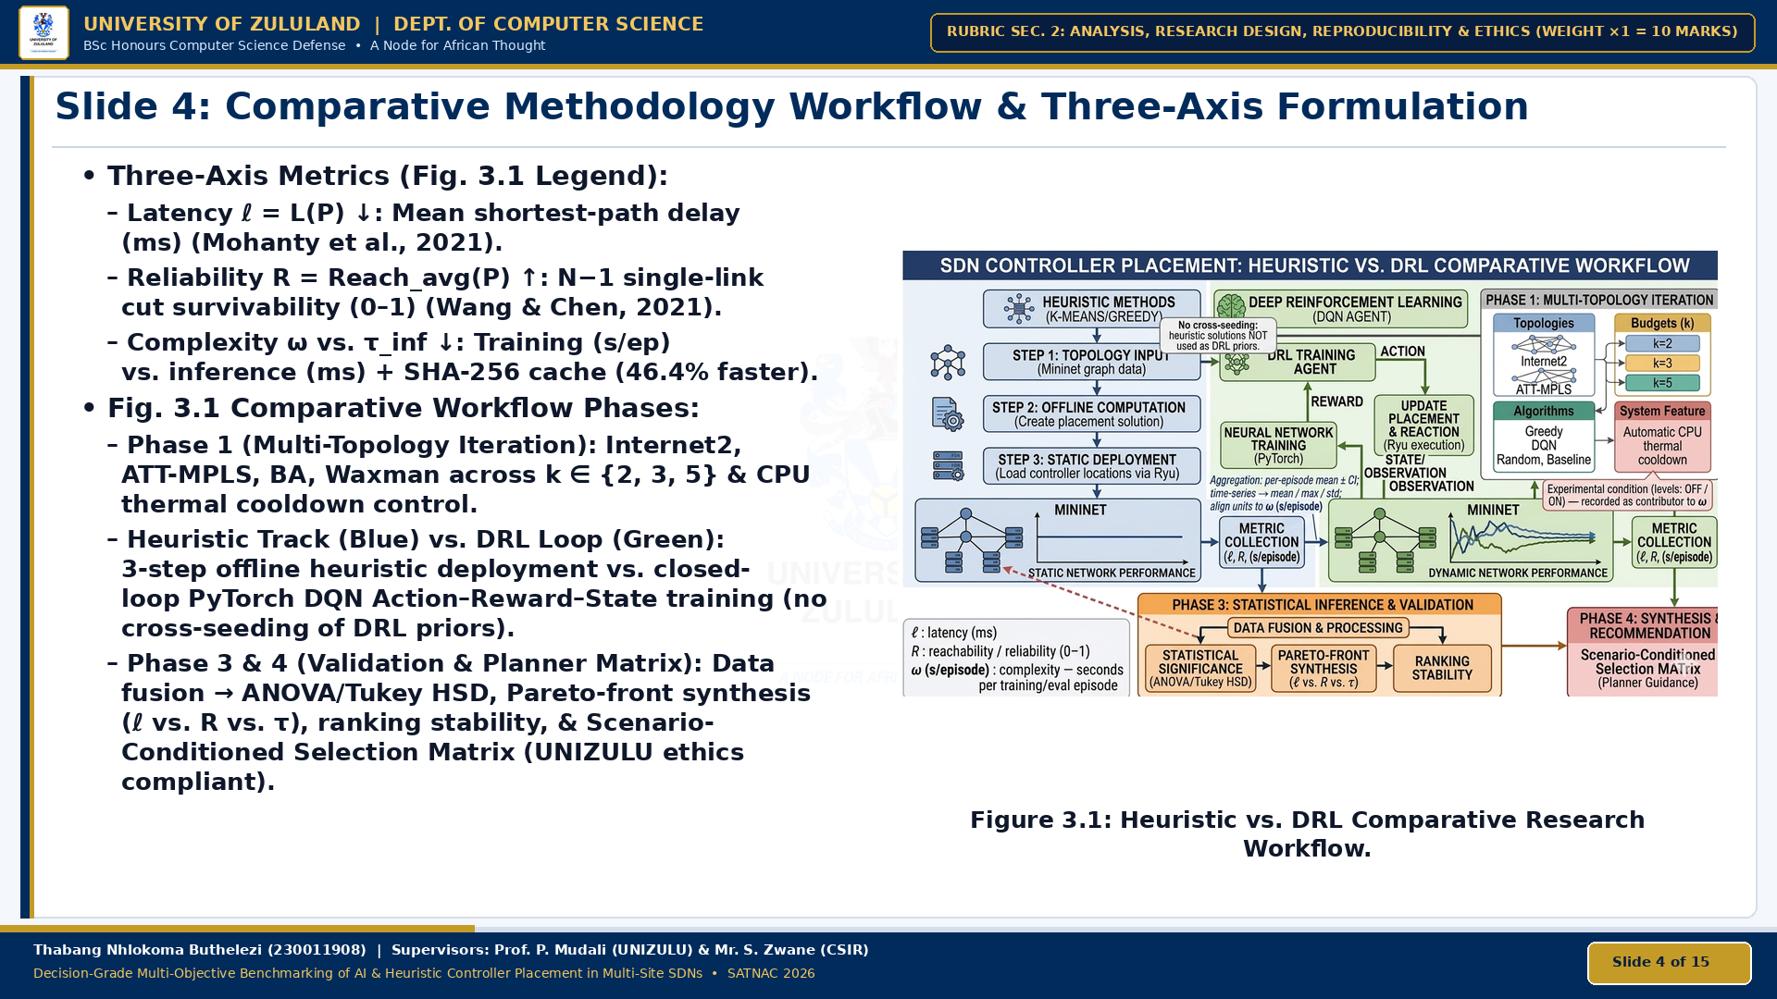
Notes:
On Slide 4, we address Section 2 of the scoring rubric—Analysis, Research Design, Reproducibility, and Ethics—by walking directly through our end-to-end comparative methodology workflow in Figure 3.1.
[Gesture to Top-Right of Figure 3.1]
Look first at Phase 1 in the top-right corner of the diagram: our experimental harness iterates across canonical carrier backbones—Internet2 and ATT-MPLS—as well as synthetic Barabási-Albert and Waxman topologies under controller budgets k = 2, 3, and 5, incorporating automatic CPU thermal cooldown controls so hardware throttling never distorts our timing measurements.
[Gesture to Left Blue Column and Center Green Column]
From Phase 1, the workflow splits into two strictly isolated tracks—and notice the white callout badge at the top: "No cross-seeding: heuristic solutions are NOT used as DRL priors," ensuring a completely fair, unassisted benchmark:
- In the left blue track, heuristic methods—Greedy K-Center, K-Means, and GA—take the topology input in Step 1, compute a placement offline in Step 2, and deploy into Mininet in Step 3 to measure static network performance.
- In the center green track, our PyTorch Deep Q-Network operates as a closed-loop agent: selecting placement Actions, observing network State transitions, updating neural weights via Reward backpropagation, and aggregating episodic metrics.
[Gesture to Bottom-Left Legend]
As shown in the bottom-left legend of Figure 3.1, both tracks collect three exact metrics: propagation latency ℓ = L(P) in milliseconds, N−1 single-link reachability R = Reach_avg(P) in [0, 1] accelerated by 46.4% via our SHA-256 component cache, and computational complexity ω separated into training time per episode versus online inference τ_inf.
[Gesture to Bottom Orange and Red Blocks]
Finally, Phase 3 fuses all outputs for Multi-Factor ANOVA and Tukey HSD testing, 3D Pareto-front synthesis, and Mininet ranking stability, which feed directly into Phase 4 in the bottom-right corner: our Scenario-Conditioned Selection Matrix for network planners. All experiments use fixed random seeds on non-human topologies in full compliance with UNIZULU ethics guidelines.

Slide 5


Slide 4: Comparative Methodology Workflow & Three-Axis Formulation
Three-Axis Metrics (Fig. 3.1 Legend):
  Latency ℓ = L(P) ↓: Mean shortest-path delay (ms) (Mohanty et al., 2021).
  Reliability R = Reach_avg(P) ↑: N−1 single-link cut survivability (0–1) (Wang & Chen, 2021).
  Complexity ω vs. τ_inf ↓: Training (s/ep) vs. inference (ms) + SHA-256 cache (46.4% faster).
Fig. 3.1 Comparative Workflow Phases:
  Phase 1 (Multi-Topology Iteration): Internet2, ATT-MPLS, BA, Waxman across k ∈ {2, 3, 5} & CPU thermal cooldown control.
  Heuristic Track (Blue) vs. DRL Loop (Green): 3-step offline heuristic deployment vs. closed-loop PyTorch DQN Action–Reward–State training (no cross-seeding of DRL priors).
  Phase 3 & 4 (Validation & Planner Matrix): Data fusion → ANOVA/Tukey HSD, Pareto-front synthesis (ℓ vs. R vs. τ), ranking stability, & Scenario-Conditioned Selection Matrix (UNIZULU ethics compliant).
Figure 3.1: Heuristic vs. DRL Comparative Research Workflow.
Notes:
On Slide 4, we address Section 2 of the scoring rubric—Analysis, Research Design, Reproducibility, and Ethics—by walking directly through our end-to-end comparative methodology workflow in Figure 3.1.
[Gesture to Top-Right of Figure 3.1]
Look first at Phase 1 in the top-right corner of the diagram: our experimental harness iterates across canonical carrier backbones—Internet2 and ATT-MPLS—as well as synthetic Barabási-Albert and Waxman topologies under controller budgets k=2,3, and 5, incorporating automatic CPU thermal cooldown controls so hardware throttling never distorts our timing measurements.
[Gesture to Left Blue Column and Center Green Column]
From Phase 1, the workflow splits into two strictly isolated tracks—and notice the white callout badge at the top: 'No cross-seeding: heuristic solutions are NOT used as DRL priors,' ensuring a completely fair, unassisted benchmark:
In the left blue track, heuristic methods—Greedy K-Center, K-Means, and GA—take the topology input in Step 1, compute a placement offline in Step 2, and deploy into Mininet in Step 3 to measure static network performance.
In the center green track, our PyTorch Deep Q-Network operates as a closed-loop agent: selecting placement Actions, observing network State transitions, updating neural weights via Reward backpropagation, and aggregating episodic metrics.
[Gesture to Bottom-Left Legend] As shown in the bottom-left legend of Figure 3.1, both tracks collect three exact metrics: propagation latency ℓ=L(P) in milliseconds,
N−1 single-link reachability Reachavg ∈ [0,1] R=Reachavg
​
(P)∈[0,1] accelerated by 46.4% via our SHA-256 component cache, and computational complexity ω separated into training time per episode versus online inference τ.
[Gesture to Bottom Orange and Red Blocks]
Finally, Phase 3 fuses all outputs for Multi-Factor ANOVA and Tukey HSD testing, 3D Pareto-front synthesis, and Mininet ranking stability, which feed directly into Phase 4 in the bottom-right corner: our Scenario-Conditioned Selection Matrix for network planners. All experiments use fixed random seeds on non-human topologies in full compliance with UNIZULU ethics guidelines."

Slide 6

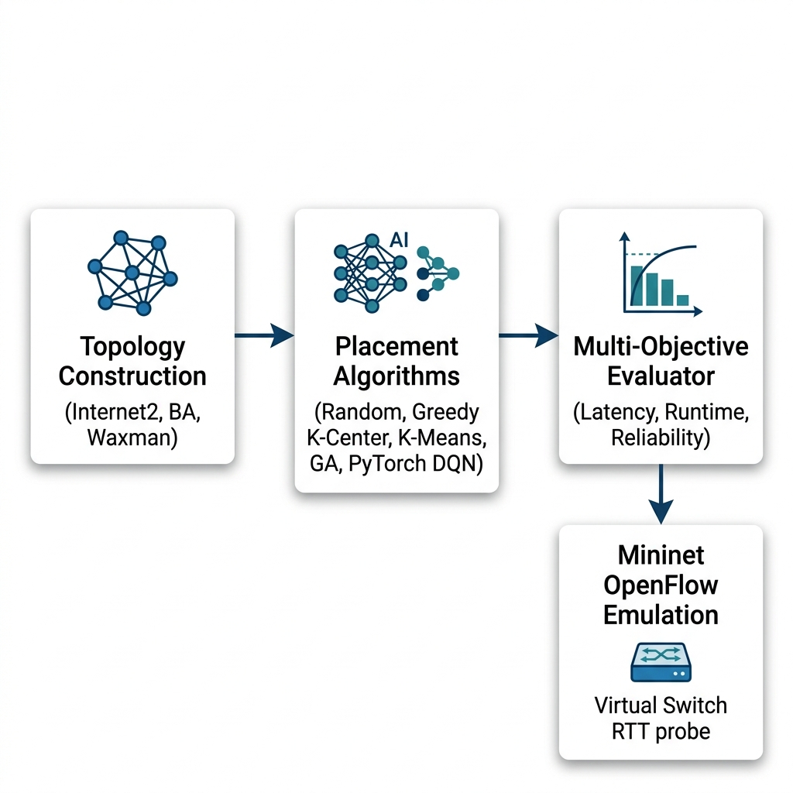
Slide 5: System Architecture & Five Competing Placement Paradigms
1. Random Baseline: Seeded uniform sampling without replacement (22/22 unit tests passing).
2. Greedy K-Center: Farthest-first 2-approximation in O(kN) lookups (Mohanty et al., 2021; Vardhan & SriBhargav, 2025).
3. Spatial K-Means: Coordinate partitioning with graph medoid snapping (Xiao & Chen, 2021; Priya et al., 2025).
4. Genetic Algorithm (GA): Tournament selection, uniform crossover, swap mutation p_m = 0.15 (Radam et al., 2022; Xu et al., 2023).
5. PyTorch DQN & Bandit RL: Replicates AP-DQN (Farahi et al., 2026) — MLP N → 64 → 64 → N, α = 0.001, γ = 0.99, batch 32, replay 10,000:
  Composite Reward: R(P) = 10 · (L_max − L(P)) / L_max + 5 · Reach_avg(P) ∈ [0, 15].
Figure 3.2: System Architecture of the Benchmark and Mininet Harness.
Notes:
On Slide 5, we present our software architecture and the five competing placement paradigms.​
​[Gesture toward Figure 3.2]​
All five strategies are unified within a single modular Python and PyTorch testbed, verified by 22 automated unit tests ensuring strict algorithmic parity.​
​​In addition to our seeded Random baseline and Gonzalez’s deterministic Greedy K-Center heuristic, we implemented:​
​Spatial K-Means Clustering, using coordinate partitioning and discrete graph medoid snapping;​ ​An elitist Genetic Algorithm, driven by tournament selection, uniform crossover, and swap mutation.​
​[Emphasize; deliberate pause]​
For our reinforcement learning solver, we faithfully replicated Farahi et al.’s 2026 AP-DQN specification:​
​The neural network is a three-layer Multi-Layer Perceptron mapping an N-dimensional node-degree state vector through two 64-unit ReLU hidden layers to output N action Q-values.​
​It trains with an experience replay capacity of 10,000 transitions and periodic target-network synchronization, optimizing a composite reward bounded between 0 and 15 that penalizes propagation delay while rewarding single-link reachability.​
​
​Let us now inspect the training convergence of this Py​
Torch model on Slide 6.​

Slide 7

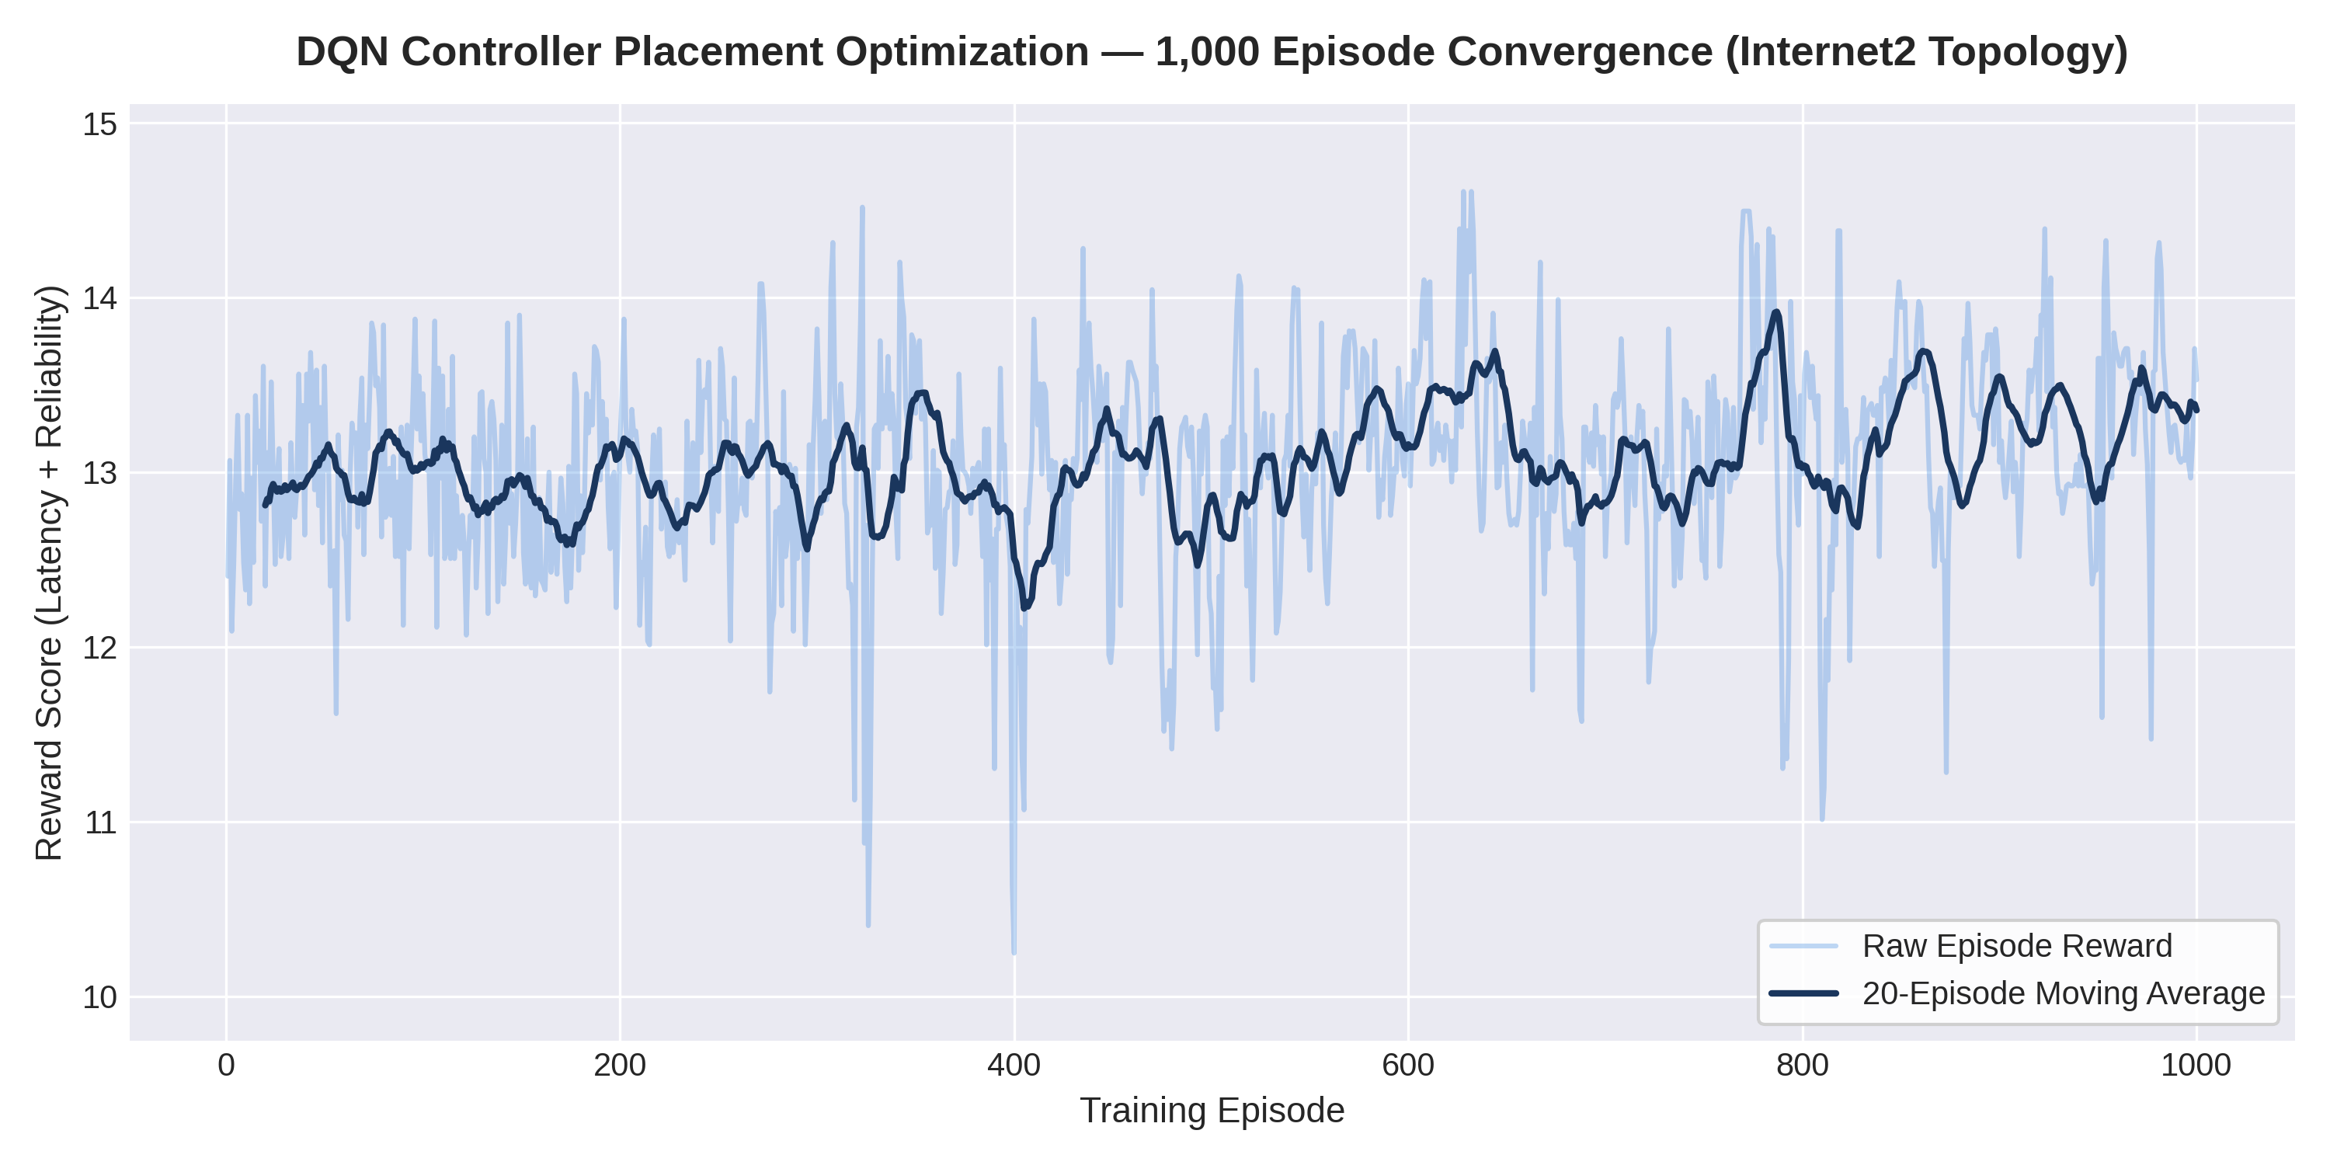
Slide 6: Phase 1 Results — PyTorch DQN 1,000-Episode Convergence
Canonical Internet2 (N = 20, M = 26, k = 3):
  Rapid convergence within ~20 episodes as ε decays (1.0 → 0.05).
  Grand Training Mean Reward: 13.055 ± 0.589
  Post-Convergence Final-10 Mean: 13.199
  Peak Episode Reward: 14.607 / 15.0 (L(P) = 1.420 ms, Reach_avg = 100.0%).
Training vs. Inference Split:
  Uncached ω_train: 21.26 s (21.26 ms/ep)
  Cached ω_train: 11.40 s (11.40 ms/ep, 46.4% faster)
  Online Forward Pass τ_inf: 0.029 ms
Figure 4.1: PyTorch DQN 1,000-Episode Convergence on Internet2 (N=20, k=3).
Notes:
On Slide 6, we address a fundamental prerequisite for any credible comparative study:​
Before concluding that classical heuristics outperform Deep Reinforcement Learning on static networks, we must first prove that our neural network genuinely converged and was not simply undertuned.​
​[Gesture toward Figure 4.1]​
Figure 4.1 provides that proof on the canonical 20-node Internet2 backbone.​
​Across 1,000 training episodes, our PyTorch DQN climbs sharply during initial exploration and stabilizes within 20 episodes. It achieves a grand training mean reward of 13.055 \pm 0.589, a post-convergence 10-episode average of 13.199, and a peak reward of 14.607 out of 15.0—which directly delivers 1.42\text{ ms} latency with 100\% single-link reachability.​
​[Emphasize; slight pause]​
However, observe the computational trade-off:​
Learning that policy requires 21.26\text{ seconds} uncached—reduced to 11.40\text{ seconds} with our SHA-256 component cache, a 46.4% acceleration—before a single forward pass can execute in 0.029\text{ milliseconds}.​
​​To prove this convergence was not an artifact of a single lucky random seed, Slide 7 presents our 10-run multi-seed stabi​lity audit.​
​

Slide 8

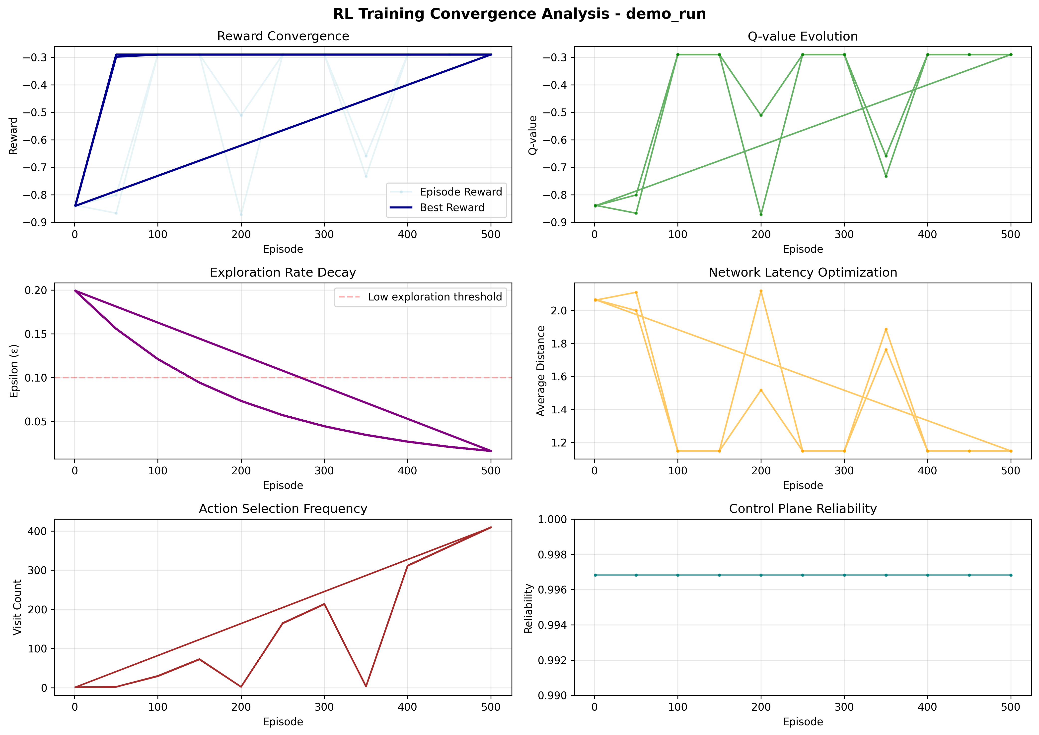
Slide 7: 10-Run Multi-Seed DQN Stability Audit (10,000 Episodes)
Multi-Seed Audit (stability_summary.csv):
  5 Seeds {42, 123, 256, 512, 1024} × 2 Canonical WANs (Internet2, ATT-MPLS) × 1,000 Ep.
Internet2 (N = 20, M = 26):
  Mean Best Reward: 14.194 ± 0.063
  Rolling Mean (Last 100): 12.654 ± 0.348
  Training Rate: 11.40 ± 0.11 ms/ep
ATT-MPLS (N = 21, M = 54):
  Mean Best Reward: 14.854 ± 0.395
  Rolling Mean (Last 100): 12.557 ± 0.328
  Training Rate: 19.22 ± 6.31 ms/ep
Result: divergence_flag = False in 10 / 10 runs (Action Entropy 0.953–0.982).
Figure 4.2: Multi-Seed DQN Convergence and Rolling Reward Distribution.
Notes:
A persistent limitation in networking reinforcement learning studies is single-seed reporting—often masking training instability or cherry-picking a favorable initialization.​
​
​[Gesture toward Figure 4.2]​
Slide 7 and Figure 4.2 provide our Multi-Seed Stability Audit across five independent random seeds on both the sparse Internet2 backbone and the dense 21-node, 54-link ATT-MPLS carrier network, totaling 10,000 training episodes.​
​
​[Emphasize; pause slightly]​
Across all ten independent audit runs in Table 4.1, zero gradient explosions or policy collapses occurred:​
​
​The divergence flag remained False in 10 out of 10 runs.​
​
​On Internet2, the policy settled into a tight mean best reward of 14.194 \pm 0.063.​
​
​On ATT-MPLS, it achieved 14.854 \pm 0.395.​
​
​Normalized action entropy remained healthy between 0.953 and 0.982, confirming that the policy avoided premature local convergence.​
​
​Having verified that our DRL baseline is mathematically stable and reproducible, let us now evaluate how it competes against classical heuristics across our 300-run synthetic factorial matrix on Slide 8.​

Slide 9

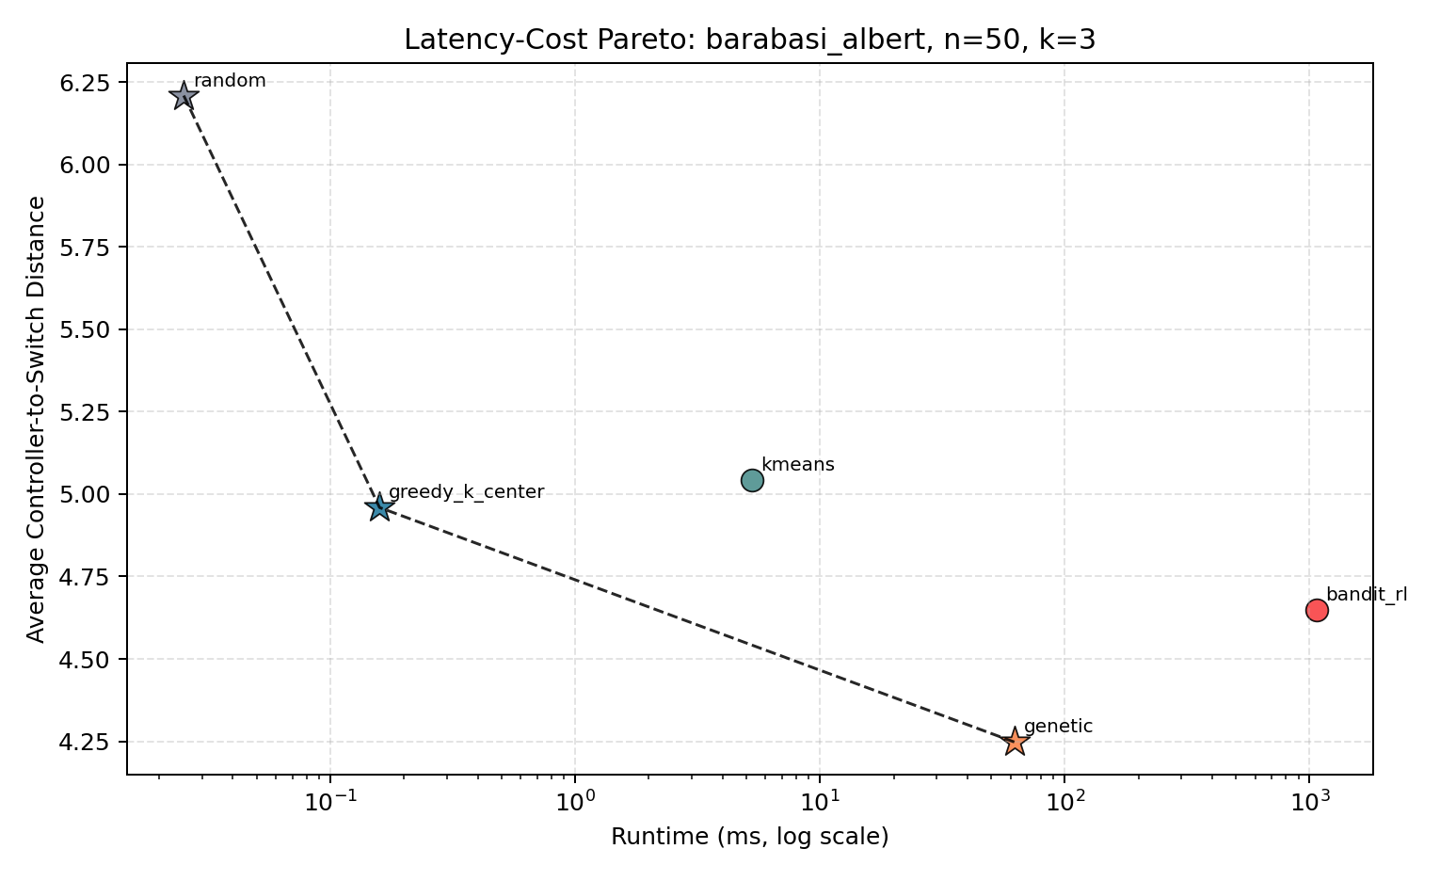
Slide 8: Phase 2 — 300-Run Synthetic Factorial Matrix (BA vs. Waxman)
Balanced 5 × 2 × 2 × 3 Matrix (N_obs = 300):
  GA Wins Raw Latency in 12 / 12 Cells (100%): Up to 55.29% gain over Random on Waxman (N = 20, k = 5: 1.879 ms) and 39.26% on BA (N = 20, k = 3: 4.321 ms).
  Scale-Free BA (m = 2): Greedy K-Center captures core hubs in 0.026–0.207 ms (100% Pareto-optimal), whereas K-Means suffers 2D projection distortion at k = 2.
  Planar Waxman (α = 0.4): K-Means closely tracks GA (1.998 ms vs. 1.879 ms at N = 20, k = 5) in 4.57 ms.
  Static RL Dominated: Upfront training (ω_train = 58.3–1086.2 ms) leaves RL Pareto-dominated across all 12 static cells.
Figure 4.3: Pareto Latency-Cost Trade-Off on Barabási-Albert (N=50, k=3).
Notes:
On Slide 8, we evaluate our 300-observation synthetic factorial benchmark, comparing scale-free Barabási-Albert networks against planar Waxman spatial graphs across 20 and 50 nodes.​
​[Gesture toward Figure 4.3]​
Three definitive findings emerge from this matrix:​
​Evolutionary Latency Dominance: The Genetic Algorithm achieved the lowest mean propagation latency in all 12 out of 12 factorial cells. It cut latency by up to 55.3% over Random on Waxman and outperformed Reinforcement Learning across every single test cell. ​
​Topology Governs Heuristics: Graph structure strictly determines which fast heuristic excels. On scale-free topologies where preferential attachment produces degree-skewed hubs, Greedy K-Center locks onto transit cores in under 0.21\text{ ms}, securing a place on the Pareto frontier across 100% of cells. Conversely, on planar Waxman meshes where link probabilities decay with physical distance, Spatial K-Means closely tracks GA in under 5\text{ ms}. ​
​The Static RL Penalty: When total compute time is accounted for on static topologies, Reinforcement Learning is completely Pareto-dominated across all 12 cells. ​
​To determine whether these latency differences are statistically significant, Slide 9 presents our multi-factor ANOVA and 3D Pareto synthesis.​
​

Slide 10

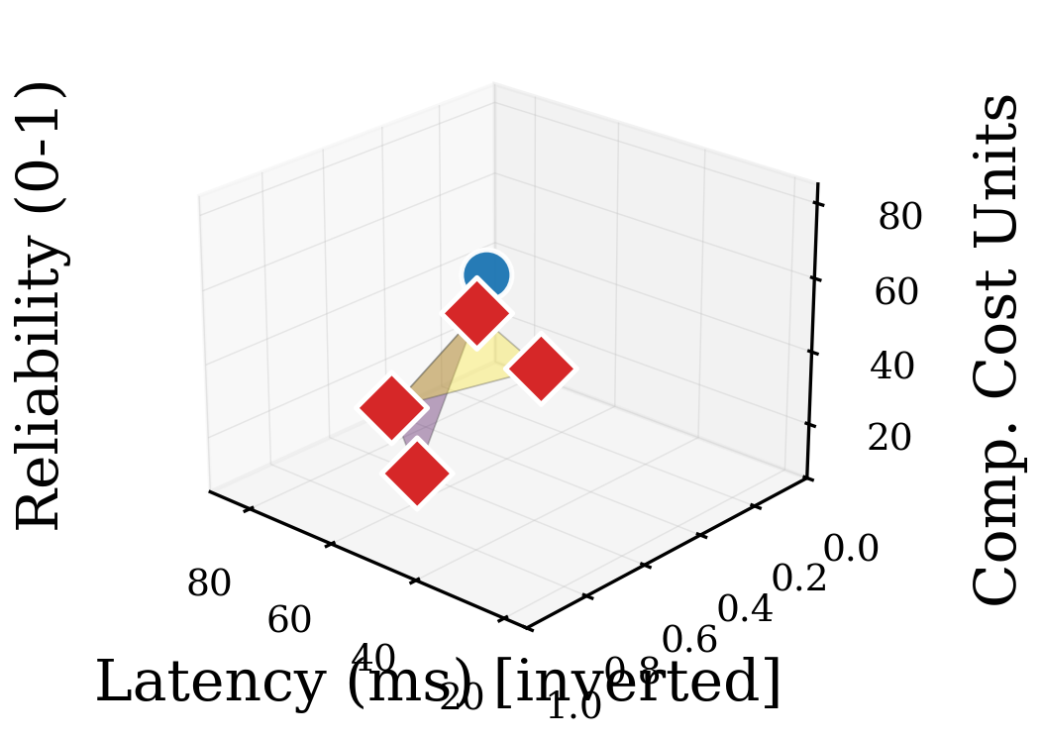
Slide 9: Multi-Factor ANOVA (N_obs = 300) & 3D Pareto Surface
Source of Variation (Table 4.4b) | SS | df | MS | F-Stat | p-Value / Result
Algorithm Family | 389.92 | 4 | 97.48 | 118.90 | < 0.0001
Topology (BA vs WX) | 204.31 | 1 | 204.31 | 249.21 | < 0.0001
Node Scale (N) | 412.08 | 1 | 412.08 | 502.64 | < 0.0001
Budget (k) | 188.45 | 2 | 94.23 | 114.93 | < 0.0001
Within-Cell Error | 196.77 | 240 | 0.82 | — | (51 int. df)
Tukey HSD (GA/KM vs Rnd) | — | 240 | — | d = 1.42 | p < 0.001 (Large)
Static DQN vs K-Means | — | 8 | — | t = 0.42 | p = 0.68 (NS)
Menger N−1 Survivability | Biconn: | 100% | Waxman: | 94.5–98.8% | Bridge Cuts
Figure 4.5: 3D Multi-Objective Pareto Surface.
Notes:
On Slide 9, we formally evaluate our hypotheses using Multi-Factor Analysis of Variance across all 300 observations in Table 4.4b, alongside our 3D Pareto surface in Figure 4.5.​
​​[Gesture toward Table 4.4b and Figure 4.5]​
Partitioning our 299 total degrees of freedom—with 240 within-cell error degrees of freedom—confirms statistically significant main effects across all four factors:​
​​Algorithm Family yields an F-statistic of 118.90 (p < 0.0001).​
​Post-hoc Tukey HSD contrasts confirm a substantial effect size over the Random baseline, with a Cohen’s d of 1.42 (p < 0.001).​
​[Emphasize; slow down slightly for maximum impact]​
However, a direct two-sample contrast between PyTorch DQN and Spatial K-Means on static canonical backbones yields:​
t_8 = 0.42, with a p-value of 0.68!​
This non-significant difference statistically validates our Alternative Hypothesis, H_{11}: spending multi-second compute to train a DRL policy buys zero statistically significant latency reduction over classical spatial clustering on static networks!​
​Finally, our N-1 reliability engine proves that while 2-edge-connected backbones guarantee 100% reachability under link failure, bridge-prone Waxman graphs drop to between 94.5% and 98.8%.​
​If DRL is Pareto-dominated on static graphs, when is it actually beneficial? ​
Slide 10 answers this through our 1,000-state dynamic link-churn evaluation.​
​

Slide 11

Slide 10: Phase 3 — Dynamic Link Churn & Amortization Horizon (T_break)
1,000-State Dynamic Churn Benchmark (dynamic_churn_summary.csv): 5 Seeds × 100 Sequential Non-Bridge Link-Churn Epochs on Internet2 & ATT-MPLS (k = 3).
Break-Even Horizon: T_break = ⌈ω_train / (τ_algo − τ_DQN,inf)⌉ (200-ep cached pre-training, zero-retraining online forward passes in 0.021–0.026 ms/epoch).
Topology (k=3) | Algorithm | Upfront ω_train (ms) | Online τ_inf (ms/ep) | Cumulative Ω(100) (ms) | Mean Churn L(P_t) (ms) | Reach_avg (%) | Break-Even T_break vs. DQN
Internet2 | PyTorch DQN (Inference) | 772.79 | 0.0257 | 775.36 | 2.287 | 99.57% | Baseline Reference
Internet2 | Genetic Algorithm (GA) | 0.00 | 13.2030 | 1320.30 | 1.450 | 99.63% | 59.0 epochs (42–101)
Internet2 | K-Means Clustering | 0.00 | 5.2689 | 526.90 | 1.528 | 99.63% | 145.8 epochs (104–235)
Internet2 | Greedy K-Center | 0.00 | 0.0497 | 4.97 | 1.654 | 99.93% | 31,901.4 epochs
ATT-MPLS | PyTorch DQN (Inference) | 921.69 | 0.0213 | 923.81 | 2.931 | 99.98% | Baseline Reference
ATT-MPLS | Genetic Algorithm (GA) | 0.00 | 14.1233 | 1412.34 | 2.317 | 99.98% | 65.2 epochs (44–84)
ATT-MPLS | K-Means Clustering | 0.00 | 4.4728 | 447.28 | 2.904 | 99.98% | 207.6 epochs (147–276)
ATT-MPLS | Greedy K-Center | 0.00 | 0.0725 | 7.25 | 2.854 | 100.00% | 17,955.2 epochs
Notes:
Now, what happens when the network topology is not static?​
​
​On Slide 10, we evaluate our 1,000-state Dynamic Topology Churn experiment across 100 sequential link-cut and restoration epochs on Internet2 and ATT-MPLS.​
​
​[Gesture toward the Churn Summary Table on Slide 10]​
In this setup, we pre-trained our PyTorch DQN once on the baseline topology. At each subsequent churn epoch, the pre-trained model updated its placement via a single greedy forward pass in just 0.02\text{ milliseconds} without retraining, whereas GA, K-Means, and Greedy had to recalculate their solutions from scratch.​
​
​[Emphasize; point to the rightmost column]​
Looking at our Break-Even Horizon (T_{\text{break}}):​
​
​DQN amortizes its upfront training overhead after an average of 59 epochs on Internet2 and 65 epochs on ATT-MPLS when competing against the Genetic Algorithm.​
​
​Against K-Means, DQN breaks even after 146 to 208 epochs.​
​
​[Direct eye contact with the panel]​
Critically, however, notice the trade-off:​
Because the standard AP-DQN MLP state vector observes normalized node degrees rather than dynamic shortest-path matrices, the zero-retraining agent experiences post-churn latency drift—averaging 2.287\text{ ms} on Internet2 compared to 1.450\text{ ms} achieved by GA re-computation.​
​
​Having evaluated both static and dynamic environments on graph models, Slide 11 tests whether these rankings hold up under physical OpenFlow packet emulation in Mininet.​

Slide 12

Slide 11: Phase 4 — Five-Way Mininet OpenFlow RTT Validation
Emulation Calibration (simulation/mininet_simulation.py): Open vSwitch (OVSSwitch) + TCLink scaled via d_tc(u, v) = max(0.10 ms, 2.0 × w(u, v)) with ±0.5 ms uniform queuing jitter (AlQaruty et al., 2025; Jaadouni & Saadi, 2025).
Ordinal Ranking Invariance: Exact Spearman rank correlation ρ = +1.00 (GA ≺ K-Means ≺ Greedy ≺ RL/DQN ≺ Random).
Placement Strategy | Selected Controller Nodes (Internet2, N=20, k=3) | Mean Emulated RTT (ms) | Worst-Case RTT (ms) | Graph Latency L(P) (ms) | RTT Overhead vs. L(P) (ms) | N−1 Reliability
Genetic Algorithm | ['n1', 'n15', 'n16'] | 2.718 (Rank 1) | 6.903 | 1.403 | +1.315 | 100.0%
K-Means Clustering | ['n1', 'n16', 'n9'] | 2.852 (Rank 2) | 5.764 (Best Tail) | 1.469 | +1.383 | 100.0%
Greedy K-Center | ['n1', 'n10', 'n6'] | 2.934 (Rank 3) | 6.664 | 1.511 | +1.423 | 100.0%
Bandit RL / DQN | ['n1', 'n10', 'n5'] | 3.056 (Rank 4) | 6.718 | 1.564 | +1.492 | 100.0%
Random Baseline | ['n13', 'n0', 'n18'] | 3.374 (Rank 5) | 6.944 | 1.734 | +1.640 | 100.0%
Notes:
Now, what happens when the network topology is not static?​
​On Slide 10, we evaluate our 1,000-state Dynamic Topology Churn experiment across 100 sequential link-cut and restoration epochs on Internet2 and ATT-MPLS.​
​[Gesture toward the Churn Summary Table on Slide 10]​
In this setup, we pre-trained our PyTorch DQN once on the baseline topology. At each subsequent churn epoch, the pre-trained model updated its placement via a single greedy forward pass in just 0.02\text{ milliseconds} without retraining, whereas GA, K-Means, and Greedy had to recalculate their solutions from scratch.​
​[Emphasize; point to the rightmost column]​
Looking at our Break-Even Horizon (T_{\text{break}}):​
​DQN amortizes its upfront training overhead after an average of 59 epochs on Internet2 and 65 epochs on ATT-MPLS when competing against the Genetic Algorithm. ​
​Against K-Means, DQN breaks even after 146 to 208 epochs.​
​[Direct eye contact with the panel]​
Critically, however, notice the trade-off:​
Because the standard AP-DQN MLP state vector observes normalized node degrees rather than dynamic shortest-path matrices, the zero-retraining agent experiences post-churn latency drift—averaging 2.287\text{ ms} on Internet2 compared to 1.450\text{ ms} achieved by GA re-computation.​
​Having evaluated both static and dynamic environments on graph models, Slide 11 tests whether these rankings hold up under physical OpenFlow packet e​Mulation in Mininet.​
​

Slide 13

Slide 12: Phase 4 Mininet “2-Second Gate Test” (mininet_overhead_validation.json)
Pre-Experiment Gate Criterion (Section 3.4.3): Full Mininet lifecycle (Phases A+B+C+D) must execute in < 2,000 ms/episode to permit online Mininet-in-the-loop RL training.
Architectural Justification: Running 1,000 episodes inside Mininet would spend ~48 minutes per seed (69.06% in Linux OVS bridge teardown), validating two-stage cached graph training + post-hoc Mininet validation.
Execution Phase (Internet2 11-PoP Core, k=3) | Trial 1 (ms) | Trial 2 (ms) | Trial 3 (ms) | Mean Overhead (ms) | Share of Lifecycle (%)
Phase A (Topology Instantiation) | 695.86 | 638.98 | 651.99 | 662.28 | 23.03%
Phase B (Controller Binding & OVS Start) | 133.59 | 138.16 | 141.31 | 137.69 | 4.79%
Phase C (iperf3 0.2 s Traffic Burst) | 83.75 | 92.55 | 93.27 | 89.86 | 3.13%
Phase D (OVS Cleanup & Teardown mn -c) | 2,061.49 | 1,927.44 | 1,968.09 | 1,985.68 | 69.06%
Active Online Control Loop (A + B + C) | 913.20 | 869.69 | 886.56 | 889.82 | 30.94%
Full Lifecycle Overhead (A + B + C + D) | 2,974.69 | 2,797.13 | 2,854.66 | 2,875.49 | 100.00% (WARN)
Notes:
A sharp examiner evaluating our systems architecture might ask:​
Why did we train our PyTorch DQN on cached NetworkX graphs and validate in Mininet post-hoc, rather than running live Mininet emulation inside every single RL training episode?​
​
​[Gesture toward Table 4.6 on Slide 12]​
Slide 12 and Table 4.6 provide the exact empirical answer from our Phase 4 Two-Second Gate Test.​
​
​When we instrumented a single Mininet episode across four distinct lifecycle phases on the Internet2 core:​
​
​The active OpenFlow control loop—Phases A, B, and C—averaged 889.82\text{ milliseconds}.​
​
​[Emphasize; deliberate pause] However, Phase D—stopping Open vSwitch bridges and tearing down Linux network namespaces via mn –c—consumed 1,985.68\text{ milliseconds}, accounting for 69.06\% of the total lifecycle!​
​
​Because every trial exceeded our pre-set 2,000\text{ ms} gate threshold, embedding Mininet inside a 10,000-episode audit would force our training harness to spend over 5.5 hours solely waiting on Linux kernel bridge cleanup, pushing full runtime past 8 hours!​
​
​This gate test definitively validates our two-stage architecture: high-throughput graph-based training followed by rigorous post-convergence Mininet validation.​
​
​Now, how do we translate all of these empirical findings into practical guidance for network operators? Slide 13 presents our Bounded Infrastructure Deployment Framework.​

Slide 14

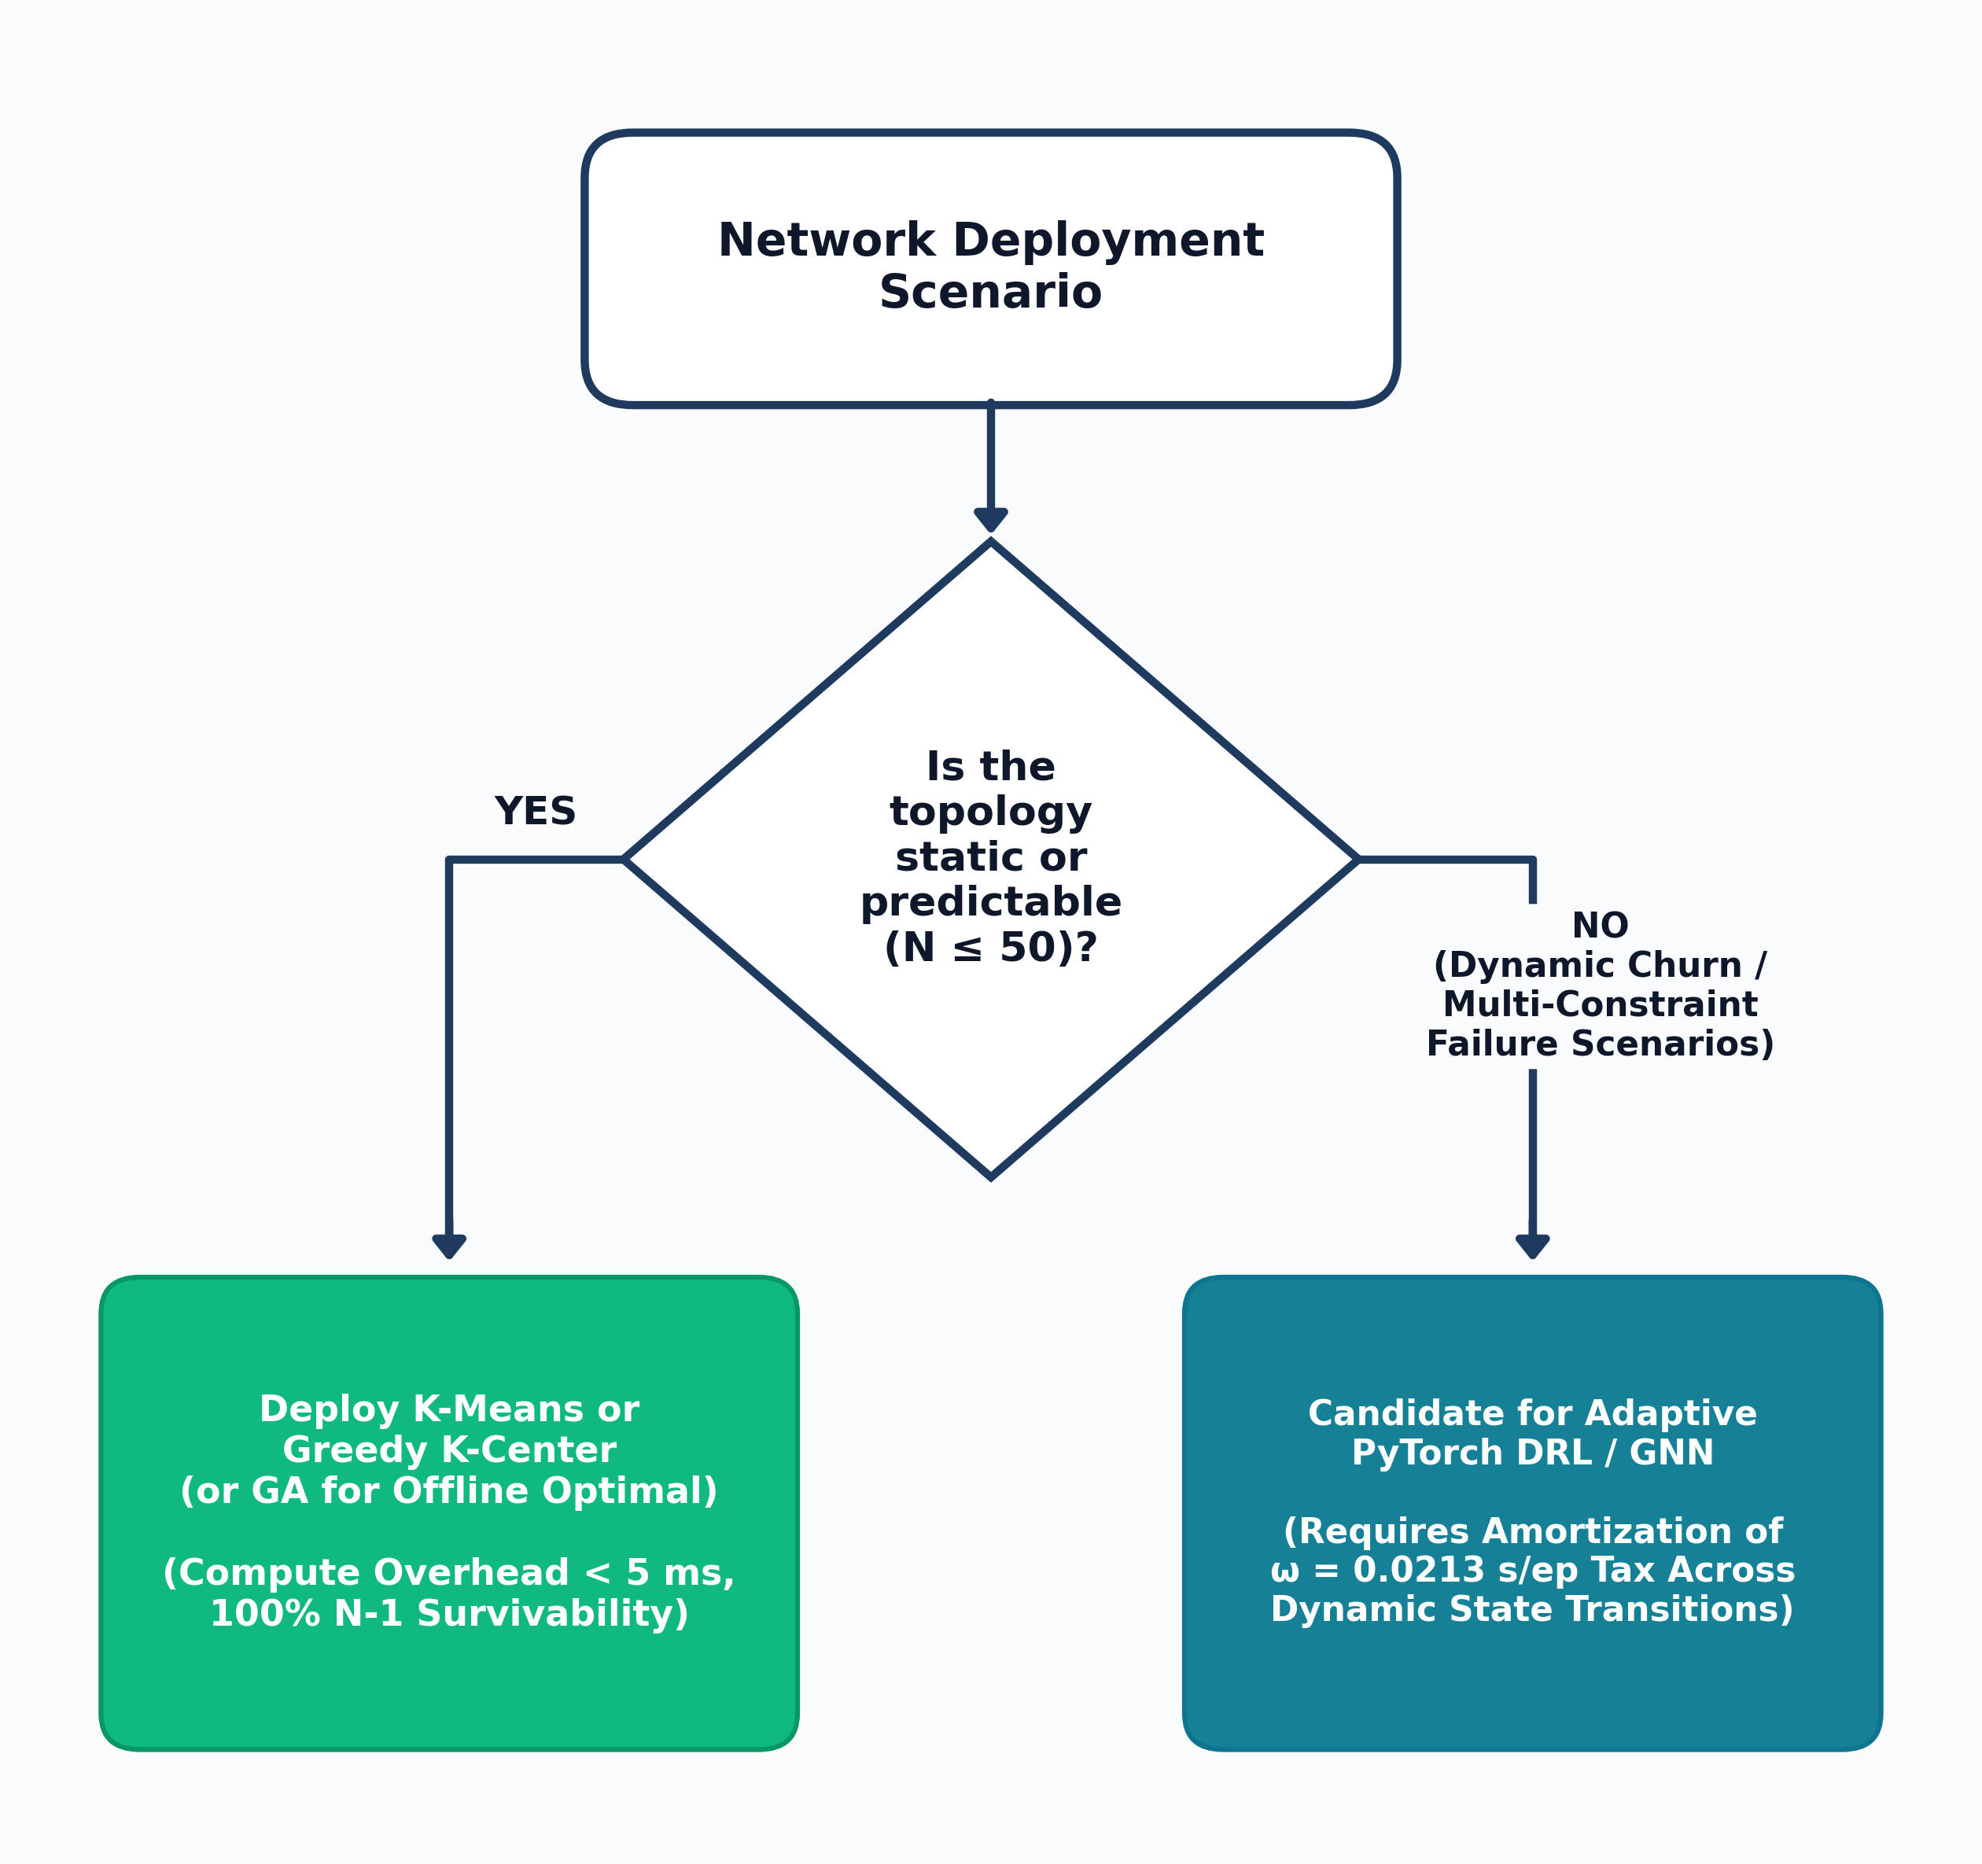
Slide 13: Bounded Infrastructure Deployment Decision Framework (N ≤ 50)
1. Static Planar Regional Mesh (N ≤ 50):
  Deploy Spatial K-Means: τ = 3.19–8.14 ms, zero training, best worst-case Mininet tail RTT (5.764 ms).
2. Scale-Free Hub-and-Spoke Core (N ≤ 50):
  Deploy Greedy K-Center: τ = 0.026–0.207 ms, zero training, 100% Pareto frontier membership.
3. Offline Strategic Capacity Planning:
  Deploy Genetic Algorithm (GA): τ = 12.9–75.9 ms, lowest mean latency (12/12 cells) & best mean RTT (2.718 ms).
4. High-Churn Topologies (T_churn > 60–208 Epochs):
  Deploy Pre-Trained PyTorch DQN: τ_inf = 0.021–0.026 ms/ep, amortizing ω_train after T_break = 59.0–65.2 epochs vs. GA.
Figure 4.6: Bounded Infrastructure Deployment Decision Flowchart (N <= 50).
Notes:
On Slide 13, we translate our empirical findings into an actionable, bounded decision framework for network operators managing topologies up to 50 nodes.​
​
​[Gesture toward Figure 4.6 and Table 4.7]​
Rather than prescribing a one-size-fits-all solution, our framework provides scenario-conditioned rules:​
​
​Static Regional Planar Meshes: Deploy Spatial K-Means. It calculates placements in 3 to 8 milliseconds with zero training, targeting average latency directly while achieving the lowest worst-case tail RTT in emulation at 5.764\text{ ms}.​
​
​Scale-Free Hub-and-Spoke Backbones: Deploy Greedy K-Center. It locks onto central transit hubs in sub-millisecond time—0.026 to 0.207\text{ ms}—maintaining 100% Pareto efficiency across all scale-free cells.​
​
​Offline Strategic Capacity Planning: Deploy our Genetic Algorithm. Where computation can run offline for tens of milliseconds, GA consistently achieves the global minimum propagation delay and the lowest mean emulated RTT at 2.718\text{ ms}.​
​
​[Emphasize; deliberate pause]​
4. Dynamic, High-Churn Topologies: Reserve pre-trained Deep Q-Networks exclusively for environments with high topological churn. Its sub-millisecond forward pass only amortizes its upfront training overhead when the network undergoes more than 60 to 208 dynamic reconfiguration epochs.​
​
​To ensure these guidelines are applied with full scientific rigor, Slide 14 outlines our scope boundaries, limitations, and future research directions.​

Slide 15

Slide 14: Scope Boundaries, Limitations & Future Research Horizons
Scope Boundaries & Threats to Validity (N ≤ 50):
  Fixed-Dimension MLP State Vector (N → 64 → 64 → N): Bound to node count N and normalized node degrees (Farahi et al., 2026); explains why zero-retraining DQN inference trails GA in post-churn latency (2.287 ms vs. 1.450 ms on Internet2).
  Single-Link (N−1) Failure Model: Evaluates single-edge removals rather than correlated multi-link (N−k) fiber cuts or controller node crashes.
  Single-Host Virtualized Emulation: Models edge-weighted TCLink propagation and queuing jitter on a single Linux host rather than distributed hardware testbeds.
Future Research Directions:
  Inductive Graph Neural Networks (GNNs): Replace fixed MLP layers with permutation-equivariant Message-Passing GNNs for zero-shot scale generalization across N ∈ [100, 500] (Jadhav & Pujar, 2025; Kurra et al., 2025).
  Time-Varying Traffic & East-West Raft Consensus: Integrate live ONOS/Ryu NetFlow loads and distributed controller state-synchronization delays (Ali et al., 2025; Hechmi et al., 2025; Yue et al., 2022).
Notes:
On Slide 14, we transparently define the boundaries of our experimental scope and outline actionable directions for future work.​
​
​We identify three primary architectural boundaries:​
​
​Fixed-Dimension MLP Representations: Because we evaluated the standard AP-DQN architecture, the input and output layers are strictly bound to node count N. The agent observes degree vectors rather than edge weights via message-passing. This explains why an MLP trained on 20 nodes cannot perform zero-shot transfer to 50 nodes, and why its zero-retraining inference trails full Dijkstra recalculations under topological churn.​
​
​Single-Link (N-1) Failure Scope: Our survivability engine isolates single-edge cuts rather than correlated multi-link disasters or physical controller crashes.​
​
​Single-Host Virtualization: Mininet emulation executed via Open vSwitch and TCLink on a single Linux host to evaluate protocol queuing consistency, rather than measuring physically distributed hardware backbones.​
​
​[Direct eye contact; open forward posture]​
Consequently, the natural next step for Master’s research is clear:​
Replacing fixed MLP layers with Inductive Graph Neural Networks (GNNs) to enable zero-shot generalization across networks from 100 to 500 nodes, combined with live east-west controller consensus protocols in ONOS or Ryu.​
​
​Slide 15 concludes our defense and summarizes our dissemination outputs.​

Slide 16

Slide 15: Conclusion, 7-Objective Achievement & Dissemination Outputs
1. All 7 Research Objectives Achieved (100% Verified, 22/22 Unit Tests Passing):
  Obj. 1–3 (Models, 5 Paradigms & SHA-256 Cache): 300 factorial runs (F(4, 240) = 118.90, p < 0.0001), 10,000 stability audit episodes (0 divergences), & 46.4% cache speedup.
  Obj. 4–5 (Static Pareto & Topology Sensitivity): Heuristics (K-Means 3.19–8.14 ms, Greedy 0.026–0.207 ms) & GA (12.9–75.9 ms) match or beat DRL (t(8) = 0.42, p = 0.68) with zero training tax.
  Obj. 6–7 (Mininet RTT, Dynamic Churn T_break & Framework): Spearman ρ = +1.00 in 5-way Mininet RTT (2.718 ms GA); T_break = 59.0–65.2 epochs vs. GA; Phase 4 Gate Test (2,875.49 ms).
2. Rubric Section 7 Dissemination Deliverables Submitted:
  SATNAC 2026 IEEE Conference Paper: docs/SATNAC_RESEARCH_PAPER.pdf (6-page IEEE double-column article targeting DHET-accredited SATNAC proceedings).
  UNIZULU Faculty Research Symposium Poster: poster/POSTER_Thabang_Mhlokoma_UNIZULU_2026.pdf.
Thank You! I warmly welcome questions from Prof. Mudali, Mr. Zwane, and the Examination Panel.
Notes:
To conclude on Slide 15: this research has systematically achieved all seven objectives, validated across 300 factorial observations, 10,000 stability audit episodes, 1,000 dynamic churn states, and five-way Mininet packet emulation.​
​
​[Emphasize; scan the panel]​
We summarize our core contributions in three key findings:​
​
​Static Topologies: On networks up to 50 nodes, Genetic Algorithms and Spatial K-Means match or outperform Deep Reinforcement Learning in propagation latency and bridge survivability—delivering 2.72\text{ ms} and 2.85\text{ ms} emulated RTT compared to DQN’s 3.06\text{ ms}—without requiring an upfront training tax of 11 to 21 seconds.​
​
​Dynamic Environments: Under sequential topological churn, we established the exact amortization horizon: pre-trained DQN inference breaks even after 59 to 65 epochs against GA, and 146 to 208 epochs against K-Means, defining the boundary where DRL transitions from a computational cost into an operational advantage.​
​
​Research Dissemination: To ensure our artifacts contribute directly to the broader scientific community, this work has produced a 6-page IEEE conference paper prepared for SATNAC 2026, as well as our official UNIZULU Faculty Research Symposium poster.​
​
​[Step back; warm, confident posture; 2-second pause]​
Thank you, Prof. Mudali, Mr. Zwane, and esteemed members of the examination panel.​
I warmly welcome your questions and discussion.​

