Slide 1

UT Coding Bootcamp
UTA-VIRT-BO-FSF-PT
Instructor: Richard Hosek
Fall 2020
Group 3:
Auto-Tracker Application
Richard Ay
Owais Islam
Lorena Kell
Cameron Wills

Slide 2

Auto-Tracker – Data Safe
Blah blah blah.
Blah blah blah.
Blah blah blah.
Blah blah blah.
Blah blah blah :
Notes:
This is the ‘elevator pitch’ – why this application is needed.
A single repository of auto data prevents important lapses.
Eliminates the need for paste-notes on walls/refrigerators.

Slide 3
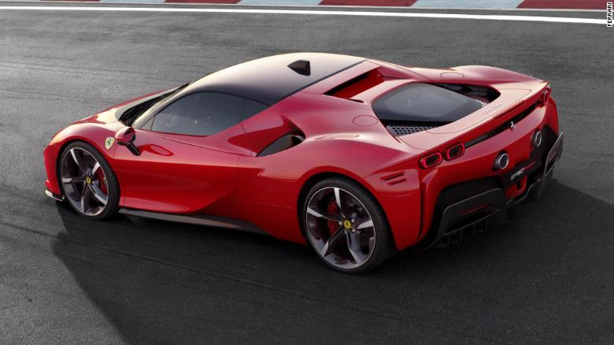
Auto-Tracker – The Concept (User Story)
Blah blah blah.
Notes:
The user story

Slide 4
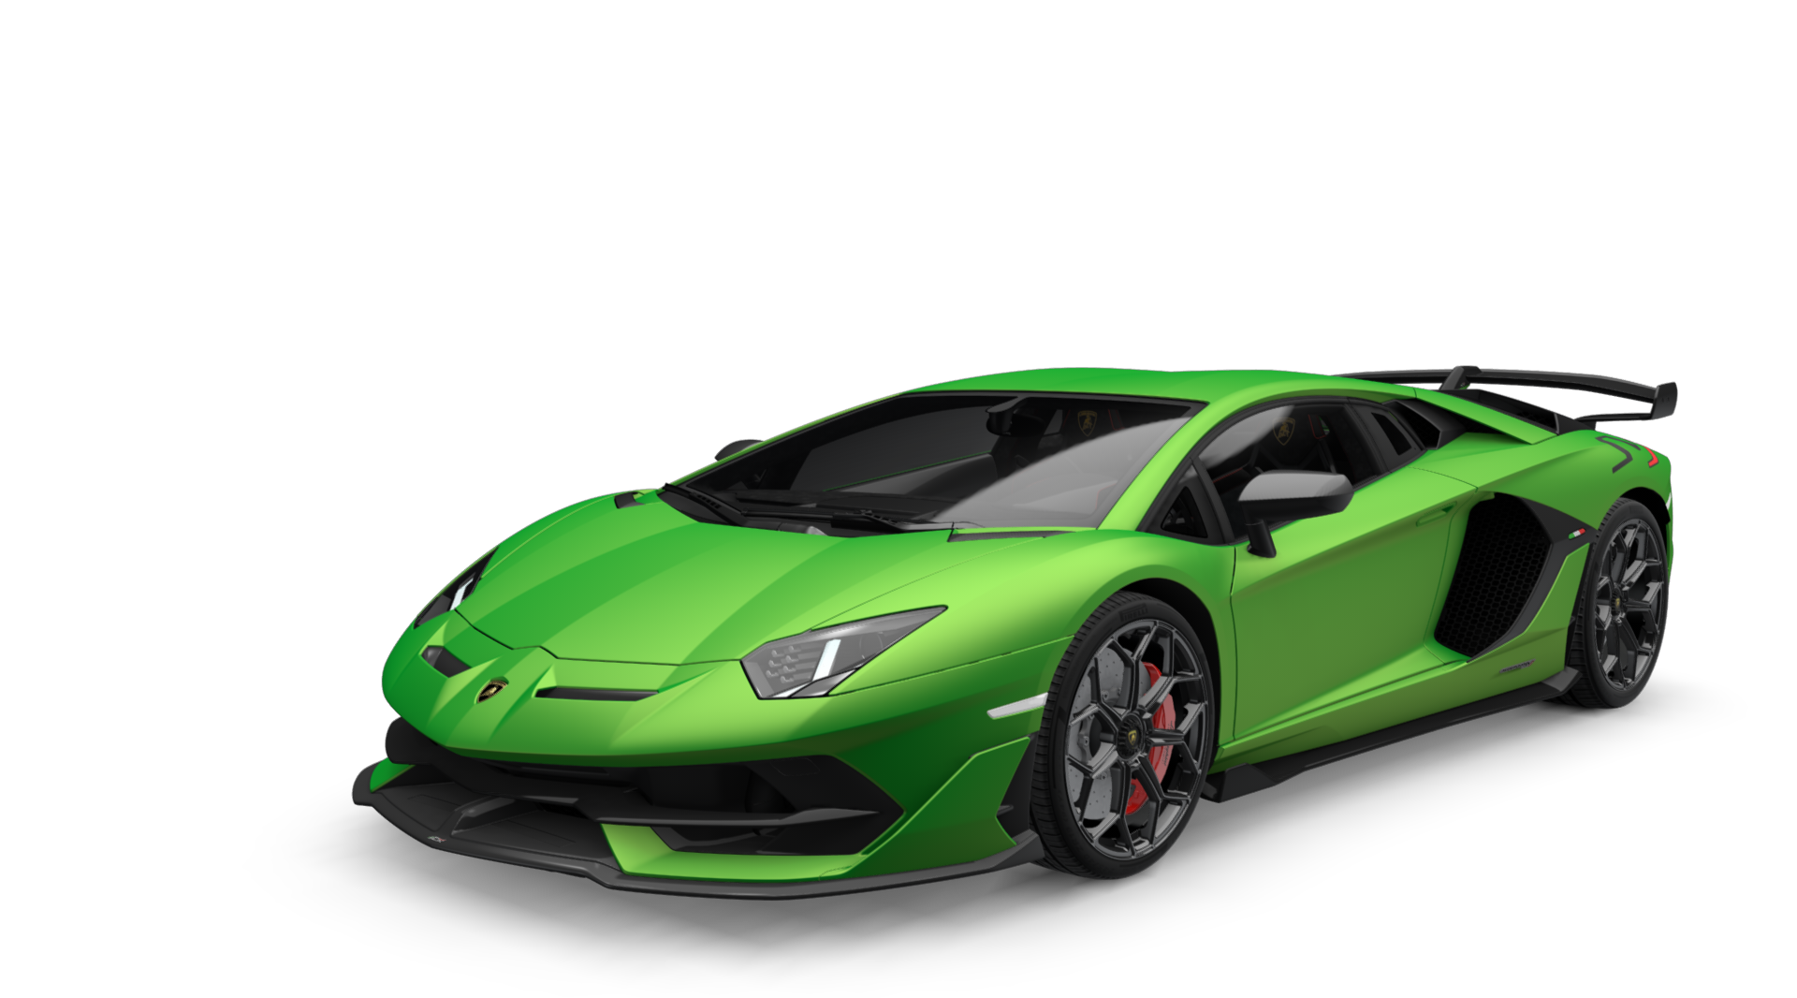
Auto-Tracker – The Concept, Details
Blah blaah blah.
Blah blaah blah :
Blah blaah blah
Blah blaah blah..
Blah blaah blah:
Notes:
A description of what the application does.
The motivation for development

Slide 5
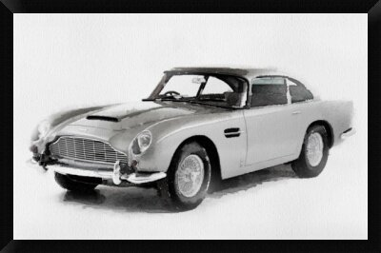
Auto-Tracker – How it Works
The architecture.
The technologies used:
- AlphaAdvantage.co - Finnhub.io
- Nomics.com
Project roles: how we spit up the work.
Challenges & Success:
Blah blah blah.
Blah blah blah.
Blah blah blah
Blah blah blah.
Notes:
A description of what the application does.
The motivation for development

Slide 6
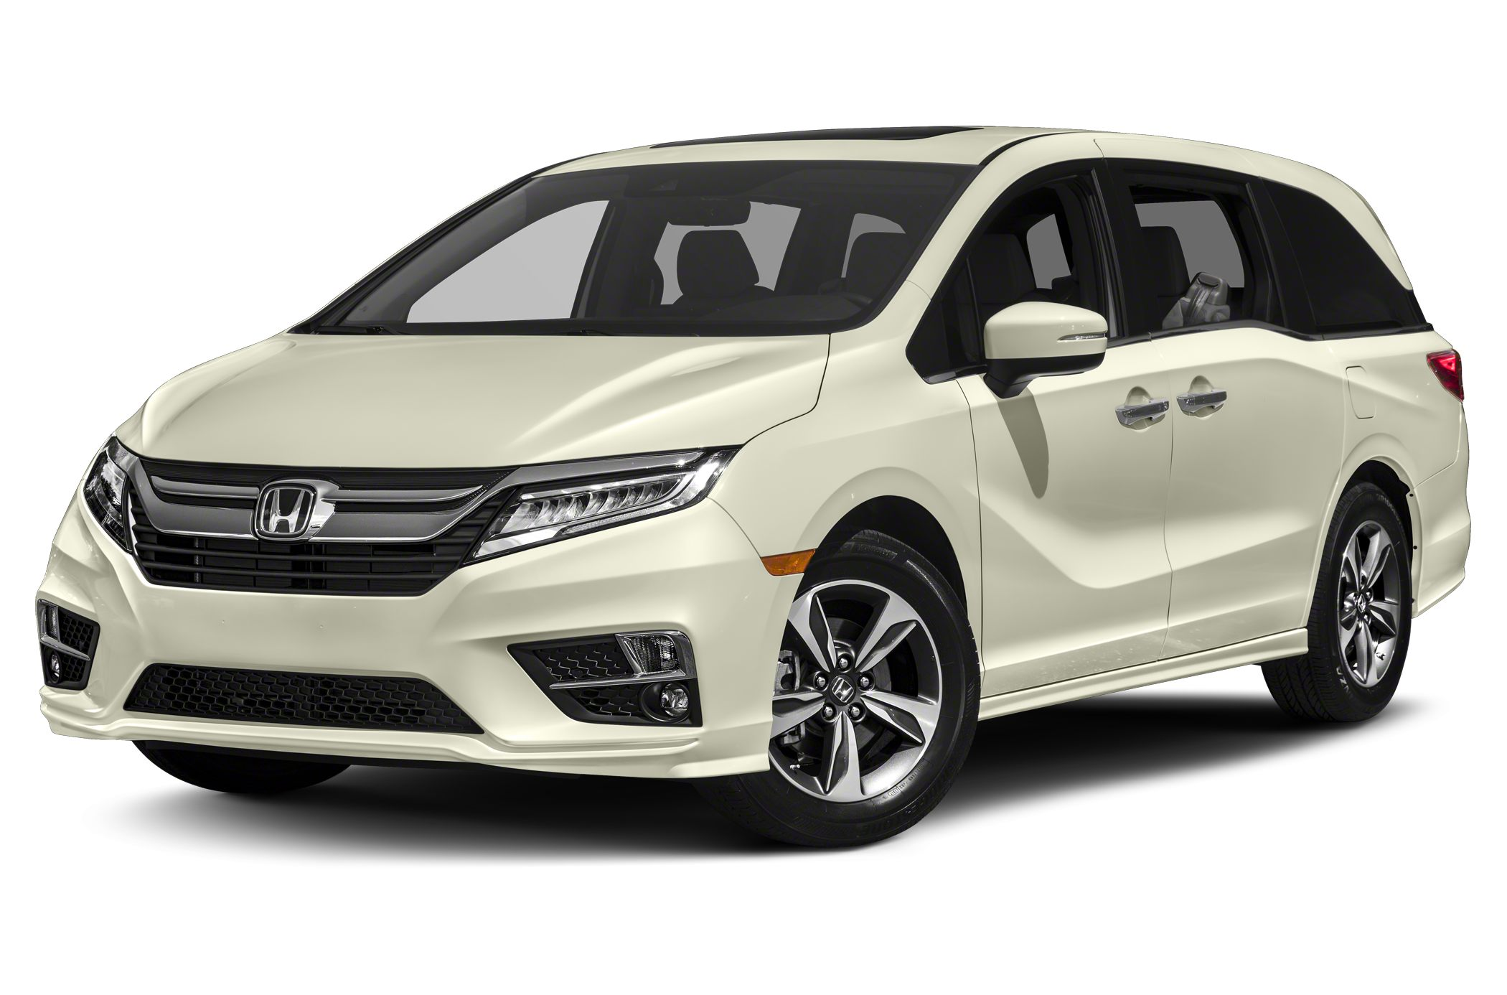
Auto-Tracker – Application Details
Blah blah blah.
Blah blah blah.
Blah blah blah.
Blah blah blah.
Blah blah blah.
Blah blah blah.
Notes:
The process/execution flow through the application
Discuss how a user would use the application.

Slide 7
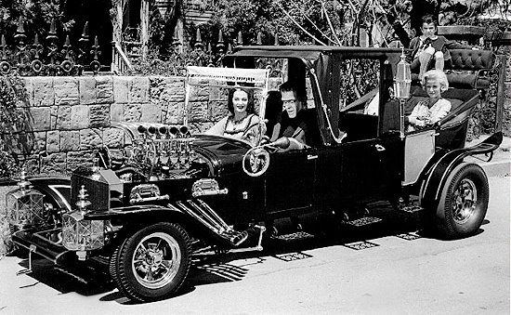
Auto-Tracker –Demonstration
The demonstration:
Blah blah blah.
Blah blah blah.
Blah blah blah.
Blah blah blah.
Notes:
A live demo of the application

Slide 8
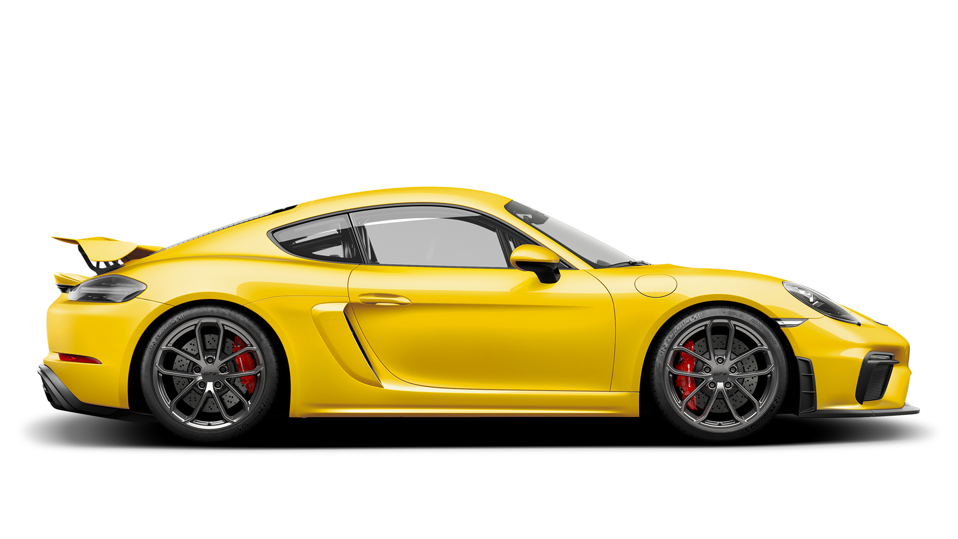
Auto-Tracker – Future Development
This application can be improved for the next version by considering.
Blah blah blah.
Blah blah blah.
Blah blah blah.
Blah blah blah
Blah blah blah.
Notes:
This slide discusses ideas and improvements that could be made in a future version of the application.

Slide 9
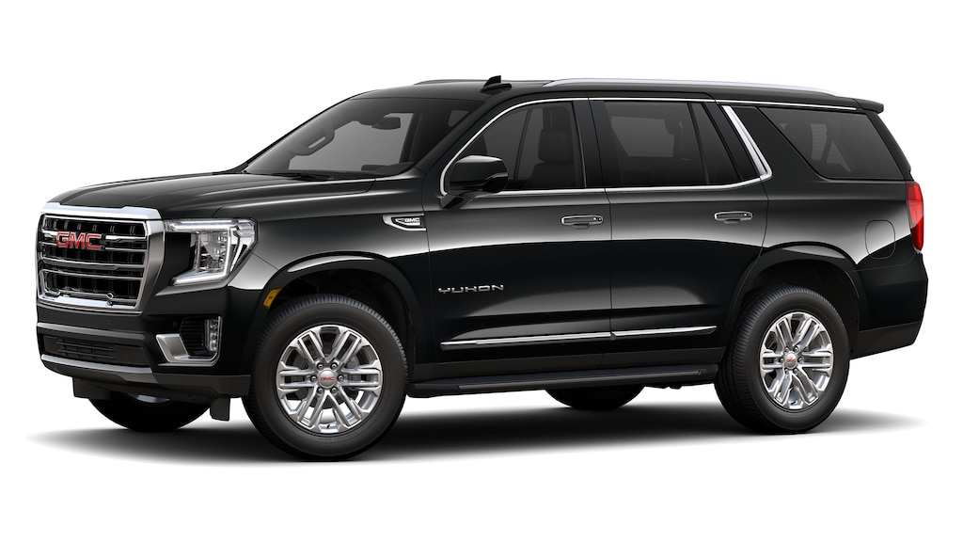
Auto-Tracker – Important Links
Link to deployed application:
https://dfdjdfjdfkdfjd.herokuapp.com
Link to GitHub Repository:
https://github.com/Team-XXXXX/Auto-Tracker .
Notes:
This slide shows the links to the “live” application on Heroku as well as the GitHub repository.

Slide 10

Auto-Tracker – Questions
Thank you for watching this presentation.
Questions ?
Notes:
Closing slide

