Slide 1

UT Coding Bootcamp
UTA-VIRT-BO-FSF-PT
Instructor: Richard Hosek
Fall 2020
Group 2:
Living Real Application
Richard Ay
Owais Islam
Seth Uschuk
Grey Whittenberger
Cameron Wills

Slide 2
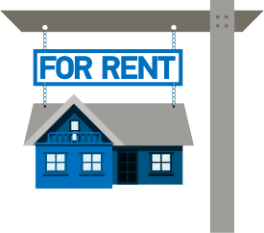
Living Real – Property Management
Owners renting multiple residences need a way to advertise and monitor their properties, as well as interact with renters..
Present properties for review.
Accept applications, rents, and fees.
Add properties and renters.
Update property details when necessary.
This application is an on-line repository of (the owner’s) property details for review by potential tenants.
Tenants can view the site to pay their rent (and other fees), view their lease agreement, and submit maintenance requests..
Notes:
This is the ‘elevator pitch’ – why this application is needed.
A single repository of leased property data, for the owner, the tenants, and potential applicants..

Slide 3
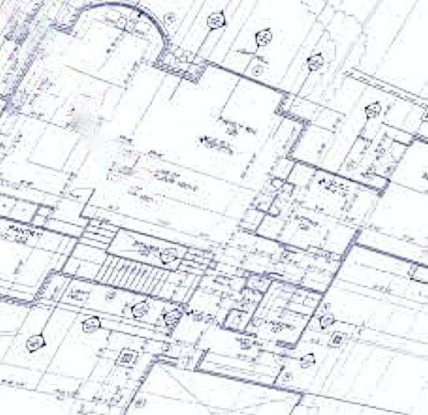
Living Real – The Concept (User Story)
As the owner of several properties, I want an application that can:
List my rental properties with their details.
Allow potential tenants to review the properties and submit an application.
Allow owners to add and update property and tenant details.
Allow tenants and applicants to submit payments.
Be installable and responsive when used on mobile devices.
Allow usage in an off-line mode when connectivity is lost.
In using the application, I want to:
Be able to add & update tenants.
Be able to add & update properties.
Accept and review maintenance requests.
Use the app from any device.
Notes:
The user story, from the owner’s perspective. Other user stories can be found in the various ‘readme.md’ files in the repository.

Slide 4
Living Real – The Concept, Details
The application is setup as a Progressive Web Application.
The application stores data in a Mongoose database, running on Heroku.
The application implements React for performance and Redux to maintain state between operations.
The application utilizes Stripe for payment operations.
A custom CSS style sheet is used for page presentation.
The ‘Material UI’ library is used for the image carousels.
Property images are stored on AWS S3.
Authentication and security is provided by JWT and hidden keys.
Notes:
A description of what development concepts are utilized.

Slide 5
Living Real – Project Details
Technologies Implemented: .
Project roles and work split.
Cameron laid out the application structure and framework, worked on the frontend, CSS, and the carousel, as well as assisting with the backend.
Owais worked on both the frontend and the backend, as well as the PWA and Stripe capabilities.
Rich worked on the initial backend, the frontend, CSS styling, the carousel, and the documentation.
Seth laid out the custom CSS file and worked on both the frontend and the backend, and the AWS S3 bucket.
Grey created the backend and the PWA capabilities, helped with the frontend and styling.
Everyone contributed to coding (often in a group via Zoom). We used pair program most of the time.
AWS S3
GraphQL
Apollo Server
JWT
NodeJS, Express.JS
React
Redux
Material UI
Success:
A responsive application
Team work - great peer/pair programming
Good organization, planning, availability
Understanding new technologies
Challenges:
Challenging use of ‘state’
Use of Semantic UI
Intense effort to get the carousel working, state to respond properly, and protect the S3 keys

Slide 6
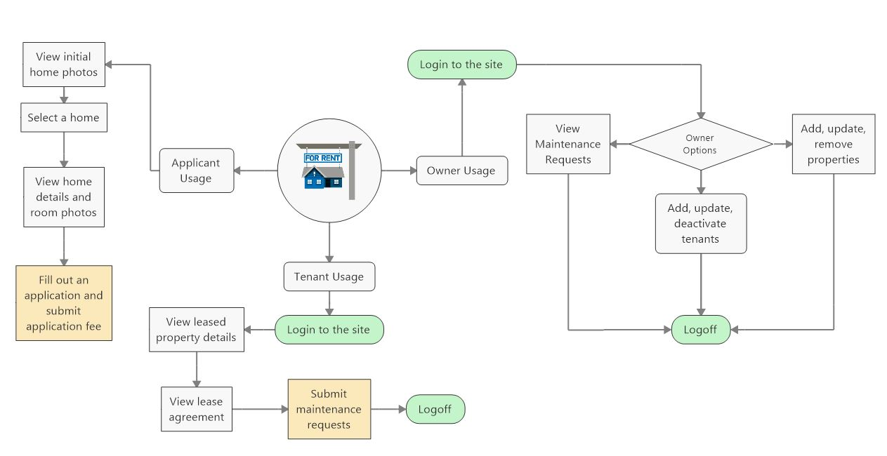
Living Real – Application Details
An owner/tenant/applicant would utilize this application by:
Applicants can view the properties and request additional information.
Tenants can login, view their property details, lease agreement and submit maintenance requests.
Owners can login, maintain users and properties, and view maintenance requests.
Notes:
The process/execution flow through the application
Discuss how the various user types would use the application.

Slide 7
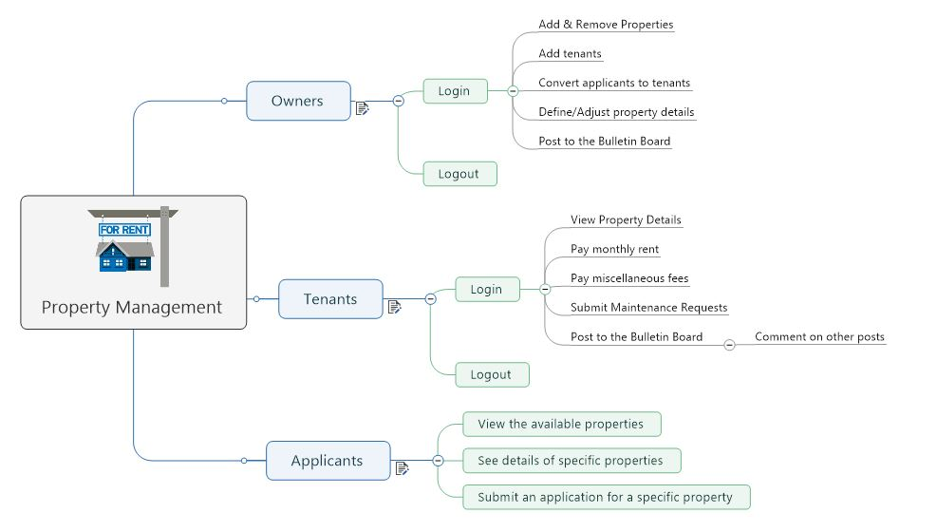
Living Real – Demonstration
The demonstration:
Run the application from Heroku.
Show the applicant walk-thru, viewing properties.
Login as a user and view the tenant dashboard and lease agreement.
Logout, then login as an owner and show the owner dashboard.
Show updating properties, adding users, adding properties.
Notes:
A live demo of the application.

Slide 8
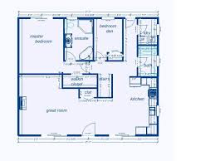
Living Real – Future Development
This application can be improved for the next version by considering.
Add to the ‘resolvers’ so multiple maintenance requests can be viewed by both the owner and the tenant.
Enable the status of maintenance requests to be updated (open, in-progress, closed).
Add a map to the property location for prospective tenants.
Add a bulletin/message board for the owner to disseminate news to the tenants. This should include a feature for tenant reactions..
Notes:
This slide discusses ideas and improvements that could be made in a future version of the application.

Slide 9
Living Real – Important Links
Link to deployed application:
https://living-real.herokuapp.com/
Link to GitHub Repository:
https://github.com/P3T2-Realty-Rogues/living-real
Notes:
This slide shows the links to the “live” application on Heroku as well as the GitHub repository.

Slide 10

Living Real – Questions
Thank you for watching this presentation.
Questions ?
Notes:
Closing slide

