Slide 1
Global Coral reef fish
Camara

Slide 2
Introduction
In this paper, we study the distribution of coral genera and
fish species across the world coral reef.

Slide 3
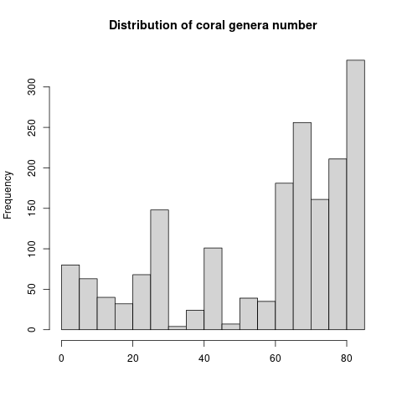
Results
In this data table we have 1783observations (coral reef cells)

