Slide 1

CRYPTOGRAPHY
Created By: Chitrangi Ambegaonkar

Slide 2
Table Of Contents
Origin of cryptography
Definition of cryptography
Classification of cryptography
Types of cryptography algorithm
Benefits of cryptography
Drawbacks of cryptography
Future of cryptography

Slide 3
Origin of cryptography
The origin of cryptography took place in around 2000 B.C in Egypt.
Cryptography comes from the Greek words kryptos and graphein, which mean hidden and writing, respectively.
The former meaning of cryptography was simple writing of messages such that only selected people could view and read it.
The earliest concerned of cryptography was converting messages into unreadable figures to protect the contents of messages during its transmission.

Slide 4
What is cryptography
Cryptography is about constructing and analyzing protocols that prevent third parties or the public from reading private messages.
Cryptography is the science of using the mathematics to encrypt and decrypt data.
Cryptography enables you to store sensitive information as well as transmit it across insecure networks so that it cannot be read by anyone except the intended recipient.
Cryptography relies on two basic components: a cryptographic algorithm and a cryptographic key.

Slide 5
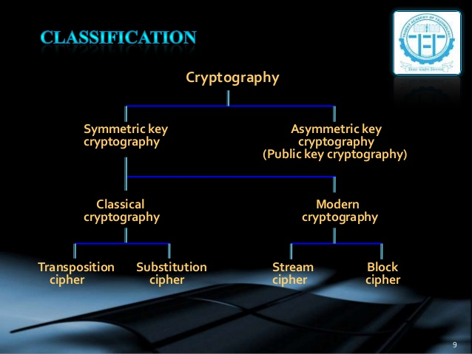

Slide 6
Symmetric Key Cryptography
It mainly possess a classical way of cryptography.
It consists of further two sub types such as transposition cipher and substitution cipher.

Slide 7
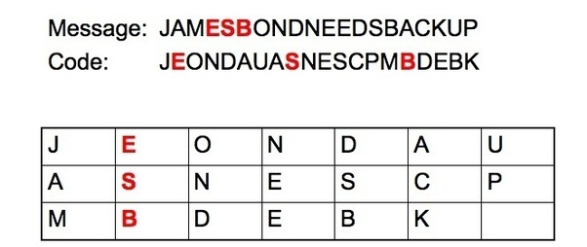
Transposition Cipher
A transposition cipher is a method of encryption by which the positions held by units of plaintext (which are commonly characters or groups of characters) are shifted according to a regular system, so that the cipher text constitutes a permutation of the plaintext.

Slide 8
Substitution Cipher
A substitution cipher is a method of encrypting by which units of plaintext are replaced with cipher text, according to a fixed system; the "units" may be single letters (the most common), pairs of letters, triplets of letters, mixtures of the above, and so forth.
The receiver deciphers the text by performing the inverse substitution.
Substitution ciphers can be compared with transposition cipher. In a transposition cipher, the units of the plaintext are rearranged in a different and usually quite complex order, but the units themselves are left unchanged.
By contrast, in a substitution cipher, the units of the plaintext are retained in the same sequence in the cipher text, but the units themselves are altered.

Slide 9
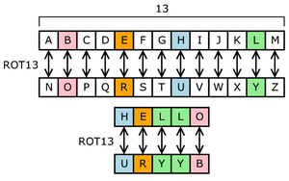

Slide 10
Asymmetric Key Cryptography
It mainly possess a modern and modified way of cryptography.
It consists of further two sub types such as stream cipher and block cipher.

Slide 11
Stream Cipher
A stream cipher is a symmetric key cipher where plaintext digits are combined with a pseudorandom cipher digit stream.
In a stream cipher, each plain text digit is encrypted one at a time with the corresponding digit of the keystream, to give a digit of the cipher text stream. Since encryption of each digit is dependent on the current state of the cipher, it is also known as state cipher.

Slide 12
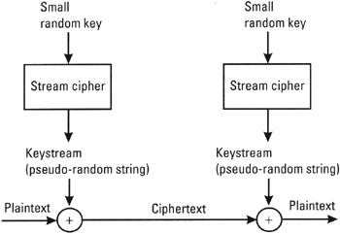

Slide 13
Block Cipher
A block cipher is a deterministic algorithm operating on fixed-length groups of bits, called a block, with an unvarying transformation that is specified by a symmetric key.
Block ciphers operate as important elementary components in the design of many cryptographic protocols, and are widely used to implement encryption of bulk data.
The size of block is generally 64 or 128 bits.

Slide 14
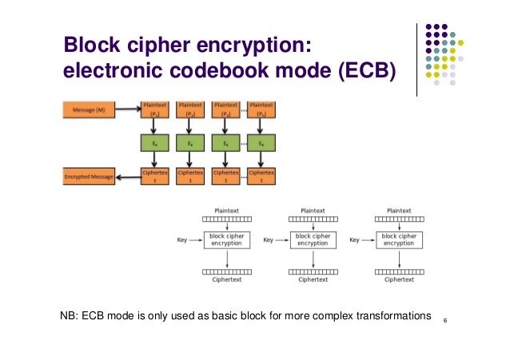

Slide 15
Types of cryptography algorithm
A cryptographic algorithm is a mathematical function used for encryption and decryption of data. The fundamental set of cryptographic algorithms can be divided into three groups:
Symmetric
Asymmetric
Hash functions

Slide 16
Symmetric Algorithm
Symmetric key algorithm are algorithms for cryptography that use the same cryptographic keys for both encryption of plain text and decryption of cipher text.
The keys may be identical or there may be a simple transformation to go between the two keys.
The keys, in practice, represent a shared secret between two or more parties that can be used to maintain a private information link.
This requirement that both parties have access to the secret key is one of the main drawbacks of symmetric key encryption, in comparison to public key encryption also termed as asymmetric key encryption.

Slide 17
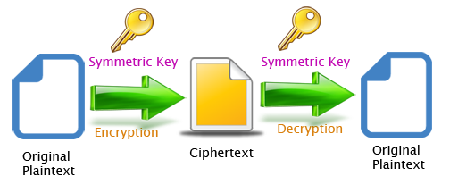

Slide 18
Asymmetric Algorithm
In asymmetric cryptography different keys (a public key and its corresponding private key) must be used for encryption and decryption.
The encrypting key is called the public key and the decrypting key is the private key.
Asymmetric cryptography has two primary use cases: authentication and confidentiality.

Slide 19
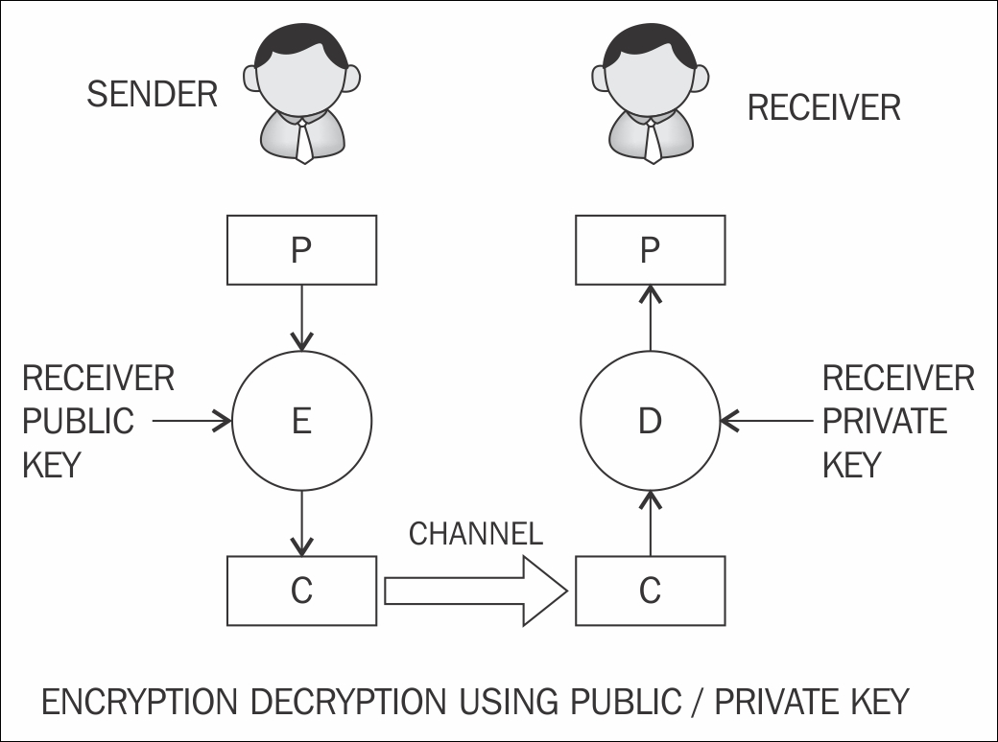

Slide 20
Hash Functions
Hash functions take some data of an arbitrary length (and possibly a key or password) and generate a fixed-length hash based on this input. Hash functions used in cryptography have the property that it is easy to calculate the hash, but difficult or impossible to re-generate the original input if only the hash value is known.
In addition, hash functions useful for cryptography have the property that it is difficult to craft an initial input such that the hash will match a specific desired value.
Nowadays, most commonly used hashing algorithm is SHA-256.

Slide 21
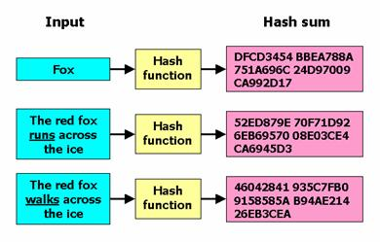

Slide 22
Benefits of Cryptography
Confidentiality: Encryption technique can guard the information and communication from unauthorized revelation and access of information.
Authentication: The cryptographic techniques such as MAC and digital signatures can protect information against spoofing and forgeries.
Data Integrity: The cryptographic hash functions are playing vital role in assuring the users about the data integrity

Slide 23
Drawbacks of Cryptography
A strongly encrypted, authentic, and digitally signed information can be difficult to access even for a legitimate user at a crucial time of decision-making.
Cryptography does not guard against the vulnerabilities and threats that emerge from the poor design of systems, protocols, and procedures. These need to be fixed through proper design and setting up of a defensive infrastructure.
The use of public key cryptography requires setting up and maintenance of public key infrastructure requiring the handsome financial budget.
Addition of cryptographic techniques in the information processing leads to delay.

Slide 24
Future of Cryptography
Elliptic Curve Cryptography (ECC) has already been invented but its advantages and disadvantages are not yet fully understood. ECC allows to perform encryption and decryption in a drastically lesser time, thus allowing a higher amount of data to be passed with equal security.
Quantum computation is the new phenomenon. While modern computers store data using a binary format called a "bit" in which a "1" or a "0" can be stored; a quantum computer stores data using a quantum superposition of multiple states. These multiple valued states are stored in "quantum bits" or "qubits“.

Slide 25
References
https://en.wikipedia.org/wiki/Transposition_cipher
https://en.wikipedia.org/wiki/Substitution_cipher
https://en.wikipedia.org/wiki/Stream_cipher
https://en.wikipedia.org/wiki/Block_cipher
https://www.tutorialspoint.com/cryptography/benefits_and_drawbacks.htm

