Slide 1
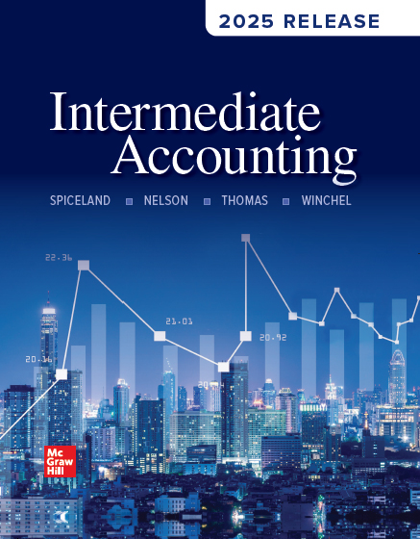
Chapter 12
Investments
© McGraw Hill LLC. All rights reserved. No reproduction or distribution without the prior written consent of McGraw Hill LLC.
Notes:
In this chapter, you will learn about various approaches we use to account for investments that companies make in the debt and equity securities of other companies.
In appendices to this chapter, we discuss other types of investments as well as how to deal with an investment whose value has been impaired.

Slide 2
Investments
L O12.1
Financial instruments:
Equity securities | Debt securities
Common stock Preferred stock | Bonds Notes
Purchased by individual investors, mutual funds, and corporations.
Objective:
To earn a return from the dividends or interest the securities pay or from increases in the market prices of the securities.
To develop ongoing affiliations with the companies whose securities are acquired.
Notes:
Corporations raise funds to finance their operations by selling equity securities (common and preferred stock) and debt securities (bonds and notes). These securities, also called financial instruments, are purchased as investments by individual investors, mutual funds, and also by other corporations. In later chapters we discuss equity and debt securities from the perspective of the issuing company. Our focus in this chapter is on the corporations that invest in debt and equity securities issued by other corporations as well as in debt securities issued by governmental units (bonds, Treasury bills, and Treasury bonds).
Most companies invest in financial instruments issued by other companies. For some investors, these investments represent ongoing affiliations with the companies whose securities are acquired. Some investments, though, are made only to earn a return from the dividends or interest the securities pay or from increases in the market prices of the securities— the same reasons that might motivate you to buy stocks, bonds, or other investment securities.
With such diversity in investment objectives, it’s not surprising that there is diversity in the approaches used to account for investments.

Slide 3
Accounting for Debt Investments
L O12.1
Debt Security:
Specified date when it matures.
Principal amount paid to investors on maturity.
Interest paid to investors.
The principal and interest payments are a stream of cash flows the investor receives in the future in exchange for purchasing the bond today.
Notes:
Let’s say you buy a $500, 2-year, 4% CD (certificate of deposit) at a bank. What’s happened is that you are lending the bank $500 for 2 years and the bank is promising to pay you 4% interest each year before returning your $500 after two years. The bank’s debt (the $500 borrowed from you) is represented by a debt instrument (the CD), which specifies the maturity date (two years), the principal ($500), and the annual rate of interest (4%).
Companies invest in debt too. Like a CD, a bond or other debt instrument has a specified date when it matures, and on that maturity date, the principal (also called the face amount or maturity value) is paid to investors. In the meantime, interest equal to some stated interest rate multiplied by the principal is paid to investors on specified interest dates (usually twice a year). Think of the principal and interest payments of a bond as a stream of cash flows that an investor will receive in the future in exchange for purchasing the bond today. The investor values that stream of future cash flows based on the prevailing market interest rate for debt of similar risk and maturity at the time the investor purchases the bond.

Slide 4
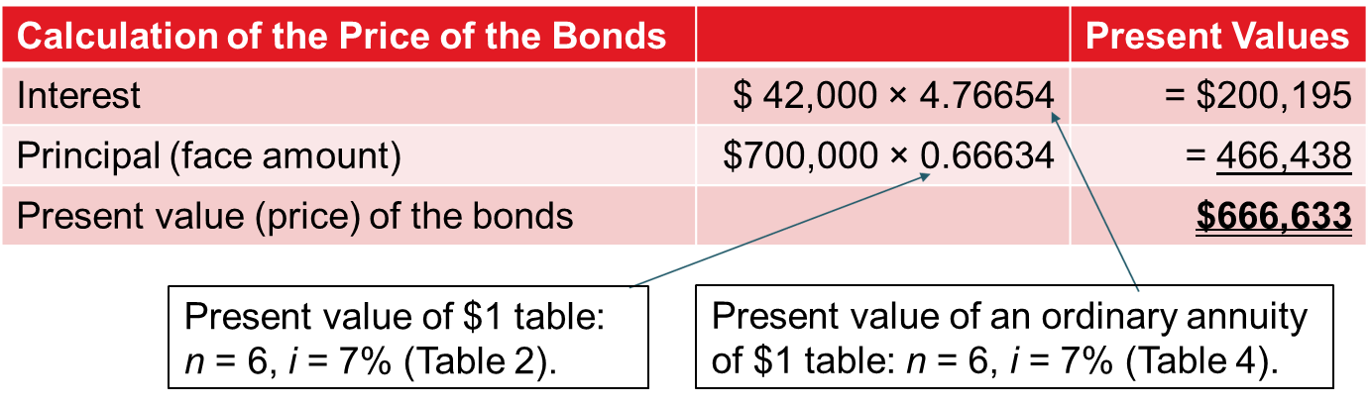
Debt Investment: Bonds Purchased at a Discount
L O12.1
On July 1, 2027, Masterwear Industries issued $700,000 of 12% bonds, dated July 1.
Interest of $42,000 is payable semiannually on June 30 and December 31.
The bonds mature in three years, on June 30, 2030.
United Intergroup, Inc., purchased the entire bond issue on a date when the market interest rate for bonds of similar risk and maturity was 14%.
Access the text alternative for slide images.
Notes:
Illustration 12–1 Example of a Debt Investment: Bonds Purchased at a Discount
This illustration shows that United will pay Masterwear $666,633 on July 1, 2027. In return, United expects to receive from Masterwear $42,000 every six months for the next three years plus the principal of $700,000 when the bonds mature on June 30, 2030. Of course, if United sells the bonds to another investor, that investor will receive the remaining payments of interest and principal.

Slide 5
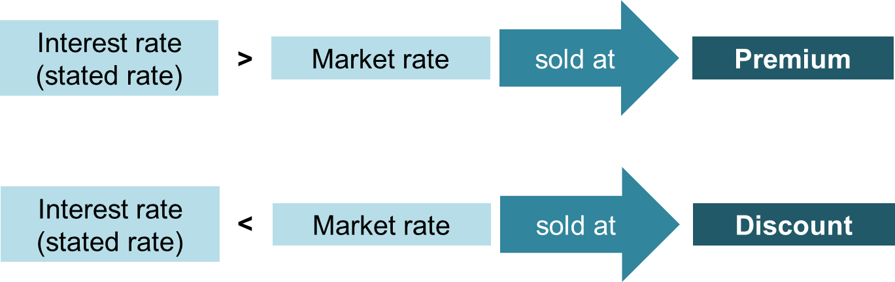
Bond Investments: Premiums and Discounts
L O12.1
Fair value of a bond changes when market interest rates change.
Market value of a fixed-rate investment moves in the opposite direction of market rates of interest.
Access the text alternative for slide images.
Notes:
Notice that United paid $666,633 to purchase the $700,000 bonds. Why the difference? Masterwear was offering its bonds for 12%, but investors could have obtained bonds of similar risk and maturity at a more favorable, higher rate of 14%. To attract investors, Masterwear had to sell its bonds at a discount.
More generally, bonds are sold at a discount if the interest rate paid by the bond (the stated rate) is lower than the market rate, because investors are only willing to purchase the bond for less than its maturity value. Bonds are sold at a premium if the stated rate is higher than the market rate, because investors are willing to purchase the bond for more than its maturity value.

Slide 6
Key Events in the Life of a Debt Investment
L O12.1
Characteristics of all debt investments:
Purchasing the investment.
Receiving periodic interest payments.
Holding the bonds during periods in which fair value changes (incurring unrealized holding gains and losses).
Selling the bonds before maturity or receiving principal at maturity.
Notes:
There are four key characteristics of all debt investments:
Purchasing the debt investment
Receiving periodic interest payments
Holding the bonds during periods in which the bonds’ fair value changes (and thus incurring unrealized holding gains and losses, since the bonds have not been sold).
Either selling the bonds before maturity or receiving the principal payment at their maturity date.

Slide 7
Recording the Purchase of a Debt Investment
L O12.1
When debt investments are purchased, they are recorded at cost—that is, the total amount paid for the investment, including any brokerage fees. United paid $666,633 to purchase Masterwear’s $700,000 bonds. United debits Investment in bonds for the face amount and credits Cash for the price paid for the bonds. Because United purchased the bonds for an amount that’s less than their face amount, it credits Discount on bond investment for the difference.
Journal Entry – July 1, 2027 | Debit | Credit
Investment in bonds | 700,000
Discount on bond investment |  | 33,367
Cash |  | 666,633
Notes:
When debt investments are purchased, they are recorded at cost—that is, the total amount paid for the investment, including any brokerage fees. Referring back to the previous illustration, we see that United paid $666,633 to purchase Masterwear’s $700,000 bonds. United would record the purchase as shown.
Because United purchased the bonds for an amount that’s less than their face amount, it credits Discount on bond investment for the difference. Discount on bond investment is a contra-asset to the investment account that serves to reduce the carrying value of the investment to its cost at the date of purchase. If United instead had purchased the bonds for an amount (say, $725,000) that is higher than the face amount of the bond ($700,000), it would instead debit Premium on bond investment (for $25,000) to record the investment at its cost at the date of purchase.

Slide 8
Recording Interest Revenue
L O12.1
Journal Entry – Dec. 31, 2027 | Debit | Credit
Cash | 42,000
Discount on bond investment | 4,664
Interest revenue |  | 46,664
Notes:
United will record interest revenue using the effective interest method. Under the effective interest method, interest for a period equals the market rate of interest when the debt was purchased multiplied by the outstanding balance of the debt at the beginning of the period. Here’s how it works.
Masterwear’s bonds have a stated rate of 12%, payable semiannually. This means that every six months, United will receive exactly $42,000 in cash from Masterwear. $700,000 face value x (12% / 2) stated rate = $42,000 interest received.
However, recall that United purchased the $700,000 bonds at a discounted amount of $666,633. At the time United purchased the bonds, the market rate of interest for bonds of similar risk was 14%. So, United would only be willing to invest in these bonds if it could earn the 14% it could get elsewhere (not the 12% stated rate). To earn this higher rate, United needed to pay only $666,633. Paying the lower amount means United lowered its investment cost and effectively increased its rate of return to 14% (refer back to the previous illustration to see the details of this calculation). While United will receive $42,000 (6%) in interest from Masterwear in the first six months, it will effectively earn interest revenue of $46,664 (7%) on its investment. $666,633 outstanding balance x (14% / 2) market rate = $46,444 interest revenue.
The amount by which interest revenue exceeds interest received ($46,664 − $42,000 = $4,664 in the first six months) represents a piece of the cost savings from purchasing the investment at a discount. This piece of the cost savings increases United’s investment return from the rate the bond pays (12%) to the higher rate (14%) that investors could have earned on other similar bonds at the time they purchased the bonds. In fact, this approach is called the effective interest method because interest revenue is based on the effective interest rate that the investment earns over its lifetime.
The journal entry to record the interest received for the first six months as investment revenue is to debit Cash for the stated rate multiplied by the face amount, in this case $42,000. Debit the difference of $4,664 to the Discount on bond investment account. Note, this entry reduces the discount from $33,367 to $28,703. Because the discount gets smaller, the amortized cost of the investment (equal to $700,000 less discount) gets larger by the same amount (from $666,633 to $671,297). Then credit Interest revenue for the market rate multiplied by the outstanding balance.

Slide 9
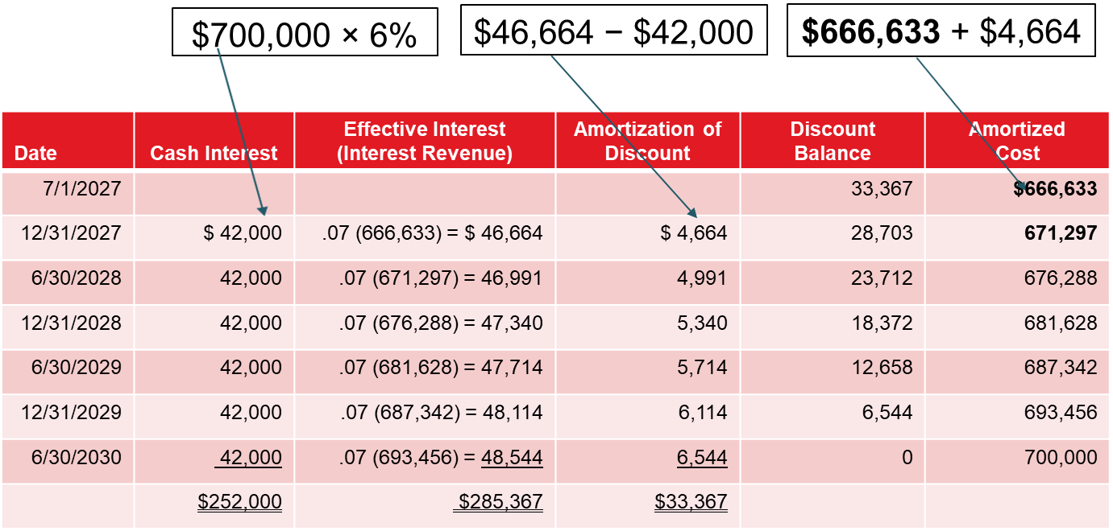
Amortization Schedule—Discount
L O12.1
Access the text alternative for slide images.
Notes:
Illustration 12–2 Amortization Schedule—Discount
Here’s the amortization table that would be used for the Masterwear bond. It shows interest being recorded at the effective rate over the life of this investment. As you can see, amortization of the discount gradually increases the amortized cost of the investment, until the investment reaches its principal amount of $700,000, which is the amount to be received when the debt matures.
If the bonds were instead purchased at a premium, a similar amortization schedule would reduce the premium over time until the bond’s amortized cost reached the face amount of $700,000, which is the amount to be received when the debt matures.

Slide 10
Classification of Debt Investments
L O12.1
The fair value of bonds will change as market interest rates change resulting in unrealized holding gains and losses:
Unrealized holding losses happen when the market interest rate rises after a bond is purchased.
Unrealized holding gains happen when the market interest rate falls after a bond is purchased.
Notes:
The amortization schedule shown on the previous slide is based on the market interest rate (14%) that prevailed at the time United purchased the Masterwear bonds. United will use that amortization schedule for the life of the investment, and won’t change it in response to changes in prevailing interest rates. However, the prevailing market rate may not always be 14%. Because market participants will use the prevailing market interest rate to compute the present value of the cash flows provided by the bonds, the fair value of the bonds will change as interest rates change. United will incur unrealized holding gains and losses as a result of holding the bonds during periods in which its fair value changes.
Unrealized holding losses happen when the market rate of interest rises after a bond is purchased. The market will compute the present value of the cash flows provided by the bond using that higher discount rate, so the fair value of the bond falls. The fair value of the bond has decreased, but that loss hasn’t been realized, because the investment has not been sold.
Unrealized holding gains happen when the market rate of interest falls after a bond is purchased. The market will calculate the present value of the cash flows provided by the bond using that lower rate, so the fair value of the bond rises. The fair value of the bond has increased but that gain hasn’t yet been realized, because the investment hasn’t been sold.

Slide 11
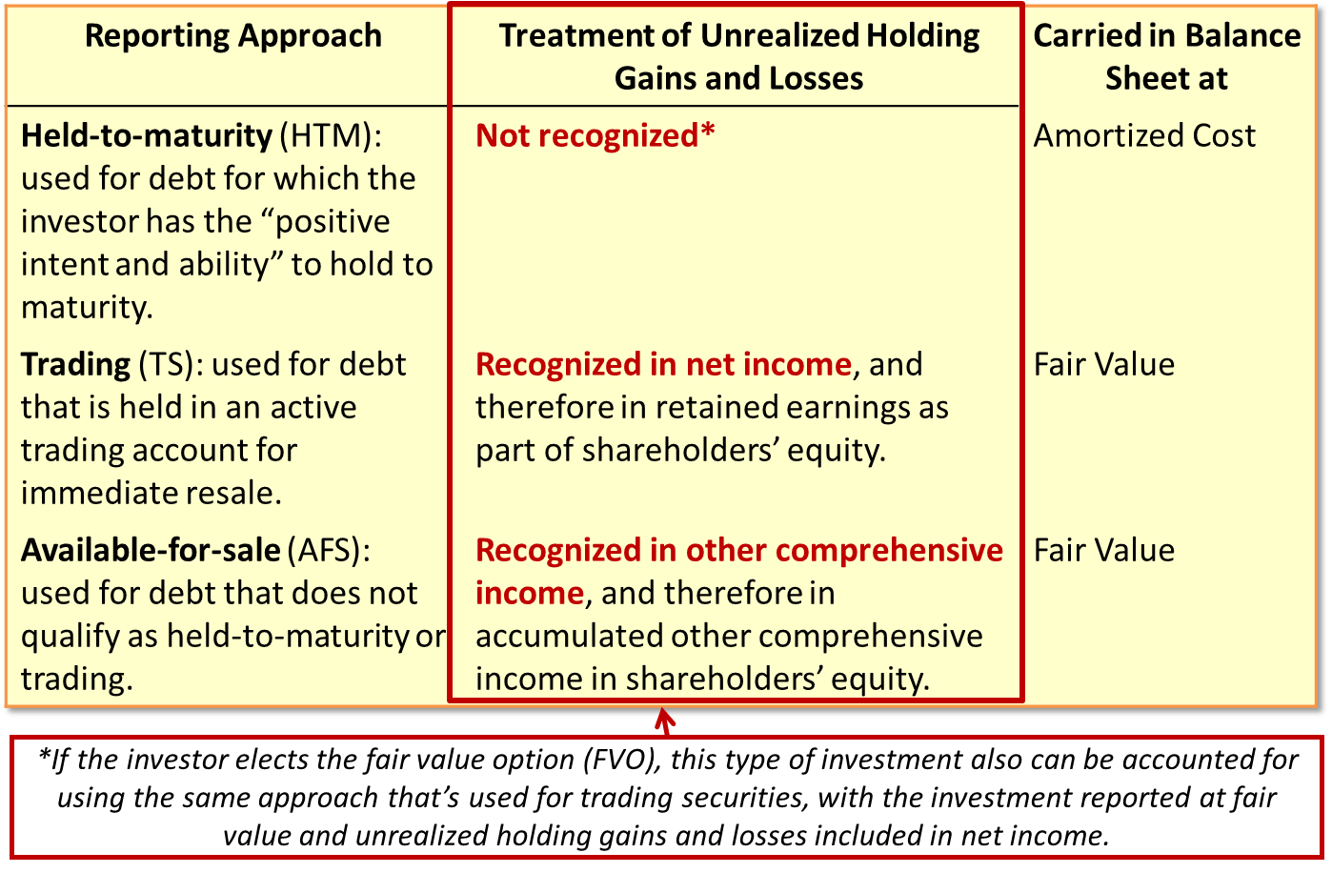
Three Classifications of Debt Investments
L O12.1
Access the text alternative for slide images.
Notes:
Illustration 12–3 Accounting for Unrealized Holding Gains and Losses on Debt Investments
Accounting for changes in fair value depends on the classification of the debt investment. As shown here, debt investments are classified in one of three categories: held-to-maturity (HTM) securities, trading securities (TS), and available-for-sale (AFS) securities.
Why treat unrealized holding gains and losses differently depending on the type of investment? As you know, the primary purpose of accounting is to provide information useful for making decisions. What’s most relevant for that purpose is not necessarily the same for each investment a company might make. For example, a company might invest in corporate bonds to provide a steady return until the bonds mature, in which case day-to-day changes in fair value may not be viewed as very relevant, so the held-to-maturity approach is preferable. On the other hand, a company might invest in the same bonds because it plans to sell them at a profit in the near future, in which case the day-to-day changes in fair value could be viewed as very relevant, and the trading security or available-for-sale approach is preferable.

Slide 12
Disclosure about Investments—United Parcel Service, Inc.
L O12.1
Note 1. Summary of Accounting Policies:
Marketable Securities and Non-Current Investments:
Debt securities are classified as either trading or available-for-sale securities and are carried at fair value. Unrealized gains and losses on trading securities are reported as Investment income and other on the statements of consolidated income. Unrealized gains and losses on available-for-sale securities are reported within other comprehensive income, a separate component of shareowners’ equity. The amortized cost of debt securities is adjusted for amortization of premiums and accretion of discounts to maturity. Such amortization and accretion is included in Investment income and other, together with interest and dividends. The cost of securities sold is based on the specific identification method; realized gains and losses resulting from such sales are included in Investment income and other.
Notes:
Illustration 12–4 Disclosure about Investments—United Parcel Service, Inc.
This illustration provides a description from a recent annual report of how UPS accounts for unrealized gains and losses arising from its investments in trading and available-for-sale investments.

Slide 13
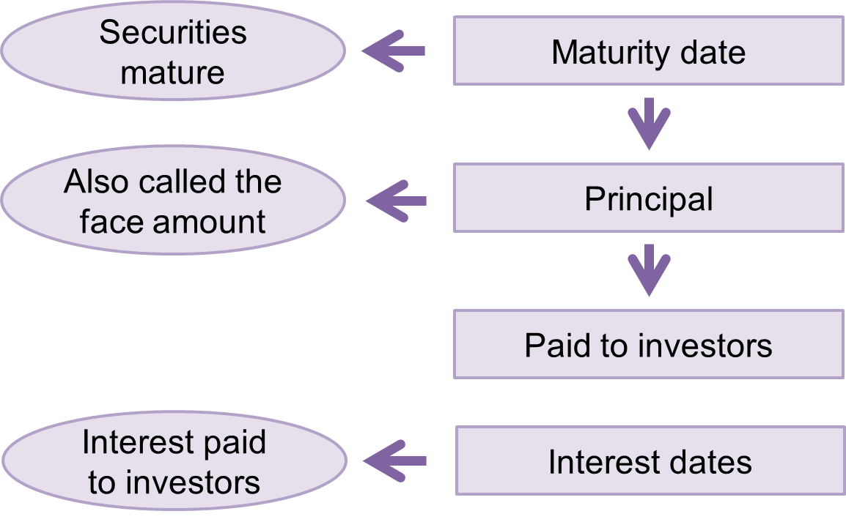
Debt Investments to Be Held-to-Maturity (H T M)
L O12.2
Investor has the “positive intent and ability” to hold the investment to maturity.
Access the text alternative for slide images.
Notes:
A debt investment is classified as held-to-maturity (HTM) if the investor has the “positive intent and ability” to hold the investment to maturity. For HTM investments, unrealized holding gains and losses arising from changes in fair value are less important. Sale before maturity isn’t an alternative, so those gains and losses will never be realized. Therefore, HTM investments typically are reported at their amortized cost in the balance sheet, and unrealized gains and losses are only disclosed in a note to the financial statements.
The investor’s commitment to not sell their investment is key to classifying the investment as HTM. A debt security cannot be classified as HTM if the investor might sell it before maturity in response to changes in market prices or interest rates, to meet the investor’s liquidity needs, or similar factors.

Slide 14
For H T M Investments, Do Not Recognize Unrealized Holding Gains and Losses
L O12.2
Example:
The Wall Street Journal indicates that the fair value of the Masterwear bonds on 12/31/2027 is $714,943. How will United account for this increase in fair value?
If viewed as an H T M investment:
The investment simply will be recorded at amortized cost.
United will disclose the fair value of its H T M investments in a note to the financial statements.
It will not recognize any fair value changes in the income statement or balance sheet.
Notes:
As an example of accounting for HTM investments, suppose that on December 31, 2027, the market interest rate for securities similar to the Masterwear bonds has fallen to 11%. An investor valuing the Masterwear bonds at that time would do so considering the current market interest rate (11%) because that’s the rate of return available for similar bonds. Calculating the present value of the bonds using a lower discount rate results in a higher present value (price).
Let’s say that checking market prices in The Wall Street Journal indicates that the fair value of the Masterwear bonds on December 31, 2027, is $714,943.
As shown in a prior illustration, those same bonds have an amortized cost of $671,297. This means there is an unrealized gain of $43,646 for the difference. If United views the bonds as HTM investments, that change in fair value will not affect the value of those bonds shown in United’s balance sheet. Instead, the investment will be shown in the balance sheet at amortized cost of $671,297.
United will disclose the fair value of its HTM investments in a note to the financial statements, but will not recognize any fair value changes in the income statement or balance sheet.

Slide 15
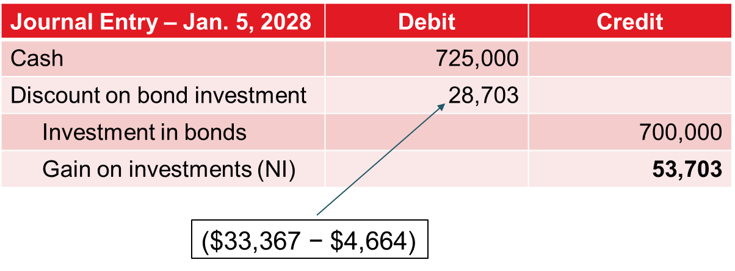
Sale of H T M Investments
L O12.2
On July 1, 2027, Masterwear Industries issued $700,000 of 12% bonds, dated July 1. Interest of $42,000 is payable semiannually on June 30 and December 31. The bonds mature in three years, on June 30, 2030. The market interest rate for bonds of similar risk and maturity is 14%. The entire bond issue was purchased by United Intergroup, Inc.
Due to unforeseen circumstances the company decided to sell its debt investment for $725,000 on January 5, 2028.
Access the text alternative for slide images.
Notes:
Typically, held-to-maturity investments are held to maturity. However, suppose that due to unforeseen circumstances the company decided to sell its debt investment for $725,000 on January 5, 2028.
United would record this sale just like any other asset sale, with a realized gain or loss determined by comparing the cash received with the carrying value (in this case, the amortized cost) of the asset sold.

Slide 16
Impairment of H T M Investments
L O12.2
There is one important exception to the general rule that companies don’t recognize unrealized gains and losses for H T M investments. If viewed as an H T M investment:
Companies likewise are required to use the Current Expected Credit Loss (C E C L) model to account for credit losses on H T M investments.
This requires companies to make an estimate of the amount of interest and principal payments they won’t receive in the future.
Companies account for that estimate by recognizing a credit loss in net income and reducing the carrying value of the H T M investment with an allowance for credit losses.
Notes:
There is one important exception to the general rule that companies don’t recognize unrealized gains and losses for HTM investments. You learned in Chapter 7 that companies are required to use the Current Expected Credit Loss (CECL) model to account for bad debts with respect to accounts receivable and notes receivable. Companies likewise are required to use the CECL model to account for credit losses on HTM investments. That requires companies to make an estimate of the amount of interest and principal payments they won’t receive in the future. Companies account for that estimate by recognizing a credit loss in net income and reducing the carrying value of the HTM investment with an allowance for credit losses, just like they recognize bad debt expense and an allowance for uncollectible accounts for accounts receivable. In Appendix 12B we provide an illustration of recognizing credit losses for HTM investments.

Slide 17
Financial Statement Presentation—H T M
L O12.2
Income Statement and Statement of Comprehensive Income:
Realized gains and losses are shown in net income in the period in which securities are sold.
Unrealized holding gains and losses are disclosed in notes to financial statements.
Do not affect other comprehensive income (O C I).
Balance Sheet:
Investments in H T M securities are reported at amortized cost, less any allowance for credit losses.
Fair values of those investments are disclosed in the notes to financial statements.
Cash Flow Statement:
Cash flows from buying and selling H T M securities typically are classified as investing activities.
Notes:
HTM securities appear in the financial statements as follows:
Income Statement and Statement of Comprehensive Income: Realized gains and losses are shown in net income in the period in which securities are sold. Unrealized holding gains and losses are disclosed in the notes to financial statements. Investments in HTM securities do not affect other comprehensive income.
Balance Sheet: Investments in HTM securities are reported at amortized cost, less any allowance for credit losses. Fair values of those investments are disclosed in the notes to financial statements.
Cash Flow Statement: Cash flows from buying and selling HTM securities typically are classified as investing activities.

Slide 18
Reporting Held-to-Maturity Investments
L O12.2
(Ignoring income taxes) | 2027 | 2028
Statement of Comprehensive Income
Revenues | $ - | $ -
Expenses | - | -
Other income (expense):
Interest revenue | 46,664 | 0
Gain on investments | 0 | 53,703
Net income | 46,664 | 53,703
Other comprehensive income (O C I) | 0 | 0
Comprehensive income (Net income + O C I) | $ 46,664 | $ 53,703
Balance Sheet
Assets:
Investments in bonds (HTM) | $ 671,297 | $ 0
Shareholders’ equity:
Retained earnings | 46,664 | 100,367*
Statement of Cash Flows (direct method)
Operating activities:
Cash from interest received | $ 42,000 | $ 0
Investing activities
Purchase of H T M securities | (666,633) | 0
Sale of H T M securities | 0 | 725,000
*Net income of $46,664 (2027) + $53,703 (2028) = $100,367 accumulates in retained earnings by the end of 2028.
Notes:
Illustration 12–5 Reporting Held-to-Maturity Investments
Assuming United sold its investment on January 5, 2028, United’s 2027 and 2028 financial statements will include the amounts shown above.
Note that only realized gains and losses are included in net income. HTM securities are reported at amortized cost less any allowance for credit losses. Cash flows from buying and selling HTM securities are classified as investing activities.

Slide 19
Disclosure of Unrealized Gains and Losses on H T M Investments
L O12.2
Dec 31, 2022 ($ in millions) | Amortized Cost | Gross Unrealized Gains | Gross Unrealized Losses | Fair Value
Held-to-maturity debt securities
Agency mortgage-backed securities | $503,233 | -- | $ (87,319) | $415,914
U S Treasury and government agencies | 121,597 | -- | (20,259) | 101,338
Other taxable securities | 8,033 | -- | (1,018) | 7,015
Total held-to-maturity debt securities | $632,863 | -- | $(108,596) | $524,267
Notes:
Illustration 12–6 Disclosure of Unrealized Gains and Losses on Held-to-Maturity Investments Bank of America Corporation
Illustration 12–6 shows a typical disclosure of unrealized gains and losses on HTM investments, taken from Bank of America’s 2022 10-K.
This highlights that Bank of America had a huge amount of unrealized losses on its HTM investment portfolio at the end of 2022. Almost $109 billion dollars! But Bank of America is a very large financial institution. Silicon Valley Bank, a smaller institution, had $18 billion of unrealized losses on HTM and AFS investments disclosed in its 2022 10-K. When SVB had to sell its investments to raise cash in early 2023, it was forced to immediately recognize those losses and quickly collapsed. As Dave Zion noted, those were “bank losses hiding in plain sight” in SVB’s disclosure notes.

Slide 20
Trading Securities (T S)
L O12.3
Investments in debt or equity securities acquired principally for the purpose of selling them in the near term.
Active buying and selling of securities.
Holding period generally is measured in hours and days rather than months or years.
Typically reported among the investor’s current assets.
Fair value information is more relevant, so,
Carried at fair value on the balance sheet, and,
Unrealized holding gains and losses are included in net income in the income statement.
Notes:
Trading securities are investments in debt that are acquired for purposes of earning profits on short-term price fluctuations. The holding period for trading securities generally is measured in hours and days rather than months or years, so these investments typically are reported among the investor’s current assets. Usually only banks and other financial institutions invest in trading securities.
Just like HTM investments, trading securities are recorded at cost when they are purchased, and any discount or premium is amortized to interest revenue over time as periodic interest payments are received.
However, in subsequent periods, there are two important differences between how we account for trading securities and HTM investments.
1. Trading securities are written up or down to their fair value, or “marked to market,” in the balance sheet. (HTM securities are kept at amortized cost.)
2. Corresponding unrealized holding gains and losses on trading securities are included in net income in the income statement. (HTM securities do not include unrealized holdings gains and losses in net income.)
Reporting trading securities at their fair value is a departure from amortized cost, so they are treated differently than are many other assets reported in the balance sheet. Why the difference? Fair value information is more relevant for trading securities than it is for assets intended primarily to be used in company operations, like buildings, land and equipment, or for debt investments intended to be held-to-maturity. Changes in fair values provide an indication of management’s success in deciding when to acquire the investment, when to sell it, whether to invest in fixed-rate or variable-rate securities, and whether to invest in long-term or short-term securities. For that reason, it makes sense to report unrealized holding gains and losses on trading securities in net income during a period that fair values change, even though those gains and losses haven’t yet been realized through the sale of the securities.
To see how we account for trading securities, let’s return to our Masterwear bond example, but assume that those debt investments are held in an active trading portfolio. As of December 31, 2027, United has recorded the purchase of the bonds as well as receipt of the first semiannual interest payment, so the bonds have an amortized cost of $671,297.

Slide 21
Adjust Trading Security Investments to Fair Value (2027)
L O12.3
Assuming the Masterwear bonds have a fair value of $714,943 as of December 31, 2027, the table shows the calculation of the balance in the fair value adjustment account that is required on that date.
December 31, 2027
Security | Amortized Cost | Fair Value | Necessary Fair Value Adjustment Balance
Masterwear | $671,297 | $714,943 | $43,646
Journal Entry – Dec. 31, 2027 | Debit | Credit
Fair value adjustment | 43,646
Gain on investments—(unrealized, N I) |  | 43,646
*Sometimes companies don’t bother with a separate fair value adjustment account and simply adjust the investment account to fair value.
†We indicate “unrealized, N I” to highlight that, for trading securities, unrealized holding gains and losses are included in the income statement in the period in which they occur.
Notes:
Unlike HTM securities, trading securities are carried at fair value in the balance sheet, so their carrying value must be adjusted to fair value by the end of every reporting period. In fact, many companies adjust trading securities to fair value at the end of every day. Rather than increasing or decreasing the investment account itself, we use a valuation allowance, fair value adjustment, to increase or decrease the carrying value of the investment. At the same time, we record an unrealized holding gain or loss that is included in net income in the period in which fair value changes (remember, the gain or loss is unrealized because the securities haven’t been sold).
Because the bonds currently are recorded at their amortized cost of $671,297, the fair value adjustment account needs a debit balance of $43,646 to have the bonds reported at their fair value. United will recognize whatever unrealized holding gain or loss is necessary to move the fair value adjustment from its current balance of $0 (at purchase date) to $43,646 (on December 31, 2027). This is shown in the journal entry above.
Each period United owns the Masterwear bonds, it will recognize whatever unrealized holding gain or loss is necessary to move the fair value adjustment to the value it needs to have at the end of the accounting period. Increases in the fair value adjustment produce gains on trading securities that increase net income; decreases produce losses that decrease net income.

Slide 22
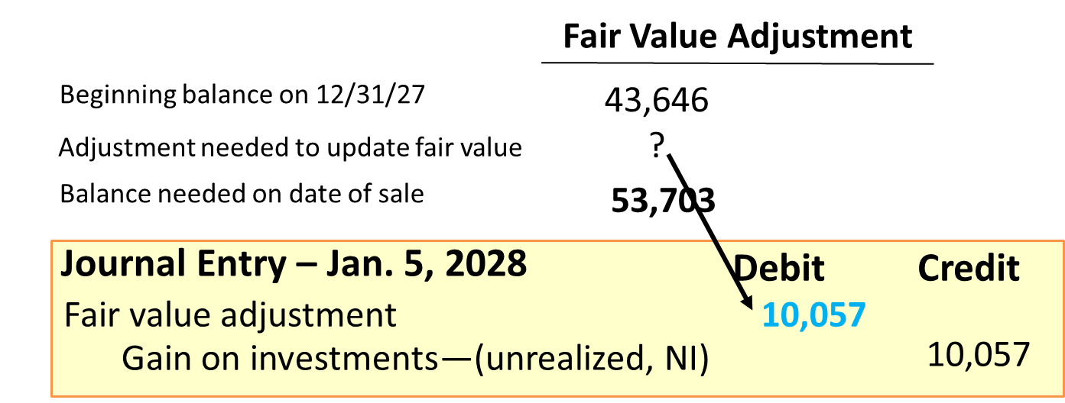
Sale of Trading Security Investments 1
L O12.3
Assume United sells the bond for $725,000 on January 5, 2028.
Adjust trading securities to fair value (2028).
January 5, 2028
Security | Amortized Cost | Fair Value | Necessary Fair Value Adjustment Balance
Masterwear | $671,297 | $725,000 | $53,703
Access the text alternative for slide images.
Notes:
Assume that United sells the bonds for $725,000 on January 5, 2028. To account for the sale, United needs to do two things. First, United needs to update the carrying value of the bonds to fair value and record in net income any unrealized holding gains and losses that occurred during 2028 up to the date of sale. Second, on the date of sale, United needs to record the receipt of cash and remove the amounts associated with the investment from the relevant balance sheet accounts. Let’s record each of these entries. (As in our example for HTM investments, for simplicity we ignore interest earned during the first five days of 2028.)
Adjust Trading Securities to Fair Value (2028). We first need to update the fair value adjustment and recognize any unrealized holding gains or losses that have occurred during the current reporting period prior to the date of sale. We already have accounted for fair value changes that occurred during 2027. Now we need to record the additional fair value changes and their related unrealized holding gains and losses that have occurred each day in 2028 up to the moment of sale. Companies might record these changes in fair value at the end of each day, but we use a single summary entry that captures those changes in fair value up to the moment of sale.
Remember that on December 31, 2027, the amortized cost of the Masterwear bonds was $671,297, and the fair value was $714,943. We recorded a fair value adjustment of $43,646 for this unrealized holding gain. Now, on January 5, 2028, the fair value has increased further to $725,000, so we need to update the fair value adjustment for the additional $10,057 increase in fair value.

Slide 23
Sale of Trading Security Investments 2
L O12.3
Assume United sells the bond for $725,000 on January 5, 2028.
Record the sale transaction.
January 5, 2028
Security | Amortized Cost | Fair Value | Necessary Fair Value Adjustment Balance
Masterwear | $671,297 | $725,000 | $53,703
Journal Entry – Jan. 5, 2028 | Debit | Credit
Cash | 725,000
Discount on bond investment | 28,703
Investment in bonds |  | 700,000
Fair value adjustment |  | 53,703
Notes:
Record the Sale Transaction. After making the previous journal entry, the investment is carried at its fair value as of the date it is being sold, and already has included in net income any gain or loss arising from the difference between amortized cost and fair value as of the date of sale. All that remains is for United to record receipt of cash and remove the investment-related accounts from the balance sheet (again, for simplicity we ignore interest earned during the first five days of 2028).
As with the sale of the HTM investment, we record the receipt of $725,000 cash and remove all the balance sheet accounts associated with the investment. However, unlike the HTM investment, our TS investment has an additional balance sheet account, the fair value adjustment, that needs to be removed when we record the sale. Another difference between the HTM and TS approach is that, because we already have included in net income the entire gain associated with changes in the fair value of the investment, there is no gain or loss to recognize on the date of sale. Over the life of the investment, United recognized the same amount of gain under the TS approach ($43,646 + $10,057 = $53,703) as it recognized upon sale under the HTM approach ($53,703). The only difference is timing, with trading securities recognizing unrealized holding gains and losses from fair value changes as they occur but the HTM approach recognizing gains or losses only when they are realized upon sale.

Slide 24
What If the Company Doesn’t Update F V Adjustment as of January 5, 2028?
L O12.3
As noted in F A S B A S C 320-10-40, for expediency companies may not update the fair value adjustment to the fair value as of the date of sale before recording the sale. In that case, the investment is carried at fair value as of the last balance sheet date, and this second entry would include a gain or loss based on the difference between the cash received and the carrying value of the investment. In our example, the fair value adjustment balance was $43,646 on December 31, 2027, and United would record the following sale entry on January 5, 2028:
Journal Entry – Jan. 5, 2028 | Debit | Credit
Cash | 725,000
Discount on bond investment | 28,703
Investment in bonds |  | 700,000
Fair value adjustment |  | 43,646
Gain on investments—NI |  | 10,057
Notes:
As noted in FASB ASC 320-10-40: Investments—Debt Securities—Overall—Derecognition, for expediency companies may not update the fair value adjustment to the fair value as of the date of sale before recording the sale. In that case, the investment is carried at fair value as of the last balance sheet date, and this second entry would include a gain or loss based on the difference between the cash received and the carrying value of the investment. In our example, the fair value adjustment balance was $43,646 on December 31, 2027, and United would record the journal entry shown here.

Slide 25
Financial Statement Presentation: Trading Securities
L O12.3
Income statement and statement of comprehensive income:
Gains and losses are included in the income statement in the periods in which fair value changes, regardless of whether they are realized or unrealized.
Do not affect other comprehensive income (O C I).
Balance sheet:
Investments in trading securities are reported at fair value, typically as current assets.
Cash flow statement:
Cash flows from buying and selling trading securities are classified as operating activities.
Notes:
Trading securities appear in the financial statements as follows:
Income Statement and Statement of Comprehensive Income: For trading securities, gains and losses are included in the income statement in the periods in which fair value changes, regardless of whether they are realized or unrealized. Investments in trading securities do not affect other comprehensive income.
Balance Sheet: Investments in trading securities are reported at fair value, typically as current assets.
Cash Flow Statement: Cash flows from buying and selling trading securities typically are classified as operating activities, because the financial institutions that routinely hold trading securities consider them as part of their normal operations.

Slide 26
Reporting Trading Securities
L O12.3
(Ignoring income taxes) Statement of Comprehensive Income | 2027 | 2028
Revenues | $ - | $ -
Expenses
Other income (expense):
Interest revenue | 46,664 | 0
Gain on investments | 43,646 | 10,057
Net income | 90,310 | 10,057
Other comprehensive income (O C I) | 0 | 0
Comprehensive income (Net income + O C I) | $ 90,310 | $ 10,057
Balance Sheet
Assets:
Investment in bonds (TS) | $ 714,943 | $ 0
Shareholders’ equity:
Retained earnings | 90,310 | 100,367*
Statement of Cash Flows (direct method)
Operating activities:
Cash from interest received | $ 42,000 | $ 0
Purchase of trading securities | (666,633) | 0
Sale of trading securities | 0 | 725,000
*Net income of $90,310 (2027) + $10,057 (2028) = $100,367 accumulates in retained earnings by the end of 2028.
Notes:
Illustration 12–7 Reporting Trading Securities
Assuming United sold its investment on January 5, 2028, United’s 2027 and 2028 financial statements will include the amounts shown above.

Slide 27
Debt Investments Classified as Available-for-Sale Securities
L O12.4
Available-for-sale (A F S) securities aren’t held for trading or designated as held to maturity.
The investment is available for sale.
Reported in balance sheet at fair value.
Unrealized holding gains and losses are not included in net income but reported in statement of comprehensive. income as other comprehensive income (O C I).
Notes:
The HTM treatment assumes we hold the bonds for their entire life. The trading securities treatment assumes we are planning to sell the bonds in the very near future. Our third treatment, available-for-sale (AFS) securities, falls in the middle. We aren’t planning to trade the debt investment actively, but the investment is available to sell if, for example, cash needs arise or the market is particularly favorable. In that case, the company classifies its debt investment as AFS. Like trading securities, we report AFS securities in the balance sheet at fair value. Unlike trading securities, though, unrealized holding gains and losses on AFS securities are not included in net income. Instead, they are reported in the statement of comprehensive income as other comprehensive income (OCI). Then, as with HTM securities, any gain or loss realized upon sale is included in net income.
Why use an approach for accounting for AFS securities that differs from that used for trading securities? AFS securities are likely to be held for multiple reporting periods, so including unrealized holding gains and losses in income each period could confuse investors by making income appear more volatile than it really is over the long run. But how can we show AFS investments at fair value in the balance sheet without recording in net income the unrealized gains and losses associated with changes in fair value? The solution is to show those unrealized gains and losses in OCI as they occur and then only include realized gains and losses in net income in the period in which an investment is actually sold.

Slide 28
Adjust A F S Investments to Fair Value
L O12.4
Let’s assume the Masterwear bond investment is classified as A F S. As of December 31, 2027, United has recorded the purchase of the bonds on July 1, 2027, as well as receipt of the first semiannual interest payment, so the bonds have an amortized cost of $671,297. The fair value of the bonds on December 31, 2027, is $714,943.
December 31, 2027
Security | Amortized Cost | Fair Value | Necessary Fair Value Adjustment Balance
Masterwear | $671,297 | $714,943 | $43,646
Journal Entry – Dec 31, 2027 | Debit | Credit
Fair value adjustment | 43,646
Gain on investments (unrealized, O C I) |  | 43,646
*Sometimes companies don’t bother with a separate fair value adjustment account and simply adjust the investment account to fair value.
†We indicate “Unrealized, O C I” to highlight that, for available-for-sale securities, unrealized holding gains and losses are included in other comprehensive income (O C I) in the period in which they occur.
Notes:
United needs to adjust the balance of the fair value adjustment account from its current balance of $0 (at purchase date) to a debit balance of $43,646 (on December 31, 2027).
Notice that the amount of unrealized holding gain is the same for these AFS securities as it was for the trading securities in the previous section. What differs is that the unrealized holding gain is included in OCI for AFS securities instead of net income as it is for trading securities. At the end of the reporting period, the unrealized holding gain is closed to a shareholders’ equity account for both approaches. What differs is that net income gets closed to retained earnings, and OCI gets closed to Accumulated Other Comprehensive Income (AOCI). As with trading securities, the fair value adjustment will be increased or decreased each period as necessary to carry the investment at fair value in the balance sheet. The corresponding unrealized holding gain or loss will be reported in OCI. Net income normally is not affected by AFS investments until the period an AFS investment is sold.

Slide 29
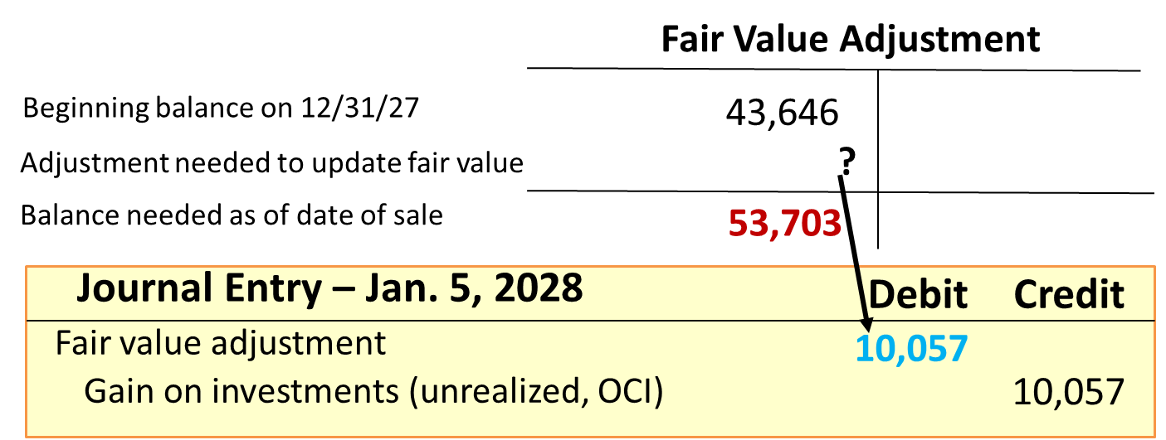
Sale of A F S Investments 1
L O12.4
Assume that United sells the Masterwear bonds for $725,000 on January 5, 2028.
Adjust A F S investment to fair value (2028).
January 5, 2028
Security | Amortized Cost | Fair Value | Necessary Fair Value Adjustment Balance
Masterwear | $671,297 | $725,000 | $53,703
Access the text alternative for slide images.
Notes:
Let’s once again assume that United sells its Masterwear bonds for $725,000 on January 5, 2028 (as with our HTM and TS examples, for simplicity we ignore any interest earned during 2028).
As with trading securities, we first need to update the fair value adjustment and recognize any unrealized holding gains or losses that have occurred during the current reporting period prior to the date of sale. Remember that on December 31, 2027, the amortized cost of the Masterwear bonds was $671,297, and the fair value was $714,943. We recorded a fair value adjustment of $43,646 for this unrealized holding gain. Now, on January 5, 2028, the fair value has increased further to $725,000, so we need to update the fair value adjustment for the additional $10,057 increase in fair value.
The journal entry to record an increase in the fair value adjustment and an additional unrealized gain of $10,057 that occurred during the first week of 2028 is shown.
The investment is carried in the balance sheet at its fair value as of the date it is being sold and all unrealized gains and losses associated with the investment have been included in OCI. Because OCI gets closed to AOCI, the unrealized gains and losses accumulate in AOCI, which acts as a sort of “holding tank” in the shareholders’ equity section of the balance sheet. Unrealized holding gains in some years offset unrealized losses in other years as they accumulate in the tank.

Slide 30
Sale of A F S Investments 2
L O12.4
Assume that United sells the bond for $725,000 on January 5, 2028.
Reverse previous fair value adjustments.
January 5, 2028
Security | Amortized Cost | Fair Value | Necessary Fair Value Adjustment Balance
Masterwear | $671,297 | $725,000 | $53,703
Journal Entry – Jan. 5, 2028 | Debit | Credit
Reclassification adjustment (O C I) | 53,703
Fair value adjustment (account balance) |  | 53,703
Notes:
United has been recording changes in fair value over the life of the investment. If United now sells that investment, the effects of those fair value changes must be reversed. United reverses previous unrealized holding gains included in OCI by debiting a reclassification adjustment to OCI for the same amount. Similarly, the account balance of the fair value adjustment is eliminated.
After this journal entry is recorded, the fair value adjustment account has a zero balance. Also, after the reclassification adjustment is closed to AOCI, all of the unrealized gains that are associated with the investment have been removed from the AOCI holding tank in shareholders’ equity. It’s as if no accounting for unrealized gains and losses had ever taken place. That’s important, because in the next entry United recognizes in net income a gain or loss on sale. If United didn’t use the reclassification entry to back out the unrealized gains and losses from AOCI, it would end up having double counted them in comprehensive income and shareholders’ equity after it records the sale in the next entry.

Slide 31
Sale of A F S Investments 3
L O12.4
Assume that Masterwear sells the bond for $725,000 on January 5, 2028.
Record the sale transaction.
January 5, 2028
Security | Amortized Cost | Fair Value | Necessary Fair Value Adjustment Balance
Masterwear | $671,297 | $725,000 | $53,703
Journal Entry – Jan. 5, 2028 | Debit | Credit
Cash | 725,000
Discount on bond investment | 28,703
Investment in bonds |  | 700,000
Gain on investment (NI) |  | 53,703
Notes:
Now that all of the unrealized holding gains and losses and the fair value adjustment have been cleared away, the final step is to “plug” for the realized gain or loss (a gain in this case).
This entry is identical to the entry United made to record sale of the investment under the HTM approach. As with the HTM investments, no gain or loss is recognized in net income over the life of the investment. Instead, the entire gain or loss is recognized in net income at the time of the sale. The difference between HTM and AFS is that unrealized gains and losses are recognized in OCI prior to sale. That requires an investor to remove the amounts that are included in OCI and recognize them in net income at the time of sale. In United’s case, the second and third entries essentially reclassify a $53,703 gain from OCI to net income (and thus to retained earnings). That’s why the process is called reclassification.

Slide 32
Impairment of A F S Investments
L O12.4
Companies are required to account for impairments of A F S investments, but the accounting depends on management:
If fair value is less than amortized cost, impairment exists. Accounting for the impairment depends on management’s belief about whether it will sell the investment.
If management either intends to sell the investment or believes it is more likely than not that it will have to sell it before fair value recovers, the A F S investment is written down to fair value and the impairment loss recognized in net income.
If management does not intend to sell the investment and does not believe it is more likely than not it will have to sell the investment before fair value recovers, management is required to estimate and recognize credit losses and reduce the carrying value of the A F S investment with an allowance for credit losses.
Notes:
As with HTM investments, companies are required to account for impairments of AFS investments, but the accounting depends on management’s belief about whether it will sell the investment. If management either intends to sell the investment or believes it is more likely than not that it will have to sell it before fair value recovers, the AFS investment is written down to fair value and the impairment loss is recognized in net income. If, on the other hand, management does not intend to sell the investment and does not believe it is more likely than not it will have to sell the investment before fair value recovers, management is required to estimate and recognize credit losses and reduce the carrying value of the AFS investment with an allowance for credit losses, just as we do for HTM investments. Any remaining impairment is accounted for normally as an unrealized holding loss in other comprehensive income.

Slide 33
Financial Statement Presentation: A F S
L O12.4
Income statement and statement of comprehensive income:
Unrealized holding gains and losses are shown in O C I in the periods in which changes in fair value occur.
Those amounts are reclassified out of O C I and recognized in net income in the periods in which securities are sold.
Balance sheet:
Investments in A F S securities are reported at fair value.
Unrealized holding gains and losses become part of A O C I in shareholders’ equity, and are reclassified out of A O C I in the periods in which securities are sold.
Cash flow statement:
Cash flows from buying and selling A F S securities are classified as investing activities.
Notes:
AFS securities appear in the financial statements as follows:
Income Statement and Statement of Comprehensive Income: Unrealized holding gains and losses are shown in OCI in the periods in which changes in fair value occur. Those amounts are reclassified out of OCI and recognized in net income in the periods in which securities are sold and any gain or loss on sale is realized.
Balance Sheet: Investments in AFS securities are reported at fair value. Unrealized holding gains and losses become part of AOCI in shareholders’ equity, and are reclassified out of AOCI in the periods in which securities are sold.
Cash Flow Statement: Cash flows from buying and selling AFS securities typically are classified as investing activities.

Slide 34
Reporting Available- for-Sale Securities
L O12.4
Statement of Comprehensive Income (ignoring income taxes) | 2027 | 2028
Revenues | $ - | $ -
Expenses
Other income (expense):
Interest revenue | 46,664 | 0
Gain on AFS investments | 0 | 53,703
Net income | 46,664 | 53,703
Other comprehensive income (loss) items (O C I):
Gain on investments (unrealized) | 43,646 | 10,057
Reclassification adj. for net gains and losses inc’d in N I | 0 | (53,703)
Total O C I | 43,646 | (43,646)
Comprehensive income (Net income + O C I) | $ 90,310 | $ 10,057
Balance Sheet
Assets:
Investment in bonds (A F S) | $714,943 | $ 0
Shareholders’ equity:
Accumulated other comprehensive income (A O C I) | 43,646 | 0
Retained earnings | 46,664 | 100,367†
Statement of Cash Flows (direct method)
Operating activities:
Cash from interest received | $ 42,000 | $ 0
Investing activities
Purchase of available-for-sale securities | (666,633) | 0
Sale of available-for-sale securities | 0 | 725,000
†Net income of $46,664 (2027) + $53,703 (2028) = $100,367 accumulates in retained earnings by the end of 2028.
Notes:
Illustration 12–7 Reporting Trading Securities
Assuming United sold its investment on January 5, 2028, United’s 2027 and 2028 financial statements will include the amounts shown above.

Slide 35
Investments in Securities Available-for-Sale—Cisco Systems
L O12.4
Note 10: Summary of Available-for-Sale Debt Investments (in part):
The following tables summarize our available-for-sale debt investments (in millions).
 | Amortized Cost | Gross Unrealized Gains | Gross Unrealized Losses | Fair Value
U S government securities | $ 3,587 | $ 1 | $ (62) | $ 3,526
U S government agency securities | 428 | ― | (5) | 423
Non-U S government and agency securities | 364 | ― | (1) | 363
Corporate debt securities | 7,238 | 3 | (327) | 6,914
U S agency mortgage-backed securities | 2,421 | 14 | (230) | 2,205
Commercial paper | 1,484 | ― | ― | 1,484
Certificates of deposit | 677 | ― | ― | 677
Total | $16,199 | $18 | $(625) | $15,592
Notes:
Illustration 12–9 Investments in Securities Available-for-Sale—Cisco Systems
Individual securities available for sale are classified as either current or noncurrent assets, depending on how long they’re likely to be held. An example from the 2023 annual report of Cisco Systems is shown above.

Slide 36
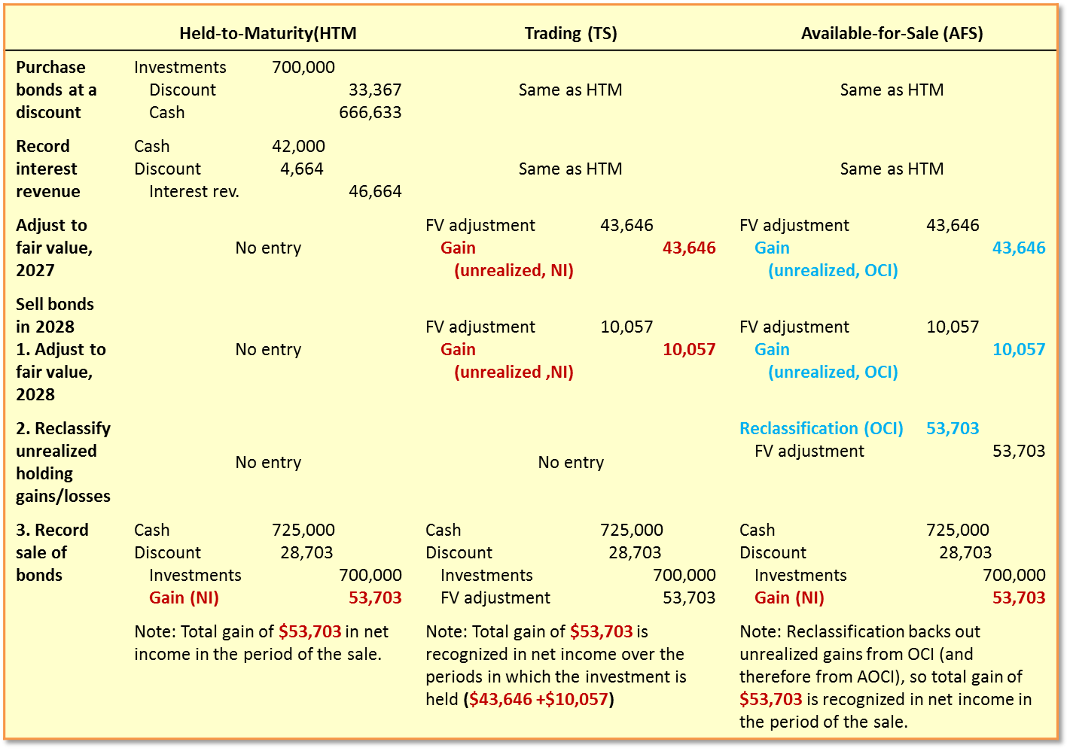
Comparison of H T M, T S, and A F S Approaches
L O12.4
Access the text alternative for slide images.
Notes:
Illustration 12–10 Comparison of HTM, TS, and AFS Approaches
This side-by-side comparison highlights several aspects of these accounting approaches:
To record the purchase of an investment and the receipt of interest revenue, we use identical entries in all three approaches.
To record changes in fair value, the entries we use for TS and AFS securities have the same effect on the investment (via the fair value adjustment valuation allowance) and the same eventual effect on total shareholders’ equity. What differs is whether the unrealized holding gain or loss is recognized in net income and then in retained earnings (TS) or recognized in OCI and then in AOCI (AFS). No fair value adjustment is reported for HTM securities.
Regardless of approach, the cash flows are the same, and the same total amount of gain or loss is recognized in the income statement (TS: $43,646 in 2027 + $10,057 in 2028 = $53,703 total; AFS and HTM: $53,703 in 2028). The question is not how much total net income is recognized, but when the amounts are recognized in net income.

Slide 37
Accounting for Debt Investments (I F R S)
L O12.9
U S G A A P I F R S No. 9 governs the treatment of debt and equity investments | I F R S I F R S No. 9 governs the treatment of debt and equity investments
Allows H T M and A F S classifications. | More restrictive classifications including amortized cost, fair value through other comprehensive income (F V O C I), or fair value through profit or loss (F V P L).
Allows specialized accounting for particular industries like securities brokers/dealers, investment companies, and insurance companies. | Does not allow specialized accounting.
Notes:
IFRS No. 9 governs the treatment of debt and equity investments. IFRS No. 9 eliminates the HTM and AFS classifications, replaced by new classifications that are more restrictive. Specifically, under IFRS No. 9, investments in debt securities are classified either as amortized cost (accounted for like HTM investments in U.S. GAAP), fair value through other comprehensive income (“FVOCI,” accounted for like AFS investments, except for different impairment recognition criteria), or fair value through profit or loss (“FVPL,” accounted for like trading securities). Classification depends on two criteria: (1) whether the investment’s contractual cash flows consist solely of payments of principal and interest (SPPI) and (2) whether the business purpose of the investment is to hold it for purposes of collecting contractual cash flows, sell the investment at a profit, or both. If the investment qualifies as SPPI and is held only to collect cash flows, it is classified as amortized cost. If it qualifies as SPPI and is held both to collect cash flows and potentially be sold, it is classified as FVOCI. Otherwise, it is classified as FVPL.
One other difference between U.S. GAAP and IFRS is worth noting. U.S. GAAP allows specialized accounting (beyond the scope of this textbook) for particular industries like securities brokers/dealers, investment companies, and insurance companies. IFRS does not.

Slide 38
Transfers between Reporting Categories
L O12.4
Transfer from: | To: | Unrealized Gain or Loss from Transfer at Fair Value
Either H T M or A F S | Trading | Include in current net income the total unrealized gain or loss, as if it all occurred in the current period.
Trading | Either HTM or A F S | Include in current net income any unrealized gain or loss that occurred in the current period prior to the transfer. (Unrealized gains and losses that occurred in prior periods already were included in net income in those periods.)
Held-to-maturity | Available-for-sale | No current income effect. Report total unrealized gain or loss as a separate component of shareholders’ equity (in A O C I).
Available-for-sale | Held-to-maturity | No current income effect. Record HTM investment FV. Don’t write off any existing unrealized holding gain or loss in A O C I, but instead amortize over the remaining life of the security the amount in AOCI and the offsetting premium or discount on the HTM investment.
Notes:
Illustration 12–11 Transfer between Investment Categories
At each reporting date, the appropriateness of the classification of a debt investment is reassessed. For instance, if the investor no longer has the ability to hold certain securities to maturity and will now hold them for resale, those securities would be reclassified from HTM to AFS. When a security is reclassified between two reporting categories, the security is transferred at its fair value on the date of transfer. Any unrealized holding gain or loss at reclassification should be accounted for in a manner consistent with the classification into which the security is being transferred. A summary is provided here.
Transfers between investment categories are quite unusual, so when they occur, disclosure notes should describe the circumstances that resulted in the transfers.

Slide 39
Transfers between Investment Categories (I F R S)
L O12.9
U S G A A P Transfers Between Investment Categories | I F R S Transfers Between Investment Categories
Allows transfers out of the trading security category, but reclassifications under this continue to be rarer events than that occurred under I F R S with this change. | Transfers of debt investments between the amortized cost, F V O C I, and F V P L categories occurs only if the company changes its business model with respect to the debt investment.
Notes:
Transfers Between Investment Categories. Under IFRS No. 9, transfers of debt investments between the amortized cost, FVOCI, and FVPL categories occurs if and only if the company changes its business model with respect to the debt investment.

Slide 40
Fair Value Option (F V O—H T M & A F S)
L O12.8
The election is optional but irrevocable on the date of investment purchase. Under F V O:
H T M and A F S investments are shown in the balance sheets at fair value.
Unrealized gains and losses are recognized in net income in the period in which they occur.
Purchases and sales of investments are likely to be classified as investing activities.
Notes:
GAAP allows a fair value option (FVO) that permits companies to account for most financial assets and liabilities at fair value. Under the FVO, HTM and AFS investments are shown in the balance sheet at their fair values, and unrealized gains and losses are recognized in net income in the period in which they occur. That accounting approach is the same approach we use to account for trading securities. However, unlike trading securities, purchases and sales of investments accounted for under the FVO are likely to be classified as investing activities in the statement of cash flows, because those investments are not held for sale in the near term and therefore are not operational in nature.
The company decides whether to elect the FVO on the date the company purchases the investment. The company can elect the FVO for some securities and not for identical others—it’s entirely up to the company, but the company has to explain in the notes why it made a partial election. The election is irrevocable.
As described in Appendix A of this book, companies sometimes enter into hedging arrangements that are intended to reduce earnings volatility by offsetting changes in the fair value of assets with changes in the fair value of liabilities. Complex rules apply to many hedging arrangements. The FVO simplifies this process by allowing companies to choose whether to use fair value for most types of financial assets and liabilities. That way, when a company enters into a hedging arrangement, it just has to make sure to elect the FVO for each asset and liability in the hedging arrangement, and fair value changes of those assets and liabilities will be included in earnings.

Slide 41
Fair Value Option (I F R S)
L O12.9
U S G A A P Fair Value Option | I F R S Fair Value Option
Less restrictive than I F R S. It indicates that the intent of the fair value option is to address specific circumstances, but it does not require that those circumstances exist. | More restrictive than U S standards for determining when firms are allowed to elect the fair value option. Under I F R S No. 9, companies can elect the fair value option only in specific circumstances.
Notes:
International accounting standards are more restrictive than U.S. standards for determining when firms are allowed to elect the FVO. Under and IFRS No. 9, companies can elect the FVO only in specific circumstances. For example, a firm could elect the FVO for an asset or liability in order to avoid the “accounting mismatch” that occurs when some parts of a fair value risk-hedging arrangement are accounted for at the fair value, and others are not. Although U.S. GAAP indicates that the intent of FVO is to address these sorts of circumstances, it does not require that those circumstances exist.

Slide 42
Financial Statement Presentation and Disclosure
L O12.8
Trading securities, held-to-maturity securities, and available-for-sale securities are either current or noncurrent depending on when they are expected to mature or to be sold.
Investors should disclose the following in the disclosure notes for each year presented:
Aggregate fair value.
Gross realized and unrealized holding gains.
Gross realized and unrealized holding losses.
Change in net unrealized holding gains and losses.
Amortized cost basis by major security type.
Notes:
Trading securities, held-to-maturity securities, and available-for-sale securities are either current or noncurrent depending on when they are expected to mature or to be sold. It’s not necessary that a company report individual amounts for the three categories of investments—held-to-maturity, available-for-sale, or trading—on the face of the balance sheet as long as that information is presented in the disclosure notes.
Investors should disclose the following in the disclosure notes for each year presented:
Aggregate fair value
Gross realized and unrealized holding gains
Gross realized and unrealized holding losses
Change in net unrealized holding gains and losses
Amortized cost basis by major security type
The notes also include disclosures designed to help financial statement users understand the quality of the inputs companies use when determining fair values and to identify parts of the financial statements that are affected by those fair value estimates. For example, the notes should include the level of the fair value hierarchy (levels 1, 2, or 3) in which all fair value measurements fall. For level 2 or 3 fair values, the notes to the financial statements must include a description of the valuation technique(s) and the inputs used in the fair value measurement process. For level 3 fair values, the notes must indicate the significant inputs used in the fair value measurement, the sensitivity of fair values to significant changes in those inputs, and information about the effect of fair value measurements on earnings, including a reconciliation of beginning and ending balances of the investment that identifies the following:
Total gains or losses for the period (realized and unrealized), unrealized gains and losses associated with assets and liabilities still held at the reporting date, and where those amounts are included in earnings or shareholders’ equity.
Purchases, sales, issuances, and settlements.
Transfers in and out of the level 3 category.

Slide 43
Fair Value Disclosures of Investment Securities H P Incorporated
L O12.8
Note 9: Fair Value (in part).
As of October 31, 2022
Fair Value Measured Using
(in millions) | Level 1 | Level 2 | Level 3 | Total
Assets:
Cash Equivalents
Corporate debt | $ ― | $ 904 | $ ― | $ 904
Government debt | 1,289 | ― | ― | 1,289
Available-for-Sale Investments
Financial institution instruments | ― | 5 | ― | 5
Marketable equity securities and mutual funds | 17 | 41 | ― | 58
Derivative instruments
Foreign currency contracts | ― | 1,088 | ― | 1,088
Other derivatives | ― | 2 | ― | 2
Total Assets | $1,306 | $2,040 | $ ― | $3,346
Notes:
Illustration 12-12 - Fair Value Disclosures of Investment Securities – HP Incorporated
All of this disclosure is designed to provide financial statement users with information about those fair values that are most vulnerable to bias or error in the estimation process. For example, as shown in Illustration 12–12, HP Inc.’s 2022 annual report includes the following discussion of fair values.
We can see from these disclosures that HP has no level 3 investments (which are those with the most subjectively estimated fair values). That fact should give financial statement users more faith in the reliability of HP’s fair value estimates.

Slide 44
Accounting for Equity Investments
L O12.5
Critical events over the life of an investment in the equity of another company.
Purchasing the equity security.
Receiving dividends (for some equity securities).
Holding the investment during periods in which the investment’s fair value changes.
Unrealized holding gains and losses.
Selling the Investment.
Realized gains and losses.
Notes:
The critical events over the life of an investment in the equity of another company, such as shares of common stock, include:
Purchasing the equity security
Receiving dividends (for some equity securities)
Holding the investment during periods in which the investment’s fair value changes (and thus incurring unrealized holding gains and losses, since the security has not yet been sold)
Selling the investment (and thus incurring realized gains and losses, since the security has been sold and the gains or losses actually incurred)
Also, equity investors typically get to vote on key decisions made by the company, such as who will serve on the company’s board of directors. Each share of common stock gets a vote, so if an equity investor owns enough shares, the investor has enough votes to influence the operations of the company whose shares it owns. Therefore, accounting for equity investments also considers the extent to which the investor can influence the activities of the investee.

Slide 45
Reporting Categories for Equity Investments
L O12.5
Characteristics of the Equity Investment | Reporting Method Used by the Investor
The investor does not have significant influence over the operating and financial policies of the investee (typically owns less than 20% of voting stock). | Fair value through net income—similar to the trading-securities approach used for debt; investment reported at fair value (with unrealized holding gains and losses included in net income), unless fair value is not readily determinable.*
The investor has significant influence over the operating and financial policies of the investee (typically owns between 20% and 50% of the voting stock). | Equity method—investment reported at cost adjusted for investor’s share of subsequent earnings and dividends of the investee.**
The investor controls the investee (typically owns more than 50% of voting stock). | Consolidation—the financial statements of the investor and investee are combined as if they are a single company.
*Later in this chapter we discuss in an Additional Consideration box the alternative approach that is used if fair value is not readily determinable.
**If the investor elects the fair value option, this type of investment also can be accounted for using the fair-value-through-net-income approach.
Notes:
Illustration 12–13 Reporting Categories for Equity Investments
As shown above, we use three different approaches to account for equity investments.
We’ll first discuss the fair value through net income approach that is used when the investor lacks significant influence over the investee. Then we’ll cover the equity method that’s used when the investor does have significant influence. We won’t cover consolidation accounting, which is used when the investor controls the investee, as that topic is beyond the scope of what we cover. However, we will discuss consolidations briefly when we discuss the equity method, as the two approaches are related.

Slide 46
When the Investor Does Not Have Significant Influence 1
L O12.5
Less than 20% of voting shares:
Lacks significant influence over the investee.
The following events during 2027 and 2028 pertain to United Intergroup’s investment in the common stock of Arjent, Inc.:
July 1, 2027 | Purchase Arjent, Inc., common stock for $1,500,000
December 31, 2027 | Recognize investment revenue for a $75,000 cash dividend received from Arjent
December 31, 2027 | Record a fair value adjustment to recognize a decline in the value of the Arjent stock investment to $1,450,000
January 5, 2028 | Sell the Arjent stock for $1,446,000
Notes:
Illustration 12–14 Example of an Equity Investment Accounted for as Fair Value Through Net Income
If an investor owns less than 20% of the voting shares of an investee, the investor is typically presumed to not have significant influence over the investee. In other words, the investor is in the same position you would be in if you bought a share of the company’s stock—the investor hopes to receive dividends and that the value of the shares appreciate over time, but can’t really tell the company what to do.
When investors lack significant influence over the investee, equity investments are accounted for like trading securities, using an approach commonly referred to as fair value through net income. The equity investments are carried at fair value in the balance sheet, with unrealized holding gains and losses recognized in net income in whatever period they occur. Presented here is a simple example of an equity investment that we’ll use throughout this section. Let’s go through the key events in the life of United’s Arjent investment to see how the fair value through net income approach works for an equity investment.

Slide 47
When the Investor Does Not Have Significant Influence 2
L O12.5
Purchase Investments:
Journal Entry – July 1, 2027 | Debit | Credit
Investment in equity securities | 1,500,000
Cash |  | 1,500,000
Recognize Investment Revenue:
Journal Entry – Dec. 31, 2027 | Debit | Credit
Cash | 75,000
Dividend revenue |  | 75,000
Notes:
The journal entry to record the purchase of an equity investment is simple, just exchanging one asset (cash) for another (investment).
The journal entry to record the receipt of dividends related to the Arjent equity investment also is straightforward.

Slide 48
Adjust Equity Investments to Fair Value (2027)
L O12.5
Adjust investments to fair value:
Valued the Arjent stock at $1,450,000.
December 31, 2027
Security | Cost | Fair Value | Necessary Fair Value Adjustment
Arjent | $1,500,000 | $1,450,000 | $(50,000)
Fair Value Adjustment
Beginning balance on 7/1/2027 | 0
Adjustment needed to update fair value |  | ? 50,000
Balance needed December 31, 2027 |  | 50,000
Journal Entry – Dec. 31, 2027 | Debit | Credit
Loss on investments (unrealized, NI) | 50,000
Fair value adjustment |  | 50,000
Notes:
The carrying value of equity investments must be adjusted to fair value at the end of every reporting period. As with trading securities, we use a valuation allowance, fair value adjustment, to increase or decrease the carrying value of the investment, and we simultaneously record an unrealized holding gain or loss that is included in net income in the period in which fair value changes.
United needs to move the fair value adjustment from a balance of $0 (at purchase date) to a credit balance of $50,000.
The journal entry to record United’s unrealized holding loss of $50,000 and the corresponding decrease in United’s fair value adjustment account is shown in the slide. We indicate “unrealized, NI” to highlight that, for equity investments accounted for as fair value through net income, unrealized holding gains and losses are included in net income in the period in which they occur.
If Arjent’s investment instead had a fair value of, say, $1,550,000 as of December 31, 2027, United would have an unrealized holding gain of $50,000, which would require a debit to the fair value adjustment account to increase the carrying value of the equity to fair value.

Slide 49
Sell the Equity Investment
L O12.5
Step 1. Adjust securities to fair value (2028):
January 5, 2028
Security | Cost | Fair Value | Necessary Fair Value Adjustment
Arjent | $1,500,000 | $1,446,000 | $(54,000)
Fair Value Adjustment
Beginning balance 1/1/2028 | 0 | 50,000
Adjustment needed to update fair value |  | 4,000
Balance needed as of date of sale |  | 54,000
Journal Entry – Jan. 5, 2028 | Debit | Credit
Loss on investments (unrealized, NI) | 4,000
Fair value adjustment |  | 4,000
Step 2. Record the sale:
Journal Entry – Jan. 5, 2028 | Debit | Credit
Cash | 1,446,000
Fair value adjustment | 54,000
Investment in equity securities |  | 1,500,000
Notes:
Now assume United sells the Arjent stock for $1,446,000 on January 5, 2028. According to the FASB, “because all changes in an equity security’s fair value are reported in earnings as they occur, the sale of an equity security does not necessarily give rise to a gain or loss. Generally, a debit to cash . . . is recorded for the sales proceeds, and a credit is recorded to remove the security at its fair value (or sales price).” Thus, as with trading securities, United will make two journal entries. United first records in net income any unrealized holding gains and losses that occurred during 2028 prior to the date of sale. Then, on the date of sale, United records the receipt of cash and removes the amounts associated with the investment from the relevant balance sheet accounts.
In Step 1 Adjust Securities to Fair Value, we first need to update the fair value adjustment and recognize any unrealized holding gains or losses that have occurred during the current reporting period prior to the date of sale. United needs to move the fair value adjustment from the credit balance of $50,000 existing at the end of 2027 to a credit balance of $54,000 as of January 5, 2028, which requires a credit of $4,000 to the fair value adjustment account.
In Step 2 Record the Sale, the investment is carried at its fair value as of the date it is being sold, and all gains and losses associated with the investment have been included in net income over the time the investment was held. All that remains is for United to record receipt of cash and remove the investment-related accounts from the balance sheet. Because United carries the investment at fair value as of the date of sale, and already included in net income the entire loss associated with the investment, there is no additional gain or loss to recognize on the date of sale.

Slide 50
Adjust Remaining Equity Investments to Fair Value (2028)
L O12.5
December 31, 2028
Security | Cost | Fair Value | Necessary Fair Value Adjustment
Arjent | $1,500,000 | $1,300,000 | $(200,000)
Fair Value Adjustment
12/31/2027 balance |  | 50,000
Adjustment needed to update fair value |  | 150,000
12/31/2028 balance |  | 200,000
Journal Entry – Dec. 31, 2028 | Debit | Credit
Loss on investments (unrealized, NI) | 150,000
Fair value adjustment |  | 150,000
Notes:
If United hadn’t sold the Arjent investment during 2028, it would just keep recording whatever fair value adjustment would be necessary to carry the investment at fair value in the balance sheet. For example, if the Arjent investment had a fair value of $1,300,000 at December 31, 2028, United would need to credit the fair value adjustment account by another $150,000 to account for the large drop in fair value that occurred during 2028.

Slide 51
Accounting for Equity Investments When the Investor Does Not Have Significant Influence (I F R S)
L O12.9
Under I F R S No. 9, investments in equity securities are classified as either F V P L (fair value through profit or loss) or F V O C I (fair value through other comprehensive income). If the equity is held for trading, it must be classified as F V P L, but otherwise the company can irrevocably elect to classify it as F V O C I. F V O C I is similar to the A F S treatment used for debt investments in U S G A A P, and dividend income is included in net income for F V O C I just as interest income is included for A F S. However, unlike A F S, realized gains and losses are not reclassified out of O C I and into net income when the investment is later sold. Rather, the accumulated unrealized gain or loss associated with a sold investment is just transferred from A O C I to retained earnings (both shareholders’ equity accounts), without passing through the income statement.
Notes:
Accounting for Equity Investments When the Investor Does Not Have Significant Influence. IFRS No. 9 governs treatment of debt and equity investments. Under IFRS No. 9, investments in equity securities are classified as either FVPL (fair value through profit or loss) or FVOCI (fair value through other comprehensive income). If the equity is held for trading, it must be classified as FVPL, but otherwise the company can irrevocably elect to classify it as FVOCI. FVOCI is similar to the AFS treatment used for debt investments in U.S. GAAP, and dividend income is included in net income for FVOCI just as interest income is included for AFS. However, unlike AFS, realized gains and losses are not reclassified out of OCI and into net income when the investment is later sold. Rather, the accumulated unrealized gain or loss associated with a sold investment is just transferred from AOCI to retained earnings (both shareholders’ equity accounts), without passing through the income statement.

Slide 52
Financial Statement Presentation—Equity Securities
L O12.5
Balance sheet:
Short term: Current assets.
Long term: Noncurrent assets.
Cash flow statement:
Short term: Operating activities.
Long term: Investing activities.
Notes to financial statement:
Disclose the portion of unrealized gains and losses for the period.
How carrying value was calculated when fair value is not readily determinable.
Notes:
Equity investments for which the investor does not have significant influence are classified as either current (short-term) or noncurrent (long-term) in the balance sheet. Those that are held with an intent for short-term profit are normally treated as operating activities in the statement of cash flows, similar to debt investments that are classified as trading securities. Other current equity investments, and long-term equity investments, are classified as investing activities in the statement of cash flows. Notes to the financial statements should disclose the portion of unrealized holding gains and losses for the period that relate to any equity securities still held by the company at the end of the reporting period. Notes also should provide information about how the carrying value was calculated for equity investments for which fair value is not readily determinable.

Slide 53
When the Investor Has Significant Influence—The Equity Method
L O12.6
Control exists when a company acquires more than 50% of the voting stock of another company.
The parent company reports consolidated financial statements.
Significant influence usually is assumed to exist if the investor owns between 20% and 50% of the investee’s voting shares.
What does significant influence mean?
Decisions can be swayed in the direction the investor desires.
Investment is accounted for by the equity method.
Investment is initially recorded at cost.
Investment balance is adjusted for net income/loss, dividends, and potentially other items.
Notes:
If a company acquires more than 50% of the voting stock of another company, it’s said to have control, because by voting those shares, the investor actually can control the company acquired. The investor is called the parent; the investee is called the subsidiary. Both companies continue to operate as separate legal entities, and the subsidiary reports separate financial statements. However, because of the controlling interest, the parent company reports consolidated financial statements which treat the parent and the subsidiary as if there were only one company. This entails an item-by-item combination of the parent and subsidiary statements (after first eliminating any amounts that are shared by the separate financial statements).
Even if control is absent, the investor still may be able to exercise significant influence over the operating and financial policies of the investee. This would be the case if the investor owns a large percentage of the outstanding shares relative to other shareholders. By voting those shares as a block, decisions often can be swayed in the direction the investor desires. It is presumed, in the absence of evidence to the contrary, that the investor exercises significant influence over the investee when it owns at least 20% of the investee’s voting shares.
When significant influence exists but the investor does not have effective control, the investment should be accounted for by the equity method. Under the equity method, the investment is initially recorded at cost. After that, the investment balance is:
Increased by the investor’s percentage share of the investee’s net income (or decreased by its share of a loss)
Decreased by the investor’s percentage share of the investee’s dividends paid
Potentially adjusted for other items
This approach presumes that the fortunes of the investor and investee are so intertwined that, as the investee prospers, the investor prospers proportionately. Stated differently, as the investee earns additional net assets (income), the investor’s share of those net assets increases. When the investee pays out assets (dividends), the investor’s share of the remaining net assets decreases.

Slide 54
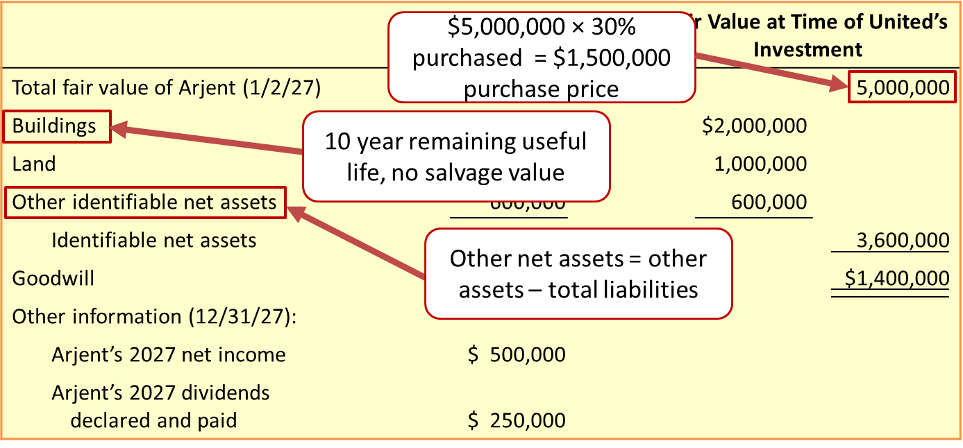
Equity Method—Purchase of Investment 1
L O12.6
On 1/2/27 United Intergroup purchased 30% of Arjent, Inc.’s, common stock for $1,500,000 cash.
Access the text alternative for slide images.
Notes:
Illustration 12–15 Information for Arjent, Inc., at the Time United Intergroup Purchased 30% for $1,500,000
To see how the equity method works, let’s turn to the illustration shown. In this illustration, we assume that United Intergroup purchased 30% of Arjent, Inc.’s, common stock for $1,500,000 cash on January 2, 2027.
As shown above, buying 30% of Arjent for $1,500,000 implies that the full (100%) fair value of Arjent is $5,000,000 (because $5,000,000 × 30% purchased = $1,500,000 purchase price). However, notice that the book value of Arjent’s identifiable net assets is only $2,100,000. What accounts for the difference of $2,900,000? Part of the difference represents identifiable assets (in this case, buildings and land) that have fair values greater than their book values. Arjent recorded those assets at historical cost and recognized depreciation of the buildings over time, so the book values of those assets don’t reflect their fair values. The remaining difference is previously unrecognized goodwill (e.g., because of loyal customers, well-trained workers, etc.) that GAAP doesn’t capture as separate identifiable assets but nevertheless represents value for which United was willing to pay. Under the equity method, all of these amounts are shown in a single investment account, but we still need to track their individual information to account for them correctly.

Slide 55
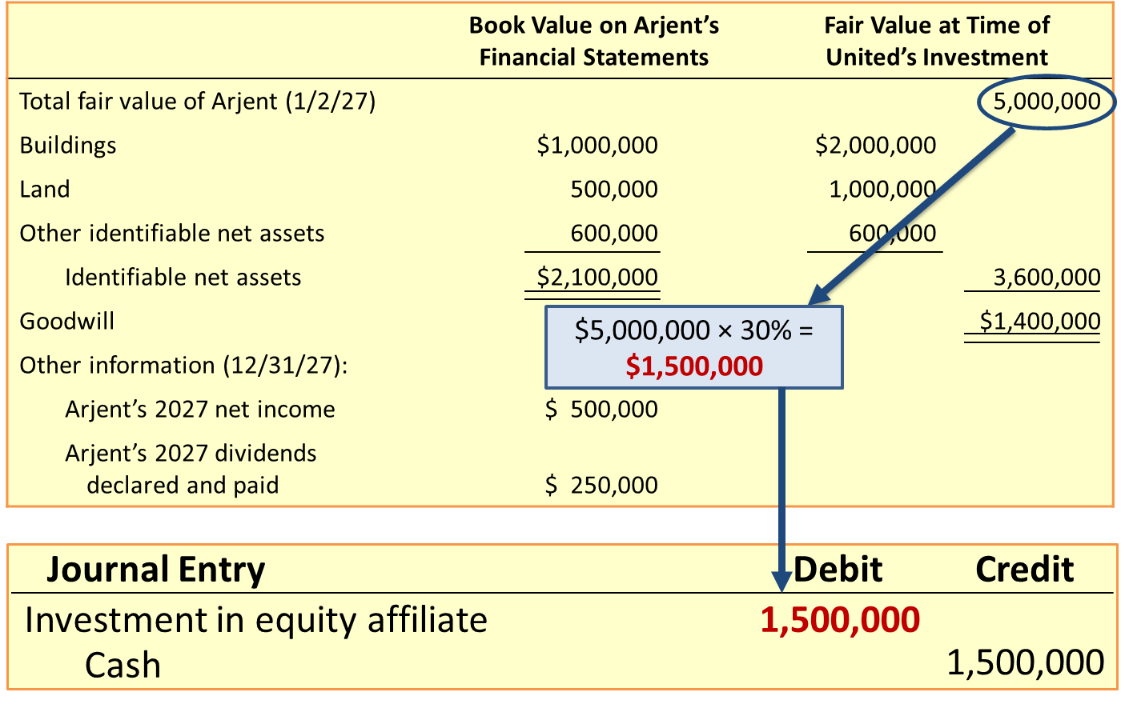
Equity Method—Purchase of Investment 2
L O12.6
Access the text alternative for slide images.
Notes:
Illustration 12–15 Information for Arjent, Inc., at the Time United Intergroup Purchased 30% for $1,500,000 (continued)
Recording United’s purchase of 30% of Arjent is straightforward. The investment is recorded at cost as shown here.

Slide 56
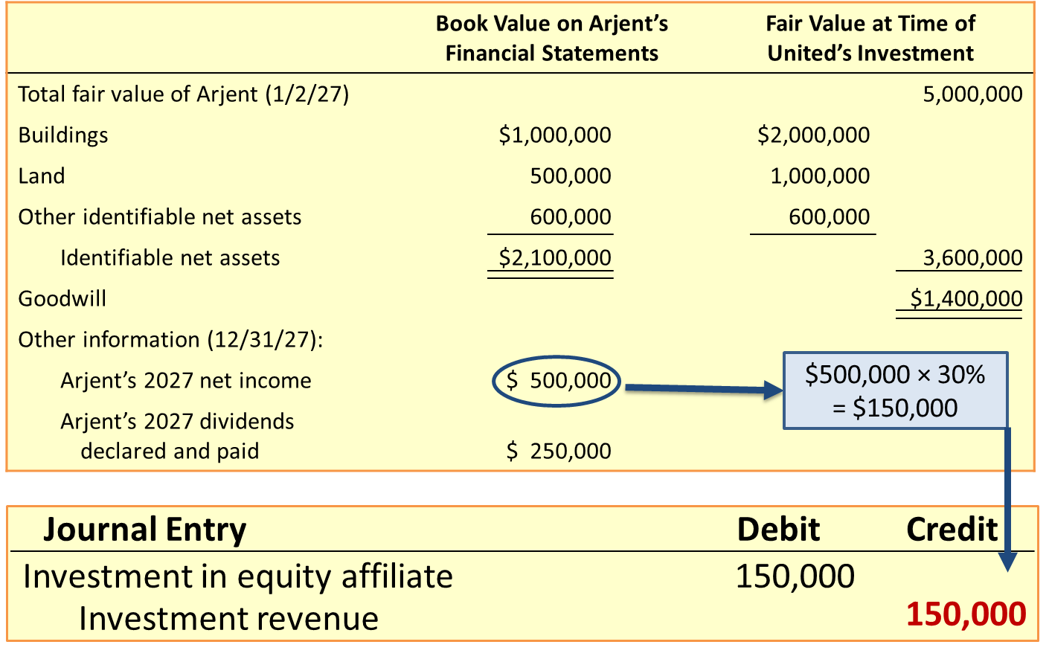
Equity Method—Recording Investment Revenue
L O12.6
Access the text alternative for slide images.
Notes:
Illustration 12–15 Information for Arjent, Inc., at the Time United Intergroup Purchased 30% for $1,500,000 (continued)
Under the equity method, the investor includes in net income its proportionate share of the investee’s net income. The reasoning is that, as the investee’s net assets increase, the value of the investor’s share of those net assets also increases, so the investor increases its investment by the amount of income recognized. United’s entry would be as shown above.
Of course, if Arjent had recorded a net loss rather than net income, United would reduce its investment in Arjent and recognize a loss on investment for its share of the loss. You won’t always see these amounts called “investment revenue” or “investment loss.” Rather, United might call this line “equity in earnings (losses) of affiliate” or some other title that suggests it is using the equity method.

Slide 57
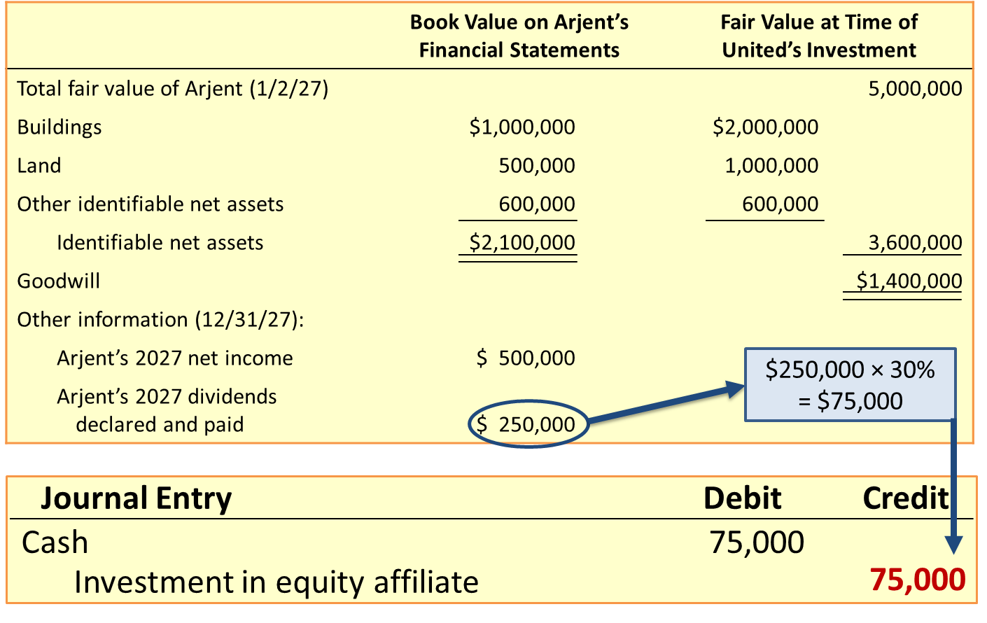
Equity Method—Receiving Dividends
L O12.6
Access the text alternative for slide images.
Notes:
Illustration 12–15 Information f or Arjent, Inc., at the Time United Intergroup Purchased 30% for $1,500,000 (concluded)
Because we recognize investment revenue when net income is recognized by the investee, it would be inappropriate to recognize revenue again when that income is distributed as dividends. That would be double counting. Instead, we view the dividend distribution as reducing the investee’s net assets. The rationale is that the investee is returning assets to its investors in the form of a cash payment, so each investor’s equity interest in the remaining net assets declines proportionately.

Slide 58
Further Adjustments under the Equity Method
L O12.7
Occur when investor’s expenditure to acquire an equity-method investment exceeds the book value of the underlying net assets acquired.
Purpose:
To approximate the effects of consolidation, without actually consolidating financial statements.
Amortizing the differential between purchase price and book value:
Adjust investment account and investment revenue to act as if consolidation procedures had been followed.
If assets would have been written up to fair value, act as if that happened.
Impute higher expenses in subsequent periods when those assets are expensed, such that,
Earnings are lower by the investor’s share in that additional expense.
Notes:
When the investor’s expenditure to acquire an equity-method investment exceeds the book value of the underlying net assets acquired, additional adjustments to both the investment account and investment revenue might be needed. The purpose is to approximate the effects of consolidation without actually consolidating financial statements. More specifically, both the investment account and investment revenue are adjusted for differences between net income reported by the investee and what that amount would have been if consolidation procedures had been followed. This process is often referred to as “amortizing the differential,” because it mimics the process of expensing some of the difference between the price paid for the investment and the book value of the investment.
Consolidated financial statements report (a) the acquired company’s assets at their fair values on the date of acquisition rather than their book values on the investee’s balance sheet and (b) goodwill for the excess of the acquisition price over the fair value of the identifiable net assets acquired. This matters because increasing asset balances to their fair values can result in higher expenses in the future. If it’s land or goodwill that’s increased, there is no income effect because we don’t depreciate or amortize those assets over time. On the other hand, if buildings, equipment, or other depreciable assets are recorded at higher values, depreciation expense will be higher during their remaining useful lives. Likewise, if the recorded amount of inventory is increased, cost of goods sold will be higher when the inventory is sold. When expenses rise, income falls. It is this negative effect on income that the equity method seeks to imitate.

Slide 59
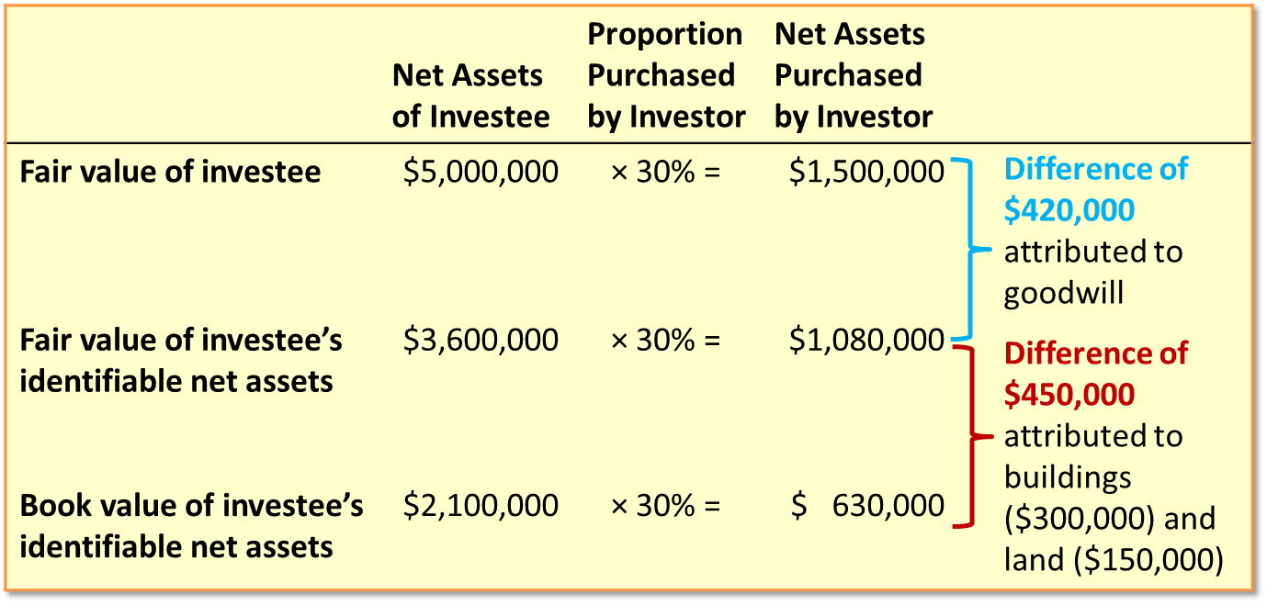
Source of Differences between the Investment and the Book Value of Net Assets Acquired
L O12.7
Access the text alternative for slide images.
Notes:
Illustration 12–16 Explanation for Differences Between the Investment and the Book Value of Net Assets Acquired
In our example, United needs to make adjustments for the fact that, at the time it purchased its investment in Arjent, the fair values of Arjent’s identifiable assets and liabilities were higher than the book values of those assets and liabilities in Arjent’s balance sheet. The illustration shows United’s 30% proportionate share of the amounts shown previously.
Notice in the illustration shown here, that United paid $1,500,000 for 30% of the identifiable net assets that, sold separately, would have a fair value of $1,080,000. The $420,000 difference between the price paid and the fair value of United’s share of Arjent’s identifiable net assets is attributable to goodwill. The 30% of identifiable net assets with a fair value of $1,080,000 have a book value on Arjent’s balance sheet of only $630,000. The $450,000 difference is attributable to undervalued buildings ($300,000) and land ($150,000). Now let’s consider what adjustments, if any, United needs to make for these differences.

Slide 60
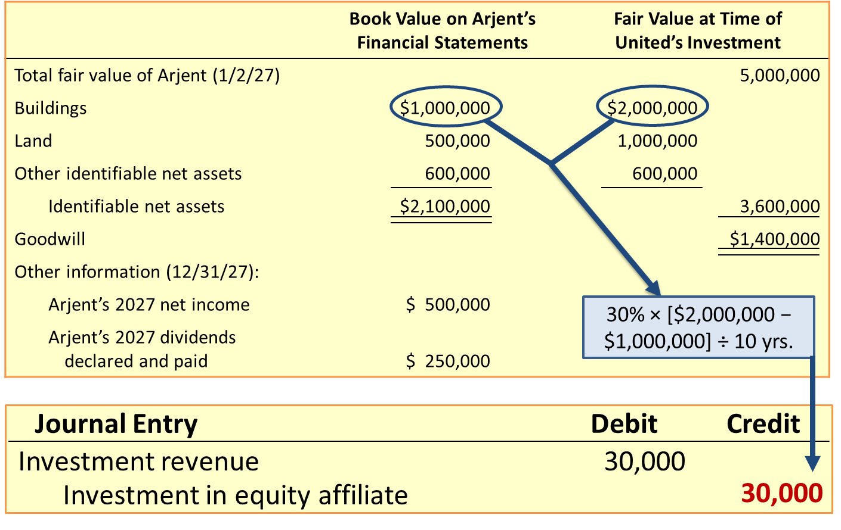
Equity Method—Adjustments for Additional Depreciation
L O12.7
Access the text alternative for slide images.
Notes:
When Arjent determines its net income, it bases depreciation expense on the book value of its buildings on its own balance sheet. United, however, needs to depreciate its share of the fair value of those buildings at the time it made its investment. To account for this higher amount of depreciation expense, United reduces investment revenue as if Arjent had included the additional expense in its earnings.
As shown in an earlier illustration, the book value of Arjent’s buildings is $1,000,000 and the fair value is $2,000,000, which creates a difference of $1,000,000. United will need to recognize its 30% share of additional depreciation expense for this difference, totaling $300,000 over the remaining life of the buildings. Assuming a 10-year life of the buildings and straight-line depreciation, that implies $30,000 of additional depreciation each year for ten years. Had Arjent recorded that additional depreciation in its income statement, United’s portion of Arjent’s net income would have been lower by $30,000 (ignoring taxes). So, to act as if Arjent had recorded the additional depreciation, United reduces investment revenue and reduces its investment in Arjent stock by $30,000.

Slide 61
No Adjustments for Land or Goodwill
L O12.7
Land:
Land is not depreciated.
Difference between the fair value and book value of the land would not cause higher expenses.
Goodwill:
Unlike most of the other intangible assets, goodwill is not amortized.
No need to adjust for goodwill.
Notes:
United makes no adjustments for land or goodwill.
Land is not an asset we depreciate, so the difference between the fair value and book value of the land would not cause higher expenses, and we have no need to adjust investment revenue or the investment in Arjent stock for the land.
Goodwill, unlike most other intangible assets, is not amortized. In that sense, goodwill resembles land, so we have no need to adjust investment revenue or the investment in Arjent stock for goodwill.

Slide 62
Adjustments for Other Assets and Liabilities
L O12.7
If the fair value of purchased inventory exceeds its book value, the period in which that inventory is sold should be identified.
Investment revenue and the investment in the stock is reduced by share of the difference between the fair value and book value.
Notes:
In our example there is no difference between the book value and fair value of the remaining net assets, so we don’t need an adjustment for them either. However, that often will not be the case. For example, Arjent’s inventory could have had a fair value that exceeded its book value at the time United purchased its Arjent investment. To recognize expense associated with that higher fair value, United would need to identify the period in which that inventory is sold (usually the next year) and, in that period, reduce its investment revenue and its investment in Arjent stock by its 30% share of the difference between the fair value and book value of the inventory. If, for instance, the $1,000,000 difference between fair value and book value had been attributable to inventory rather than buildings, and that inventory was sold by Arjent in the year following United’s investment, United would reduce investment revenue by its 30% share of the difference ($300,000) in the year following the investment. More generally, an equity method investor needs to make these sorts of adjustments whenever there are revenues or expenses associated with an asset or liability that had a difference between book value and fair value at the time the investment was made.

Slide 63
Reporting the Investment
L O12.7
The fair value of the investment shares at the end of the reporting period is not reported when using the equity method. The investment account is reported at its original cost, increased by the investor’s share of the investee’s net income, and decreased by the portion of those earnings actually received as dividends.
The balance of United’s 30% investment in Arjent at December 31, 2027, is calculated as:
Investment in Equity Affiliate
Purchase price | 1,500,000
Share of income | 150,000
 |  | 75,000 | Dividends
 |  | 30,000 | Depreciation adjustment
 | 1,545,000
Notes:
The fair value of the investment shares at the end of the reporting period is not reported when using the equity method. The investment account is reported at its original cost, increased by the investor’s share of the investee’s net income (adjusted for additional expenses like depreciation), and decreased by the portion of those earnings actually received as dividends.
The balance of United’s 30% investment in Arjent at December 31, 2027, would be calculated as shown above.
In the statement of cash flows, we report the purchase and sale of the investment as outflows and inflows of cash in the investing activities section, and the receipt of dividends is reported as an inflow of cash in the operating activities section.

Slide 64
Investment Acquired Mid-Year
L O12.7
Only recognize the investor’s share of the year’s activity.
Example: If United purchased 30% of Arjent on October 1:
Investment in Equity Affiliate
Notes:
Obviously, we’ve simplified the illustration by assuming the investment was acquired at the beginning of 2027, entailing a full year’s income, dividends, and adjustments to account for the income effects of any differences between book value and fair value on the date the investment was acquired. In the more likely event that an investment is acquired sometime after the beginning of the year, applying the equity method is easily modified to include the appropriate fraction of each of those amounts. For example, if United’s purchase of 30% of Arjent had occurred on October 1 rather than January 2, we would simply record income, dividends, and adjustments for three months (3⁄12) of the year. This would result in the shown entries to the investment account.

Slide 65
Equity Method Investments in the Balance Sheet—A T&T
L O12.7
(in millions) | Dec. 31, 2022 | Dec. 31, 2021
Total Current Assets | $ 33,108 | $ 170,768
Property, Plant, and Equipment-Net | 127,445 | 121,649
Goodwill-Net | 67,895 | 92,740
Licenses-Net | 124,092 | 113,830
Other Intangible Assets-Net | 5,354 | 5,391
Investments in and Advances to Equity Affiliates | 3,533 | 6,168
Operating Lease Right-of-Use Assets | 21,814 | 21,824
Other Assets | 19,612 | 19,252
Total Assets | $402,853 | $ 551,622
Source: A T&T 2022 10-K
Notes:
Illustration 12–17 Equity Method Investments in the Balance Sheet—AT&T
AT&T reported its 2022 investments in affiliated companies for which it exercised significant influence using the equity method as shown.

Slide 66
Impairment of Equity Method Investments
L O12.7
A series of losses or other factors could indicate that an equity-method investment’s fair value has declined to an amount below its current carrying value.
If that decline is viewed as other than temporary, the investor should:
Recognize an impairment loss in net income and reduce the carrying value of the investment to fair value in the balance sheet.
Continues with accounting under the equity method.
Notes:
A series of losses or other factors could indicate that an equity-method investment’s fair value has declined to an amount below its current carrying value. If that decline is viewed as other than temporary, the investor should recognize an impairment loss in net income and reduce the carrying value of the investment to fair value in the balance sheet. The investor then continues with accounting under the equity method.

Slide 67
What If Conditions Change?
L O12.7
A change from the equity method to fair value through net income:
No adjustment is made to the remaining carrying amount of the investment.
Equity method is discontinued and the investment is accounted for as fair value through net income from then on.
The balance in the investment account serves as the starting point for the new method.
A change from fair value through net income to the equity method:
Securities are marked to fair value and any unrealized holding gains or losses are recorded on the income statement.
Any cost of additional shares is added to the balance and that balance is adjusted going forward.
A disclosure note should describe the change.
Notes:
When the investor’s level of influence changes, it may be necessary to change from the equity method to accounting for the investment as fair value through net income. When this situation happens, no adjustment is made to the remaining carrying amount of the investment. Instead, the equity method is simply discontinued and the investment is accounted for as fair value through net income from then on. The balance in the investment account when the equity method is discontinued would serve as the new cost basis for writing the investment up or down to fair value in the next set of financial statements.
Sometimes companies change from fair value through net income to the equity method. When a change to the equity method is appropriate, the securities are marked to fair value on the date of the change and any unrealized holding gains or losses are recorded on the income statement. That way, the fair value of the securities—as if they had just been acquired—becomes the starting balance in the equity method investment account. Any cost of acquiring additional shares is added to that balance, and going forward that balance is adjusted for the investor’s portion of investee earnings and dividends. A disclosure note also should describe the change.

Slide 68
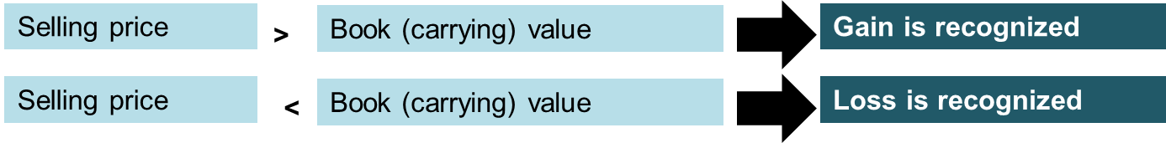
If an Equity Method Investment is Sold
L O12.7
When an investment reported by the equity method is sold:
Example:
The balance of United’s 30% investment in Arjent at December 31, 2027, is $1,545,000. United sells its investment in Arjent on January 1, 2028, for $1,446,000.
Journal Entry – Jan. 1, 2028 | Debit | Credit
Cash | 1,446,000
Loss on investments (NI) | 99,000
Investment in equity affiliate |  | 1,545,000
Access the text alternative for slide images.
Notes:
When an investment reported by the equity method is sold, we recognize a gain or loss if the selling price is more or less than the carrying amount of the investment. For example, let’s continue our illustration and assume United sells its investment in Arjent on January 1, 2028, for $1,446,000. A journal entry would record a loss as shown above.

Slide 69
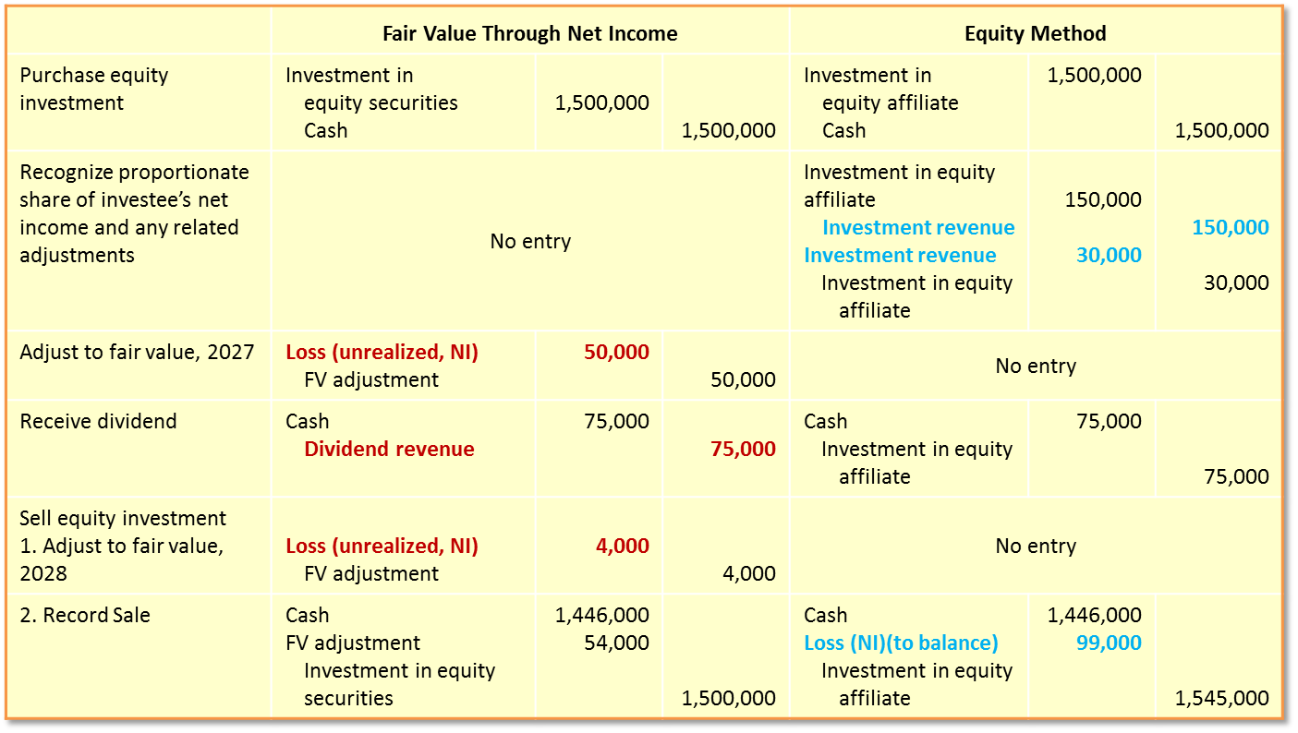
Comparison of Fair Value and the Equity Methods
L O12.7
Access the text alternative for slide images.
Notes:
Illustration 12–18 Comparison of Fair Value and Equity Methods
This side-by-side comparison highlights several aspects of these accounting approaches:
To record the purchase of an investment, we use the same basic entry for both approaches.
The two approaches differ in whether we record investment revenue when dividends are received and whether we recognize unrealized holding gains and losses associated with changes in the fair value of the investment.
The differences in how the two approaches account for unrealized holding gains and losses result in different carrying values for the investment at the time the investment is sold, and therefore result in different realized gains or losses when the investment is sold.
Regardless of approach, the same cash flows occur, and the same total amount of net income is recognized over the life of the investment. In the case of Arjent,
Fair value through net income: A total of $21,000 of net income is recognized over the life of the investment, equal to $75,000 of dividend revenue minus $54,000 ($50,000 + $4,000) loss on the investment.
Equity method: A total of $21,000 of net income is recognized over the life of the investment, equal to $150,000 of United’s portion of Arjent’s net income minus $30,000 depreciation adjustment and minus $99,000 loss realized on sale of investment.
Thus, the question is not how much total net income is recognized, but when that net income is recognized.

Slide 70
Fair Value Option: Equity Method
L O12.8
Irrevocable decision about whether to elect the fair value option or not is made by the company and can make that election for some investments and not for others.
Company carries the investment at fair value in the balance sheet and unrealized gains and losses are included in earnings.
Investments are shown on their own line in the balance sheet or are combined with equity method investments with the amount at fair value shown parenthetically.
Alternatives for bookkeeping:
Investment is accounted for using the entries that would be used if the investor lacked significant influence and accounted for it at fair value through net income.
Record all the accounting entries during the period under the equity method, and then record a fair value adjustment at the end of the period.
Notes:
Companies can choose the fair value option (FVO) for “significant influence” investments that otherwise would be accounted for under the equity method. The company makes an irrevocable decision about whether to elect the FVO and can make that election for some investments and not for others. As shown in Illustration 12–18, the company carries the investment at fair value in the balance sheet and includes unrealized gains and losses in net income. These investments are shown on their own line in the balance sheet or are combined with equity method investments with the amount at fair value shown parenthetically. Also, all of the disclosures that are required when reporting fair values as well as some of those that would be required under the equity method still must be provided.
Exactly how a company does the bookkeeping necessary to comply with these broad requirements is up to the company. One alternative is to account for the investment using the entries that would be used if the investor lacked significant influence and accounted for it at fair value through net income. A second alternative is to record all of the accounting entries during the period under the equity method, and then record a fair value adjustment at the end of the period.

Slide 71
Fair Value Option—Equity Method I F R S
L O12.9
U S. G A A P Equity Method | I F R S Equity Method
This is not a requirement. Provides fair value option for all investments that qualify for the equity method. | Under I A S No. 28, requires investees to adjust to correspond to the accounting policies of the investor when applying the equity method. I F R S does not provide the fair value option for most investments that qualify for the equity method.
Notes:
Equity Method. Like U.S. GAAP, international accounting standards require the equity method for use with significant influence investees (which they call “associates”) but there are a few important differences. First, IAS No. 28 governs application of the equity method and requires that the accounting policies of investees be adjusted to correspond to those of the investor when applying the equity method. U.S. GAAP has no such requirement.
Second, IFRS does not provide the fair value option for most investments that qualify for the equity method. U.S. GAAP provides the fair value option for all investments that qualify for the equity method.

Slide 72
Financial Instruments and Investment Derivatives
L O12.8
A financial instrument is defined as one of the following:
Cash.
Evidence of an ownership interest in an entity.
A contract that (a) imposes on one entity an obligation to deliver cash (say accounts payable) or another financial instrument and (b) conveys to the second entity a right to receive cash (say accounts receivable) or another financial instrument.
A contract that (a) imposes on one entity an obligation to exchange financial instruments on potentially unfavorable terms (say the issuer of a stock option) and (b) conveys to a second entity a right to exchange other financial instruments on potentially favorable terms (say the holder of a stock option).
Derivatives are financial instruments that “derive” their values from some other security or index.
Notes:
A financial instrument is defined as one of the following:
Cash.
Evidence of an ownership interest in an entity.
A contract that (a) imposes on one entity an obligation to deliver cash (say accounts payable) or another financial instrument and (b) conveys to the second entity a right to receive cash (say accounts receivable) or another financial instrument.
A contract that (a) imposes on one entity an obligation to exchange financial instruments on potentially unfavorable terms (say the issuer of a stock option) and (b) conveys to a second entity a right to exchange other financial instruments on potentially favorable terms (say the holder of a stock option).
Derivatives are financial instruments that “derive” their values from some other security or index. These financial instruments have been created to hedge against risks created by other financial instruments or by transactions that have yet to occur but are anticipated. Financial futures, interest rate swaps, forward contracts, and options are all examples of derivatives. Their rapid acceptance as indispensable components of the corporate capital structure has left the accounting profession scrambling to keep pace.

Slide 73
Other Investments
Appendix 12A
Special purpose funds:
Amount set aside by companies to be used for specific purposes.
A special purpose fund can be established for virtually any purpose.
Some special purpose funds—like petty cash— are current assets.
Special purpose funds that serve longer-term needs are reported as noncurrent assets.
Noncurrent special purpose funds are reported within the category investments and funds.
Investments in life insurance policies:
Objective:
To compensate the company for the untimely loss of a valuable resource in the event the officer dies.
When the insured is still alive, life insurance policy can be surrendered in exchange for a determinable amount of money (called the cash surrender value).
Notes:
Special Purpose Funds. It’s often convenient for companies to set aside money to be used for specific purposes. Recall that a petty cash fund is money set aside to conveniently make small expenditures using currency rather than having to follow the time-consuming, formal procedures normally used to process checks. Similar funds sometimes are used to pay interest, payroll, or other short-term needs. Like petty cash, these short-term special-purpose funds are reported as current assets.
Special purpose funds also are sometimes established to serve longer-term needs. It’s common, for instance, to periodically set aside cash into a fund designated to repay bonds and other long-term debt. Such funds usually accumulate cash over the debt’s term to maturity and are composed of the company’s periodic contributions plus interest or dividends from investing the money in various return-generating investments. Of course, funds that won’t be used within the upcoming operating cycle are noncurrent assets. They typically are reported as part of investments. The same criteria for classifying securities into reporting categories that we discussed previously should be used to classify securities in which funds are invested. Any investment revenue from these funds is reported as such on the income statement.
Investments in Life Insurance Policies. Companies frequently buy life insurance policies on the lives of their key officers. Under normal circumstances, the company pays the premium for the policy and, as beneficiary, receives the proceeds when the officer dies. Of course, the objective is to compensate the company for the untimely loss of a valuable resource in the event the officer dies. However, some types of life insurance policies can be surrendered while the insured is still alive in exchange for a determinable amount of money, called the cash surrender value. In effect, a portion of each premium payment is not used by the insurance company to pay for life insurance coverage, but instead is invested on behalf of the insured company in a fixed-income investment. Accordingly, the cash surrender value increases each year by the portion of premiums invested plus interest on the previous amount invested. From an accounting standpoint, the periodic insurance premium should not be expensed in its entirety. Rather, part of each premium payment, the investment portion, is recorded as an asset.

Slide 74
Cash Surrender Value 1
Appendix 12A
Several years ago, American Capital acquired a $1 million insurance policy on the life of its chief executive officer, naming American Capital as beneficiary. Annual premiums are $18,000, payable at the beginning of each year. In 2027, the cash surrender value of the policy increased according to the contract from $5,000 to $7,000. The C E O died at the end of 2027.
Journal Entry | Debit | Credit
Insurance expense | 16,000
Cash surrender value of life insurance ($7,000 − $5,000) | 2,000
Cash (2027 premium) |  | 18,000
To record insurance expense and the increase in the investment.
Notes:
Illustration 12A–1 Cash Surrender Value
Here’s an example of accounting for cash surrender values. The entry to record insurance expense and the increase in the investment is shown above. Part of each insurance premium represents an increase in the cash surrender value, and that amount is recorded in an asset account rather than being expensed.

Slide 75
Cash Surrender Value 2
Appendix 12A
The cash surrender value is considered a noncurrent investment and would be reported in the investments section of the balance sheet. When the insured officer dies, the corporation receives the death benefit of the insurance policy, and the cash surrender value ceases to exist because canceling the policy no longer is an option. The corporation recognizes a gain for the amount of the death benefit less the cash surrender value.
Journal Entry | Debit | Credit
Cash (death benefit) | 1,000,000
Cash surrender value of life insurance |  | 7,000
Gain on life insurance settlement |  | 993,000
To record the proceeds at death
Notes:
Illustration 12A–1 Cash Surrender Value (continued)
The cash surrender value is considered to be a noncurrent investment and would be reported in the investments section of the balance sheet. Of course when the insured officer dies, the corporation receives the death benefit of the insurance policy, and the cash surrender value ceases to exist because canceling the policy no longer is an option. The corporation recognizes a gain for the amount of the death benefit less the cash surrender value.

Slide 76
Credit Losses for Held-to-Maturity Investments 1
Appendix 12B
Companies recognize credit losses for H T M investments by using a contra asset account, an allowance for credit losses, to reduce the carrying value of H T M investments to the net amount expected to be collected.
Each period they record whatever credit loss expense or recovery of credit loss is necessary to adjust that allowance to its appropriate balance.
The C E C L model allows for various methods to estimate credit losses for H T M debt investments.
A very common approach is for the investor to estimate the future cash flows it expects to receive and then discount those cash flows at the effective interest rate that existed when the debt investment was purchased.
The investor then compares that discounted cash flow estimate to the balance (amortized cost) of the debt and adjusts the allowance for credit losses to reduce the carrying value of the debt to that estimate.
Notes:
Companies also must account for credit losses with respect to debt investments. They don’t need to worry about recognizing credit losses for trading securities or investments for which a company has chosen the fair value option, because all changes in the fair values of those investments, including credit losses, always are recognized in net income. However, that’s not the case for held-to-maturity (HTM) and available-for-sale (AFS) debt investments, because changes in the fair value of those investments are not always recognized in net income. Rather, declines in fair value typically are ignored for HTM investments and are recorded in OCI for AFS investments, and only included in net income when HTM and AFS investments are sold. Therefore, companies do need to account for credit losses with respect to HTM and AFS investments.
Companies recognize credit losses for HTM investments the same way they recognize bad debts for a note receivable. They use a contra asset account, an allowance for credit losses, to reduce the carrying value of HTM investments to the net amount expected to be collected. Each period they record whatever credit loss expense (bad debt expense) or recovery of credit loss is necessary to adjust that allowance to its appropriate balance.
The CECL model allows companies to choose from various methods to estimate credit losses for HTM debt investments. A very common approach is for the investor to estimate the future cash flows it expects to receive and then discount those cash flows at the effective interest rate that existed when the debt investment was purchased. The investor then compares that discounted cash flow estimate to the balance (amortized cost) of the debt and adjusts the allowance for credit losses to reduce the carrying value of the debt to that estimate.

Slide 77
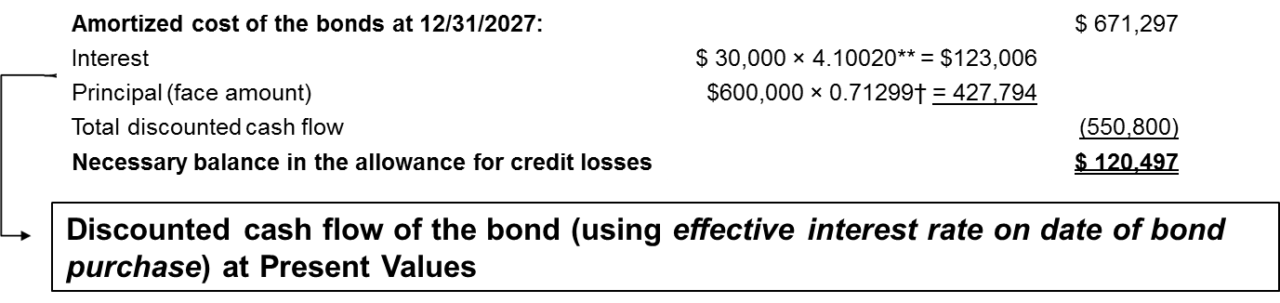
Credit Losses for Held-to-Maturity Investments 2
Appendix 12B
On July 1, 2027, United Industries purchased bonds with a face value of $700,000 from Masterwear Industries. The stated rate of interest for the bonds is 12%, so $42,000 of interest is receivable semiannually on June 30 and December 31. The bonds mature in three years, on June 30, 2030. The market interest rate for bonds of similar risk and maturity is 14%. United purchased the bonds for $666,633, reflecting a discount of $33,367.
United received its $42,000 interest payment on December 31, 2027, so it amortized $4,664 of discount, leaving the amortized cost of the bond investment at $671,297.* When preparing its 2027 financial statements, United considered whether credit losses had occurred with respect to the Masterwear investment. United concluded that it was likely to receive interest payments of only $30,000 each period and a return of principal at maturity of only $600,000. To calculate its credit loss, United discounted those cash flows at the 7% effective interest rate that existed when the bonds were purchased, and compared that discounted amount to the amortized cost of the bonds at 12/31/2027:
Access the text alternative for slide images.
Notes:
Illustration 12B–1 Credit Losses for an HTM Investment
In this illustration, we modify the Masterwear Industries example from Illustration 12-1 to demonstrate accounting for credit losses for an HTM investment.
*Refer to Illustration 12–2 for the amortization table that applies to the Masterwear bonds.
**Present value of an ordinary annuity of $1: n = 5, i = 7% (Table 4).
†Present value of $1: n = 5, i = 7% (Table 2).

Slide 78
Credit Losses for Held-to-Maturity Investments 3
Appendix 12B
On July 1, 2027, United Industries purchased bonds with a face value of $700,000 from Masterwear Industries. The stated rate of interest for the bonds is 12%, so $42,000 of interest is receivable semiannually on June 30 and December 31. The bonds mature in three years, on June 30, 2030. The market interest rate for bonds of similar risk and maturity is 14%. United purchased the bonds for $666,633, reflecting a discount of $33,367.
United received its $42,000 interest payment on December 31, 2027, so it amortized $4,664 of discount, leaving the amortized cost of the bond investment at $671,297.* When preparing its 2027 financial statements, United considered whether credit losses had occurred with respect to the Masterwear investment. United concluded that it was likely to receive interest payments of only $30,000 each period and a return of principal at maturity of only $600,000.
To record the $120,497 credit loss, United makes the following journal entry:
Journal Entry | Debit | Credit
Credit loss expense | 120,497
Allowance for credit losses |  | 120,497
Notes:
Illustration 12B–1 Credit Losses for an HTM Investment (concluded)
United’s 2027 before-tax net income will be reduced by the $120,497 credit loss, and the Masterwear investment will be reported in the balance sheet at a carrying value of $550,800. In future periods, United will re-estimate the discounted cash flows associated with the Masterwear bonds and adjust the allowance for credit losses up or down as necessary to state the carrying value of the investment at the appropriate amount.

Slide 79
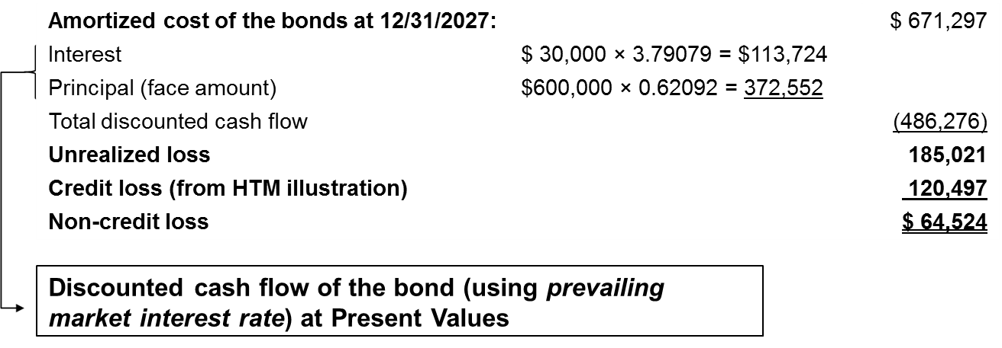
Credit Losses for Available-for-Sale Investments
Appendix 12B
Assume the same facts as in the previous illustration. Also assume that United believes that, given the troubles Masterwear Industries has been facing, a discount rate of 20% (10% every six months) is appropriate for valuing those bonds in the current market. Using a discounted cash flow approach to value the Masterwear bonds, the fair value of those bonds and the related unrealized loss would be calculated as follows at 12/31/2027:
United could use other valuation approaches to estimate fair value, but assuming a discounted cash flow approach highlights the difference between credit losses and other unrealized losses.
Access the text alternative for slide images.
Notes:
Illustration 12B–2 Credit and Non-Credit Losses of an AFS Investment
The FASB requires that investors calculate credit losses for AFS investments using the discounted cash flow approach shown in Illustration 12B–1. However, accounting for credit losses is complicated by the fact that AFS investments must be carried at fair value, with unrealized gains and losses shown in OCI. To help us consider this difference, Illustration 12B–2 modifies Illustration 12B–1 to show how the fair value of the Masterwear bonds might be calculated.
United could use other valuation approaches to estimate fair value, but assuming a discounted cash flow approach highlights the difference between credit losses and other unrealized losses.

Slide 80
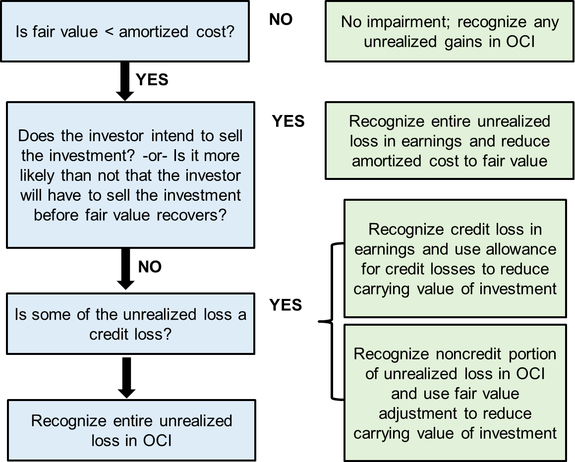
Decision Tree to Account for Impairment of A F S Investments
Appendix 12B
*Note: The amount of credit loss is limited to the amount by which fair value is lower than amortized cost.
Access the text alternative for slide images.
Notes:
Illustration 12B–3 Decision Tree to Account for Impairment of AFS Investments
We see from the previous illustration that the fair value estimate can differ from the value used to calculate credit losses. The credit-loss calculation requires that the discount rate be the effective interest rate as of the date the investment was purchased. However, the fair value calculation uses the current discount rate appropriate for the investment. Market conditions change over time, so it makes sense that these two discount rates could differ. In this case, because United believes market participants would use a relatively high discount rate (reflecting higher risk) when valuing the Masterwear investment, it assigns a relatively low fair value to that investment. How should United account for these losses? The flowchart shown here provides guidance.
If an investment’s fair value is not less than amortized cost, there is no impairment of the investment, and any unrealized gain should be shown in OCI. If instead, fair value is less than amortized cost, there is some impairment of the investment. At this point, we need to consider what the investor intends to do with the investment. If the investor intends to sell the investment, or if the investor is more likely than not to have to sell the investment before the fair value of the investment can recover, we act as if the investor has realized that loss. The investor recognizes the entire loss in earnings and reduces the carrying value of the investment to its fair value. No recovery of that write-down is permitted if fair value recovers in the future. Rather, the new amortized cost will be compared to fair value and any unrealized gains or losses will be recorded in OCI as typically done for AFS investments.
If, on the other hand, the investor does not intend to sell the investment and does not believe it is more likely than not the investment will be sold before fair value recovers, the amount of the unrealized loss that is due to a credit loss must be identified. The credit loss portion is recognized in earnings, and an allowance for credit losses is established, just like we did for HTM investments. If the credit loss decreases in the future, a reversal of credit loss can be included in earnings, just like for HTM investments. Any remaining noncredit-loss component is recognized as an unrealized loss in OCI, just as other unrealized losses are recognized for AFS investments.
*Note: The amount of credit loss is limited to the amount by which fair value is lower than amortized cost.

Slide 81
Impairment of A F S Investments 1
Appendix 12B
Case 1: If United intends to sell the bonds, or thinks it will have to sell the bonds before the fair value of the bonds can recover to amortized cost, United would make the following journal entry to write down the investment and recognize a loss in net income:
Journal Entry – Dec. 31, 2027 | Debit | Credit
Loss on impairment (NI) | 185,021
Discount on bond investment |  | 185,021
Notes:
Returning to Illustration 12B–2, let’s consider how United should account for its AFS investment. We can see that the fair value of the Masterwear bonds is less than amortized cost, so it is clear that the investment is impaired. Let’s consider two alternative cases.
Case 1: If United intends to sell the bonds, or thinks it will have to sell the bonds before the fair value of the bonds can recover to amortized cost, United would make this journal entry to write down the investment and recognize a loss in net income.
By increasing the discount on bond investment, this journal entry reduces the amortized cost of the bonds to their fair value of $486,276.
An added complication arises if United has already accounted for some of this decline in fair value by reducing the carrying value of the investment and including the unrealized loss in OCI. In that case, United will also have to record a reclassification adjustment to remove those effects from the balance sheet accounts, debiting the fair value adjustment and crediting OCI, just as it would for a loss recognized upon sale of an AFS investment.
If the fair value of the investment increases in the future, United will not be able to reverse that write-off. Rather, it will debit the fair value adjustment to show an increase in fair value and credit OCI as an unrealized gain, just as it treats other unrealized gains on AFS investments.

Slide 82
Impairment of A F S Investments 2
Appendix 12B
Case 2: If United does not intend to sell the investment and does not believe it is more likely than not that it will have to sell the investment before fair value recovers, it will make the following journal entries:
Journal Entry – Dec. 31, 2027 | Debit | Credit
Credit loss expense | 120,497
Allowance for credit losses |  | 120,497
Journal Entry – Dec. 31, 2027 | Debit | Credit
Loss on AFS investment (unrealized, OCI) | 64,524
Fair value adjustment |  | 64,524
Notes:
Case 2: If United does not intend to sell the investment and does not believe it is more likely than not that it will have to sell the investment before fair value recovers, it will make these journal entries.
With regard to the impairment, United is separately accounting for the credit loss and the noncredit loss. The credit loss reduces net income, and the noncredit loss reduces OCI. The allowance for credit losses and fair value adjustment are both contra accounts to the investment, and together reduce the carrying value of the bonds to their fair value of $486,276. Going forward, United will adjust the allowance for credit losses up or down as credit losses increase or are recovered, and will recognize any remaining (noncredit loss) unrealized gains or losses on its AFS investments as it would normally.
For both cases, United carries its investment at fair value. They differ in how the impairment loss is reported. For case 1, the entire impairment loss reduces current-period earnings, but for case 2, only the credit loss reduces current-period earnings.
Companies are required to show AFS investment at fair value in the balance sheet and to present parenthetically the amortized cost basis and the allowance for credit losses.

Slide 83
Impairment of A F S Investments 3
Appendix 12B
Case 1: In Case 1, United has reduced the amortized cost of its Masterwear investment to fair value. Therefore, United would show its Masterwear investment in the balance sheet as follows:
AFS Investment (amortized cost: $486,276) | $486,276
Case 2: In Case 2, United has recognized both an allowance for credit losses as well as a fair value adjustment. It must disclose amortized cost and the allowance as well as fair value. Therefore, United would show its Masterwear investment in the balance sheet as follows:
AFS Investment (amortized cost: $671,297, allowance for credit losses: $120,497) | $486,276
Notes:
Companies are required to show AFS investment at fair value in the balance sheet and to present parenthetically the amortized cost basis and the allowance for credit losses. Let’s consider how each of our two cases would be presented in Masterwear’s 12/31/2027 balance sheet.
Case 1: In Case 1, United has reduced the amortized cost of its Masterwear investment to fair value. Therefore, United would show its Masterwear investment in the balance sheet as follows:
AFS Investment (amortized cost: $486,276) $486,276
Case 2: In Case 2, United has recognized both an allowance for credit losses as well as a fair value adjustment. It must disclose amortized cost and the allowance as well as fair value. Therefore, United would show its Masterwear investment in the balance sheet as follows:
AFS Investment (amortized cost: $671,297,
allowance for credit losses: $120,497) $486,276

Slide 84
Impairments – I F R S
L O12.9
U S G A A P Impairments | I F R S Impairments
Impairment of debt investments is calculated using the C E C L model. | Impairment of debt investments is calculated using the expected credit loss (“E C L”) model.
U S C E C L model calculates the expected credit losses over the remaining life of the investment, regardless of whether there has been a significant increase in credit risk. Because of this, it tends to recognize impairment losses earlier, and in higher amounts, than are recognized under I F R S. | I F R S E C L model measured either as the 12-month expected credit loss (if the credit risk on the investment has not increased significantly) or the lifetime expected credit loss (if the credit risk on the investment has increased significantly).
Notes:
Accounting for Impairments. Under IFRS No. 9, companies recognize impairments for debt investments that are accounted for at amortized cost (rather than fair value through net income) or at fair value through other comprehensive income (FVOCI). The impairment is calculated using the Expected Credit Loss (ECL) model discussed previously, and is measured either as the 12-month expected credit loss (if the credit risk on the investment has not increased significantly) or the lifetime expected credit loss (if the credit risk on the investment has increased significantly.) Companies can elect to always recognize lifetime credit losses, but only have to do so when a significant increase in credit loss has occurred. As in U.S. GAAP, IFRS allows recoveries of impairments to be recognized in earnings.
IFRS No. 9 requires companies to recognize changes in the ECL as impairment losses or recoveries of impairment losses in the income statement, but the offsetting entry depends on whether the investment is accounted for at amortized cost or FVOCI. If the debt investment is accounted for at amortized cost, the offsetting entry creates or adjusts an impairment allowance account that reduces the carrying value of the investment. However, if the investment is accounted for at FVOCI, the balance sheet already reflects the fair value of the investment. Therefore, the offsetting entry is to OCI, creating a "Reserve for credit losses" as a portion of AOCI. When the FVOCI investment is sold or matures, any accumulated amounts in that AOCI reserve are reclassified to net income.

Slide 85
End of Main Content
© McGraw Hill LLC. All rights reserved. No reproduction or distribution without the prior written consent of McGraw Hill LLC.

Slide 86
Accessibility Content: Text Alternatives for Images

Slide 87
Debt Investment: Bonds Purchased at a Discount – Text Alternative
Return to parent-slide containing images.
The column headers are the calculation of the price of the bonds and present values. The row headers are interest, principal of face amount, and present value (price) of the bonds. An arrow indicates the present value of an ordinary annuity of 1 dollar table with n equals 6 and i equals 7%, resulting in 4.76654 for the interest. Another arrow indicates the present value of 1 dollar table with n equals 6 and i equals 7%, resulting in 0.66634 for the principal of face amount.
Return to parent-slide containing images.

Slide 88
Bond Investments: Premiums and Discounts – Text Alternative
Return to parent-slide containing images.
It presents the following 2 cases. Interest rate (stated rate) less than the market rate, sold at a premium. Interest rate (stated rate) greater than the market rate, sold at a discount.
Return to parent-slide containing images.

Slide 89
Amortization Schedule—Discount – Text Alternative
Return to parent-slide containing images.
The table has 6 columns and 7 rows. The column headers are date, cash interest, effective interest (interest revenue), amortization of discount, discount balance, and amortized cost. An arrow indicates the cash interest of 42,000 dollars, which is obtained from 700,000 dollars multiplied by 6%, for 1/31/2027. Another arrow indicates the amortization discount of 4,664 dollars, which is obtained from 46,664 dollars minus 42,000 dollars, for 12/31/2027. Another arrow indicates the amortized cost of 671,297, which is obtained from 666,633 dollars plus 4,664 dollars, for 12/31/2027.
Return to parent-slide containing images.

Slide 90
Three Classifications of Debt Investments – Text Alternative
Return to parent-slide containing images.
1. Reporting Approach. Held-to-maturity, H T M: used for debt for which the investor has the positive intent and ability to hold to maturity. Trading T S: used for debt that is held in an active trading account for immediate resale. Available-for-sale, A F S: used for debt that does not qualify as held-to-maturity of trading. 2. Treatment of Unrealized Holding Gains and Losses. Not recognized. Recognized in net income, and therefore in retained earnings as part of shareholders' equity. Recognized in other comprehensive income, and therefore in accumulated other comprehensive income in shareholders' equity. 3. Carried in balance sheet at amortized cost. Fair value. Fair value.
Return to parent-slide containing images.

Slide 91
Debt Investments to Be Held-to-Maturity (H T M) – Text Alternative
Return to parent-slide containing images.
Maturity date, securities mature, leads to the principal, also called the face amount, that is paid to the investors on interest dates, interest paid to investors.
Return to parent-slide containing images.

Slide 92
Sale of H T M Investments – Text Alternative
Return to parent-slide containing images.
The column headers are journal entry - January 5, 2028, debit, and credit. The row headers are cash, discount on bond investment, investment in bonds, and gain on investments. An arrow indicates the discount on bond investment has a debit of 28,703, which is obtained from 33,367 dollars minus 4,664 dollars.
Return to parent-slide containing images.

Slide 93
Sale of Trading Security Investments 1 – Text Alternative
Return to parent-slide containing images.
Top. Adjust trading securities to fair value. It has 4 columns and 1 row. The column headers are security, amortized cost, fair value, and necessary fair value adjustment balance. Bottom. It has 3 columns and 2 rows. The column headers are journal entry - January 5, 2028, debit, and credit. The row headers are fair value adjustment and gain on investments - (unrealized N I).
Return to parent-slide containing images.

Slide 94
Sale of A F S Investments – Text Alternative
Return to parent-slide containing images.
Top. Adjust A F S investment to fair value. It has 4 columns and 1 row. The column headers are security, amortized cost, fair value, and necessary fair value adjustment balance. Bottom. It has 3 columns and 2 rows. The column headers are journal entry - January 5, 2028, debit, and credit. The row headers are fair value adjustments and gain on investments - (unrealized O C I).
Return to parent-slide containing images.

Slide 95
Comparison of H T M, T S, and A F S Approaches – Text Alternative
Return to parent-slide containing images.
The columns have the fields of held-to-maturity, H T M, trading, T S, and available for sale, A F S. The rows have the categories, purchase bonds at a discount, record interest revenue, Adjust to fair value, 2027, Sell bonds in 2028, 1, adjust to fair value 2028, 2, reclassify unrealized holding gains and losses, record sale of bonds. The table gives corresponding values for discounts, investments, cash, and further adjustments.
Return to parent-slide containing images.

Slide 96
Equity Method—Purchase of Investment 1 – Text Alternative
Return to parent-slide containing images.
It has 4 columns and 10 rows. The row headers are the total fair value of Arjent (1/2/27), buildings, land, other identifiable net assets, identifiable net assets, goodwill, other information (12/31/27), Arjent's 2027 net income, Arjent's 2027 dividends, declared and paid. An arrow indicates 5,000,000 dollars multiplied by 30%, purchased equals 1,500,000 dollars purchased price. Another arrow shows the buildings with 10 years remaining useful life and no salvage value. Another arrow indicates other net assets equal to other assets minus total liabilities.
Return to parent-slide containing images.

Slide 97
Equity Method—Purchase of Investment 2 – Text Alternative
Return to parent-slide containing images.
Top. It has 3 columns and 10 rows. The column headers are the book value on Arjent's financial statements and fair value at the time of United's investment. The row headers are the total fair value of Arjent (1/2/27), buildings, land, other identifiable net assets, identifiable net assets, goodwill, other information (12/31/27), Arjent's 2027 net income, Arjent's 2027 dividends, declared and paid. Bottom. It has 3 columns and 2 rows. The column headers are journal entry, debit, and credit. The row headers are an investment in equity affiliate and cash. An arrow indicates the investment in equity affiliate has a debit of 1,500,000, which is obtained from the total fair value of Arjent (1/2/27), 5,000,000 dollars, multiplied by 30%.
Return to parent-slide containing images.

Slide 98
Equity Method—Recording Investment Revenue – Text Alternative
Return to parent-slide containing images.
Top. It has 3 columns and 10 rows. The column headers are the book value on Arjent's financial statements and fair value at the time of United's investment. The row headers are the total fair value of Arjent (1/2/27), buildings, land, other identifiable net assets, identifiable net assets, goodwill, other information (12/31/27), Arjent's 2027 net income, Arjent's 2027 dividends, declared and paid. Bottom. It has 3 columns and 2 rows. The column headers are journal entry, debit, and credit. The row headers are an investment in equity affiliate and investment revenue. An arrow indicates the investment revenue includes a credit of 150,000, which is obtained from Arjent's 2027 net income of 500,000 dollars, multiplied by 30%.
Return to parent-slide containing images.

Slide 99
Equity Method—Receiving Dividends – Text Alternative
Return to parent-slide containing images.
Top. It has 3 columns and 10 rows. The column headers are the book value on Arjent's financial statements and fair value at the time of United's investment. The row headers are the total fair value of Arjent (1/2/27), buildings, land, other identifiable net assets, identifiable net assets, goodwill, other information (12/31/27), Arjent's 2027 net income, Arjent's 2027 dividends, declared and paid. Bottom. It has 3 columns and 2 rows. The column headers are journal entry, debit, and credit. The row headers are cash and investment in equity affiliate. An arrow indicates the investment in equity affiliate has a credit of 75,000, which is obtained from declared and paid, which is 250,000 dollars, multiplied by 30%.
Return to parent-slide containing images.

Slide 100
Source of Differences between the Investment and the Book Value of Net Assets Acquired – Text Alternative
Return to parent-slide containing images.
It has 4 columns and 3 rows. The column headers are net assets of investee, proportion purchased by investor, and net assets purchased by investor. The row headers are fair value of investee, fair value of investee's identifiable net assets, and book value of investee's identifiable net assets. The table marks the difference of 420,000 dollars attributed to goodwill, difference of 450,000 dollars attributed to buildings, which is 300,000 dollars, and land, which is 150,000 dollars.
Return to parent-slide containing images.

Slide 101
Equity Method—Adjustments for Additional Depreciation – Text Alternative
Return to parent-slide containing images.
Top. It has 3 columns and 10 rows. The column headers are the book value on Arjent's financial statements and fair value at the time of United's investment. The row headers are the total fair value of Arjent (1/2/27), buildings, land, other identifiable net assets, identifiable net assets, goodwill, other information (12/31/27), Arjent's 2027 net income, Arjent's 2027 dividends, declared and paid. Bottom. It has 3 columns and 2 rows. The column headers are journal entry, debit, and credit. The row headers are investment revenue and investment in equity affiliate. An arrow indicates the investment in equity affiliate has a credit of 30,000, which is obtained from 30% multiplied by the output of book value on Arjent's financial statements, 1,000,000 dollars, and fair value at the time of United's investment, 2,000,000 dollars, which is then divided by 10 years.
Return to parent-slide containing images.

Slide 102
If an Equity Method Investment is Sold – Text Alternative
Return to parent-slide containing images.
If the selling price is greater than book carrying value, then gain is recognizable. If the selling price is smaller than book carrying value, then loss is recognizable.
Return to parent-slide containing images.

Slide 103
Comparison of Fair Value and the Equity Methods – Text Alternative
Return to parent-slide containing images.
Values are given for purchase equity investment, investment in equity securities cash, investment in equity affiliate cash. Other fields provided with values are recognize proportionate share of investee's net income and any related adjustments, adjust to fair value 2027, receive dividend, sell equity investment. 1. adjust to fair value 2028, record sale, and other fields.
Return to parent-slide containing images.

Slide 104
Credit Losses for Held-to-Maturity Investments 2 – Text Alternative
Return to parent-slide containing images.
The amortized cost of the bonds on 12/31/2027 is 671,297. It includes interest, principal (face amount), total discounted cash flow, and necessary balance in the allowance for credit losses. Interest and principal lead to the discounted cash flow of the bond, using effective interest rate on date of bond purchase, at present values.
Return to parent-slide containing images.

Slide 105
Credit Losses for Available-for-Sale Investments – Text Alternative
Return to parent-slide containing images.
The amortized cost of the bonds on 12/31/2027 is 671,297. It includes interest, principal (face amount), total discounted cash flow, unrealized loss, credit loss from H T M illustration, and non-credit loss. Interest and principal lead to the discounted cash flow of the bond, using prevailing market interest rate, at present values.
Return to parent-slide containing images.

Slide 106
Decision Tree to Account for Impairment of A F S Investments – Text Alternative
Return to parent-slide containing images.
The flow begins with the decision statement that reads, Is fair value greater than amortized cost? If no, leads to no impairment; recognize any unrealized gains in O C I, if yes, leads to the next decision statement that reads, Does the investor intend to sell the investment? or Is it more likely than not that the investor will have to sell the investment before fair value recovers? If yes, leads to recognize entire unrealized loss in earnings and reduce amortized cost to fair value, if no, leads to the next decision statement that reads, Is some of the unrealized loss a credit loss? If the statement is yes, the flow leads to recognizing credit loss in earnings and using the allowance for credit losses to reduce the carrying value of the investment, followed by recognizing the noncredit portion of the unrealized loss in O C I and using fair value adjustment to reduce carrying value of the investment. If the statement is not satisfied, the flow leads to recognizing the entire unrealized loss in O C I. A note at the bottom right reads as follows. The amount of credit loss is limited to the amount by which fair value is lower than amortized cost.
Return to parent-slide containing images.

