Slide 1

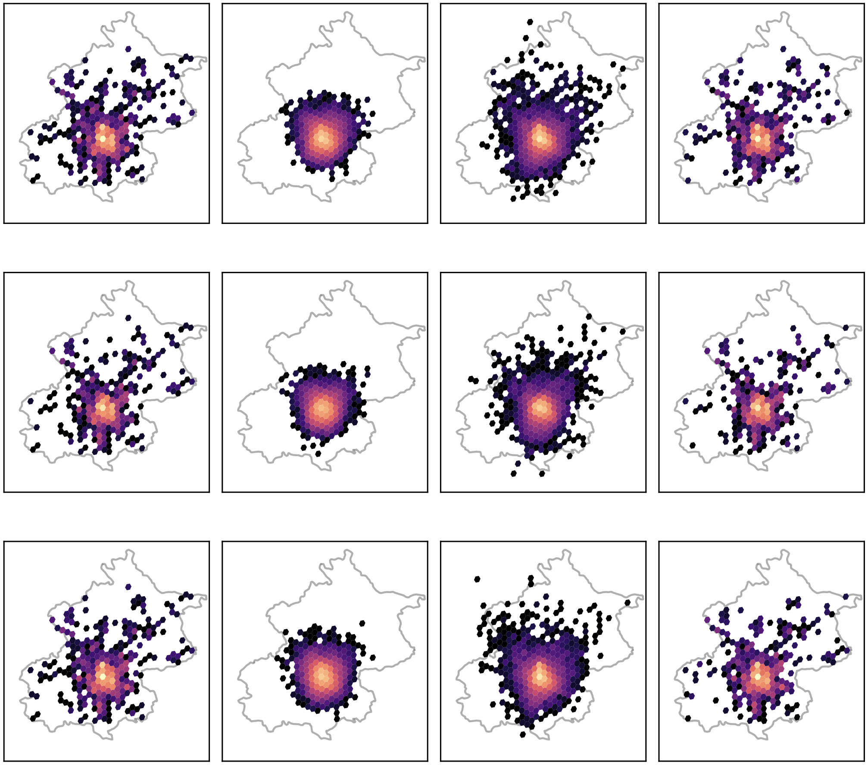
Synthetic Mobility Data:
A User-Level Membership Inference Assessment
Campbell Gray
Supervisor: Manuel Portela

Slide 2


Motivation
The Issue: Lack of open access mobility dataset due to privacy concerns
SENSITIVE Mobility Data
Generator
Synthetic Mobility Data
Home location
Work location
Regular travel schedule
Details obscured
The idea: generate & publish a version of the dataset with privacy protected

Slide 3
Research Questions
RQ1: Can generative models accurately reproduce origin–destination mobility patterns from real trip data?
RQ2: To what extent do these models leak information about individual users through membership inference attacks?
RQ3: Are users with more trips at a greater risk of privacy leakage than less active users?
Utility
Privacy
Privacy by Activity Group

Slide 4

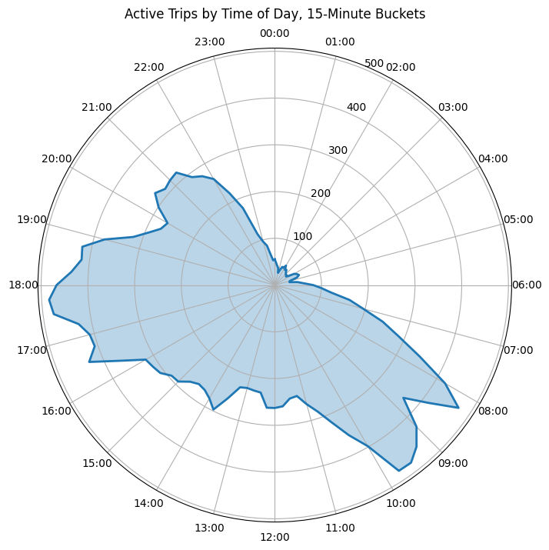
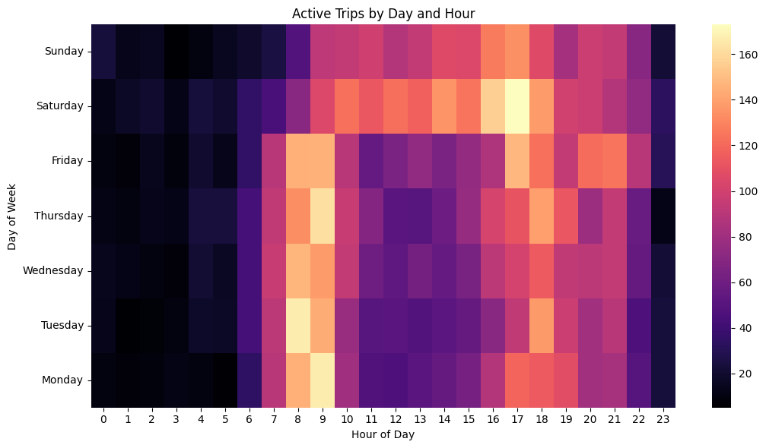
Dataset Introduction
GeoLife Dataset (Microsoft Asia Research)
GPS Trajectories → OD trips segmentation
7,739 trips across 154 users
(average trip being 28.7 minutes & 13.6km)
Clear schedule change on weekends
Clear ‘rush hour’ peaks

Slide 5
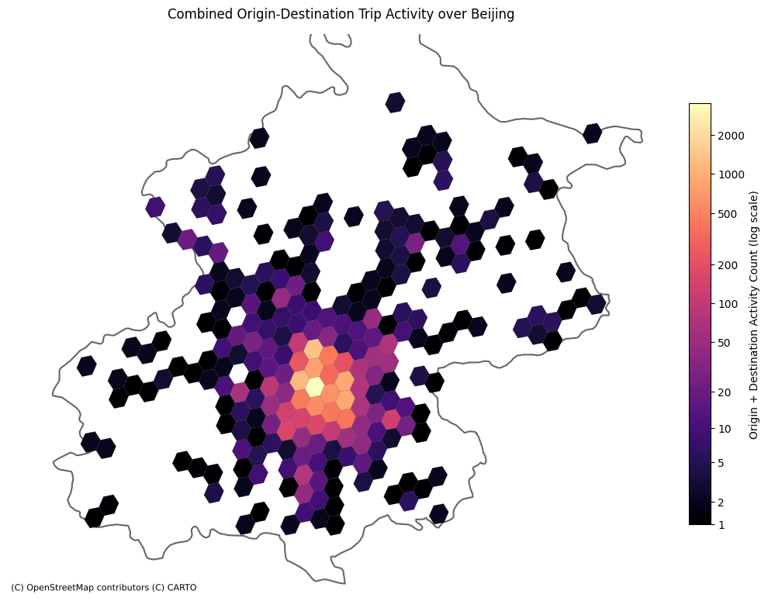
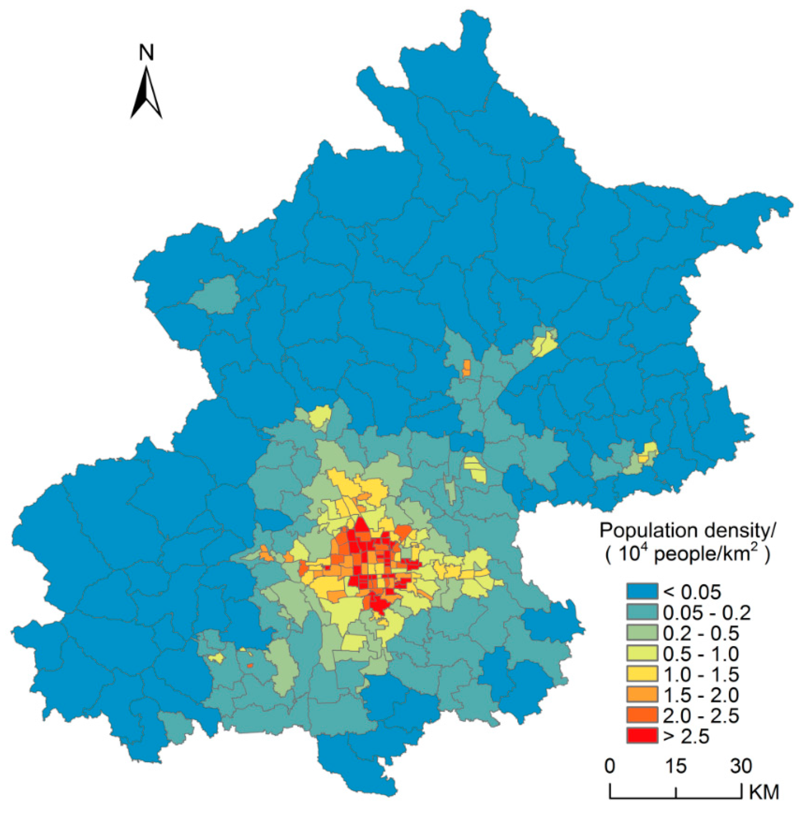
Dataset Introduction
Dataset OD Coverage
Population Density [2]
[2] Population Spatialization in Beijing City Based on Machine Learning and Multisource Remote Sensing Data - Miao He,Yongming Xu, Ning Li, 2020
Notes:
GeoLife dataset is mainly in Beijing, but did have trips outside and further afield internationally. For simplicity these were omitted from the research dataset.

Slide 6
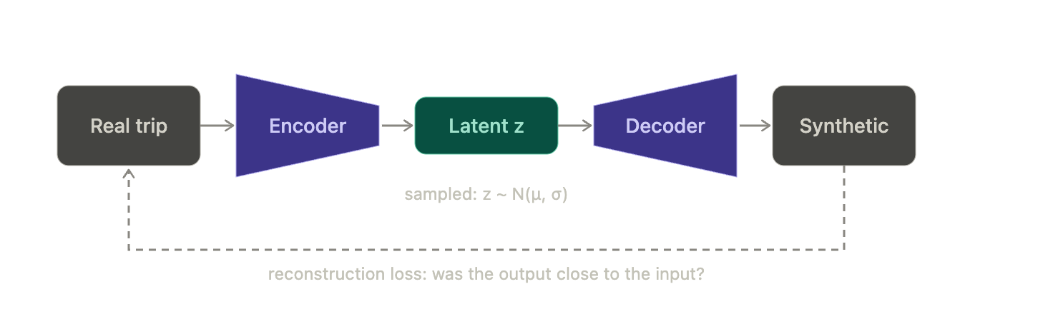
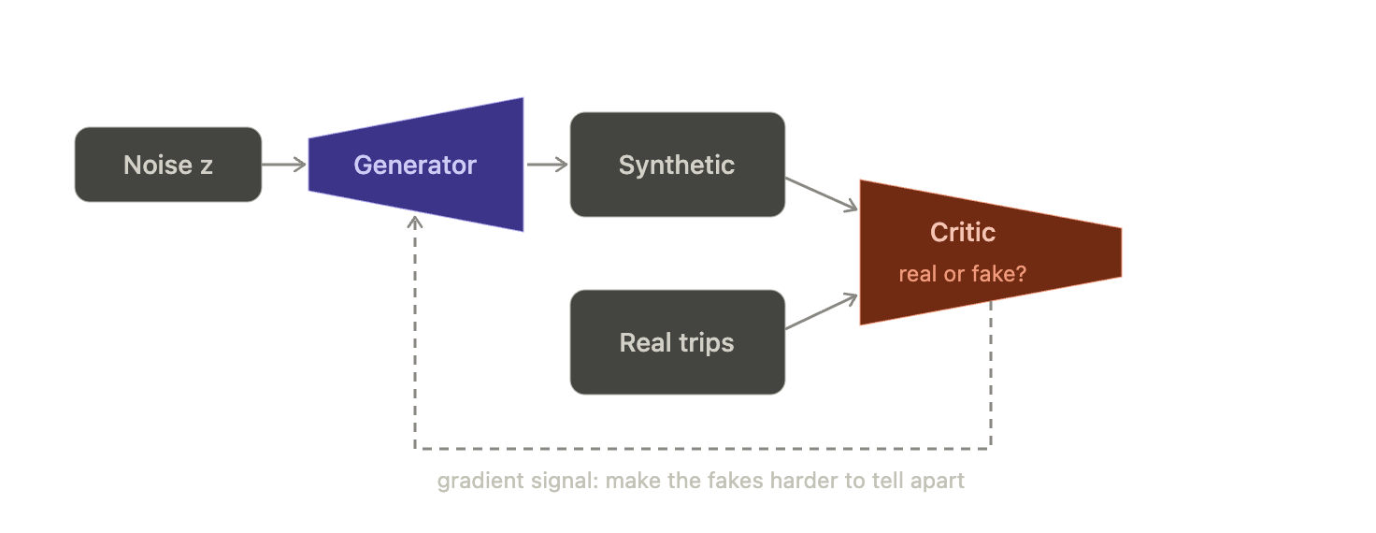

Models
VAE (Variational Autoencoder) — reconstruction loss + KL loss
WGAN-GP (Wasserstein GAN with Gradient Penalty) — generator vs. critic adversarial game
Benchmark) Bootstrap — resampling real trips directly with replacement
Operating on transformed features (continuous OD coordinates, trip distance/duration, hour/day-of-week)
Manual hyperparameter search

Slide 7
Utility Evaluation
Similarity Comparison
Compares discrete marginals (Jensen–Shannon distance) between real and synthetic dataset. Locational attributes are banded into grid cells and temporal attributes are put into hour and day of week,
0 = identical distributions, 1 = no overlap at all.
Downstream Task
Train a model (random forest) to predict a trip's destination cell from its origin coordinate, using duration and distance as well. Trained on Synthetic dataset and tested on real data set, this is then normalised by performance score when using the holdout subset of real data.
1.0 = synthetic is a perfect substitute; 0 = useless.

Slide 8
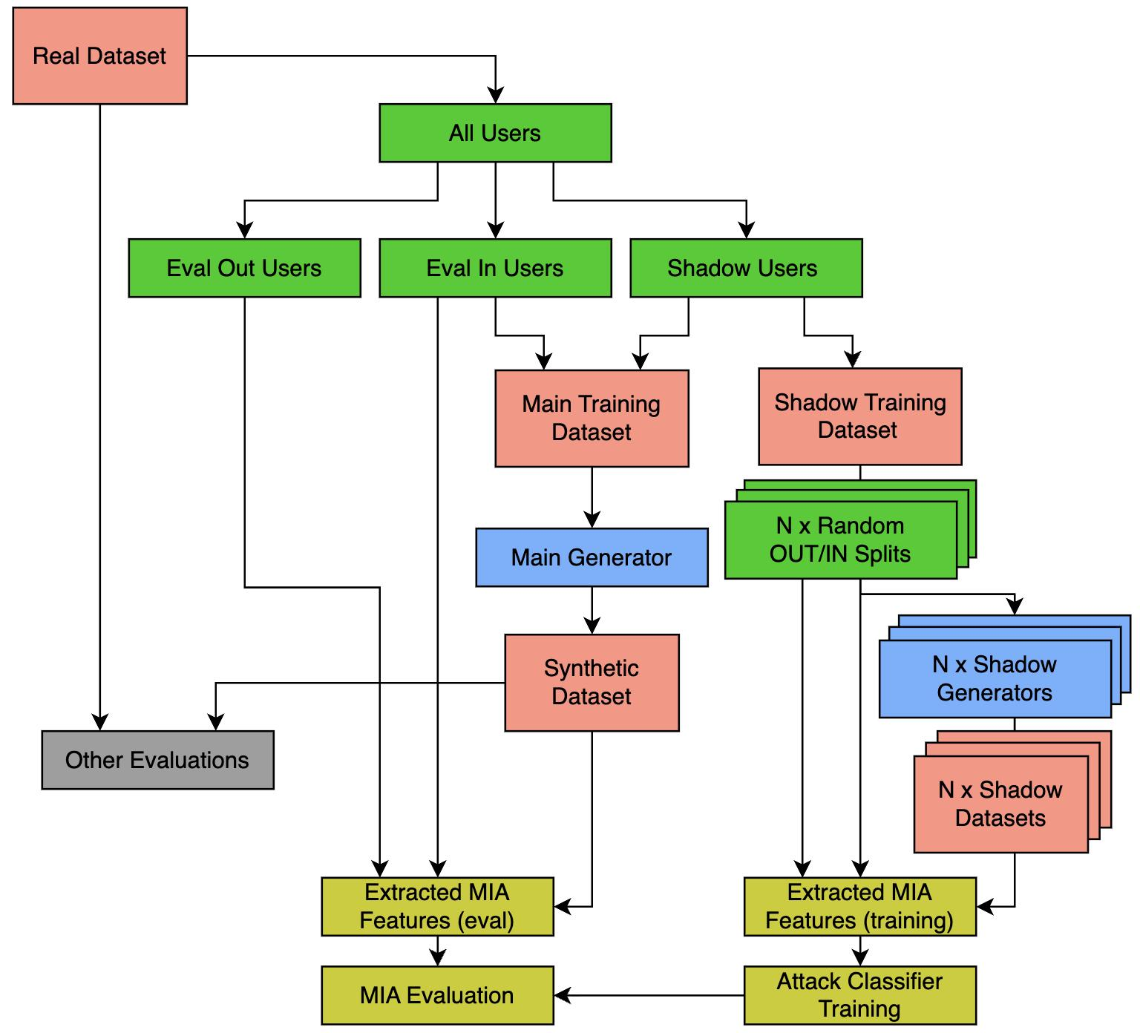
Membership Inference
Was this real user used to generate the synthetic dataset or not?
High accuracy to the (Yes/No) inference question → Privacy Leak
Notes:
This Classifier outputs a probability score of membership
YES/NO decision classification can be used via threshold of 0.5
The known membership is known so a accuracy score can then be calculate
However slightly better metric for representing attack sucess is the AUC (area under the cuver for the Receiver Operating Characteristic curve). This is a better metric because it’s not dependant on a threshold and summarise success at all operating points (so AUC is main metric that I’ll show later)

Slide 9
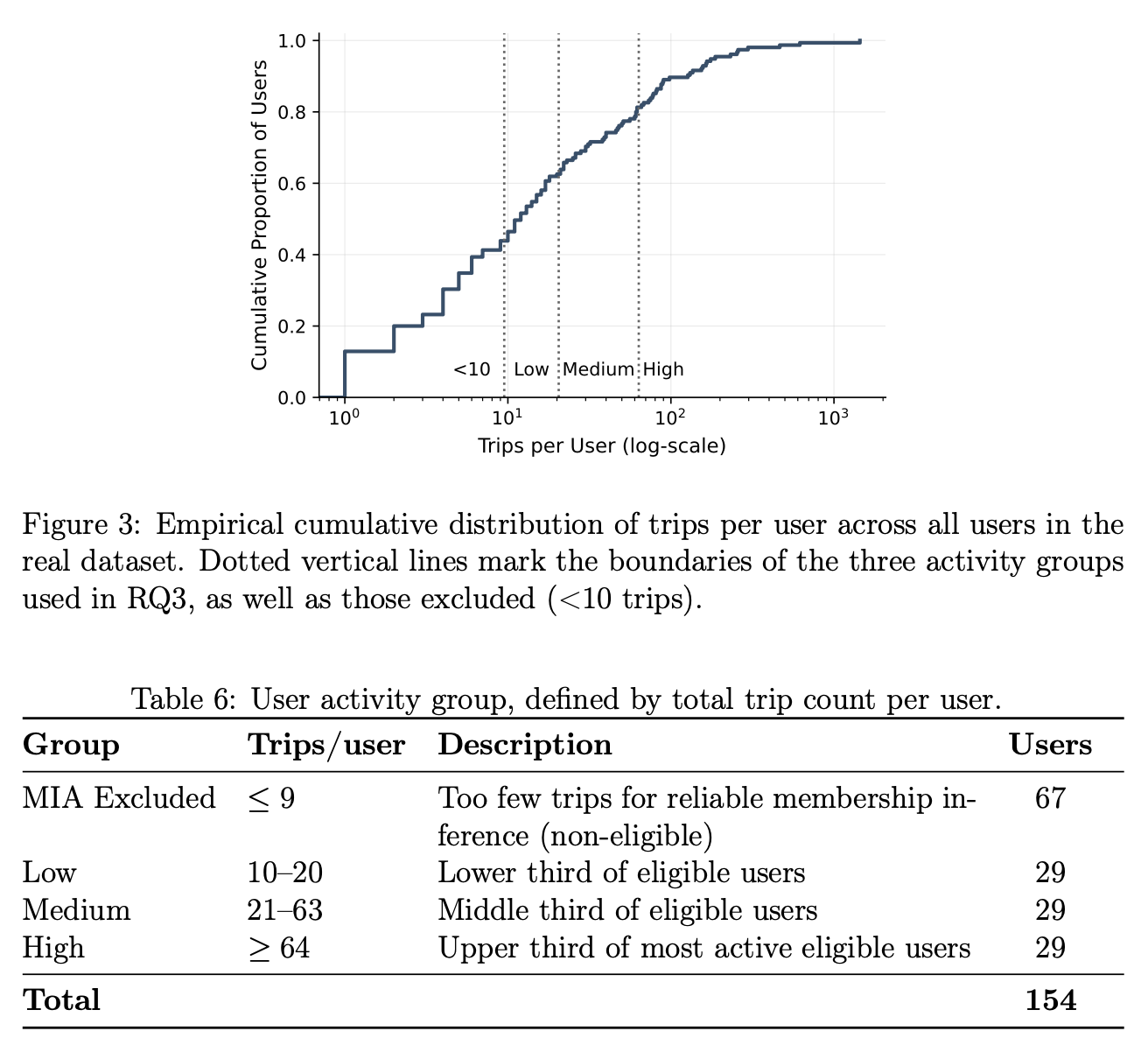
Membership Inference
Notes:
This Classifier outputs a probability score of membership
YES/NO decision classification can be used via threshold of 0.5
The known membership is known so a accuracy score can then be calculate
However slightly better metric for representing attack sucess is the AUC (area under the cuver for the Receiver Operating Characteristic curve). This is a better metric because it’s not dependant on a threshold and summarise success at all operating points (so AUC is main metric that I’ll show later)

Slide 10
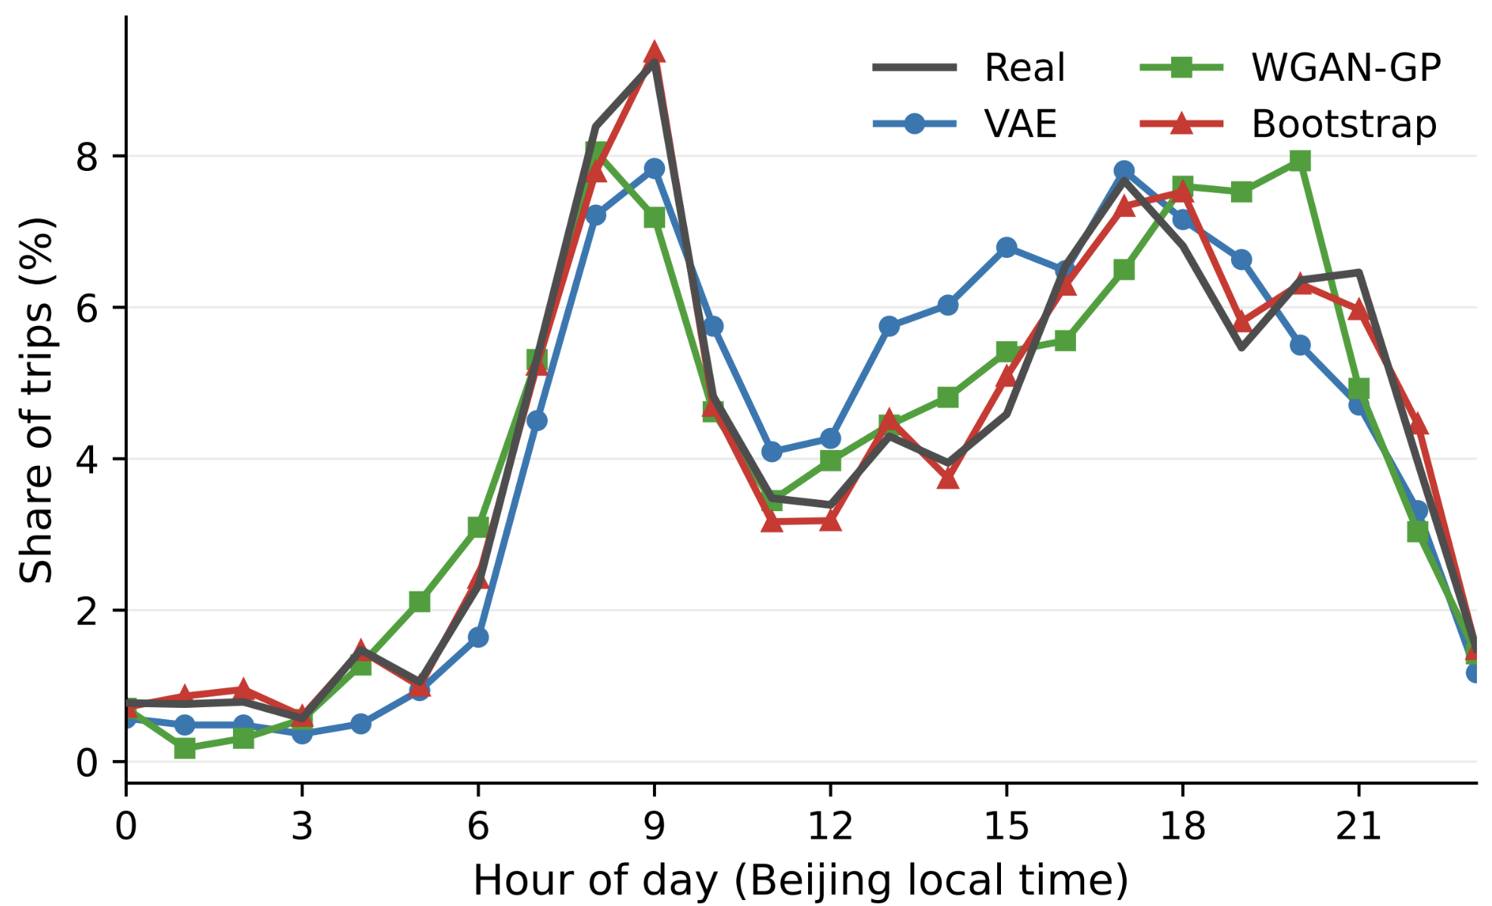
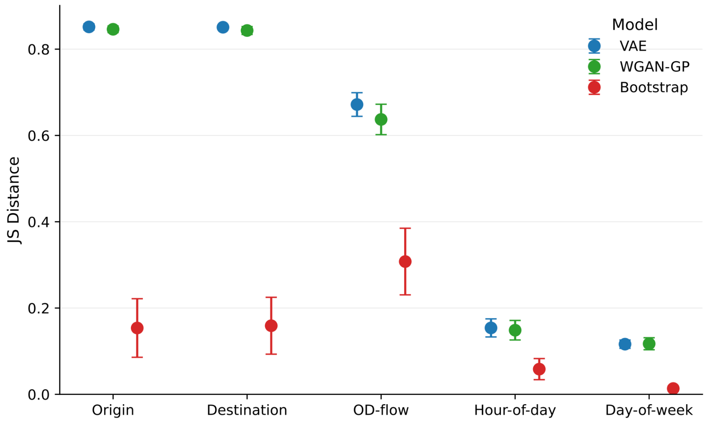
RQ1 - Utility
Temporal structure reproduced well (realistic trip start times)
JS distance 0.12–0.15 for hour-of-day/day-of-week

Slide 11
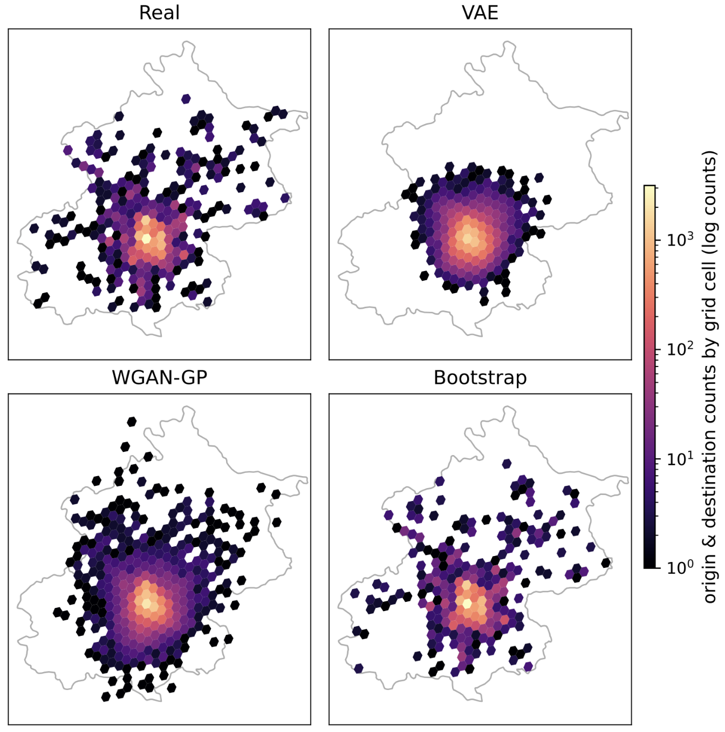
Results
Overgeneralization to unobserved locations
(even outside of Beijing)
WGAN-GP preserved real spatial dispersion better; VAE compressed trips toward the urban centre
Notes:
Discretised representation of locations
Tendency to generalise to unseen locations (including outside beijing)

Slide 12
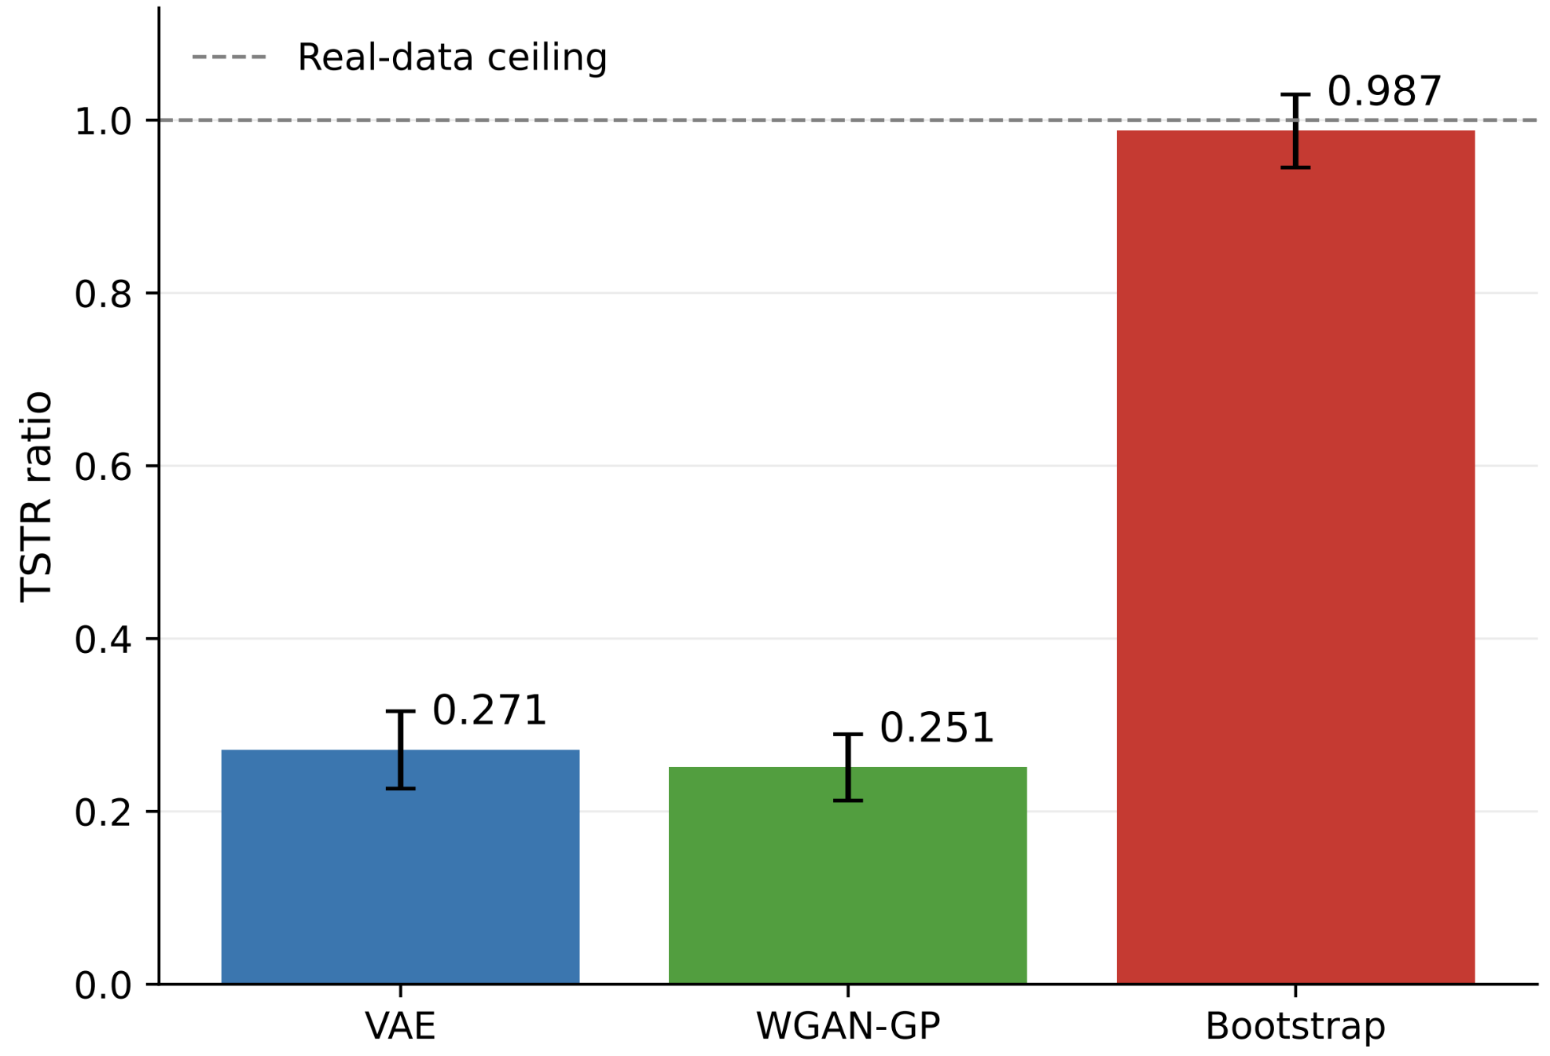
RQ1 - Utility
Spatial structure reproduced poorly
(JS distance >0.8; TSTR ratio 0.25–0.27 vs. 0.99 for the bootstrap)

Slide 13
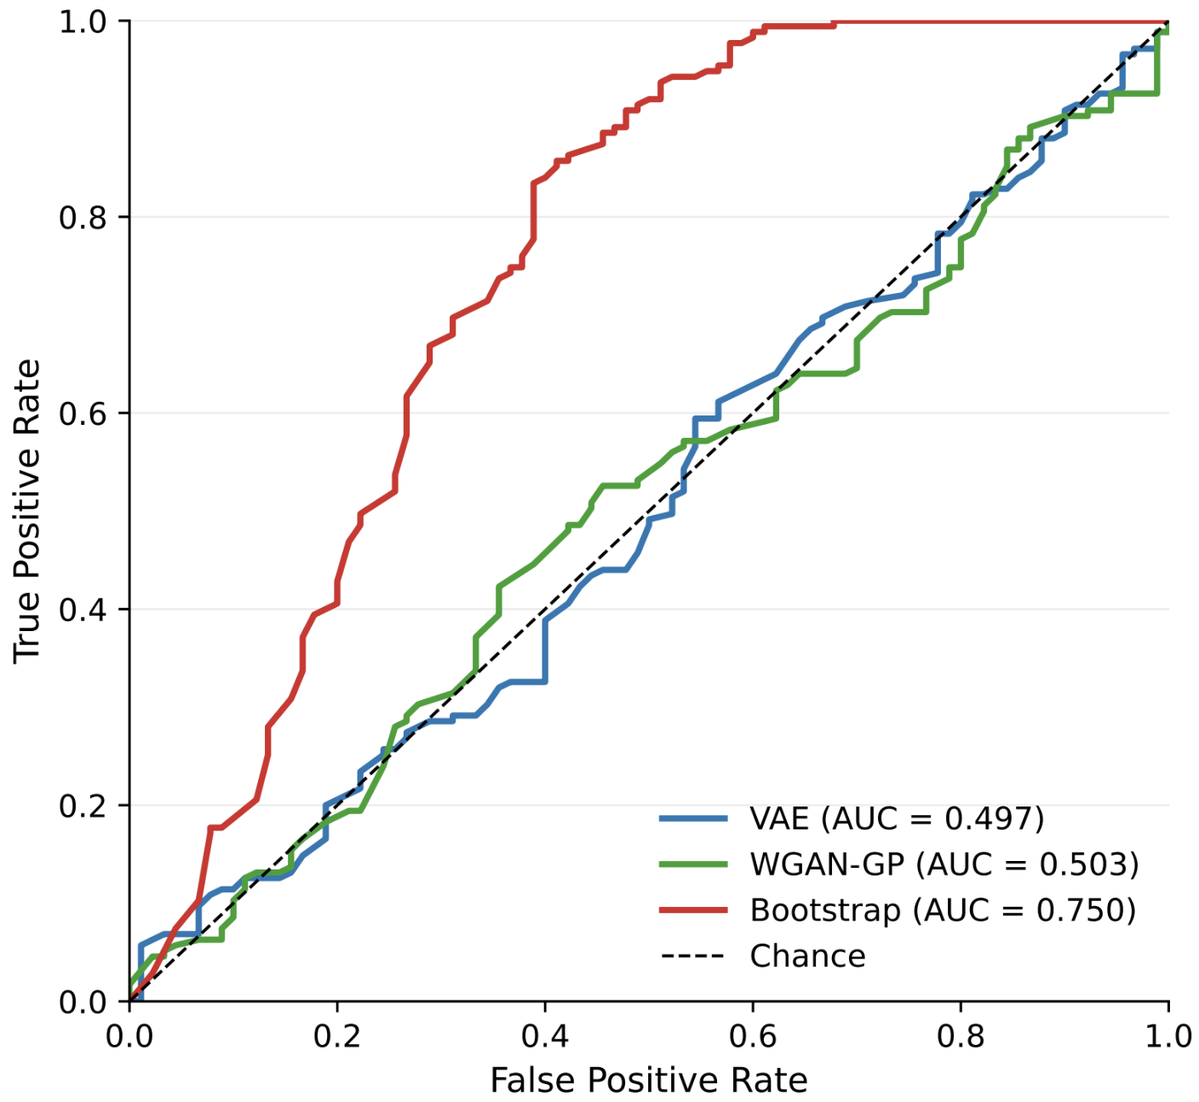
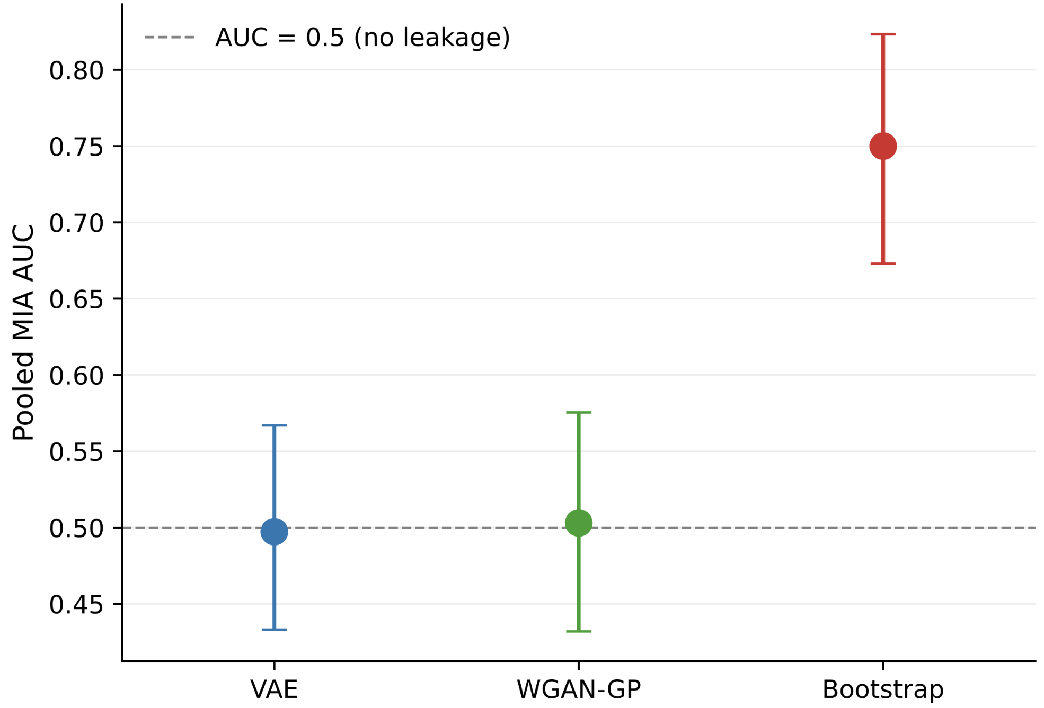
RQ2 Results - MIA
Bootstrap positive control confirmed a working attack (AUC 0.75)
Neither generative model showed measurable leakage (AUC 0.50)
Notes:
Bootstrap positive control confirmed a working attack (AUC 0.75); its sub-1.0 ceiling reflects ambiguity from OD discretisation shared across individuals
Neither generative model showed measurable leakage (AUC ≈0.50)

Slide 14
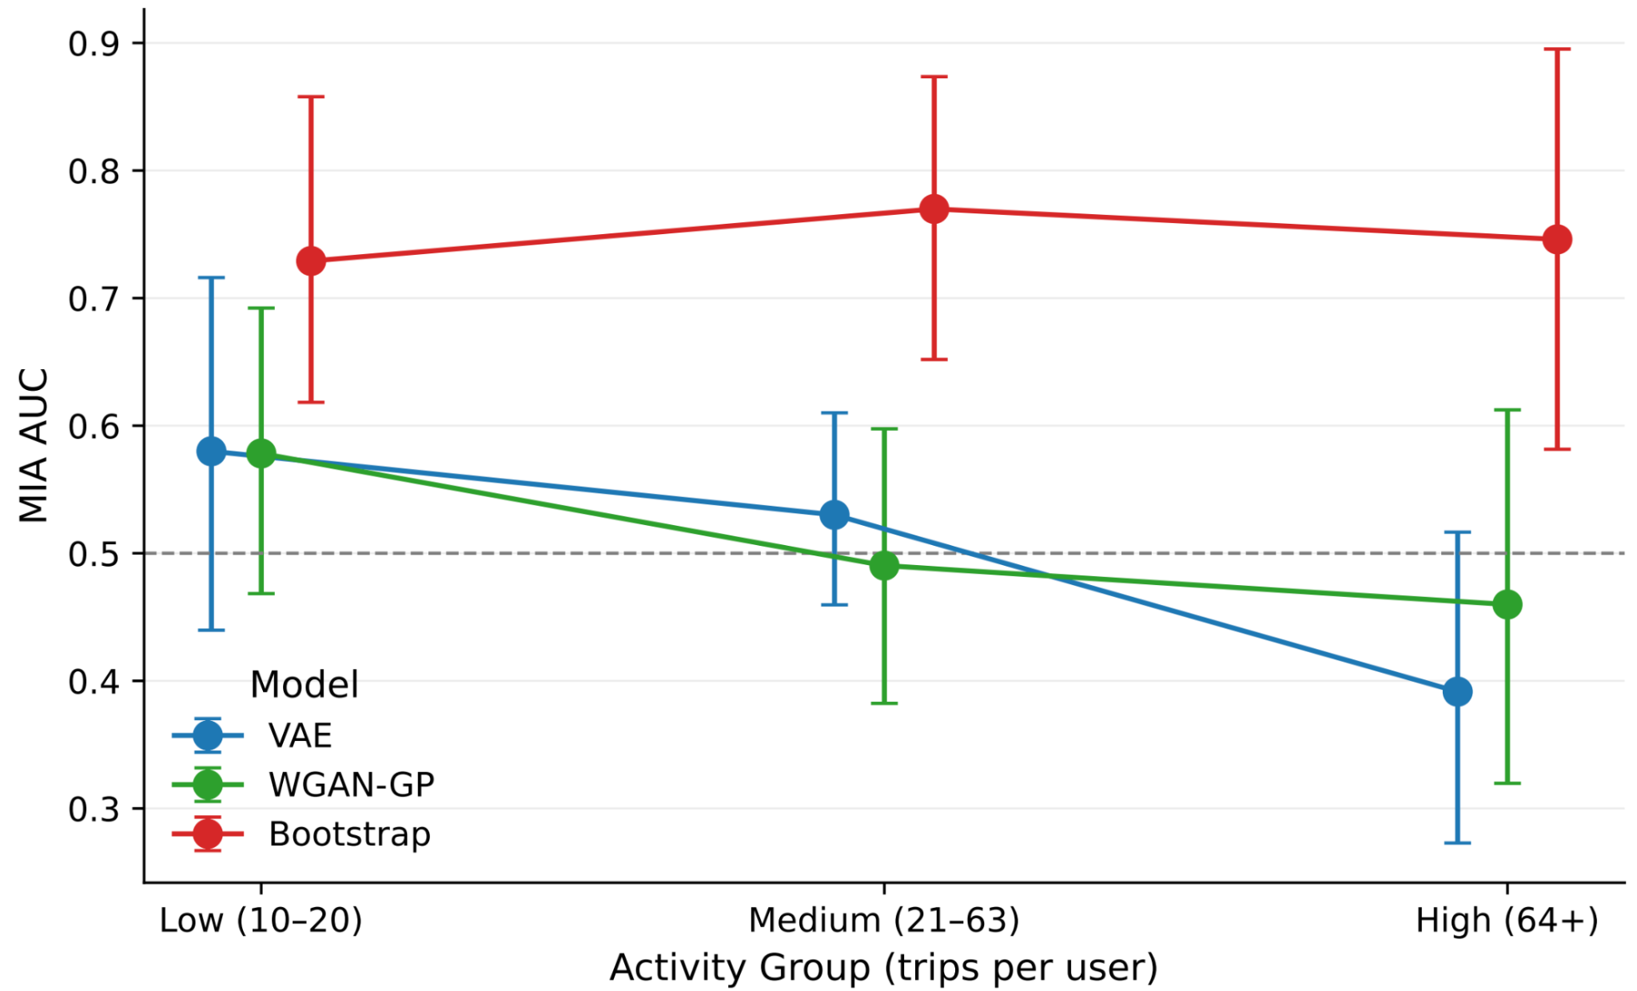
RQ3 Results - By Activity Group
MIA-by-activity-group was inconclusive:
as few as 28 users per group gave confidence intervals too wide to support any claim
Notes:
MIA-by-activity-group was inconclusive: as few as 28 users per group gave confidence intervals too wide to support any claim

Slide 15
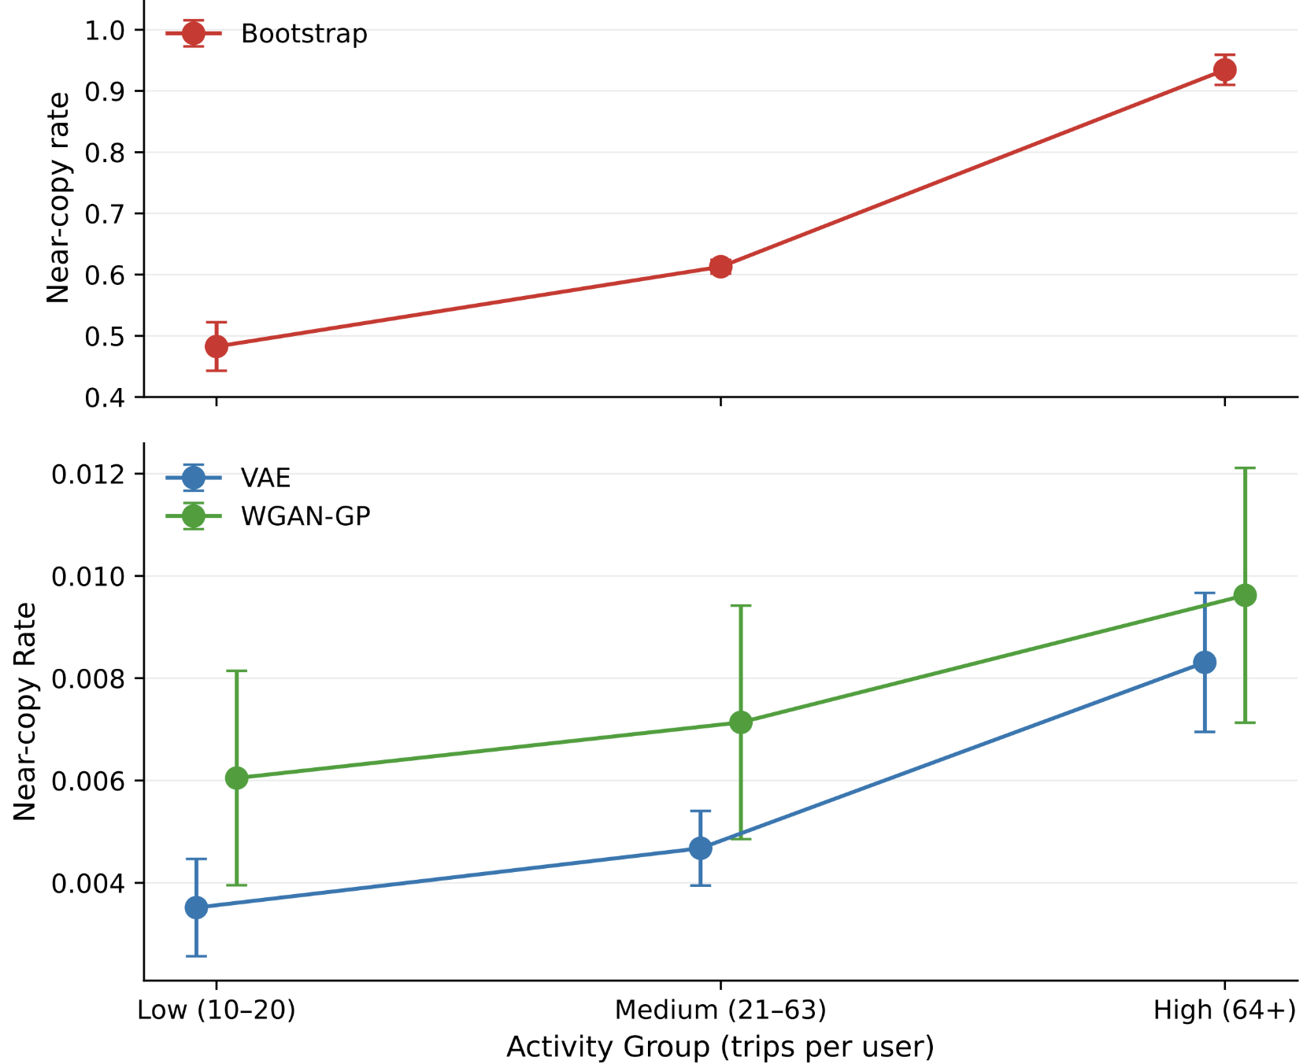
RQ3 Results - By Activity Group
Near-copy rate rose monotonically with activity across all models (including the bootstrap)
indicating higher-activity users carry greater record-reproduction risk in principle
Notes:
Near-copy rate rose monotonically with activity across all models, including the bootstrap, indicating higher-activity users carry greater record-reproduction risk in principle

Slide 16
Further Research
Learned embeddings as an alternative spatial representation (vs. raw coordinates), which is better suited to the discrete nature of real-world travel behaviour, which should addresses the over-generalisation to unobserved locations.
Use a larger dataset to give greater statistical power
(particularly for RQ3: activity-stratified MIA).
Additional models, both architectures and training variants to trace the trade-off region between the bootstrap and deep-model unfitting extremes, rather than only the two endpoints.

Slide 17
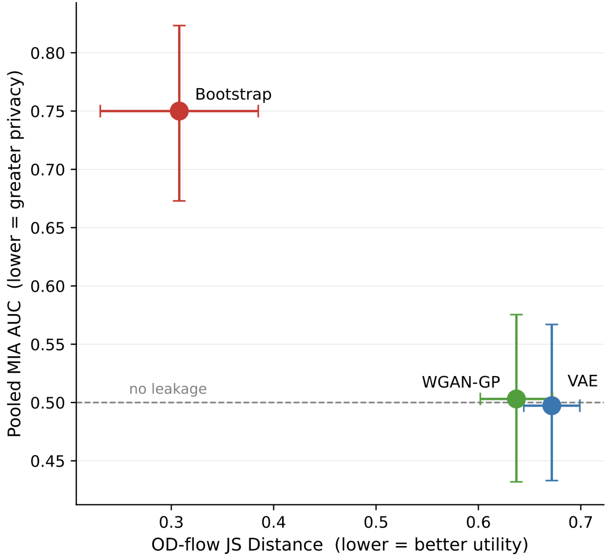
Further Research
Good Utility, Poor Privacy
The ideal!
(Good Utility & Privacy)
Poor Utility, Good Privacy
Notes:
Explain location on graph
More model variations (specifically better fit models) to trace intermediate region between the two extremes
Where we want to be Ideal

Slide 18
Conclusions
Central finding: strong privacy achieved at substantial cost to utility (no observed decoupling)
RQ1 (Utility):
Temporal structure reproduced well (JS distance 0.12–0.15 for hour-of-day/day-of-week; realistic trip start times and durations)
Spatial structure reproduced poorly (JS distance >0.8; TSTR ratio 0.25–0.27 vs. 0.99 for the bootstrap)
WGAN-GP preserved real spatial dispersion better; VAE compressed trips toward the urban centre
Both models generalised to unobserved locations (over-generalisation)
RQ2 — Privacy
Bootstrap positive control confirmed a working attack (AUC 0.75); its sub-1.0 ceiling reflects ambiguity from OD discretisation shared across individuals
Neither generative model showed measurable leakage (AUC ≈0.50)
RQ3 — Activity-level risk:
MIA-by-activity-group was inconclusive: as few as 28 users per group gave confidence intervals too wide to support any claim
Near-copy rate rose monotonically with activity across all models, including the bootstrap, indicating higher-activity users carry greater record-reproduction risk in principle

Slide 19


Slide 20
References
Shadow-model attack paradigm — the method for RQ2: train shadow models on known IN/OUT splits, learn a membership classifier from their outputs. → Shokri, R. et al. (2017). Membership Inference Attacks against Machine Learning Models. arXiv:1610.05820.
MIA adapted to generative models — closest prior work; attacker sees only a synthetic dataset, reduced to a fixed-length feature vector. → Stadler, T., Oprisanu, B. & Troncoso, C. (2022). Synthetic Data – Anonymisation Groundhog Day. arXiv:2011.07018.
The VAE → Kingma, D.P. & Welling. Auto-Encoding Variational Bayes. arXiv:1312.6114.
WGAN-GP → Gulrajani, I. et al. (2017). Improved Training of Wasserstein GANs. arXiv:1704.00028

Slide 21
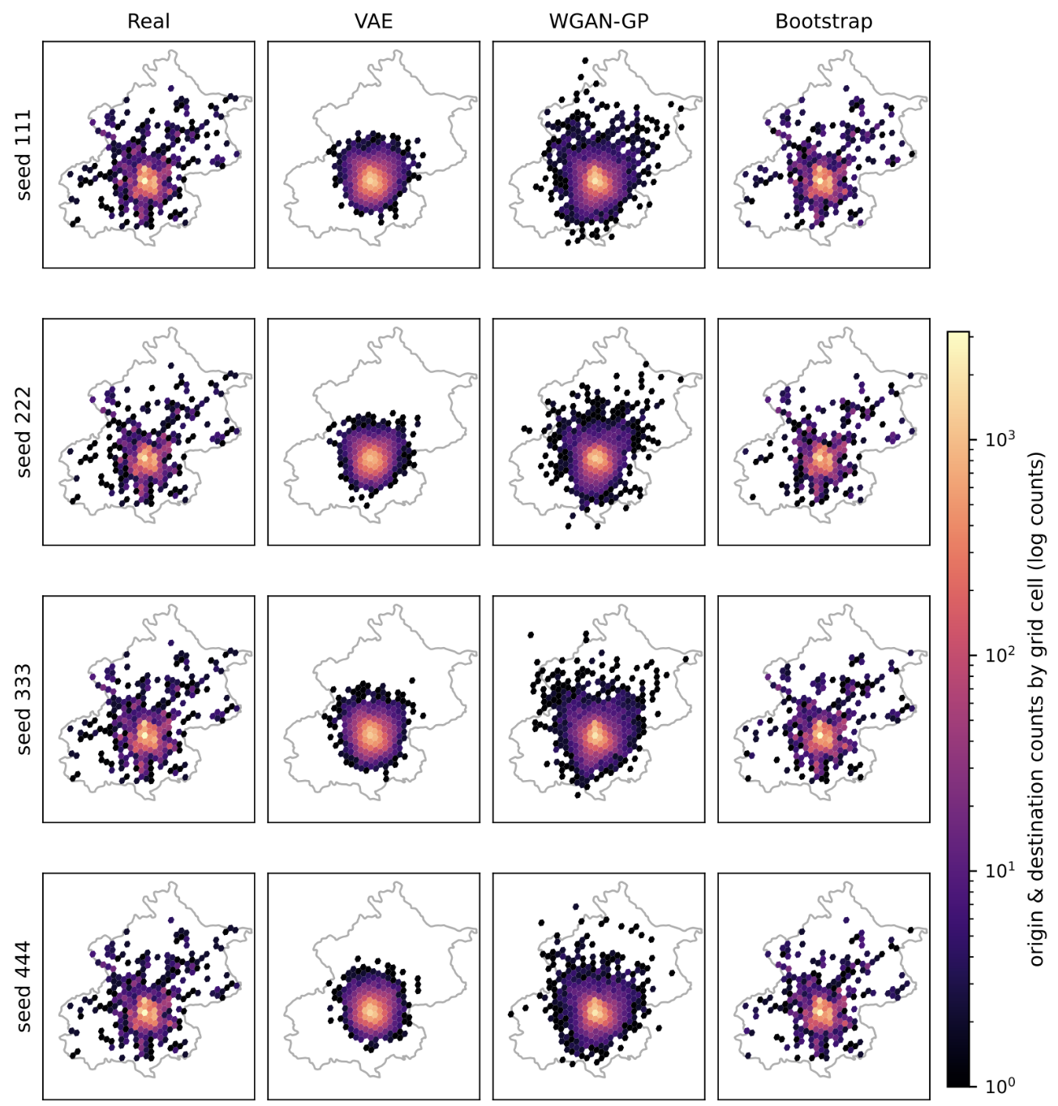

Slide 22
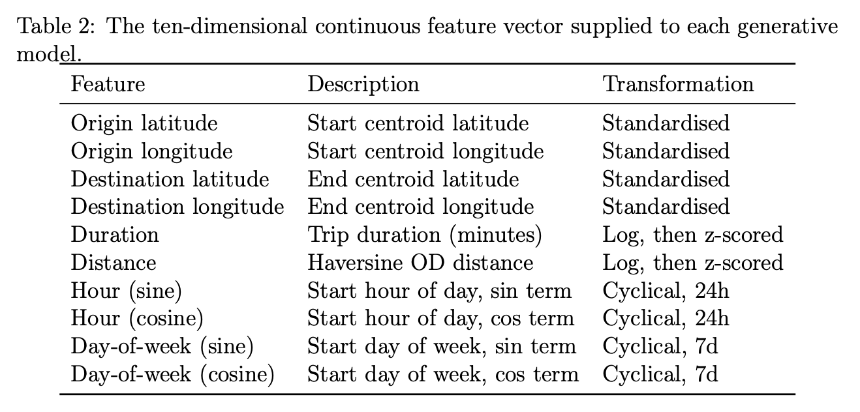
Model Parameters

Slide 23
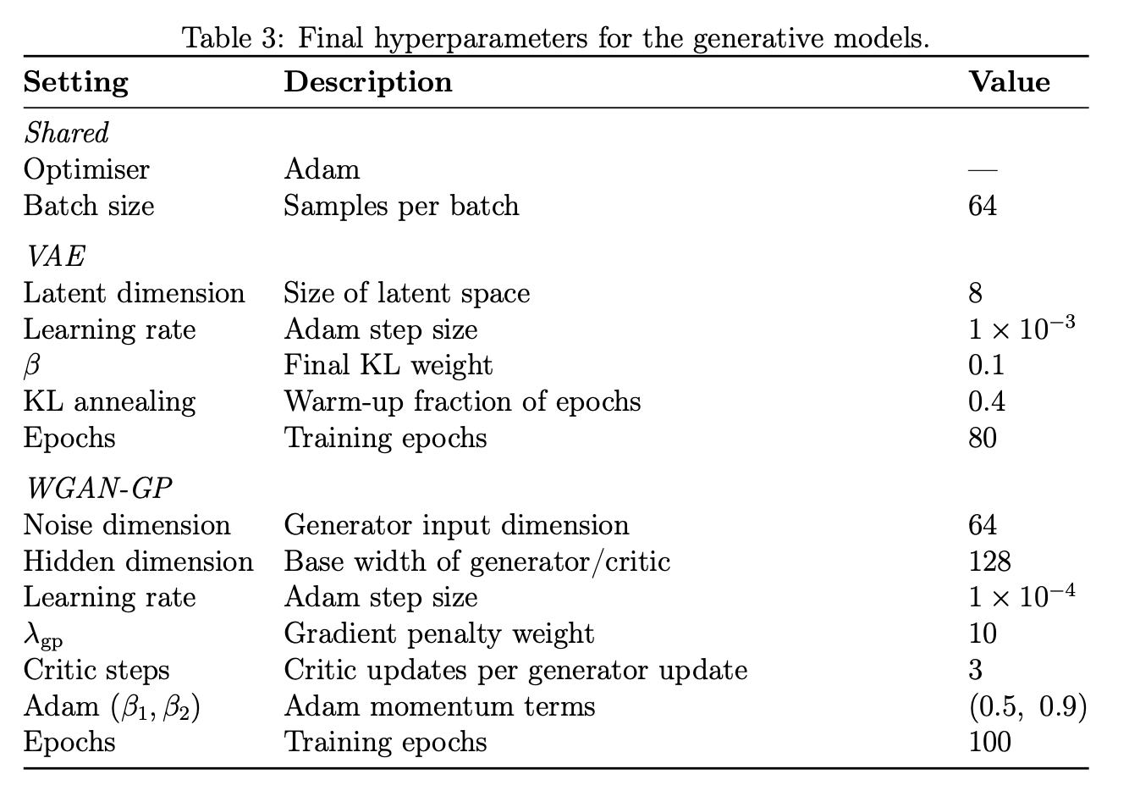
Model Parameters

Slide 24
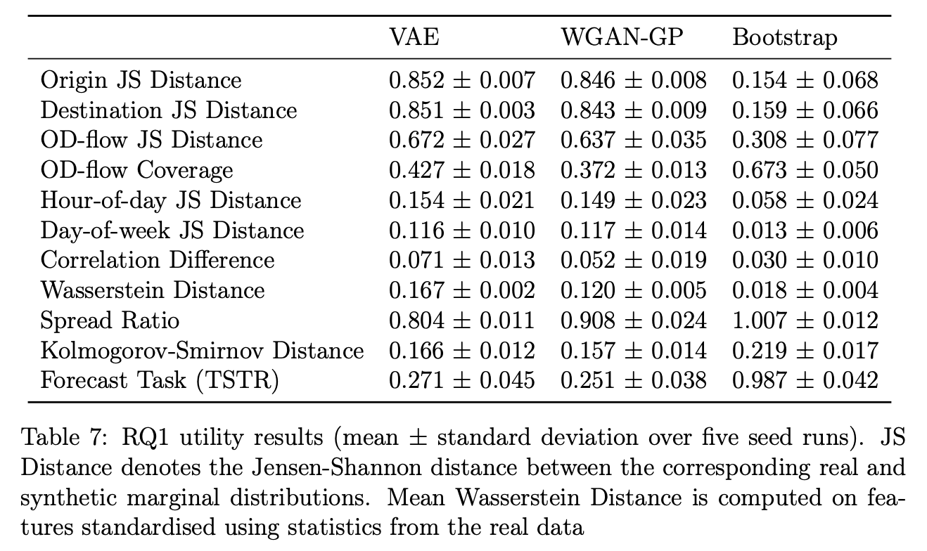

Slide 25
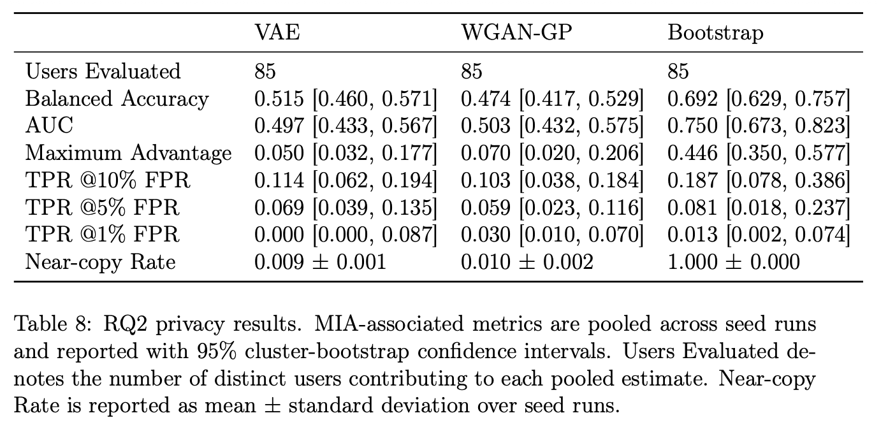

Slide 26


