Slide 1
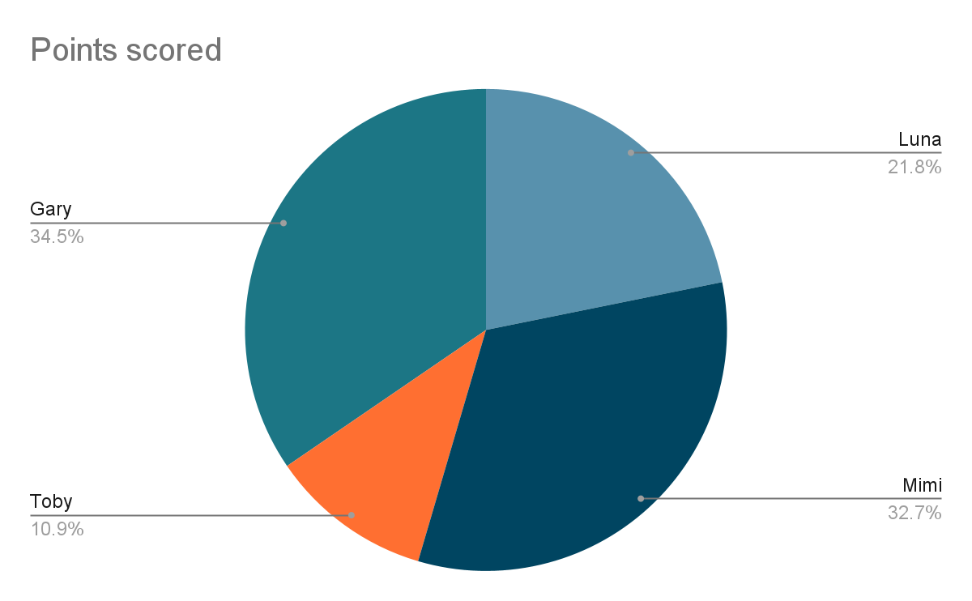
Dog Name | Type | Age
Mimi | Chihuahua | 2
Luna | Border Collie | 13
Toby | Golden Retriever | 7
Gary | Beagle | 4
In a sunny backyard, four spirited dogs—Toby, Luna, Gary, and Mimi—engaged in a lively game that captivated the hearts of their onlookers. Toby, the enthusiastic golden retriever, led the charge with his boundless energy, chasing after a bright red ball that seemed to never tire him. Luna, a nimble border collie, skillfully weaved through the grassy field, her keen eyes always on the prize. Gary, a playful beagle, added his voice to the mix with cheerful barks, while the tiny yet swift Mimi, a chihuahua, darted around, showcasing her impressive speed and agility. Their game was a delightful display of camaraderie and fun, highlighting each dog's unique personality and zest for life.

