Slide 1

EN.580.428 Genomic Data Visualization Lesson 8 Differential Expression Analysis
Prof. Jean Fan

Slide 2
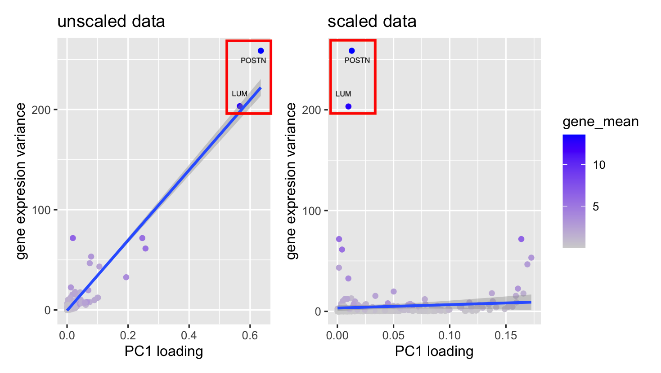

Slide 3
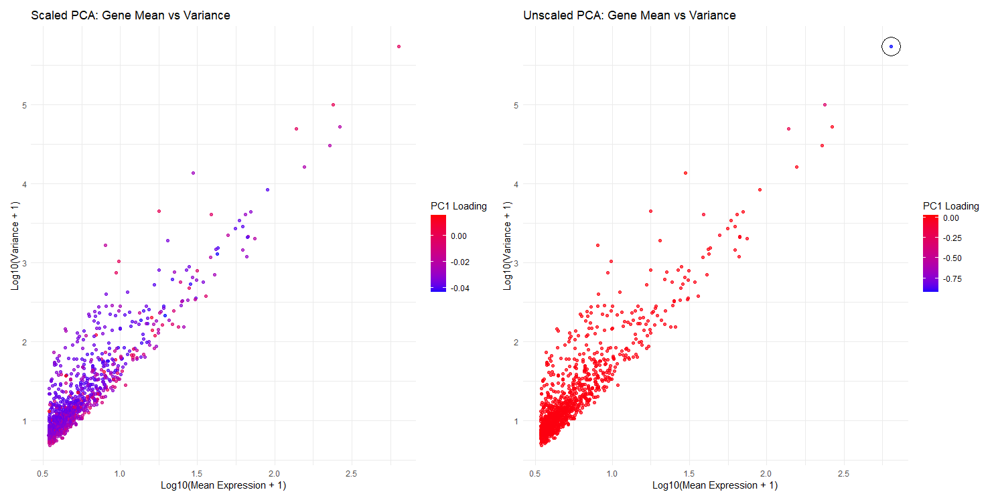

Slide 4
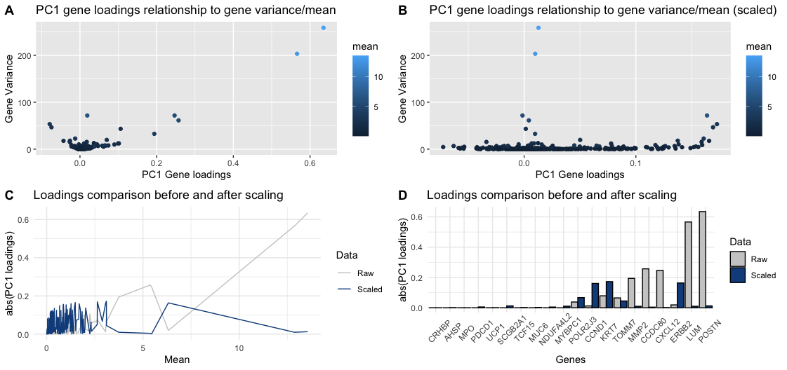

Slide 5
Learning objectives
Learn about and apply statistical approaches to identify differentially expressed genes

Slide 6
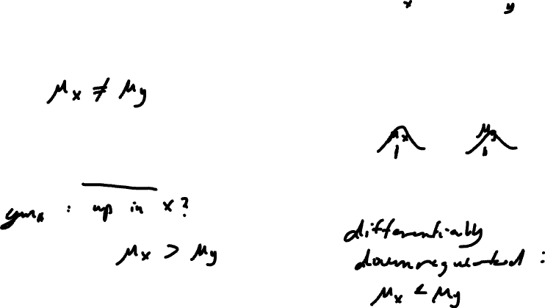
Definitions
Gene B
Differentially expressed genes
Differentially upregulated genes
Gene A

Slide 7
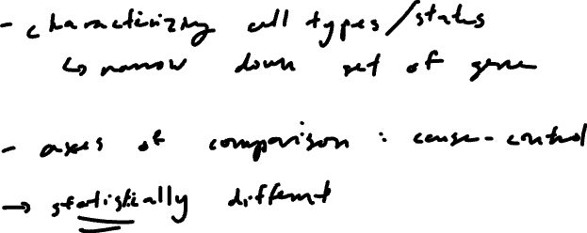
Motivation
Why identify differentially expressed genes?
Notes:
Differentially expressed genes
Differentially upregulated genes

Slide 8
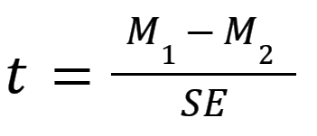
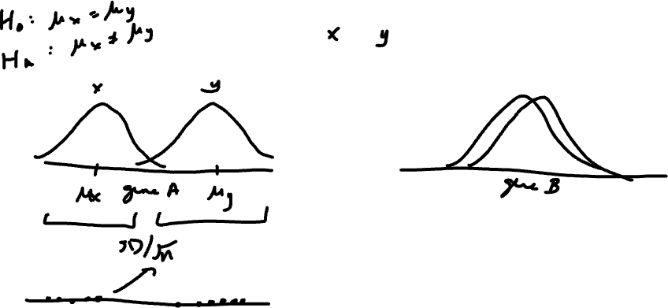
T-test: testing a difference of means (intuition)

Slide 9
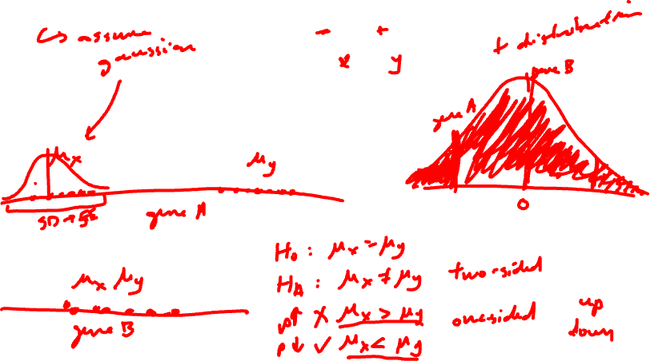
T-test: testing a difference of means (math)

Slide 10
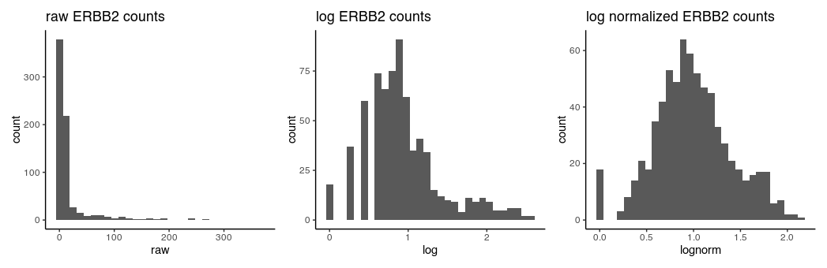
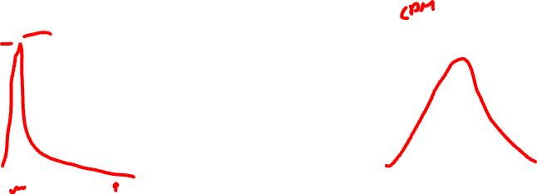
T-test assumptions and data visualization
that the data are quantitative and plausibly Gaussian
that the two samples come from distributions that may differ in their mean value, but not in the standard deviation

Slide 11
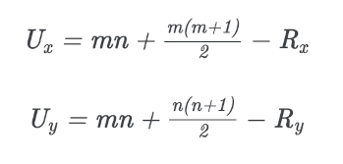
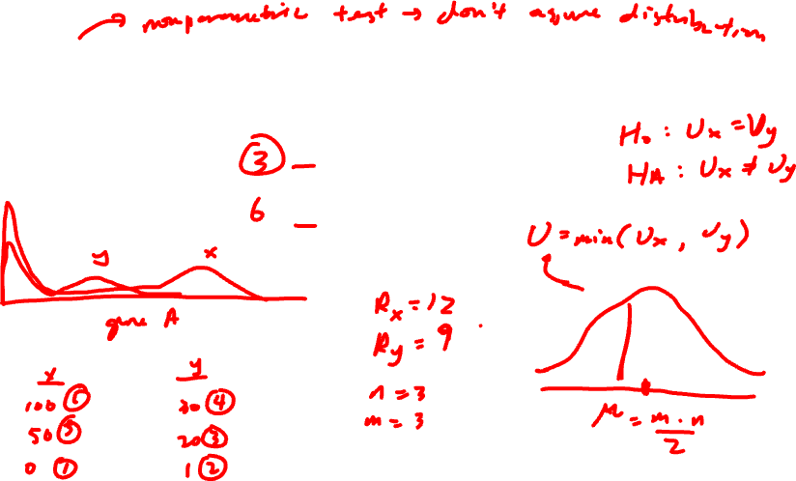
Wilcoxon Rank Sum Test (Mann–Whitney U test ): testing a difference in ranks (intuition)

Slide 12
Wilcoxon Rank Sum Test (Mann–Whitney U test ): testing a difference in ranks (math)

Slide 13
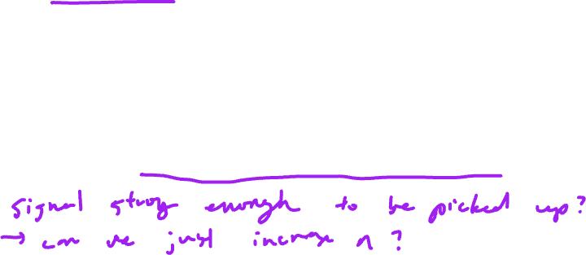
Other statistical tests
Many other tests that incorporate different normalizations, error modeling, Bayesian approaches, etc
Goal is to improve our statistical power in detecting true positives and true negatives while minimizing false positives and false negatives
Often becomes a trade-off with speed and computational complexity

Slide 14
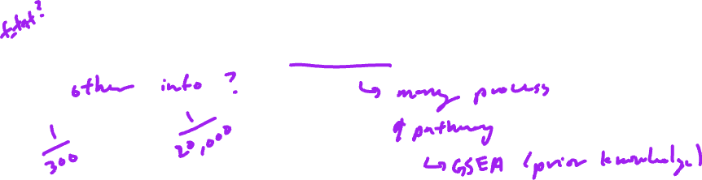
Discussion (no right answer)
Practice
In a spatial transcriptomics experiment, we perform k-means clustering to identify 10 cell clusters. For one cell cluster, there is only 1 gene significantly upregulated. Do you believe this cell cluster represents a distinct cell-type? Why or why not?

Slide 15

Discussion (no right answer)
Practice
In a spatial transcriptomics experiment, we perform k-means clustering to identify 10 cell clusters. For one cell cluster, there are are 100 genes significantly upregulated. But this cell cluster only has 2 cells. Do you believe this cell cluster represents a distinct cell-type? Why or why not?

Slide 16
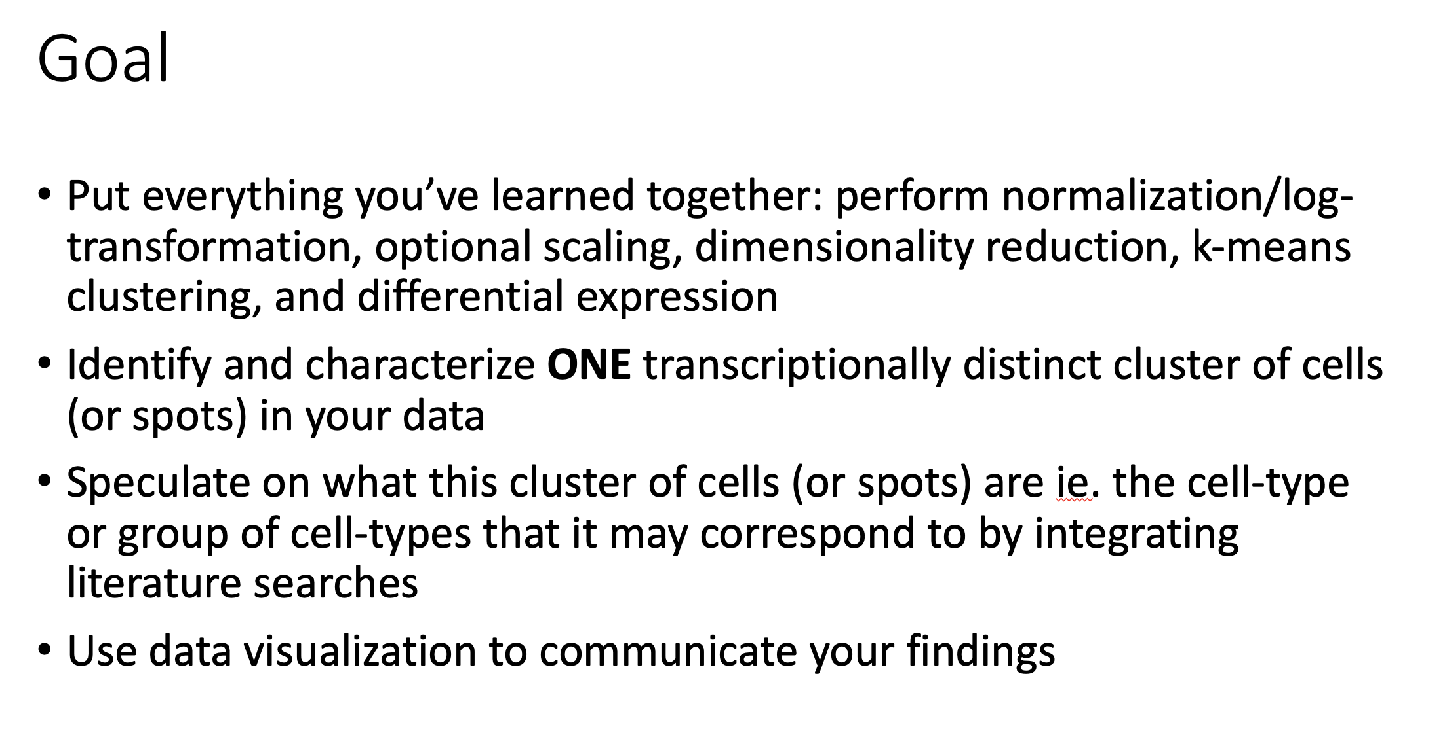
HW3 assigned (due Wednesday)

Slide 17
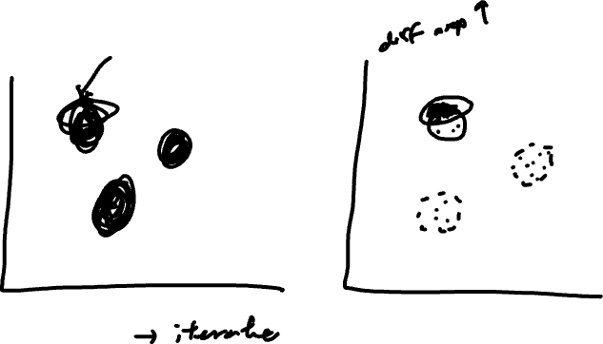
Tips of what not to do

Slide 18
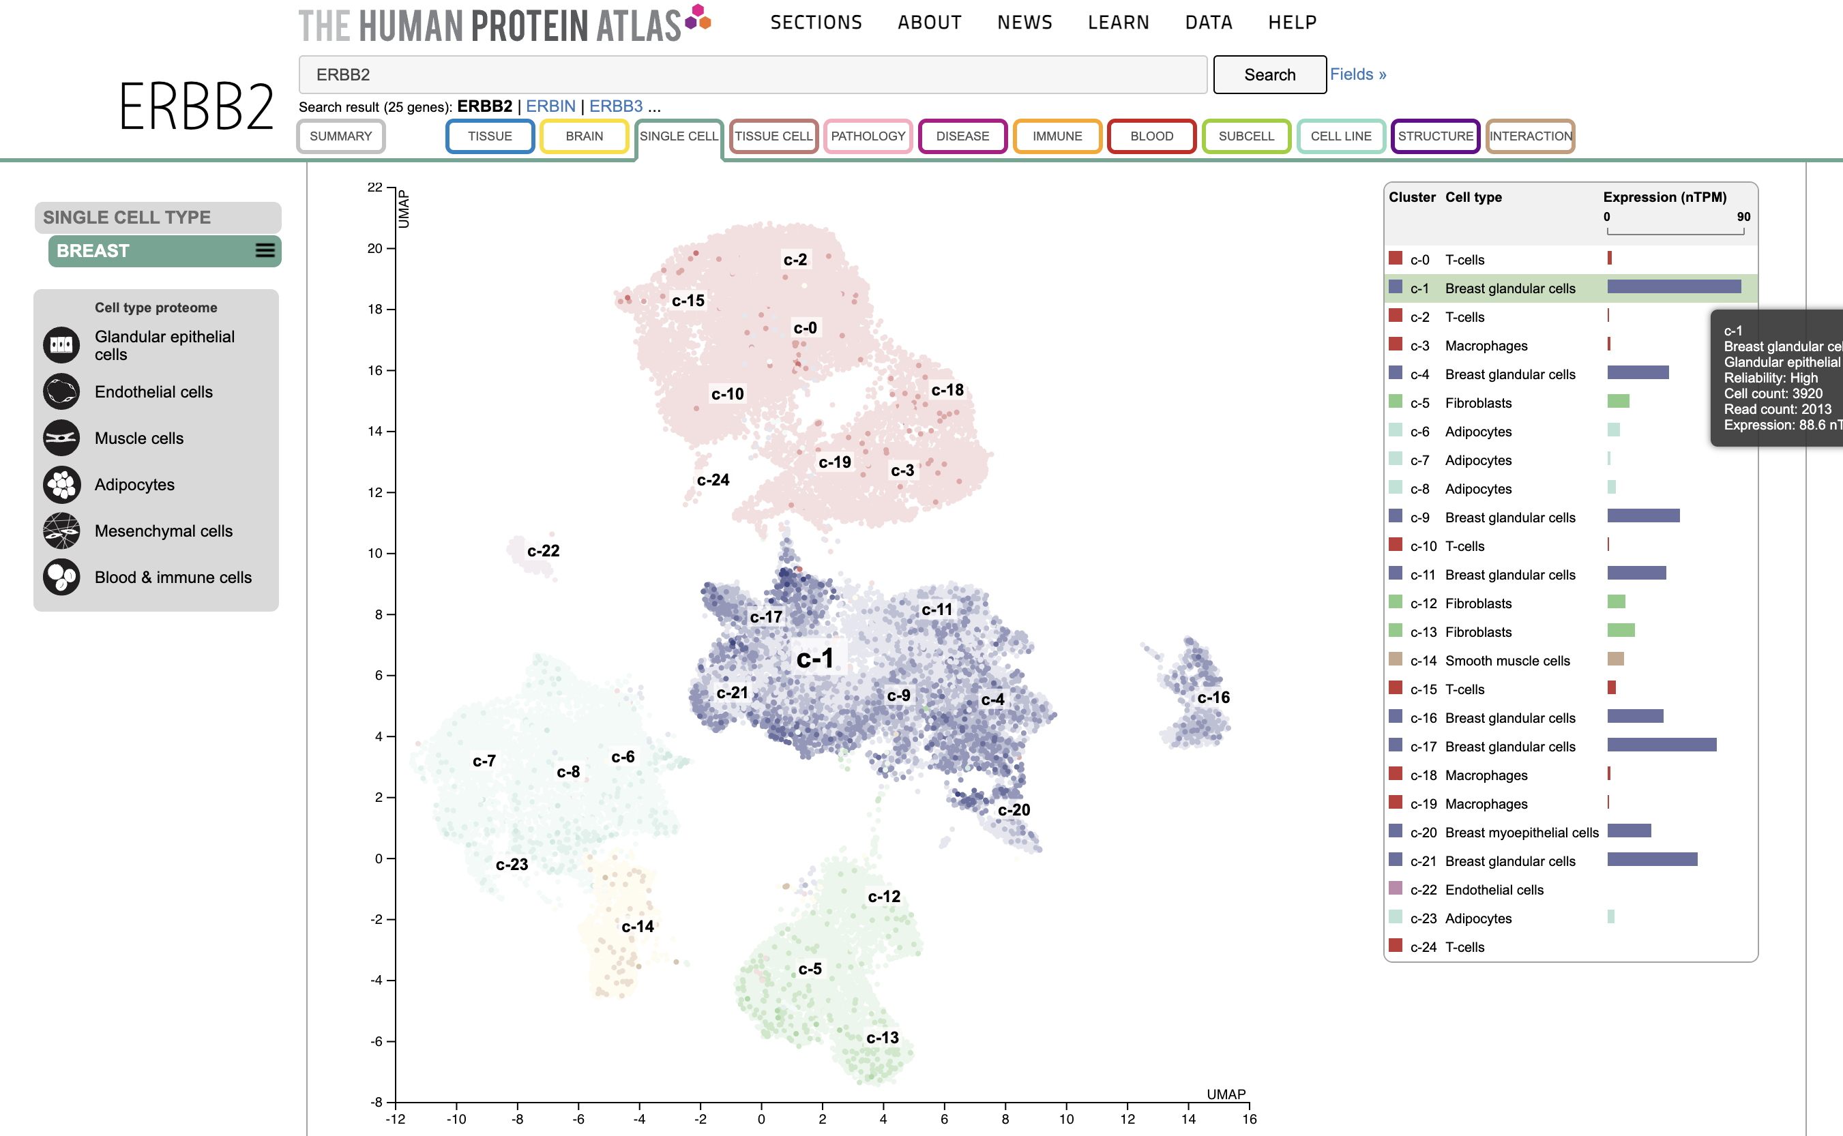
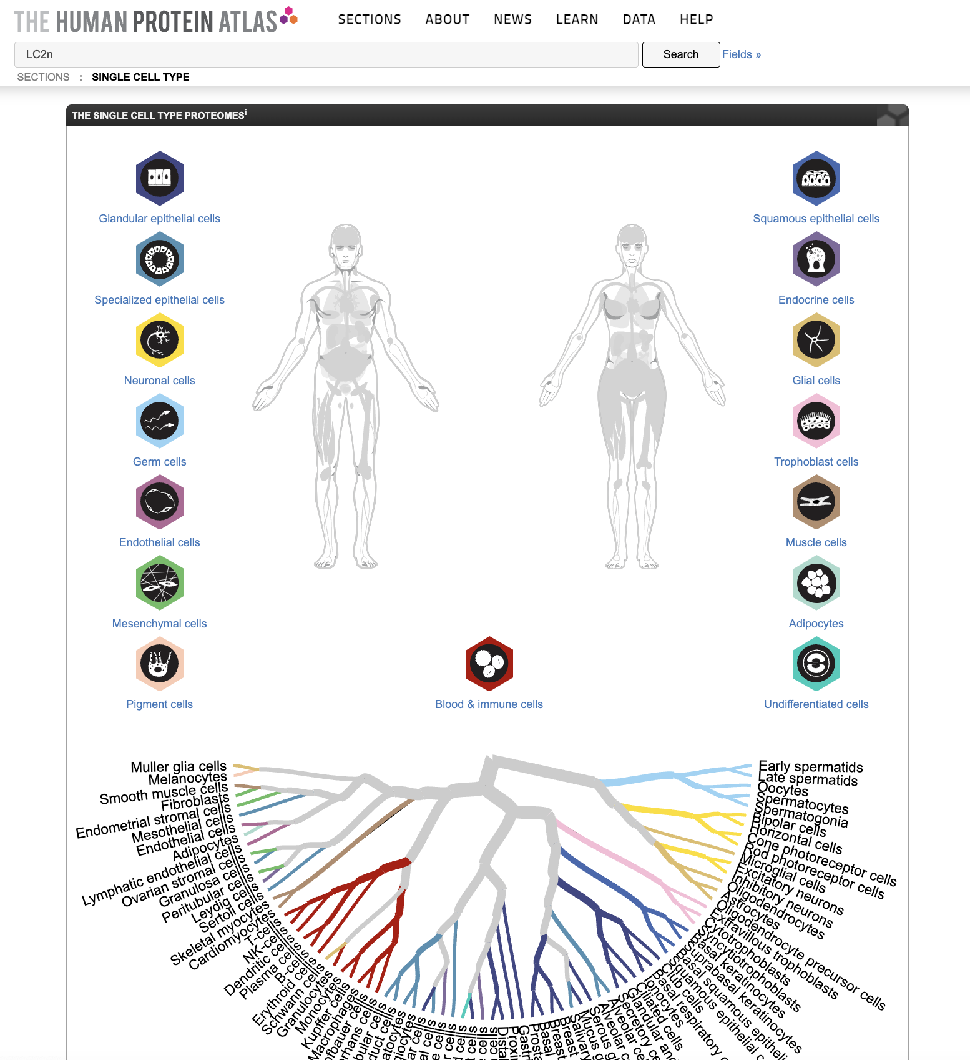
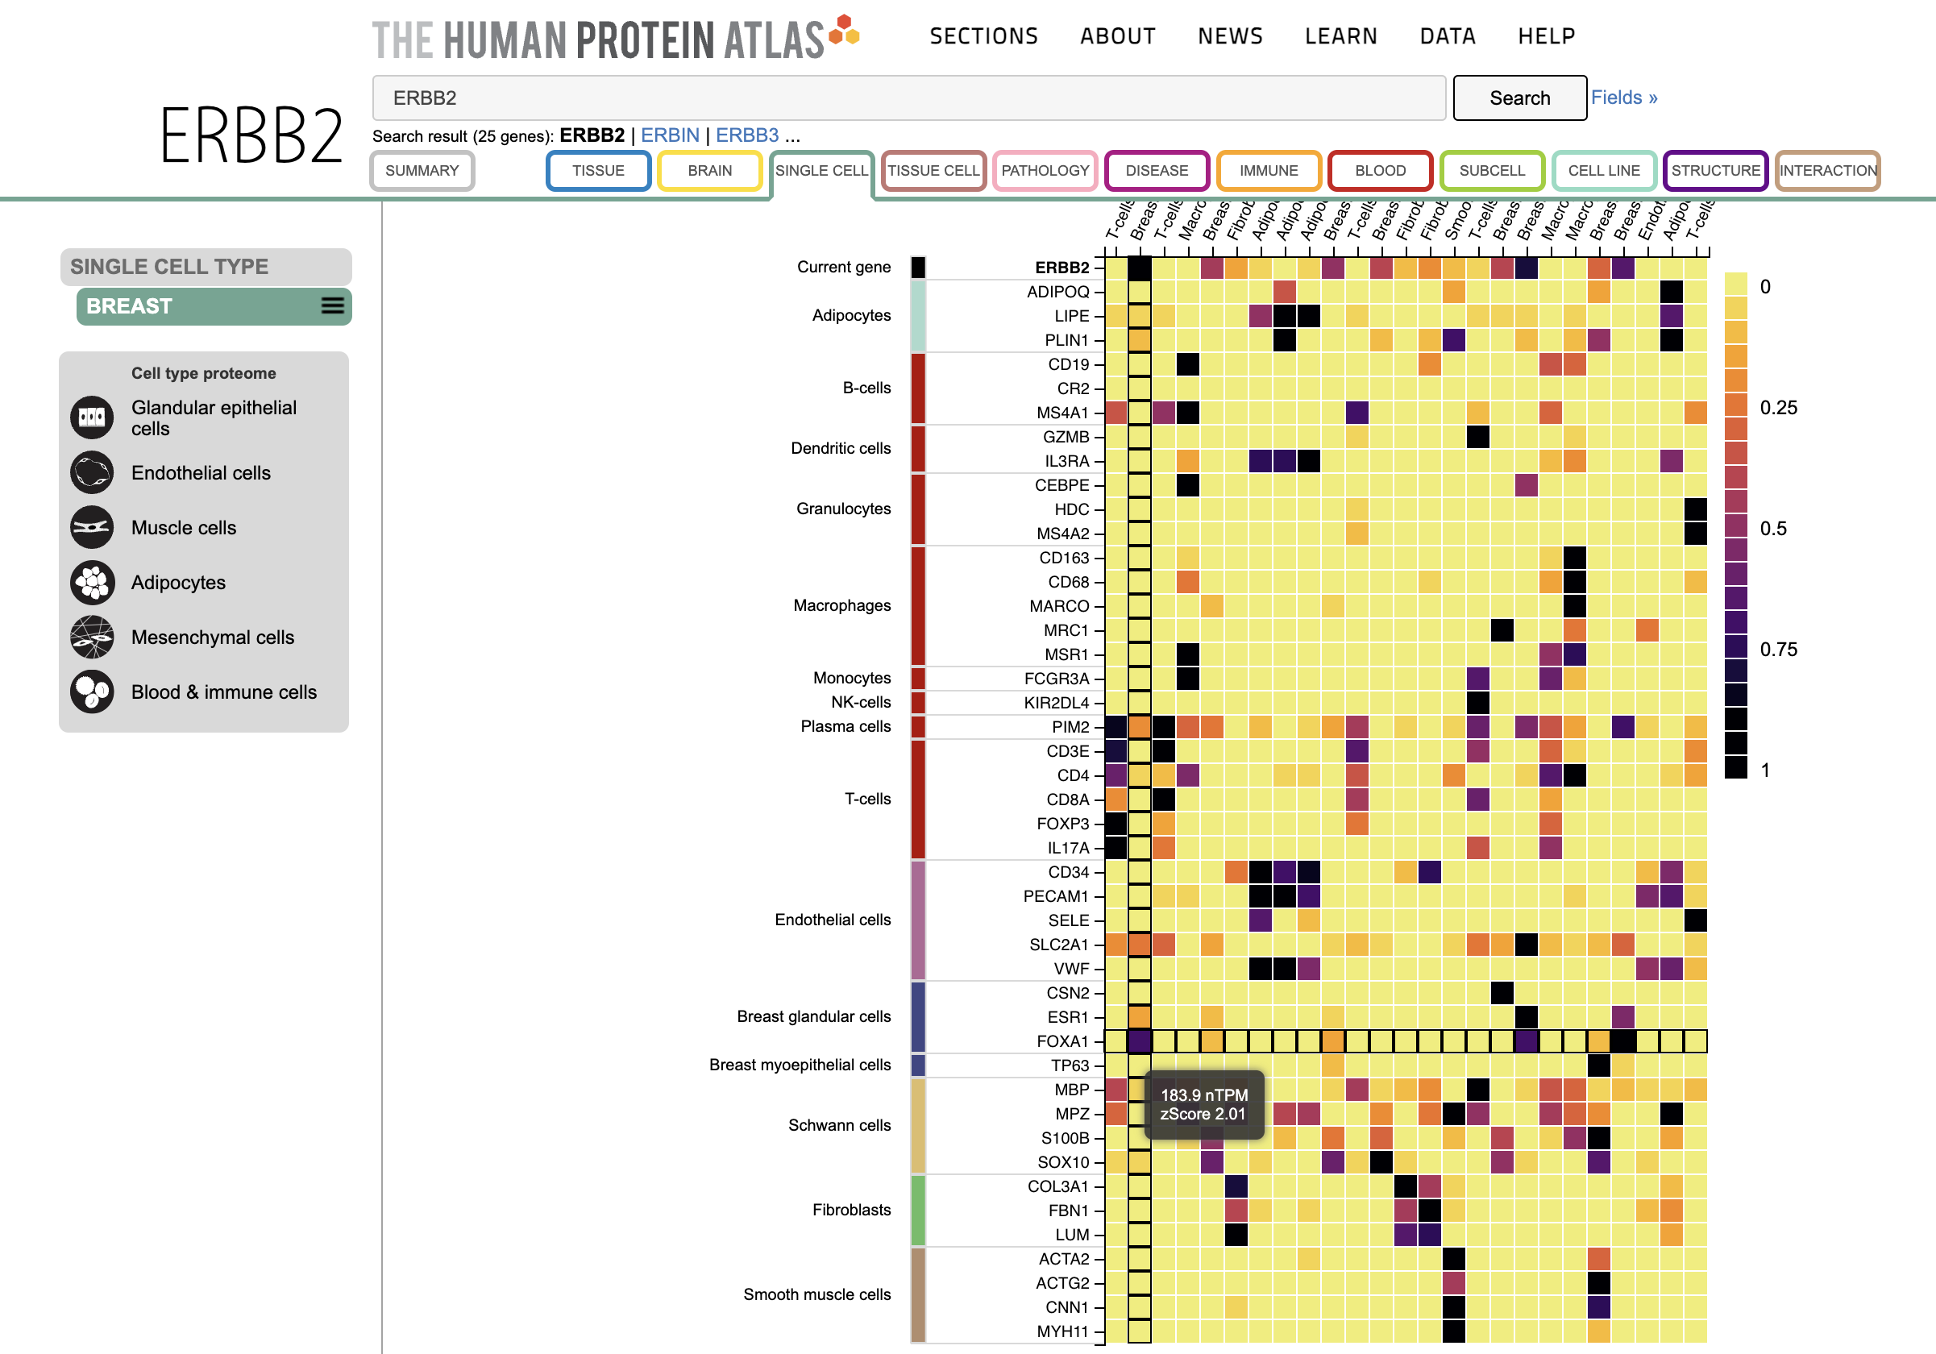
https://www.proteinatlas.org/humanproteome/single+cell+type

