Slide 1
Homework Assignment 1
Due Wednesday (Midnight Baltimore Time)

Slide 2
Create and describe a Data Visualization using YOUR DATA
Your description of your data visualization must address the following questions:
What data types are you visualizing?
What data encodings (geometric primitives and visual channels) are you using to visualize these data types?
What about the data are you trying to make salient through this data visualization?
What Gestalt principles and/or knowledge about perceptiveness of visual encodings are you using to accomplish this?
Your description must use vocabulary terms from Lesson1. You must include the entire code you used to generate the figure so that it can be reproduced. You must provide attribution to external resources referenced (if any) in writing your code.

Slide 3
Submitting your HW

Slide 4
To submit your homework, follow the steps from HW0, summarized here (see additional slides for more details)
0. Update your personal fork by fetching upstream
1. Save your data visualization to the homework/hw[N]/ folder using hw[N]_[jhed].png
2. Create a .md file in main/_posts/ following the template in 2025-01-13-jfan9.md file
- update the file names, paths, and JHED info appropriately!
- be careful about your file path like in HW0!
3. Double check your post and make a pull request as you learned from HW0

Slide 5
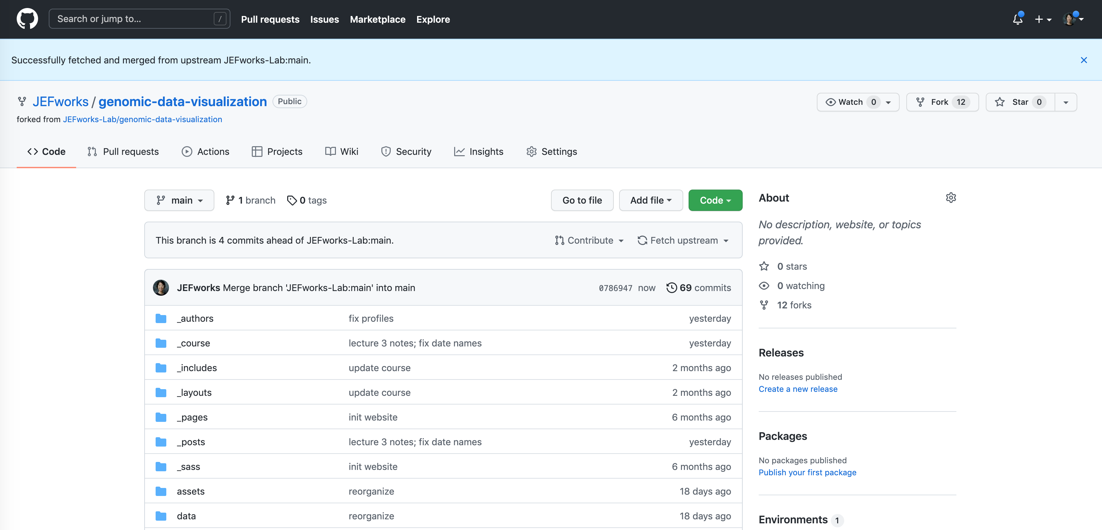
0. Update your personal fork by fetching upstream

Slide 6
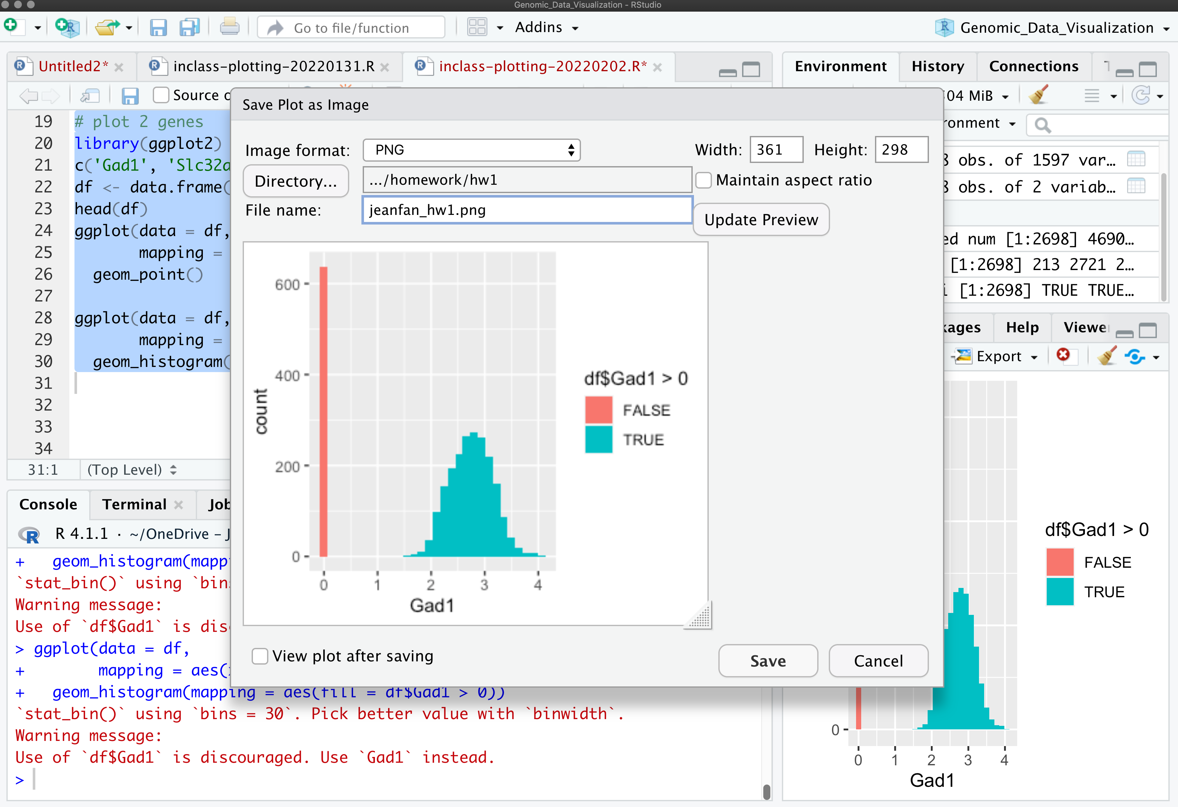
1. Save your data visualization to the homework/hw[N]/ folder using /hw[N]/ folder using hw[N]_[jhed].png

Slide 7
2. Create a .md file in main/_posts/ following the 2025-01-13-jfan9.md file
Update the date on the file name to [the date the homework is submitted]-[your jhed].md
Note that the format of the date is [year]-[month]-[day]
Your file will likely look something like this to the right but with the highlighted components changed
Note that the ”image:” should point to the image you just uploaded to the homework/ folder so please update the file names accordingly
---
layout: post
title: "Sample Homework Submission"
author: Prof. Jean Fan
jhed: jfan9
categories: [ HW1 ]
image: homework/hw1/jeanfan_hw1.png
featured: false
---
[description]
```{r}
[code]
```

Slide 8
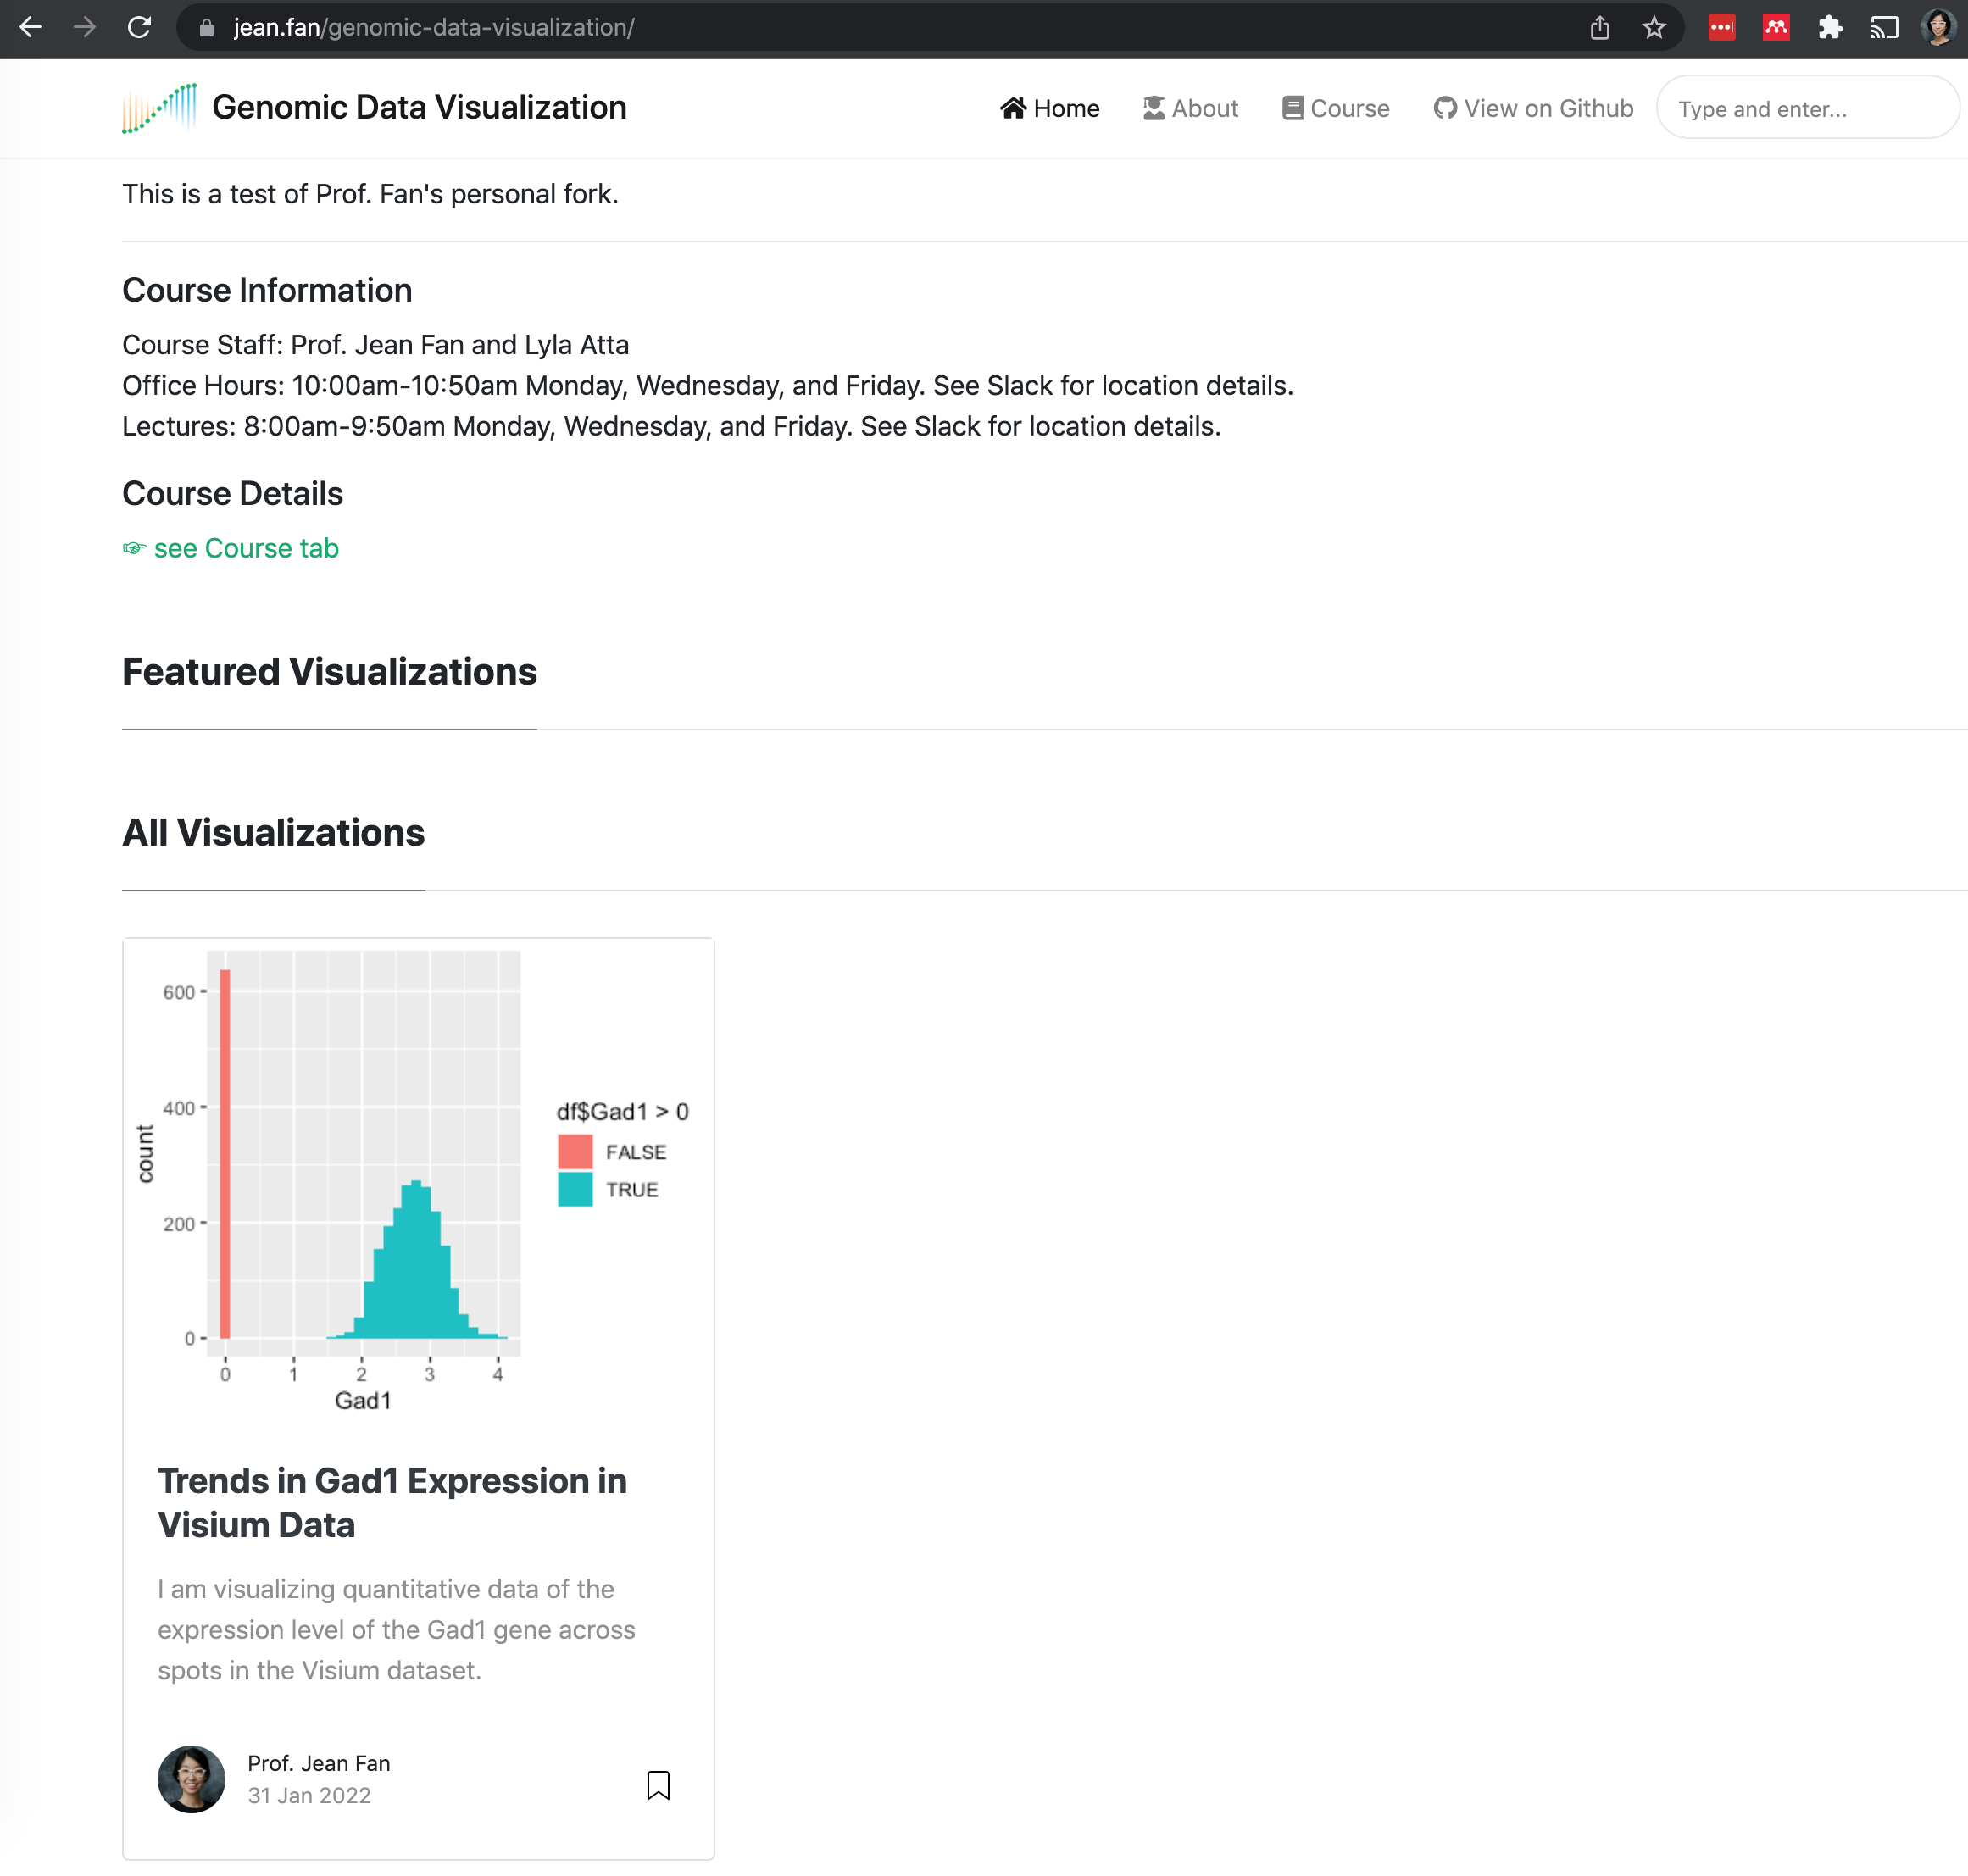
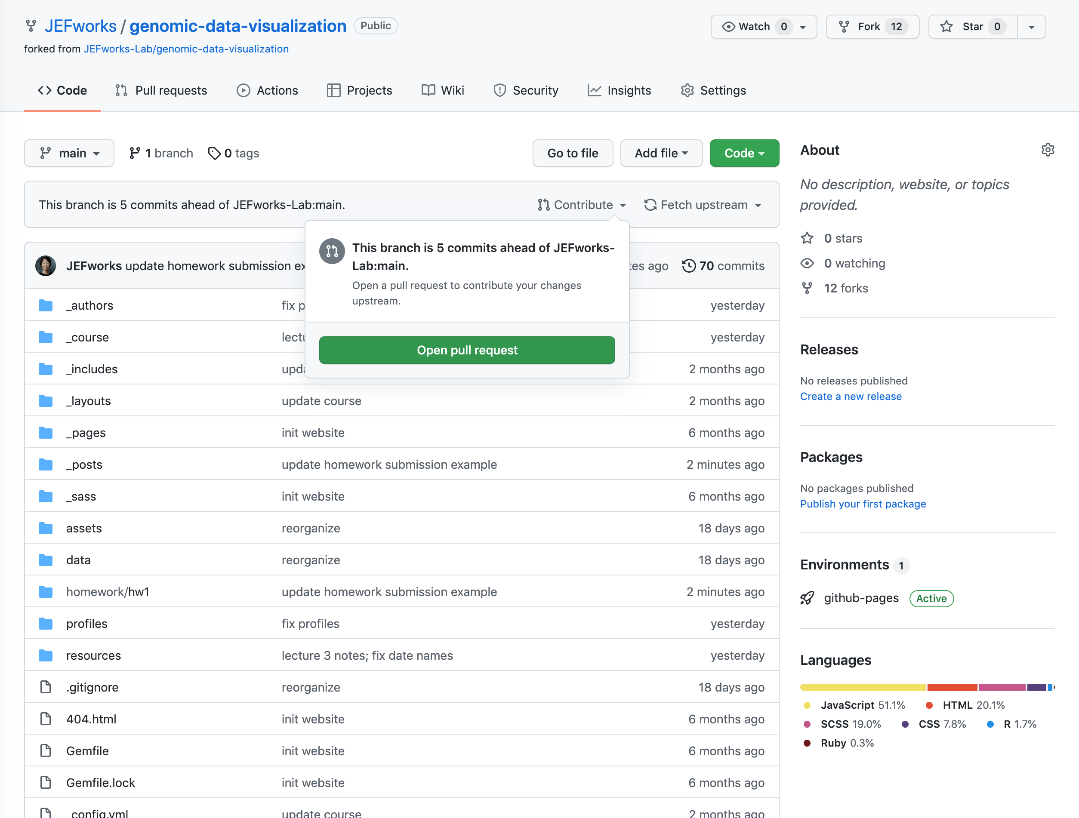
3. Double check your post and make a pull request as you learned from HW0

