Slide 1
EN.580.428 Genomic Data Visualization Lesson 3 Linear Dimensionality Reduction: Principal Components Analysis
Prof. Jean Fan

Slide 2
Lesson learning objectives
Learn about and apply linear dimensionality reduction via principal components analysis

Slide 3
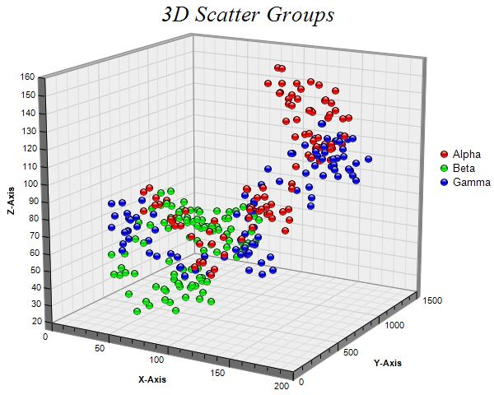
Why do we need dimensionality reduction?
4D?

Slide 4
Linear dimensionality reduction: principal components analysis
Gene B
Gene A

Slide 5
Step 1: center the data
Gene B
Gene A

Slide 6
Step 2: find the of best fit
Gene B
Gene A

Slide 7
Equivalent Step 2: find the line of best fit
Gene B
Gene A

Slide 8
Scree plot: PC# vs stdev

Slide 9
PCs are linear combinations of genes (why this is linear dimensionality reduction)
PC1
Gene B
Gene A

Slide 10
Consider the following centered gene expression
Practice
Are solutions unique?
Gene B
Gene A

Slide 11
Genes that are more highly expressed tend to be more variable. How does this impact our PCs?
Practice
Gene B
Gene A

Slide 12
Gene expression is correlated with cell size (for imaging-based ST) or number of cells per spot (for sequencing-based ST). How does this impact our PCs?
Practice

Slide 13
For next class, please install these R packages
Rtsne
install.packages('Rtsne’)
patchwork
https://patchwork.data-imaginist.com/

Slide 14
Fill out your reflection card
Take Home Quiz Friday

