Slide 1

EN.580.428 Genomic Data Visualization Lesson 5 Linear Dimensionality Reduction: Principal Components Analysis
Prof. Jean Fan

Slide 2
Lesson learning objectives
Learn about and apply linear dimensionality reduction via principal components analysis

Slide 3
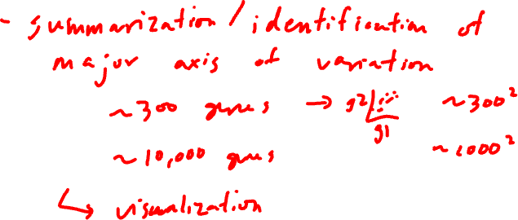
Why do we need dimensionality reduction?

Slide 4
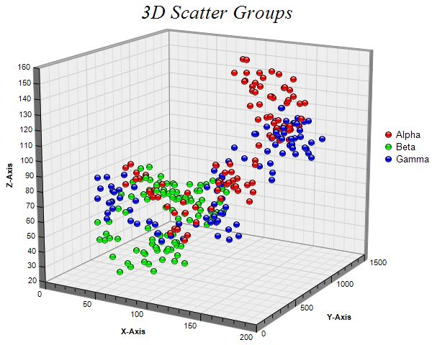
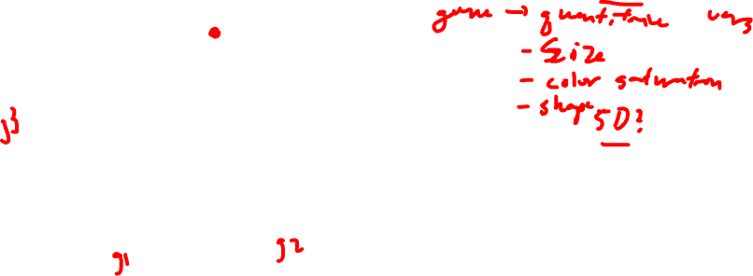
Why do we need dimensionality reduction?
4D?

Slide 5
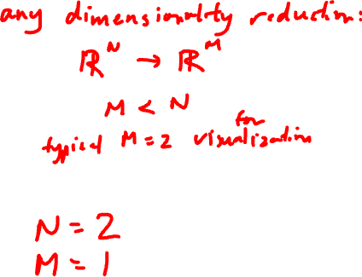
Linear dimensionality reduction: principal components analysis
Gene B
Gene A

Slide 6
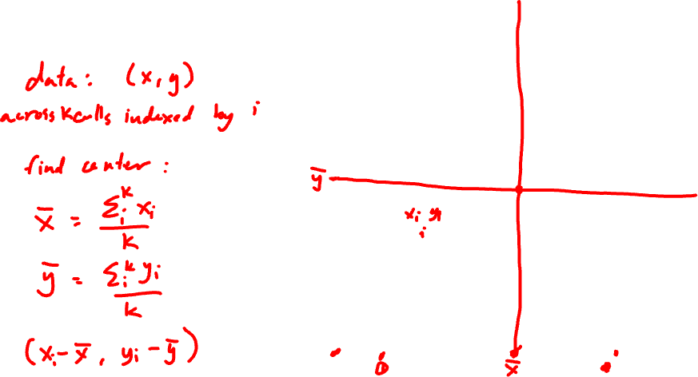
Step 1: center the data
Gene B
Gene A

Slide 7
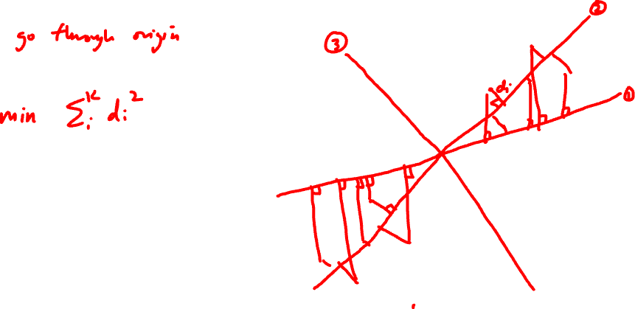
Step 2: find the of best fit
Gene B
Gene A

Slide 8
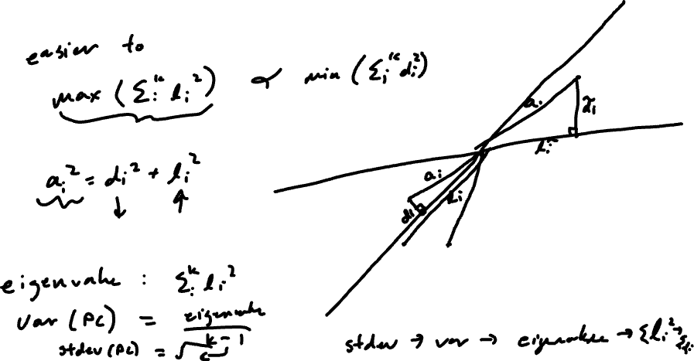
Equivalent Step 2: find the line of best fit
Gene B
Gene A

Slide 9
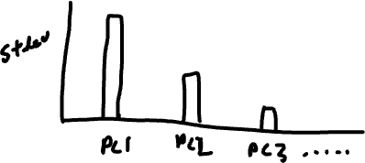
Scree plot: PC# vs stdev

Slide 10

Which of these can be screen plots?
Practice
Stdev
Stdev
Stdev
1 2 3 4
1 2 3 4
1 2 3 4
PC
PC
PC

Slide 11
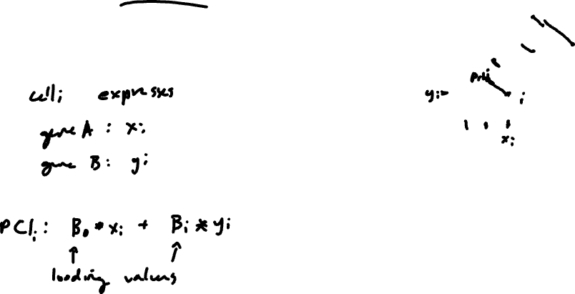
PCs are linear combinations of genes (why this is linear dimensionality reduction)
PC1
Gene B
PC2
Gene A

Slide 12
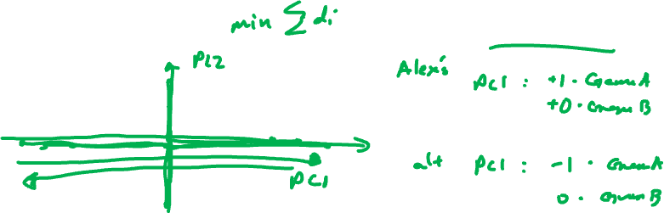
Consider the following centered gene expression
Practice
Are solutions unique?
Gene B
Gene A

Slide 13
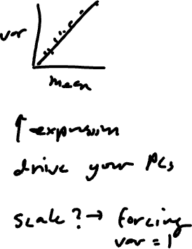
Genes that are more highly expressed tend to be more variable. How does this impact our PCs?
Practice
Gene B
Gene A

Slide 14
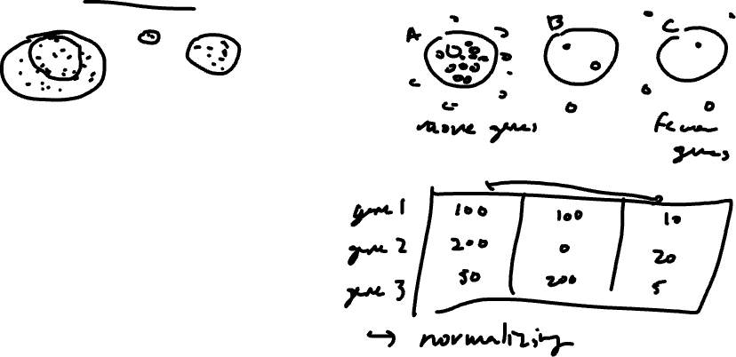
Gene expression is correlated with cell size (for imaging-based ST) or number of cells per spot (for sequencing-based ST). How does this impact our PCs?
Practice

Slide 15
Homework 2 assigned and due Wednesday
Goal is to explore PCA
Please do not commit and submit .RData, .Rhistory, other extraneous files
We will take off 5% if we need to clean up your submission

