Slide 1

EN.580.428 Genomic Data Visualization Lesson 6 Non-linear Dimensionality Reduction: T-distributed Stochastic Neighbor Embedding
Prof. Jean Fan

Slide 2
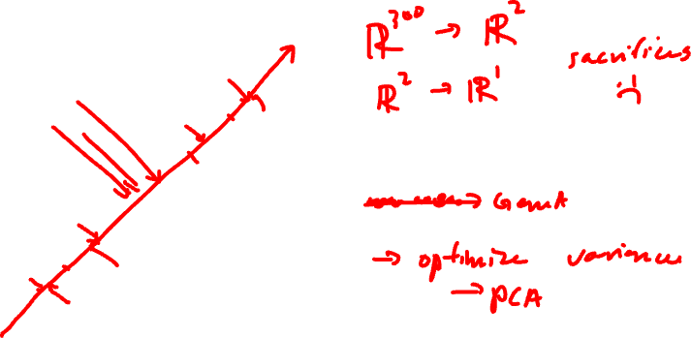
Remotivating Dimensionality Reduction
Gene B
Gene A

Slide 3
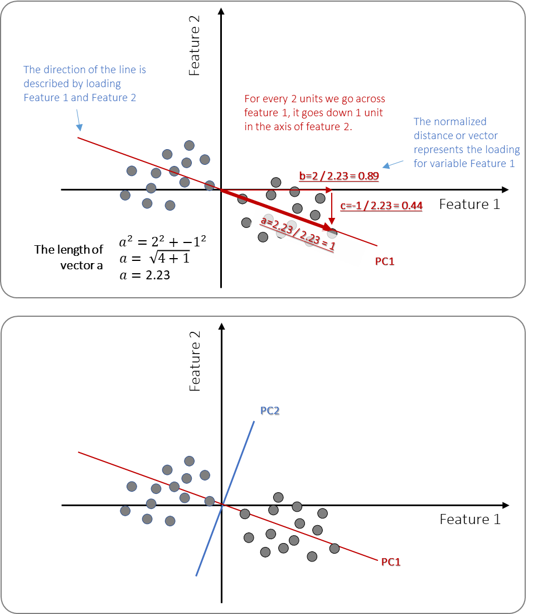
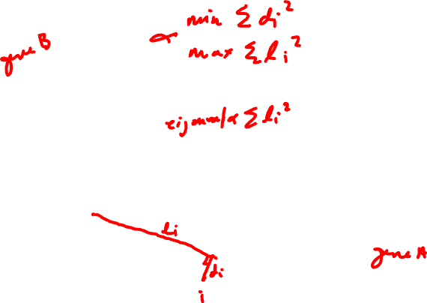
PCA review

Slide 4
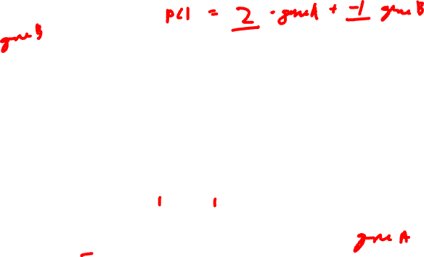
PCA review

Slide 5
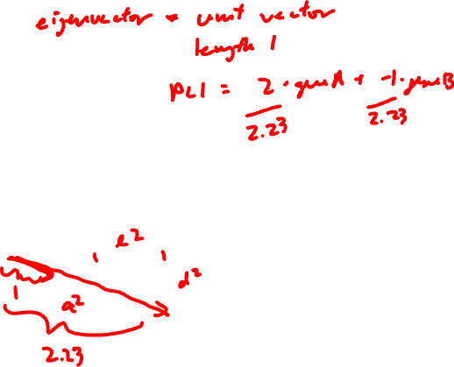
PCA review

Slide 6
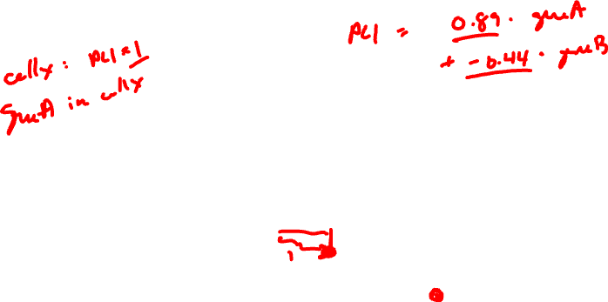
PCA review

Slide 7

PCA review
Practice
The loading value of geneA on PC1 is 1
What is the loading value of all other genes on PC1?

Slide 8
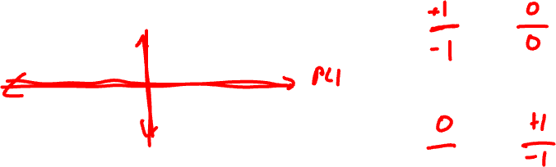
Consider the following centered gene expression
Practice
Gene B
PC1 = geneA + geneB
Gene A
PC2 = geneA + geneB

Slide 9
Lesson learning objectives
Learn about and apply t-SNE

Slide 10
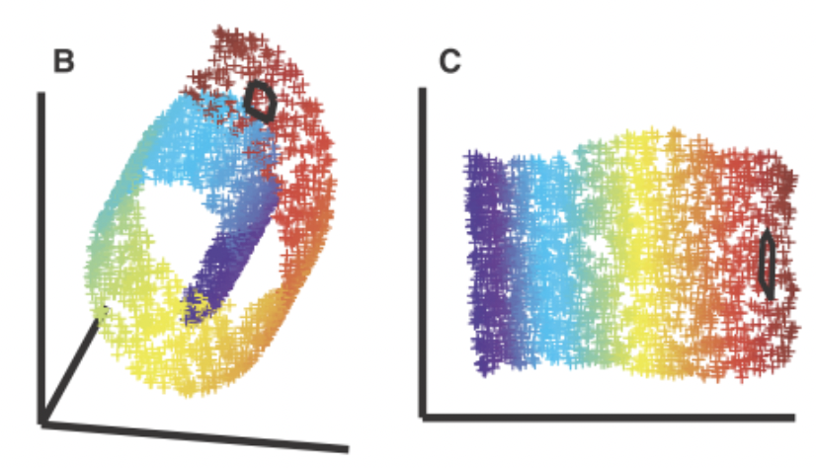
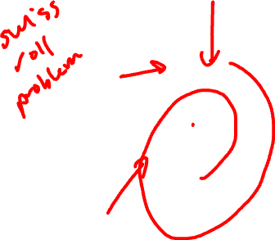
Motivating non-linear dimensionality reduction → linear dimensionality reduction insufficient
3D
Nonlinear 2D

Slide 11
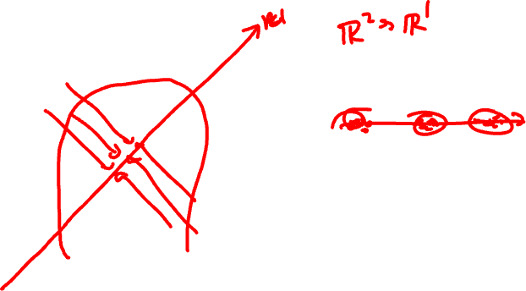
T-distributed Stochastic Neighbor Embedding
Gene B
Gene A

Slide 12
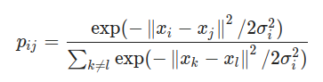
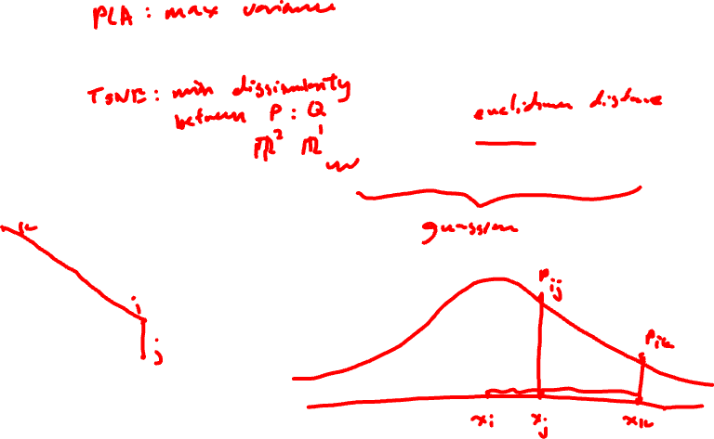
Step 1: compute scaled similarity P in high-dimensional space
Gene B
Gene A

Slide 13

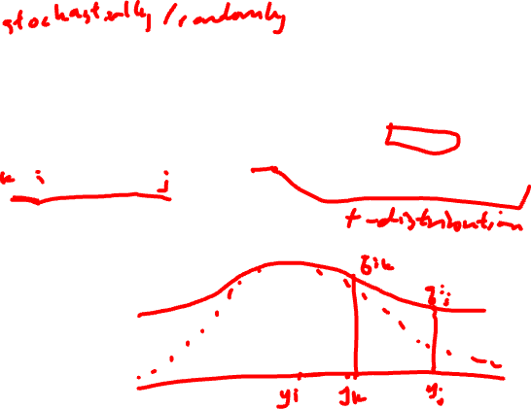
Step 2: place cells into low dimensional space and compute another scaled similarity metric Q
tSNE-1

Slide 14

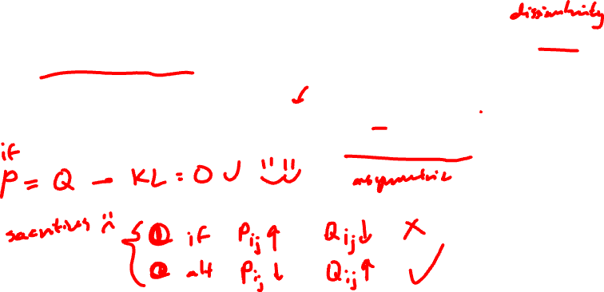
Step 3: P is fixed. Iteratively find a Q to minimize the KL divergence between P and Q

Slide 15
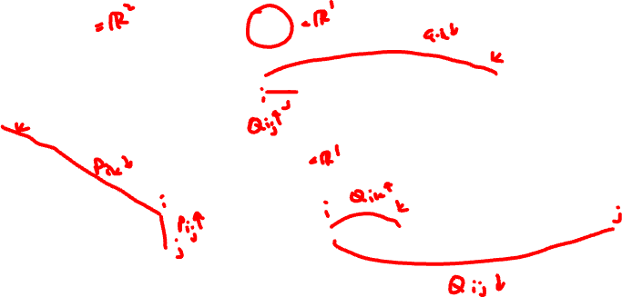
Given P, which Q has a smaller KL divergence?
Practice
P
Q₁
Gene B
tSNE-1
Q₂
tSNE-1
Gene A

Slide 16
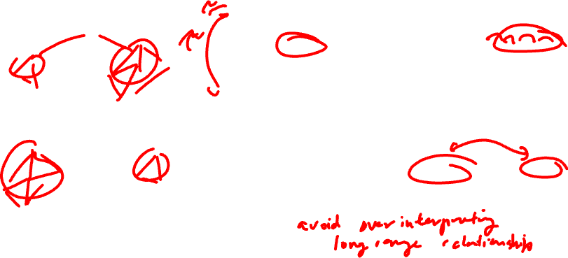
Given P, which Q has a smaller KL divergence?
Practice
P
Q₁
Gene B
tSNE-1
Q₂
tSNE-1
Gene A

Slide 17
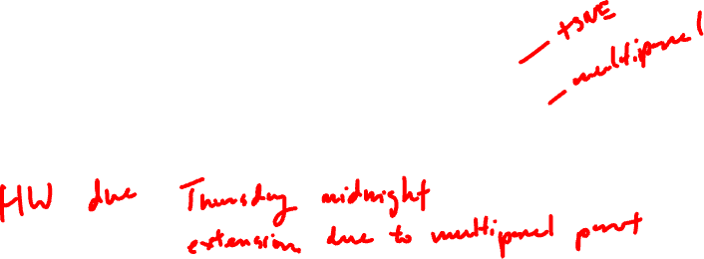
Hands-on Component
Please install these R packages
install.packages(‘Rtsne’)
install.packages(‘patchwork’)

