Slide 1
Introduction to decision trees
Machine Learning Study Group
Ole Schulz-Trieglaff
Dec 9th 2015

Slide 2
Why decision trees?
  Basic version is easy to understand and implement
  “White box” method = you can actually understand how the tree derives a certain classification
  But can get arbitrarily complex.
  Is not a “toy method”, variations of the decision tree are used in real-world problems.

Slide 3
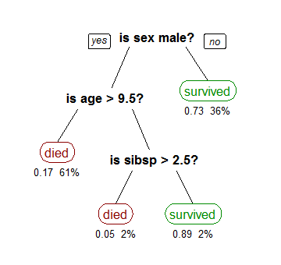
"CART tree titanic survivors" by Stephen Milborrow - Wikipedia

Slide 4
ID3 algorithm 1
Base case:
  Create root node for the tree
  If all examples are positive, return single node tree and assign label “+”
  If all examples are negative, return single node tree and assign label “-”

Slide 5
ID3 algorithm 2
If not base case:
  For all attributes/features/columns in your training data:
    Compute the information gain and remember the attribute A with the highest information gain
  Introduce a new node which splits the data by A
  For each possible value v of A
    Introduce a tree branch corresponding to A=vi
    Examples vi = subset of data which have value vi
      If vi is empty add a leaf node
      Recurse and build new subtree with examples vi and all attributes without A

Slide 6


Entropy and Information Gain

Slide 7
How to get started?
Think about how to represent the tree.
  Explicit with a class for nodes?
  Just dictionary of dictionaries?
Implement information gain and play with
Implement a split function that splits your training data
Combine all of this..

Slide 8
Literature
T. Mitchell “Machine Learning”
Friedman/Tibshirani/Hastie “Elements of Statistical Learning”
http://kldavenport.com/pure-python-decision-trees/
More advanced topics :
  Search google for “random forests” and “gradient tree boosting”

