Slide 1

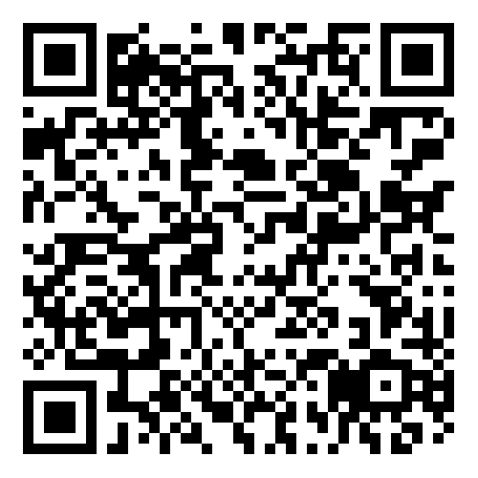
Tompkins County SS4A Joint Safety Action Plan
Public Meeting
July 24, 2024
Visit safestreetstompkins.com or scan here to give safety feedback:
Cambridge Systematics, Inc.
with Sam Schwartz Engineering
FHI Studio
Planning4Places

Slide 2
Agenda
Project Team
Project Overview
Tompkins County Safety Analysis
Next Steps
Q & A

Slide 3
Project Team

Slide 4



Project Team
Project Team from Jurisdictions in Tompkins County
Tompkins County
City of Ithaca
Town of Ithaca
Village of Cayuga Heights
Town of Caroline
Town of Danby
Town of Dryden
Village of Dryden
Town of Lansing
Village of Lansing
Town of Newfield
Consultant Team

Slide 5
Project Overview

Slide 6
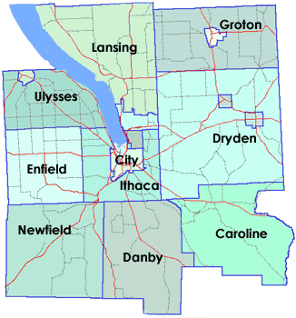
Tompkins County
Purpose of the Project
Develop a comprehensive SS4A Joint Safety Action Plan for Tompkins County
Provide recommendations for prioritized locations to help improve safety and strategies for eliminating fatalities and serious injuries throughout the region
Tompkins County and ten municipalities within Tompkins County have come together to prepare the Joint Safety Action Plan

Slide 7
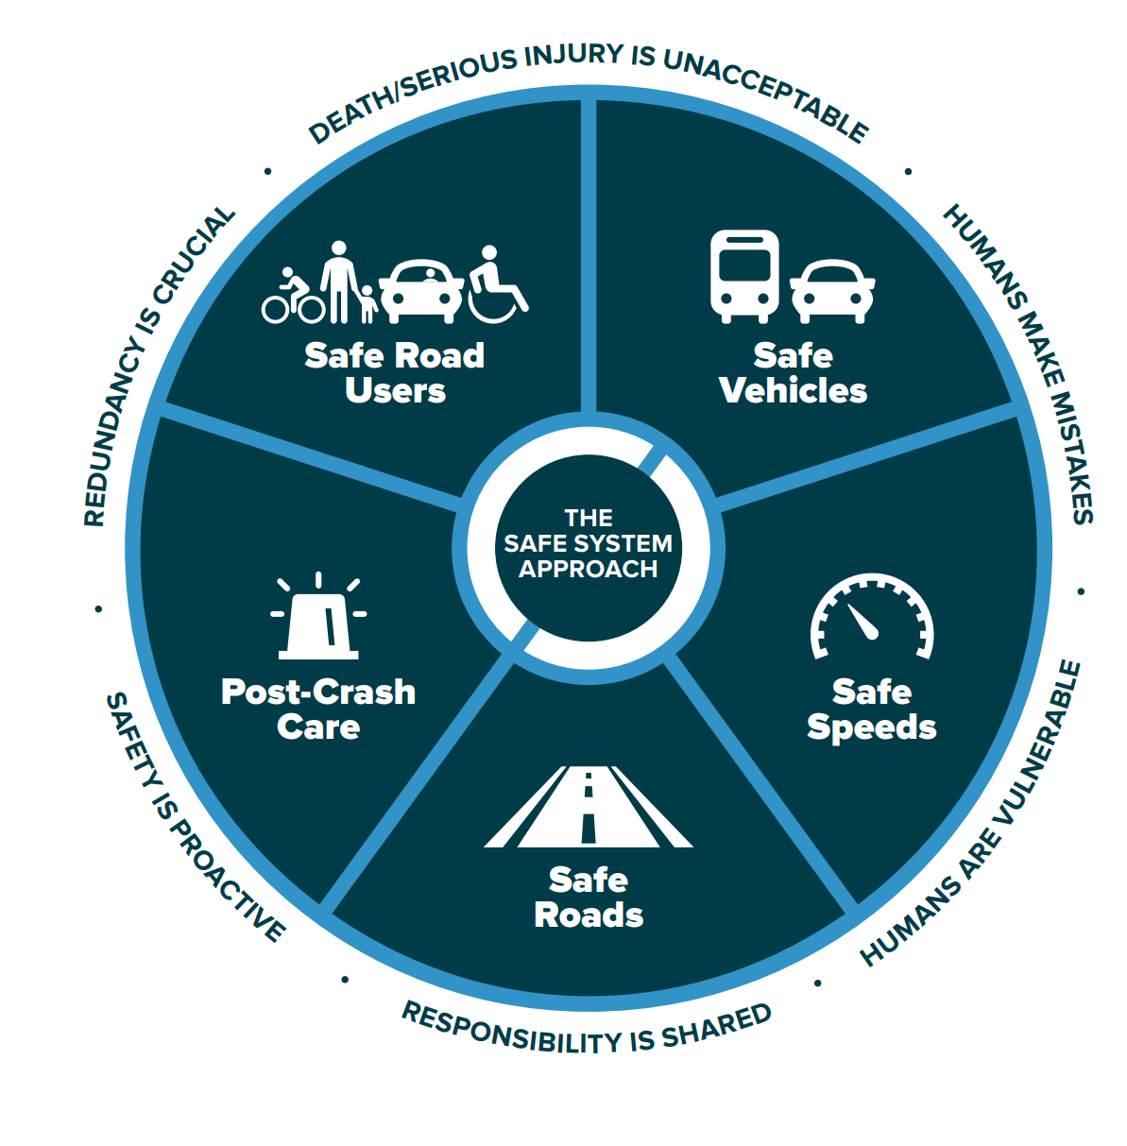
Safe System Approach
New York State adopted FHWA’s Safe System Approach for its transportation system.
NY SHSP’s Vision:
“New York State strives for an equitable and sustainable transportation system that works towards zero fatalities and zero serious injuries for all roadway users.”

Slide 8
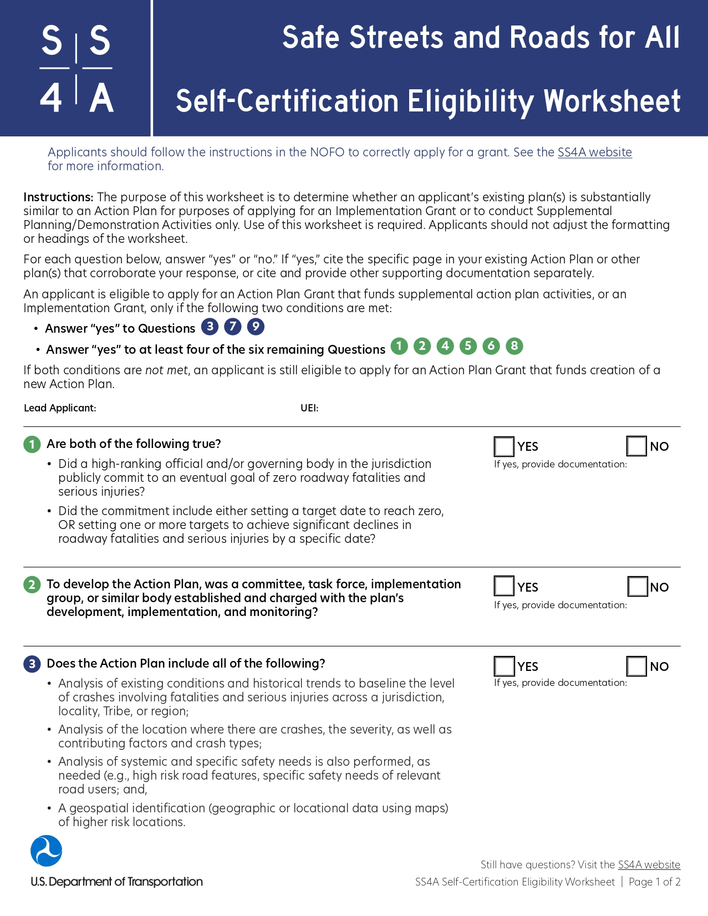
Joint Safety Action Plan Process
Identify key risk factors through a data-driven process
Engage with communities and local representatives
Determine policy and process changes
Prioritize strategies and projects to address safety concerns
Develop a plan compliant with SS4A requirements

Slide 9
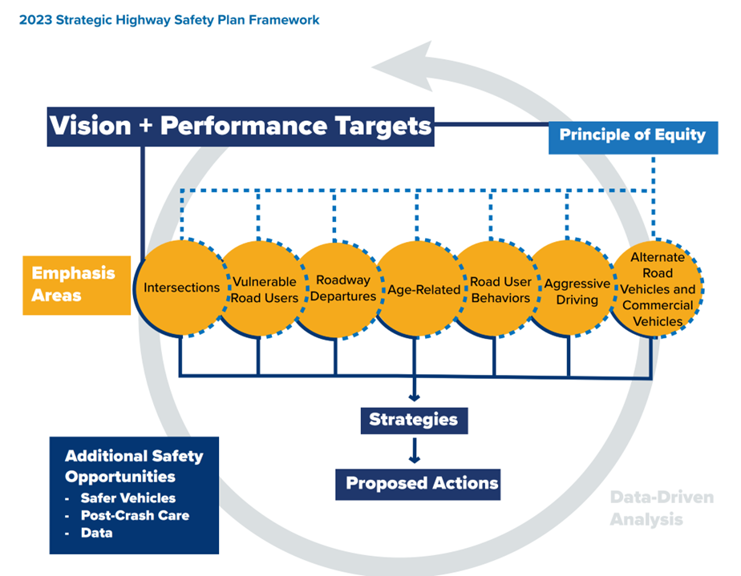
Joint Safety Action Plan Outcomes
Infrastructure, behavioral, and/or operational solutions
List of feasible, measurable, and scheduled action items aligned with 2023 New York SHSP
Performance measures to track efforts
Actions in alignment with Safe Systems Approach and National Roadway Safety Strategy
Lay the groundwork to successfully procure SS4A Implementation Grants

Slide 10

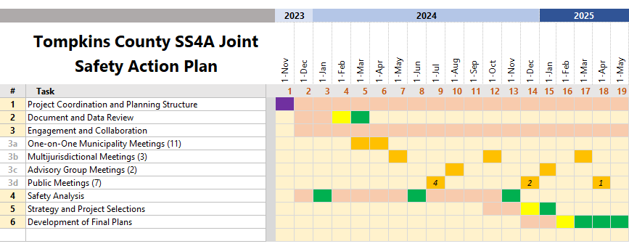
Project Schedule
Current Stage

Slide 11
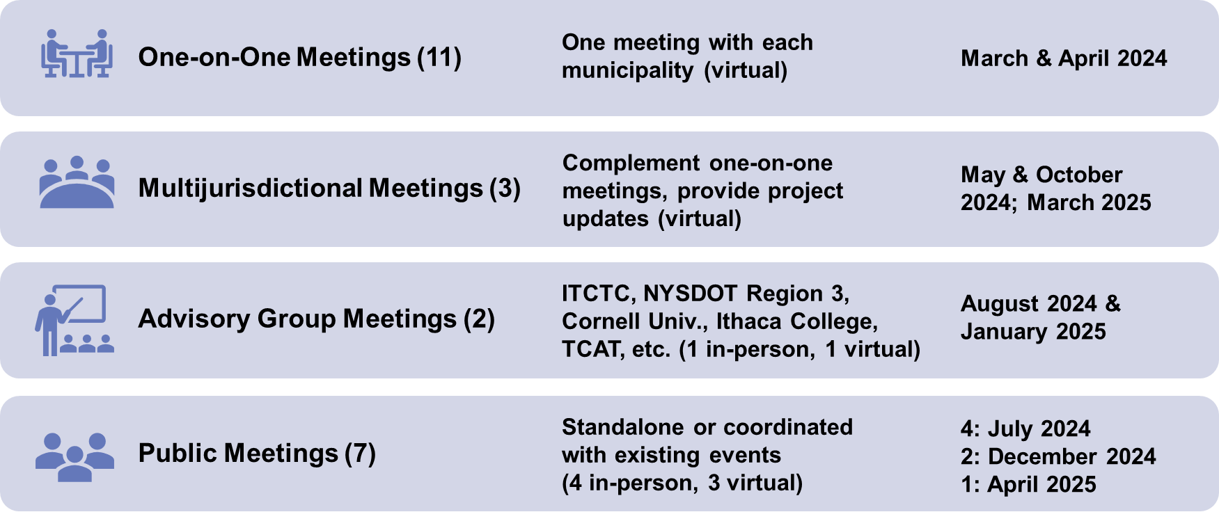
Public Engagement and Collaboration

Slide 12
Public Website & Feedback Opportunity
Visit safestreetstompkins.com to learn more and provide feedback on our interactive safety feedback map, which you can also get to by scanning this QR code:

Slide 13
Completed Tasks
Document Review Memo
Public Engagement Plan
Data Analysis Approach Memo
One-on-One Municipality Meetings and Summary Memo
Historic Trend Analysis
Network Analysis

Slide 14
Tompkins County Safety Analysis

Slide 15
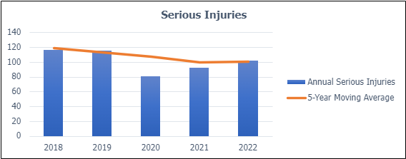
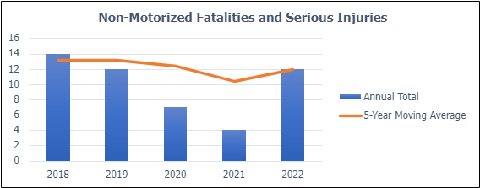
Key Safety Trends: Tompkins County
The NYS Vulnerable Road User Safety Assessment (2023) identified the City of Ithaca as a “Municipality with Vulnerable Road User High Risk Areas”
Per the VRU, "These municipalities are areas where NYS DOT will target outreach and safety initiatives”
Notes:
Municipality with Vulnerable Road User High Risk Areas: on account of there being at least one High Risk Census Tract

Slide 16
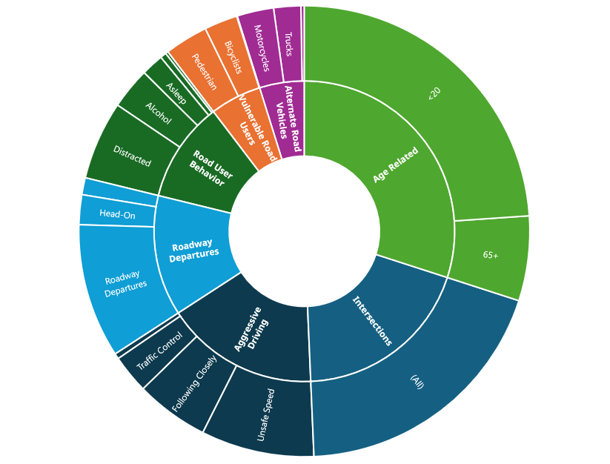
Emphasis Areas
NYS Strategic Highway Safety Plan
Fatal and Serious Injury Crashes
(2018-2022)
Note: Individual crashes can contribute to the totals for more than one Emphasis Area

Slide 17
Network Analysis
Potential for Safety Improvement
Vulnerable Road User High Risk Areas
Equity Priority Areas
Other Planning Factors
Community Engagement

Slide 18
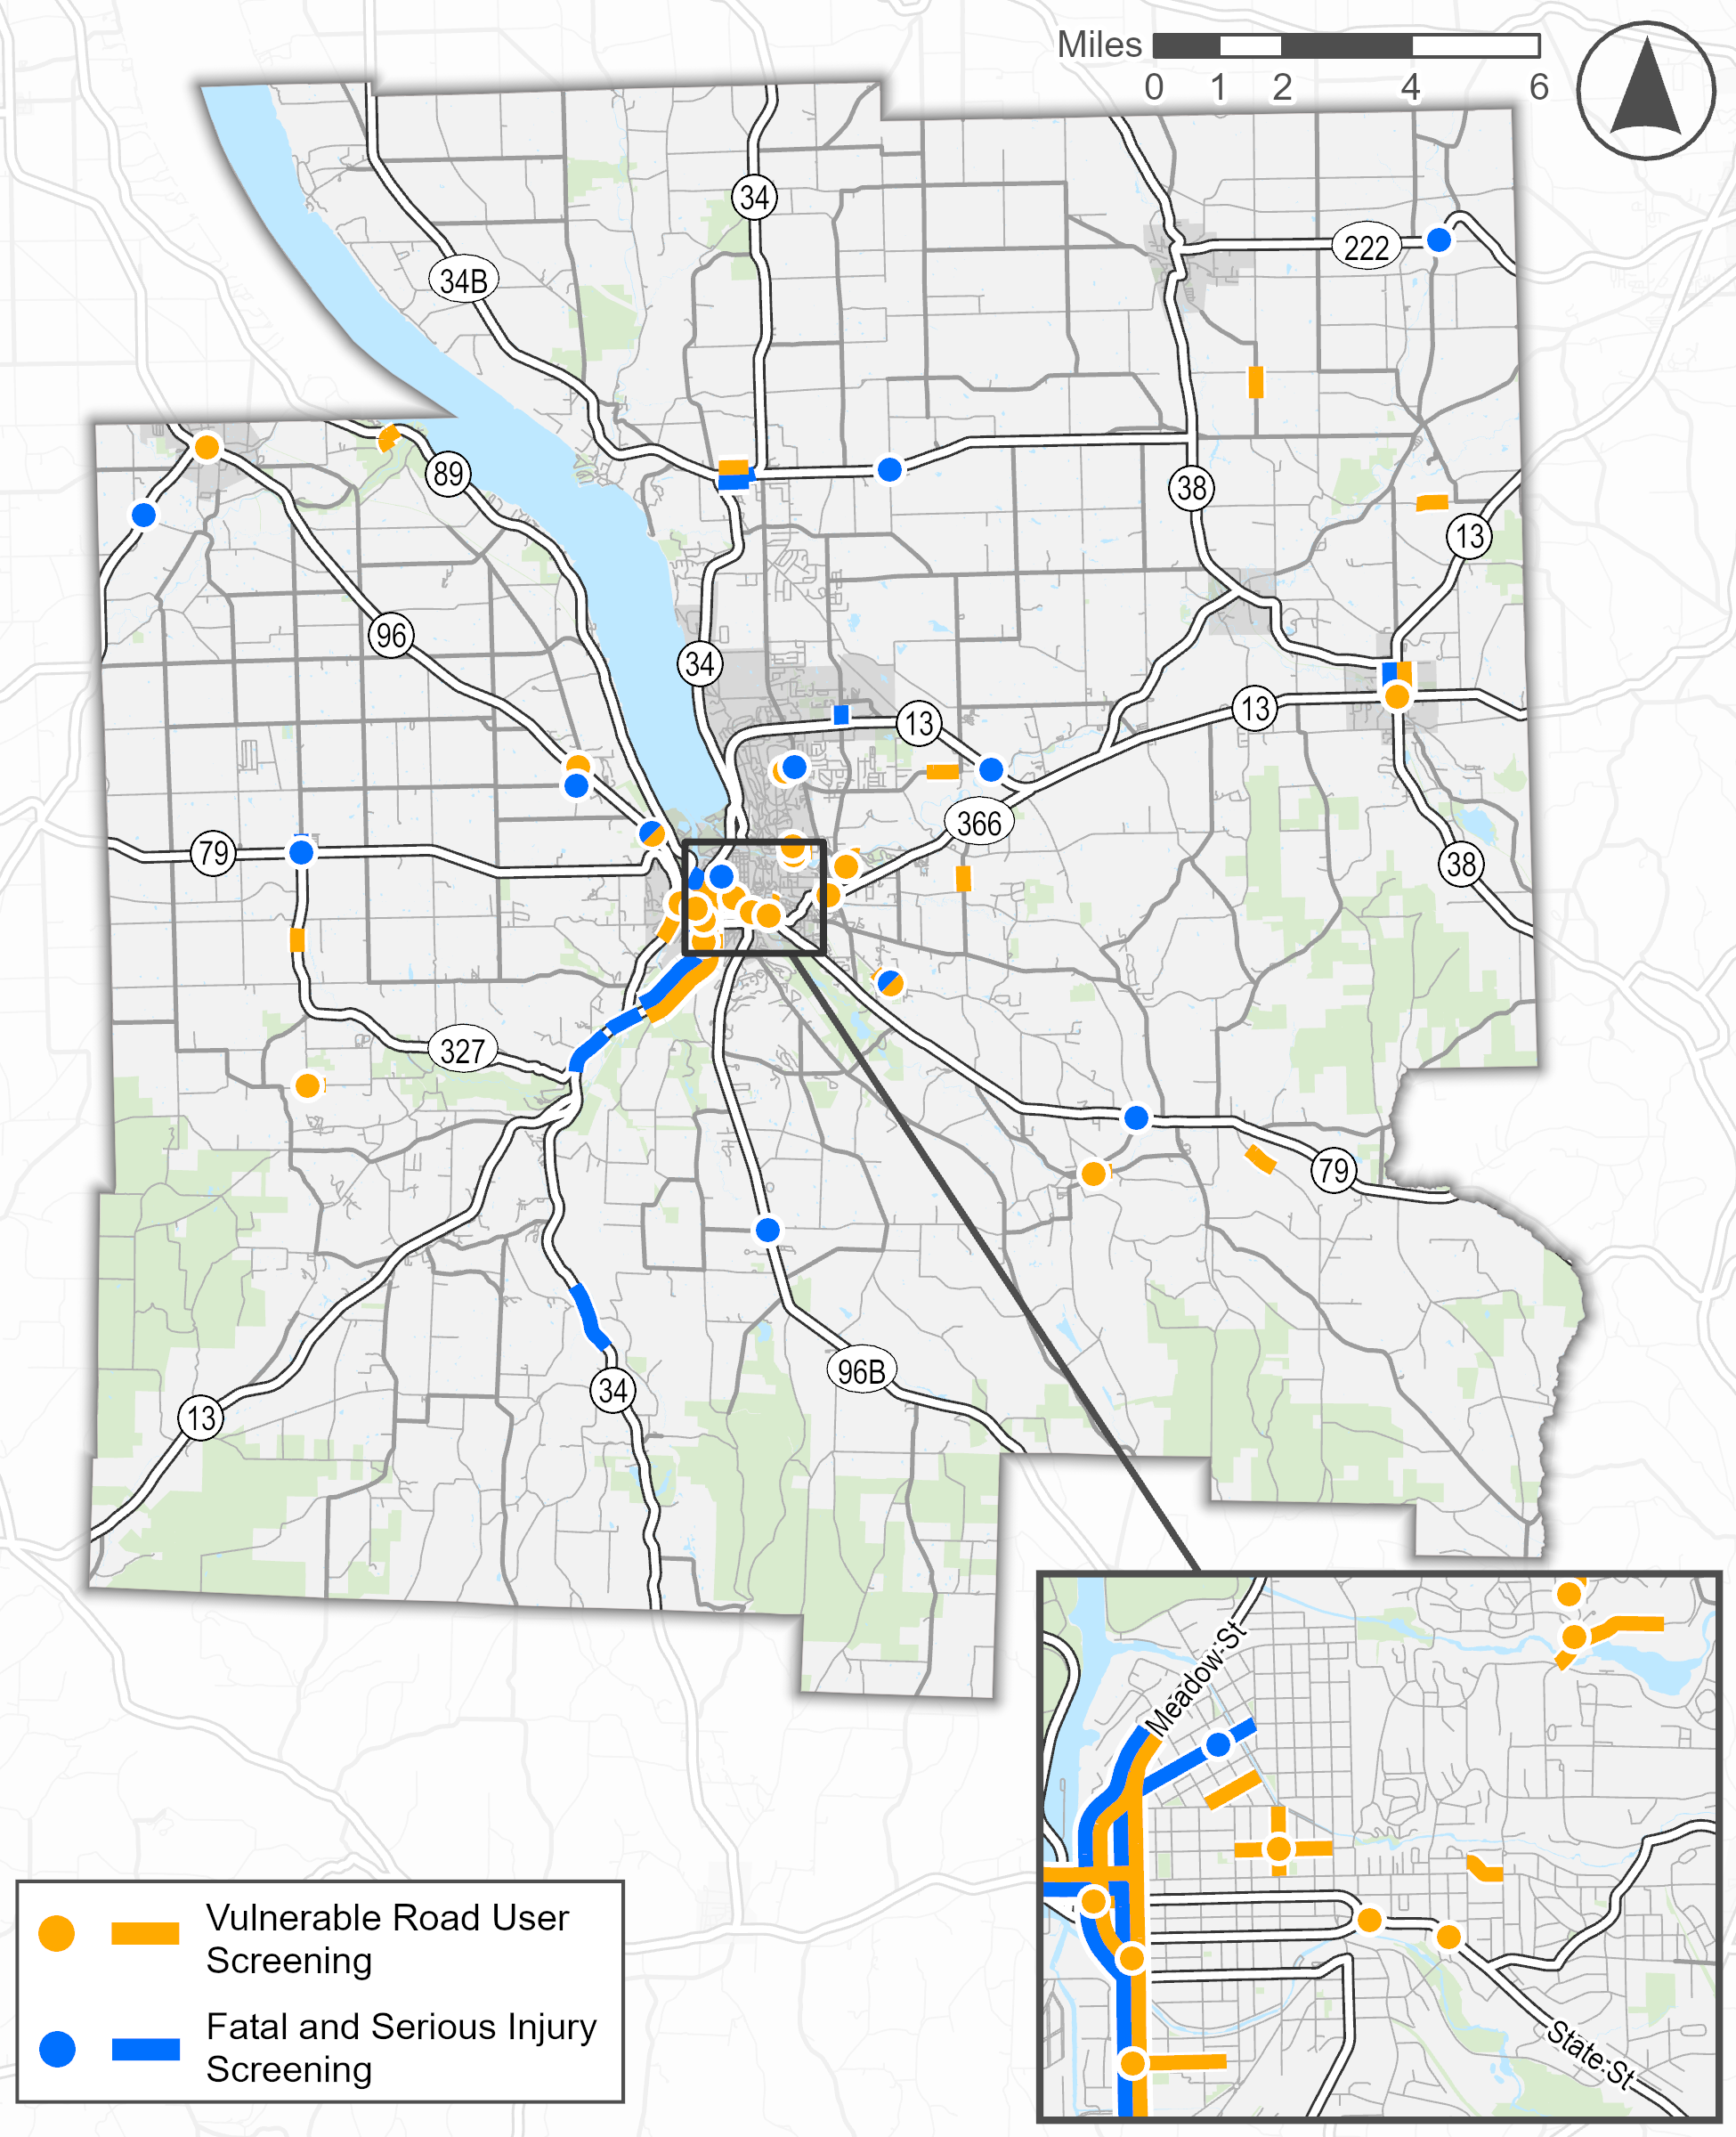
Network Analysis – Potential for Safety Improvement
The Potential for Safety Improvement is a road safety measure that compares similar roadway location types based on the number and severity of reported crashes. The locations shown on the map are most likely to benefit from safety improvements.
Notes:
Alex – to note we will do investigations and recommended improvements at top priority locations

Slide 19
Next Steps

Slide 20
Next Steps
Outreach & Engagement
In-person outreach in July
Newfield Old Home Days: July 26, 4 PM – 9 PM
Ithaca Farmer’s Market: July 27, 9 AM – 3 PM
Trumansburg Farmers’ Market: July 31, 4 PM – 7 PM
Advisory committee meeting August 1
Next in-person outreach in December
Finalizing goals of the plan
Continue data analysis & bring equity and other factors into the network screening

Slide 21
Q & A
Visit safestreetstompkins.com or scan here to give safety feedback:

