Slide 1


Peregrine Jet UAV
Team Members: Nabil Osorio, Christian Cambron, Anthony Messina
Faculty Sponsor: Siddhartha Bhattacharyya
Website: peregrinejetuav.com

Slide 2
Overview
Create Test Plan
Create Design Document
Create Requirement Document
Compare and select collaboration tools for software development, documents/presentations, communication, task calendar
Resolve Technical Challenges
Investigate IDE’s, libraries and frameworks for our system
Provide Small Demos to evaluate our tools selected. This demo would be showing Ardupilot working on our Pixhawk

Slide 3
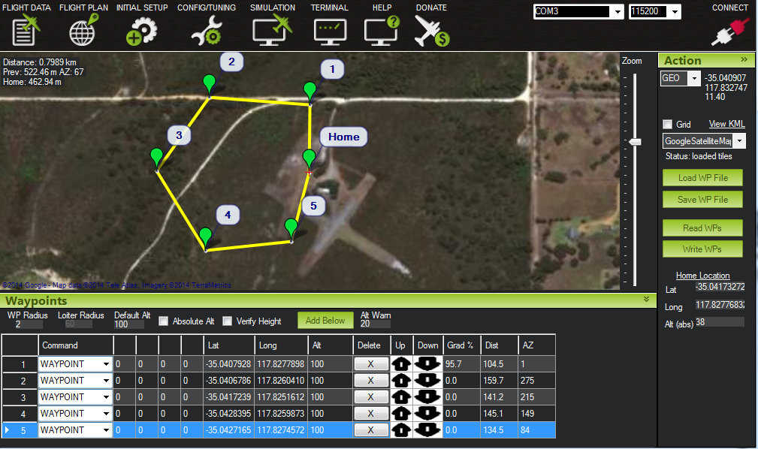
Ardupilot
Ardupilot is an open source project that connects to the Pixhawk and allows for modification of the software to specific needs.

Slide 4
Requirements Document
Describes product and system overview
Lists Features and their requirements
Lists other kinds of requirements for the system

Slide 5
Test Plan
Verifying proper UAV functionality and safety protocols
Outlines different functionality test cases with inputs and expected behavior
List scenarios for input

Slide 6
Design Document
describes the technical specifications for the UAV
Shows how the flow of data between subsystems will work

Slide 7
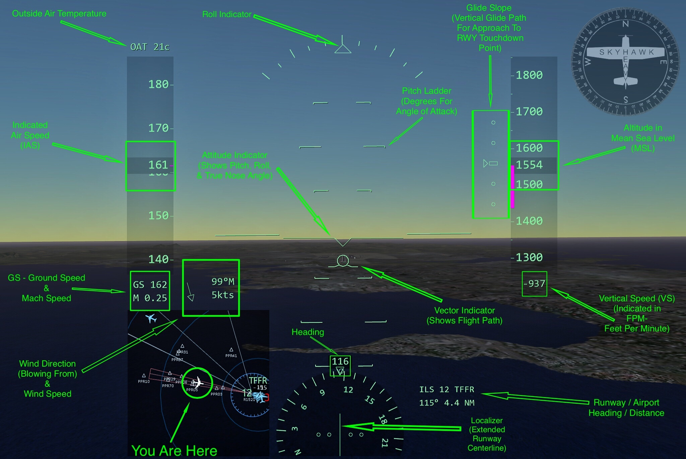
HUD Design Mockup

Slide 8
Milestones 1 Matrix
Task | Completion % | Anthony | Christian | Nabil | To Do
1.Investigate tools | 100 | 60 | 20 | 20 | none
2. Hello World demos | 100 | 40 | 20 | 40 | none
3. Requirement Document | 100 | 33 | 33 | 34 | none
4. Design Document | 100 | 33 | 34 | 33 | none
5. Test Plan | 100 | 34 | 33 | 33 | none
6. Ensure ardupilot works on Pixhawk4 | 100 | 25 | 25 | 50 | implement
7. Setup required dependencies for ardupilot | 100 | 33 | 33 | 34 | implement

Slide 9
Milestone 2 Goal
Implement, test, and demo controller functionality with xplane.
Implement, test, and demo a simple ardupilot code to be flashed on Pixhawk.
Test latency of camera based on distance and connection type.

Slide 10
Questions?

