Slide 1
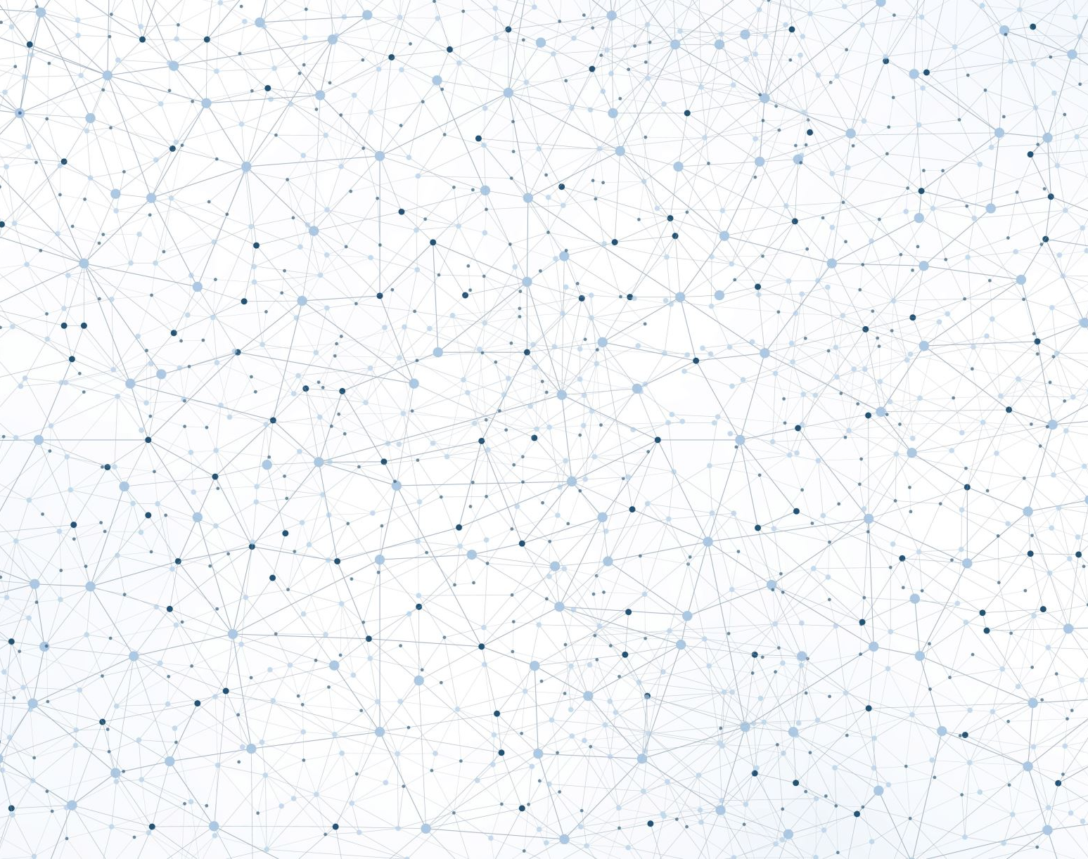

Homework 1 – Hands-on machine learning chapter I
Damiano Rousselet - 12225451

Slide 2
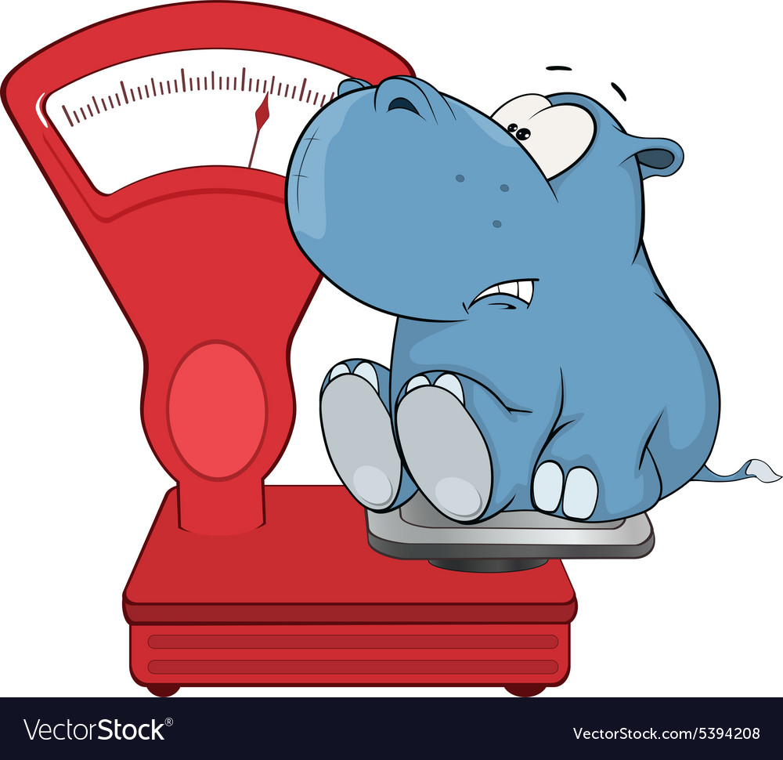
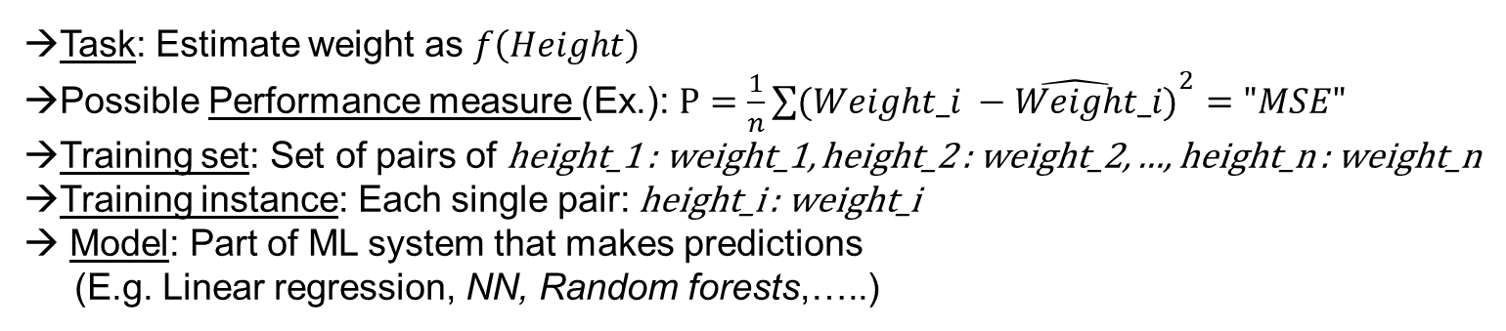
1. Definition and Motivation of Machine Learning
Read through the definition of machine learning. You want to estimate the weight of a person based on his or her height. Now try to describe the terms task, performance measure, training set, training instance, and model using this concrete example.
→ engineering-oriented definition:
A computer program is said to learn from experience E with respect to some task
T and some performance measure P, if its performance on T, as measured by P,
improves with experience E.
—Tom Mitchell, 1997
→Task: Estimate weight as $f\left(Height\right)$
→Possible Performance measure (Ex.): $P=\frac{1}{n}{\sum{(Weight_i −\hat{Weight}_i)}}^{2}="MSE"$
→Training set: Set of pairs of height_1 : weight_1, height_2 : weight_2, …, height_n : weight_n
→Training instance: Each single pair: height_i : weight_i
→ Model: Part of ML system that makes predictions (E.g. Linear regression, NN, Random forests,…..)

Slide 3
What is the difference between the traditional programming and the machine learning approach?
In traditional programming we would examine the situation and write an algorithm for each case, for example:
If x: do 1
If y: do 2 […]
Then test if the algorithm is good enough to work with all/enough cases, else modify code / approach Traditional programming
→ In ML
Analyse problem
2. Train model to automatically learn what elements / patterns predict the outcome best
3. Evaluate model outcome / predictions
4. If good: launch
4.1. If bad: analyse errors and restart from 1.
ML approach

Slide 4
What motivates the machine learning approach?
→One reason to use ML is that it has a great ability to adapt to a situation that is changing constantly (“Fluctuating environment”).
Screenshot: ML adapting to change
→Also, in situations that require long lists of instructions for many cases, here ML can perform better and present more elegant, readable code.
When will I use one approach and when will I use the other, think about an example.
→ A traditional programming approach can be better in situations that do not change, like an automated electric door opening system. If the sensor detects motion, it activates the engine which opens the door. The system is cheaper to build and more robust. Obviously, this is useful if no particular security is required etc….
→A ML approach is suited for a case where the input is not constant like face recognition. It would be impossibly overwhelming to write code to recognize each face, in a multitude of different light / angle / colour conditions. Here ML would shine and be much more efficient.

Slide 5
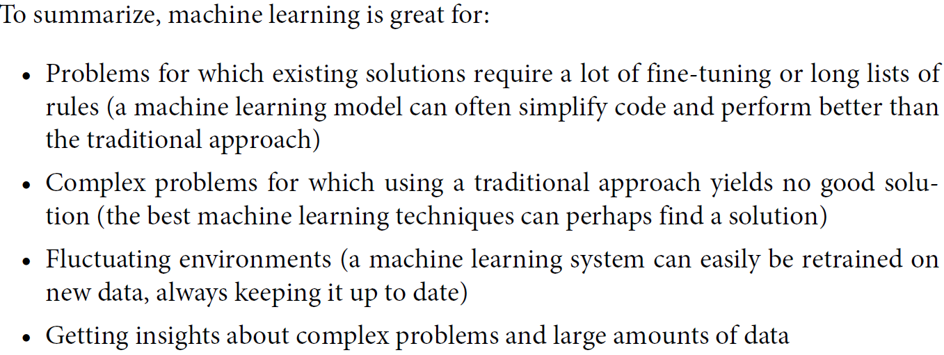
What other strengths does a machine learning approach have? Try using the terms “fluctuating environments” and “data mining”.
Another advantage is that sometimes by training a ML model for one task, we gain insight into huge amounts of data and find new patterns, which leads to a better understanding of the problem. Digging into data to find patterns is called “data mining”.
ML can be used for complex problems where traditional approaches have failed. For example ML models trained to play board games like chess or “Go!”, have performed new moves / strategies which were counterintuitive and unknown to humans.
Screenshot from book: advantages of ML

Slide 6
2. Types of Machine Learning Systems
Try to summarize all five training supervisions (supervised learning, unsupervised learning, self-supervised learning, semi-supervised learning, and reinforcement learning).
Supervised: The training set includes “labels” for each instance. Used for classification and prediction as “regression” models (“label” = “target”). New elements are presented without labels and the model tries to categorise or predict a value.
Screenshot: A regression problem: predict a value, given an input feature

Slide 7
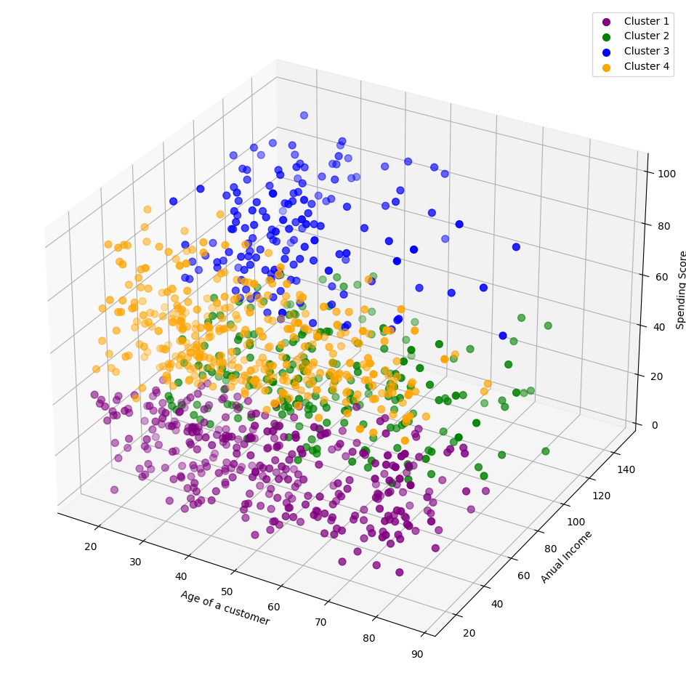
→Unsupervised: Training data is not labelled, for example clustering algorithms like K-means. Here the training set is not labelled, the algorithm places (“clusters”) data together according to measures of similarity or difference. For example by minimizing intra-group differences and maximizing inter-group differences. Another example is visualization algorithms which try to visualize a lot of complex unstructured data in 2D or 3D, such that it is easily readable by humans.
Screenshot: Representation of clusters of supermarket customers from unstructured data (source)
Screenshot: Anomaly detection
→ Another important unstructured task is detecting anomalies, e.g. for financial transactions.

Slide 8
Semi-supervised learning: As the name suggests, this type of algorithms can deal with data that is partially labeled. This is often the case because labeling is time/cost intensive. They often combine an unsupervised and a supervised part. For example, a clustering algorithm can cluster unlabeled data and then label the unlabeled training instances according to the most common label in the cluster it has been put into.
Self-supervised learning: This method generates a labeled training set from an unlabeled one. Then a supervised algorithm can be used. For example, a model can be trained to generate a missing or damaged part of an image. Here a part of a complete image is hidden and the model trained to regenerate it. The image with the masked part is the input and the complete image is the label:
„Transfer learning“ → Often, models using self-supervised learning are an intermediate step to a final goal, like training a model to repair images, can later be used to recognize images; as to repair images, it has to know which parts should be placed in an image, and which not.
Screenshot: Self-supervised learning example: input (left), target (right)

Slide 9
→Reinforcment learning: Is a different approach, the system („agent“) is able to observe the environment and make choices. Then a reward / punishment is given to it according to how well it performs. The systems adapts ist choices and develops the best „policy“ to maximize reward and minimize punishments. →A famous example is Google‘s Alpha Go model, which analyzed many games and played against itself, until it was very good at minimizing the cost function – avoiding punishments, chasing rewards.
Screenshot from book: agent in reinforcment learning

Slide 10
What is the difference between batch and online learning? What is the disadvantage of batch learning?
→Batch learning:
In this mode, a model is incapable of incrementally learning new things. It is trained on the training set and then performs updating.
The main disadvantage is that in the real world, its performance worsens (“model rot”, ”data drift”) – as the world advances – without it. It is not a big issue in cases where the environment changes slowly, like species recognition. (Although recording technologies like cameras likely change faster than evolution)
Online learning:
In this mode, a system is capable of adding new knowledge incrementally to its pre-existing one.
Screenshot from book
Screenshot: in online learning a model keeps learning as data comes in

Slide 11
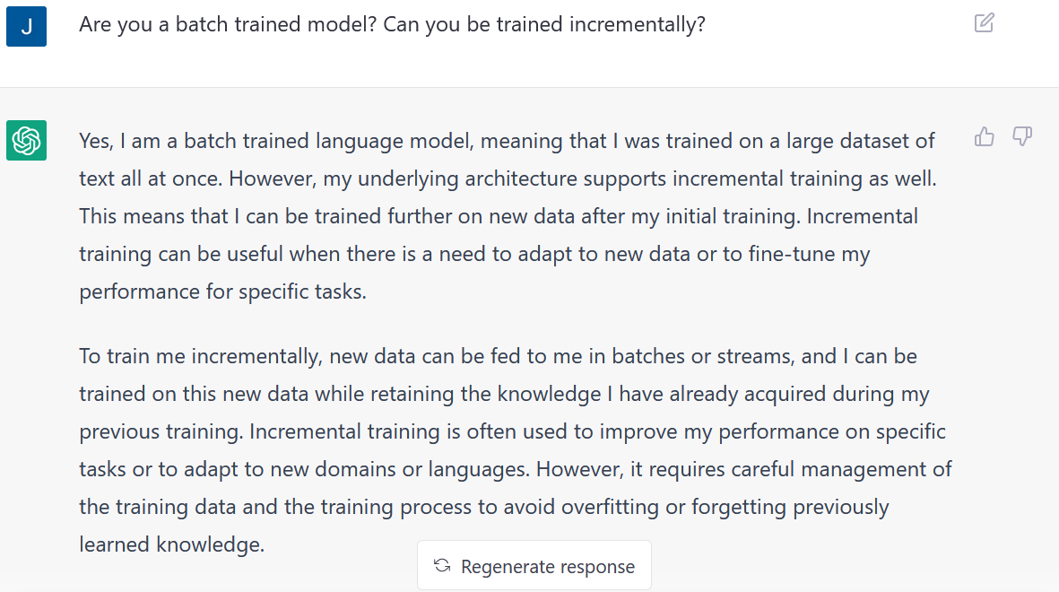
Do you already know of models that definitely do batch learning?
When ChatGPT came out it was trained on data until 2021 beforehand. However, as it says itself, it is also capable of incremental learning, by tuning the parameters of its Deep Neural Network. This is a special case of a batch-trained model that has the ability to incrementally train.
Another example of a batch-trained model is BERT: huggingface.co/docs/transformers/model_doc/ bert
Screenshot: ChatGPT interface explaining itself (chat.openai.com)

Slide 12
What does the term “out-of-core learning” mean?
It is a technique, used if the resources are limited compared to the dataset, that might be huge. If the training set does not fit into memory, it is broken into smaller chunks and these are processed sequentially until the whole dataset has been worked through training.
What are challenges in online learning?
A big challenge is that is if bad data is given to a system, it learns the wrong things and its performance can drop. To fight against it, the system should be monitored and learning disabled if performance is dropping. Also, the input data can be monitored using E.g. an anomaly detection algorithm
Another important challenge is selecting the right “learning rate” – how fast the system should adapt to new data while forgetting old data (high learning rate); or how slowly the system should learn (low learning rate) and be less sensitive to noise/outliers.
Screenshot: out-of-core learning process

Slide 13
3. The main challenges in Machine Learning
Briefly name all the challenges we encounter in Machine Learning
They can be summarized in 2 categories: Bad model & bad data
Bad Data:
Insufficient quantity, small sample →
Nonrepresentative data
Sampling noise
Sampling bias
What do we mean by sampling noise and sampling bias?
Screenshot: Nonrepresentative data, sampling - noise, sampling - bias
Screenshot: performance increasing with enough data “The Unreasonable Effectiveness of Data”, IEEE Intelligent Systems 24, no. 2 (2009)

Slide 14
Further challanges with data:
Poor quality data
What are features?
→Features are attributes of the data, used to train the model, for example, “age”. They need to be relevant to make meaningful predictions
Irrelevant features: Important to select relevant features → “feature engineering”:
Use a simple ML model and describe what is meant by feature selection and feature extraction?
If we build a model to predict the weight of a person, feature selection is the process of selecting relevant attributes for the prediction like “sex”, “age”, “ethnicity” and discarding irrelevant ones such as “name”.
Feature extraction: would be synthetizing attributes into a more meaningful one, in the case of humans it could be something like body-mass-index or athleticism level.

Slide 15
Examples of bad model (algorithm):
What is and what favours overfitting in Machine Learning and how can we prevent it?
Overfitting: Model too complex, fitting the training set too tightly, wrongfully detecting patterns in noise
Screenshot: constrained model (dashed) generalizing better than non-constrained one (dotted)
→ Important to tune hyperparameters to right value of regularization
Screenshot from book: Overfitting & solutions
What is and what favors underfitting in Machine Learning and how can we prevent it?
→ Underfitting: Model is too simple to describe reality or structure in data

Slide 16
3. Testing and Validating
What is the motivation of holdout validation? Using Figure 1-25, try to explain what is the test set, the training set, and the validation set?
It is an approach to avoid having the model and its hyperparameters overfitting only to the training set and not generalizing well to real-life predictions.
1. Split the data into a training set used to train multiple models with different hyperparameters.
2. Use part of the remaining data as a validation (dev) set, onto which we test the different models.
3. Select the model with the best performance on the validation set, train it on training + validation sets joined together.
4. This gives us the best model (hyperparameters) which we test on the remaining test set to get an estimate of the generalization error
Screenshot: holdout validation

Slide 17
Sources
Hands-on machine Learning with Scikit Learn Keras and TensorFlow Third Edition, 1st chapter.
https://uibkacat-my.sharepoint.com/:p:/g/personal/lars_hofmann_student_uibk_ac_at/EYcCueCPQc9Gv0UrPnGFaOoBI3AZTbmXzOKaPlMgG14nng?rtime=9CkJiBIi20g
chat.openai.com (Slide 10)
huggingface.co/docs/transformers/model_doc/bert
www.alphagomovie.com

