Slide 1

IDENTIFYING CLUSTERS IN CONSUMER DATA
USING HIERARCHICAL AND K-MEANS CLUSTERING¹
by David Cloos, Karl Heynen, Lars Hofmann, Damiano Rousselet
¹https://github.com/DavidC0011/MiniTermProject

Slide 2
INTRODUCTION
INTRO
DATASET
HIERARCHICAL CLUSTERING
K-MEANS CLUSTERING
CONCLUSION
Initial Situation: Retailer with already collected customer data
Question: How to generate value from this data?
Goal: Market („Customer “) segmentation → Find groups → Specific targeting
Demographic¹
Psychographic¹
Age
Annual Income (k$)
Spending Score (1-100)
Clustering: Find subgroups with commonalities / differences to target them specifically.
¹Kotler (1991)
Notes:
A supermarket has many different customers each day, without knowing much about them
It is a competitive advantage to know more about them in order to target them more specifically
To achieve this, customer segmentation should be done
Clustering provides an easy way to do a customer segmentation
This will result in further insights on different types of customers
The insights lead to differentiated marketing strategies

Slide 3
INTRO
DATASET
HIERARCHICAL CLUSTERING
K-MEANS CLUSTERING
CONCLUSION
OVERVIEW OF THE DATA (1/2)
Count = 1082 | Gender | Age | Annual Income (k$) | Spending Score (1-100)
Mean | 0.51 | 43.2 | 57.5 | 44.4
σ_{s} | 0.50 | 17.72 | 30.49 | 25.96
Min |  | 16 | 15 | 4
25% |  | 30 | 32 | 22
50% |  | 40 | 54 | 42
75% |  | 56 | 78 | 63
Max |  | 87 | 148 | 100
!
Hopkins test to check clustering tendency.
→ 0.65 implies some clustering.

Slide 4
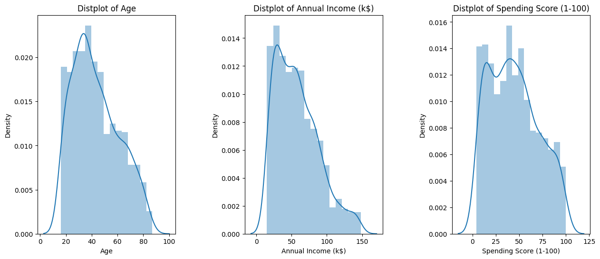
INTRO
DATASET
HIERARCHICAL CLUSTERING
K-MEANS CLUSTERING
CONCLUSION
OVERVIEW OF THE DATA (2/2)

Slide 5

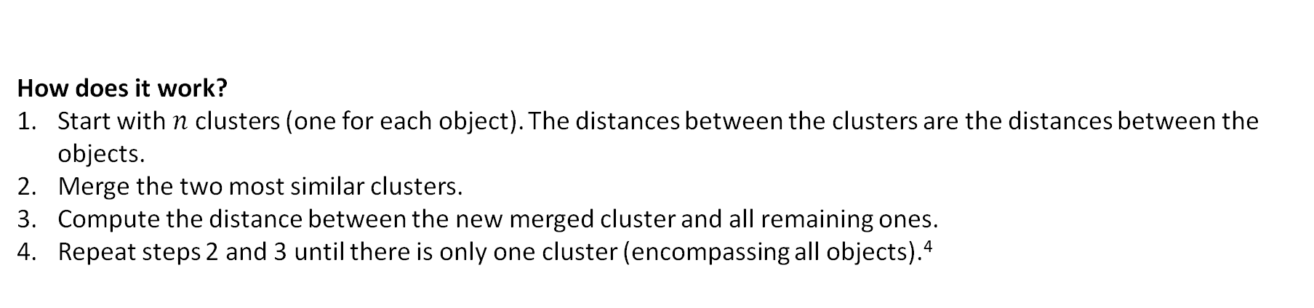
HOW DOES HIERARCHICAL CLUSTERING WORK?
INTRO
DATASET
HIERARCHICAL CLUSTERING
K-MEANS CLUSTERING
CONCLUSION
“Hierarchical clustering is a method of cluster analysis which seeks to build a hierarchy of
clusters.”¹
How does it work?
Start with $n$ clusters (one for each object). The distances between the clusters are the distances between the objects.
Merge the two most similar clusters.
Compute the distance between the new merged cluster and all remaining ones.
Repeat steps 2 and 3 until there is only one cluster (encompassing all objects).⁴
Classifies as: hierarchical clustering method ² | $n$ = Number of clusters
In this case the Agglomerative hierarchical clustering was used ³
¹Rani et al., (1967) | ² Khan et al., (2019) | ³Scipy Documentation, (2023)| ⁴Walde et Zeileis, (2022)

Slide 6
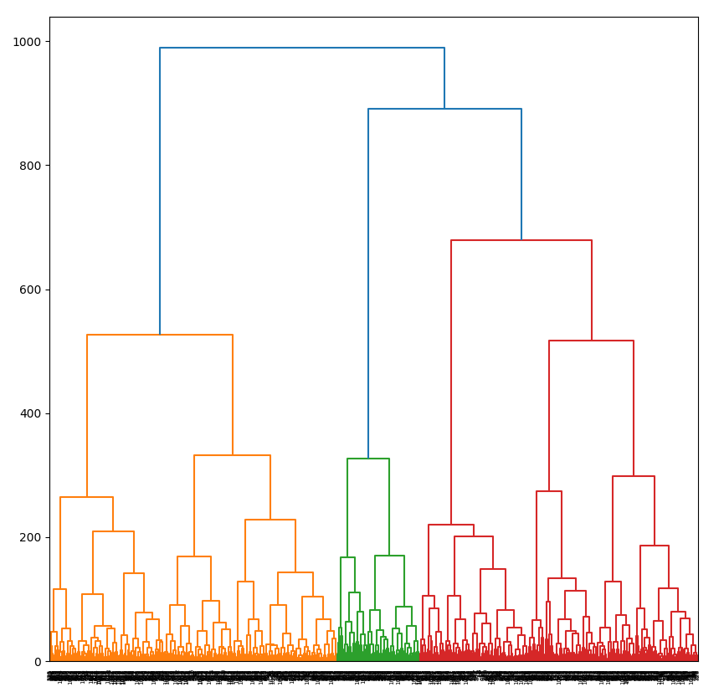
WHAT IS THE OPTIMAL NUMBER OF CLUSTERS?
INTRO
DATASET
HIERARCHICAL CLUSTERING
K-MEANS CLUSTERING
CONCLUSION
More generalized clusters
Threshold
1
2
3
4
More fine-grained clusters
We decided to chose 4 clusters for a good balance between generalized and fine-grained clusters.
https://www.kaggle.com/code/gauravduttakiit/mall-customer-segmentation-using-hierarchical-clus

Slide 7
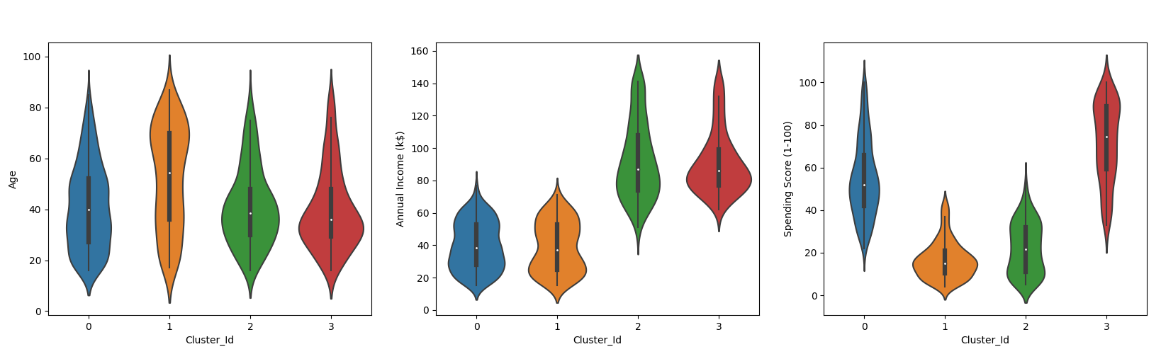
INTRO
DATASET
HIERARCHICAL CLUSTERING
K-MEANS CLUSTERING
CONCLUSION
OVERVIEW OF CLUSTERS (1/2)
1 2 3 4
1 2 3 4
1 2 3 4
https://www.kaggle.com/code/gauravduttakiit/mall-customer-segmentation-using-hierarchical-clus

Slide 8




INTRO
DATASET
HIERARCHICAL CLUSTERING
K-MEANS CLUSTERING
CONCLUSION
OVERVIEW OF CLUSTERS (2/2)
Cluster 1: The Over-Extenders Middle Aged (M: 40) Low Income (M: 38k$) High Spending Score (M: 53)
Cluster 2: Low Income Seniors Elderly (M:58) Low Income (M: 37k$) Low Spending Score (M: 17)
Cluster 3: The Savers Middle Aged (M: 38) High Income (M: 84k$) Low Spending Score (M: 20)
Cluster 4: The Wealthy Leisure Youngest (M: 35) High Income (M: 83k$) Very High Spending Score (M: 77)

Slide 9
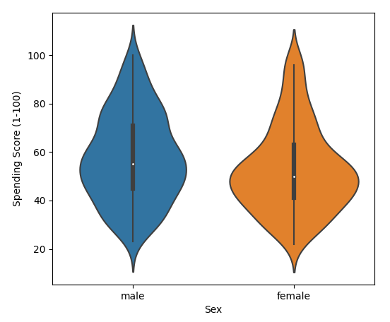
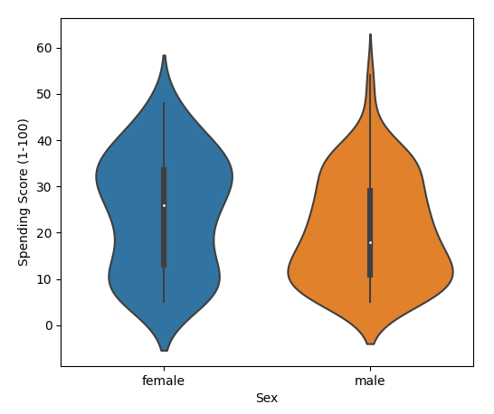
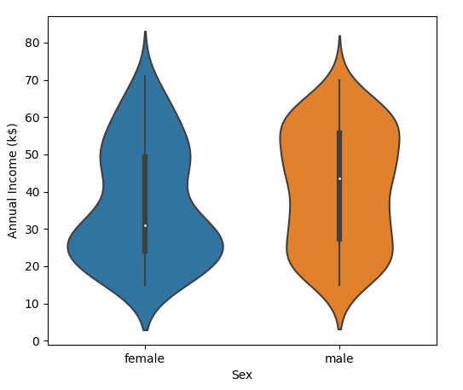
INTRO
DATASET
HIERARCHICAL CLUSTERING
K-MEANS CLUSTERING
CONCLUSION
GENDER DIFFERENCES IN CLUSTERS
Spending Score
Annual Income
Cluster 1
Cluster 3
Cluster 2
Important to also analyze Sex to be able to make an informed decision with all the data provided!
https://www.kaggle.com/code/gauravduttakiit/mall-customer-segmentation-using-hierarchical-clus

Slide 10
INTRO
DATASET
HIERARCHICAL CLUSTERING
K-MEANS CLUSTERING
CONCLUSION
HOW DOES K MEANS CLUSTERING WORK?
“K-means clustering is a method commonly used to automatically partition a data set into k groups”¹
Classifies as: partitioning clustering method ² | $k$ = Number of clusters| Means = Mean of each cluster
¹MacQueen, (1967) | ²Kaufmann and Rousseeuw (1987)

Slide 11


INTRO
DATASET
HIERARCHICAL CLUSTERING
K-MEANS CLUSTERING
CONCLUSION
HOW DOES K MEANS CLUSTERING WORK?
“K-means clustering is a method commonly used to automatically partition a data set into k groups”¹
How does it work?
= Iterative method¹
First: Cluster centers (centroids) are randomly positioned
Each iteration: Move centroids to minimize clustering error³
Very sensitive to the initial position of the centroids^{4,5}
Classifies as: partitioning clustering method ² | $k$ = Number of clusters| Means = Mean of each cluster
¹MacQueen, (1967) | ²Kaufmann and Rousseeuw (1987) | ³Likas et al., (2003) | ⁴Bradley & Fayyard (1998) | ⁵Pena et al., (1999)

Slide 12
INTRO
DATASET
HIERARCHICAL CLUSTERING
K-MEANS CLUSTERING
CONCLUSION
HOW DOES K MEANS CLUSTERING WORK?

Slide 13
INTRO
DATASET
HIERARCHICAL CLUSTERING
K-MEANS CLUSTERING
CONCLUSION
CALCULATE DISTANCES TO CENTROIDS
E.g. create 3 Clusters
c
a
b
Three centroids (means of each cluster)

Slide 14

INTRO
DATASET
HIERARCHICAL CLUSTERING
K-MEANS CLUSTERING
CONCLUSION
CALCULATE DISTANCES TO CENTROIDS
$$c=\sqrt{x^{2}+y^{2}}$$
E.g. create 3 Clusters
c
a
b
Three centroids (means of each cluster)

Slide 15
INTRO
DATASET
HIERARCHICAL CLUSTERING
K-MEANS CLUSTERING
CONCLUSION
CHOOSE THE SHORTEST DISTANCE
$$c=\sqrt{x^{2}+y^{2}}$$
a
c
b

Slide 16
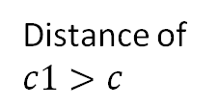
INTRO
DATASET
HIERARCHICAL CLUSTERING
K-MEANS CLUSTERING
CONCLUSION
CHOOSE THE SHORTEST DISTANCE
$$c=\sqrt{x^{2}+y^{2}}$$
Distance of $c1>c$
c
a
b
a1
c1
b1

Slide 17
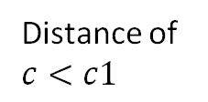
INTRO
DATASET
HIERARCHICAL CLUSTERING
K-MEANS CLUSTERING
CONCLUSION
CLUSTER SELECTION
Distance of $c<c1$
Datapoint is assigned to the blue cluster

Slide 18
INTRO
DATASET
HIERARCHICAL CLUSTERING
K-MEANS CLUSTERING
CONCLUSION
REPEAT FOR EVERY DATAPOINT

Slide 19
INTRO
DATASET
HIERARCHICAL CLUSTERING
K-MEANS CLUSTERING
CONCLUSION
CALCULATE MEAN OF EACH CLUSTER
Move centroids to its clusters mean

Slide 20
INTRO
DATASET
HIERARCHICAL CLUSTERING
K-MEANS CLUSTERING
CONCLUSION
MOVE CENTROIDS
We now, focus on caluclating the mean of each cluster separately

Slide 21
INTRO
DATASET
HIERARCHICAL CLUSTERING
K-MEANS CLUSTERING
CONCLUSION
2nd ITERATION – MEASURE DISTANCES

Slide 22
INTRO
DATASET
HIERARCHICAL CLUSTERING
K-MEANS CLUSTERING
CONCLUSION
2nd ITERATION – SELECT SHOREST CENTROID

Slide 23
INTRO
DATASET
HIERARCHICAL CLUSTERING
K-MEANS CLUSTERING
CONCLUSION
2nd ITERATION – MOVE CENTROIDS

Slide 24
INTRO
DATASET
HIERARCHICAL CLUSTERING
K-MEANS CLUSTERING
CONCLUSION
2nd ITERATION – MOVE CENTROIDS

Slide 25
INTRO
DATASET
HIERARCHICAL CLUSTERING
K-MEANS CLUSTERING
CONCLUSION
2nd ITERATION – REPEAT

Slide 26
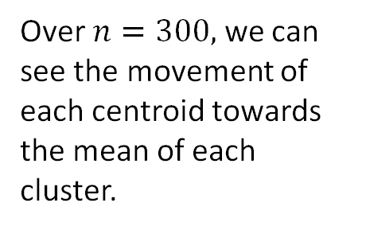
INTRO
DATASET
HIERARCHICAL CLUSTERING
K-MEANS CLUSTERING
CONCLUSION
K-MEANS IMPROVING OVER $N=300$
Over $n=300,$we can see the movement of each centroid towards the mean of each cluster.
¹https://github.com/DavidC0011/MiniTermProject/blob/main/Centroids_Animation.ipynb

Slide 27
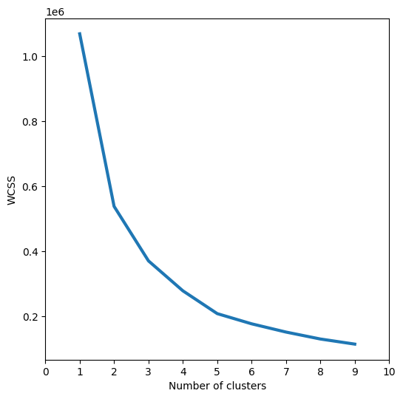
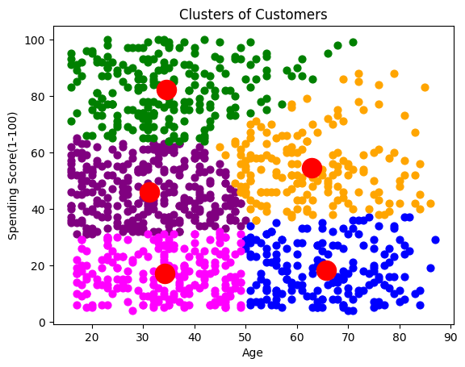
INTRO
DATASET
HIERARCHICAL CLUSTERING
K-MEANS CLUSTERING
CONCLUSION
CLUSTERING OF SPENDING SCORE AGAINST AGE
Optimal number of clusters: 5
https://www.kaggle.com/code/mbalvi75/13-kmeans-clustering

Slide 28
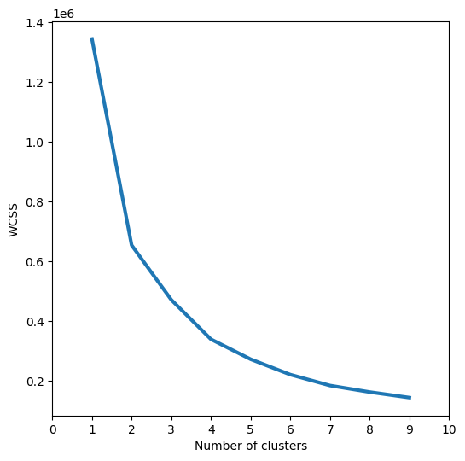
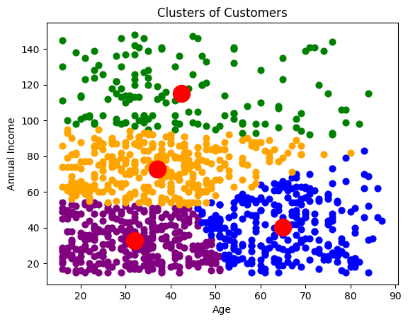
INTRO
DATASET
HIERARCHICAL CLUSTERING
K-MEANS CLUSTERING
CONCLUSION
CLUSTERING OF ANNUAL INCOME AGAINST AGE
Optimal number of clusters: 4
https://www.kaggle.com/code/mbalvi75/13-kmeans-clustering

Slide 29
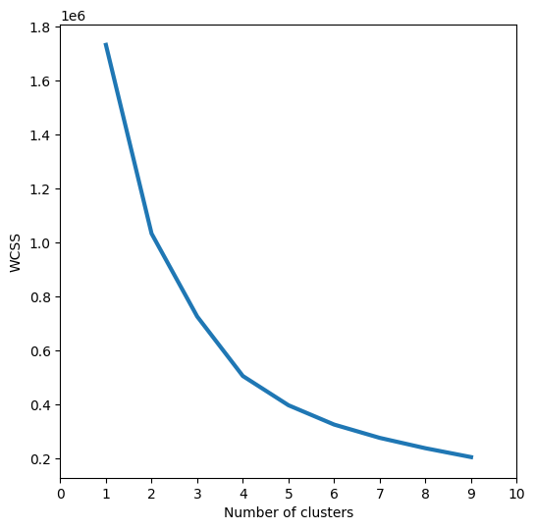
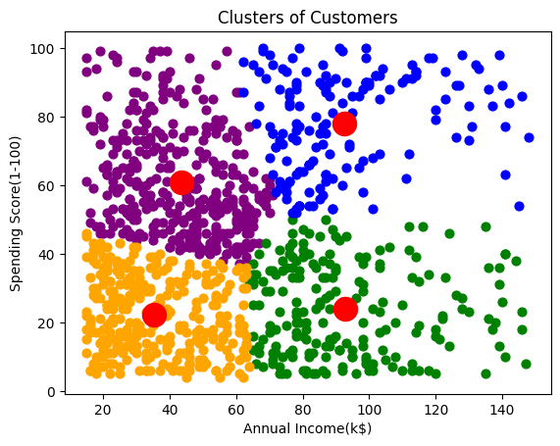
INTRO
DATASET
HIERARCHICAL CLUSTERING
K-MEANS CLUSTERING
CONCLUSION
CLUSTERING OF SPENDING SCORE AGAINST ANNUAL INCOME
“Earners“
“Spenders“
“Low Budgeters“
Optimal number of clusters: 4
“Frugals“
https://www.kaggle.com/code/mbalvi75/13-kmeans-clustering

Slide 30
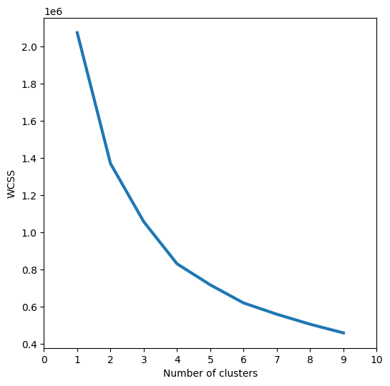
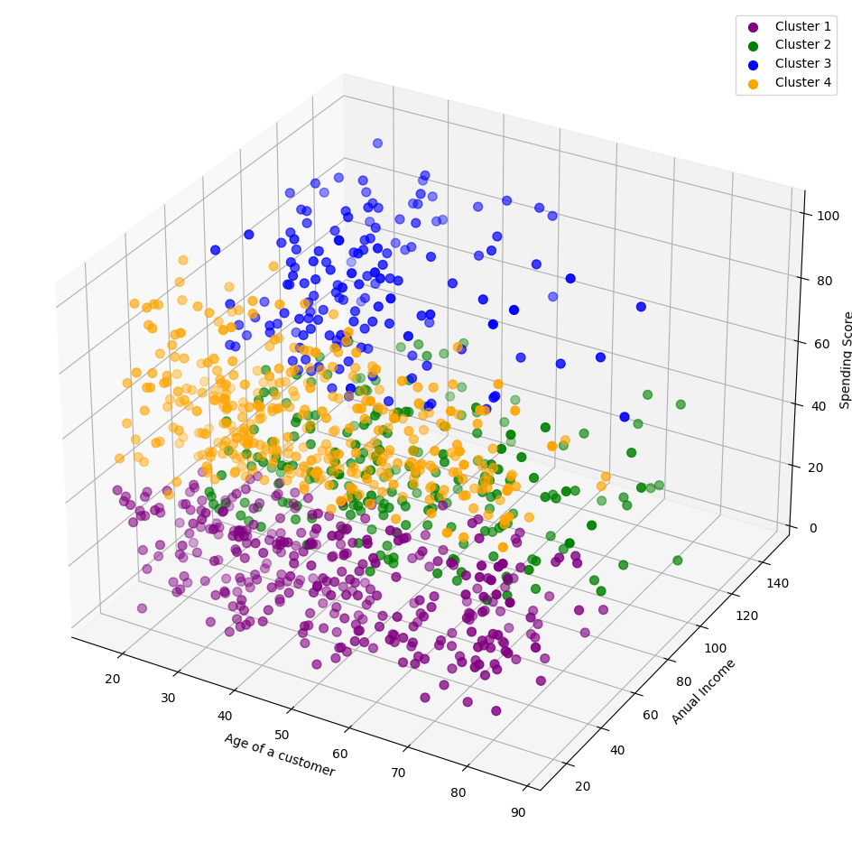
INTRO
DATASET
HIERARCHICAL CLUSTERING
K-MEANS CLUSTERING
CONCLUSION
COMBINING ALL THREE VARIABLES
Problem
Detectability of the individual observations no longer guaranteed!
Optimal number of clusters: 4
SOLUTION
https://www.kaggle.com/code/naren3256/kmeans-clustering-and-cluster-visualization-in-3d/notebook

Slide 31
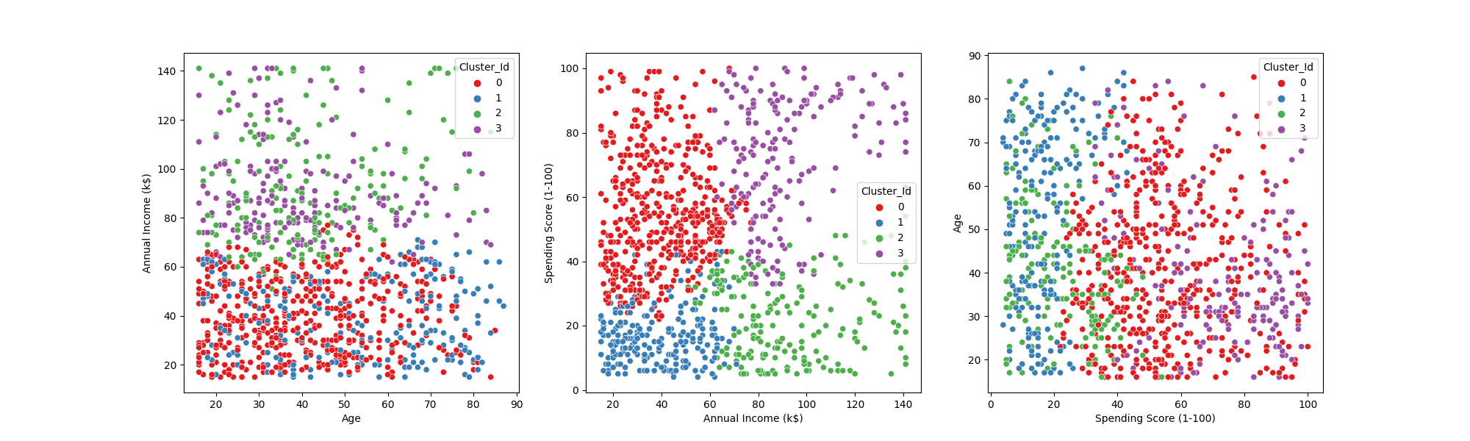
INTRO
DATASET
HIERARCHICAL CLUSTERING
K-MEANS CLUSTERING
CONCLUSION
CONCLUSION: IMPLICATIONS
“Spenders“
“Earners“
“Low Budgeters“
“Frugals“
K Means Clustering
Hierarchical Clustering
Each cluster needs to be targeted differently
Supermarket setting: “Low Budgeters“ receive weekly saving offers via mail, “Earners“ receive specially tailored culinary trips by mail
Market research for products
Compare how products are received in the different customer segments and use specific marketing campaigns for these products
Realignment of the company strategy
Liquor store setting: Based on the number of customers per cluster either choose a “discounter“ strategy or “luxury goods“ strategy

Slide 32
INTRO
DATASET
HIERARCHICAL CLUSTERING
K-MEANS CLUSTERING
CONCLUSION
THANK YOU!

Slide 33
INTRO
DATASET
HIERARCHICAL CLUSTERING
K-MEANS CLUSTERING
CONCLUSION
REFERENCES
Rani, Y., & Rohil, H. (2013). A study of hierarchical clustering algorithm. International Journal of Information and Computation Technology. ISSN 0974-2239. (Volume 3, Number 10), pp. 1115-1122 Khan, S.S., Ahamed, S., Jannat, M., Shatabda, S., Farid, D.M. (2020). Classification by Clustering: An Approach of Classifying Big Data Based on Similarities. docs.scipy.org/doc/scipy/reference/generated/scipy.cluster.hierarchy.linkage.html#scipy.cluster.hierarchy.linkage discdown.org/dataanalytics/hierarchical-clustering.html#hierarchical-clustering-1 Bradley, P. S., & Fayyad, U. M. (1998, July). Refining initial points for k-means clustering. In ICML (Vol. 98, pp. 91-99).
King, B. Step-wise Clustering Procedures, J. Am. Stat. Assoc. 69, pp. 86-101, 1967.
Kotler, P. (1991). Principles of marketing. Englewood Cliffs, N.J. Prentice Hall.
Lavine, B. K., & Mirjankar, N. (2000). Clustering and classification of analytical data. Encyclopedia of analytical chemistry, 11, 9689-9710.
Likas, A., Vlassis, N., & Verbeek, J. J. (2003). The global k-means clustering algorithm. Pattern recognition, 36(2), 451-461.
Milligan, G. W., & Cooper, M. C. (1987). Methodology review: Clustering methods. Applied psychological measurement, 11(4), 329-354.
Murtagh, F. A survey of recent advances in hierarchical clustering algorithms which use cluster centers. Comput. J. 26 354-359, 1984.
Omran, M. G., Engelbrecht, A. P., & Salman, A. (2007). An overview of clustering methods. Intelligent Data Analysis, 11(6), 583-605.
Pena, J. M., Lozano, J. A., & Larranaga, P. (1999). An empirical comparison of four initialization methods for the k-means algorithm. Pattern recognition letters, 20(10), 1027-1040.
Rokach, L., & Maimon, O. (2005). Clustering methods.
Zahn, C. T., Graph-theoretical methods for detecting and describing gestalt clusters. IEEE trans. Comput. C-20 (Apr.), 68-86, 1971.

Slide 34
INTRO
DATASET
HIERARCHICAL CLUSTERING
K-MEANS CLUSTERING
CONCLUSION
REFERENCES
Fraley, C., & Raftery, A. E. (1998). How many clusters? Which clustering method? Answers via model-based cluster analysis. The computer journal, 41(8), 578-588.
MacQueen, J. (1967, June). Classification and analysis of multivariate observations. In 5th Berkeley Symp. Math. Statist. Probability (pp. 281-297). Los Angeles LA USA: University of California.
https://towardsdatascience.com/elbow-method-is-not-sufficient-to-find-best-k-in-k-means-clustering-fc820da0631d
https://www.kaggle.com/code/naren3256/kmeans-clustering-and-cluster-visualization-in-3d/notebook
https://www.kaggle.com/code/gauravduttakiit/mall-customer-segmentation-using-hierarchical-clus
https://www.kaggle.com/code/mbalvi75/13-kmeans-clustering

Slide 35
BACKUP SLIDES

Slide 36
INTRO
DATASET
HIERARCHICAL CLUSTERING
K-MEANS CLUSTERING
CONCLUSION
HIERARCHICAL CLUSTERING OVERVIEW
https://www.kaggle.com/code/gauravduttakiit/mall-customer-segmentation-using-hierarchical-clus

Slide 37

INTRO
DATASET
HIERARCHICAL CLUSTERING
K-MEANS CLUSTERING
CONCLUSION
WHY DID WE SELECT THE TWO PRESENTED METHODS
Hierarchical methods:
“Perhaps the most popular clustering algorithm have been hierarchical methods” ²
Agglomerative hierarchical clustering has been the dominant approach to constructing embedded classification schemes⁵
Partitioning methods
“Linear complexity is one of the reasons for the popularity of KMeans”¹
“the most intuitive and frequently used method”¹
“ease of interpretation, simplicity of implementation, speed of convergence and adaptability to sparse data” ⁴
Both (Hierarchical and partitioning) methods supplement each other
“The two most widely studied clustering algorithms are partitional and hierarchical clustering”⁶
“Advantages of hierarchical algorithms are the disadvantages of the partitional algorithms and vice versa”³
¹Rokach & Maimon (2005) | ²Milligan & Cooper (1987) | ³Omran et al. (2007) | ⁴Dhillon and Modha (2001) | ⁵Murtagh & Contrera (2012)| ⁶Reddy & Vinzamuri (2018)

Slide 38

INTRO
DATASET
HIERARCHICAL CLUSTERING
K-MEANS CLUSTERING
CONCLUSION
CONCLUSION: COMPARATIVE RESEARCH
Controversy about classification of clustering methods¹
Lavine & Mirjankar (2000) divides clustering methods in 3 groups:
Hierarchical
Object-functional
Graph theoretical
Fraley and Raftery (1998) suggest dividing the clustering methods into two groups:
Hierarchical
Partitioning methods
¹Rokach & Maimon (2005)

Slide 39
INTRO
DATASET
HIERARCHICAL CLUSTERING
K-MEANS CLUSTERING
CONCLUSION
CONCLUSION: COMPARATIVE RESEARCH
Based on Fraley and Raftery (1998)
Hierarchical method^{2,3}:
Divisive hierarchical clustering ^{1,4}
All objects belong to one cluster -> then the cluster is divided into their own subclusters and so on
Partitioning method:
E.g.:
K-medoids/PAM^{1,4}
Centroids represent not the mean of each cluster → rather centroids are represented by the most centric object in each cluster¹
¹ Rokach & Maimon (2005) | 2King (1967) | ³Murtagh (1984) | ⁴Kaufmann and Rousseeuw (1987)

Slide 40
APPENDIX
Code: https://github.com/DavidC0011/MiniTermProject

