Slide 1
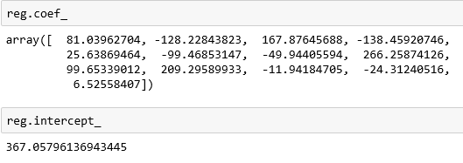

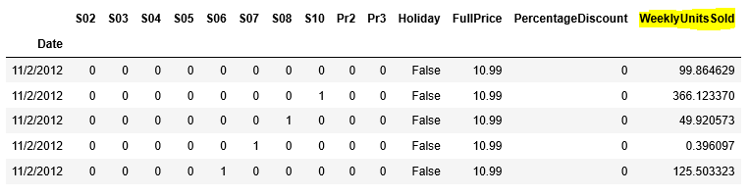
Below screen shot shows the coefficient and intercept values
Below is the screenshot that shows different weekly units sold across various products and stores

Slide 2
Here are the steps performed to do this predictive model
Data Wrangling
Calculated percentage discount
Created dummy variables for categorical variables(nominal values)
Dropped variable with high correlations (multicollinear) to overcome dummy variable trap
Then ran the regression model to calculate all coefficient variables
Then created test data based on business needs
Finally forecasted the sales in CSV format.

Slide 3
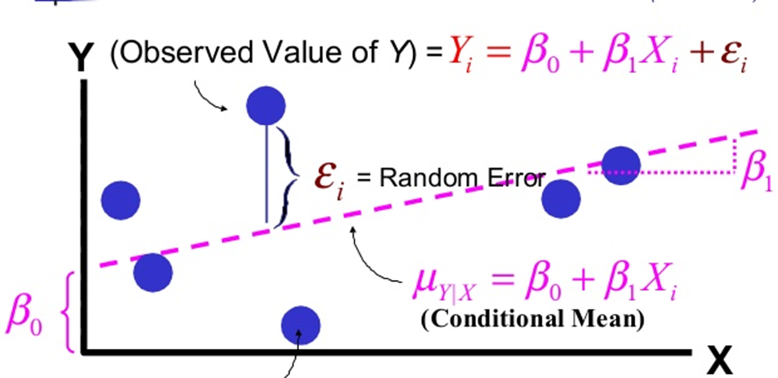
Regression Analysis
In statistical modeling, regression analysis is a set of statistical processes for estimating the relationships between a dependent variable (often called the 'outcome variable') and one or more independent variables (often called 'predictors', 'covariates', or 'features'). The most common form of regression analysis is linear regression, in which a researcher finds the line (or a more complex linear function) that most closely fits the data according to a specific mathematical criterion
Source: wikipedia

