Slide 1

Optimizing Beamforming Vectors for Uniform Linear Arrays
This presentation explores methods for calculating optimal beamforming vectors for uniform linear arrays.
Ivan Kakurin

Slide 2
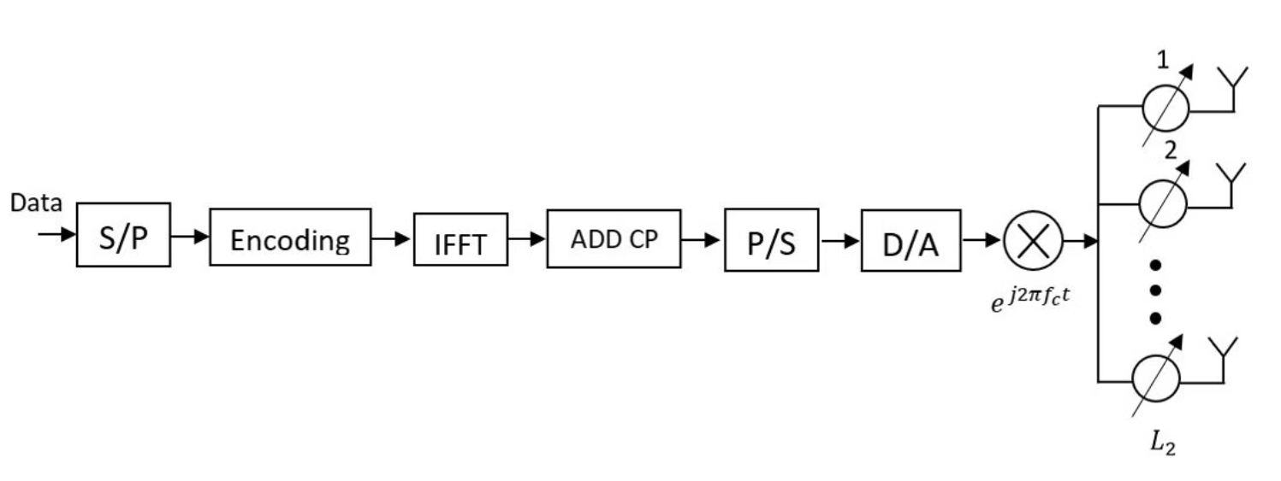
Optimal Beamforming Vector Calculation
Objective
Constraints
Maximize signal strength in desired direction
Multi-dimensional problem
Minimize interference from other directions
Non-convex, no closed-form solution

Slide 3
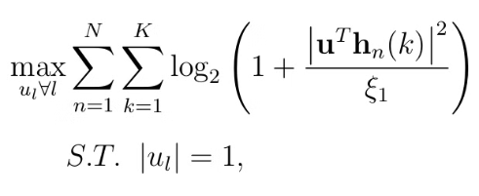
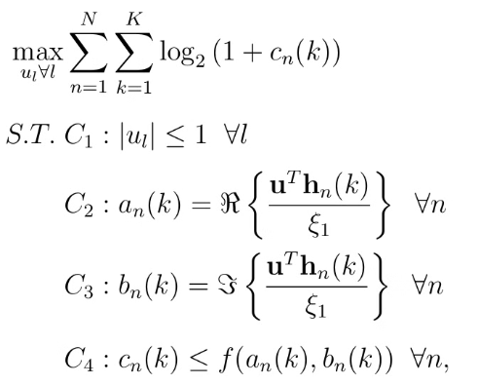


Solutions
Problem Formulation
Successive Convex Optimization
Brute-force search
We have finite number of possible beamforming vectors for b-bit phase shifters, so we can use brute-force search using cupy
We're maximizing Sound-to-Noise ratio of signal using b-bit phase shifters with phases u from P:

Slide 4
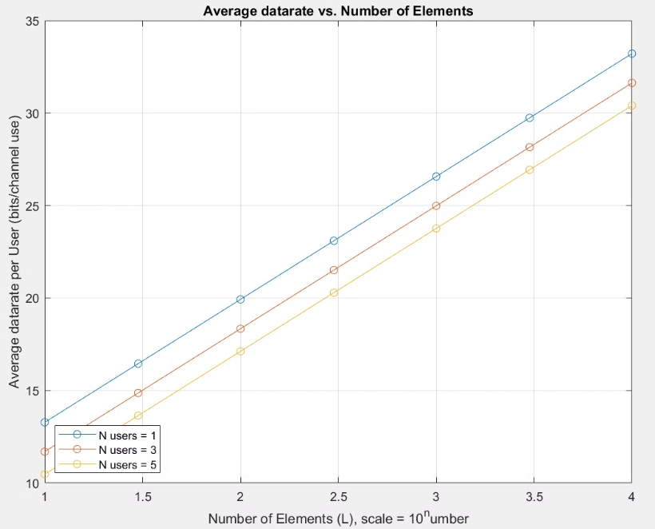
Convex Optimization Approach
I've used MATLAB CVX library for convex optimization
Computation time: 13882 s
Computation complexity: O(K^4.5; N^3.5; L)
where N is the number of users,
K is the number of OFDMA sub-carriers per user
L is the number of antennas

Slide 5
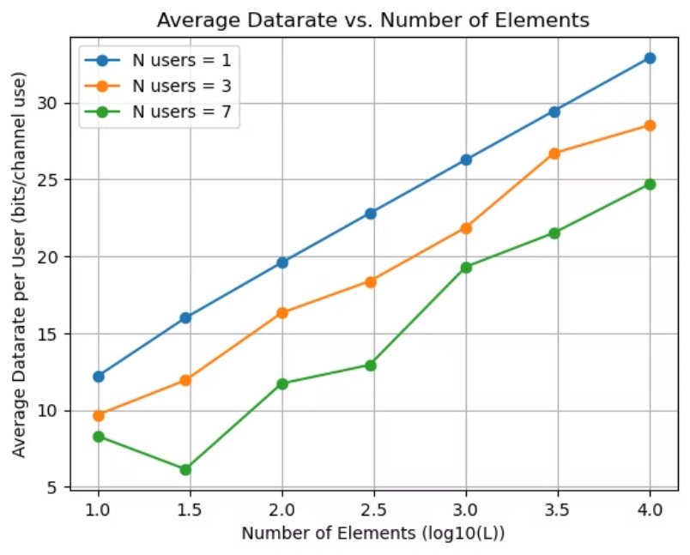
Brute-force search
I've used Python with cupy library
Computation time: 1034 s
Computation complexity: O(K; N; L, 2^b)
where N is the number of users,
K is the number of OFDMA sub-carriers per user
L is the number of antennas
2^b is the number of possible phase-shifts
Results are almost the same as with CVX

Slide 6
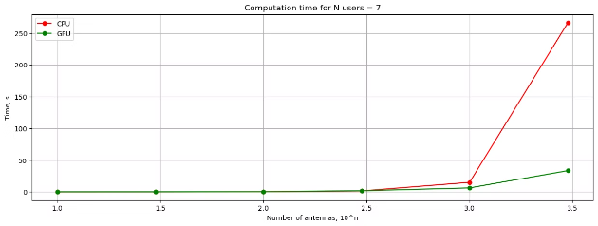
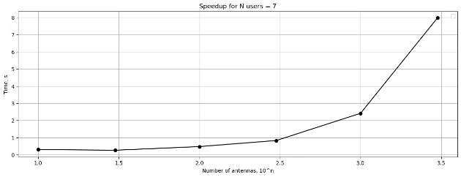
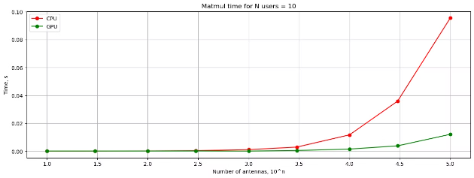
Results Comparison
Comparing njit and cupy,
Brute-force search is 8 times faster using GPU for large antenna arrays (L = 10^4). It's because most computation time is matrix multiplication, which is 8 times faster.
Comparing cupy and CVX,
cupy is 13 times faster for large antenna arrays (L = 10^4)
Method
Computation Time (s)
njit
9231 s
cupy
1034 s
CVX
13882 s

Slide 7




Conclusion
Convex Optimization
Effective for calculating optimal beamforming vectors for small antenna arrays, provides optimal solution for continious phase-shifts
Cupy
Accelerates computation and improves scalability for big antenna arrays, provides optimal solution for discrete phase-shifts
Future Work
Explore combination of CVX and GPU-accelerated computations

