Slide 1

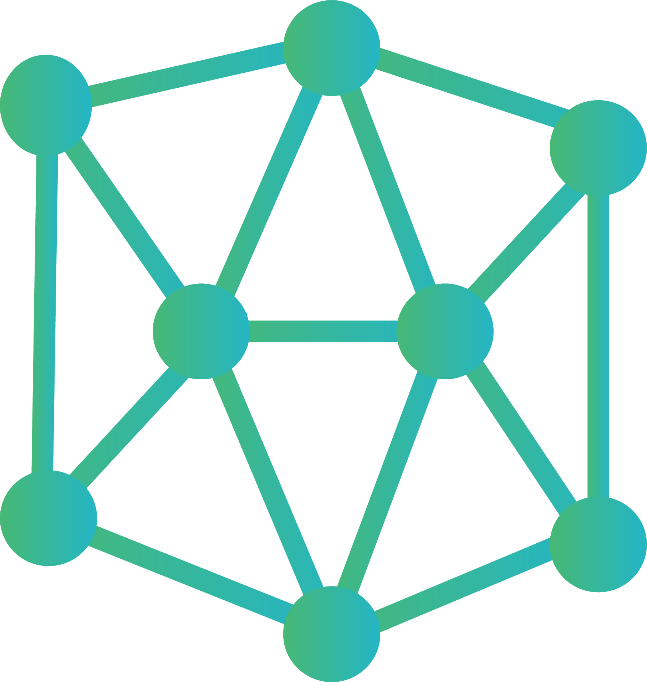





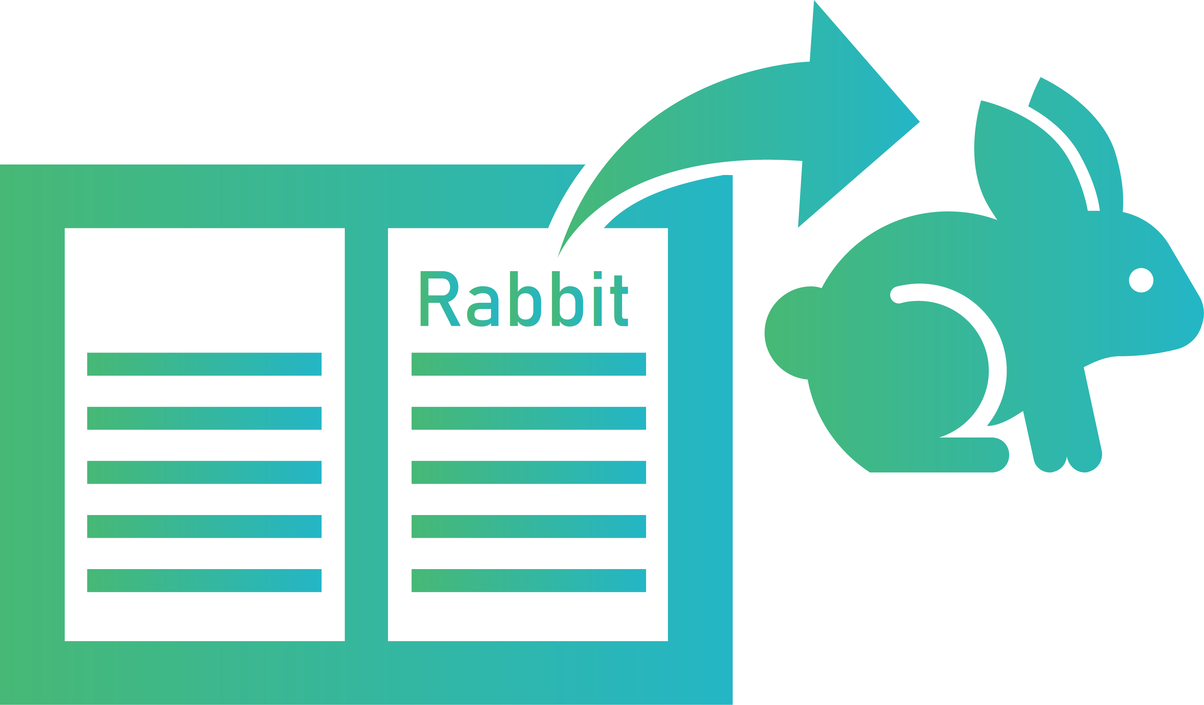

CHAPTER 9
Think and Create
Empowerment 3
Version 1.0

Slide 2

Content
Empowerment
Introduction to Keypoint Detection Models
Fine-Tuning a Keypoint-RCNN Model

Slide 3
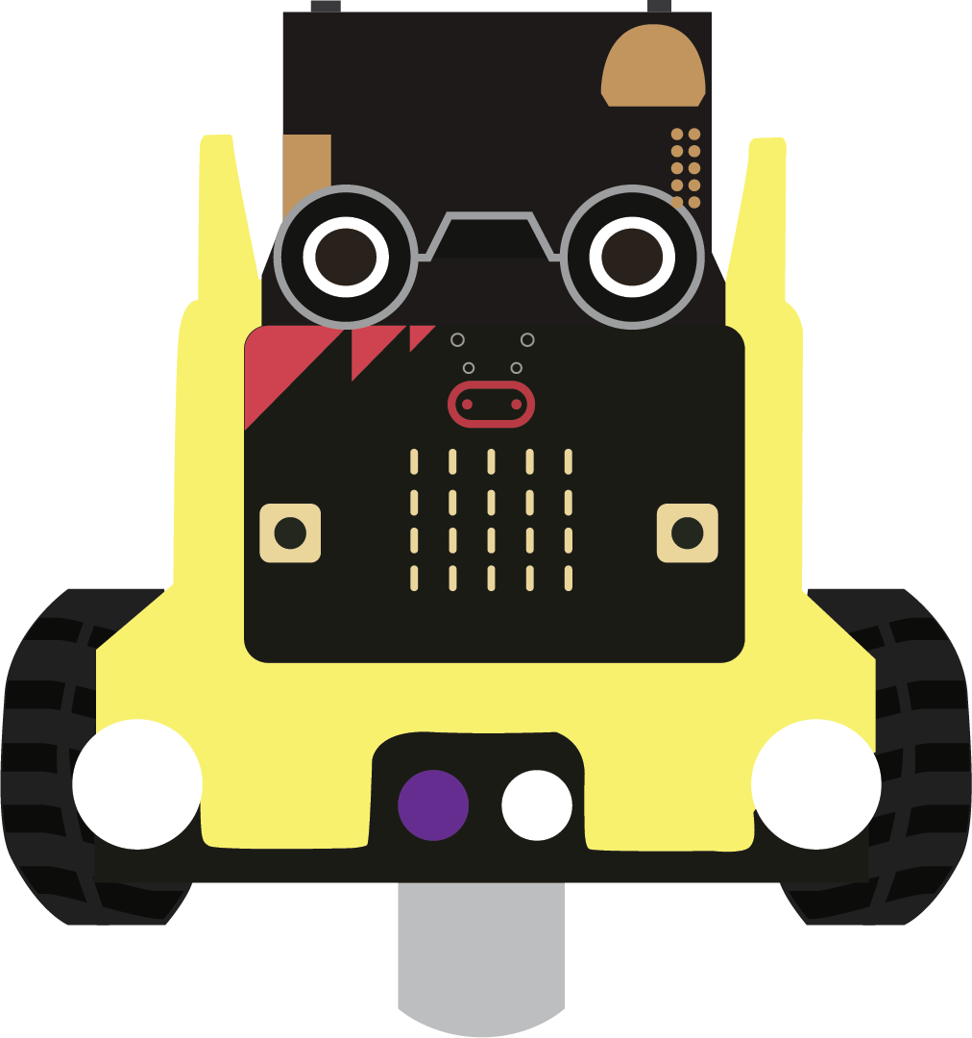
Empowerment

Slide 4
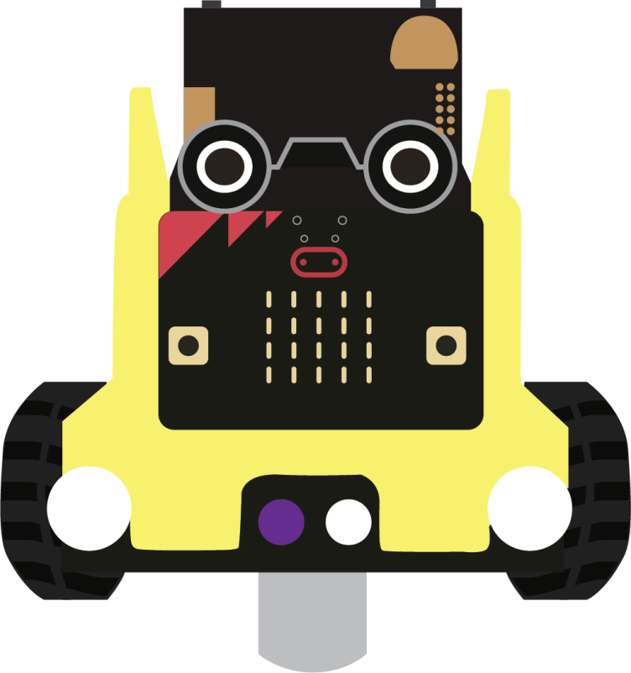
Introduction to Keypoint Detection Models
4

Slide 5
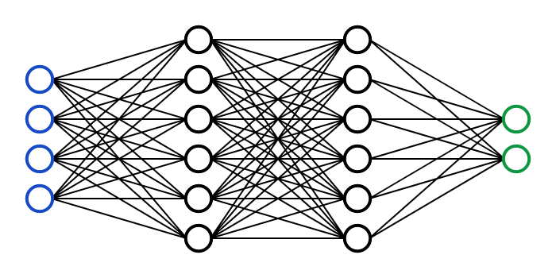
What Can Keypoint Detection Models Do?
A Keypoint Detection Model is the model used to track the motion of the keypoints we specified:
Each fine-tuned model has its own keypoints to detect.
Input a picture, the model will give you the position of the desired keypoint(s)
Stable Diffusion
Input: Text prompt
Output: Images
EXAMPLE PICS HERE
EXAMPLE PICS HERE
Copyright © CUHK Jockey Club AI for the Future Project. All rights reserved.
5

Slide 6
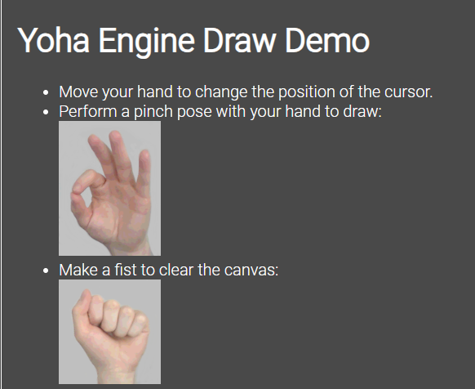
Taste 1: Hand Motion Tracking
Let's try tracking the hand motion and gestures!
https://handtracking-io.github.io/yoha/draw_demo/
Mark: It is also a good demo and explanation of why we need a boundary box
Copyright © CUHK Jockey Club AI for the Future Project. All rights reserved.
6
Notes:
Notes for teachers:
https://stablediffusionweb.com/#demo

Slide 7
How Are the Models Trained?
People train models with a very large dataset
Datasets often include millions of labelled pictures
Famous and widely used datasets: COCO(cocodataset.org), MPII(http://human-pose.mpi-inf.mpg.de/), MS COCO, etc.
Common models: YOLO, OpenPose, Keypoint-RCNN
Copyright © CUHK Jockey Club AI for the Future Project. All rights reserved.
7
Notes:
Notes for teachers:
Credit of the cat images: https://developer.nvidia.com/blog/improving-diffusion-models-as-an-alternative-to-gans-part-2/

Slide 8
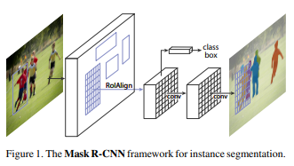
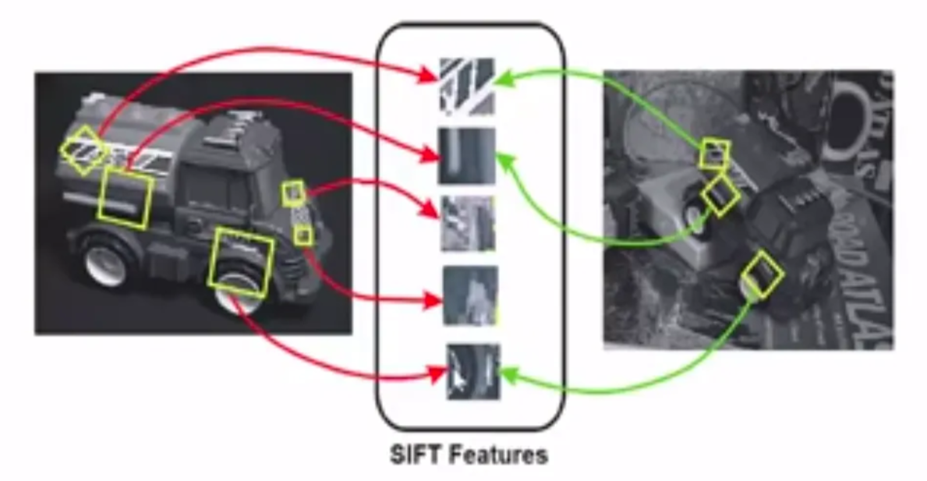
How Are the Keypoints Detected?
Important Algo: SIFT
Note: This is not the whole story yet…
Credit of the cat images: NVIDIA
Copyright © CUHK Jockey Club AI for the Future Project. All rights reserved.
8
Notes:
Notes for teachers:
Credit of the cat images: https://developer.nvidia.com/blog/improving-diffusion-models-as-an-alternative-to-gans-part-2/

