Slide 1

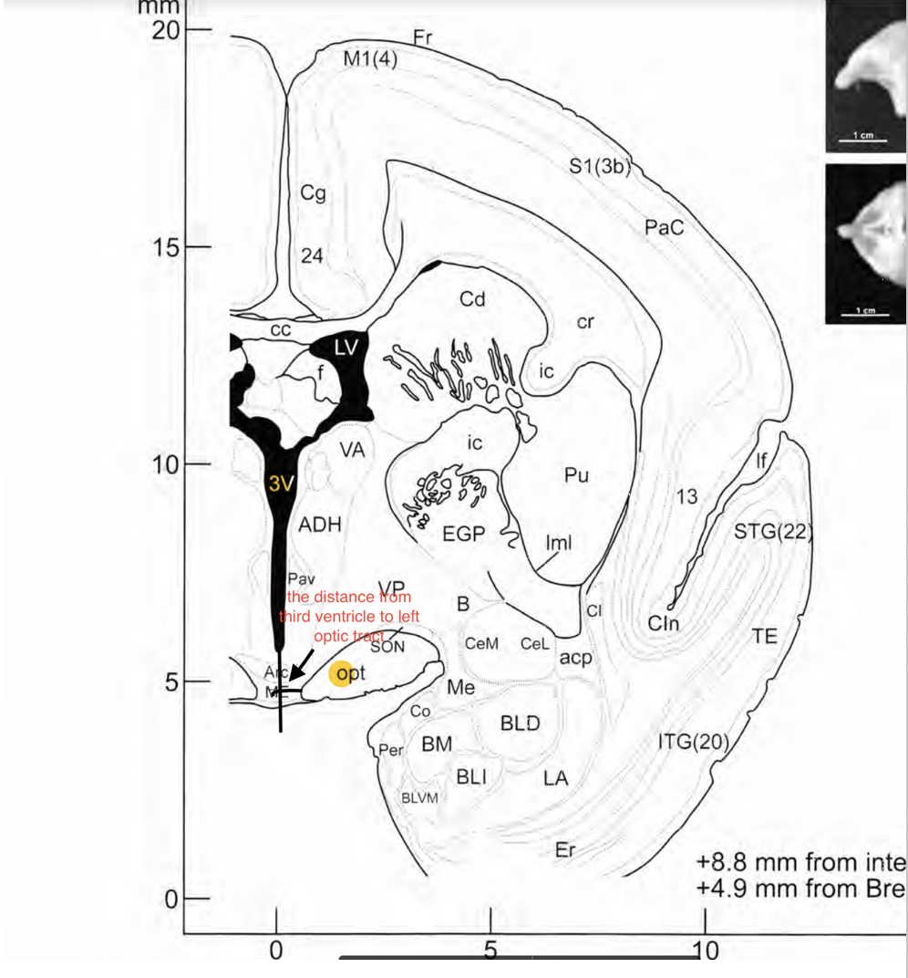
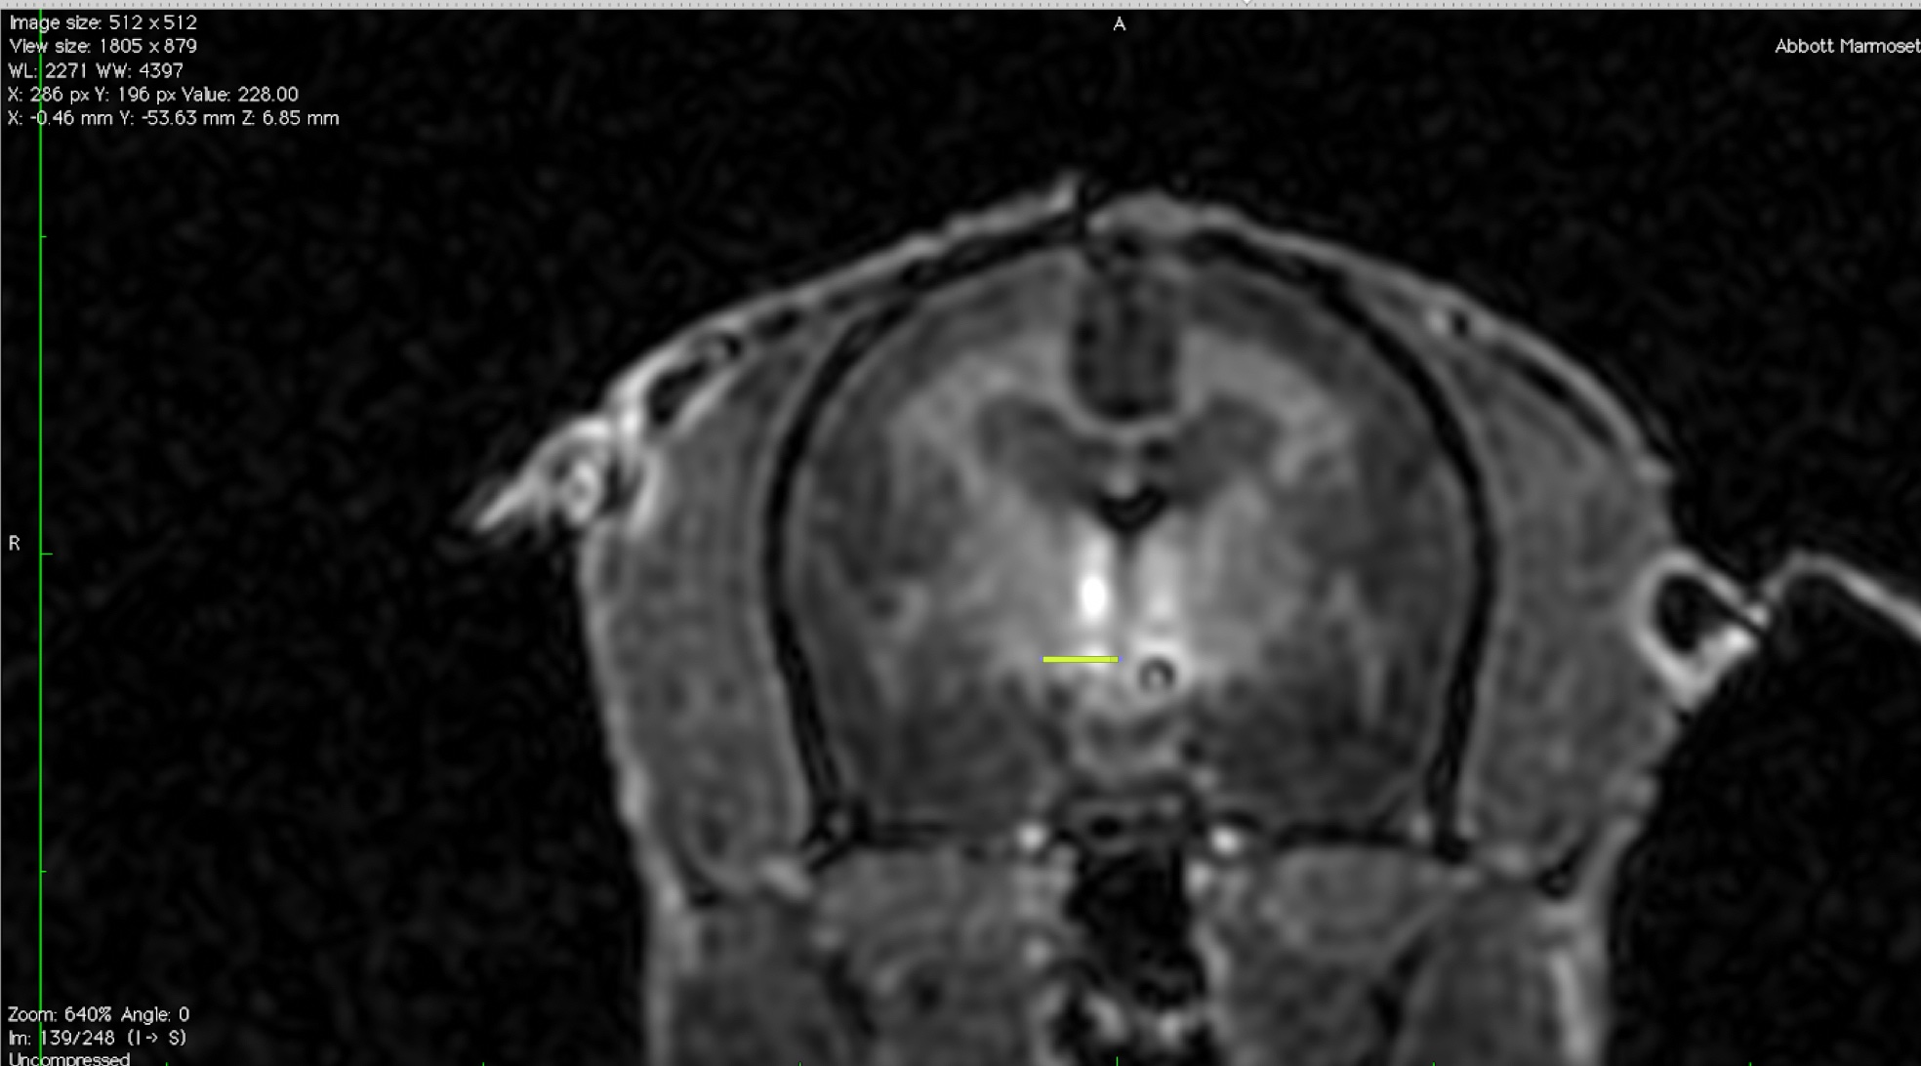
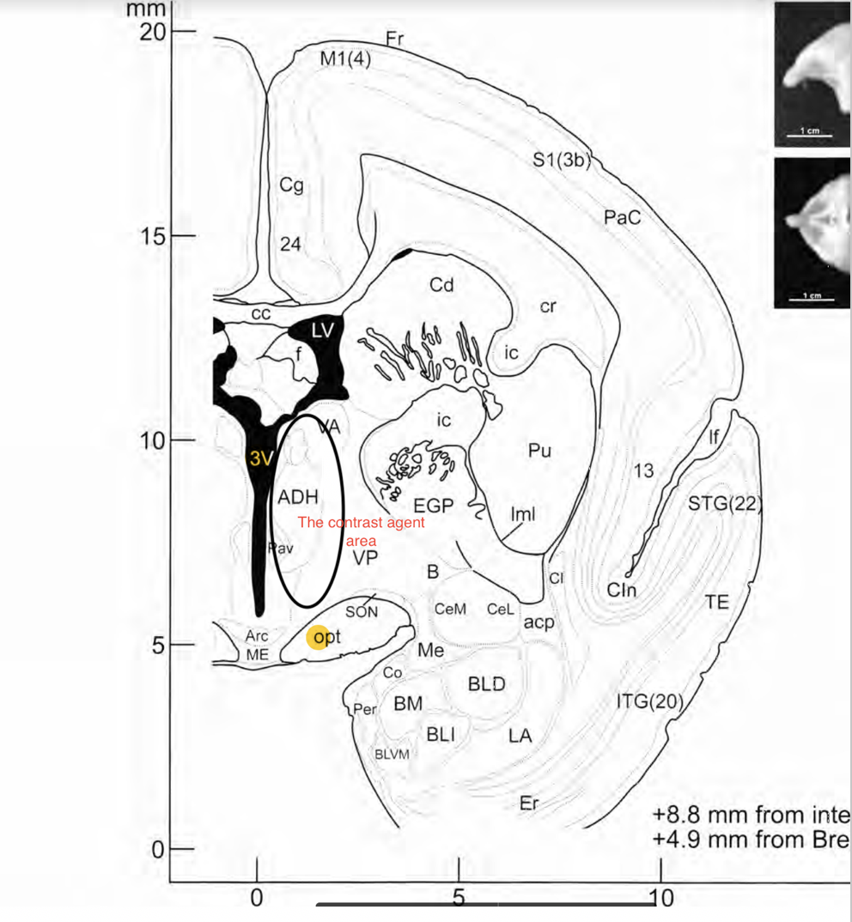
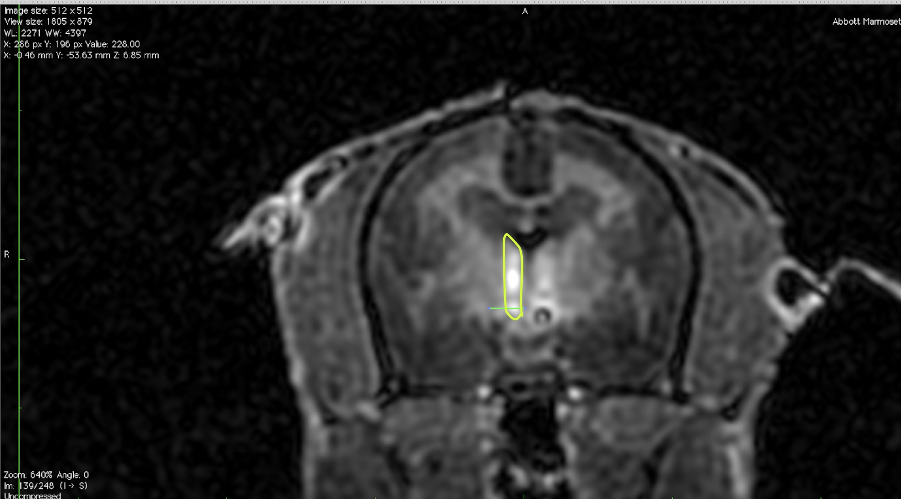
MRI Validation of Silenced Estrogen Receptor Alpha Expression
In The Female Marmoset Monkey Hypothalamus
Camellia(Xinyue) Rui¹, Hannah R Yohnk¹, Daniel J Uhlrich², Marissa Kraynak⁴, Jon E Levine^{1,2,4} and David H Abbott^{1,3,4} (Mentor)
¹Wisconsin National Primate Research Center, Departments of ²Neuroscience and ³Obstetrics & Gynecology, and ⁴Endocrinology-Reproductive Physiology Training Program, University of Wisconsin, Madison, WI.
INTRODUCTION
METHODS
RESULTS
Estradiol (E₂) or estrogen receptor alpha (ERα) deficiency accompany polycystic ovary syndrome (PCOS)-like traits in female rodents. PCOS affects ~10% of women, inflicting infertility, obesity and cardiometabolic disease. This research project aims to investigate the role of ERα in regulating female body weight and metabolic homeostasis in a nonhuman primate, the common marmoset monkey (Callithrix jacchus). To achieve this goal, we needed to test the hypothesis that ERα-expressing neurons of the hypothalamic ventromedial nucleus (VMN) mediate some or all the effects of E₂ on energy homeostasis in female marmosets. The identity of the ER regulating female metabolism in primates, including humans, is unknown. We propose that hypothalamic VMN ERα plays the key role in regulating metabolism in female marmosets. In this study, we have begun our validation of a magnetic resonance imaging (MRI)-guided approach for infusion of MRI contrast agent (Fig. 1-2) along with adeno-associated virus 8 (AAV8) that infects neurons with either ERα silencing shRNA or a control shRNA, and both types of AAV8 also deliver the gene for green fluorescent protein (GFP) so we can identify which cells were infected. Accurate VMN placement of this specific gene silencing vector is vital for testing our hypothesis that selectively removing VMN ERα expression will induce female obesity, potentially leading to metabolic disease commonly accompanying PCOS in women.
cj1756 Control | Area of Contrast Agent (cm²) |  |  | Average area (cm²) | Length of Contrast Agent (cm) |  |  | Average left side ventricle-optic tract in brain sections (cm) | Volume of contrast agent between MRI coronal sections (cm³) | Aligned MRI-brain sections
3/23/ 2015 | 0.081 | 0.082 | 0.076 | 0.080 | 1.288 | 1.341 | 1.274 | 0.19 | 0.057 | EFH
12:41 PM | 0.074 | 0.064 | 0.061 | 0.066 | 1.312 | 1.31 | 1.23 | 0.195 | 0.0585 | GJI
 | 0.069 | 0.089 | 0.085 | 0.081 | 1.406 | 1.507 | 1.403 | 0.244 | 0.0732 | K
 | 0.096 | 0.123 | 0.09 | 0.103 | 1.468 | 1.666 | 1.529 | 0.213 | 0.0639
 | 0.102 | 0.123 | 0.108 | 0.111 | 1.524 | 1.663 | 1.557 | 0.217 | 0.0651
 | 0.112 | 0.108 | 0.114 | 0.111 | 1.769 | 1.715 | 1.676 | 0.273 | 0.0891 | N1
 | 0.108 | 0.109 | 0.123 | 0.113 | 1.683 | 1.675 | 1.756 | 0.304 | 0.0912
 | 0.115 | 0.105 | 0.097 | 0.106 | 1.634 | 1.58 | 1.537 | 0.322 | 0.0966
 | 0.095 | 0.106 | 0.083 | 0.095 | 1.548 | 1.603 | 1.551 | 0.369 | 0.1107
 | 0.099 | 0.089 | 0.068 | 0.085 | 1.706 | 1.678 | 1.48 | 0.425 | 0.1275
 | 0.038 | 0.031 | 0.034 | 0.034 | 0.819 | 0.772 | 0.774 | 0.409 | 0.1227
Left optic tract
3rd ventricle
Figure 1. The green line illustrates OsiriX digital caliper measurement between the left wall of the 3rd ventricle and the left optic tract in an MRI coronal brain image at the rostral-caudal level of the hypothalamus. The black line on the sketched image indicates the same. The brain section is flipped.
METHODS
MRI brain images
We used OsiriX (medical imaging software; Pixmeo SARL, Geneva, Switzerland) to quantify the volume of MRI contrast agent infused into the left VMN of adult (2-4 years) female marmoset monkeys, using consecutive (0.3 mm interval) coronal digital sections through the brain at the rostral-caudal location of the hypothalamus. The digital image of each section was sketched to scale and the distance from the left wall of the mid-line third ventricle to left optic tract(x-coordinate) was measured with OsiriX digital calipers (Fig. 1 and 3). The rostral-caudal distance (z-coordinate) from the front of the brain (rostral-most coronal section showing the brain) to the back of the brain (caudal-most coronal section showing the brain) was recorded. As the MRI image illustrates all the left side infusions, but only a single infusion on the right, only left side measurements were made. We then used OsiriX digital imaging calipers to outline the left area of contrast agent infused with the virus (Fig. 2). Each measurement above was taken 3 times and averaged to reduce error. We calculated the volume of contrast agent infused by multiplying the area by the distance between scans, 3mm (Fig. 4).
Brain sections
We ordered the postmortem brain sections rostral-caudal from the same marmosets. To date, we have only aligned our left 3rd ventricle wall-left optic tract measurements with the closest MRI image match for one control female, cj1756 (Fig. 3-4). Several brain sections clustered around only a few of the MRI images (each section has a letter/number ID), enabling us to identify the brain sections needed for comparison of left-side contrast agent volume with that for left side GFP positive cells. We anticipate obtaining an ~80% overlap between MRI-derived contrast agent volume and immunohistochemical (IHC)-derived GFP staining.
After aligning all the measurements with marmosets’ brain sections, we can identify the brain sections that we needed for comparison of the contrast agent and the area of green fluorescent protein .
Figure 3. Left side contrast agent infusion was identified in 13 MRI coronal digital sections, enabling infusion area estimates from rostral to caudal extent of the VMN. Aligning similar left side ventricle-optic tract measurements in IHC-derived coronal brain sections, we identified 4 MRI images that aligned with 8 brain sections (letter/number IDs).
Outline of left side contrast agent
Figure 4. Left side total area and volume of contrast agent derived from MRI images of control female, cj1756. Total left hypothalamus containing contrast agent = 0.96 cm³ (960µl), approximating 50% of left hypothalamic volume in an adult marmoset, and exceeding left VMN volume. In contrast, total volume of contrast agent/viral vector infused on left side = 21µl.
Figure 2. OsiriX digital caliper drawn area (green outline) and sketched area (black outline) of left side infusion of contrast agent accompanying AAV8 viral vector. As the MRI image illustrates all the infusions made on the left side, and only a single infusion of the right, only left side measurements are taken. The brain section is flipped.
SUMMARY
● MRI-derived coronal brain images enable quantification of contrast agent/viral vector diffusion through the left marmoset monkey hypothalamus, identifying delivery of either ERα gene silencing or control scramble shRNA.
● In the one control marmoset analyzed sufficiently to date, diffusion spread through ~ 50% of the left hypothalamus, exceeding the VMN target area. As ERα expression is mostly restricted to the VMN, arcuate nucleus and peri-ventricular areas of this part of the marmoset hypothalamus, the extent of diffusion is not a concern.
● This initial method establishes a viable approach to compare diffusion spread of viral infusate with GFP-determined spread of viral infection of cells, and thus valid areas in which to expect gene silencing in marmosets receiving ERα-targeted silencing RNA.
RESULTS
cj1756 Control | z = rostral-caudal position (cm) | Left wall of 3rd ventricle to left optic tract (cm) |  |  | Average left side distance | Aligned MRI-brain sections
3/17/2015 | 7.67 | 0.102 | 0.109 | 0.104 | 0.105
8:04AM | 7.37 | 0.139 | 0.155 | 0.129 | 0.141
 | 7.07 | 0.144 | 0.15 | 0.155 | 0.150
 | 6.77 | 0.176 | 0.181 | 0.182 | 0.180 | EFH
 | 6.47 | 0.217 | 0.214 | 0.198 | 0.210 | GJI
 | 6.17 | 0.242 | 0.228 | 0.251 | 0.240 | K
 | 5.87 | 0.246 | 0.239 | 0.223 | 0.236
 | 5.57 | 0.279 | 0.261 | 0.25 | 0.263
 | 5.27 | 0.3 | 0.274 | 0.28 | 0.285 | N1
 | 4.97 | 0.307 | 0.298 | 0.311 | 0.305
 | 4.67 | 0.343 | 0.327 | 0.313 | 0.328
 | 4.37 | 0.37 | 0.378 | 0.358 | 0.369
 | 4.07 | 0.38 | 0.37 | 0.382 | 0.377
Conclusion
● MRI-derived, quantitative digital brain imaging will allow efficacy assessments for viral vector-mediated ERα gene silencing in the hypothalamic VMN of female marmoset monkeys, in order to substantiate this approach to induce PCOS-like obesity and metabolic disease in a nonhuman primate model.
FUNDING
We acknowledge our funding sources:
- NIH grants P50 HD028934 (PI: Marshall, JC), P50 HD044405 (PI: Dunaif, A), T32 HD041921 (PI: Bird, IM)

