Slide 1
Camera Calibration using Different Patterns
Daniel Palomino
dapalominop@gmail.com
Based on the paper:
Asthana, Shubham. (2014). Enhanced Camera Calibration for Machine Vision using OpenCV. International Journal of Artificial Intelligence.
Volume 3.

Slide 2
What Patterns?

Slide 3
OpenCV sopport the next patterns for calibration:
CHESSBOARD
CIRCLES_GRID
ASYMMETRIC_CIRCLES_GRID
But I included the next pattern :
RINGS_GRID

Slide 4
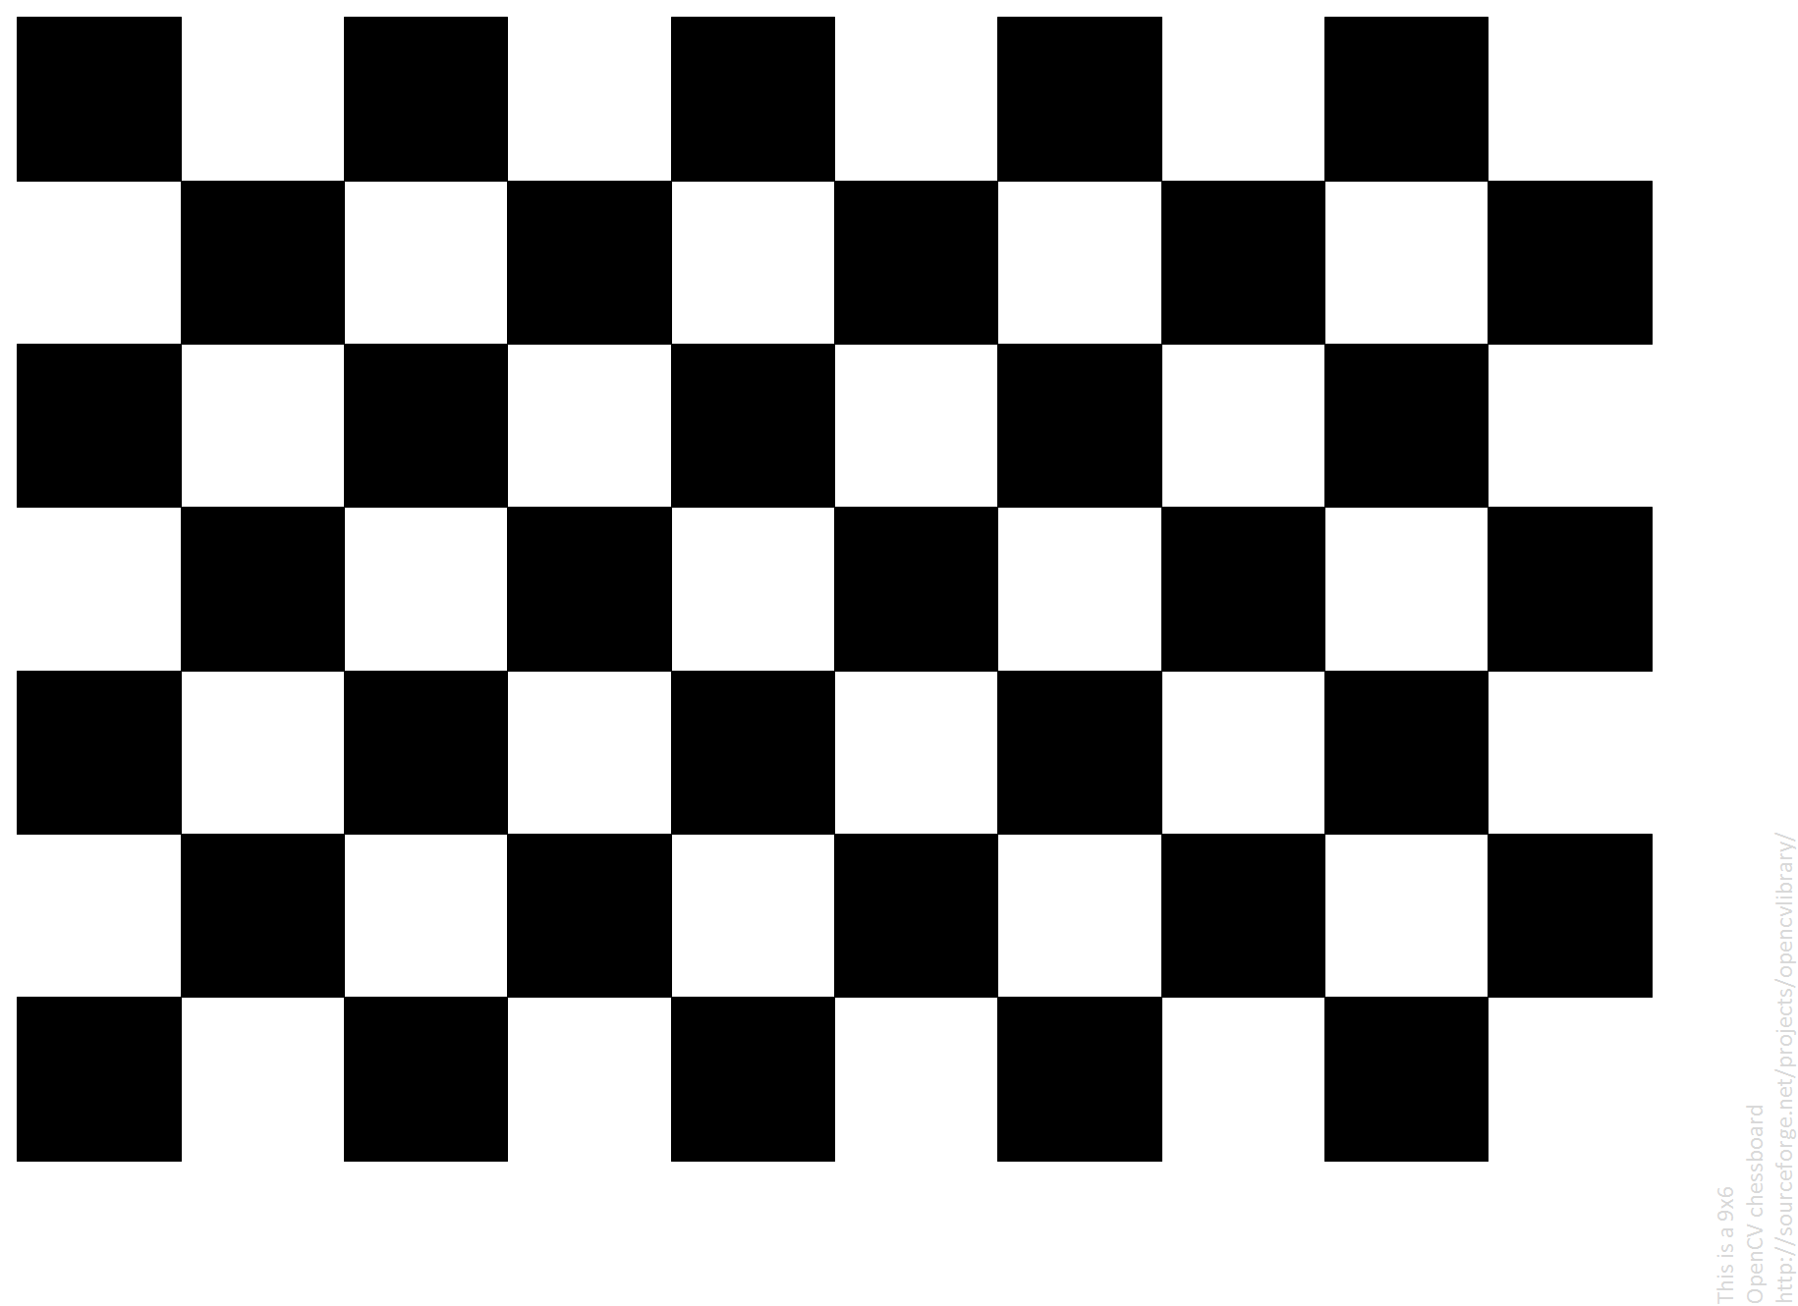
The ChessBoard Pattern

Slide 5

The Asymetric Circle Pattern

Slide 6

The New Ring Pattern

Slide 7
Benchmark
In order to compare the usefulness of the mentioned standards:
Different videos will be used to measure calibration parameters and compare the obtained precision.
The videos are in avi and mp4 format.
Different images Will be used for calculating the parameters.

Slide 8
Camera 01 using 15 Frames
 | Fx | Fy | Cx | Cy | rms
ChessBoard | 217 | 246 | 291 | 258 | 0.190
Circles | 687 | 689 | 328 | 232 | 0.229
Rings | 683 | 680 | 337 | 266 | 0.72

Slide 9
Camera 01 using 30 Frames
 | Fx | Fy | Cx | Cy | rms
ChessBoard | 264 | 276 | 292 | 266 | 0.407
Circles | 681 | 681 | 320 | 253 | 0.348
Rings | 120 | 125 | 304 | 545 | 39

Slide 10
Camera 01 using 45 Frames
 | Fx | Fy | Cx | Cy | rms
ChessBoard | 666 | 664 | 338 | 257 | 0.423
Circles | 750 | 755 | 355 | 258 | 0.685
Rings | 101 | 108 | 280 | 353 | 32

Slide 11
Camera 02 using 15 Frames
 | Fx | Fy | Cx | Cy | rms
ChessBoard | 329 | 329 | 328 | 158 | 0.217
Circles | 513 | 504 | 336 | 149 | 0.264
Rings | 572 | 570 | 348 | 161 | 0.113

Slide 12
Camera 02 using 30 Frames
 | Fx | Fy | Cx | Cy | rms
ChessBoard | 482 | 481 | 326 | 161 | 0.262
Circles | 521 | 520 | 336 | 175 | 0.319
Rings | 508 | 506 | 345 | 168 | 0.460

Slide 13
Camera 02 using 45 Frames
 | Fx | Fy | Cx | Cy | rms
ChessBoard | 517 | 518 | 327 | 174 | 0.458
Circles | 511 | 511 | 328 | 173 | 0.305
Rings | 487 | 489 | 326 | 196 | 0.546

Slide 14
Bibliography
Asthana, Shubham. (2014). Enhanced Camera Calibration for Machine Vision using OpenCV. International Journal of Artificial Intelligence. Volume 3.
https://docs.opencv.org

Slide 15
THANKS

