Slide 1
How to recognize a rings pattern
Daniel Palomino
dapalominop@gmail.com
Based on the paper:
Asthana, Shubham. (2014). Enhanced Camera Calibration for Machine Vision using OpenCV. International Journal of Artificial Intelligence.
Volume 3.

Slide 2
Why other Pattern?

Slide 3
We need a pattern that gets better camera calibration.
OpenCV only work with the next patterns:
CHESSBOARD
CIRCLES_GRID
ASYMMETRIC_CIRCLES_GRID

Slide 4

The Pattern

Slide 5
Proposed Approach
Detection of circles in each image.
Using the detected circles, finding the center of each of the concentric ring pattern.
Segregating these centers as marker or non-marker points.
Arrangement of all the center points in a systematic order that is universally followed for all images.

Slide 6
Detection of Circles
PRE-PROCESSING
Gray Scale
cv::cvtColor
Gaussian Blur
cv::blur
Threshold
cv::threshold
Find Contour
cv::Canny
cv::findContour
Min AreaRect
cv::minAreaRect
Fit Ellipse
cv::fitEllipse

Slide 7
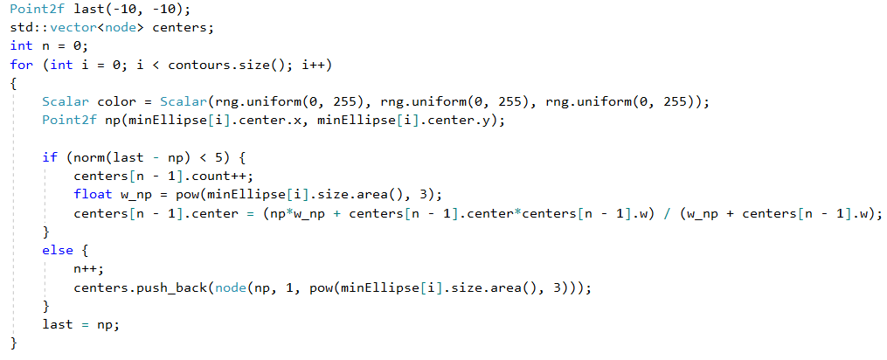
Finding the Centers

Slide 8
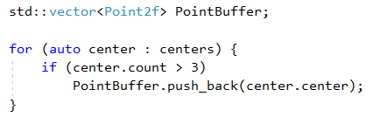
Segregation the Centers

Slide 9
Results

Slide 10
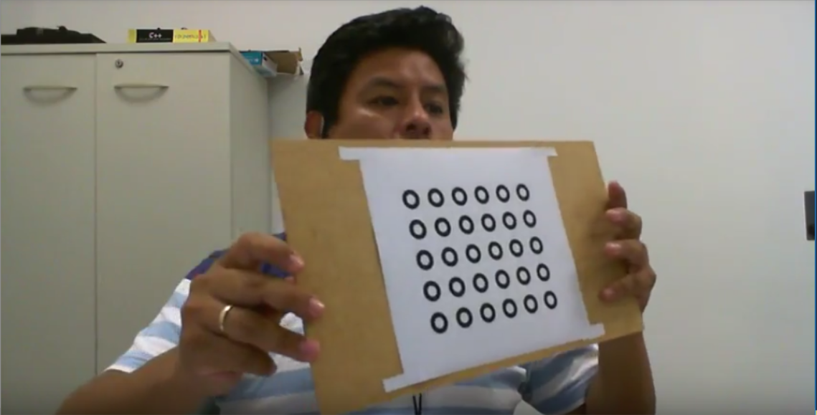
Original Pattern

Slide 11
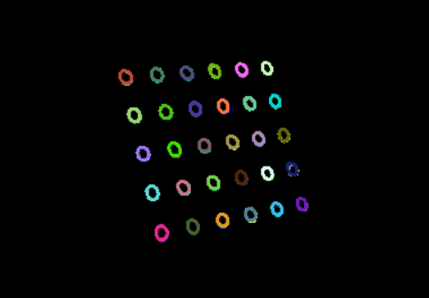
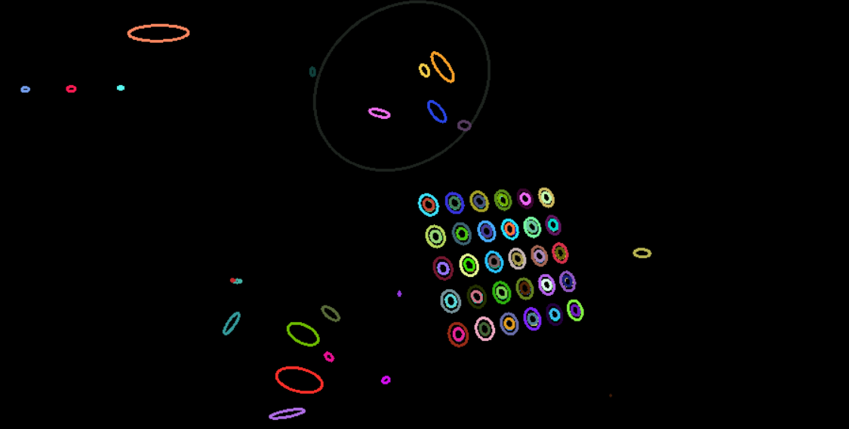
Rings Detected

Slide 12
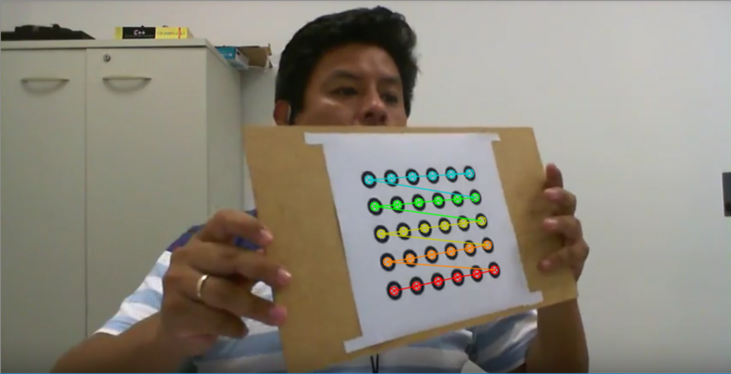
Rings Pattern Detected

Slide 13

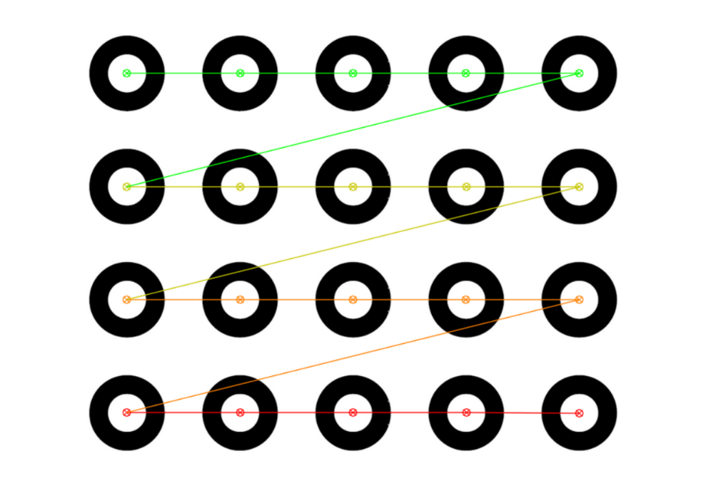

Slide 14
Bibliography
Asthana, Shubham. (2014). Enhanced Camera Calibration for Machine Vision using OpenCV. International Journal of Artificial Intelligence. Volume 3.
https://docs.opencv.org

Slide 15
THANKS

