Slide 1
How to recognize a rings pattern
Daniel Palomino
dapalominop@gmail.com

Slide 2
What is the problem?
Indique la visión y la dirección a largo plazo.

Slide 3
Proposed Approach
Detection of circles in each image.
Using the detected circles, finding the center of each of the concentric ring pattern.
Segregating these centers as marker or non-marker points.
Arrangement of all the center points in a systematic order that is universally followed for all images.

Slide 4
Detection of Circles
PRE-PROCESSING
Gray Scale
cv::cvtColor
Gaussian Blur
cv::blur
Threshold
cv::threshold
Find Contour
cv::Canny
cv::findContour
Min AreaRect
cv::minAreaRect
Fit Ellipse
cv::fitEllipse

Slide 5
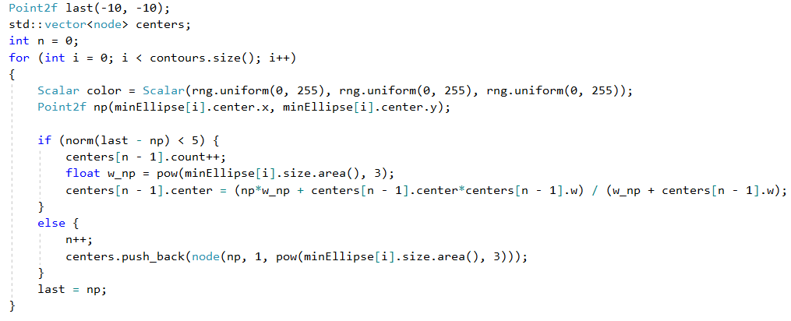
Finding the Centers

Slide 6

Segregation the Centers

Slide 7
Results

Slide 8
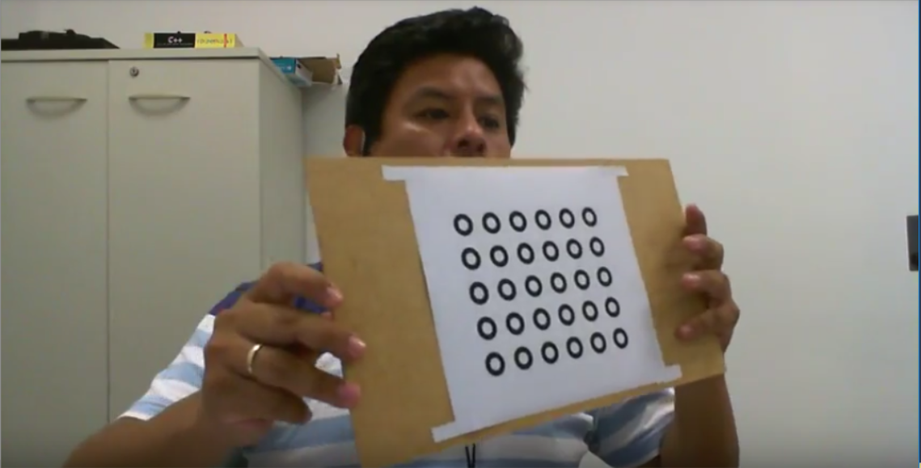
Original Pattern

Slide 9
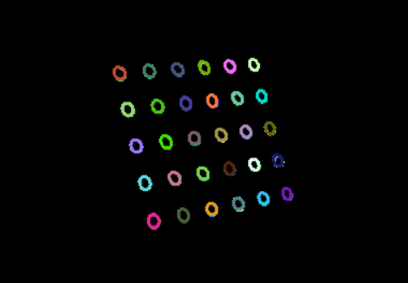
Rings Detected

Slide 10
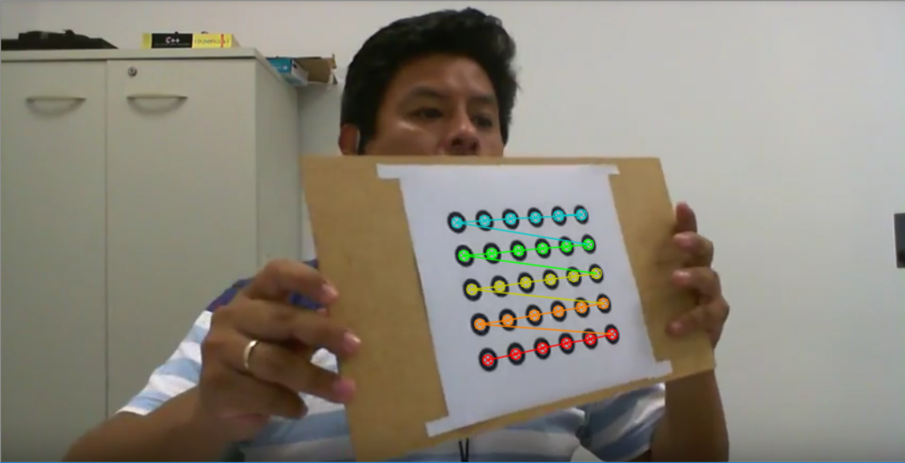
Rings Pattern Detected

Slide 11
Bibliography
Asthana, Shubham. (2014). Enhanced Camera Calibration for Machine Vision using OpenCV. International Journal of Artificial Intelligence. Volume 3.
https://docs.opencv.org

Slide 12
THANKS

