Slide 1

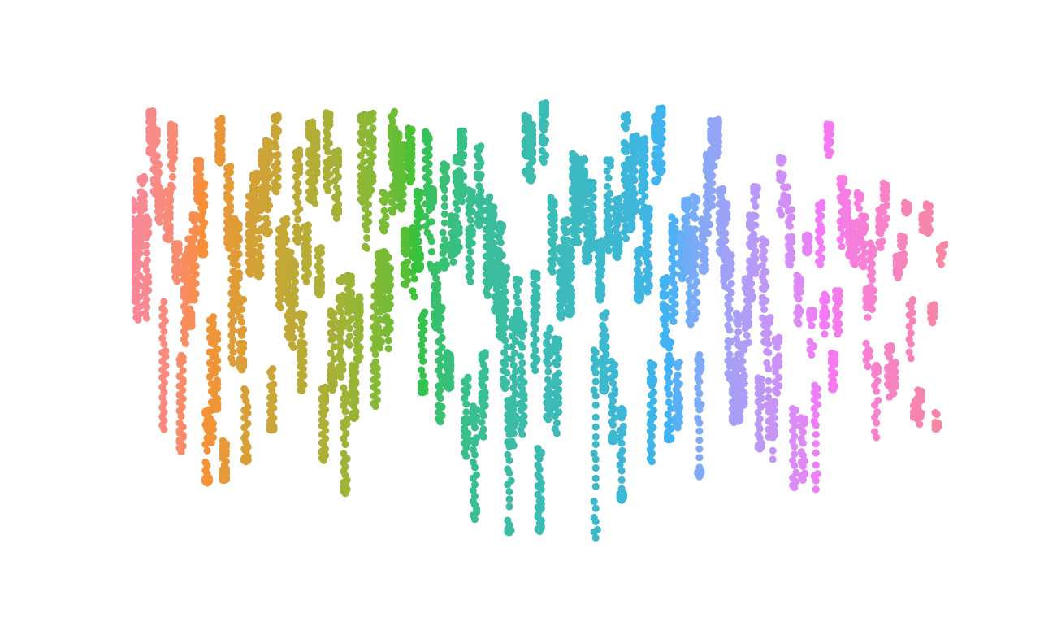
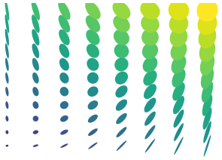

Human Development Index
UNDP
HDI
Global Studies
A better understanding, a better tomorrow.
Cameron R. Cumberland | 2019, Summer

Slide 2

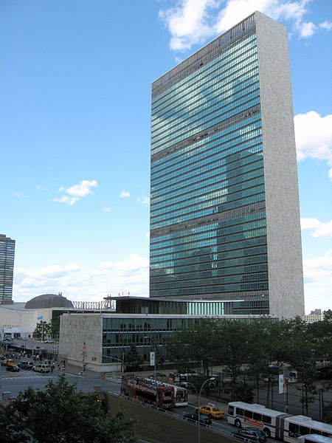
What is the UNDP?
A top-level body of the United Nations
Predecessor created with UN in 1949
Current UNDP made by General Assembly in 1964
Affiliated with the Non-Aligned Movement (NAM) and post-colonial states
Scope has been curtailed by Security Council a few times (UNSC)
Present in 170+ countries
50% of staff (board down) are women
Regional Chairs are from area of oversight (geographic)
Notes:
Present in 170+ countries
50% of staff (board down) are women
Regional Chairs are from area of oversight (geographic)

Slide 3
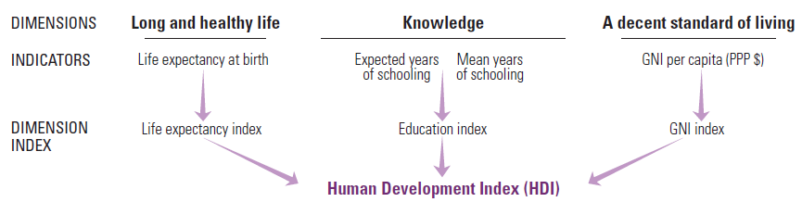
What is the Human Development Index (HDI)?
A decimal between 0 and 1 (e.g. 0.754)
Four categories:
Very High (.91 – 1)
High (.71 - .9)
Medium (.51 - .7)
Low (0 - .5)
However, HDI:
Does NOT account for inequality (of a country or globally)
Does NOT account for gender disparity or ethnic discrimination
Is NOT technically a measure of relative material development
Chart courtesy of UNDP Human Development Report Office
Notes:
The estimated global LOSS in HDI due to inequality is ~20% (UN HDRO human dev reports office)!
And indeed, “Inequality” is the title and theme of the UNDP 2019 report
Is not directly comparable because HDI may be higher or lower due to different reasons. I.e. Norway may have great health and education, but no jobs (high HDI, not easy to live). Or a country may have other issues from another one whose impact is bigger than merely HDI. i.e. A warzone may have similar rank to a country with merely a less-educated populous (if the warzone was wealthy/etc)

Slide 4
Why does HDI matter? How can we use it?
“Stuff matters”
Quality of life
Provision of goods, services
Humanitarian and business perspective
“People matter”
Increased involvement
Stability
Production and human potential
See regional divergence
Which areas “in need”
Understand global state
Track development over time
Prioritize marginalized regions
Measure policy outcomes
Have universal “meter-stick” for material provision

Slide 5

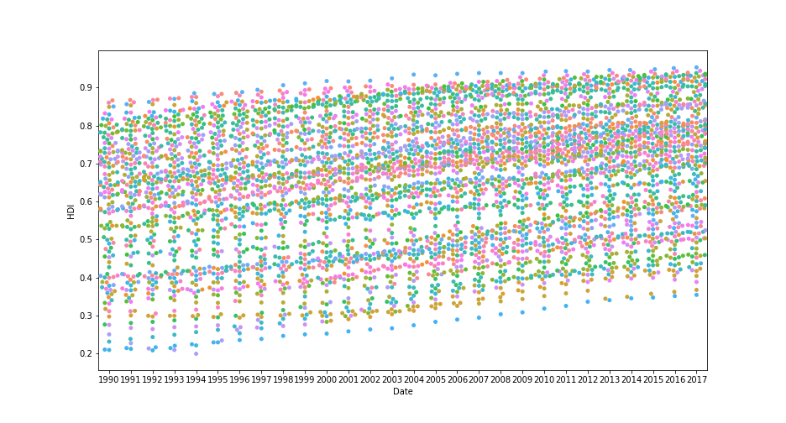
Charting the Waters (These will make sense later, I promise)
HDI Around the World
HDI Over Time
Notes:
How HDI is measured—from collections of willing governments around the world and through UN work on the ground.
The majority of data is collected and housed in regional offices, collated and distributed through the intl HQ.
Includes official statistics (government, NGO, etc) and on occasion, informal. However, data is provided with the reputation and diligence of the UN itself, and can be assumed trustworthy.

Slide 6
Charting the Waters: HDI Over time
Overall trend is upward
Disguises lost ground in war, famine, etc
i.e. Yemen and S. Sudan
Estimates from HDRO
20% of global HDI “eroded” by inequality
Over half of humanity now “middle class”
World Data Lab (FT), Oct 2018
Notes:
Data is clustered and color-coded by country (individual countries here are not the point, hence the density of the visualization)

Slide 7
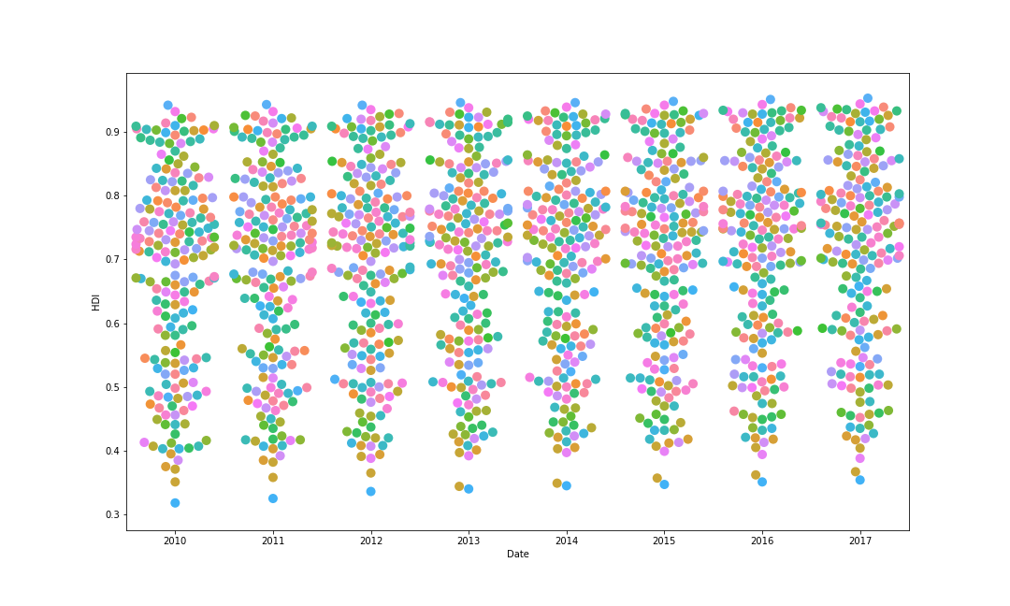
HDI Over Time (Cluster View)

Slide 8
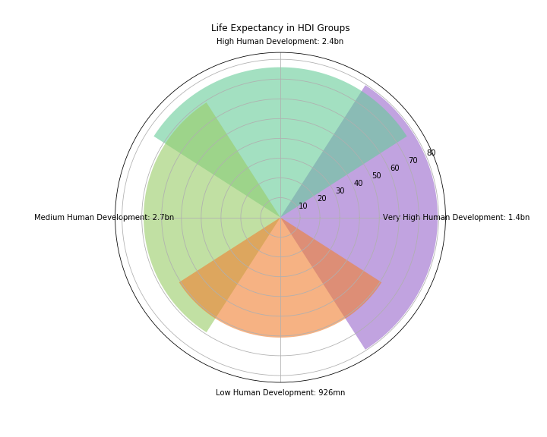
Index Snapshot: Life Expectancy
Life Expectancy ranges 20 years
60.8 to 79.6
Immense gain in last 40 years
Vaccines and “barefoot doctors”
Rising LE is an effect of better access
Also cause for ageing population, new stress
~10% of life across HDI groups is spent in “poor health” / decline

Slide 9
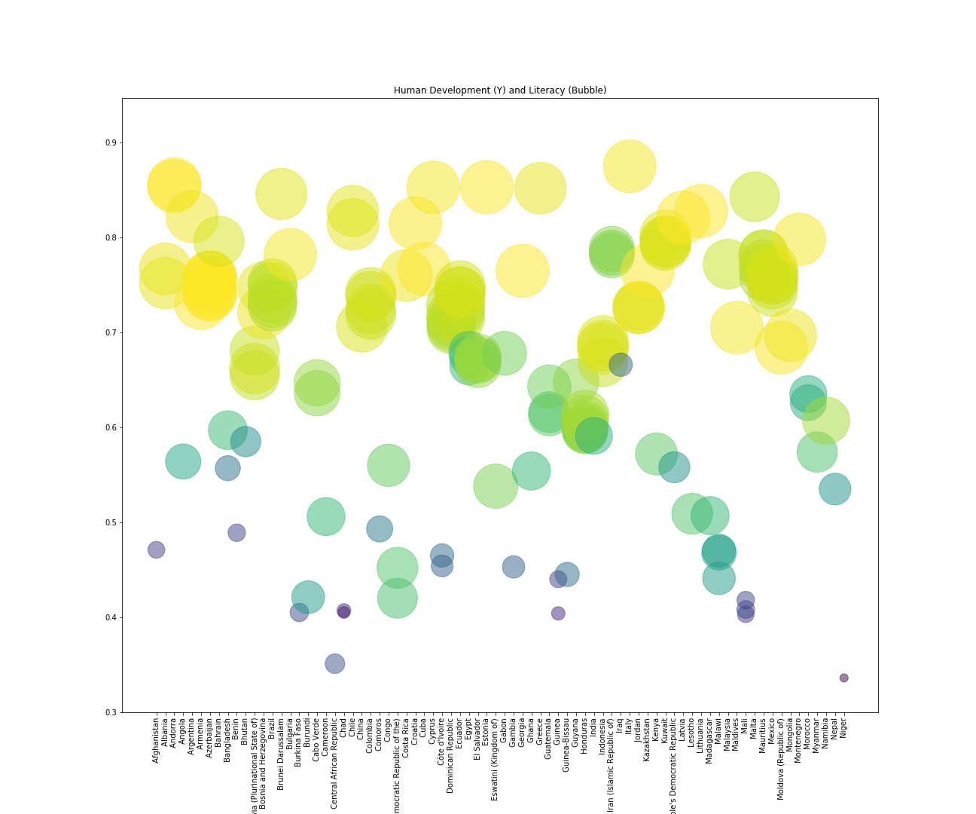
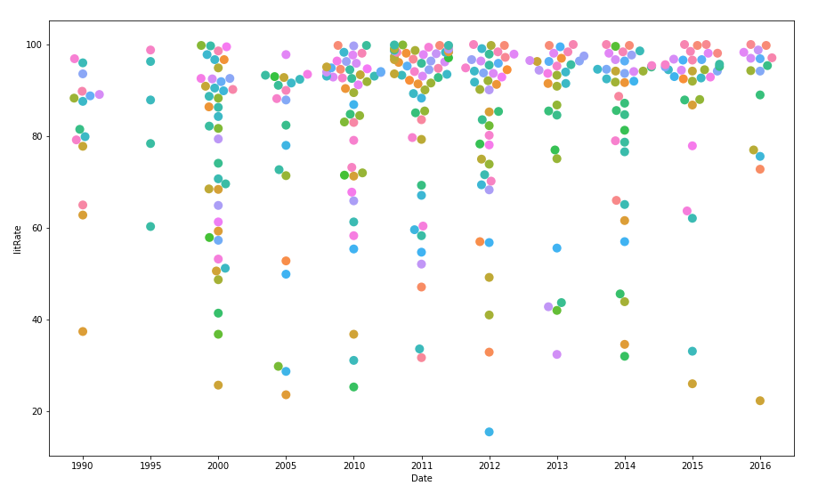
Snapshot: Literacy
HDI (Vertical) and Literacy (Bubble)| by country
Literacy Cluster | by Year
Notes:
On the left:
On the right:
The Y axis represents a nation’s HDI score 0<HDI<1

Slide 10
Data Conclusions | Toward Tomorrow
Global trends upward
Net positive for humanity
Many areas experiencing regression
Inequality (Wealth) is a big issue
So is (Gender) and (International)
Eradication of absolute poverty is possible within the century
We must continue to invest in systems and materials for a more resilient and equitable future
International Cooperation is needed in addressing issues of global scale
Public awareness and dissemination of UN data would be beneficial

Slide 11
External Locations | Sources
GitHub Repository
https://github.com/Cameron-Cn/undp_hdi
United Nations Development Programme
http://hdr.undp.org/en/data#
Financial Times
https://www.ft.com/content/e3fa475c-c2e9-11e8-95b1-d36dfef1b89a
All charts and tables created by author unless otherwise noted
Work is licensed under a Creative Commons 4.0 Attribution Share-Alike License

Slide 12
Thank You

