Slide 1
Project Pitch: Terrain Generation Tool
Presented by Cameron Dawes
Games Development Project

Slide 2
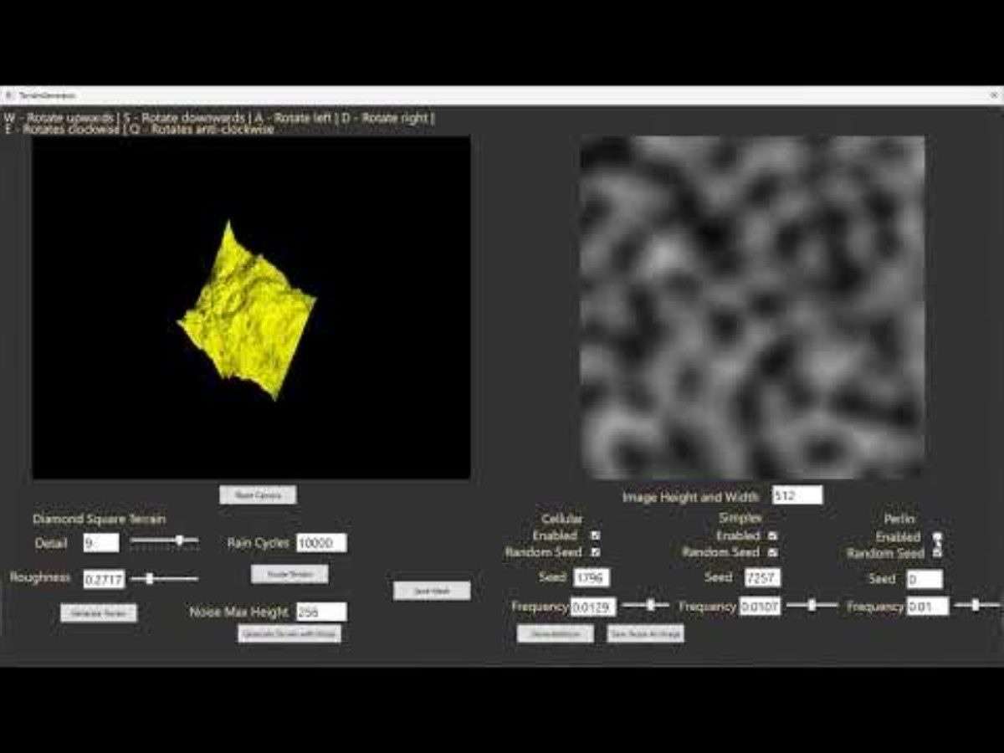
Project Problem
This is a template that you can adapt for your own presentation. Use these slides as a guide for what you should include.
When developing games a difficult part of that is always going to be the landscape/ environment and my project aims to provide a solution for infinite procedural generation and deliberate landscape generation.
With what I intend my tool to do would be to allow you to drop it in to unity and choose a set of parameters and it would work alternatively it would work stand alone allowing you to open the program up and get making a piece of terrain and exporting it for your use.
Challenges for such a problem are wide and varied, allowing for varied and unique terrain design while avoiding artifacts and keeping the program optimized enough so that it can be procedurally generated are both huge challenges along with the implementation of tools for the user to alter the terrain during the creation process.
Here is my previous project to do with terrain. I intend to start anew and take this project leaps and bounds further.

Slide 3
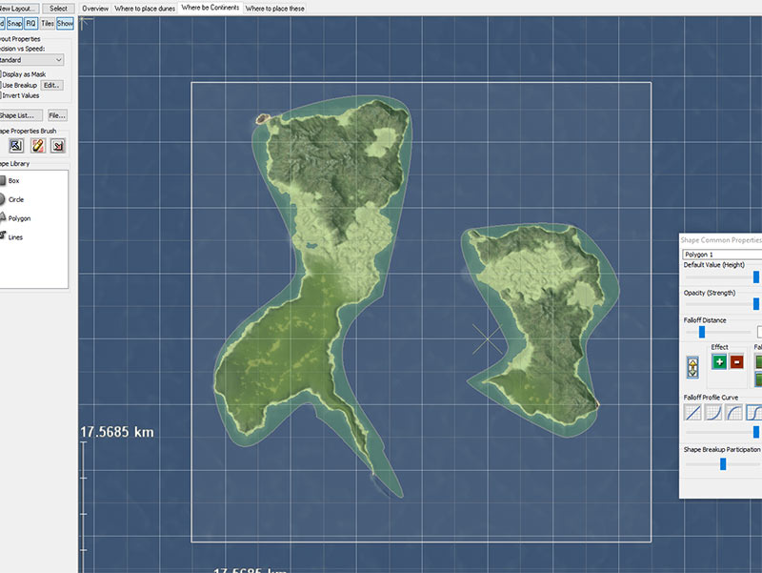
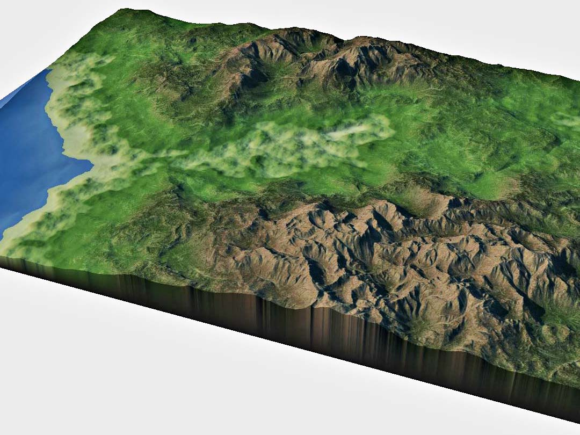
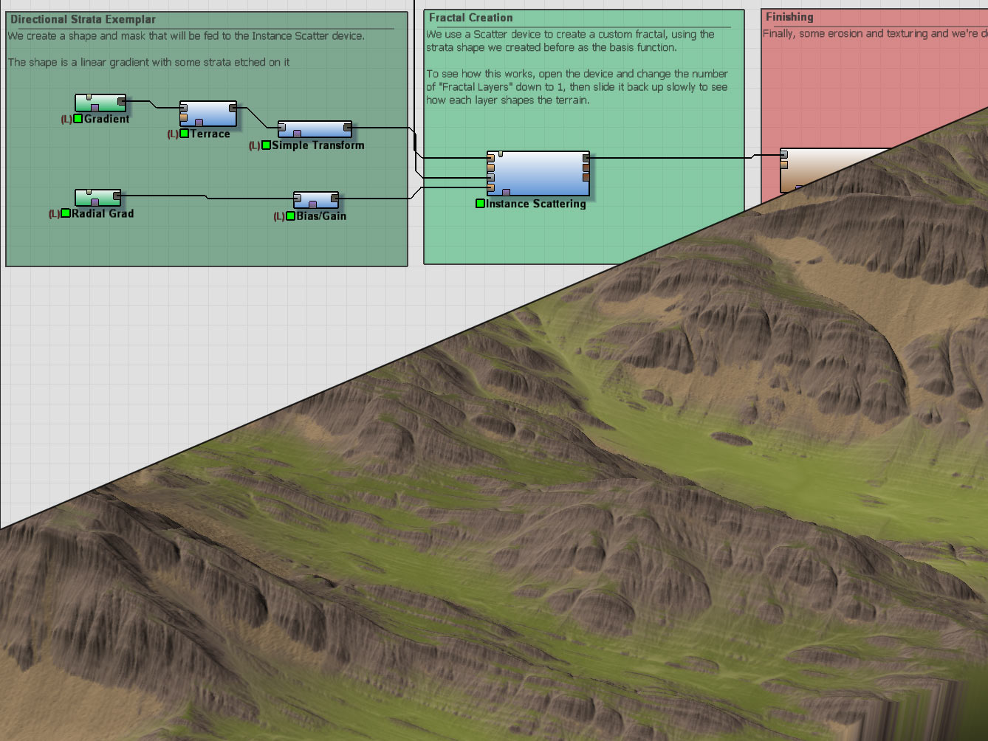

Key Influences
As stated before a key influence is my own project.
Additionally there is a very intriguing software called world machine which does amazing terrain generation using block coding and provides a plethora of tools for the user to alter the terrain post generation.
https://www.world-machine.com/content/index/how/WMFeature1.mp4
What has also acted as inspiration for the project is just a wide range of procedural tools that have completely different uses like a sound effect generation tool and a texture generation tool and all these are an absolute blast to use and made me want to give it a try.

Slide 4
Industry Relevance
Be sure to include where you have found these job listings, try all avenues-LinkedIn and Art Station are great places to start.
Linked in has locked me out of my account but applicable jobs would be game programming and tool development jobs
Role Description: creating tools to aid and streamline development along with creating relevant gameplay mechanics
Skills Alignment: C++/C# experience, use and creation of applicable algorithms, designing and applying good UI and UX practices, identifying and solving bottleknecks in the game development process

Slide 5

Research Plan
A large part of the projects research will be of scientific studies along with applicable industry software where possible.
Scientific papers on procedural terrain generation and weather and erosions simulations, I will find these papers by researching through textbooks and finding related papers online and following there references to find more information. Along with that I will reference UI and UX guides and survey friends, family and classmates to get feedback on the UX
Obstacles would be getting good relevant feedback as using your own program is not a true test. Finding recent good papers on certain topics as the papers I often find are older and more dated.

Slide 6

Examples of key literature and research
Journals and Books
Ryan Geiss. (2005) Chapter 1. Generating Complex Procedural Terrains Using the GPU. Available at: https://developer.nvidia.com/gpugems/gpugems3/part-i-geometry/chapter-1-generating-complex-procedural-terrains-using-gpu.
Blogs
Hunter Loftis (2014). Realistic terrain in 130 lines. Available at: http://www.playfuljs.com/realistic-terrain-in-130-lines/.
Talle, J. (2020). Simulating hydraulic erosion. jobtalle.com. Available at: https://jobtalle.com/simulating_hydraulic_erosion.html.
Github
Peck, J. (2021). FastNoiseLite. [online] GitHub. Available at: https://github.com/Auburn/FastNoiseLite.
Papers
Musgrave, F.K., Kolb, C.E. and Mace, R.S. (1989). The synthesis and rendering of eroded fractal terrains. 23(3), pp.41–50. doi: https://doi.org/10.1145/74334.74337.
Št'ava, O., Beneš, B., Brisbin, M. and Křivánek, J. (2008). Interactive Terrain Modeling Using Hydraulic Erosion. Available at: https://cgg.mff.cuni.cz/~jaroslav/papers/2008-sca-erosim/2008-sca-erosiom-fin.pdf.

Slide 7
Deliverables and Project Planning
Click the link to watch a TED talk by Tim Urban
Inside the mind of a master procrastinator
A tool which allows users to create and export a landscape/terrain
The tool should be able to work in game dev engines and by using user settable parameters create terrain.
Within the standalone tool there are user tools which allow manipulation of the generated terrain like manual alteration of terrain, generation of natural features and natural or man made erosion.
Clearly specifying the importance of different features of the program from the core parts of the tool to the bells and whistles
Milestones: Completion of the full initial plan for the tool and all main features along with research assisting in development
Completing the bare minimum of the tool
Implementing compatibility with game engines
UI and UX surveys and building on feedback
Bells and whistles
More feedback
Finalizing

Slide 8
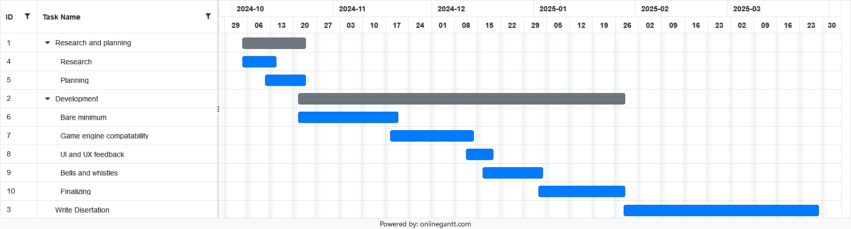
Gantt chart
Click the link to watch a TED talk by Tim Urban
Inside the mind of a master procrastinator

