Slide 1
EUP 51407 Weintraub 15T FTICR - MS Field Study – Polar “metabolite” layer
Sample Preparation: Jesse Trejo
Measurements: Rosey & Jason April 2021
Data Analysis: Nikola Sept 2021
Report: Rosey Oct 2021

Slide 2
Experimental Set-up and extraction
Sample Prep:
See separate word document for Jessie’s Mplex prep, same as for large study.
Upper M-Mplex (polar/metabolite) samples were cleaned up by SPE. There was a lot of FeCl and Cl clusters even after clean-up leading to more rigorous formula assignment. This power point contains this data.
This upper fraction, M-MpleX, was split with GC-MS before clean-up.
Lower L-Mplex samples were diluted 1:1 with MeOH.
This lower layer fraction was split with lipidomics (JK report April 2021).
Instrument Settings:
Samples were infused into the 15T FTICR by an automated direct injection system at a flow rate of 4ul/min.
Samples were co-added for 300 scans, 100Da to 900Da.
Spectra were inspected and reruns were appended to the queue.
Data analysis:
Samples were peak picked using Bruker DA software with a S/N =7.
Data were calibrated and formula assigned using in house software Formularity¹.
There were Cl- clusters affecting molecular formula assignments for CHON and CNOP, slides 3 to 5.
PCA and heatmaps were generated using MetaboAnalyst.ca from counts using R package ftmsRanalysis²
¹Tolić, N., Liu, Y., Liyu, A., Shen, Y., Tfaily, M. M., Kujawinski, E. B., ... & Hess, N. J. (2017). Formularity: software for automated formula assignment of natural and other organic matter from ultrahigh-resolution mass spectra. Analytical chemistry, 89(23), 12659-12665.
²Bramer, L. M., White, A. M., Stratton, K. G., Thompson, A. M., Claborne, D., Hofmockel, K., & McCue, L. A. (2020). ftmsRanalysis: An R package for exploratory data analysis and interactive visualization of FT-MS data. PLoS computational biology, 16(3), e1007654.

Slide 3
Upper polar layer
Screenshots
Samples contain (checked by IPA)
Na_{x}Cl_{x+1} series (x=3-9)
FeCl₃⁻ , FeCl₄⁻
C_{x}H_{2x-6}O₃S (detergents)
Lots of [M+Cl]⁻ ions
No multi charged species

Slide 4
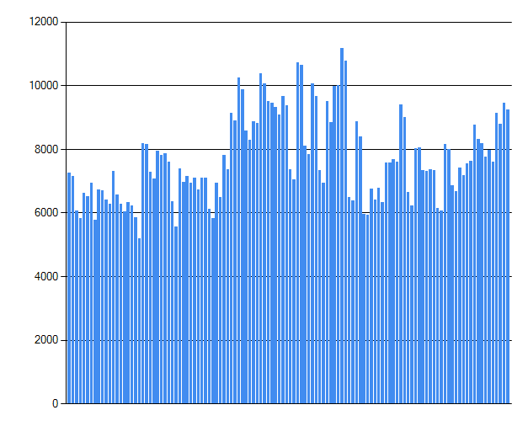
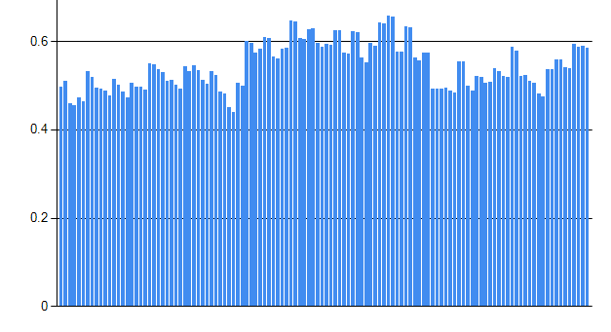
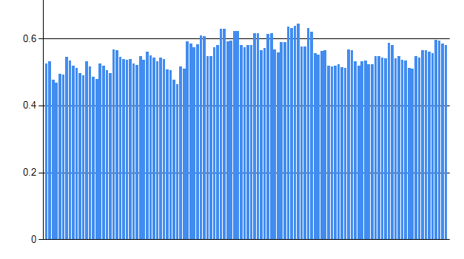
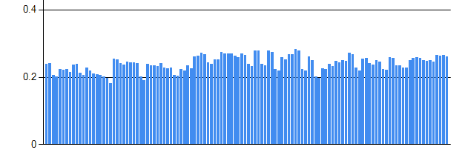
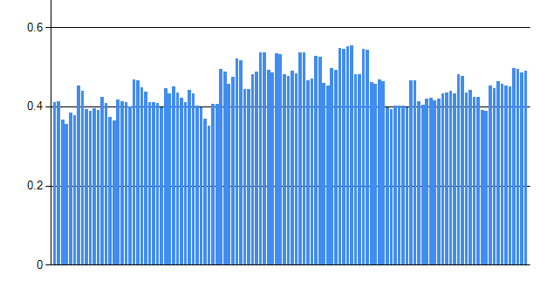
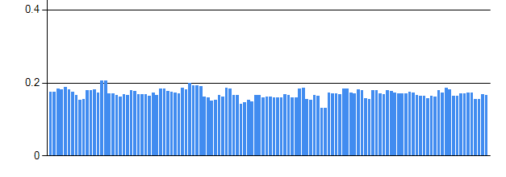
Upper polar layer
Diagnostics
peaks count
NOM Connectivity - H₂
NOM Connectivity O
¹²C-¹³C; few doubly charged ions
³⁵Cl-³⁷Cl
NOM Connectivity CH₄O₋₁

Slide 5
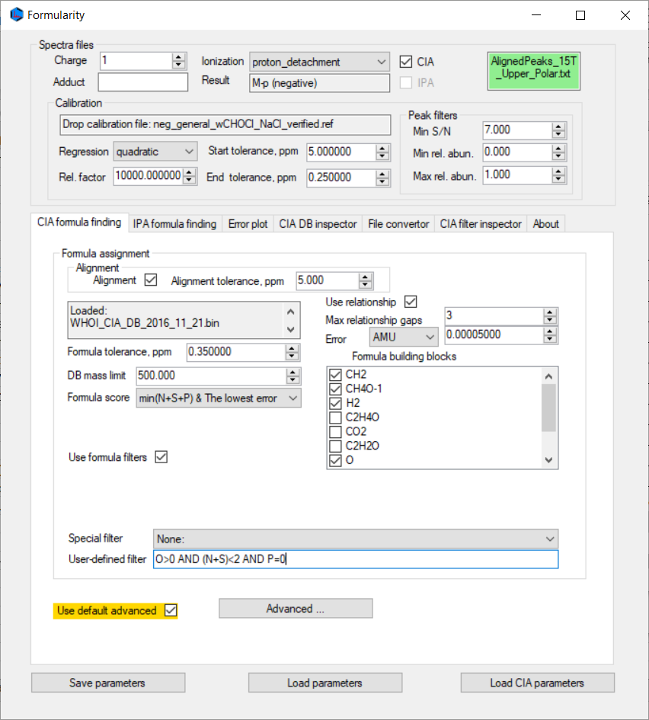

Second stage is one more [M-H]- with (N+S)<2 AND P=1

Slide 6
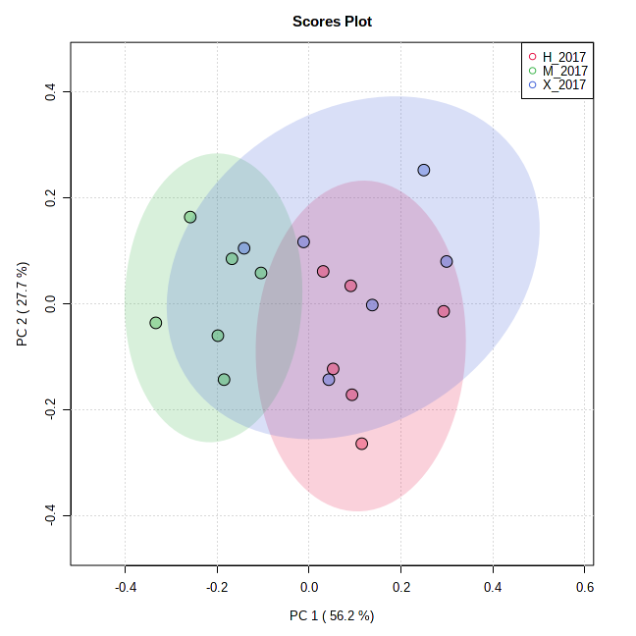
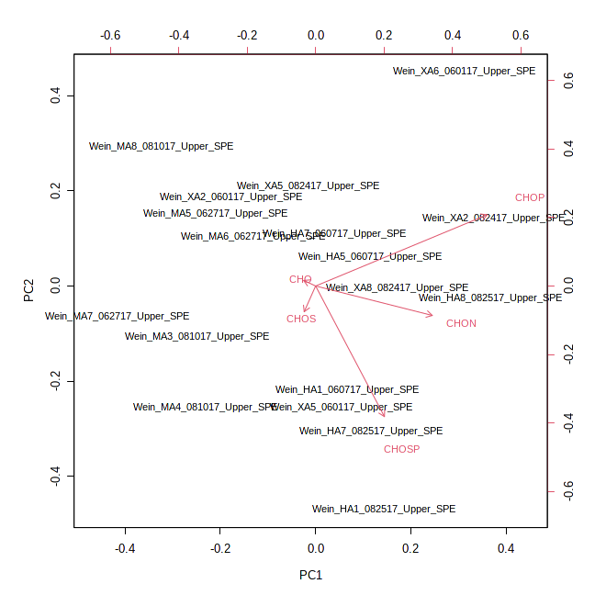
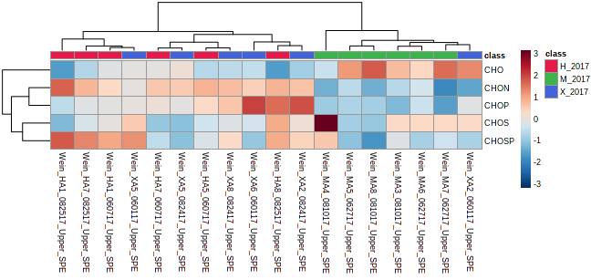
PCA of M-Mplex (SPE) Samples – 2017 - mf
Just looking at the simplified molecular formula assignments. There does seem to be some separation for site M, mostly with CHO, and some CHOS, compounds. Sites X and H separate out by CHON and CHOP assignments.

Slide 7
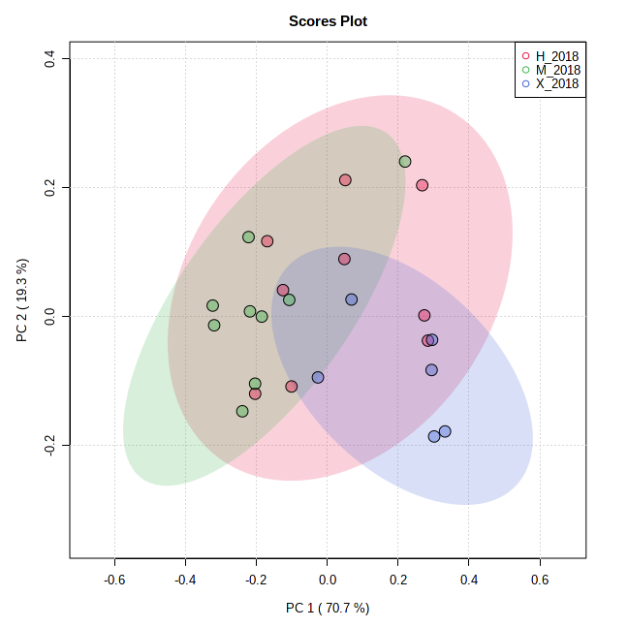
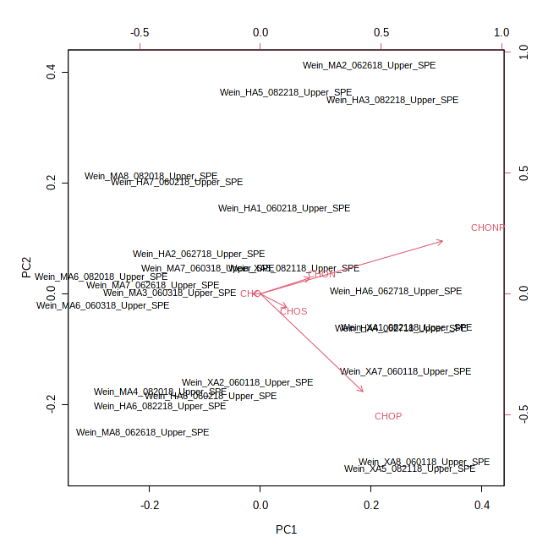
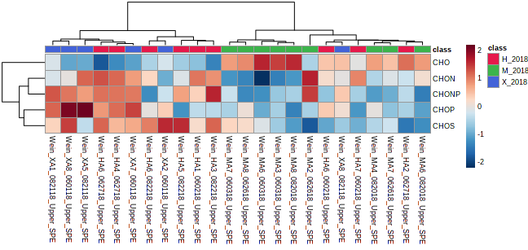
PCA of M-Mplex (SPE) Samples – 2018 - mf
Just looking at the simplified molecular formula assignments. There does seem to be some separation for site M, mostly with CHO compounds. Sites X and H separate out by CHON, CHOS and CHOP assignments.

Slide 8
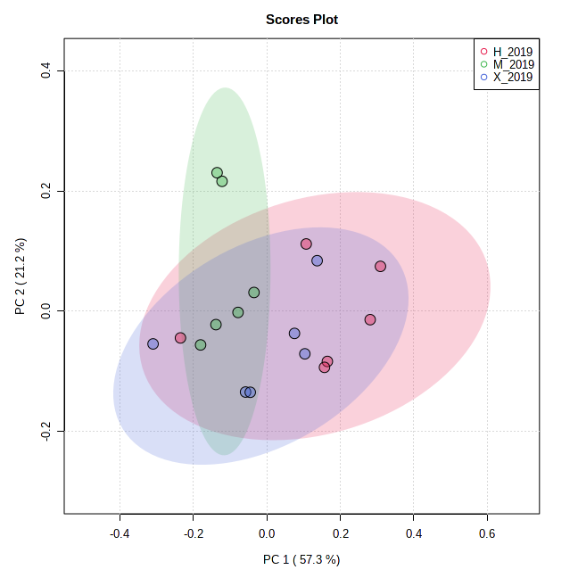
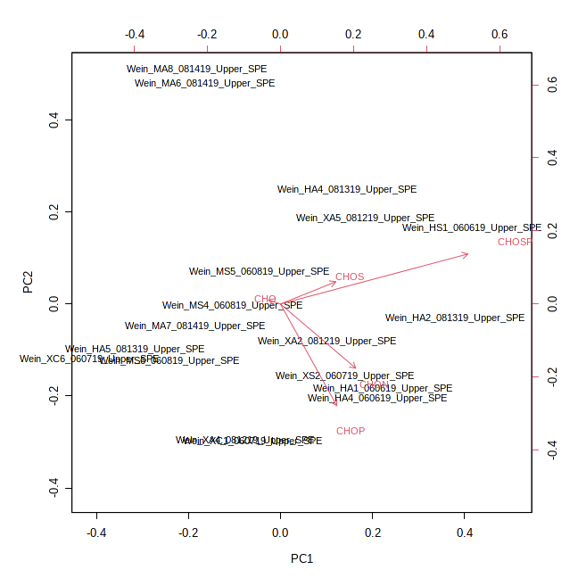
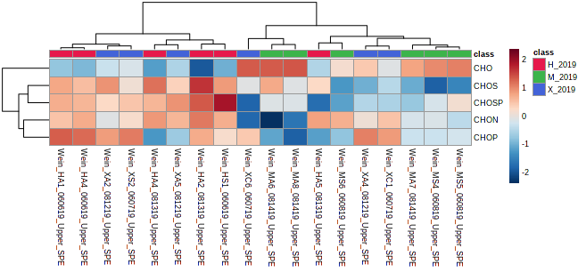
PCA of M-Mplex (SPE) Samples – 2019 - mf
Just looking at the simplified molecular formula assignments. There does seem to be some separation for site M, again mostly with CHO compounds. To pull out any differences and deep dive the data, you will need to focus on the unique formula assignments. Just looking at the heat map I would focus on the CHON/CHOP (sites H and X) and CHOS (site H) assignments.

Slide 9
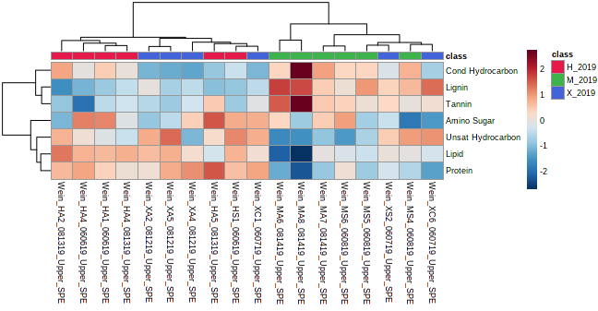
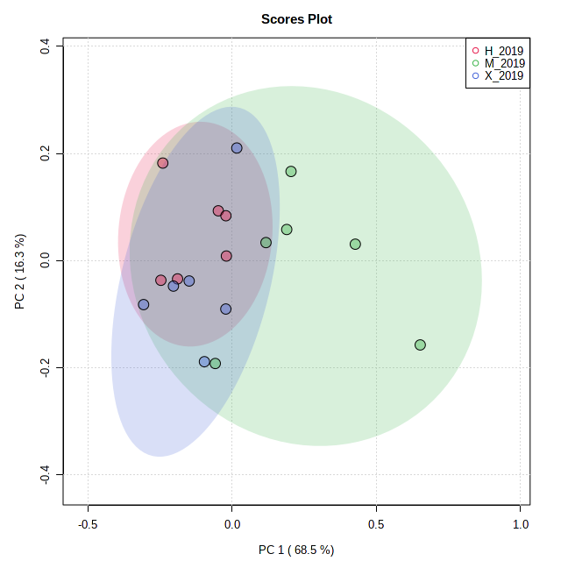
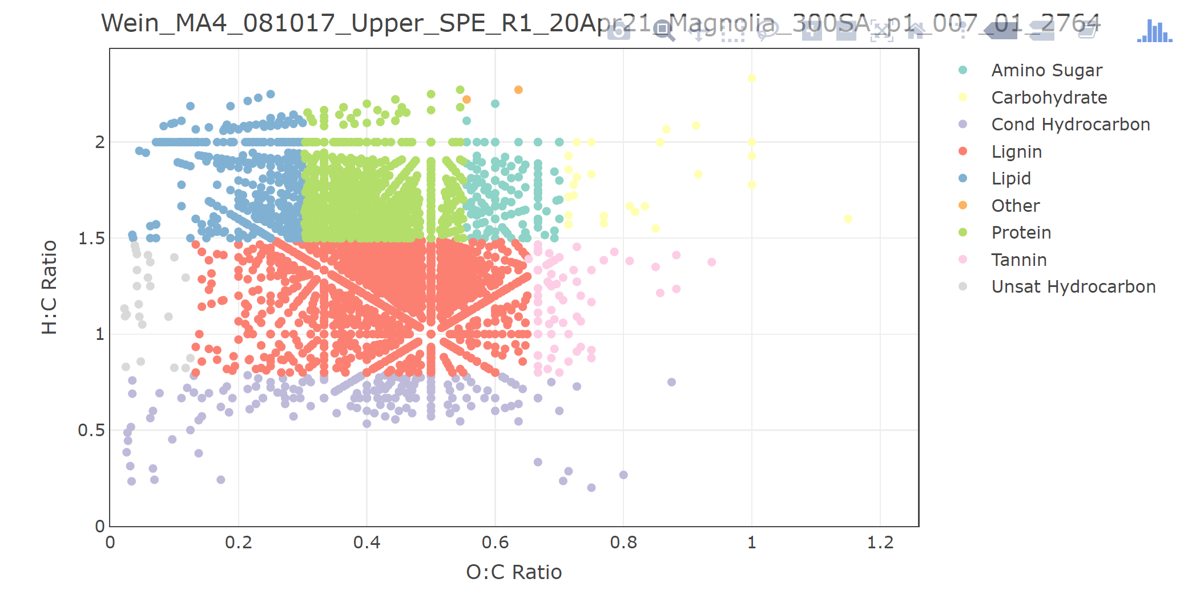
PCA of M-Mplex (SPE) Samples – 2019 - class
This year there seems to be a separation for site M, particularly lignin and tannin-like class areas as mapped on a Van Krevelen diagram.

Slide 10
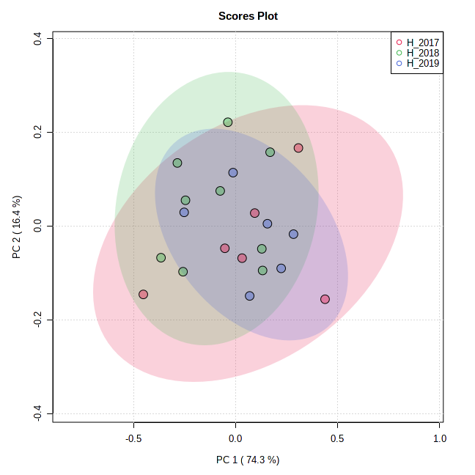
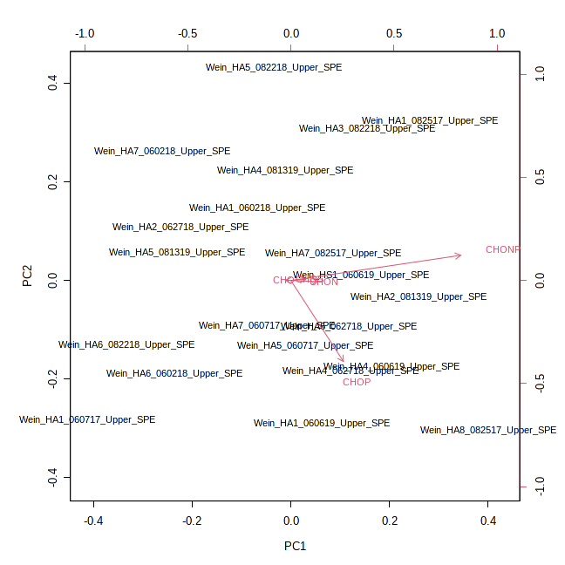
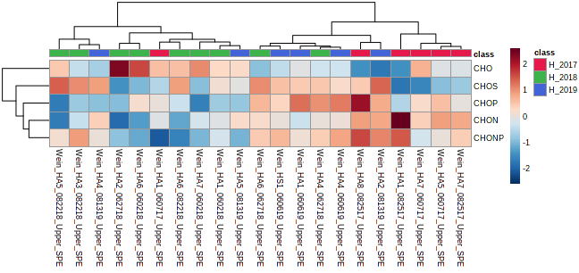
PCA of M-Mplex (SPE) Samples – H site - mf
Just looking at the simplified molecular formula assignments. There does not seem to be a distinct difference among the different years. To pull out any differences and deep dive the data, you will need to focus on the unique formula assignments. Just looking at the heat map I would focus on CHON (2017), CHO/CHOP (2018) and CHOS (2018/2019) assignments.

Slide 11
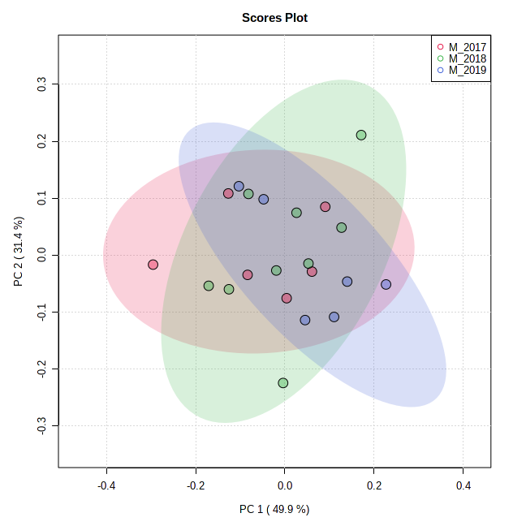
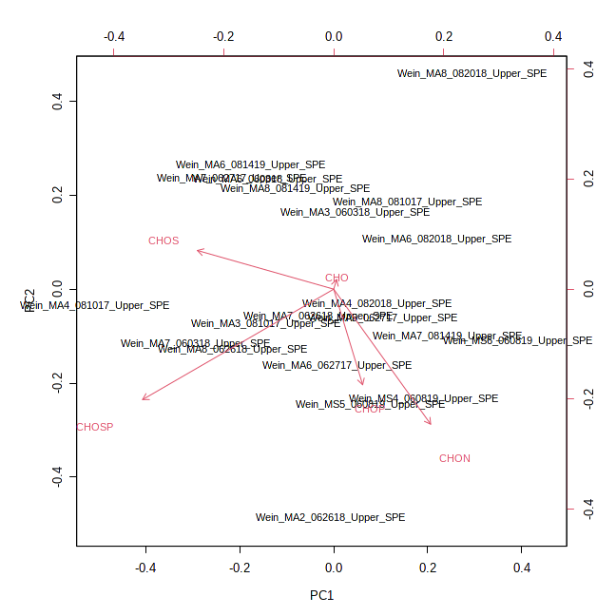
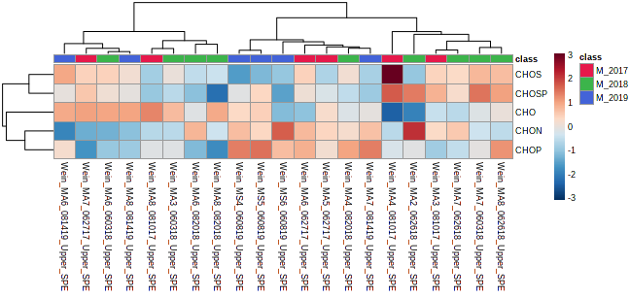
PCA of M-Mplex (SPE) Samples – M site - mf
Just looking at the simplified molecular formula assignments. There does not seem to be an apparent difference among the different years.

Slide 12
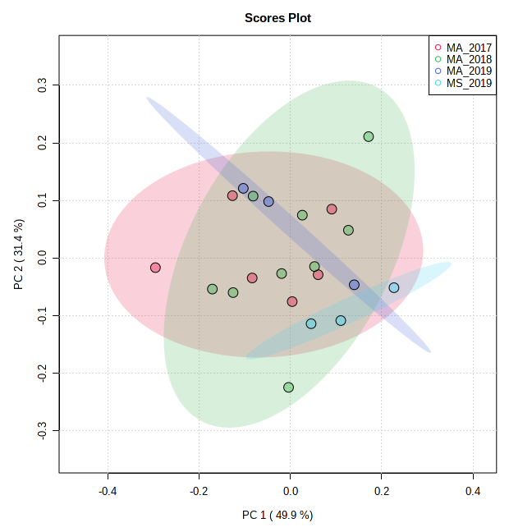
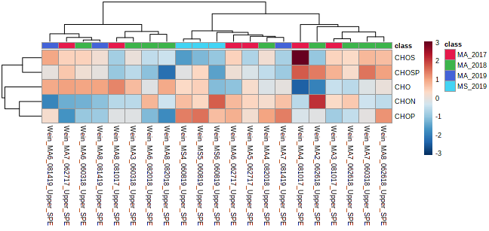
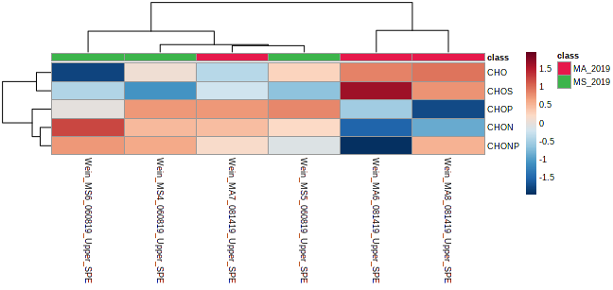
PCA of M-Mplex (SPE) Samples – M site - mf - treatment

Slide 13
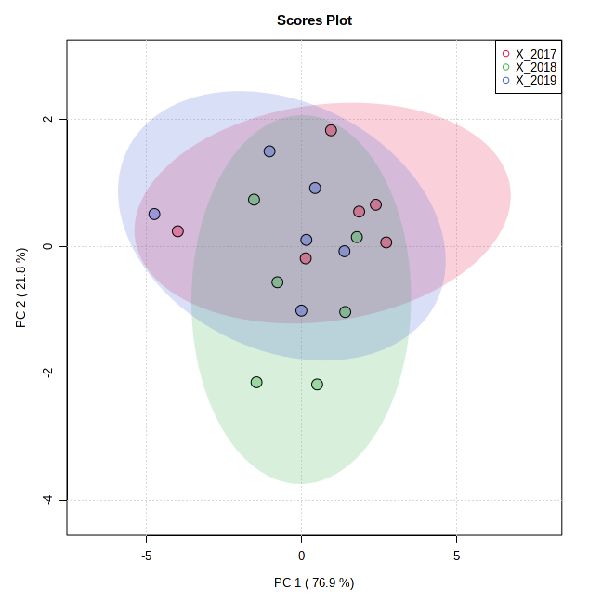
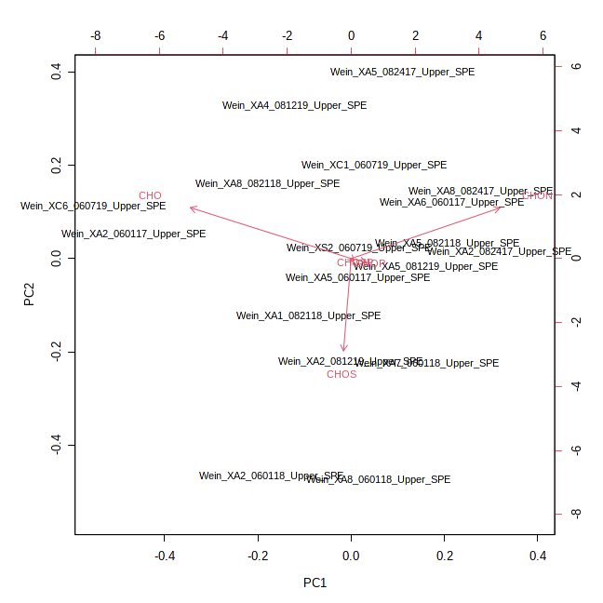
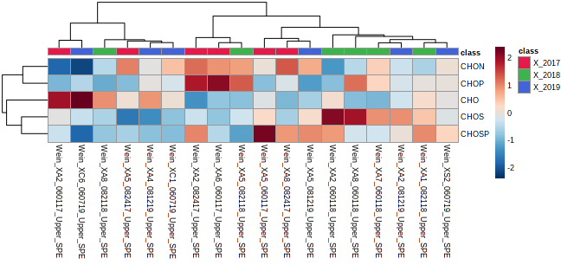
PCA of M-Mplex (SPE) Samples – X site - mf
Just looking at the simplified molecular formula assignments. There does not seem to be an apparent difference among the different years.

Slide 14
For further statistical processing and visualization:
https://msc-viz.emsl.pnnl.gov/FREDA/
Bramer, L. M., White, A. M., Stratton, K. G., Thompson, A. M., Claborne, D., Hofmockel, K., & McCue, L. A. (2020). ftmsRanalysis: An R package for exploratory data analysis and interactive visualization of FT-MS data. PLoS computational biology, 16(3), e1007654.

