Slide 1
EUP 51407 Weintraub 15T FTICR - MS Field Study – Non-Polar “lipid” layer
Sample Preparation: Jesse Trejo
Measurements: Rosey & Jason April 2021
Data Analysis: Nikola Sept 2021
Report: Rosey Oct 2021

Slide 2
Experimental Set-up and extraction
Sample Prep:
See separate word document for Jessie’s Mplex prep, same as for large study.
Upper M-Mplex (polar/metabolite) samples were cleaned up by SPE. There was a lot of FeCl and Cl clusters even after clean-up leading to more rigorous formula assignment. This power point contains this data.
This upper fraction, M-MpleX, was split with GC-MS before clean-up.
Lower L-Mplex samples were diluted 1:1 with MeOH.
This lower layer fraction was split with lipidomics (JK report April 2021).
Instrument Settings:
Samples were infused into the 15T FTICR by an automated direct injection system at a flow rate of 4ul/min.
Samples were run with a technical replicate
Samples were co-added for 300 scans, 100Da to 900Da.
Spectra were inspected and reruns were appended to the queue.
Data analysis:
Samples were peak picked using Bruker DA software with a S/N =7.
Data were calibrated and formula assigned using in house software Formularity¹.
There were Cl- clusters affecting molecular formula assignments for CHON and CNOP, slides 3 and 4.
PCA and heatmaps were generated from counts using ftmsRanalysis²
¹Tolić, N., Liu, Y., Liyu, A., Shen, Y., Tfaily, M. M., Kujawinski, E. B., ... & Hess, N. J. (2017). Formularity: software for automated formula assignment of natural and other organic matter from ultrahigh-resolution mass spectra. Analytical chemistry, 89(23), 12659-12665.
²Bramer, L. M., White, A. M., Stratton, K. G., Thompson, A. M., Claborne, D., Hofmockel, K., & McCue, L. A. (2020). ftmsRanalysis: An R package for exploratory data analysis and interactive visualization of FT-MS data. PLoS computational biology, 16(3), e1007654.

Slide 3
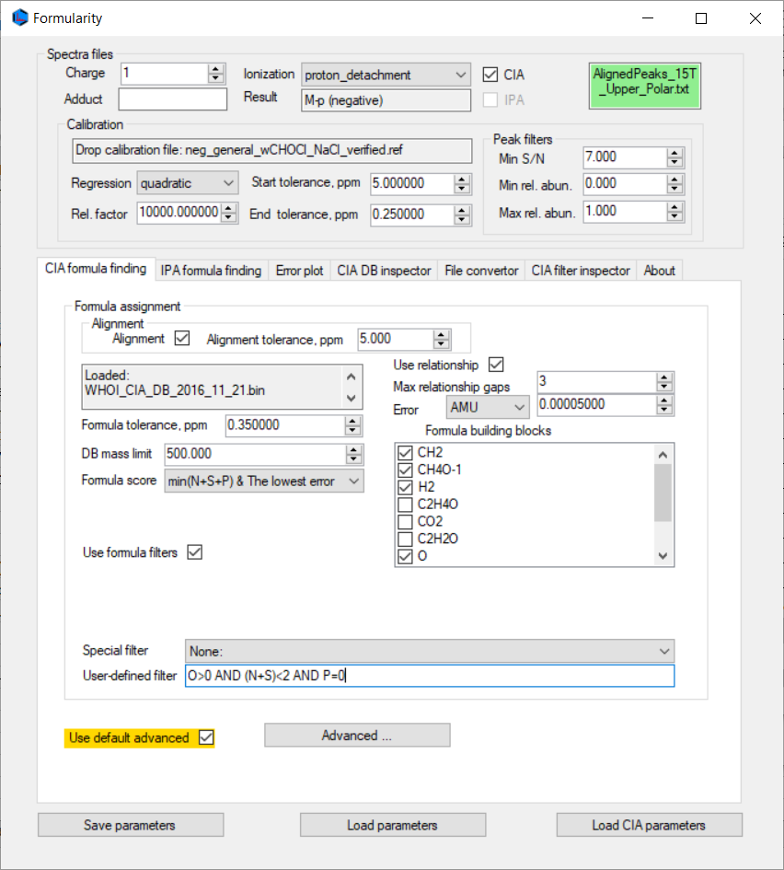

Second stage is one more [M-H]- with (N+S)<2 AND P=1

Slide 4
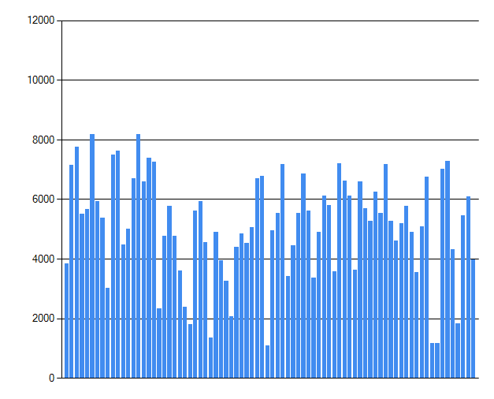
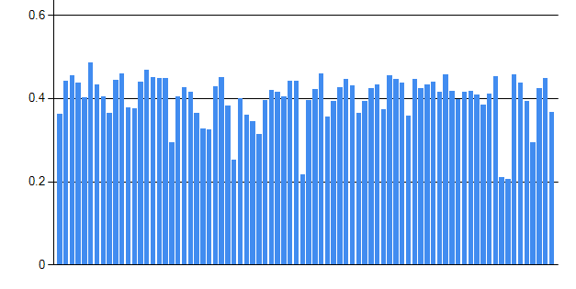
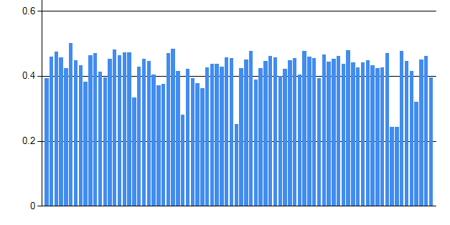
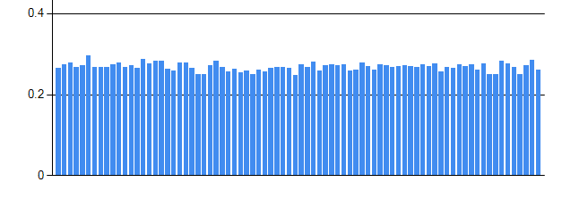
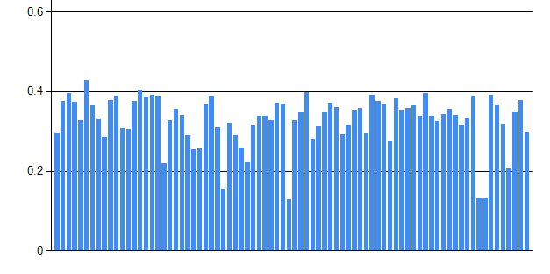
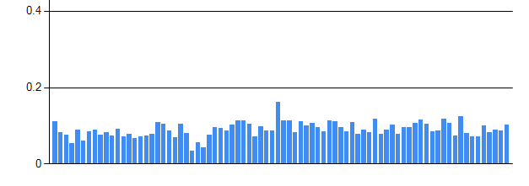
Lipids layer
Diagnostics
peaks count
NOM Connectivity - H₂
NOM Connectivity O
¹²C-¹³C; few doubly charged ions
NOM Connectivity CH₄O₋₁
³⁵Cl-³⁷Cl

Slide 5
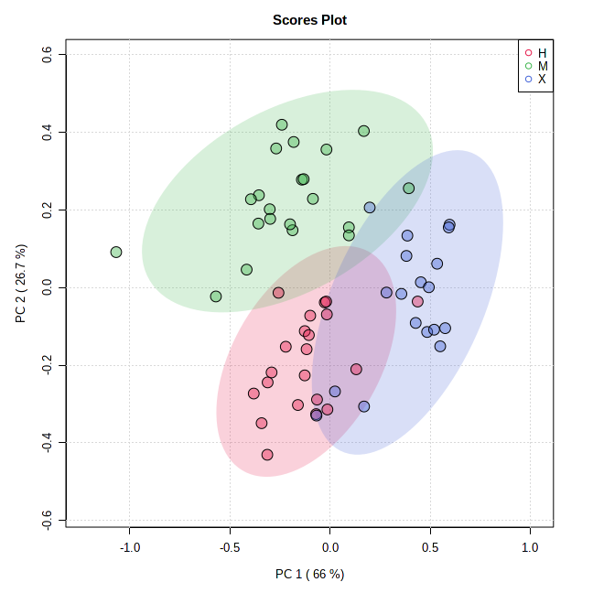
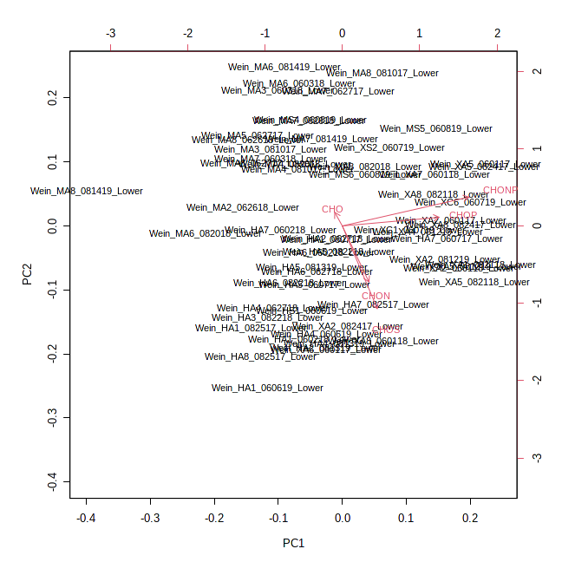
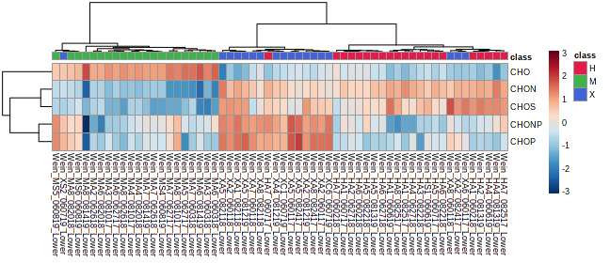
PCA of M-Mplex Samples – site - mf
The M site separated from the other two sites, regardless of sampling year, by the assigned CHO formula. Site X was also influenced by the CHOP/CHONP assignments. The H site was influenced by CHON/CHOS assignments. To deep dive and further explore the data, you will need to focus on the unique formula assignments and the lipid ID’s that were provided in April.

Slide 6
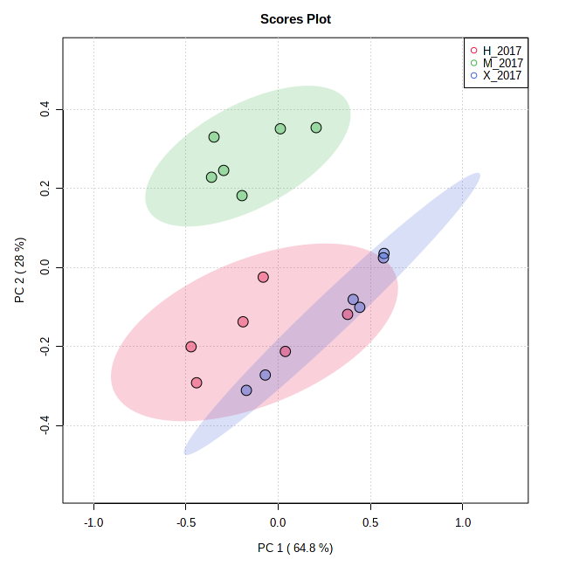
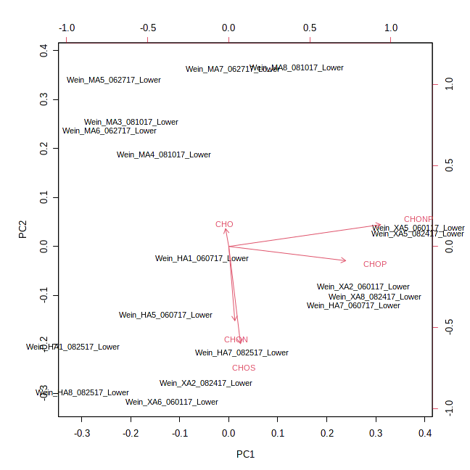
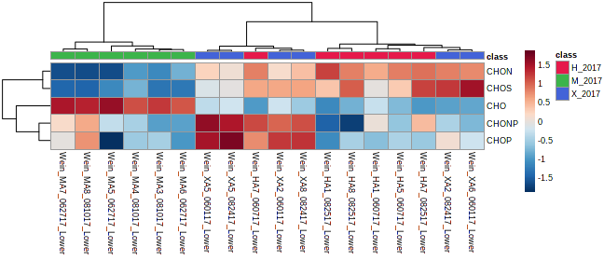
PCA of M-Mplex Samples – 2017 - mf
For the 2017 sampling date the M site separated from the other two sites by the CHO formula, site X was also influenced by the CHOP/CHONP assignments. To a lesser degree the H site was influences by CHON assignments. To deep dive and further explore the data, you will need to focus on the unique formula assignments and the lipid ID’s that were provided in April.

Slide 7
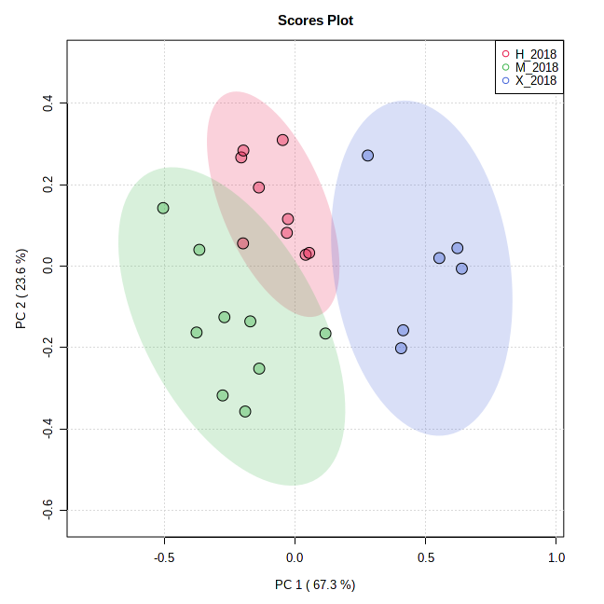
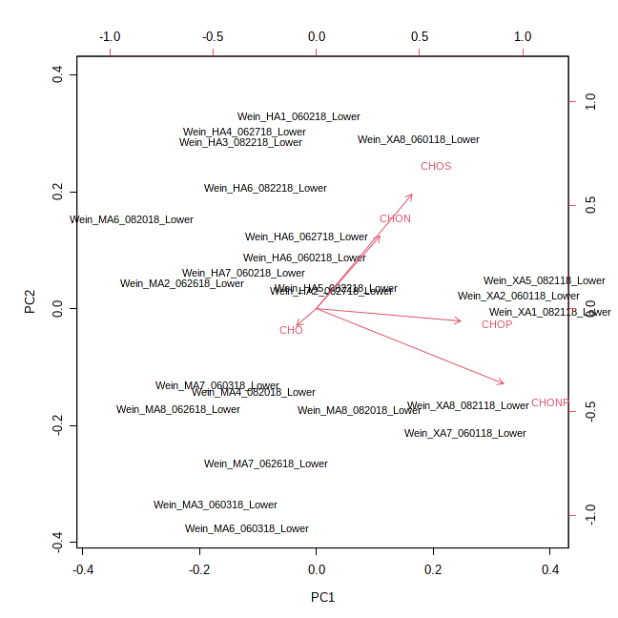
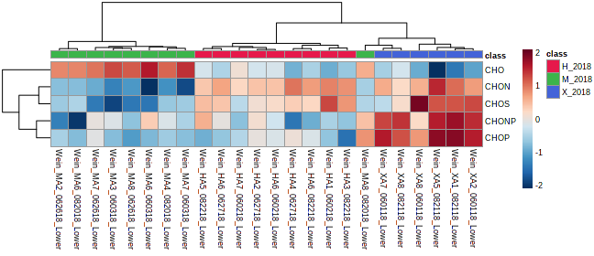
PCA of M-Mplex (SPE) Samples – 2018 - mf
As with the 2017 sampling date, in 2018, the M site separated from the other two sites by the CHO formula, site X was again influenced by the CHOP/CHONP assignments. To a lesser degree the H site was influences by CHON assignments. To deep dive and further explore the data, you will need to focus on the unique formula assignments and the lipid ID’s that were provided in April.

Slide 8
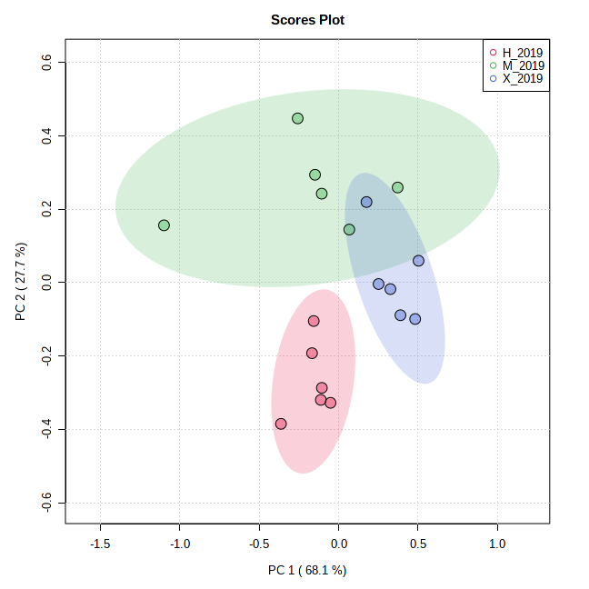
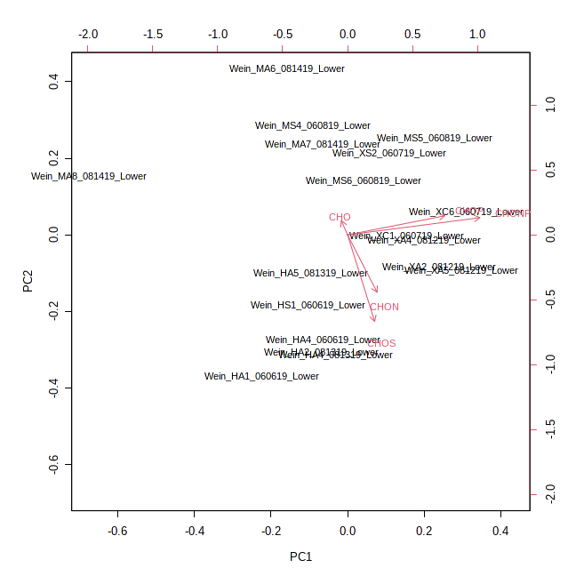
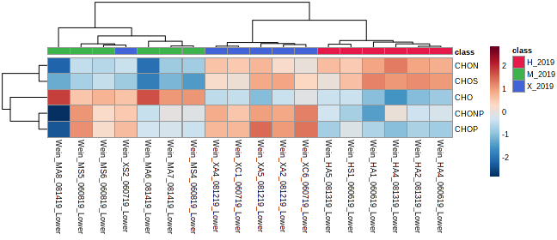
PCA of M-Mplex (SPE) Samples – 2019 - mf
As with the 2017 and 2018 sampling date, in 2019, the M site separated from the other two sites by the CHO formula, site X was again influenced by the CHOP/CHONP assignments. To a lesser degree the H site was influences by CHON/CHOS assignments. To deep dive and further explore the data, you will need to focus on the unique formula assignments and the lipid ID’s that were provided in April.

Slide 9
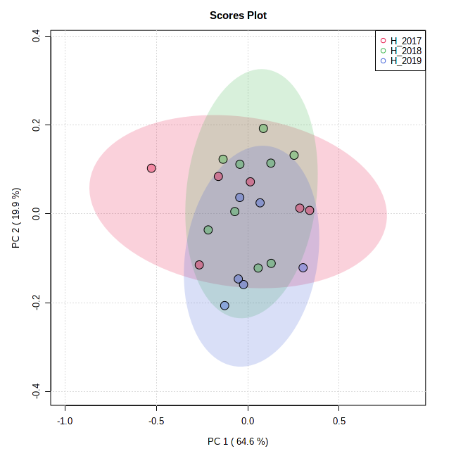
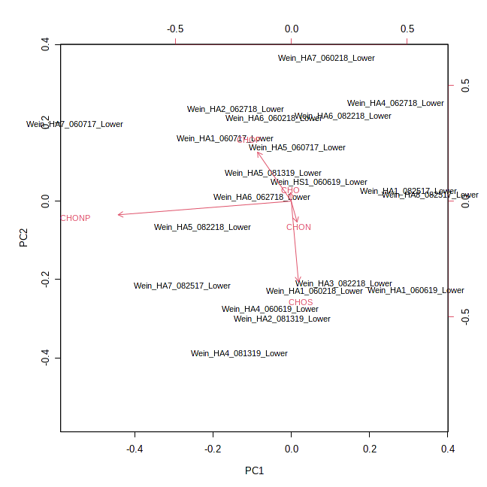
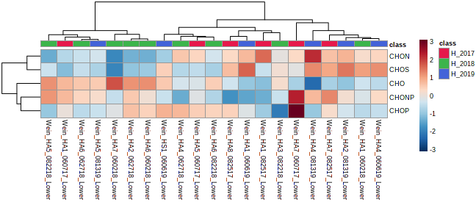
PCA of M-Mplex (SPE) Samples – Site H - mf
Not much separation among the years at this site. Possibly the CHO assignments in 2018. To deep dive and further explore the data, you will need to focus on the unique formula assignments and the lipid ID’s that were provided in April.

Slide 10
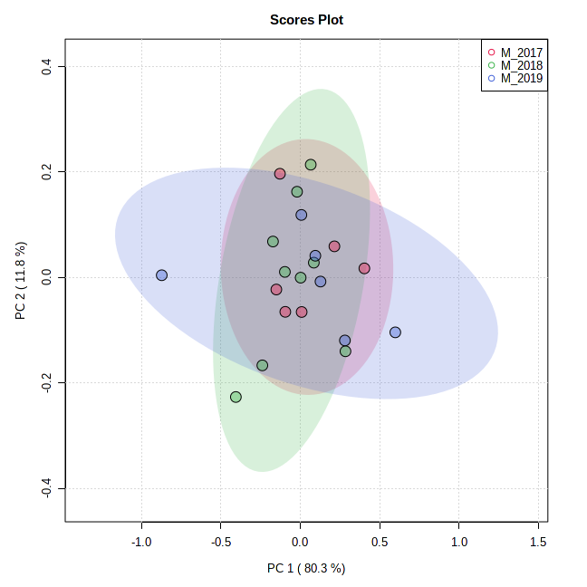
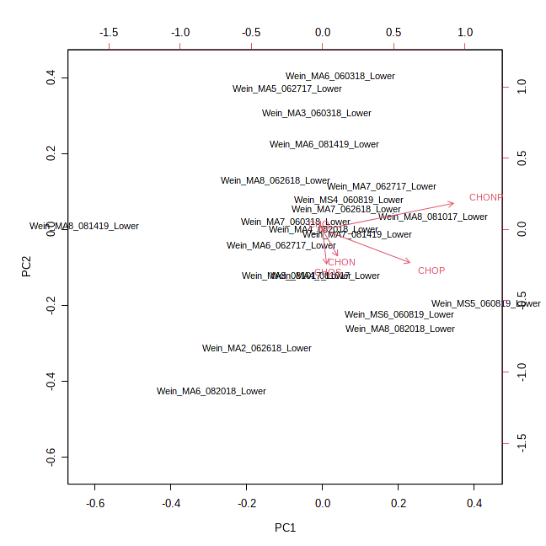
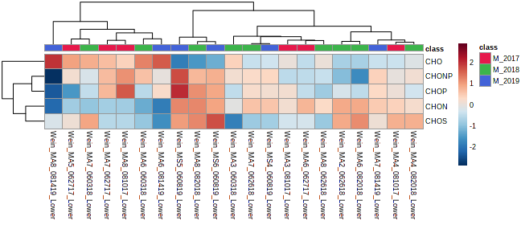
PCA of M-Mplex (SPE) Samples – Site M - mf
Not much separation among the years at this site. To deep dive and further explore the data, you will need to focus on the unique formula assignments and the lipid ID’s that were provided in April.

Slide 11
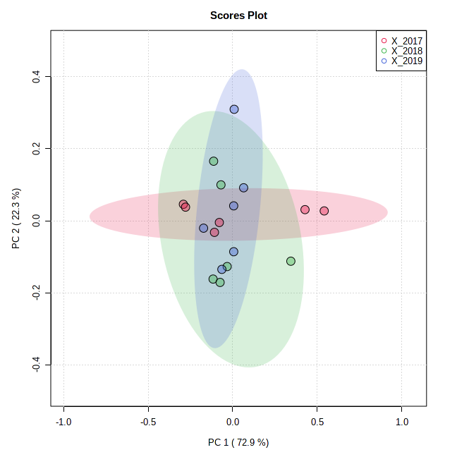
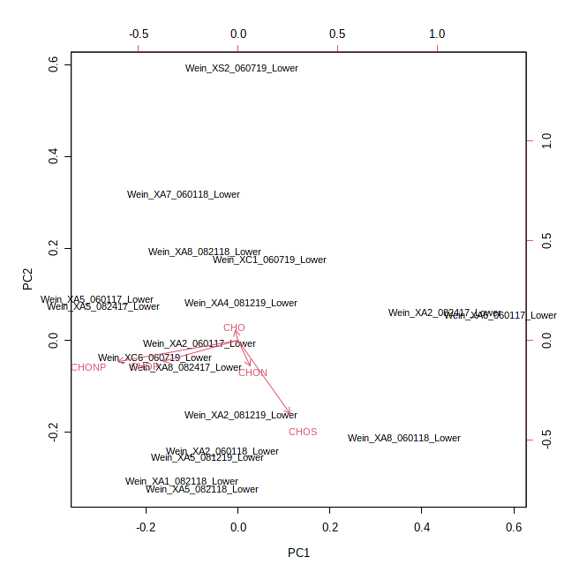
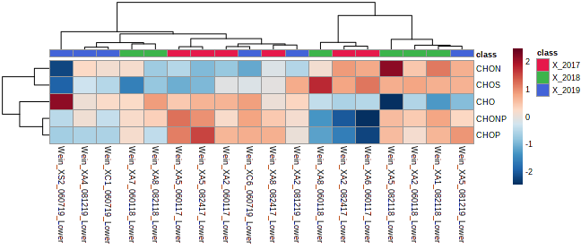
PCA of M-Mplex (SPE) Samples – Site X - mf
Not much separation among the years at this site. To deep dive and further explore the data, you will need to focus on the unique formula assignments and the lipid ID’s that were provided in April.

Slide 12
For further statistical processing and visualization:
https://msc-viz.emsl.pnnl.gov/FREDA/
Bramer, L. M., White, A. M., Stratton, K. G., Thompson, A. M., Claborne, D., Hofmockel, K., & McCue, L. A. (2020). ftmsRanalysis: An R package for exploratory data analysis and interactive visualization of FT-MS data. PLoS computational biology, 16(3), e1007654.

