Slide 1
EMSL 50209 Weintraub NOM Samples on 15T FT-ICR Large Study – Non-Polar “lipid” layer
Sample Preparation: Jesse Trejo
Measurements: Rosey & Jason March 2021
Data Analysis: Nikola Sept 2021
Report: Rosey Sept 2021

Slide 2
Experimental Set-up and extraction
Sample Prep:
See separate word document for Jessie’s Mplex prep.
Upper M-Mplex samples were cleaned up by SPE (M-MpleX_SPE). There was a lot of FeCl and Cl clusters in the non SPE’ed samples suppressing ionization and therefore significantly less assignments. The excel file has only the samples that were SPE’ed.
This upper fraction, M-MpleX, was split with GC-MS before clean-up.
Lower L-Mplex samples were diluted 1:1 with MeOH. After data evaluation we ran this sample set again for better results in March 2021.
This fraction was split with lipidomics. See Jennifer Kyle for lipid ID’s
Instrument Settings:
Samples were infused into the 15T FTICR by an automated direct injection system at a flow rate of 4ul/min.
Samples were co-added for 300 scans, 100Da to 900Da.
Spectra were inspected and reruns were appended to the queue.
Data analysis:
Samples were peak picked using Bruker DA software with a S/N =7.
Data were calibrated and formula assigned using in house software Formularity¹.
Even in this non-polar layer there were Cl- clusters affecting molecular formula assignments for CHON and CNOP, slides 3 and 4.
PCA and heatmaps were generated from counts using ftmsRanalysis²
The following samples were removed for low # assigned peaks (at or below 1000 assigned mf): 1, 9, 19, 24, 25, 29, 33, 40, 44, 49, 57, 72, 73 and 77
+6C and -10C showed the most separation.
¹Tolić, N., Liu, Y., Liyu, A., Shen, Y., Tfaily, M. M., Kujawinski, E. B., ... & Hess, N. J. (2017). Formularity: software for automated formula assignment of natural and other organic matter from ultrahigh-resolution mass spectra. Analytical chemistry, 89(23), 12659-12665.
²Bramer, L. M., White, A. M., Stratton, K. G., Thompson, A. M., Claborne, D., Hofmockel, K., & McCue, L. A. (2020). ftmsRanalysis: An R package for exploratory data analysis and interactive visualization of FT-MS data. PLoS computational biology, 16(3), e1007654.

Slide 3
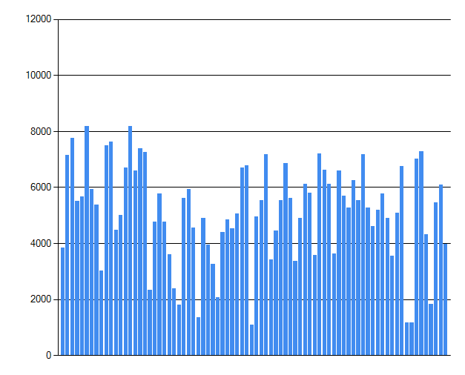
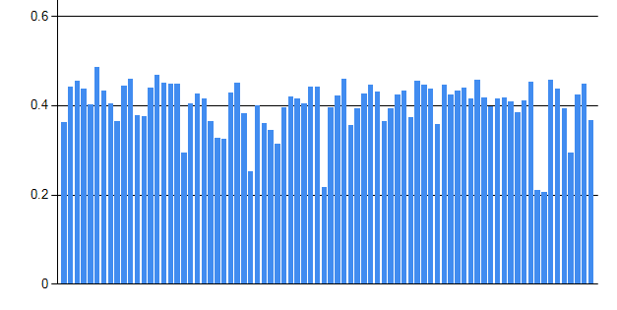
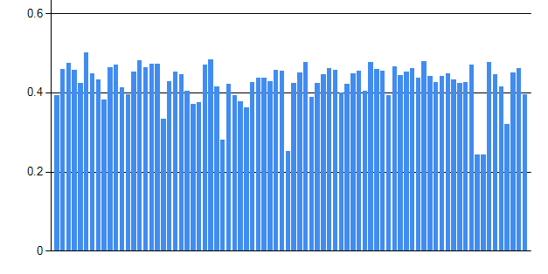
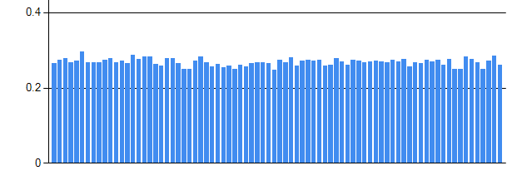
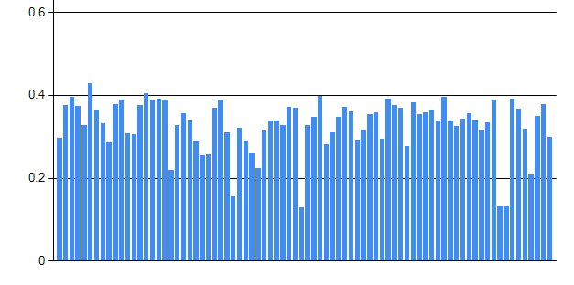
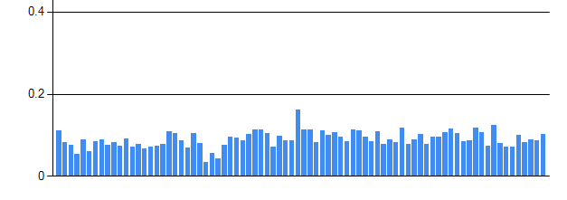
Non-Polar Lipid layer
Diagnostics
peaks count
NOM Connectivity - H₂
NOM Connectivity O
¹²C-¹³C; few doubly charged ions
NOM Connectivity CH₄O₋₁
³⁵Cl-³⁷Cl

Slide 4
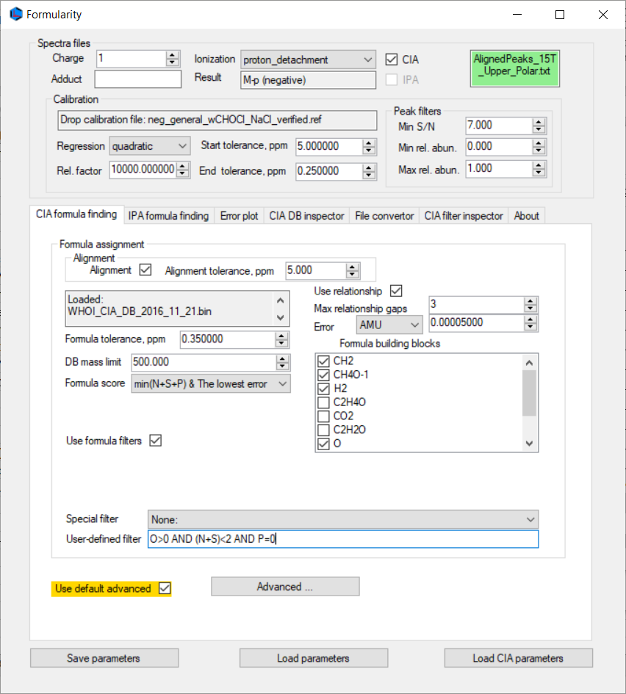

Formularity parameters for molecular formula assignment; reports were consolidated to remove ambiguous assignments.
Second stage is one more [M-H]- with (N+S)<2 AND P=1

Slide 5
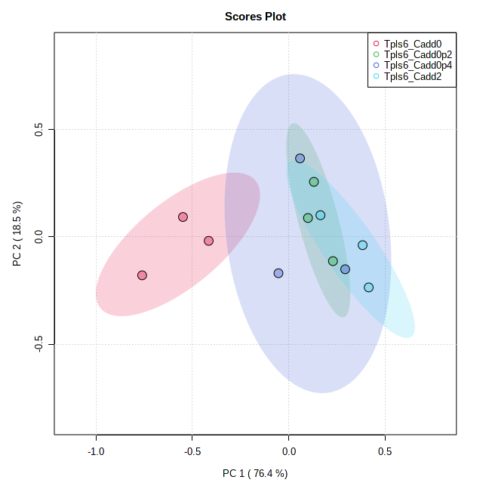
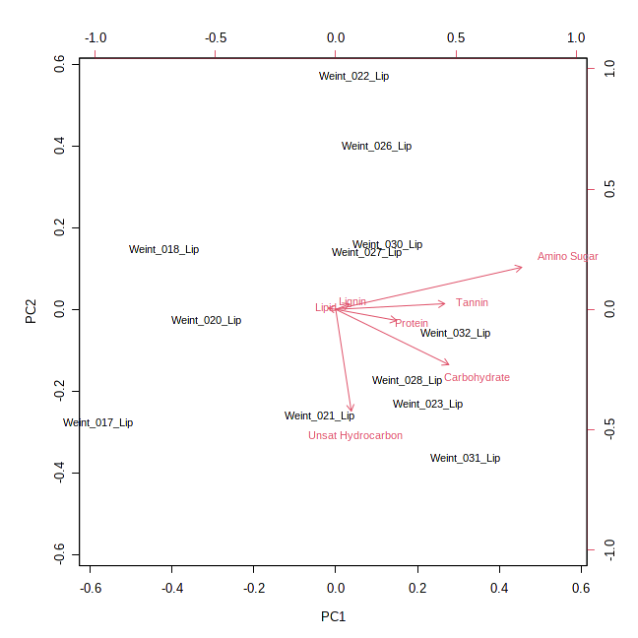
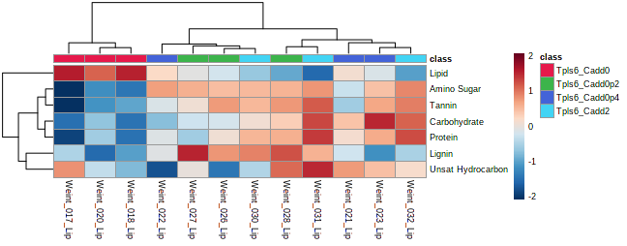
PCA of M-Mplex (SPE) Samples – Tpls6 - Class
Cadd0 separated from the other Cadd treatments mostly due to the lipid-like compound class as defined on a Van Krevelen diagram. To deep dive the data, you will need to focus on the unique formula assignments and the lipid ID’s that were provided in April.

Slide 6
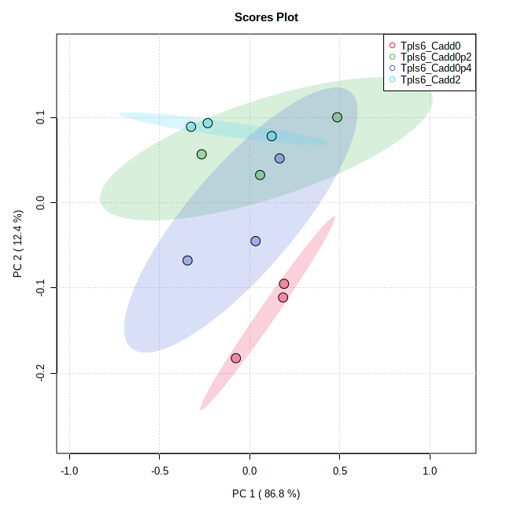
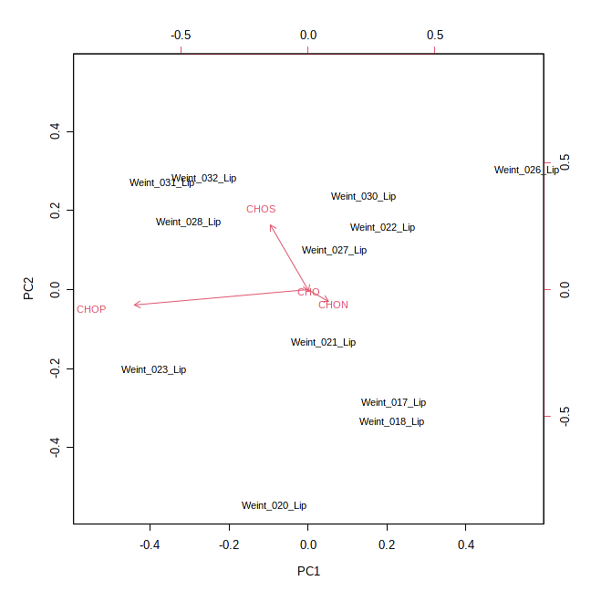
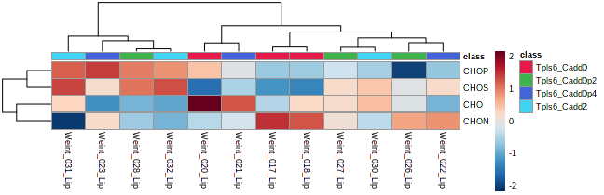
PCA of M-Mplex (SPE) Samples – Tpls6 - mf
Cadd0 separated from the other Cadd treatments mostly due to the CHO and CHON assigned formula. To deep dive the data, you will need to focus on the unique formula assignments to further understand these differences.

Slide 7
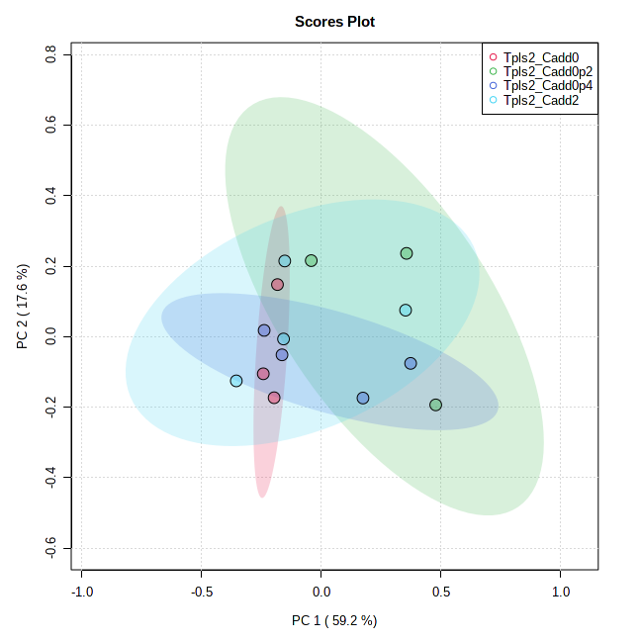
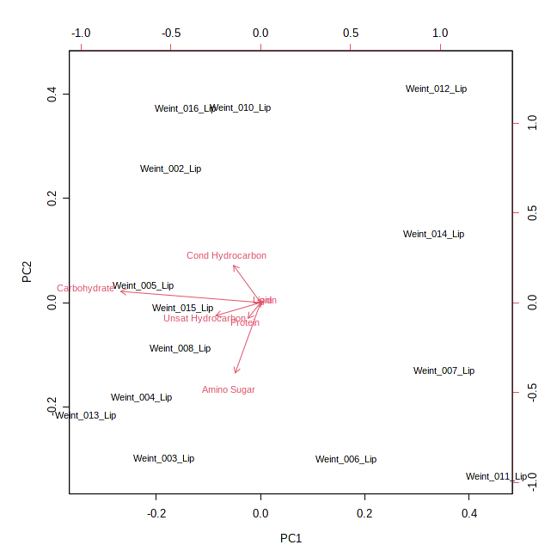
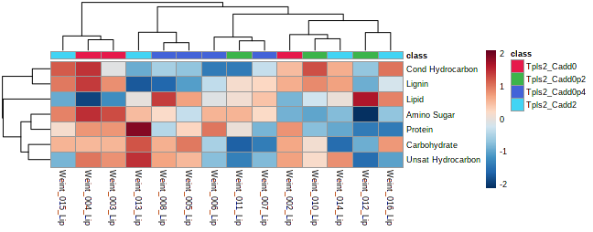
PCA of M-Mplex (SPE) Samples – Tpls2- Class
There is not a lot of separation detected at this temperature. Although the C add 0.2 and C add 2 seem to be grouping with Cond and Unsat hydrocarbon and lignin-like compounds. To deep dive the data, you will need to focus on the unique formula assignments.

Slide 8
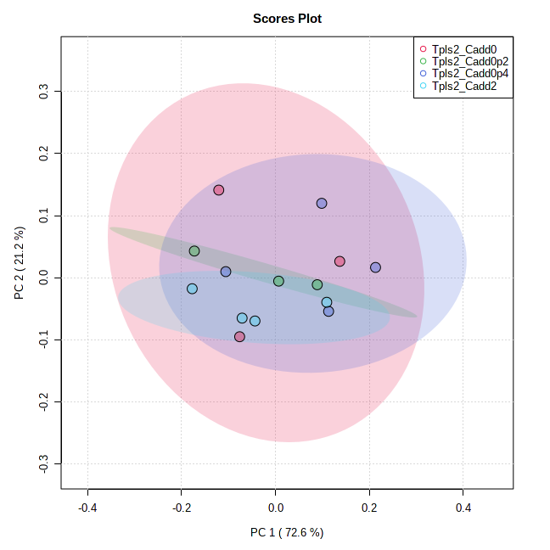
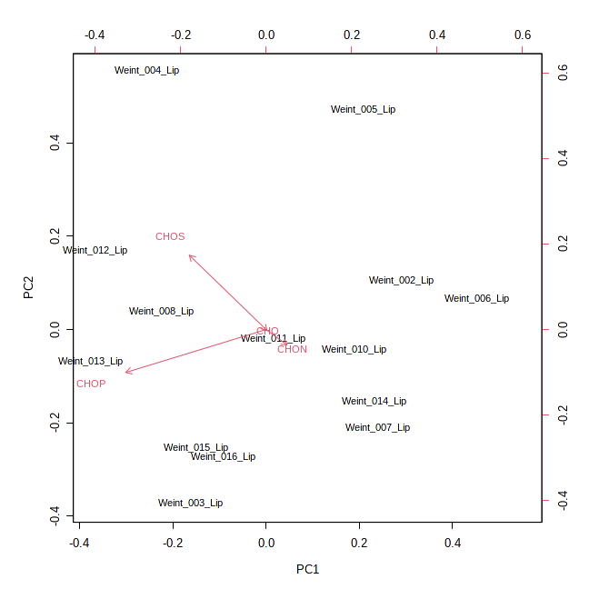
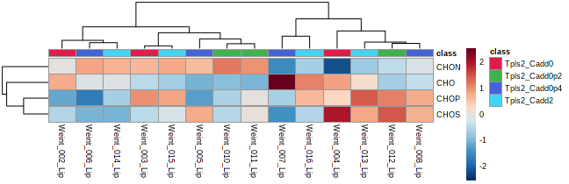
PCA of M-Mplex (SPE) Samples – Tpls2 - mf
There is not a lot of separation detected at this temperature. To deep dive the data, you will need to focus on the unique formula assignments.

Slide 9
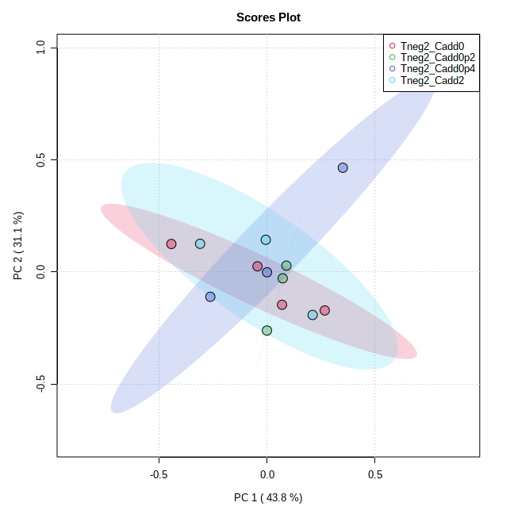
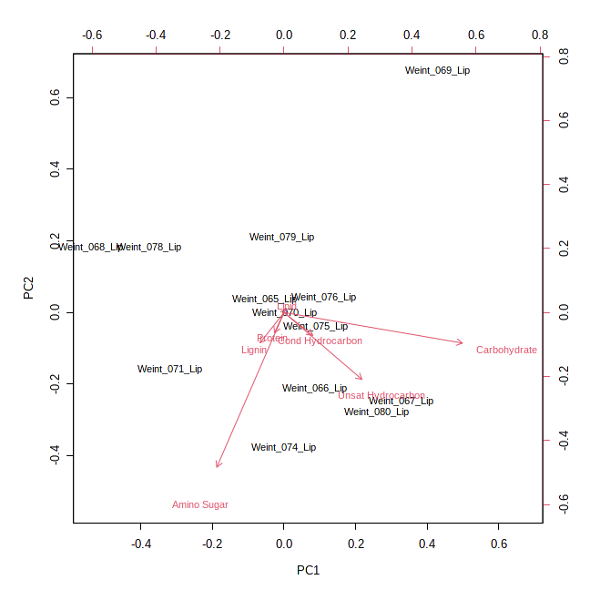
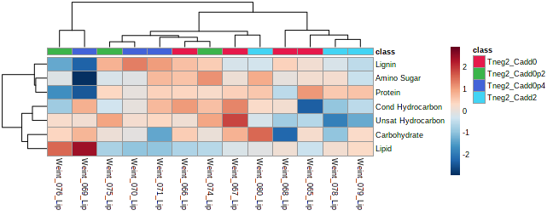
PCA of M-Mplex (SPE) Samples – Tneg2 - Class
There is not a lot of separation detected at this temperature. However, looking at the heat map C add 0 and C add 2 are grouping together and the C add 0.2 and 0.4 are grouping together. To deep dive the data, you will need to focus on the unique formula assignments.

Slide 10
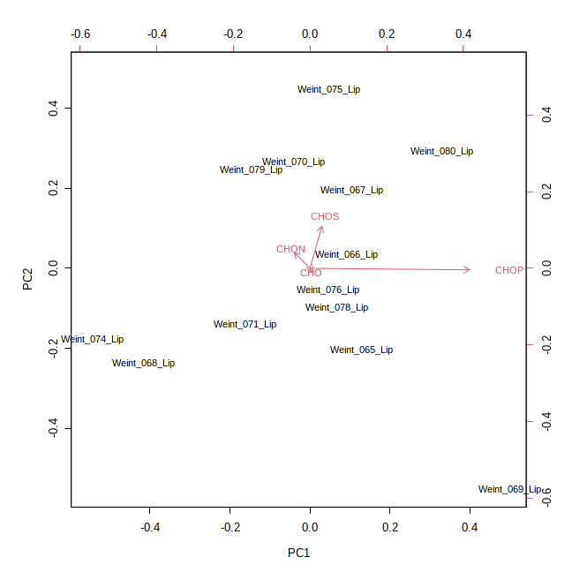
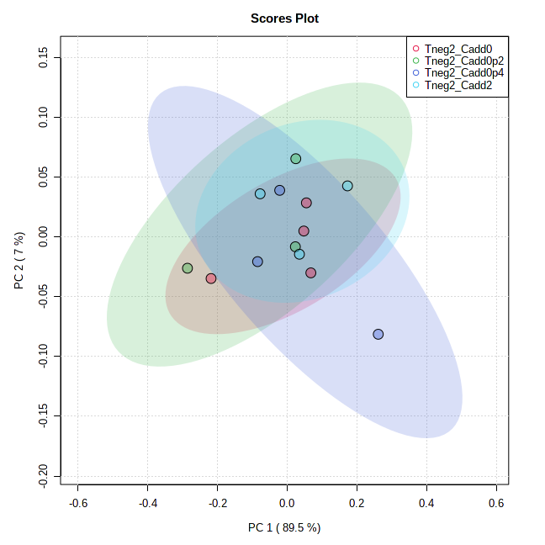
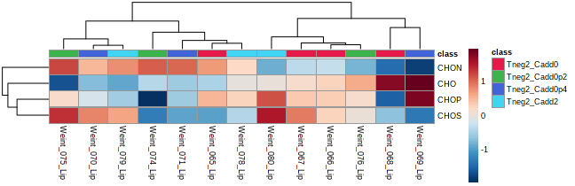
PCA of M-Mplex (SPE) Samples – Tneg2- mf
Again, there is not a lot of separation detected at this temperature. To deep dive the data, you will need to focus on the unique formula assignments.

Slide 11
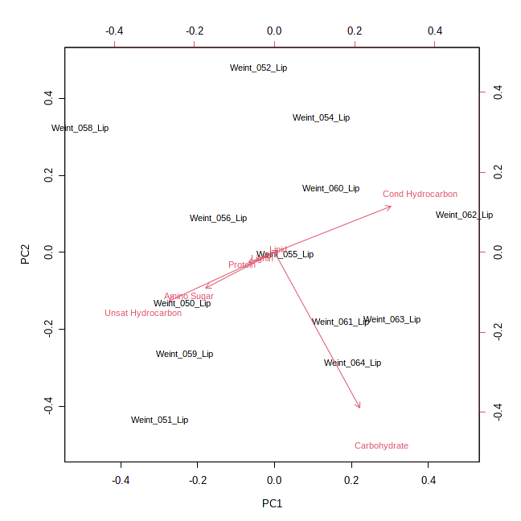
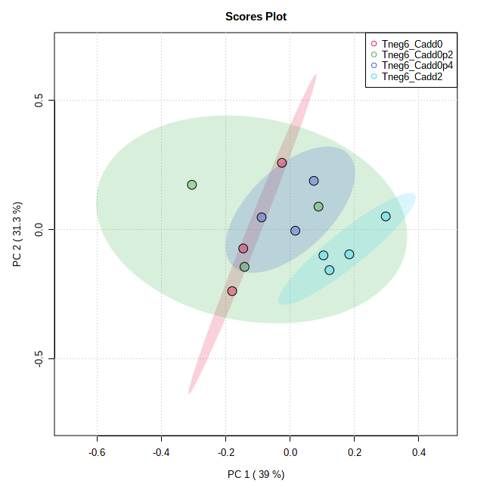
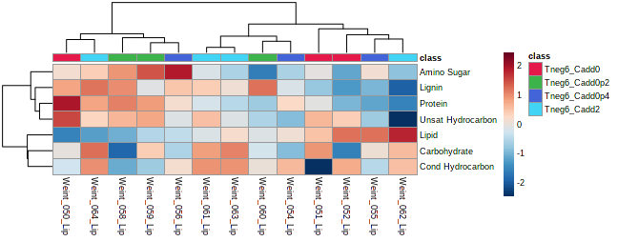
PCA of M-Mplex (SPE) Samples – Tneg6 - Class
Again, there is not a lot of separation detected at this temperature. To deep dive the data, you will need to focus on the unique formula assignments.

Slide 12
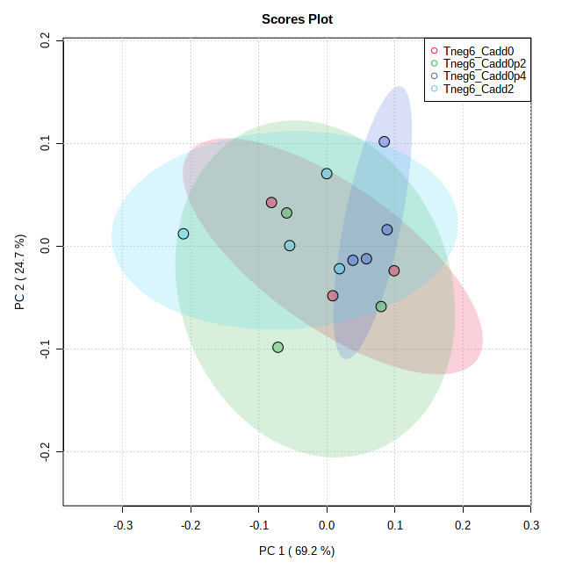
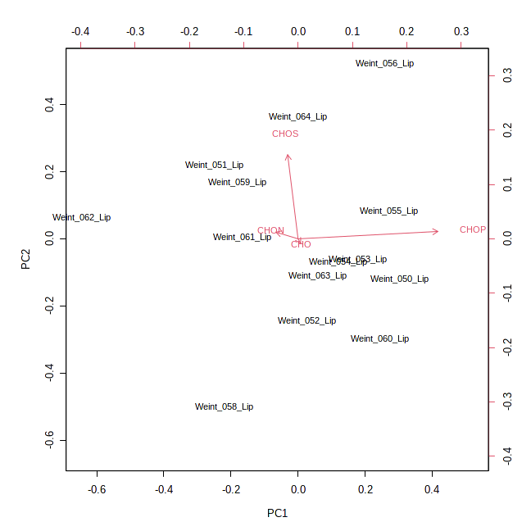
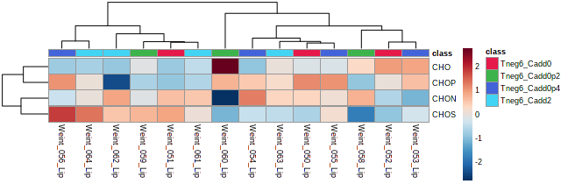
PCA of M-Mplex (SPE) Samples – Tneg6 - mf
Again, there is not a lot of separation detected at this temperature. To deep dive the data, you will need to focus on the unique formula assignments.

Slide 13
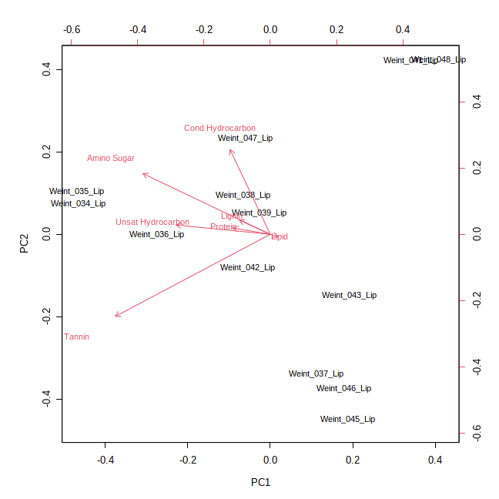
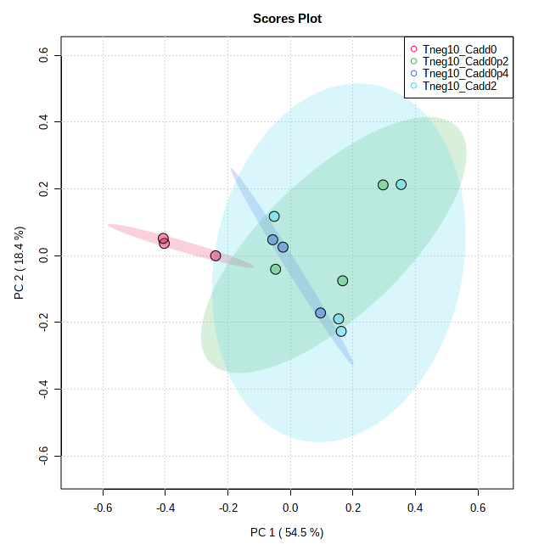
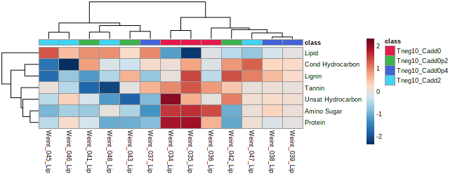
PCA of M-Mplex (SPE) Samples – Tneg10 - Class
Cadd0 separated from the other Cadd treatments mostly due to the Tannin, Amino sugar and protein-like compound class as defined on a Van Krevelen diagram. To deep dive the data, you will need to focus on the unique formula assignments and the lipid ID’s that were provided in April.

Slide 14
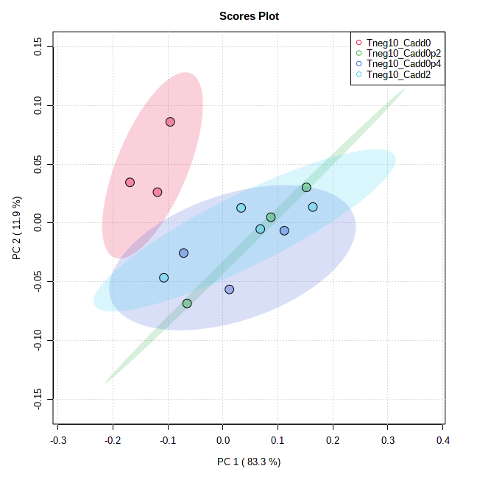
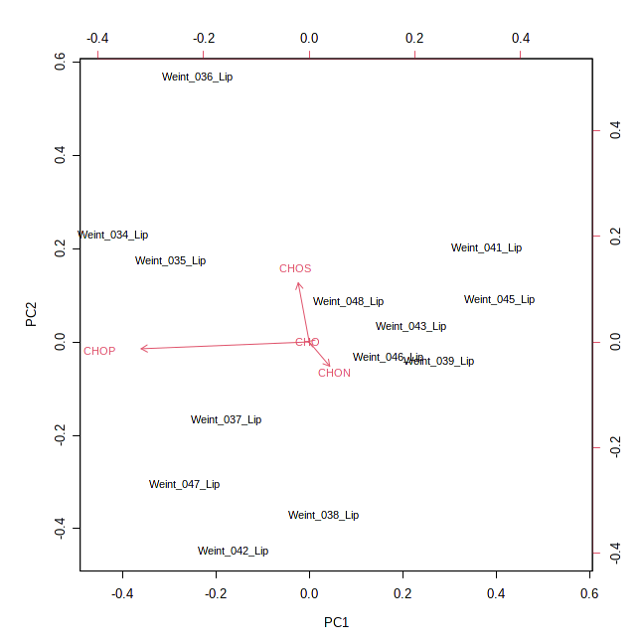
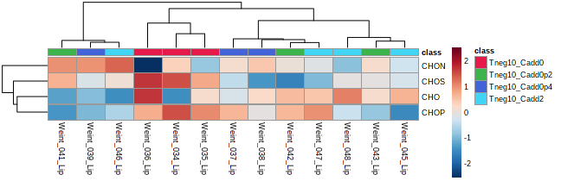
PCA of M-Mplex (SPE) Samples – Tneg10 - mf
Cadd0 separated from the other Cadd treatments mostly due to the CHOS and CHOP assigned formula. To deep dive the data, you will need to focus on the unique formula assignments to further understand these differences.

Slide 15
For further statistical processing and visualization:
https://msc-viz.emsl.pnnl.gov/FREDA/
Bramer, L. M., White, A. M., Stratton, K. G., Thompson, A. M., Claborne, D., Hofmockel, K., & McCue, L. A. (2020). ftmsRanalysis: An R package for exploratory data analysis and interactive visualization of FT-MS data. PLoS computational biology, 16(3), e1007654.

