Slide 1
12T FT-ICR
EUP# 51407 Weintraub
Upper MeOH Neg ESI (239 spectra, includes SRFAII and Blanks)
Lower CHCl3 Neg ESI (180 spectra, includes SRFAII and Blanks)
Copy MAGE, NOMSI software from the \\Floyd\software
Peak picking (NOMSI):
format cia_long
type exclusive
m inclusive 100 2000 inclusive inclusive
res 1e5
sn 7
cs -100 100

Slide 2
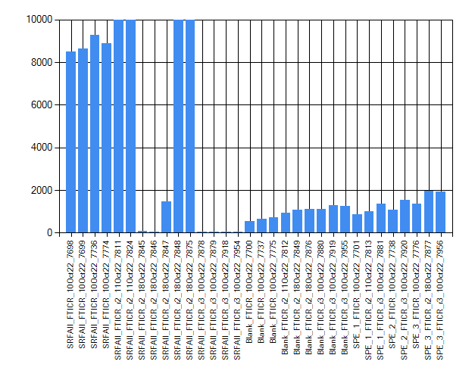
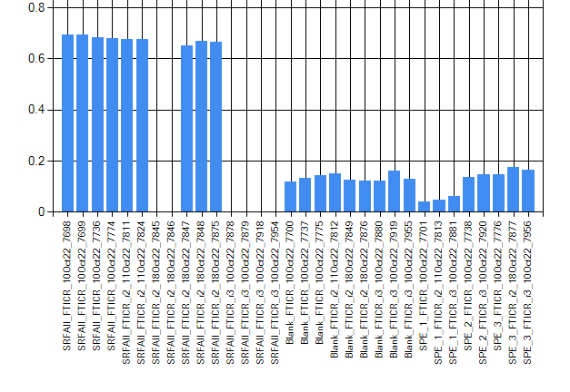
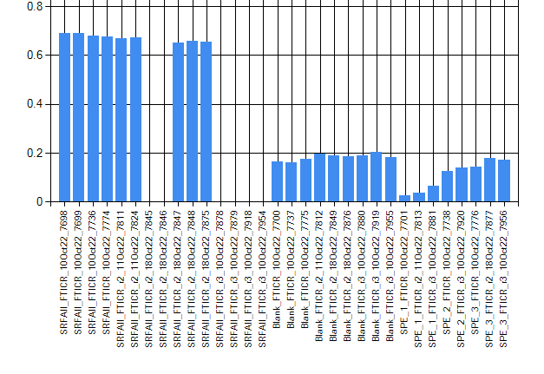
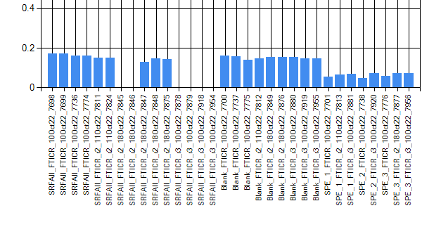
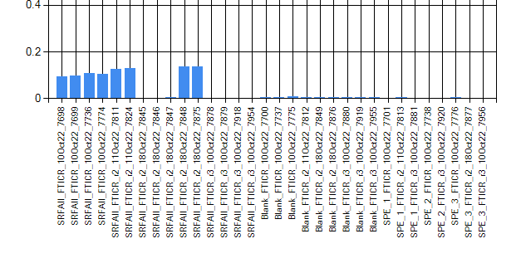
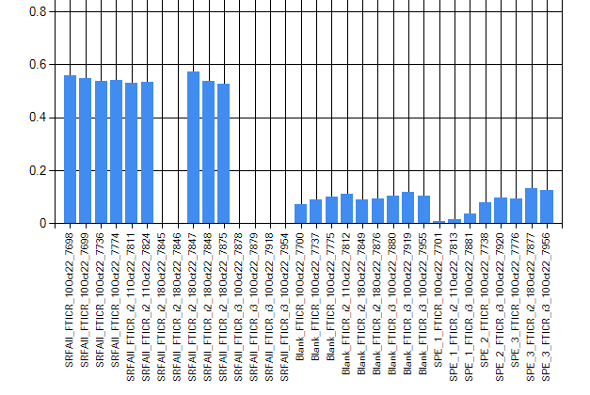
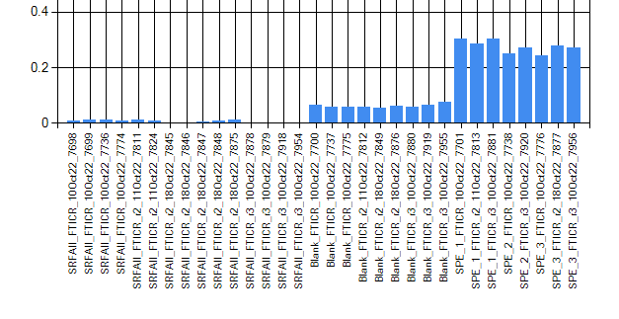
Diagnostics – MeOH Extraction – QC & Blanks - Neg.ESI
NOM connectivity - H₂
peaks count
d ¹²C-¹³C (singly-charged ions)
NOM connectivity - O
d ¹²C-¹³C (doubly charged ions)
d ³⁵Cl-³⁷Cl
NOM connectivity - CH₄O₋₁

Slide 3
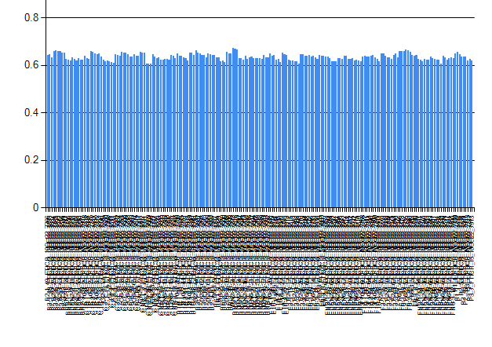
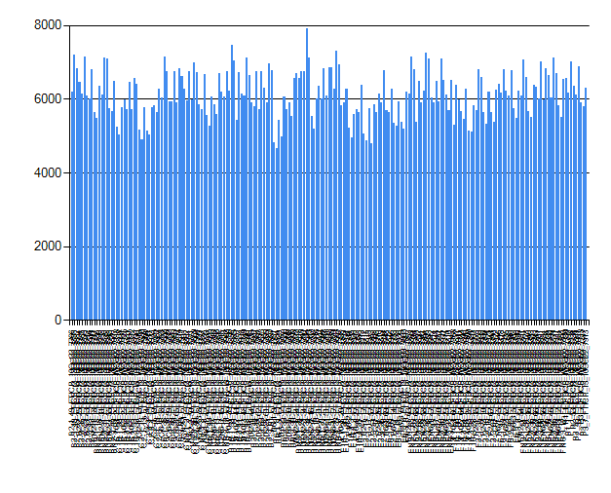
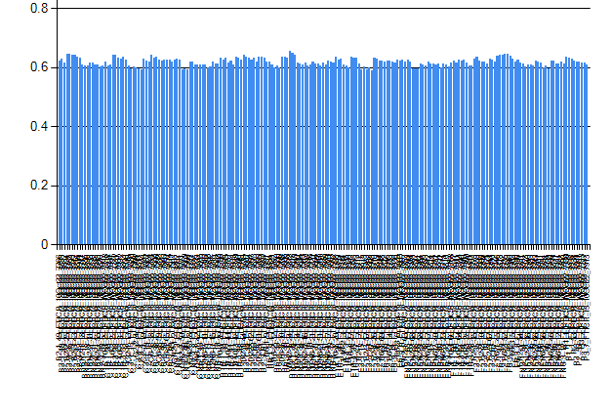
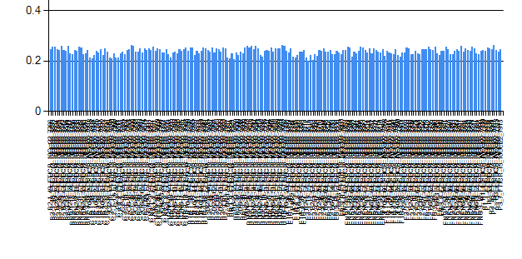
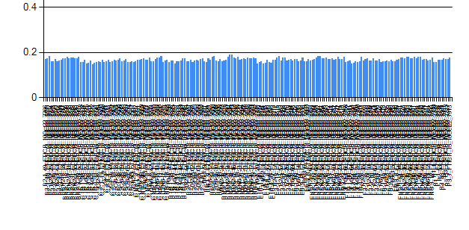
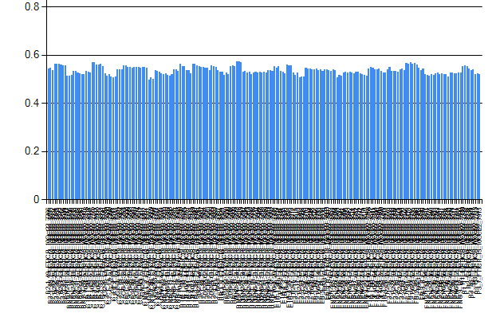
Diagnostics – MeOH Extraction – Neg.ESI
NOM connectivity - H₂
peaks count
NOM connectivity - O
d ¹²C-¹³C (no multi-charged ions)
d ³⁵Cl-³⁷Cl
NOM connectivity - CH₄O₋₁
full alignment, [M-H]- and [M+Cl]- ions, good NOM connectivity

Slide 4
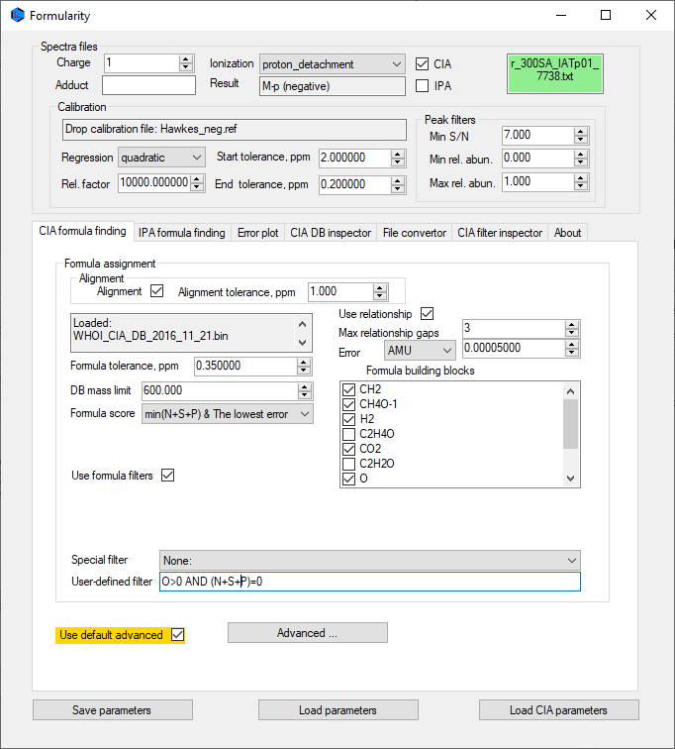
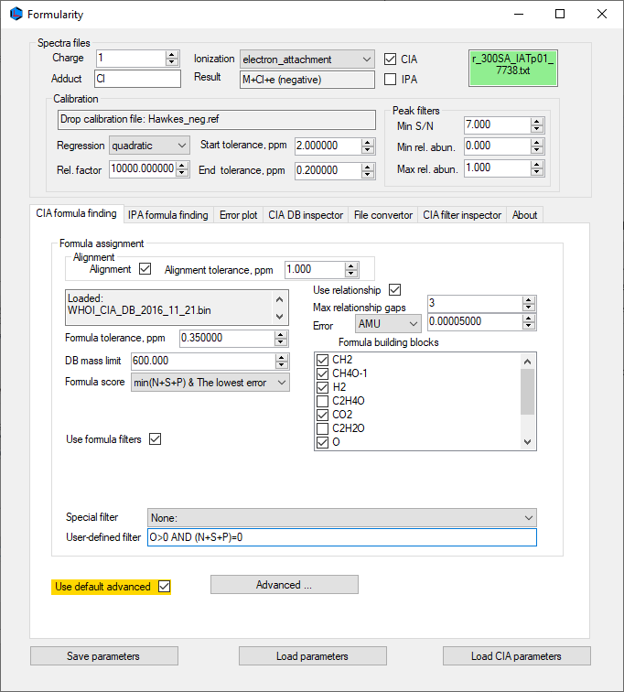
Formularity – MeOH Extraction – Samples & Blanks - Neg.ESI – Merge Stage 1

Slide 5
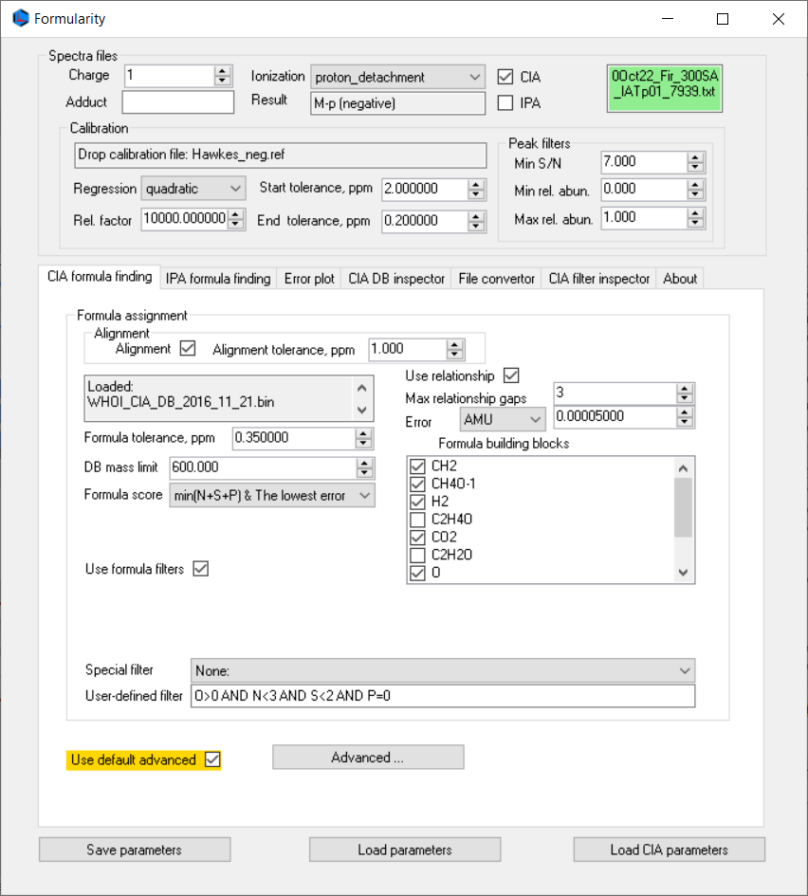
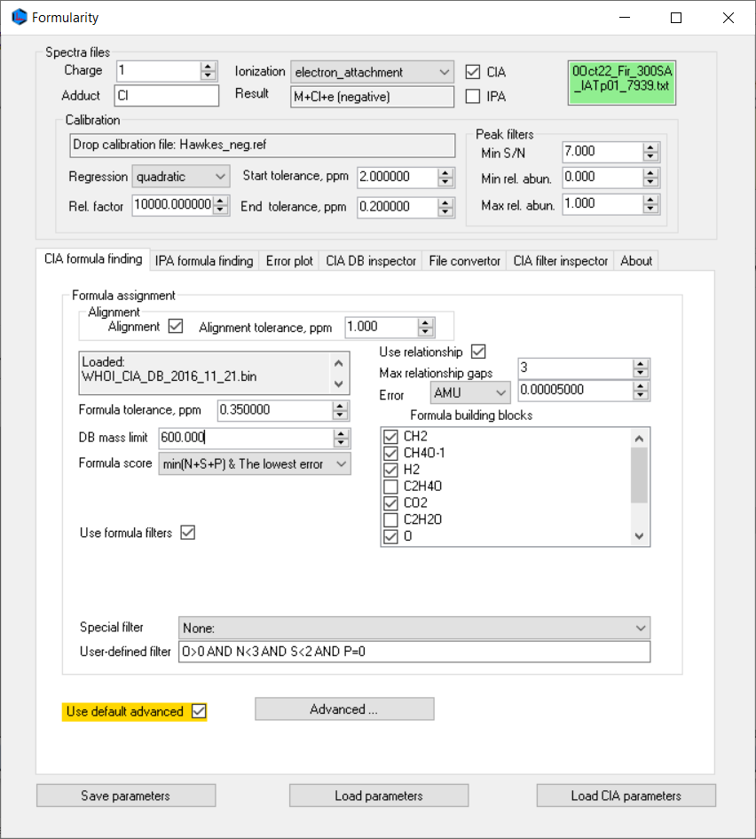
Formularity – MeOH Extraction – Samples & Blanks - Neg.ESI – Merge Stage 2

Slide 6
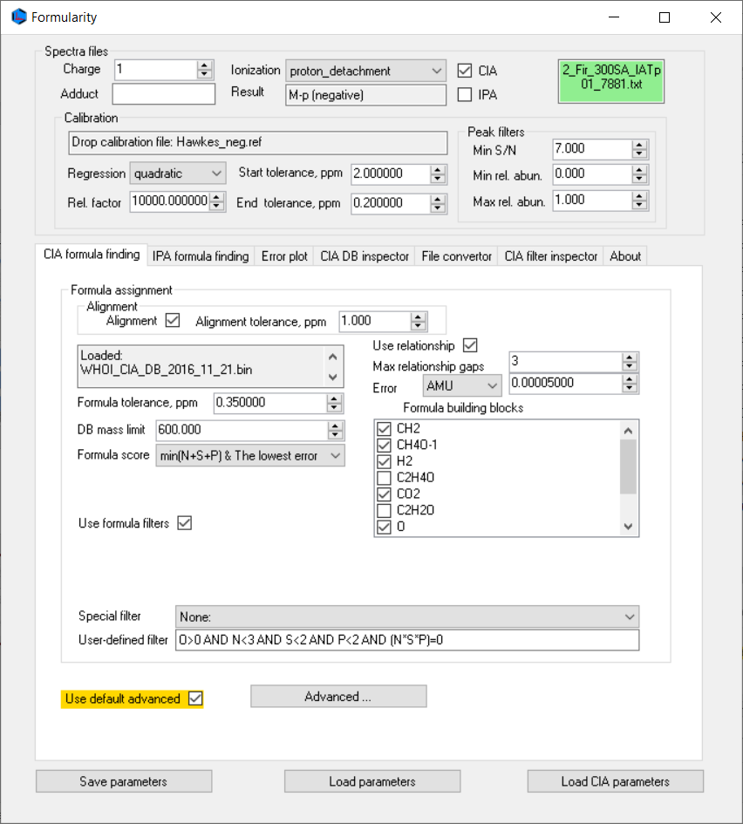
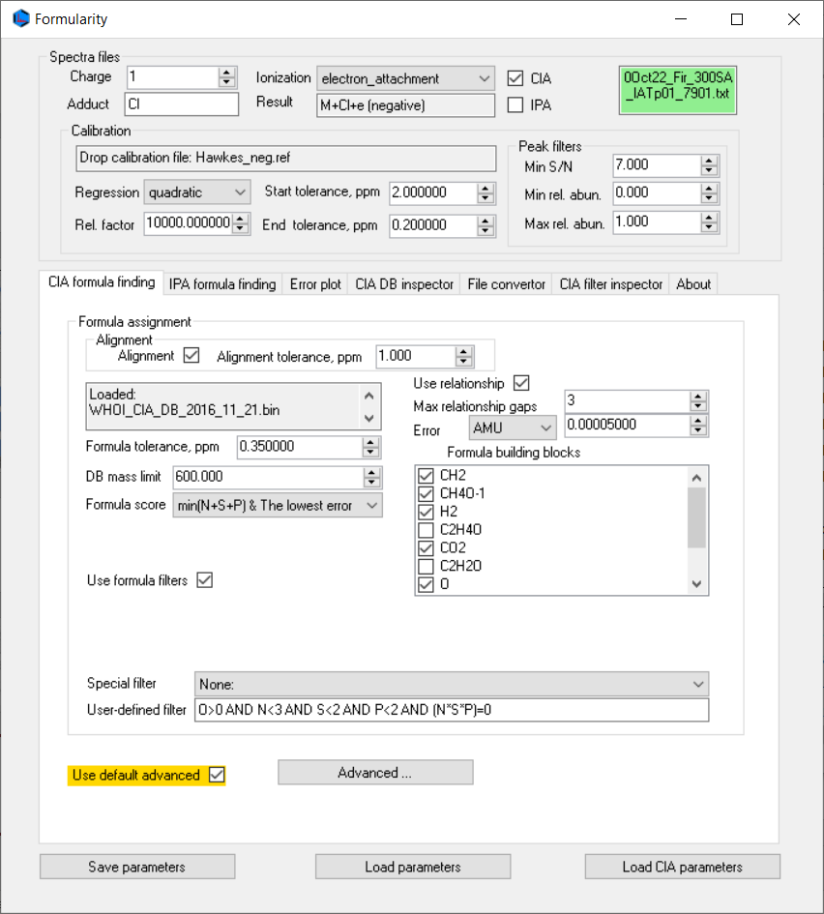
Formularity – MeOH Extraction – Samples & Blanks - Neg.ESI – Merge Stage 3

Slide 7
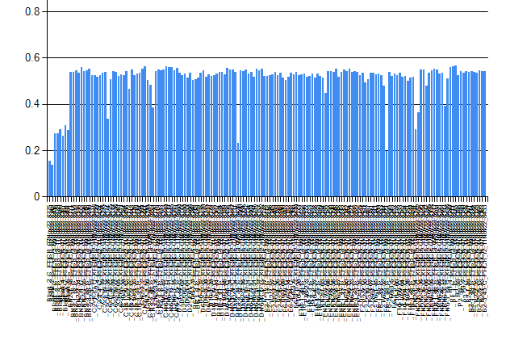
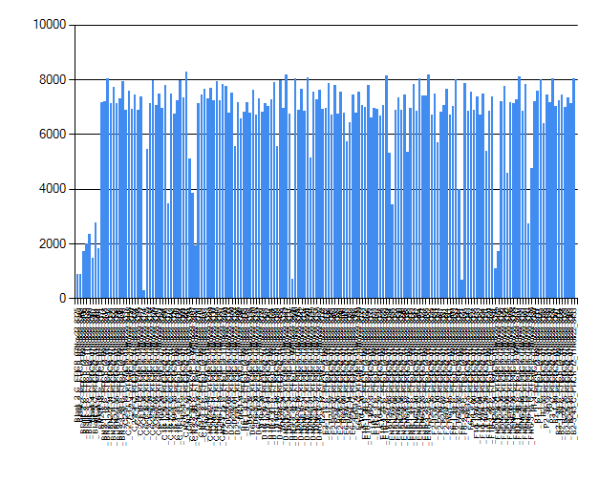
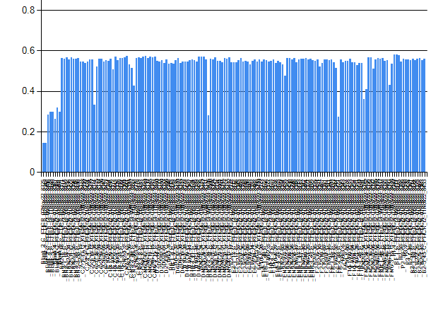
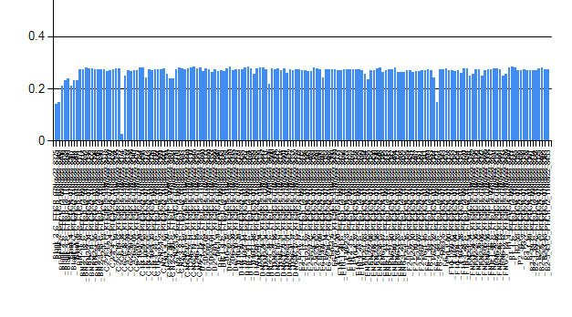
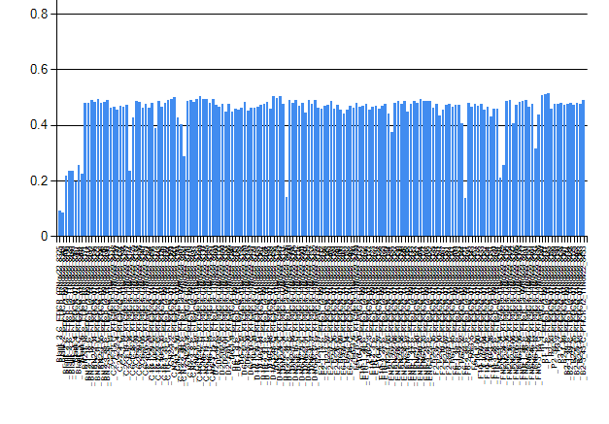
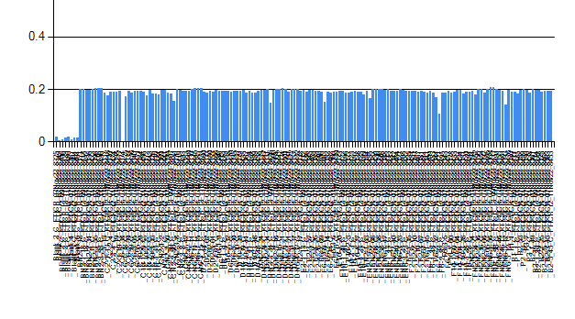
Diagnostics – CHCl3 Extraction – Blanks & Samples - Neg.ESI
NOM connectivity - H₂
peaks count
NOM connectivity - O
d ¹²C-¹³C (no multiply-charged ions)
d ³⁵Cl-³⁷Cl
NOM connectivity - CH₄O₋₁
full alignment, [M-H]- and [M+Cl]- ions, good NOM connectivity
few low count spectra; same formula assignment as with MeOH

Slide 8
Formula Assignment – CHCl3 Extraction – Neg.ESI
Significantly more [M+Cl]- assignments; it would be good idea to mark ³⁷Cl peaks so not incorrectly assigned
Example, counting CHO formula assignments
Strategy, create IPA database for [M+Cl]+ assignment
Mark matched ³⁷Cl peaks to minimize incorrect assignments in later stages of assignments with N,S,P formula
~2.1K peaks locked this way, in the final reports, these peaks were unassigned
peaks with C=0 and class [M-Cl]- are 37Cl isotopic peaks (some other isotopic peaks) but are not annotated

Slide 9
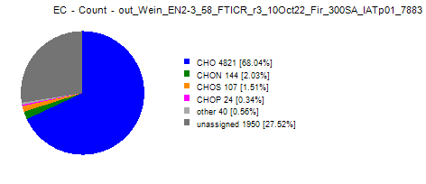
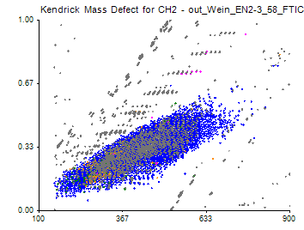
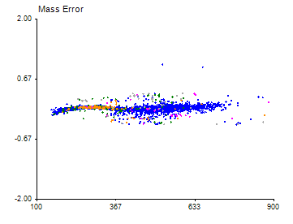
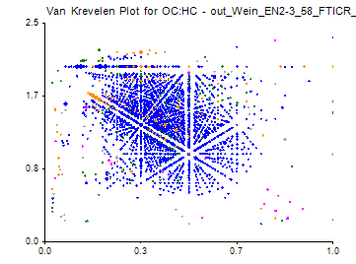
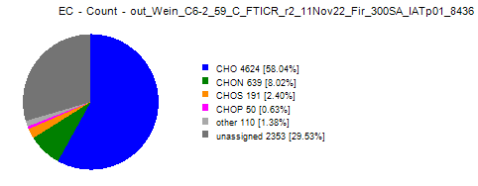
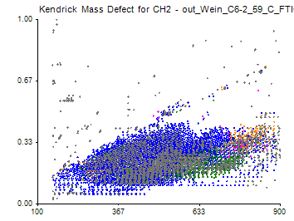
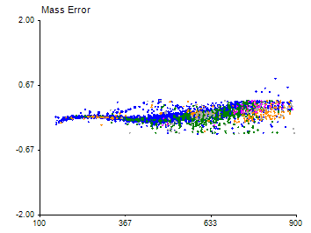
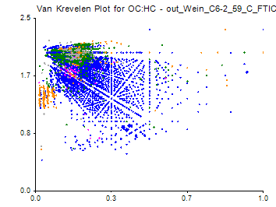
Formula Assignment – Neg.ESI
Assignment rate and mass error look very good for both extractions
CHCl3 extraction is incomplete (some missing replicates), Rosey mentioned there is no samples left .
MeOH extraction dataset is complete (triplicate for all samples). If there is more samples left, it would be nice to have also positive mode done!?

Slide 10
MeOH Extraction – Samples & Blanks - Neg.ESI – IPA findings
FeCl3
NiCl3
FeCl4
NaCl clusters
C6H2O2Br4
C6H3O2Br3
Lots of CHNOFSCl formula with excellent d scores
This is more or less found in all MeOH extraction samples and not in CHCl3 extraction samples. Difference is noticeable in defect plots
MeOH extraction
CHCl₃ extraction

