Slide 1
INTRODUCTION TO
VLSI DESIGN
By:
Ankur Agarwal

Slide 2
AGENDA
What is VLSI Design
Importance of VLSI Design
Design Methodologies
Parameters for a successful design
Introduction to EDA Tools

Slide 3
WHY IC DESIGN
Electronic systems are backbone of many systems today.
  Car electronics which includes music system, engine and dashboard controls.
  Electronics in planes, phones, TVs, Wash Machines, Computer peripherals etc.

Slide 4
ADVANTAGES OF MONOLITHIC IC
Less die area, compactness
Less power consumption
Less testing requirements at the system level
Higher reliability, due to high quality on chip interconnect
Higher speed, due to reduced interconnect length
Significant cost savings

Slide 5
WHY IC DESIGN A BIG ISSUE?
Electronic design are getting more and more complex.
The desired features are
  Reduction in size and power
  Increase in operational speed
ICs provide
  Small physical size, low power consumption and reduced cost (for large scale operations).

Slide 6
WHAT IS EDA?
Automation of the Electronic Design
Various issues
  Devices: transistors, gates, flip flops, digital building blocks, memory, processors etc.
  Levels: Chip, Board, System, Concept
  Simplicity: Custom Design vs. reuse of design.
EDA focus is mainly on digital circuit design though analog is getting in.

Slide 7
ELECTRONIC DESIGN AUTOMATION TOOLS
With high speed designs, various other issues are also important
  Interconnect resistance and capacitance
  RF interference, induced currents etc.
EDA need to take care of this using various simulations
  Many designs today are analog and digital mixed.

Slide 8
PARADIGMS FOR EDA
Capture and Implement
  Capture the design specs and implement. Use tools to verify each step of implementation
Specify and Synthesize
  Specifications are synthesized by tools into the design
Levels of specification
  Gate, RTL, State machine etc.

Slide 9
ORGANIZATION
EDA
Tools
A=~B
B
A
EDA
Tools
Functional view
Structural view
Verification tools
Verification tools
Physical view
We move from Physical view to the Functional view in this course.

Slide 10
DESIGN TECHNIQUES
Two contradicting issues
  increasing complexity of the designs
  reducing time for design.
Only possible solutions are
  increase more and more automation
  Multiple levels of abstraction for design to eliminate unnecessary details.
  Design Reuse
  Design Libraries
Hierarchical design and design abstractions are two techniques.

Slide 11
DESIGN METHODLOGIES
TOP-DOWN
BOTTOM-UP
Define the TOP Block
& identify the Sub-
Blocks in that.
Identify the building
Block & make a bigger
cell, using these again
Make a bigger module

Slide 12



EXAMPLE OF TOP-DOWN DESIGN
D_FF
T_F
RIPPLE CARRY
COUNTER
RIPPLE CARRY COUNTER
T_FF
T_FF
T_FF
D_FF
INVE-
RTER
D_FF
INVE-
RTER
D_FF
INVE-
RTER

Slide 13
EXAMPLE OF BOTTOM-UP
DESIGN
D_FF
INVE
RTER
D_FF
INVE
RTER
D_FF
INV
RTER
T_FF
T_FF
T_FF
RIPPLE CARRY COUNTER

Slide 14
HISTORY
SSI
  Small Scale Integration (0-10) : Small Gates
MSI
  Medium Scale Integration (10 – 100) : Counters, Decoders
LSI
  Large Scale Integration (100 – 1000) : Memories, ADC
VLSI
  Very Large Scale Integration (1000–10,000): CPU
ULSI
  Ultra Large Scale integration : DSP Application

Slide 15
PARAMETERS OF DESIGN MATRICS
Cost
Time to Market
Power Consumption
Flexibility
Efficiency
Performance

Slide 16
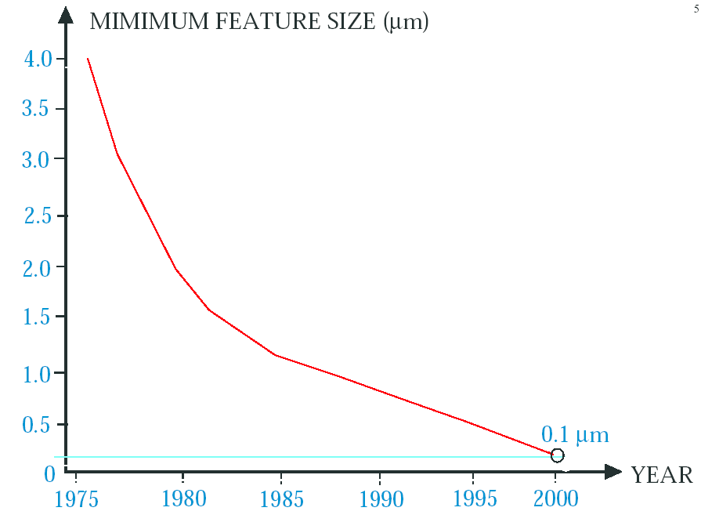
FEATURE SIZE

Slide 17
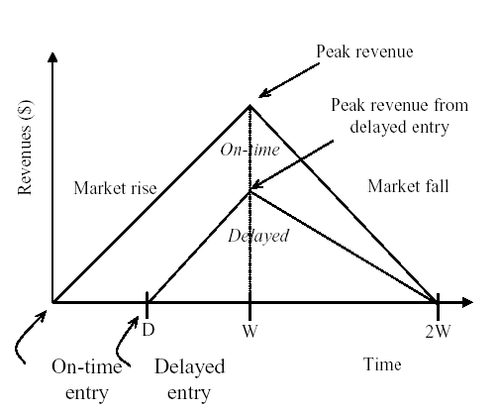
TIME TO MARKET IS CRITICAL
25% OF THE DELAY IN MARKET CAN AFFECT UPTO 75%
PROFIT MARGINS

Slide 18
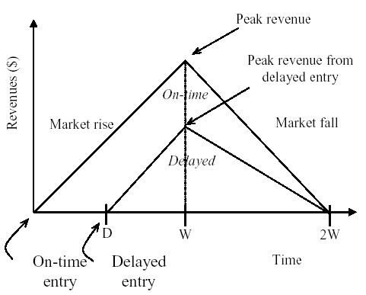
TIME TO MARKET IS CRITICAL
AREA = ½ * BASE * HEIGHT
ON-TIME = ½ * 2W * W
DELAYED = ½ * (2W-D) * (W-D)
PERCENTAGE REVENUE LOSS
=> (D (3W –D) / 2W2) * 100%
TRY SOME EXAMPLE:
2W = 52 WEEKS
D = 4 WEEKS
2W = 52 WEEKS
D = 10 WEEKS

Slide 19
TECHNIQUES TO REDUCE THE COMPLEXITY OF IC DESIGN
Hierarchy – Divide and conquer
Regularity – Reusability – transistor level, gate level
Modularity – Debugging
Locality – ‘Time locality’ – excessive interconnect delays

Slide 20
TRENDS IN VLSI
Increasing Interconnect Delay-60% of the path delay
Increasing Interconnect Area – 30% of microprocessor die area is meant for interconnect.
Increasing Number of Metal Layers – 10 layers of copper Xilinx -2005
Synthesis – Logic Synthesis and High Level Synthesis

Slide 21
