Slide 1
FORECASTING SEA LEVEL RISE
🌊
in the Pacific
Tuvalu – Funafuti Station (1977–2023)
SDG 13: Climate Action | CST184 Data Analysis & Visualisation | Project 2
NOAA Tides & Currents — Station 732-012 Funafuti B

Slide 2
WHY TUVALU?
🏝 Average elevation just 2 metres above sea level — one of the lowest nations on Earth
🌊 Among the most at-risk nations globally from sea level rise
📡 NOAA Funafuti B station: 47 years of continuous tide gauge data (1977–2023)
🎯 Directly relevant to SDG 13: Climate Action — used as our primary case study
📊 521 monthly observations — clean, consistent, scientifically validated by NOAA

Slide 3
STEPS 1–2: DATA IMPORT & EXPLORATION
Dataset Overview
Python Function: get_country_data()
📁 Source: NOAA Station 732-012
def get_country_data(country,
year_start, year_end):
return df[
(df['Country']==country) &
(df['Year']>=year_start) &
(df['Year']<=year_end)
]
📅 Years: 1977 – 2023
📊 521 monthly rows loaded
❌ Only 3 missing values
🔁 Converted metres → mm
✓ Tuvalu 2000–2020 → 21 rows returned
📍 Baselined to 1993 mean
✓ Set of unique countries: {'Tuvalu'}
✓ 47 unique years in dataset
🗓 47 annual averages used for analysis

Slide 4
STEPS 3–5: FILTERING, STATS & COUNTING
Mean Rise
2020 Level
P(>120mm)
Data Points
80.6mm
190.6mm
30.3%
521
overall average
1977–2023
above significance
threshold (156.8mm)
of all years exceed
120mm (from R)
monthly readings
47 annual averages
Decade Averages (mm)
1970s
1980s
1990s
2000s
2010s
2020s
23.7
39.4
32.9
101.9
123.6
185.3

Slide 5
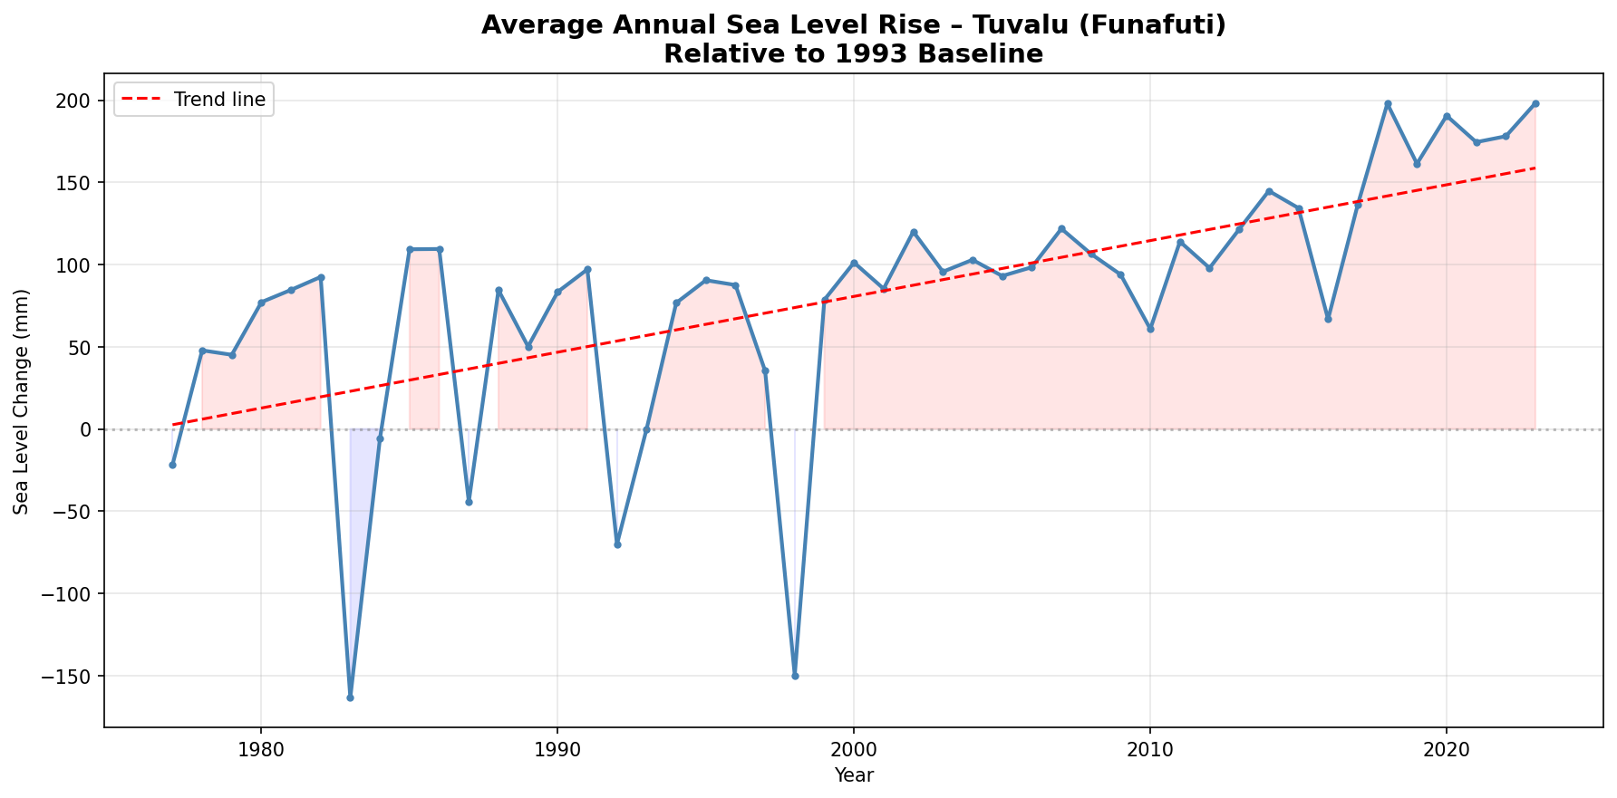
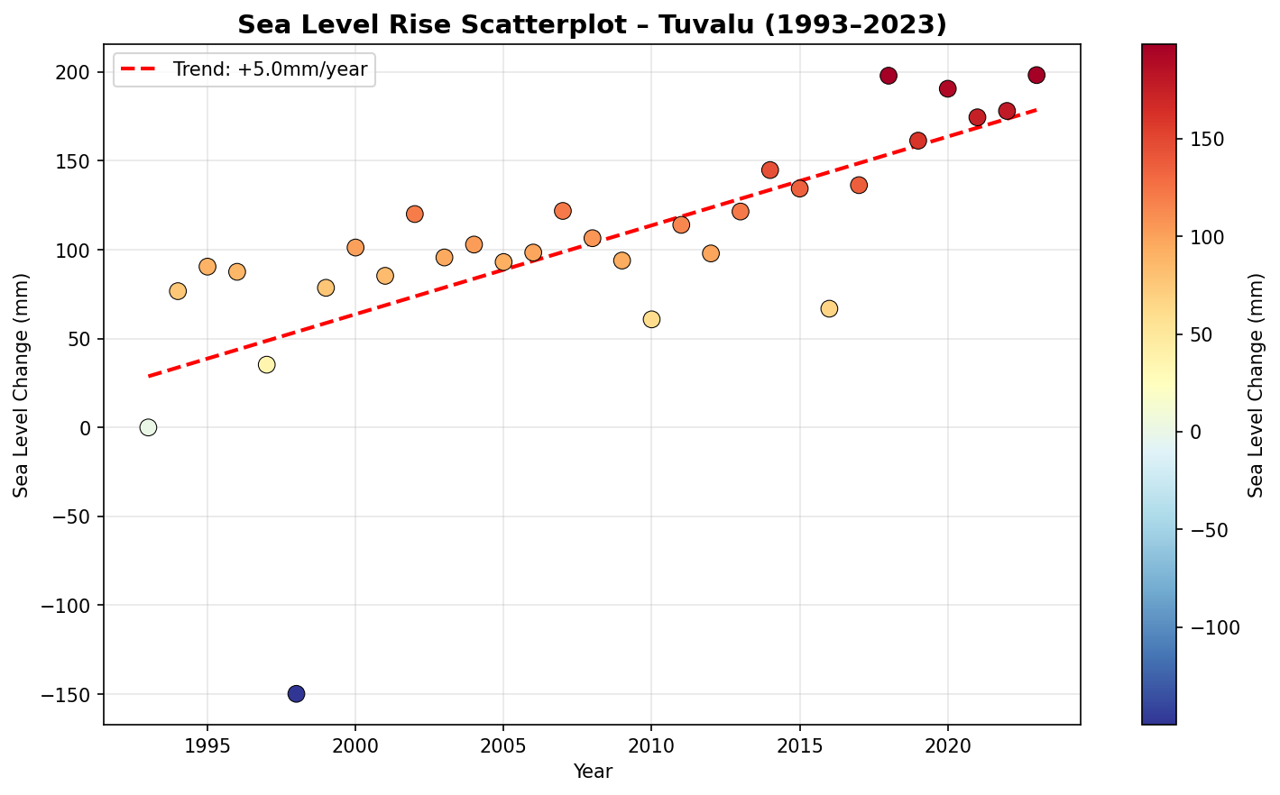
STEP 7: PYTHON VISUALISATIONS — LINE CHART & SCATTERPLOT
📈 Clear upward trend 1977–2023. Dips in 1983 and 1998 match El Niño events. Red trend line confirms consistent rise over 47 years.
🔵 Post-1993 data coloured by magnitude. Trend line shows +5.0mm/year since the satellite era baseline. Darker reds confirm recent acceleration.

Slide 6
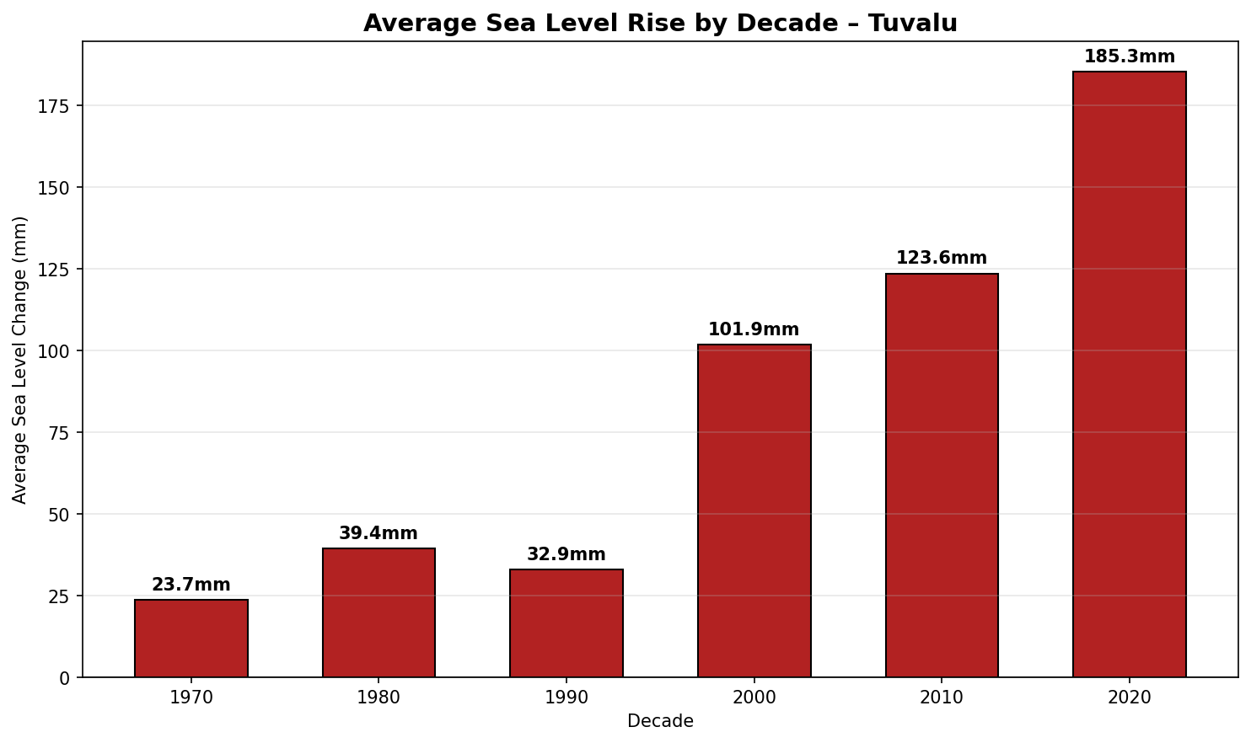
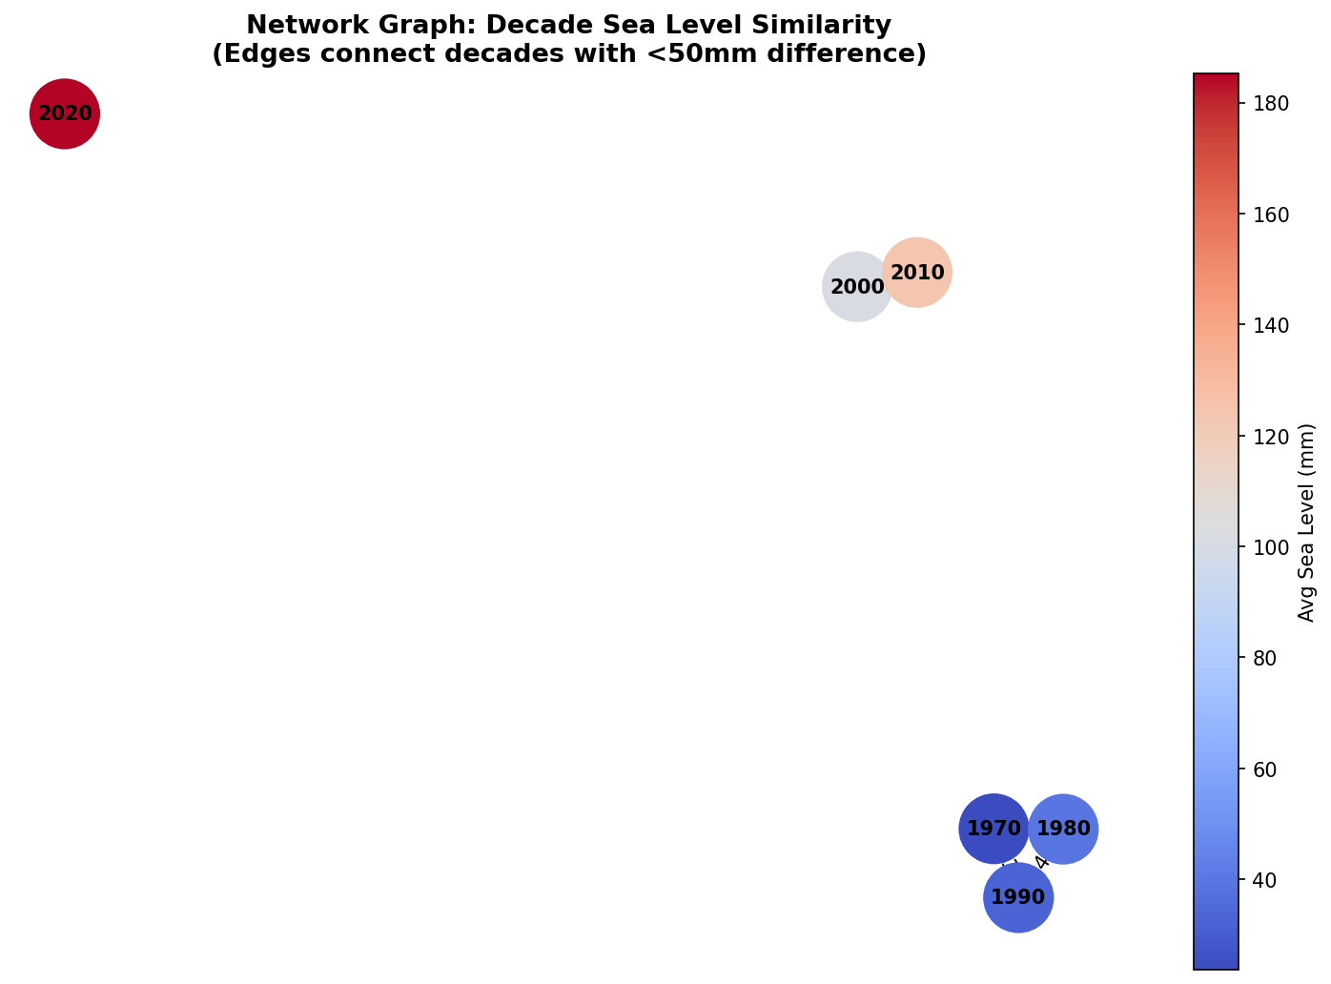
STEP 7: PYTHON VISUALISATIONS — BAR CHART & NETWORK GRAPH
📊 Decade averages show near 8× increase from 1970s (23.7mm) to 2020s (185.3mm). The acceleration is unmistakable — every decade since the 1990s has been higher.
🕸 Network graph: 1970–90s cluster together (similar sea levels). 2000s and 2010s connect. 2020s is completely isolated — sea levels now unlike any previous decade.

Slide 7
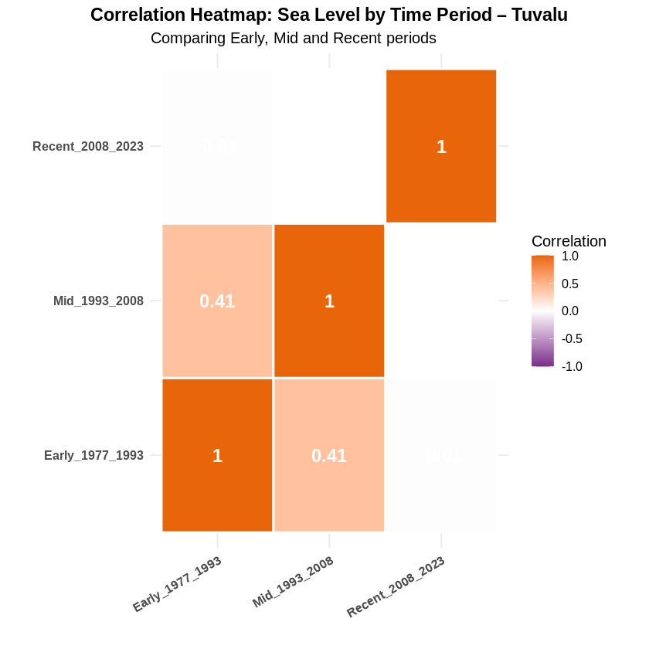
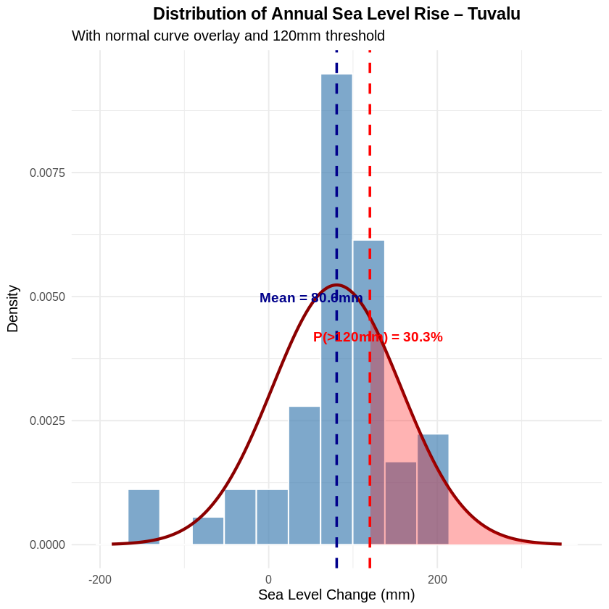
STEPS 8–9: CORRELATION HEATMAP & DISTRIBUTION (R)
Early vs Mid periods correlate at 0.41 only. Recent period (2008–2023) shows near-zero correlation with earlier decades — confirms a structural shift in sea level behaviour.
Mean = 80.6mm, SD = 76.2mm. P(>120mm) = 30.3% — nearly 1 in 3 years already exceeds 120mm. Distribution is right-skewed due to accelerating recent values.

Slide 8
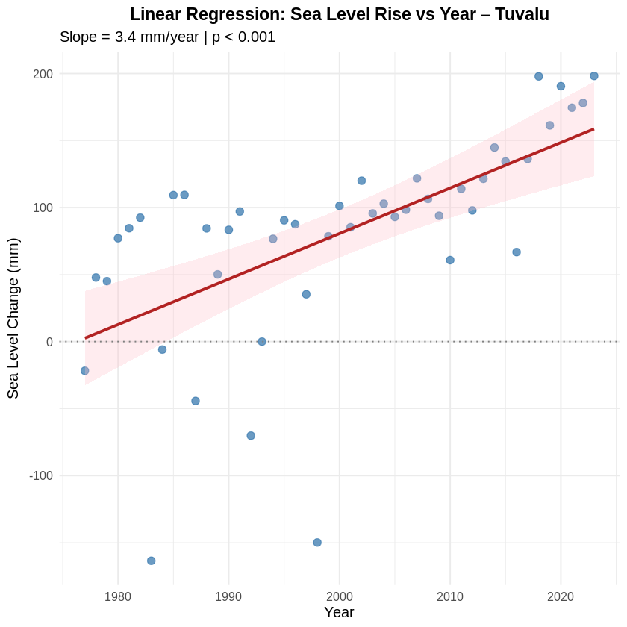
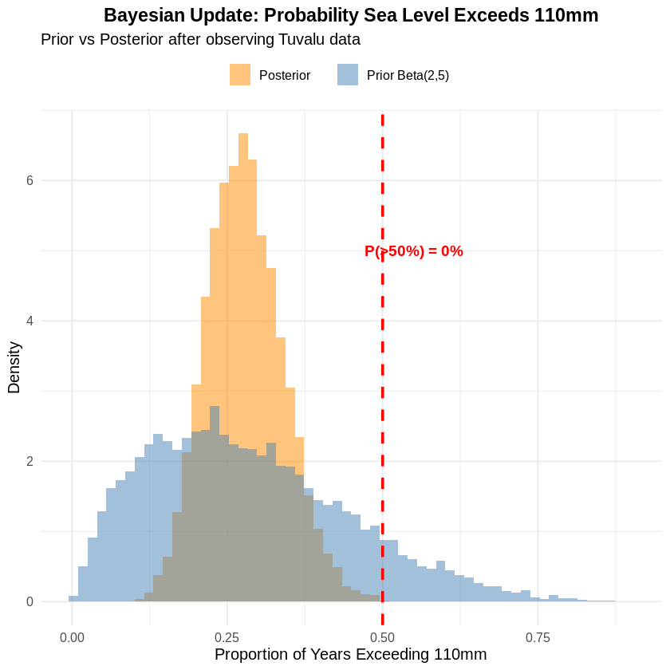
STEPS 10–11: LINEAR REGRESSION & BAYESIAN UPDATE (R)
Slope = 3.4mm/year, p < 0.001. Statistically significant upward trend confirmed. 95% CI for slope: 2.07–4.72mm/year. Projected total rise 1977–2030: ~180mm.
Prior Beta(2,5) updated with 13 years above 110mm out of 47. Posterior centres around 28% — only 13 of 47 years exceeded 110mm, but that proportion is growing rapidly.

Slide 9
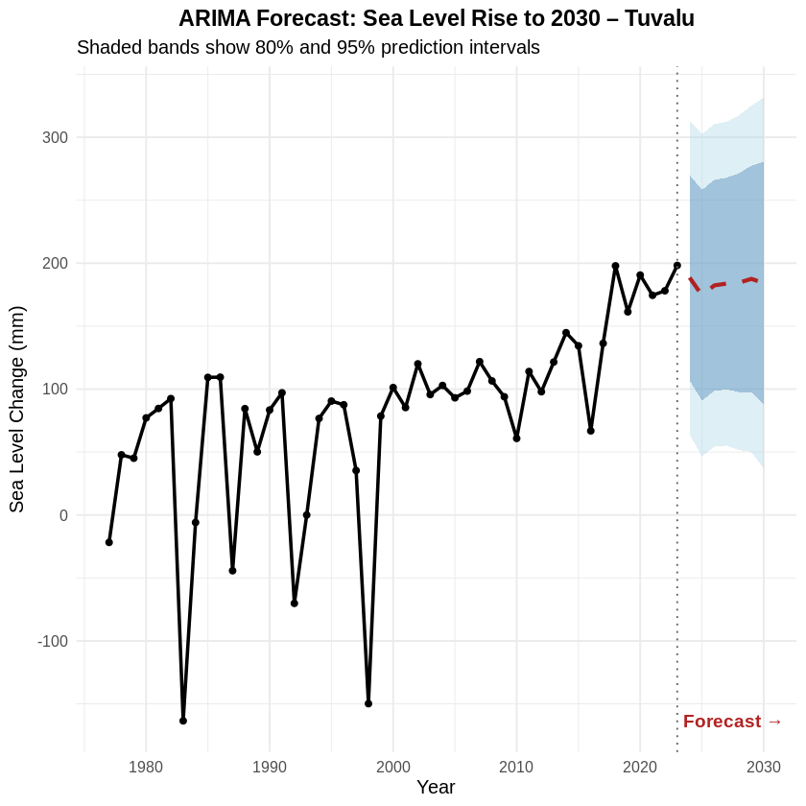
STEP 12: ARIMA FORECAST TO 2030 (R)
ARIMA(5,1,0)
auto.arima() selected this model automatically based on AIC minimisation
2024 → ~189mm
2025 → ~175mm
2026 → ~182mm
2028 → ~185mm
2030 → ~184mm
⚠ Uncertainty bands widen to 2030 — lower bound still ~37mm above 1993 baseline

Slide 10
CONCLUSION & SDG 13 IMPLICATIONS
🌊 Sea level at Funafuti has risen ~200mm since the 1993 baseline — confirmed across all 12 steps
📈 Trend is accelerating — 2020s decade average is nearly 8× higher than the 1970s
📉 1983 and 1998 dips match El Niño events — natural variability on top of the long-term trend
🔬 Regression (3.4mm/yr), Bayesian update, and ARIMA all converge on the same conclusion
⚠ With average elevation of 2m, even a 500mm rise threatens the habitability of the islands
🎯 SDG 13 action is not optional for Tuvalu — it is an existential requirement

Slide 11
REFLECTION: PYTHON vs R
🐍 Python
📊 R
✓ Great for data wrangling and cleaning
✓ lm() makes regression very readable
✓ pandas makes filtering very intuitive
✓ Built-in stats: cor(), t.test(), pnorm()
✓ networkx for graph visualisation
✓ ggplot2 produces publication-quality plots
✓ matplotlib/seaborn highly customisable
✓ forecast/auto.arima() is very powerful
✓ Faster to iterate and debug interactively
✓ Better suited for Steps 8–12 (modelling)
✓ Best for Steps 1–7 (exploration phase)
✓ Package install time can be slow in Colab

