Slide 1

Intro to Python I
Winter 2021

Slide 2
Materials for today can be found here:
https://researchguides.uoregon.edu/library_workshops/python
Check out other Data Services Workshops here:
https://library.uoregon.edu/research-data-management/training-workshops
Peer consultations:
https://library.uoregon.edu/research-data-management/consultations

Slide 3
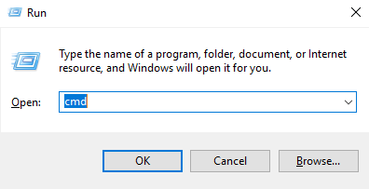
Opening in Windows
To access Python on your personal computer
Open Command Prompt (Windows+r) | Type cmd | hit enter
Type – python
Does Python open? If not, and you know you have it – Path Variable Issue – Use Google Collab
If python turns on – exit()

Slide 4
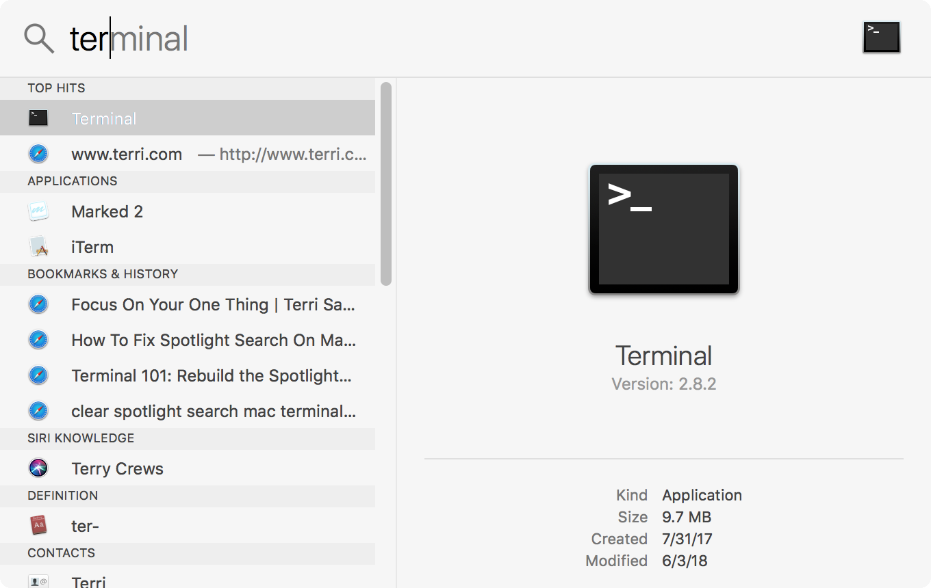
Opening on Mac
Command + Space Bar
Type terminal
Type python
Does Python open? If not and you know you have it – Path Variable Issue – Use Google Collab
If python turns on – exit()

Slide 5
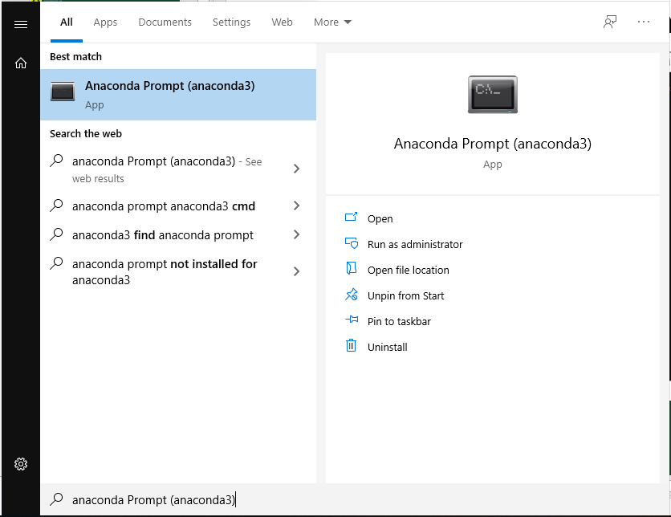
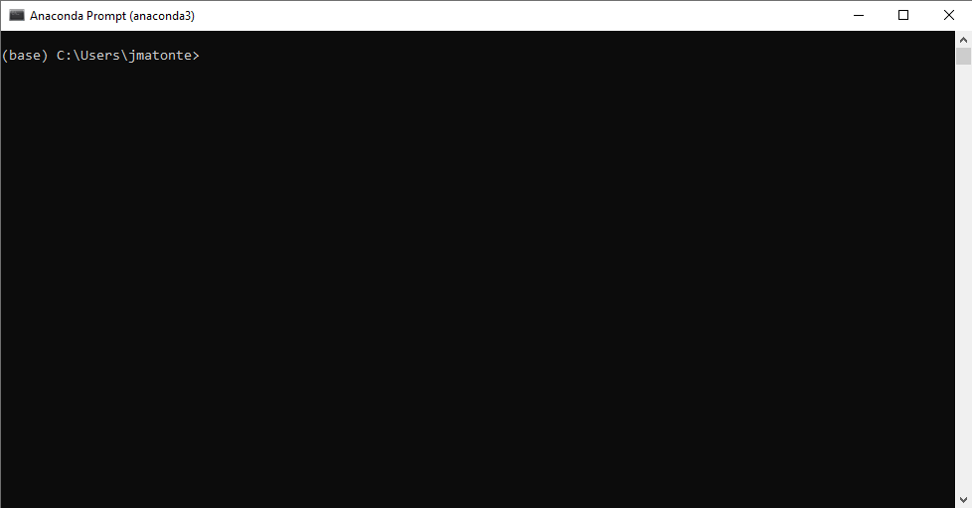
Alternative: Anaconda Prompt
Search or find Anaconda Prompt and open

Slide 6

Google Colab – Synthetic Python Environment
Do not have Python or Anaconda
Google “google colab”
Files are saved to your Google Drive
Can also open preexisting Python files on your computer

Slide 7

Jupyter Notebooks
To use Python in a more friendly environment, we will use Jupyter Notebooks
pip install jupyter OR pip3 install jupyter OR conda install jupyter (if in Anaconda)
Do not have pip? (curl https://bootsrap.pypa.io/get-pip.py -o get-pip.py)
Open Jupyter notebooks
jupyter notebook

Slide 8
Navigating Jupyter Notebooks
Opens Chrome webpage
Files and content can be saved anywhere, both on your computer or the cloud
Easy to navigate
Cells
Preformatted syntax
Google Colab -- very similar

