Slide 1

Data Science with Python
Winter 2021

Slide 2
Check out other Data Services Workshops here:
https://library.uoregon.edu/research-data-management/training-workshops
Peer consultations:
https://library.uoregon.edu/research-data-management/consultations

Slide 3

Google Colab
Do not have Python or Jupyter notebooks
Google “google colab”
Files are saved to your Google Drive
Can also open preexisting Python files on your computer

Slide 4
User-friendly
Free and open-source
Excellent documentation
Integrating data analysis into larger workflows
Statistics and visualization modules
Why use Python for data science?

Slide 5
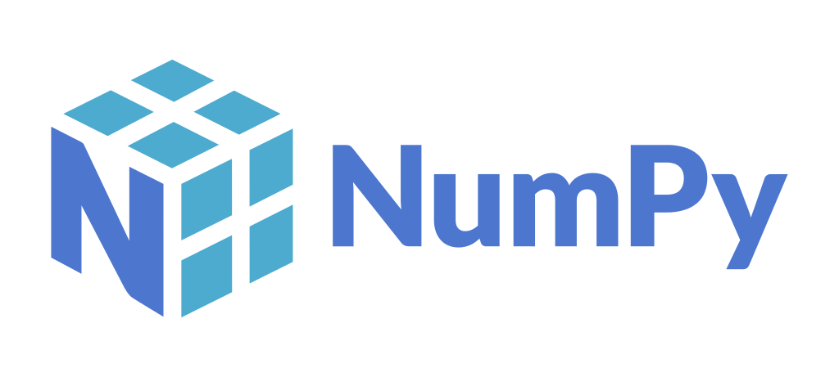

Do not come with base Python
Free to install
Designed for specific tasks
We’ll be focusing on:
Modules

