Slide 1
Improving Structural Estimation with Sequential Neural Posterior Estimation
By Cameron Fen

Slide 2
Motivation
With the curse of dimensionality, it is difficult to estimate macro models in a Bayesian fashion
The workhorse Metropolis-Hastings Markov Chain Monte Carlo (MCMC) has difficulty converging effectively to posteriors for models with more than 10-15 parameters
Sequential Neural Posterior Estimation (SNPE), a technique borrowed from machine learning, can estimate posteriors much more effectively

Slide 3
Contribution
I introduce the SNPE machine learning algorithm to improve the Bayesian estimation of structural macroeconomic models
SNPE can also handle likelihood free estimation in both a Bayesian and MLE framework
Within my SNPE procedure, I also introduce normalizing flows, for high dimensional density estimation
Empirical application estimating Krusell-Smith model solved via Winberry in a full information manner—with micro and macro moments

Slide 4
SNPE

Slide 5
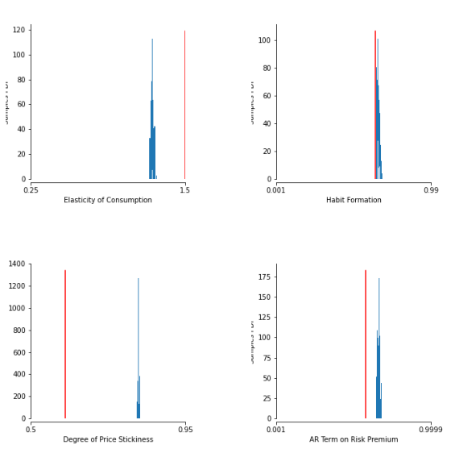
Metropolis-Hastings MCMC on Smets-Wouters after Ten Million Iterations
Additional Parameters

Slide 6
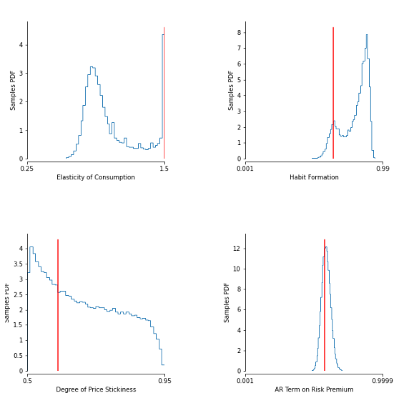
SNPE after Five Hundred Thousand Iterations
Additional Parameters

Slide 7
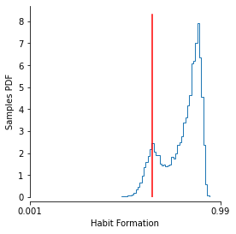
Theoretical Underpinning for SNPE Speed vs Monte Carlo
Sampling from non-log-concave distributions—for example multimodal—with MCMC and related methods don’t have polynomial computational guarantees (Chewi 2023)
Using a parametric density estimator via maximum likelihood are roughly quadratic/polynomial in cost (Farrell 2021)

Slide 8
An Explanation of SNPE

Slide 9

Bayes Rule
$$P\left(θ | X\right)= \frac{P\left(X | θ\right)P(θ)}{P(X)}$$

Slide 10
MCMC and SNPE
High level differences of MCMC and SNPE
Whereas MCMC attempts to sample from the posterior by randomly walking to different points in proportion to the posterior probability…
…SNPE samples from the joint distribution of data and the parameters and then attempts to estimate a conditional density from the joint samples

Slide 11
What if the Likelihood is Intractable?
This is likely to happen in the case of a macro model
For example, both value function iteration and projection take normal shocks and transforms them with nonlinear functions
Distribution likely will not have a parametric form and so likelihood evaluations are impossible
With these model solutions, it’s much harder to do MCMC or even maximum likelihood estimation

Slide 12
If You can’t Evaluate, Just Simulate
SNPE can estimate these models, even when the likelihood is intractable, just by simulating from the likelihood
Typically, simulation-based techniques like Method of Simulated Moments (MSM) aren't full information techniques, but can estimate more flexible models (ie ones without tractable likelihoods)
Simulation estimation literature

Slide 13
SNPE: Best of Both Worlds
SNPE combines the best of both words:
Can estimate any model that MSM can, but performs likelihood/Bayesian estimation
Additionally, adheres to the state-space assumption for the data generating process rather than a Markovian assumption for MSM

Slide 14
SNPE: Estimation Exposition

Slide 15
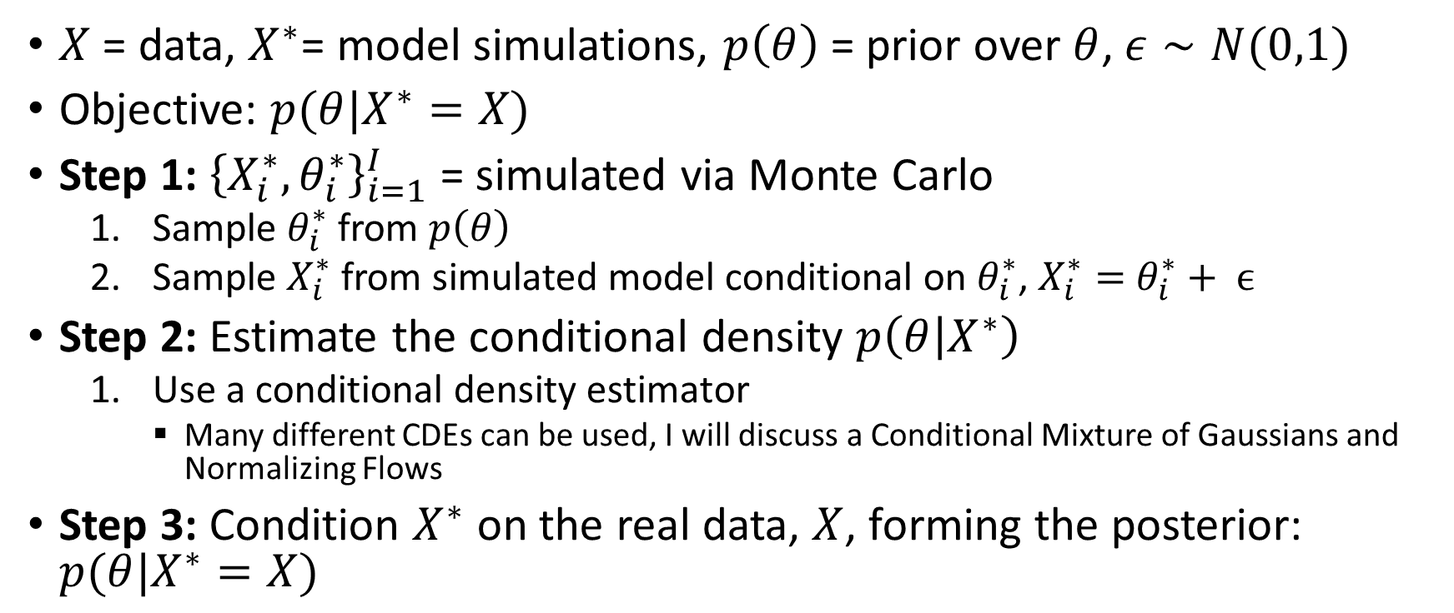

SNPE Toy Model: $X^{∗}=θ+ ϵ$
$X$ = data, $X^{∗}$= model simulations, $p\left(θ\right)$ = prior over $θ$, $ε∼N(0,1)$
Objective: $p(θ|X^{∗}=X)$
Step 1: ${\left\{X_{i}^{∗},θ_{i}^{∗}\right\}}_{i=1}^{I}$ = simulated via Monte Carlo
Sample $θ_{i}^{∗}$ from $p\left(θ\right)$
Sample $X_{i}^{∗}$ from simulated model conditional on $θ_{i}^{∗}$, $X_{i}^{∗}=$ $θ_{i}^{∗}+ ϵ$
Step 2: Estimate the conditional density $p\left(θ | X^{∗}\right)$
Use a conditional density estimator
Many different CDEs can be used, I will discuss a Conditional Mixture of Gaussians and Normalizing Flows
Step 3: Condition $X^{∗}$ on the real data, $X$, forming the posterior: $p(θ|X^{∗}=X)$
Simulate diagram
Estimate diagram
Condition diagram
SNPE
SNVI
Skip Intuition

Slide 16
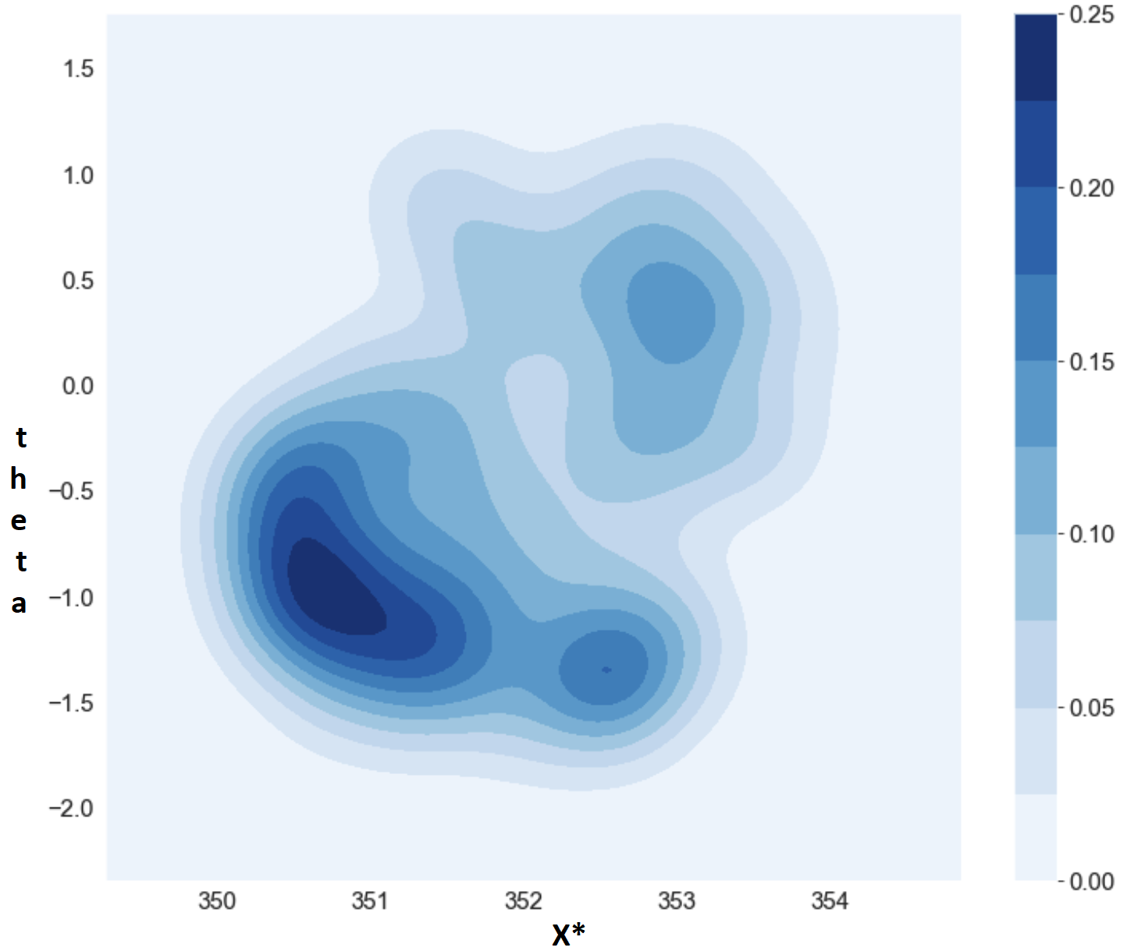

Step 1: Sample ${\left\{θ_{i}^{∗},X_{i}^{∗}\right\}}_{i=1}^{I}∼p\left(θ, X^{∗}\right)$ via Monte Carlo Simulation
Back

Slide 17
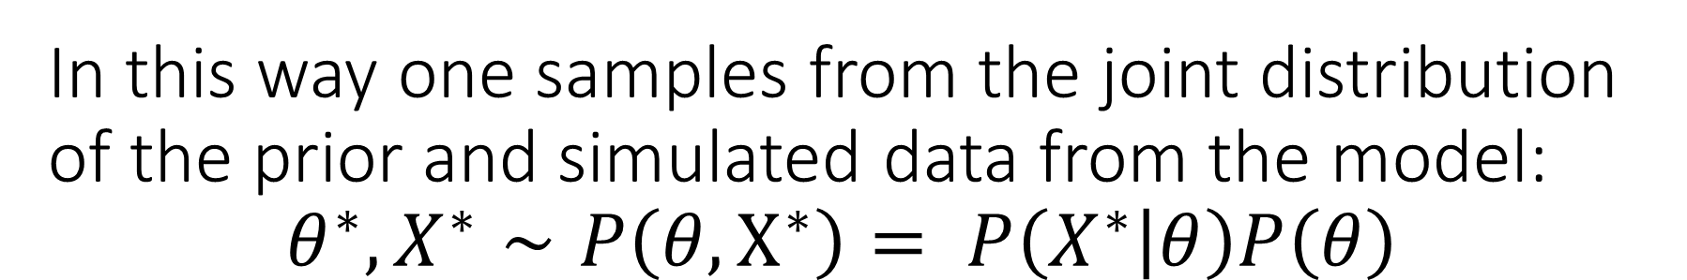
In this way one samples from the joint distribution of the prior and simulated data from the model: $$θ^{∗},X^{∗}∼P\left({θ, X}^{∗}\right)= P\left(X^{∗} | θ\right)P\left(θ\right)$$
Back

Slide 18
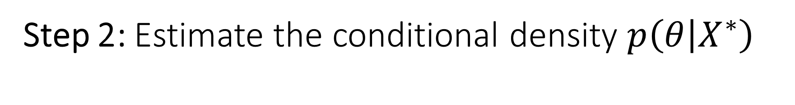
Step 2: Estimate the conditional density $p\left(θ | X^{∗}\right)$
Back

Slide 19

Step 2: Estimate the conditional density $p\left(θ | X^{∗}\right)$
Back
$$x_{3}^{∗}$$
$$x_{2}^{∗}$$
$$x_{1}^{∗}$$

Slide 20
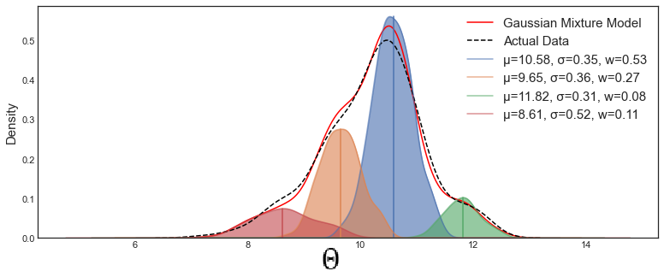

Gaussian Mixture Model
One way to do density estimation is with a Gaussian Mixture Model (first unconditional):
$P\left(θ\right)=\sum_{i}^{i=n}{α_{i}}∗N\left(θ|μ_{i},Ω_{i}\right)$
$N\left(θ|μ_{i},Ω_{i}\right)=\frac{1}{{{\det\left(Σ_{i}\right)}^{1/2}\left(2π\right)}^{k/2}}exp⁡(−\frac{1}{2}{\left(θ−μ_{i}\right)}^{T}Ω_{i}^{−1}$ $\frac{1}{2}\left(θ−μ_{i}\right))$

Slide 21
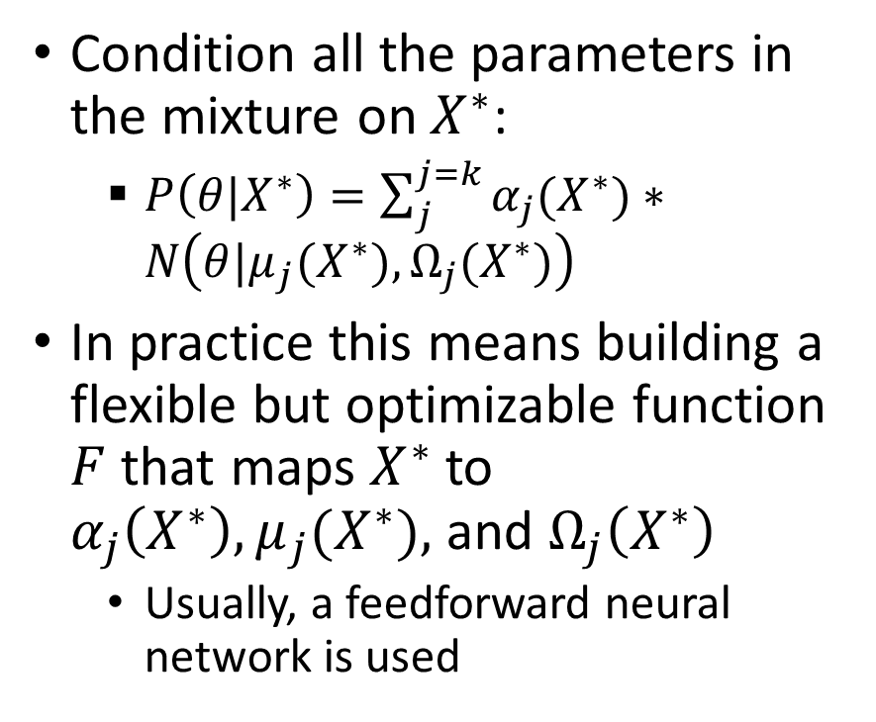

From Unconditional to Conditional Mixture of Gaussians
Condition all the parameters in the mixture on $X^{∗}$:
$P\left(θ|X^{∗}\right)=\sum_{j}^{j=k}{α_{j}(X^{∗})}∗N\left(θ|μ_{j}(X^{∗}),Ω_{j}(X^{∗})\right)$
In practice this means building a flexible but optimizable function $F$ that maps $X^{∗}$ to $α_{j}\left(X^{∗}\right), μ_{j}(X^{∗}),$ and $Ω_{j}\left(X^{∗}\right)$
Usually, a feedforward neural network is used
$$x_{3}^{∗}$$
$$x_{2}^{∗}$$
$$x_{1}^{∗}$$

Slide 22


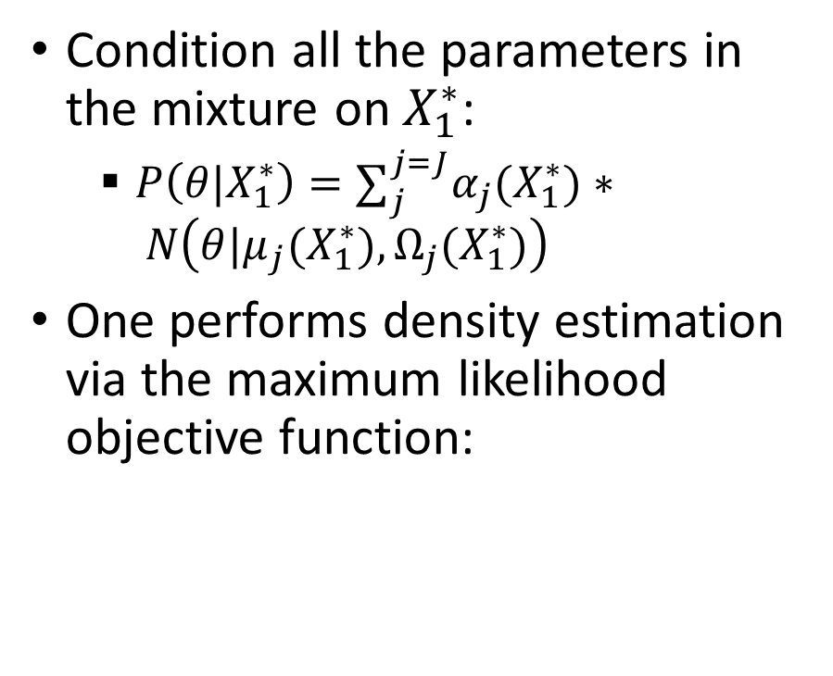
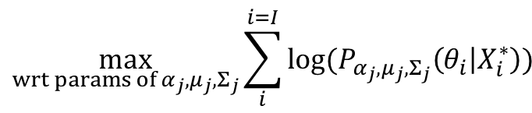

Conditional Mixture of Gaussians
$$P\left(θ|X_{2}^{∗}\right)$$
Condition all the parameters in the mixture on $X_{1}^{∗}$:
$P\left(θ|X_{1}^{∗}\right)=∑_{j}^{j=J}α_{j}(X_{1}^{∗})∗ N\left(θ|μ_{j}(X_{1}^{∗}),Ω_{j}(X_{1}^{∗})\right)$
One performs density estimation via the maximum likelihood objective function:
$$P\left(θ|X_{1}^{∗}\right)$$
$$P\left(θ|X_{3}^{∗}\right)$$
$$\max_{wrt params of{ α}_{j},μ_{j},Σ_{j}}\sum_{i}^{i=I}{log⁡(P_{α_{j},μ_{j},Σ_{j}}\left(θ_{i} | X_{i}^{∗}\right))}$$
$$x_{3}^{∗}$$
$$x_{2}^{∗}$$
$$x_{1}^{∗}$$

Slide 23

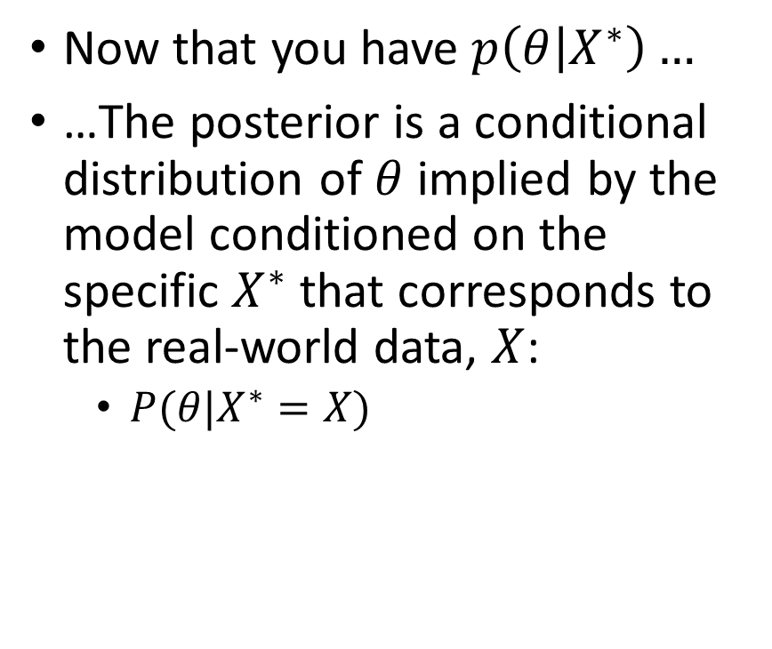

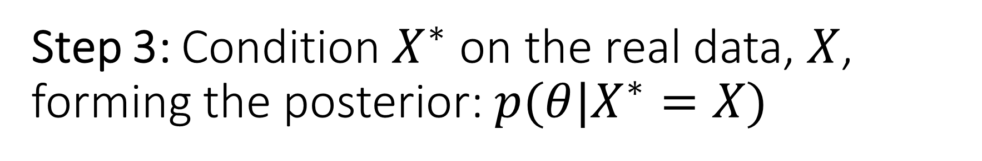

Step 3: Condition $X^{∗}$ on the real data, $X$, forming the posterior: $p(θ|X^{∗}=X)$
Now that you have $p\left(θ | X^{∗}\right)…$
…The posterior is a conditional distribution of $θ$ implied by the model conditioned on the specific $X^{∗}$ that corresponds to the real-world data, $X$:
$P(θ|X^{∗}=X)$
$$P(θ|X^{∗}=X)$$
$$x_{1}^{∗}$$
$$x$$
$$x_{3}^{∗}$$
Back

Slide 24
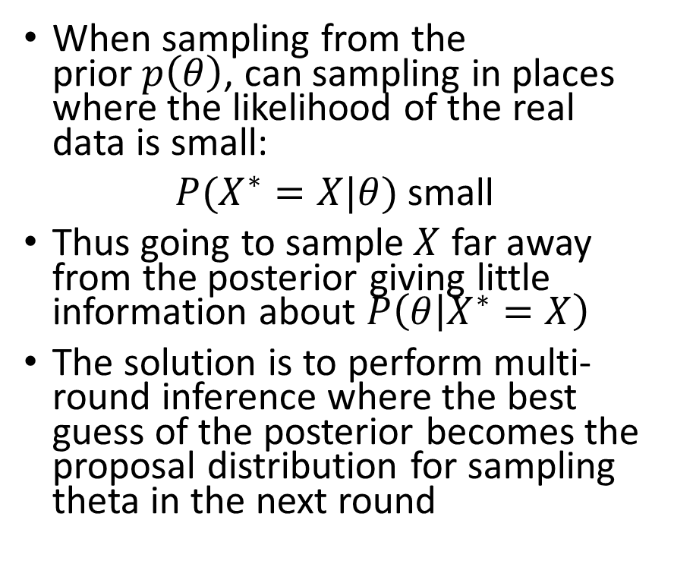
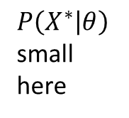
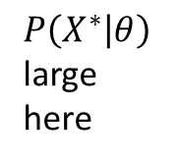
Step 3.5: Multi-Round Inference
When sampling from the prior$p\left(θ\right)$, can sampling in places where the likelihood of the real data is small:
$P(X^{∗}=X|θ)$ small
Thus going to sample$X$ far away from the posterior giving little information about $P\left(θ | X^{∗}=X\right)$
The solution is to perform multi-round inference where the best guess of the posterior becomes the proposal distribution for sampling theta in the next round
$P\left(X^{∗} | θ\right)$ large here
$P\left(X^{∗} | θ\right)$ small here
$$x$$

Slide 25
Alternative to Mixture of Gaussians: Normalizing Flows

Slide 26
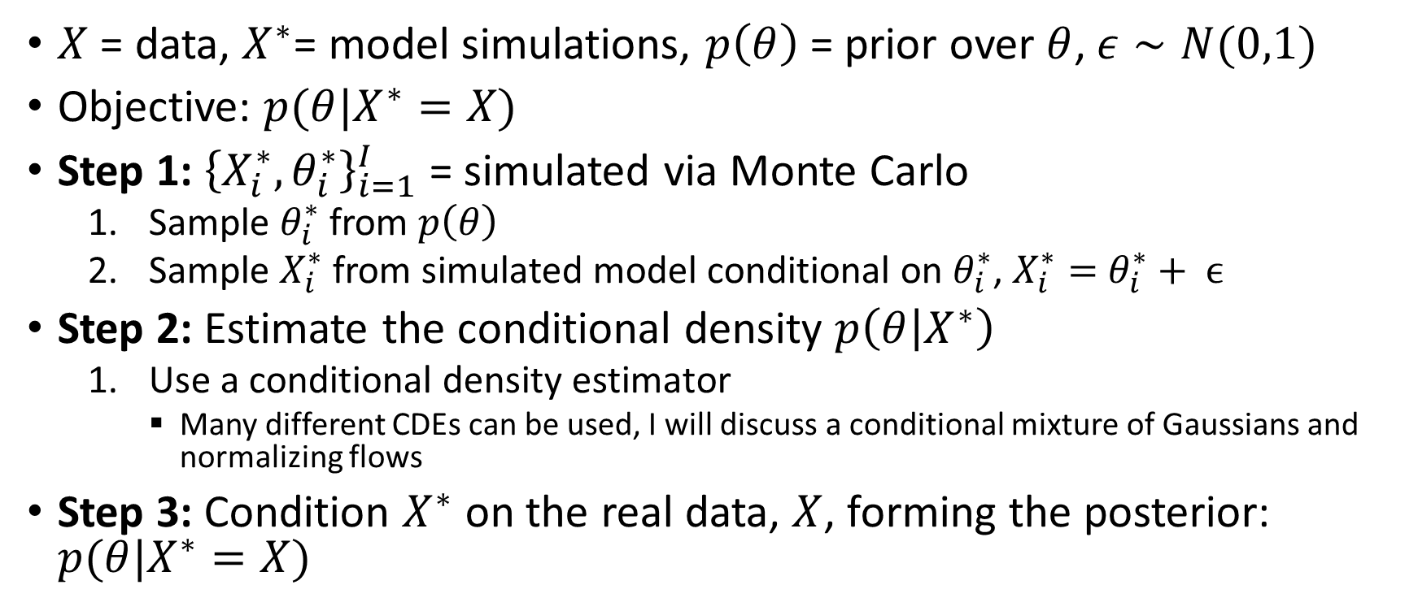

SNPE Example: $X^{∗}=θ+ ϵ$
$X$ = data, $X^{∗}$= model simulations, $p\left(θ\right)$ = prior over $θ$, $ε∼N(0,1)$
Objective: $p(θ|X^{∗}=X)$
Step 1: ${\left\{X_{i}^{∗},θ_{i}^{∗}\right\}}_{i=1}^{I}$ = simulated via Monte Carlo
Sample $θ_{i}^{∗}$ from $p\left(θ\right)$
Sample $X_{i}^{∗}$ from simulated model conditional on $θ_{i}^{∗}$, $X_{i}^{∗}=$ $θ_{i}^{∗}+ ϵ$
Step 2: Estimate the conditional density $p\left(θ | X^{∗}\right)$
Use a conditional density estimator
Many different CDEs can be used, I will discuss a conditional mixture of Gaussians and normalizing flows
Step 3: Condition $X^{∗}$ on the real data, $X$, forming the posterior: $p(θ|X^{∗}=X)$

Slide 27
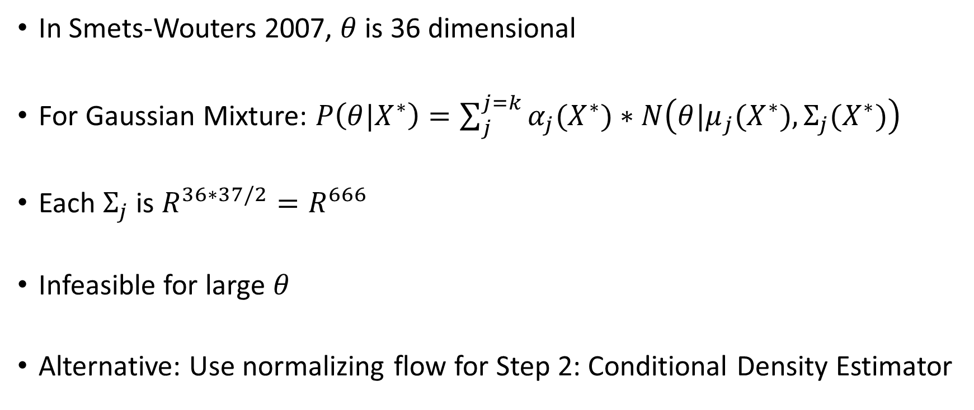
Smets-Wouters 2007
In Smets-Wouters 2007, $θ$ is 36 dimensional
For Gaussian Mixture: $P\left(θ|X^{∗}\right)=\sum_{j}^{j=k}{α_{j}(X^{∗})}∗N\left(θ|μ_{j}(X^{∗}),Σ_{j}(X^{∗})\right)$
Each $Σ_{j}$ is $R^{36∗37/2}=R^{666}$
Infeasible for large $θ$
Alternative: Use normalizing flow for Step 2: Conditional Density Estimator

Slide 28
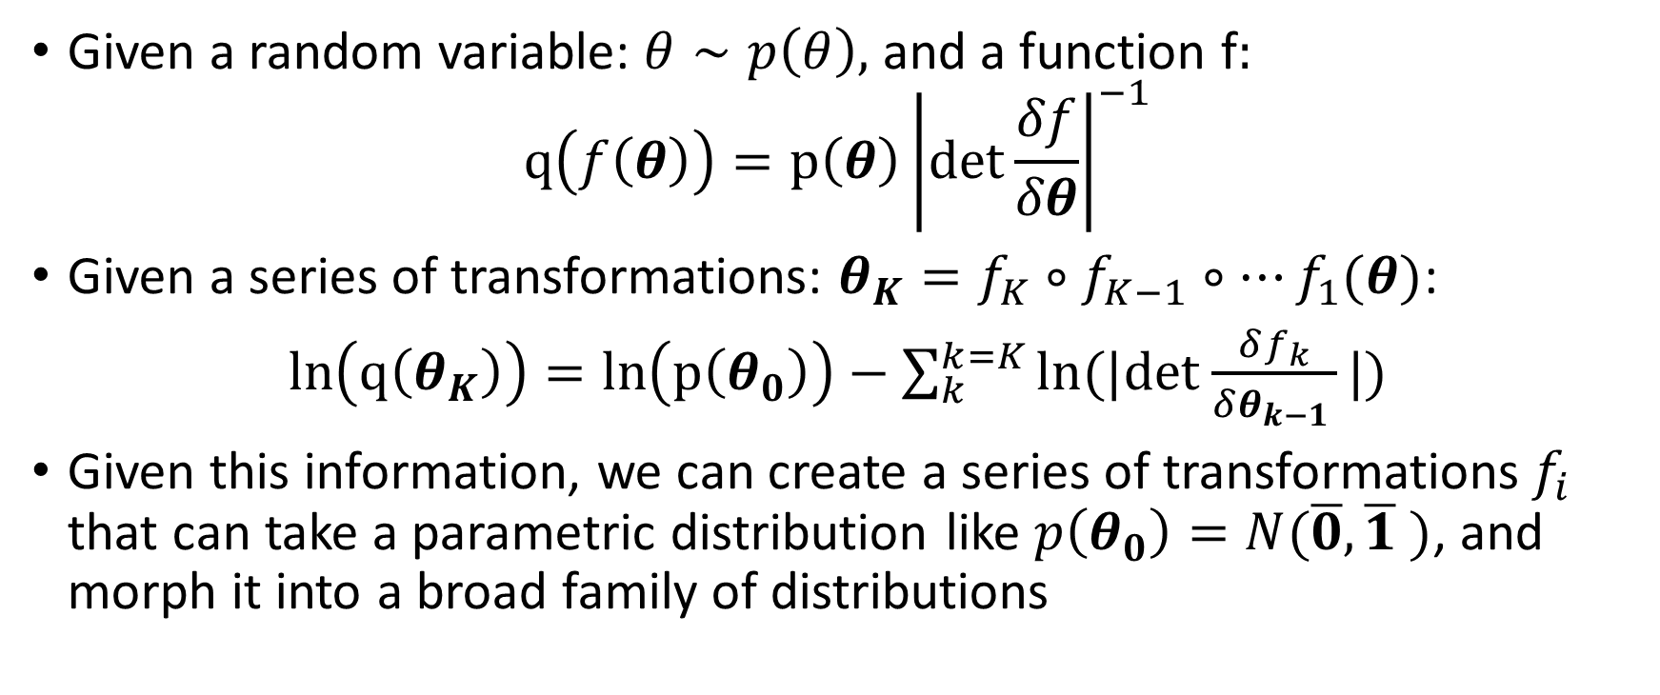
Change of Variables
Given a random variable: $θ∼p\left(θ\right),$ and a function f$:$
$$q\left(f\left(θ\right)\right)=p\left(θ\right){\left|det\frac{δf}{δθ}\right|}^{−1}$$
Given a series of transformations: $θ_{K}=f_{K}∘f_{K−1}∘…f_{1}(θ)$:
$ln\left(q\left(θ_{K}\right)\right)=ln\left(p\left(θ_{0}\right)\right)−\sum_{k}^{k=K}{ln(|det}$ $\frac{δf_{k}}{δθ_{k−1 }}|)$
Given this information, we can create a series of transformations$f_{i}$ that can take a parametric distribution like $p\left(θ_{0}\right)=N(\overline{0},\overline{1} )$, and morph it into a broad family of distributions

Slide 29
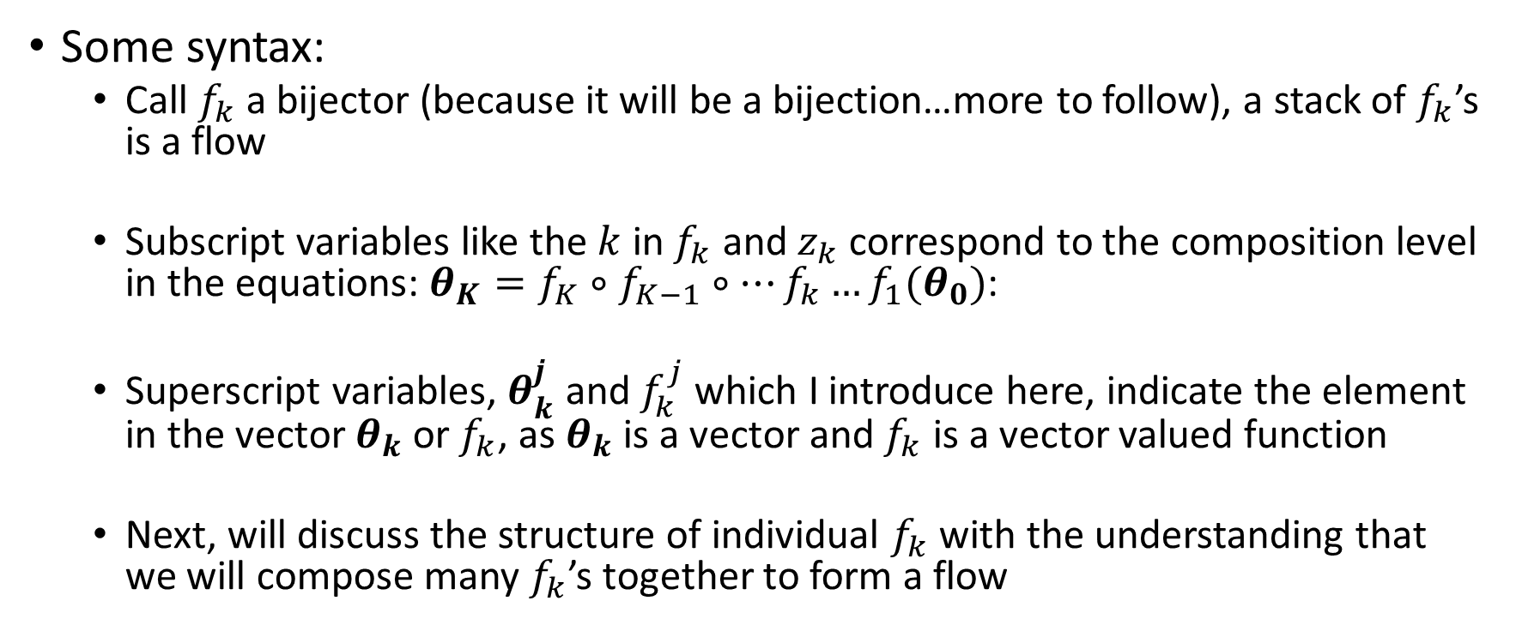
Talking Syntax
Some syntax:
Call $f_{k}$ a bijector (because it will be a bijection…more to follow), a stack of $f_{k}$’s is a flow
Subscript variables like the $k$ in $f_{k}$ and $z_{k}$ correspond to the composition level in the equations: $θ_{K}=f_{K}∘f_{K−1}∘…f_{k}…f_{1}(θ_{0})$:
Superscript variables, $θ_{k}^{j}$ and $f_{k}^{j}$ which I introduce here, indicate the element in the vector $θ_{k}$or$f_{k}$, as $θ_{k}$ is a vector and $f_{k}$ is a vector valued function
Next, will discuss the structure of individual $f_{k}$ with the understanding that we will compose many $f_{k}$’s together to form a flow

Slide 30
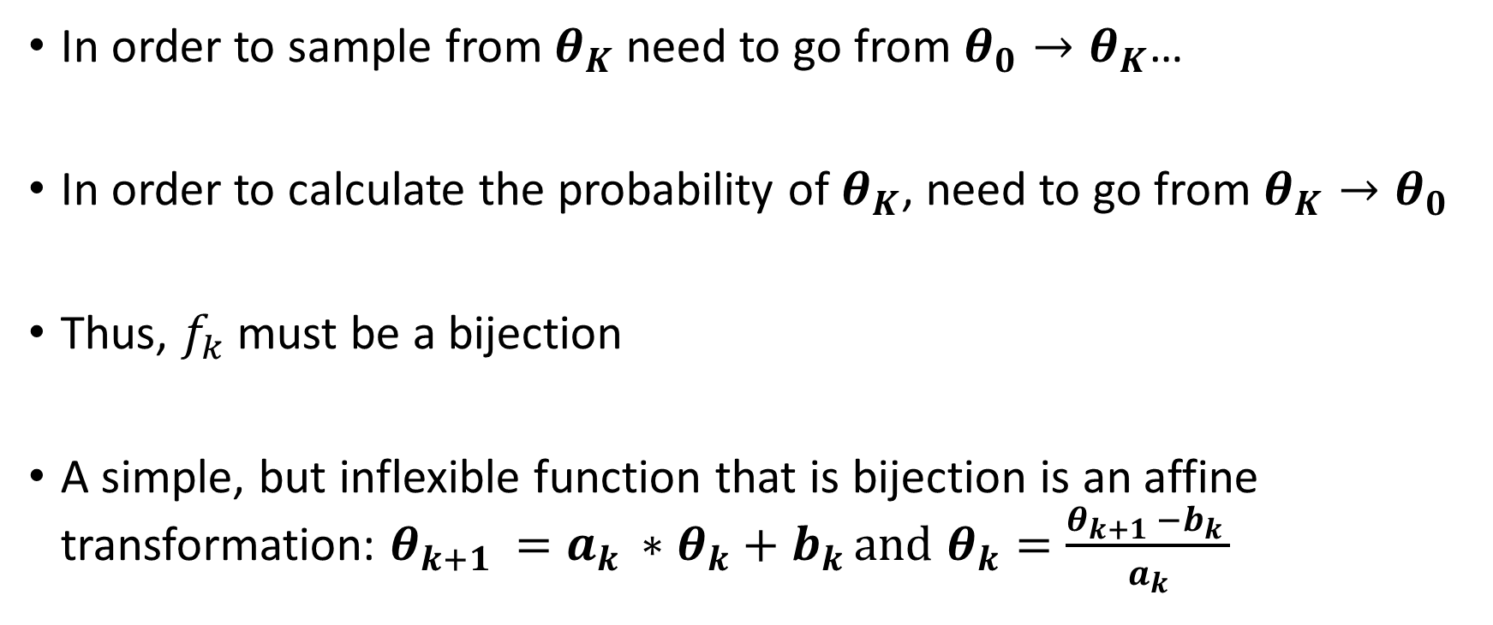
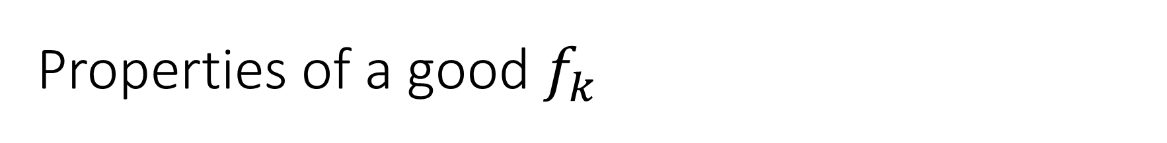
Properties of a good $f_{k}$
In order to sample from $θ_{K}$ need to go from $θ_{0}→θ_{K}$…
In order to calculate the probability of $θ_{K}$, need to go from $θ_{K}→θ_{0}$
Thus, $f_{k}$must be a bijection
A simple, but inflexible function that is bijection is an affine transformation: $θ_{k+1 }=a_{k }∗θ_{k}+b_{k }and$ $θ_{k}=\frac{θ_{k+1 }−b_{k }}{a_{k}}$

Slide 31
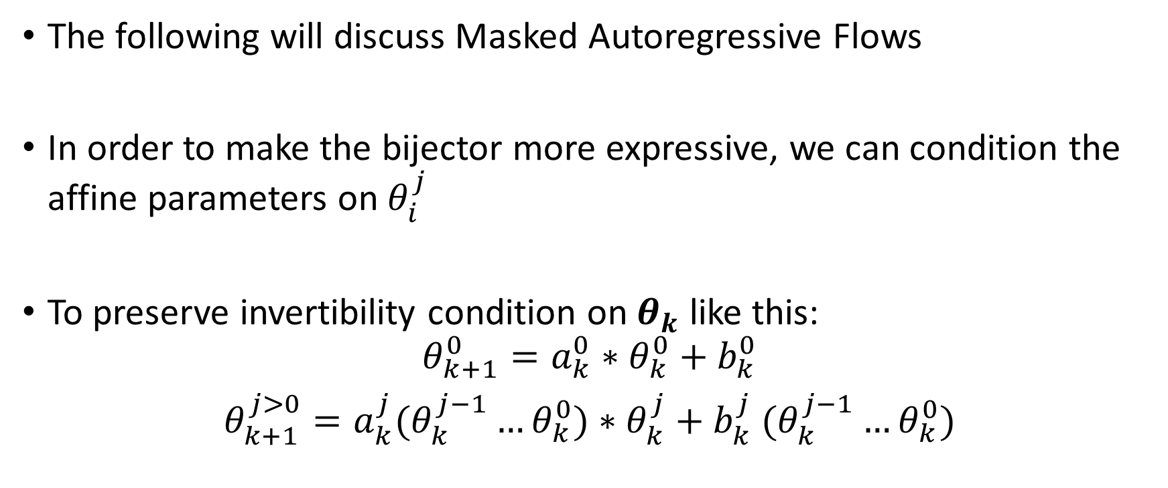
Masked Autoregressive Flows
The following will discuss Masked Autoregressive Flows
In order to make the bijector more expressive, we can condition the affine parameters on $θ_{i}^{j}$
To preserve invertibility condition on $θ_{k}$ like this:
$$θ_{k+1}^{0}=a_{k}^{0}∗θ_{k}^{0}+b_{k}^{0}$$
$θ_{k+1}^{j>0}=a_{k}^{j}(θ_{k}^{j−1}…θ_{k}^{0})∗θ_{k}^{j}+b_{k}^{j}$ $(θ_{k}^{j−1}…θ_{k}^{0})$

Slide 32
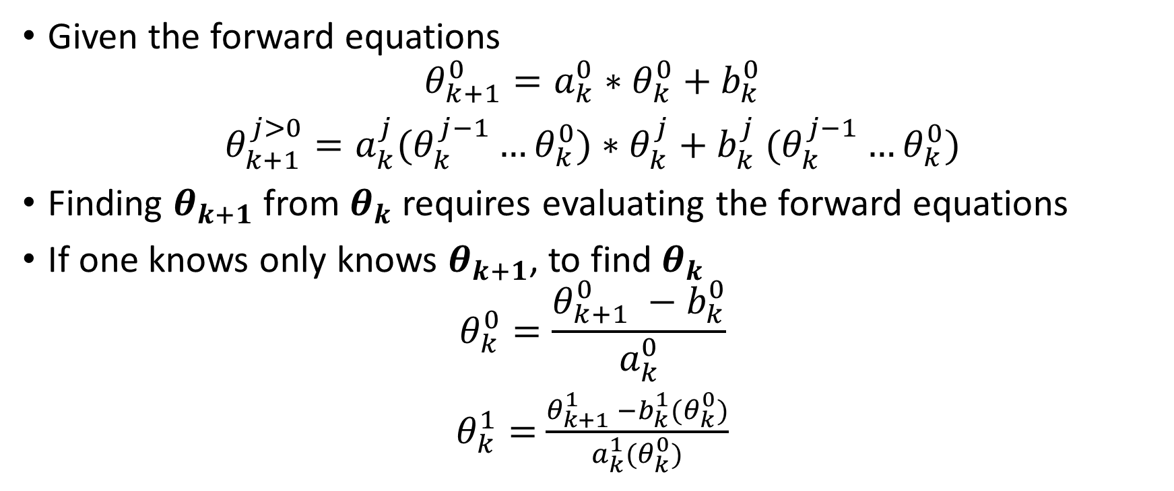
Masked Autoregressive Flows: Preserving Invertibility
Given the forward equations
$$θ_{k+1}^{0}=a_{k}^{0}∗θ_{k}^{0}+b_{k}^{0}$$
$θ_{k+1}^{j>0}=a_{k}^{j}(θ_{k}^{j−1}…θ_{k}^{0})∗θ_{k}^{j}+b_{k}^{j}$ $(θ_{k}^{j−1}…θ_{k}^{0})$
Finding $θ_{k+1}$ from $θ_{k}$ requires evaluating the forward equations
If one knows only knows $θ_{k+1}$, to find $θ_{k}$
$$θ_{k}^{0}=\frac{θ_{k+1}^{0} −b_{k}^{0}}{a_{k}^{0}}$$
$θ_{k}^{1}=$ $\frac{θ_{k+1}^{1} −b_{k}^{1}(θ_{k}^{0})}{a_{k}^{1}(θ_{k}^{0})}$
.
.
.

Slide 33
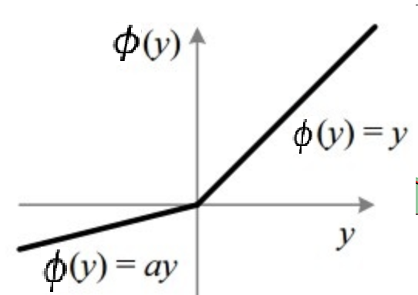

Non-Linearity
A composition of affine functions is still affine
In order to make stacks of bijectors more expressive, add a bijective nonlinear ‘link’ function between each bijector:
$$θ_{k+1}^{j}={φ(a}^{j}(.)∗θ_{k}^{j}+b^{j}(.))$$

Slide 34
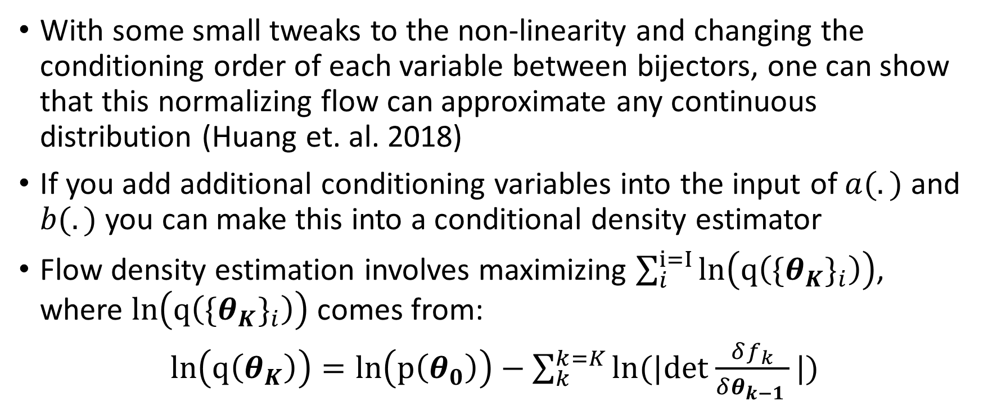
Universal Approximating Theorems
With some small tweaks to the non-linearity and changing the conditioning order of each variable between bijectors, one can show that this normalizing flow can approximate any continuous distribution (Huang et. al. 2018)
If you add additional conditioning variables into the input of $a(.)$ and $b(.)$ you can make this into a conditional density estimator
Flow density estimation involves maximizing $\sum_{i}^{i=I}{ln\left(q\left({\{θ_{K}\}}_{i}\right)\right)}$, where $ln\left(q\left({\{θ_{K}\}}_{i}\right)\right)$ comes from:
$ln\left(q\left(θ_{K}\right)\right)=ln\left(p\left(θ_{0}\right)\right)−\sum_{k}^{k=K}{ln(|det}$ $\frac{δf_{k}}{δθ_{k−1 }}|)$
Proof Intuition

Slide 35
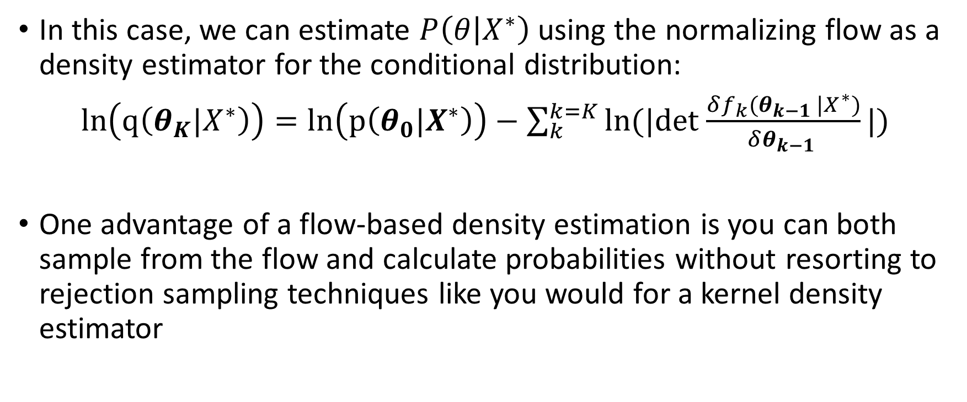
Normalizing Flows as Density Estimators
In this case, we can estimate $P\left(θ | X^{∗}\right)$ using the normalizing flow as a density estimator for the conditional distribution:
$ln\left(q\left(θ_{K}|X^{∗}\right)\right)=ln\left(p\left(θ_{0}|X^{∗}\right)\right)−\sum_{k}^{k=K}{ln(|det}$ $\frac{δf_{k}(θ_{k−1 }|X^{∗})}{δθ_{k−1 }}|)$
One advantage of a flow-based density estimation is you can both sample from the flow and calculate probabilities without resorting to rejection sampling techniques like you would for a kernel density estimator

Slide 36

SNPE Example Redux: $X^{∗}=θ+ ϵ$
$X$ = data, $X^{∗}$= model simulations, $p\left(θ\right)$ = prior over $θ$, $ε∼N(0,1)$
Objective: $p(θ|X^{∗}=X)$
Step 1: ${\left\{X_{i}^{∗},θ_{i}^{∗}\right\}}_{i=1}^{I}$ = simulated via Monte Carlo
Sample $θ_{i}^{∗}$ from $p\left(θ\right)$
Sample $X_{i}^{∗}$ from simulated model conditional on $θ_{i}^{∗}$, $X_{i}^{∗}=$ $θ_{i}^{∗}+ ϵ$
Step 2: Estimate the conditional density $p\left(θ | X^{∗}\right)$
Use a conditional density estimator
Many different CDEs can be used, I will discuss a conditional mixture of Gaussians and normalizing flows
Step 3: Condition $X^{∗}$ on the real data, $X$, forming the posterior: $p(θ|X^{∗}=X)$
Simulate diagram
Estimate diagram
Condition diagram

Slide 37
Results

Slide 38
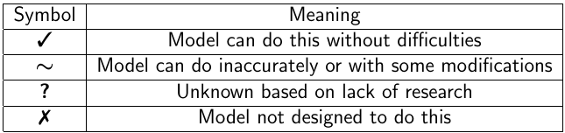
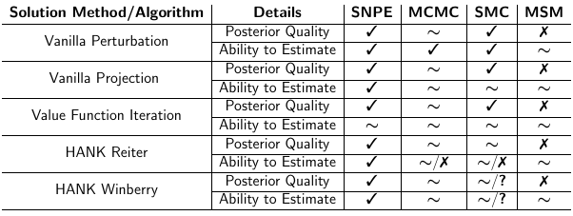
Comparison of Estimation Algorithms Ability to Handle a Selection of Solution Methods
Perturbation
Projection
Value Function Iteration
HANK Reiter
HANK Winberry

Slide 39
SNPE/MCMC Performance on Smets-Wouters

Slide 40
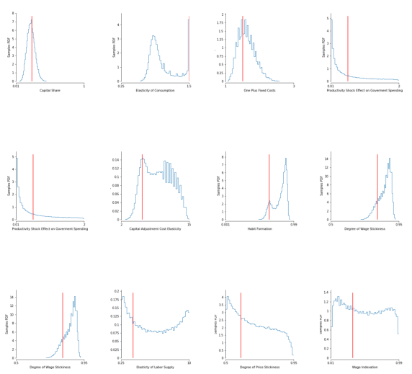
SNPE after Five Hundred Thousand Iterations
Back

Slide 41
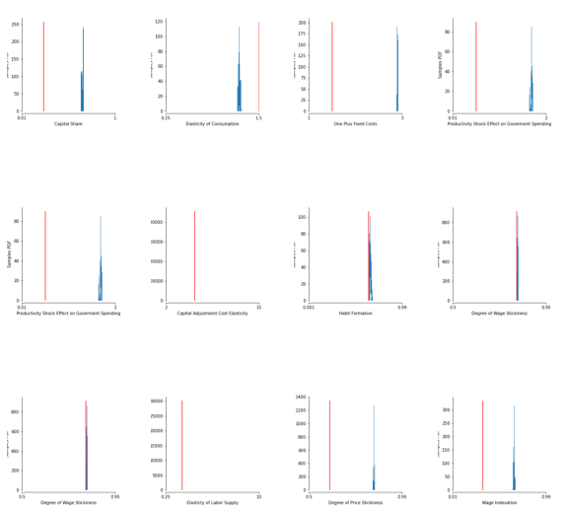
Metropolis-Hastings MCMC after Ten Million Iterations
Back

Slide 42
Discussion on Multimodality

Slide 43
Multimodality and Frequentism
Weak identification and multimodality is a problem for frequentist statistics → what is the right parameter value…
…but is just another posterior in the Bayesian approach
Furthermore, multimodality might provide important feedback to economic research

Slide 44
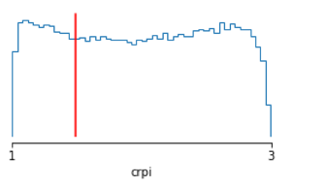
Taylor Rule Parameter on Inflation
Crpi, the Taylor rule parameter on inflation is unidentified
SW and current data cannot distinguish between the two stories of central bank inflation fighting ability

Slide 45
Multimodality and economic cycles
Like the Diamond Diybvig (1983) model of bank runs, it doesn’t require much imagination to think we coordinate on multiple equilibria
In good times we coordinate on parameter values that lead to high output, but perhaps there is a low consumption, low production equilibrium that we could coordinate on if we get knocked out of the good equilibrium
A deeper understanding of equilibrium coordination, by its nature involves deeper understanding of the multiple modes of parameter posteriors

Slide 46
SNPE Performance on Heterogenous Agent Models

Slide 47
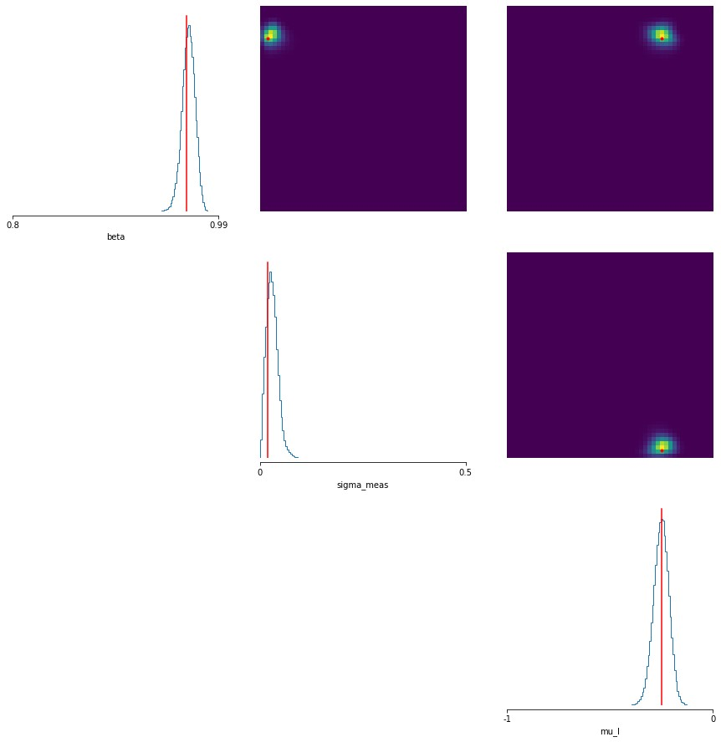
SNPE and MCMC Performance on Krusell Smith with Winberry Solution Method
Following Liu and Plagborg-Moller (2021), likelihood estimate KS with all micromoments
Liu and Plagborg-Moller (2023) is state of the art, taking 6.5 min. per CPU iteration
My approach that doesn’t have to solve for a likelihood function takes 30 seconds per CPU iteration
Back

Slide 48
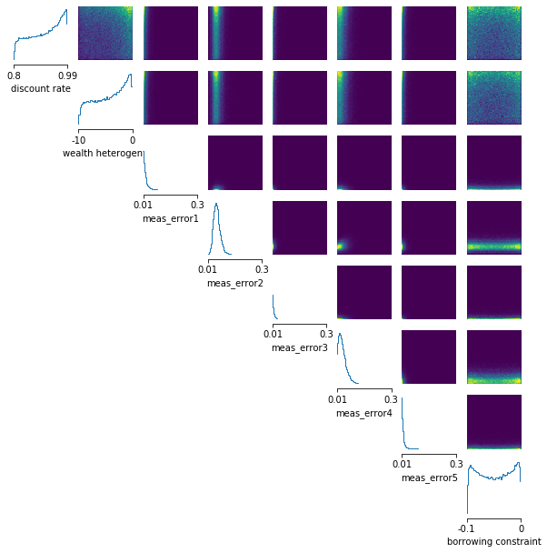
Extending KS/Winberry to Full Information Empirical Application
KS/Winberry model estimated across time on 100 microdata quantiles created from the total household net worth variable in the SIPP dataset combined with macro data
Not attempted by Liu Plagborg-Moller (2023)

Slide 49
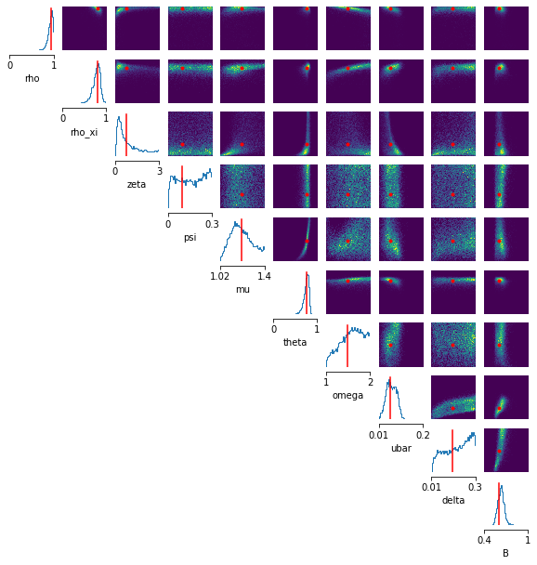
HANK Model Solved via Reiter
Using Reiter’s method, this HANK model has 1000+ states
Easy to simulate from, but takes 20-30 mins to use the Kalman filter for a single likelihood evaluation, which is intractable
Only other option is to use dimensionality reductions which loses information (Ahn et. al. 2018)
Back

Slide 50
Appendix

Slide 51
Literature
Many models are non-smooh so one can’t use perturbation and thus can’t likelihood estimated without measurement error
s-S models: Arrow et. al. 1951, Caplin and Spulber 1987, Bertola and Caballero 1990, House and Leahy 2004, Caplin and Leahy 2006, Kahn and Thomas 2008, Caplin et. al. 2020, Badoczy 2022, etc.
Structural Finance: He, Whited, and Guo 2021, Terry, Whited, and Zakolyukina 2021, Taylor 2012, Whited and Guo 2006
With non-smooth models: One generally must resort to simulation-based estimation:
Method of Simulated Moments: McFadden 1989, Pakes and Pollard 1989, Duffie and Singleton 1990, etc
Machine Learning: Kaji, Manresa, and Pouliot 2020
Back

Slide 52


Markov Assumption Versus State-Space Assumption
With MSM, we impose the Markov Assumption on the data
A small number of lags captures all necessary historical information:
$$X_{t−20},X_{t−19}…X_{t−2},X_{t−1},X_{t}$$

Slide 53


Markov Assumption Versus State-Space Assumption
With MSM, we impose the Markov Assumption on the data
A small number of lags captures all necessary historical information:
$$X_{t−20},X_{t−19}…X_{t−2},X_{t−1},X_{t}$$

Slide 54
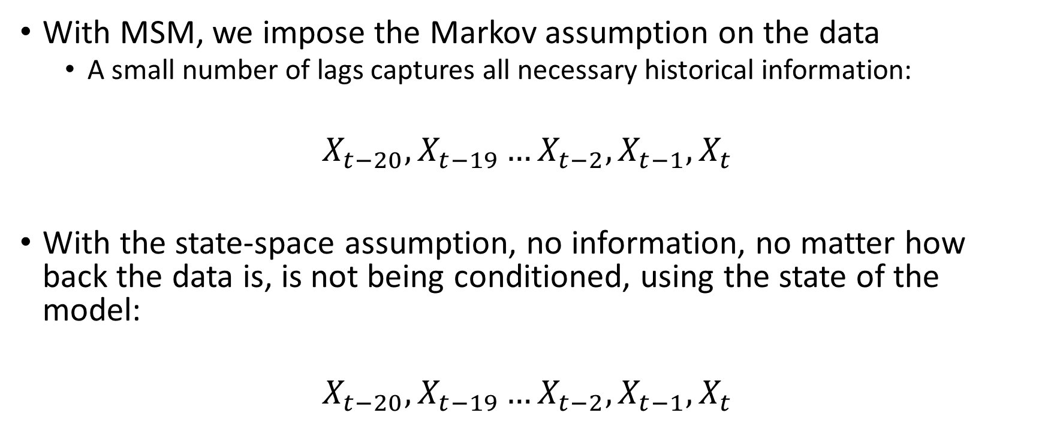
Markov Assumption Versus State-Space Assumption
With MSM, we impose the Markov assumption on the data
A small number of lags captures all necessary historical information:
$$X_{t−20},X_{t−19}…X_{t−2},X_{t−1},X_{t}$$
With the state-space assumption, no information, no matter how back the data is, is not being conditioned, using the state of the model:
$$X_{t−20},X_{t−19}…X_{t−2},X_{t−1},X_{t}$$
Back

Slide 55
Flow Universal Approximator Intuition
From Huang 2018
First a sum of step functions → universal approximator of monotonic functions
A logit can approximate a step function arbitrarily well → a sum of logit can do the same with monotonic functions
A neural autoregressive flow can universally approximate any set of parameters and thus when using a logit nonlinearity, can approximate logits → step functions → monotonic functions arbitrarily well

Slide 56
Monotonic Functions and Universal Approximators
One can map any uniform density to any distribution via the monotonic CDF
One can map any distribution to the uniform density via the inverse CDF which also is monotonic
Since you can map any distribution to a uniform via monotonic transformations and any uniform to any other distributions via monotonic transformation, then monotonic distributions can map any distribution to any other → universal approximation with flows
Back

Slide 57
Lossless Embedding
I pointed out that in comparison to (Ahn et. al. 2018), the use of an end to end embedding generally leads to lossless compression
Since a small number of parameters generate many sample data points, there likely exists a sufficient statistic the size of the parameter set
Modulo continuity and other regularity conditions
By Rao-Blackwell, if there exists a sufficient statistic, it will maximize likelihood
Caveat regarding global versus local mins
A universal approximator embedding neural network, can arbitrarily approximate any function so given enough parameters can approximate the sufficient statistic and will approximate the sufficient statistic as that will minimize MLE loss
Using PCA like in Ahn et.al. (2018) will not be lossless as it’s not trained end to end with the Bayesian objective

Slide 58
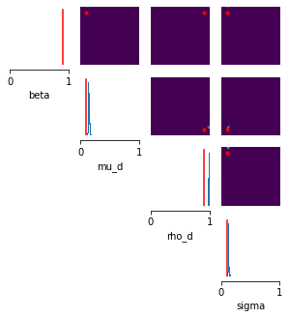
Projection Model
Lucas-Tree estimated via projection
Can see some errors with the posterior not quite aligned with the data generating parameters
No measurement error used when estimating
Back

Slide 59
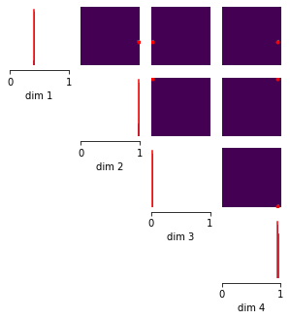
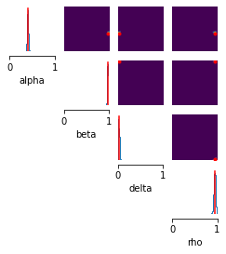
RBC Model Estimated Two Ways
MCMC Ground Truth Posterior
SNPE Posterior
Back

Slide 60
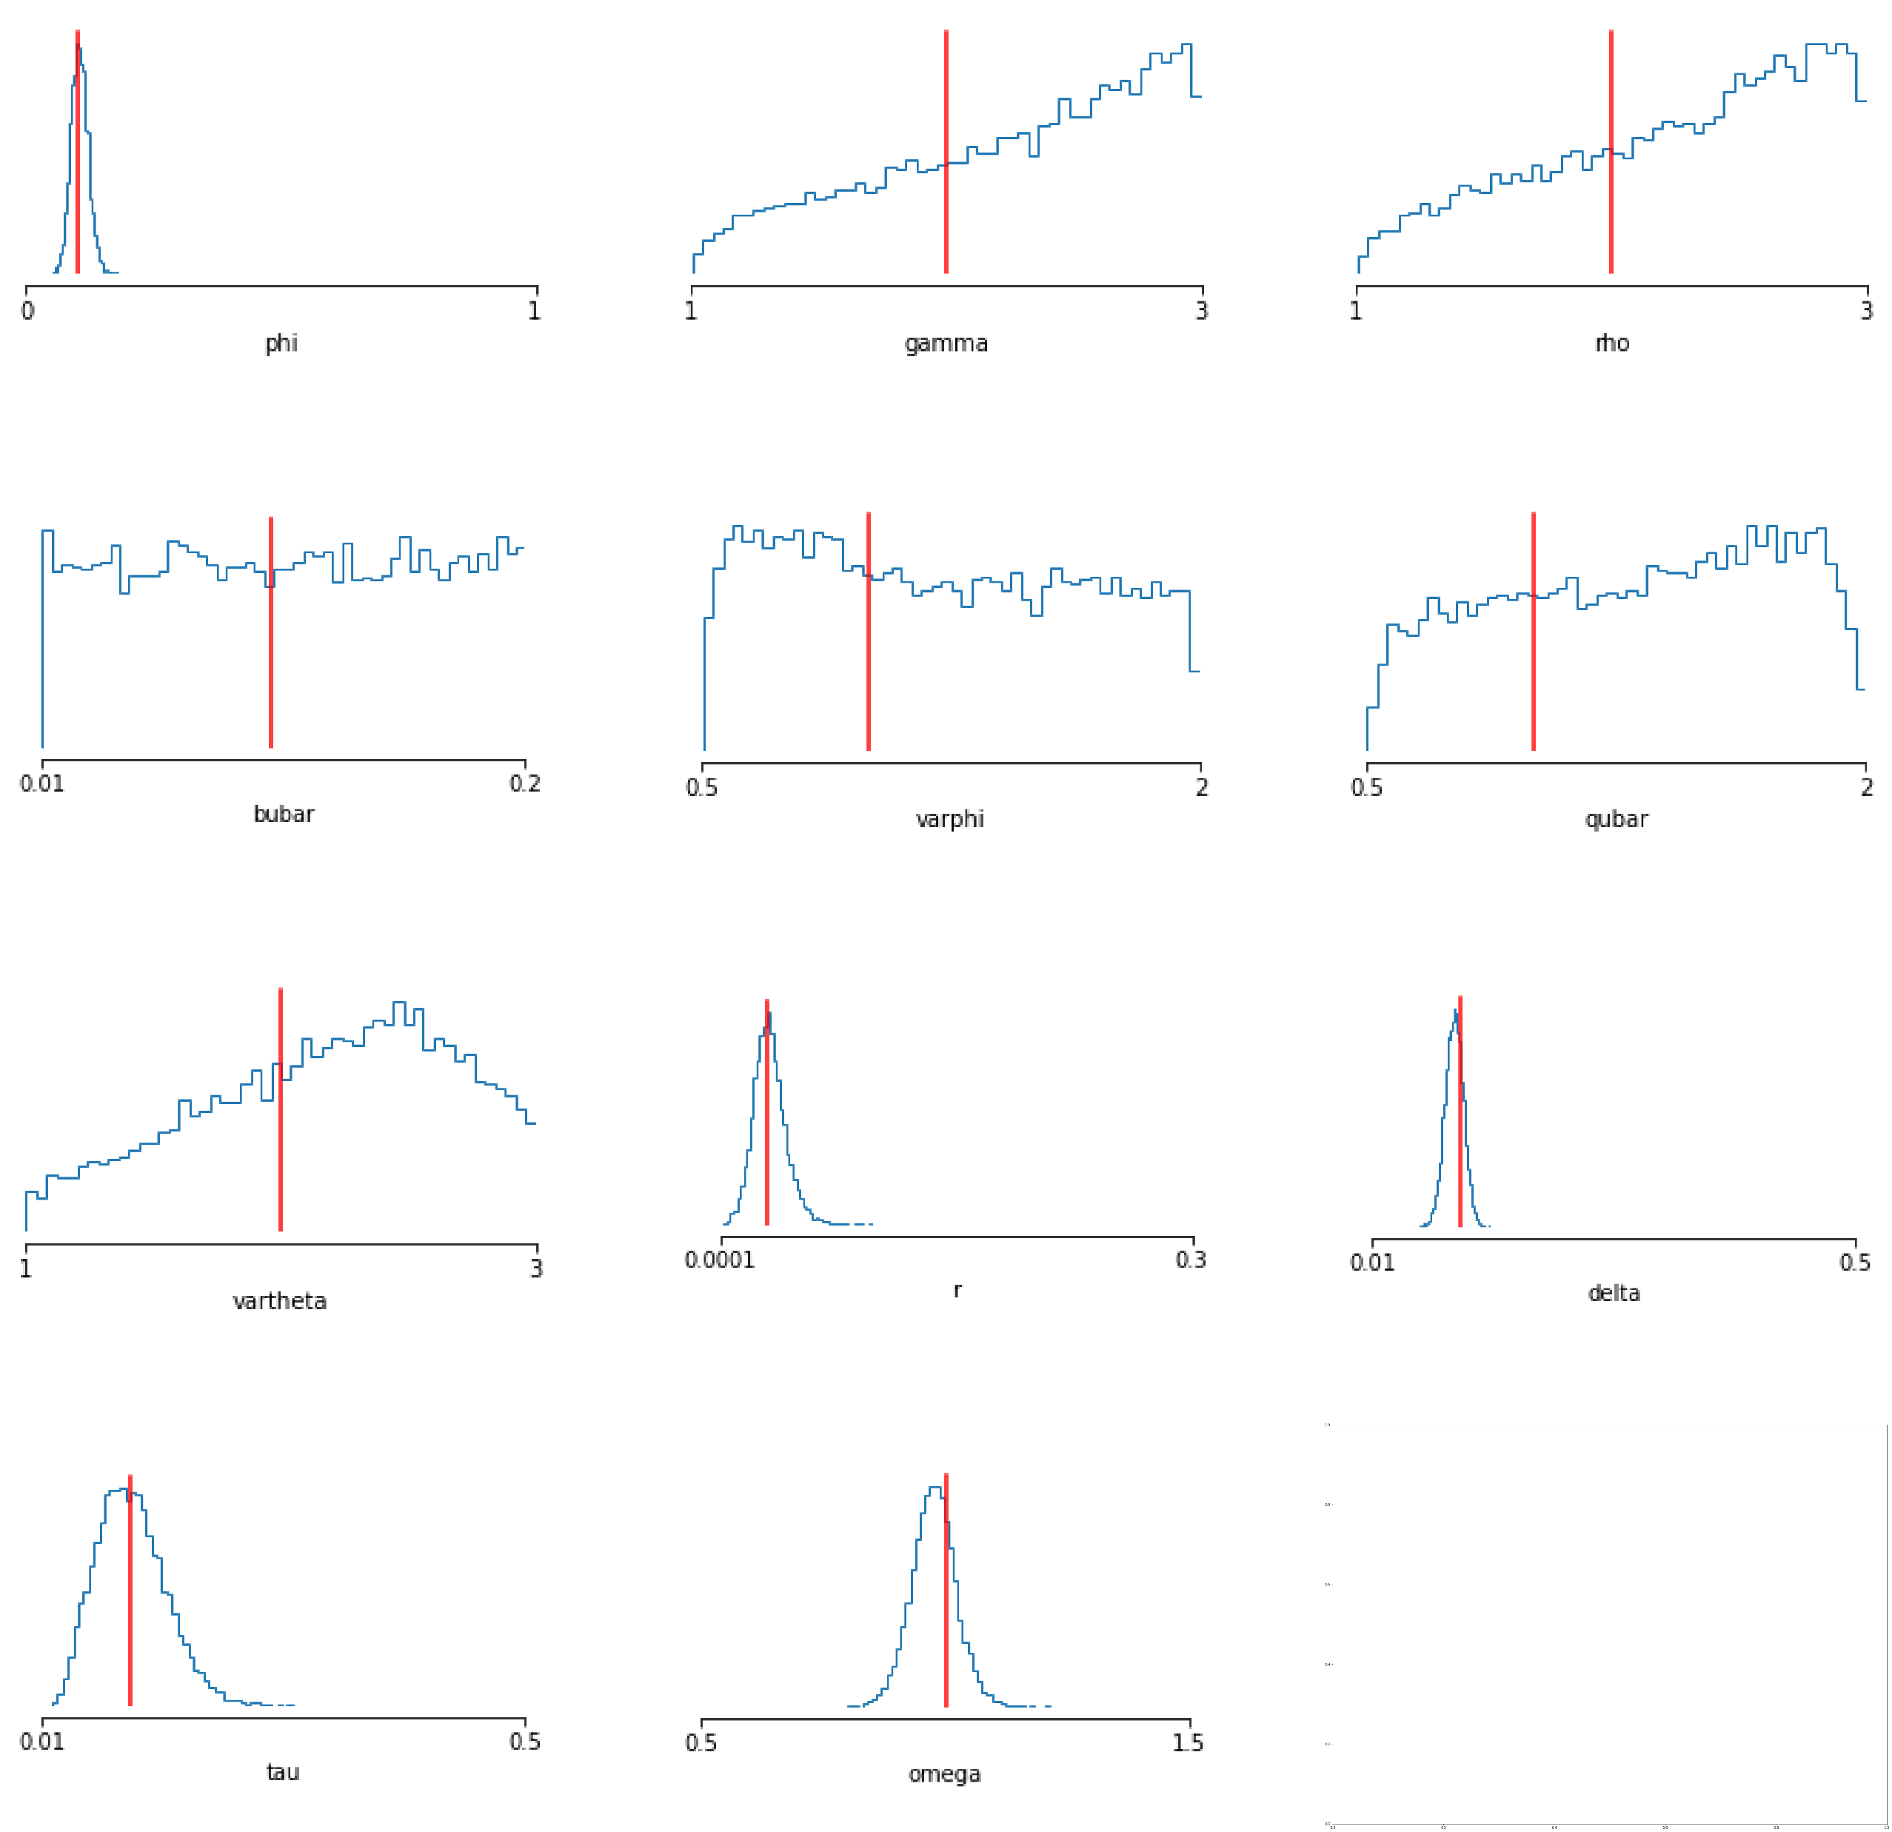
Bequests Value Function Iteration Model
Liquid and Illiquid asset
Kink at the transition point → No perturbation
Solved via value function iteration
Using measurement error
Back

Slide 61
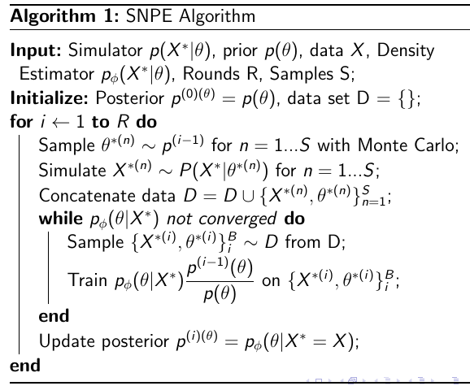
SNPE
Back

Slide 62
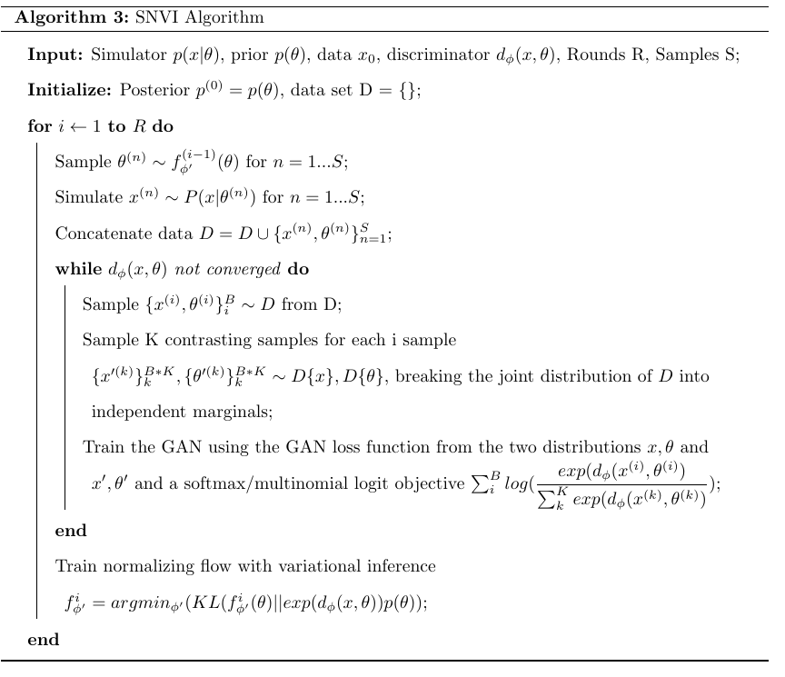
Alternative Algorithm: Sequential Neural Variational Inference
Back

Slide 63
Table Runtimes
Clean up slides
SMM comparison table
What does the model do (Reiter)? Background, what can I do with the posteriors

